Slide 1
Part 3: Prevention of Opioid Overdose
Notes:
This is the third part in a 5-part Curriculum Infusion Package (CIP) on Opioid Use Disorders (OUDs) developed in 2019 by the Pacific Southwest Addiction Technology Transfer Center (PSATTC). The main developers were Beth Rutkowski, MPH, and Nancy Roget, MS, with additional guidance and editing support provided by Drs. Thomas E. Freese and Michael Shafer.
Part 3 provides a brief overview of opioid overdose and prevention strategies and is designed to be used by academic faculty in behavioral health programs, trainers, behavioral health providers, and state/county agency staff members for a variety of audiences. Each slide has notes for the presenter to provide guidance as necessary, and references when possible.
If you require further information on this topic, please do not hesitate to contact the Pacific Southwest ATTC (http://www.psattc.org). You are free to use these slides and the pictures, but please give credit to the Pacific Southwest ATTC when using them by keeping the logo on each slide and referencing the Pacific Southwest ATTC at the beginning of your presentation.
The Pacific Southwest ATTC (HHS Region 9) is part of the SAMHSA-funded ATTC network that offers training/technical assistance (TA) services through a partnership with UCLA Integrated Substance Abuse Programs, Arizona State University School of Social Work , and University of Nevada-Reno Center for the Application of Substance Abuse Technologies. HHS Region 9 is comprised of Arizona, California, Hawaii, Nevada, and the six U.S.-affiliated Pacific Jurisdictions (American Samoa, Commonwealth of the Northern Mariana Islands, Federated States of Micronesia, Guam, Republic of the Marshall Islands, and Republic of Palau). For additional information, please access its website at http://www.psattc.org. Additional resources are available to enhance and support the information provided in this brief presentation.
IMAGE CREDIT:
Shutterstock (purchased image).

Slide 2
Opioid Overdose Definition - World Health Organization
Due to their effect on the part of the brain that regulates breathing, opioids in high doses can cause respiratory depression and death. An opioid overdose can be identified by a combination of three signs and symptoms referred to as the “opioid overdose triad”, which are:
pinpoint pupils
unconsciousness
respiratory depression
Combining opioids with alcohol and sedative medication increases the risk of respiratory depression and death, and combinations of opioids, alcohol, and sedatives are often present in fatal drug overdoses.
SOURCE: https://www.who.int/substance_abuse/information-sheet/en/.
Notes:
It is important to define what an opioid overdose is and how it occurs. Basically, overdose occurs when the dose of opioids depresses the central nervous system, which slows respiration and can lead to death. The definition of overdose on the slide comes from a Opioid Fact Sheet from the World Health Organization.
REFERENCE:
https://www.who.int/substance_abuse/information-sheet/en/.

Slide 3
Drug Overdose Deaths
The most frequently mentioned drugs involved in these deaths:
Opioids: heroin, oxycodone, methadone, morphine, hydrocodone, and fentanyl
Benzodiazepines: alprazolam and diazepam
Stimulants: cocaine and methamphetamine
SOURCE: Hedegaard et al. (2018)
Notes:
‘Among the more than 72,000 drug overdose deaths estimated in 2017*, the sharpest increase occurred among deaths related to fentanyl and fentanyl analogs (synthetic opioids) with nearly 30,000 overdose deaths.’ [Source: CDC WONDER]. Pharmaceutical fentanyl is a synthetic opioid pain reliever, approved for treating severe pain, typically advanced cancer pain.¹ It is 50 to 100 times more potent than morphine. It is prescribed in the form of transdermal patches or lozenges and can be diverted for misuse and abuse in the U.S. However, most recent cases of fentanyl-related harm, overdose, and death in the U.S. are linked to illegally made fentanyl.² It is sold through illegal drug markets for its heroin-like effect and often mixed with heroin and/or cocaine as a combination product—with or without the user’s knowledge—to increase its euphoric effects. [Source: https://www.cdc.gov/drugoverdose/opioids/fentanyl.html]
If you wish to share more information about fentanyl with your students, you can show them a video from NIDA that discusses the increase in opioid overdose due to fentanyl:
https://www.youtube.com/watch?v=gKCfegxvOPg&feature=youtu.be or https://www.drugabuse.gov/videos/dr-compton-discusses-half-opioid-related-overdose-deaths-involve-fentanyl
REFERENCES:
Hedegaard et al., 2018 National Vital Statistics Report Volume 67, Number 9. Retrieved from: https://www.cdc.gov/nchs/data/nvsr/nvsr67/nvsr67_09-508.pdf;
https.://www.drugabuse.gov/related-topics/trends-statistics/overdose-death-rates.
Jones, C.M., Einstein, E.B., & Compton, W.M. (2018). Changes in Synthetic Opioid Involvement in Drug Overdose Deaths in the United States, 2010-2016. JAMA, 319(17),1819-1821.
Algren, D., Monteilh, C., Rubin, C., et al. (2013). Fentanyl-associated fatalities among illicit drug users in Wayne County, Michigan (July 2005-May 2006). Journal Of Medical Toxicology, 9(1),106-115.
Department of Justice, Drug Enforcement Administration, DEA Investigative Reporting, January 2015.

Slide 4
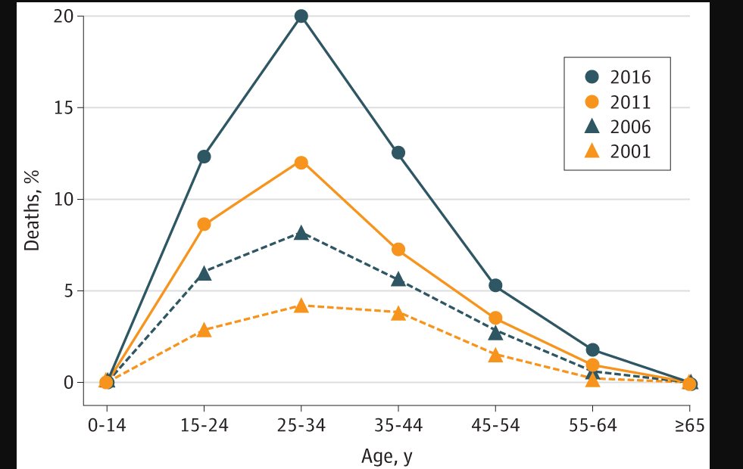
In 2016 1 in 65 deaths was opioid related.
Among adults aged 25 to 34 years 1 in 5 deaths is opioid related.
Among those aged 15 to 24 years, 12.4% of deaths were attributable to opioids.
SOURCE: Gomes et al. (2018)
Notes:
This study was conducted in 4 – 5 year intervals and demonstrated which age group was impacted the most by opioid overdose. Findings showed that adults ages 25 to 34 had the highest overdose burden (in 2016, 1 in 5 deaths in that age group was opioid related). The data shown in this chart demonstrate that opioid use disorders are taking a huge toll on individuals ages 15-34. In addition, the finding from this study point to the need to design prevention, intervention, and treatment/recovery services for the adolescent/young adult populations. These Death data were obtained from the Centers for Disease Control and Prevention WONDER online database.
REFERENCE:**
Gomes, T., Tadrous, M., Mamdani, M.M., Paterson, J.M., & Juurlink, D.N. (2018). The burden of opioid-related mortality in the United States. JAMA Network Open, 1(2), e180217, doi:10.1001/jamanetworkopen.2018.0217
**This article is open access and can be accessed by clicking on this link: file:///C:/Users/roget/Downloads/gomes_2018_oi_180031%20(2).pdf.

Slide 5
In 2017, 198 people died per day from drug overdoses- 10.2% increase from 2016
SOURCE: NCHS. (2018)
Notes:
According to new data released by the Centers for Disease Control and Prevention (CDC), there were more than 63,600 total drug overdose deaths in 2016, or 174 drug overdose deaths per day. This number represents a 21% increase (from 144 a day in 2015) in just one year. From 2002 to 2017, there was a 3.1-fold increase in the total number of deaths. This slide includes data that show 198 individuals per day died from drug overdoses in 2017, which reflects a 10.2% increase from 2016. Finally, the data also indicated that more men than women died from overdose, which is a trend that seems to be growing.
There is a 13 slide presentation that includes this slide on opioid overdose that is available for download at this link: https://www.drugabuse.gov/related-topics/trends-statistics/overdose-death-rates.
REFERENCE:
Hedegaard, H., Warner, M., & Miniño, A.M. (2017). NCHS Data Brief No. 294, December 2017. Drug Overdose Deaths in the United States, 1999–2016. https://www.cdc.gov/nchs/data/databriefs/db294.pdf.

Slide 6
Review of Scientific Prevention Literature re: Opioid Crisis
Prevention Education
Provider Education
Prescription Drug Monitoring Programs
Law Enforcement
Opioid Overdose Prevention Programs
Review done by Dr. Wilson Compton and colleagues from NIDA
SOURCE: Compton, Boyd, & Wargo. (2015)
Notes:
This slide identifies the science behind prevention activities related to preventing the initiation of prescription opioid use as well as opioid overdose. The review is solely based on the article by Compton and colleagues. Dr. Compton and his colleagues identified six different categories as a method for organizing the scientific literature, and five of these six are listed above (the sixth category refers specifically to treatment related activities).
Instructors should read the article and review the table in order to speak more thoroughly. The article can be downloaded for free at the following link: https://ac.els-cdn.com/S0091743515001036/1-s2.0-S0091743515001036-main.pdf?_tid=9c1eb958-c98a-11e7-bd08-00000aacb35e&acdnat=1510698462_ada74479ed3d506ee5726906601418d4
REFERENCE:
Compton, W.M., Boyle, M., & Wargo, E. (2015). Prescription opioid abuse: Problems and responses. Prevention Medicine, 80, 5-9.

Slide 7
- Naloxone Distribution - 911 Good Samaritan Laws
10 Evidence-Based Strategies for Preventing Opioid Overdose
SOURCE: https://www.cdc.gov/drugoverdose/pdf/pubs/2018-evidence-based-strategies.pdf.
Notes:
This recent publication from the CDC identified 10 evidence-based strategies for preventing opioid overdose. The 10 evidence-based strategies identified include:
Targeted Naloxone Distribution
Medication-Assisted Treatment (MAT)
Academic Detailing
Eliminating Prior-Authorization Requirements for Medications for Opioid Use Disorder
Screening for Fentanyl in Routine Clinical Toxicology Testing
911 Good Samaritan Laws
Naloxone Distribution in Treatment Centers and Criminal Justice Settings
MAT in Criminal Justice Settings and Upon Release
Initiating Buprenorphine-based MAT in Emergency Departments
Syringe Services Programs
Evidence-based practices were determined by the authors in ‘accordance with 3 key sources of information: (1) high quality scientific research; (2) the professional opinions and experiences of clinical and public health experts; and (3) the preferences, priorities, and values of the individuals who will be targeted or affected by that practice.’ This curricula will only discuss two of the ten strategies: Naloxone Distribution and 911 Good Samaritan.
REFERENCE:
Centers for Disease Control and Prevention. Evidence-Based Strategies for Preventing Opioid Overdose: What’s Working in the United States. National Center for Injury Prevention and Control, Centers for Disease Control and Prevention, U.S. Department of Health and Human Services, 2018. Accessed from http://www.cdc.gov/drugoverdose/pdf/pubs/2018-evidence-based-strategies.pdf.

Slide 8
Naloxone
WHO recommends that naloxone be made available to people likely to witness an opioid overdose, as well as training in the management of opioid overdose.
Opiate antagonist
Reverses or blocks the effects of other opioids
Quickly restores normal respiration to a person whose breathing has slowed or stopped as a result of abusing heroin or prescription opioids
Naloxone is short-acting
Can be injected or inhaled through a nasal spray
Auto-injectors approved in 2014
Least expensive method – syringe and vial but that requires the most training
SOURCE: DeSimone et al. (2018)
Notes:
This slide provides an overview of naloxone, a medication to prevent opioid overdose. The slide also details the World Health Organization’s recommendation for making naloxone widely available. The chart below provides a comparison of Naloxone Products. This chart comes from an article by DeSimone et al., 2018.
REFERENCE:
DeSimone, E.M., Tilleman, J.A., Kaku, K.A., & Erickson, C.T. (2018). Expanding access to naloxone. US Pharm, 43(3), 16-20.
REFERENCE:
World Health Organization Information Sheet on Opioid Overdose https://www.who.int/substance_abuse/information-sheet/en/
DeSimone, E. M., Tilleman, J. A., Kaku, K. A., & Erickson, C. T. (2018). Expanding access to naloxone. U.S. Pharmacist, 43(3), 16-20.

Slide 9
DO support the person’s breathing by administering oxygen or performing rescue breathing.
DO administer naloxone.
DO put the person in the “recovery position” on the side, if he or she is breathing independently.
DO stay with the person and keep him/her warm.
SOURCE: SAMHSA. (2018)
Notes:
The next two slides include lists of Do’s and Don’ts from the SAMHSA tool kit referenced below. Review the Do’s and Don’ts with students.
REFERENCE:
SAMHSA Opioid Overdose Prevention Toolkit. (2018). Available at: https://store.samhsa.gov/system/files/sma18-4742.pdf.

Slide 10
DON'T slap or try to forcefully stimulate the person — it will only cause further injury. If you are unable to wake the person by shouting, rubbing your knuckles on the sternum (center of the chest or rib cage), or light pinching, he or she may be unconscious.
DON'T put the person into a cold bath or shower. This increases the risk of falling, drowning or going into shock.
DON'T inject the person with any substance (salt water, milk, “speed,” heroin, etc.). The only safe and appropriate treatment is naloxone.
DON'T try to make the person vomit drugs that he or she may have swallowed. Choking or inhaling vomit into the lungs can cause a fatal injury.
SOURCE: SAMHSA. (2018)
Notes:
The Don’ts are just as important as the Do’s – maybe even more so as there are some myths regarding how to handle overdoses (put the person in the shower, walk them around, try to make them throw-up, etc.).
REFERENCE:
SAMHSA Opioid Overdose Prevention Toolkit. (2018). Available at: https://store.samhsa.gov/system/files/sma18-4742.pdf.

Slide 11
Good Samaritan Laws
As of July 15, 2017
All 50 states and DC passed legislation to improve laypersons’ access to naloxone
41 states and DC have passed legislation that provides some protection from arrest or prosecution for individuals who report an overdose
SOURCE: The Network for Public Health Law. (2017)
Notes:
This slide provides additional information about prevention/intervention activities related to law enforcement. The document referenced here provides an excellent review of state laws that refer to laypersons’ access to naloxone and protection for individuals that report overdose. If time permits, participants could be asked to go to the website cited here to review their state laws relating to this topic. As a trainer, please review this document before presenting so you are up to date on state-specific Good Samaritan and naloxone access laws.
Arizona was the 41st state to pass a Good Samaritan Law in January 2018 that went into effect in April 2018.
REFERENCE:
The Network for Public Health Law Robert Wood Johnson Foundation. (2017). Legal interventions to reduce overdose mortality: Naloxone access overdose Good Samaritan laws. https://www.networkforphl.org/_asset/qz5pvn/network-naloxone-10-4.pdf.
IMAGE CREDIT:
Getty Images (purchased image).

Slide 12
Adoption of Naloxone Access and Overdose Good Samaritan Laws Over Time
SOURCE: The Network for Public Health Law. (2017)
Notes:
This chart comes from the Robert Wood Johnson report cited on the slide. The chart shows the adoption of naloxone access and Good Samaritan laws over a period of seven years. As the chart indicates, the establishment of these types of laws has grown significantly, especially since 2013. In addition, the chart shows that access to naloxone laws have been adopted by states at a faster pace than the Good Samaritan laws. Ask participants why they think that is the case and process the discussion. Many states are worried that Good Samaritan laws give individuals implicit permission or sends a message that opioid use is acceptable (some individuals have similar reactions to Naloxone access laws, too). Interesting and thought provoking discussion can be facilitated by the instructor on this topic, time permitting.
A survey conducted at syringe exchanges found that 42% of opiate users (n=355) had witnessed an opiate overdose in the prior year and 911 was called in 50% of those incidents. This landmark study by Banta-Green and colleagues (2011) found that 88% of opiate users said they would be more likely to call 911 when an overdose occurred if they knew they wouldn’t be arrested. This study has been helpful in passing the Good Samaritan laws.
REFERENCES:
The Network for Public Health Law Robert Wood Johnson Foundation. (2017). Legal interventions to reduce overdose mortality: Naloxone access overdose Good
Samaritan laws. https://www.networkforphl.org/_asset/qz5pvn/network-naloxone-10-4.pdf.
Banta-Green, C.J., Kuszler, P.C., Coffin, P.O., & Schoeppe, J.A. (2011). Washington’s 911 Good Samaritan Drug Overdose Law - Initial Evaluation Results. University of Washington: Alcohol & Drug Abuse Institute. http://adai.uw.edu/pubs/infobriefs/ADAI-IB-2011-05.pdf.

Slide 13
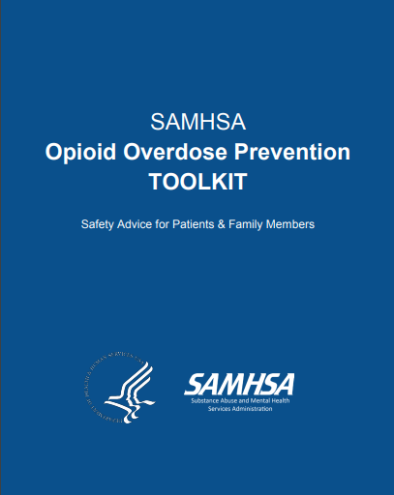
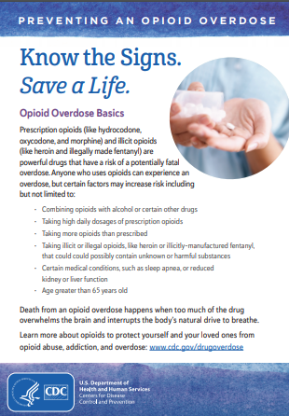
Resources for Continued Learning
Online Naloxone Trainings
https://www.getnaloxonenow.org/
http://getnaloxonenow.org>http://stopoverdose.org/section/first-responders/
http://stopoverdose.org/section/first-responders/
http://prescribetoprevent.org/
https://store.samhsa.gov/system/files/information-for-prescribers.pdf
https://store.samhsa.gov/system/files/safety-advice-for-patients-family-members.pdf
https://www.cdc.gov/drugoverdose/pdf/patients/Preventing-an-Opioid-Overdose-Tip-Card-a.pdf
Notes:
Numerous resources are available on the web and this slide highlights just a few of them. The first two resources are manuals produced by SAMHSA and are Opioid Toolkits: one for prescribers; and one for patients and family members. The links for these SAMHSA resources appear on the slide and below. Online training exists for first-responders, the general public, healthcare providers, etc. Refer students to these online resources if they want specific training on how to administer naloxone. The final resource is an Overdose Tip Card created by the CDC. This Tip Card be downloaded and copies made to have available for patients or family members. Remind students that behavioral health practitioners and recovery support specialists should be familiar with this information and have resources to share with patients and family members. Many behavioral health professionals are trained to administer naloxone and carry it as well. To encourage discussion, ask students if they plan on getting the training and carrying naloxone.
Additional components of the PSATTC’s OUD CIP include:
Part 1: Mechanism of Action of Opioids and the Impact on the User’s Brain and Body
Part 2: Review of the FDA-approved Medications for the Treatment of Opioid Use Disorders
Part 4: Stigma and Substance Use Disorders (SUDs)
Part 5: Recovery Supports and Treatment Recommendations
The full CIP is available for viewing and downloading from http://www.psattc.org.
REFERENCES:
SAMHSA Opioid Overdose Prevention Toolkit, Information for Prescribers: https://store.samhsa.gov/system/files/information-for-prescribers.pdf.
SAMHSA Opioid Overdose Prevention Toolkit, Safety Advice for Patients and Family Members: https://store.samhsa.gov/system/files/safety-advice-for-patients-family-members.pdf.
Get Naloxone Website: https://www.getnaloxonenow.org/.
Stop Overdose Now Website: http://stopoverdose.org/section/first-responders/.
Prescribe to Prevent: http://prescribetoprevent.org/.
This product was created by the Pacific Southwest Addiction Technology Transfer Center (PSATTC) under a cooperative agreement (5UR1TI080211) from the Substance Abuse and Mental Health Services Administration (SAMHSA). The opinions expressed are the views of the presentation developers and do not reflect the official position of the Department of Health and Human Services (DHHS), SAMHSA or CSAT. No official support or endorsement of DHHS, SAMHSA, or CSAT for the opinions described in this program is intended or should be inferred.

