Slide 1
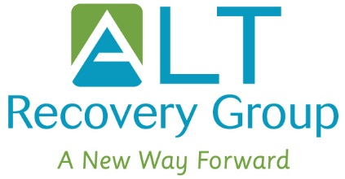
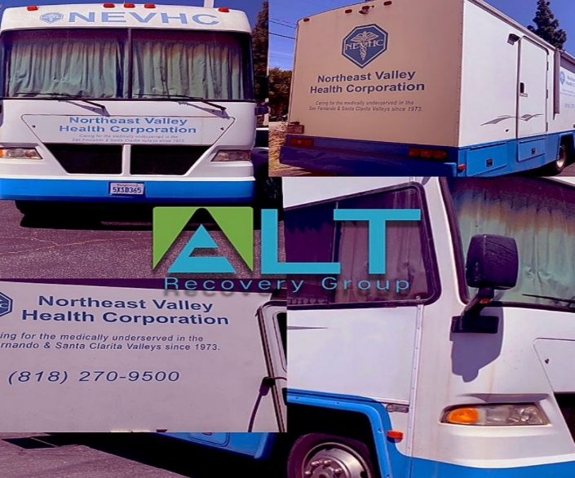
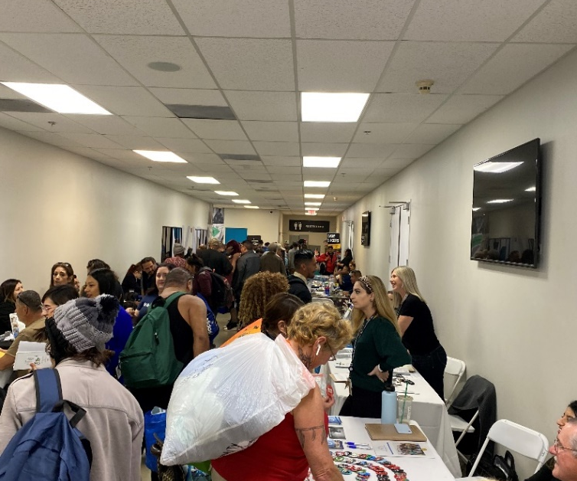
NTP CAPACITY PROJECT
Developments
Outreach:
North East Valley
LA Housing
Sisters of the Street
Education:
Staff educated on the use of buprenorphine
Training in the use of naloxone
Policy’s and Procedure:
Development of Policy’s on administering buprenorphine
Advertising:
Bus Benches, Brochures, Marketing
Newly updated website
Physical Infrastructure:
Newly built office
Additional waiting spaces
Accomplishments:
Through the efforts of our outreach program we have established connections with NEV Medical and LA Housing. These two services not only increase the rate of referrals into our program but also provide so many services to our patients in need.
Challenges:
Covid-19 has hindered our ability to make our Medical Mobile available for our homeless population, which has had an impact on the amount of referrals we’ve
We have adapted by having meetings over the phone to discuss patients needs for medical attention, prescription refills and scheduling the NP to come into our office for urgent needs.

Slide 2
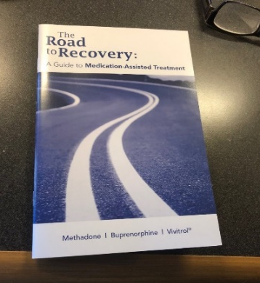
Accomplishments, Innovations, and Progress to Date along with Challenges and Proposed Solutions BAART PROGRAMS – PORTERVILLE CLINIC
New & Improved Website for BAART Porterville
Website has been updated to market the new medication being provided including buprenorphine and naltrexone at BAART Programs, Porterville clinic.
https://baartprograms.com/baart-porterville/
Developed Signage and Marketing Material
Developed and produced new flyers, brochures, clinic signage, and business cards for linkage coordinators and NTP personnel to utilize for marketing services and education for MAT treatment at BAART Programs, Porterville clinic.
Provided Referrals & Follow up for Treatment
Provided referrals for treatment and has been providing presentations in the community for outreach. Followed up on requisitions. Over 60 requisitions have been identified in the past 6 months
New Relationships have been created between BAART and the community
Presentation with Tulare County Judges at the Porterville Tulare County Court
Presentation at the Organization Meeting at the Sierra View Medical Hospital in Porterville.
Presentation for the management team and medical director at the Tule River Indian Health Center in Porterville.
Presentation for the Tulare County Visalia and Porterville jail Coordinator
Presentation at the Porterville’s Breakfast Rotary where the Tulare County Judges, Hospital Doctors and the Porterville Community was present to discuss drug recovery services, provided education on MAT treatment, new medication available for treatment and provided referrals.
Created Opportunities for Outreach and Collaboration
Currently working on collaborating with the Tule River Indian Reservation.
Current Challenges: In person Outreach
Proposed Solutions:
Providing follow ups with the relationships that have been created
Utilizing mail, fax and email to complete outreach
Continue to create posters, signs, and marketing material for the program
Utilize funds to create abilities in the clinic for more patients
Placement of Advertisement and marketing locations:
Billboards in Porterville
The Central Valley Radio Station
Signage for Local Businesses
Placing ads in the Porterville Recorder
(local newspaper)

Slide 3
San Mateo NTP REACH
My achievements have been reaching out to others in this program and the CA Bridge program getting feedback and advice while creating a resource spreadsheet.
The Covid-19 Virus was an unexpected roadblock in outreach work as were the staff changes here in San Mateo. I am open, flexible and adaptive to changing environments.
My Progress to date are the same as my achievements. After the pandemic I would like to focus on our resources and new interactions to educate the public of our MAT Program. ( and alleviate “Methadone Clinic” from our vocabulary).

Slide 4
Notable Accomplishment:
New cooperation with another local clinic nearby to intake their buprenorphine-services patient transfers and new referrals as their clinic is too busy.
Progress-to-Date:
In-person meetings before restrictions with a dozen Oakland agencies who also work with patients experiencing OUD. Agencies work with housing, detox, recovery, food & meals, HIV/AIDS, etc. Also, via phone contacts with correctional MAT programs have begun receiving reentry patients.
Challenge & Solution:
COVID-19 regulations restricting in-person meetings has slowed the networking process somewhat. My work around has been phoning & emailing to introduce our clinic’s MAT program and also to set-up future in-person meetings when possible.
May 1st, 2020
NTP REACH Learning Collaborative
Patient Navigator:
Christian Heppinstall
1124 International Blvd,
Oakland, CA 94606

Slide 5
Updates from BAART Visalia
Increase in take-home bottles for patients
Diversion
Adjusting to our new normal and being creative on providing services to patients
Tulare County Jail Collaboration
Corcoran State Prison Collaboration
Homeless Shelter Collaboration

Slide 7
HAART HAYWARD
Achievements in Adjusting MAT Delivery During COVID-19 Pandemic
Solutions
Completed client needs assessment
Added nursing staff
Procured PPE and related equipment
Maximized Take Home Options
Determined candidates for curb-side dosing
Transitioned to telephone counseling
Put greater emphasis on case management
Purchased VOIP phone system
Flag clients
Correlate counselor contact with Take Homes
Adjust Counseling Approach
Re-establish Goals
Emphasize case management
Re-evaluate infrastructure needs, methods and time frame
Current Challenges
Consistent contact between counselors and clients
Inability to reach clients without working phone numbers
Incentivizing Clients to Call Counselors
Resuming construction efforts during pandemic

Slide 8
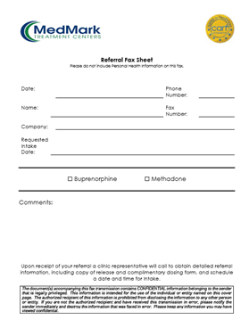
MedMark Hayward
Strategy ~ Developing a smooth referral & reaching out to be of service to our referring sources.
Challenge ~ Developing referral sources is impacted by quarantine, making personal rapport & providing marketing materials important.
Areas of Direct Contact: 6 Police Departments 2 Jails 10 Hospitals + 1 Ambulance Company 3 Shelters Youth & Family Agencies ~ including Family Treatment Courts
* Transit Advertising is being researched.

Slide 9
South County- Santa Clara County
Accomplishments:
Hiring new staff
Approval for new dispensary window
Approval for New Methadone Pumps
Ability to offer Telehealth Services
Barriers:
Contract –approval process
COVID-19

Slide 10
CVC- Santa Clara County
Accomplishments:
Hiring new staff
Provided two community in-services for MAT and Suboxone certification
Ability to offer Telehealth
Working collaboratively in expansion of MAT with ER and Inpatient
Barriers:
Contracting process
COVID -19

Slide 11
Santa Rosa Treatment Program
Melissa Nelson: Community Outreach, Counselor
Kellie Hickson: Intake Counselor
Due to COVID-19 outbreak the following amendments have been made to project deliverables:
Tower Upgrade/ Training will be postponed until shelter in place orders have been lifted.
Staff Training on Buprenorphine will be postponed until shelter in place orders have been lifted.
All Community Outreach efforts will now take place remotely, with emphasis being placed on updating company website and online platforms as well as literature and printed materials. Networking will take place via phone an email as opposed to in person.
Reallocation of funds: No longer purchasing Methadone Pump for Dispensing, or server for the clinic, in addition staff is no longer required to travel for 2 learning collaboratives. These funds will instead be used to purchase a Transfer Switch for the clinic to operate using a generator if needed. This is especially important during fire season due to rolling black outs and Sonoma County being an especially vulnerable area. In addition, funds will be used to purchase and install Plexi Glass so that a safe barrier can be installed in the front office and dispensary widows.
Projects Completed
Staff computers purchased and installed
Microsoft office for staff computers purchased and installed
All upgraded equipment is fully operational
All staff were trained on new hardware and software functions
Purchased in network cloud storage and trained staff on functions
(Network) file sharing system for all clinic staff is set up and fully operational
Projects In the Works
Train staff on Buprenorphine and Naltrexone Treatment; measure outcome by comprehensive exam at end of training
Upgrade the Tower System (operating system for the clinic)
Update software to incorporate use Electronic Medical Records through the new Tower System
Train Staff members on new Tower software
Upcoming Projects
Update all Outreach and Education Materials to include literature specific to Buprenorphine and Naltrexone including all printed materials and online platforms
Increase outreach efforts to target high need agencies and establish new pathways for mutual referral relationships (virtual, phone, email)
Server Tower Training
Learning Collaborative Dispensary Methadone Pump
Plexi Glass/ Instillation
Transfer Switch, generator and instillation

Slide 13
GROWING - Adult MAT Outpatient Program NEW - Youth Outpatient Program
LAUNCHED: Peer Support Specialist - Recovery Services
LAUNCHED: Telehealth
CONTINUED: Leadership in offering community Overdose / Naloxone Trainings
FINALIZED: Outreach plan

