Slide 1
Learning Collaborative
Resource Expansion, Access & Collaboration for Health
Los Angeles, CA
October 25, 2019

Slide 2
WELCOME and Congratulations Grantees!
You are part of an ambitious effort to expand access to and use of Medication Assisted Treatment (MAT) across California.
California is leading the nation in this life-saving effort and we are grateful for the dedication of NTPs to this effort – long before many others recognized how critical MAT is to the treatment of Opioid Use Disorders.
We hope you find today’s meeting to be valuable and sincerely want your input throughout the day.
Thank you for your active participation

Slide 3
Narcotic Treatment Programs (NTPs) had been boxed in – dispensing only methadone NTP REACH aims to change that with your programs
Through:
Funding for Expanded CAPACITY
Access, referral and connections to resources through the NTP-REACH Team’s deep knowledge and experience base
Collaborative opportunities with other NTP REACH grantees for shared learning
Project data collection, to provide your program with outputs and outcomes to evaluate your individual and collective efforts and guide “next steps”

Slide 4
WHY does NTP REACH exist?
Objective 1 Support infrastructure and personnel development for the purpose of expanding access to buprenorphine, naltrexone, and naltrexone injectables at NTPs (that are not site locations for the Hub and Spoke System)
Objective 2 Support collaboration, network building, and technology and knowledge transfer among California’s NTPs on a county, regional, and statewide basis
Objective 3 Support expansion of referral patterns and pathways from hospitals, EDs, correctional facilities, including jails and prisons, treatment court teams and other referring agencies through education of referring personnel about the availability of all types of MAT at NTPs

Slide 5
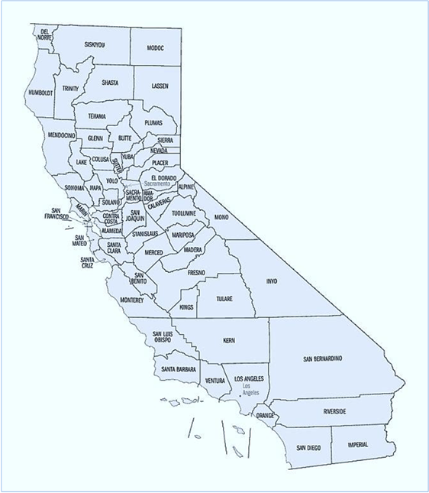
Counties Served by NTP REACH Grantees
Santa Rosa Treatment – Sonoma/Mendocino/ Napa/Lake Counties
Gold Country Health, LLC- Sacramento Co/Amador Co./Calaveras and El Dorado accessible
Sunrise Health & Wellness, LLC -Sacramento Co.
H.A.A.R.T Hayward- Alameda Co.
MedMark Treatment Centers- East Alameda Co.
ART- San Mateo - San Mateo and Santa Clara Co.
ART- Oakland - Alameda Co.
Santa Clara Co. Addiction Medicine Treatment- San Jose - Santa Clara Co.
Santa Clara Co. Addiction Medicine Treatment- San Martin - South Co. Santa Clara
Valley Health Associates- Monterey & San Benito Co.
ART- Porterville – Tulare and Kern Co
BAART – Visalia – Tulare and Kings Co.
ALT Recovery Group 2- Los Angeles and Ventura Co.

Slide 6
Structure of NTP REACH organization
DHCS
Advocates for Human Potential
(AHP)
13 NTP Subgrantees : YOU!!
UCLA-ISAP
NTP REACH TEAM:
AHP + UCLA

Slide 7
NTP REACH Project Progress
9/4/2019
RFA Release
9/24/2019
Applications Due
10/10/2019
Award Notification
10/25/2019
LAUNCH

Slide 8
Subgrantee Requirements So, What’s Next?
Upon award announcement, NTPs will develop subcontracts with AHP – happening NOW
Implement projects as specified in subcontract
Participate in-person at up to 3 Learning Collaboratives: 1 in LA on 10/25/19; 1 in San Jose in Spring 2020 1 in Sacramento in Summer 2020
Participate in outcome and data monitoring related to objectives of NTP REACH
Meet state and federal program financial reporting requirements, including 42 CFR Part 2
Submit quarterly reports on deliverables progress and invoices
Submit final report 10/2020
Participate in monthly coaching calls for support, technical assistance and referrals to additional resources as needed
Participate in at least 5 targeted webinars specifically for NTP REACH grantees
Participate in at least 1 in-person site visit

Slide 9
Contract Development & Invoice Overview
Develop agreed-upon, do-able, and relevant Statement of Work
2. Develop budget that matches Statement of Work and relevant need
IF budget involves purchasing durable goods, ie: equipment (ie: Tower server and related software, computers, printers, projectors, etc.) or property (ie: chairs, desks, pharmacy safe, other furnishings)
THEN, AHP must receive copies of all paid vendor invoices in order to reimburse. And will reimburse upon receipt of invoices (instead of waiting till end of quarter to pay deliverables invoice.)
3. Use a “hybrid” invoicing system – part deliverable- based, part itemized-budget-based due to federal accounting requirements for durable goods

Slide 10
Then, what’s next?
Embark on your project ASAP
Stay in touch with NTP REACH Team for support, questions, etc.
Attend Webinar in November (date TBD Today)
Coaching Call in November with NTP Team
Contract monitoring in December or as needed by AHP staff
Submit invoice and quarterly report on progress towards deliverables by Jan 1st 2020,
And, if relevant, individual itemized invoice with report on purchases, to be reimbursed prior to end of quarter
STAY TUNED!

Slide 11
Q U E S T I O N S ?
Kwest@ahpnet.com
Counting on Lots of Collaboration!

