Slide 1
Opioids and Chronic Pain: Recognizing and Mitigating Risks
The Science and Practice of Treating Patients with Pain and Opioid Use Disorders
September 18th, September 26th & October 10th, 2018

Slide 2
Presenters
September 18th, Oakland & October 10th, Clovis
Brian Hurley, MD, MBA, DFASAM Addiction Psychiatrist at LA County Department of Mental Health & Assistant Professor of Addiction Medicine at UCLA
September 26th, San Bernardino
Rebecca Trotzky, MD Medical Director, Jail Health Services and Urgent Care at LAC+USC & Southern California Regional Coordinator, ED-BRIDGE

Slide 3
Disclosures
The speakers do not have relevant financial relationships with commercial interests.

Slide 4
Introduction: Case Presentation
Ms. Brown is a 47 year-old school teacher who was referred to see her primary care physician after an emergency room visit.
Has chronic painful diabetic neuropathy and has been in the primary care practice for a year.
Current Pain Rx:
oxycodone 30mg three times daily as needed for pain
gabapentin 600mg three times daily
She has an up-to-date controlled substances agreement that outlines:
urine drug testing policy
pill count policy
taking her medications exactly as prescribed including NOT increasing her dose without first discussing it with her physician.
Stock Photo
Notes:
Brian

Slide 5
Introduction: Case Presentation (Part 2)
She went to an emergency room on Saturday night after running out of her oxycodone after she doubled her dose without medical advice because her pain was unbearable.
The ER physician scheduled a follow up visit with her primary care physician the following week.
A review of the CA CURES prescription drug monitoring program confirms that she was prescribed 30 tablets of oxycodone 30mg by the ER physician which she did not disclose to her primary care physician during the visit.
Stock Photo
Notes:
Brian

Slide 6
Introduction: Case Presentation (Part 3)
Which of the following is the most appropriate next step in this patient’s oxycodone management?
Stock Photo
Continue oxycodone at the current dose
Increase the standing dose of oxycodone
Lower the standing dose of oxycodone
Taper off (discontinue) the oxycodone
Refuse to prescribe more oxycodone
Notes:
Brian

Slide 7
Chronic Pain
Chronic Pain
30% of Americans with Chronic pain (40% of older adults)
100 million in U.S. with chronic pain (versus 26 m w/ DM, 16 m w/ coronary heart disease, 12 m w/ cancer)
42% with pain lasting over 1 year
33% report pain as disabling
Pain accounts for up to 20% of outpatient visits
$600 billion annual cost (healthcare expenses, lost income, lost productivity)
Institute of Medicine. 2011
Slide Credit: Scott Hunter, M.D., M.H.S. and Karen Miotto, M.D.
Notes:
Brian

Slide 8
Opioids
Most commonly prescribed class of medications in the United States
In 2014: 245M prescriptions for opioids
Of these prescriptions, 35% were for longer term therapy (>3 weeks)
3 to 4% of the adult population (9.6 million to 11.5 million people) are prescribed longer-term opioid therapy.
National Institute on Drug Abuse. The latest prescription trends for controlled prescription drugs. 2015.
Volkow ND, McLellan TA, Cotto JH, Karithanom M, Weiss SR. Characteristics of opioid prescriptions in 2009. JAMA 2011; 305: 1299-301.
Boudreau D, Von Korff M, Rutter CM, et al. Trends in long-term opioid therapy for chronic non-cancer pain. Pharmacoepidemiol Drug Saf 2009; 18: 1166-75.
Notes:
Brian

Slide 9
Opioids for Chronic Pain
Positives
Improves pain and function in some
Safe and well tolerated in some
Challenges
Opioid-centered lifestyle
Distracts from other treatments
Tolerance may occur
Hyperalgesia may occur
Physical dependence occurs
Addiction and overdose risk
Diversion risk
Labor intensive to prescribe safely
Slide Credit: Daniel Alford, M.D.
Notes:
Brian

Slide 10
Chronic Pain Co-Occurrence
Chronic Pain Co-Occurrence
Condition | Prevalence in Patients with Chronic Pain
Major Depression | 15% to 56%
Anxiety Disorders | 17% to 50%
Somatization Disorder | 20% to 31%
Personality Disorders | 31% to 81%
PTSD | 20% to 34%
Substance Use Disorders | 15% to 28%
Dersh J et al. Spine 2006
Trescot AM et al. Pain Physician 2008
Notes:
Brian

Slide 11
Chronic Pain Has Many Drivers
Patient “A”
Pain 8/10
Patient “B”
Pain 8/10
Environmental Stressors
Environmental Stressors
Cultural Background
Cultural Background
Functional
Disability
Genetics
Genetics
Functional
Disability
Physical
Injury
Physical
Injury
Cognitive
Dysfunction
Cognitive Dysfunction
Social
Disability
Addiction
Depression & Anxiety
Social
Disability
Depression & Anxiety
Gatchel RJ. Am Psychol. 2004
Notes:
Brian

Slide 12
Opioid Efficacy in Chronic Pain
Most literature surveys & uncontrolled case series
RCTs are short duration <8 months w/ small samples <300 pts
Mostly pharmaceutical company sponsored
Pain relief modest
Better analgesia with opioids vs control in all studies (statistically significant)
Mixed reports on function
Addiction not assessed
Balantyne JC, Mao J. NEJM 2003
Kalso E et al. Pain 2004
Eisenberg E et al. JAMA. 2005
Furlan AD et al. CMAJ 2006
Slide Credit: Daniel Alford, M.D.
Notes:
12
Karen
Alford, Efficacy and Safety

Slide 13
Opioid Safety
Allergies are rare
Side effects are common
Nausea, sedation, constipation
Urinary retention, sweating
Organ toxicities are rare
Hypothalamic-pituitary-gonadal axis - ↑prolactin, ↓ LH, FSH, testosterone, estrogen, progesterone
Overdose especially when combined w/ other sedatives
Notes:
Karen

Slide 14
What is the Addiction Risk?
Published rates of abuse and/or addiction in chronic pain populations are 3-19%
Known risk factors for addiction to any substance are good predictors for problematic prescription opioid use
Past cocaine use, h/o alcohol or cannabis use
Lifetime history of substance use disorder
Family history of substance abuse, a history of legal problems and drug and alcohol abuse
Tobacco dependence
History of severe depression or anxiety
Akbik H et al. JPSM 2006
Ives T et al. BMC Health Services Research 2006
Liebschutz JM et al. J of Pain 2010
Michna E el al. JPSM 2004
Reid MC et al JGIM 2002
Notes:
Karen

Slide 15
What is the Overdose Risk?
Risk of fatal overdose seems directly related to the maximum prescribed daily opioid
Doses (MSO₄ equivalents) 50-99 mg/d had a 3.7-fold increase in overdose risk
Doses >100 mg/d had an 8.9-fold increase in overdose risk with a 1.8% annual overdose rate
Dunn KM et al. Ann Intern Med 2010
Braden JB et al. Arch Intern Med 2010
Bohnert ASB et al. JAMA 2011
Notes:
Karen

Slide 16
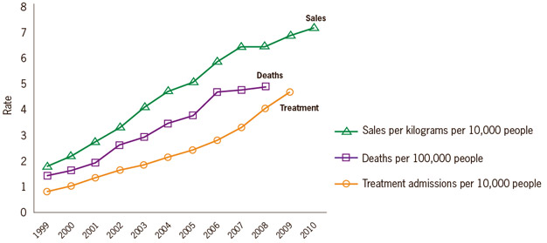
Opioid Sales, Deaths & Addiction Treatment
National Vital Statistics System, 1999-2008; Automation of Reports and Consolidated Orders System (ARCOS) of the Drug Enforcement Administration (DEA), 1999-2010; Treatment Episode Data Set, 1999-2009
Notes:
Karen

Slide 17
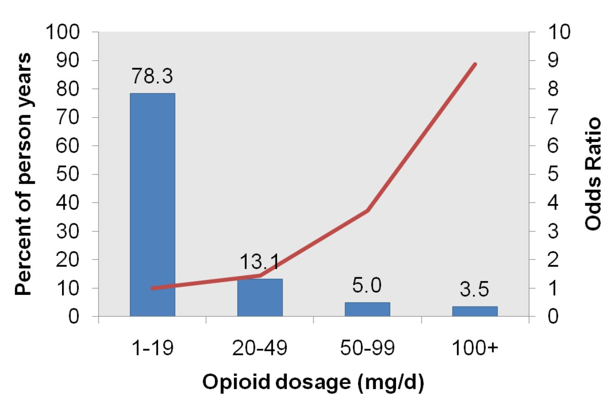
Overdose Risk and Dose
Overdose Risk and Dose
1
Percent Use
Dunn KM, et al. Ann Intern Med. 2010
Notes:
Karen
17

Slide 18
Overdose Risks
Overdose Risks
Volkow, N. D., & McLellan, A. T. (2016). Opioid abuse in chronic pain—misconceptions and mitigation strategies. New England Journal of Medicine, 374(13), 1253-1263.
Notes:
Karen
18

Slide 19
Issues Preventing Opioid Prescribing n=111
Potential for patients to become addicted | 89%
Potential for patients to sell or divert | 75%
Opioid side effects | 53%
Regulatory/law enforcement monitoring | 40%
Hassle and time required to track/refill | 28%
Upshur CC et al. J Gen Intern Med 2006
Notes:
Karen

Slide 20
Mu Receptor
Mu Receptor
G protein-coupled R
>100 polymorphisms in MOR gene
Not all respond to an opioid in same way
Not all pain responds to an opioid in the same way
Incomplete cross-tolerance between opioids
Volkow, N. D., & McLellan, A. T. (2016). Opioid abuse in chronic pain—misconceptions and mitigation strategies. New England Journal of Medicine, 374(13), 1253-1263.
Notes:
Karen

Slide 21
Tolerance
Requiring higher doses to obtain:
Analgesia, Euphoria, other desires effects
Doses up > 800 MME observed
Rate of tolerance depends on the opioid
Tolerance to respiratory depression develops slower than tolerance to analgesia and euphoria
Notes:
Karen

Slide 22
Withdrawal
Symptoms that emerge when opioids are stopped.
piloerection, chills, insomnia, diarrhea, nausea, vomiting, and muscle aches
Vary in severity (from not noticeable to quite uncomfortable) and duration (1 to 14 days) on the basis of the type, dose, and duration of opioid prescribed.
Notes:
Karen

Slide 23
Physical Dependence vs. Disordered Use
Physical Dependence
Opioid Use Disorder
Repeated administration of any opioid inevitably results in the development of tolerance and physical dependence.
Results from counter-adaptations in opioid receptors-related intracellular signaling cascades
Develops takes days-weeks
Not inevitable, and results in 3%-19% of individuals exposed to chronic opioids.
A chronic medical illness that does not resolve when chronic opioid exposure is discontinued.
Neuro-molecular processes are different than that for tolerance.
Typically takes months
Notes:
Karen

Slide 24
Opioid Use Disorder
Addiction in DSM-5:
A maladaptive pattern of substance use manifested by two (or more) of the following in the same 12-month period:
Failure to fulfill major role obligations
Use in situations in which it is physically hazardous
Continued substance use despite having persistent or recurrent problems
Tolerance
Withdrawal
Substance taken in larger amounts or over more time than intended
Unsuccessful efforts to cut down
A great deal of time is spent
Giving up activities due to substance use
Substance use continues despite recurrent problems
Craving
American Psychiatric Association. (2013). Diagnostic and statistical manual of mental disorders: DSM-5, Section II on Substance-Related and Addictive Disorders. Washington, DC: American Psychiatric Association.
Notes:
Karen

Slide 25
Physical Dependence vs. Disordered Use (continued)
Physical Dependence
Opioid Use Disorder
Reversed within a few days to a few weeks of discontinuing opioid exposure
Persist (for months to years in some, lifelong in others) after discontinuing opioid exposure.
Clinical Relevance
People with opioid use disorder patients are particularly vulnerable to overdosing: their intense drive to take the drug persists, but the tolerance that previously protected them from overdosing is no longer present.
Leads to high risk of overdosing among persons with an opioid use disorder after they have been released from prison or from a withdrawal management “detox” program.
Notes:
Karen

Slide 26
Common Misconceptions
Addiction is the same as physical dependence and tolerance.
Addiction is simply a set of bad choices.
Pain protects patients from addiction to their opioid medications.
Only long-term use of certain opioids produces addiction.
Only patients with certain characteristics are vulnerable to addiction.
Medication-assisted therapies are just substitutes for heroin or opioids.
Volkow, N. D., & McLellan, A. T. (2016). Opioid abuse in chronic pain—misconceptions and mitigation strategies. New England Journal of Medicine, 374(13), 1253-1263.
Notes:
Karen

Slide 27
Prescribing Strategies
Address Risk of Diversion, Overdose, and Opioid Use Disorder
Use “Universal Precautions” best practices: regular monitoring, urine drug testing, assess for other opioids / relevant substances
Minimize use of opioids and, if opioids used, use the lowest necessary dose
Initiate addiction treatment when needed
Co-Prescribe Naloxone
Notes:
Brian

Slide 28
Is my patient addicted?
Physical dependence
Biological adaptation
Signs and symptoms of withdrawal (e.g., pain) if opioid is abruptly stopped
Addiction (3 C’s)
Behavioral maladaptation
Loss of Control
Compulsive use
Continued use despite harm
Opioid Dependence (DSM 5)
Behavioral maladaptation +/- Biological
Aberrant Medication
Taking Behaviors
(Pattern & Severity)
Slide Credit: Daniel Alford, M.D.
Notes:
Brian

Slide 29
Aberrant Medication Taking Behaviors The Spectrum of Severity
Slide Credit: Daniel Alford, M.D.
Requests for increase opioid dose
Requests for specific opioid by name, “brand name only”
Non-adherence w/ other recommended therapies (e.g., PT)
Running out early (i.e., unsanctioned dose escalation)
Resistance to change therapy despite AE (e.g. over-sedation)
Deterioration in function at home and work
Non-adherence w/ monitoring (e.g. pill counts, urine drug tests)
Multiple “lost” or “stolen” opioid prescriptions
Illegal activities – forging scripts, selling opioid prescription
Notes:
Brian

Slide 30
Aberrant Medication Taking Behaviors Differential Diagnosis
Inadequate analgesia – “Pseudoaddiction”
Disease progression
Withdrawal mediated pain
Opioid-induced hyperalgesia
Opioid Use Disorder
Opioid analgesic tolerance
Self-medication of psychiatric and physical symptoms other than pain
Criminal intent - diversion
Weissman DE, Haddox JD. 1989
Evers GC. 1997
Chang C et al 2007
Slide Credit: Daniel Alford, M.D.
Notes:
Brian

Slide 31
Non Opioid Rx Treatment for Pain
Acetaminophen
Nonselective nonsteroidal anti-inflammatory drugs; recommended as first-line pharmacotherapy for osteoarthritis and low back pain in multiple guidelines
Cyclooxygenase-2 inhibitors
Anticonvulsants (gabapentin or pregabalin)
Antidepressants (tricyclics and serotonin and norepinephrine reuptake inhibitors)
Notes:
Brian

Slide 32
Interventional Treatment for Pain
Epidural injection; may provide short-term improvement for certain pain-associated conditions (e.g., lumbar radiculopathy)
Brain, spinal cord, and nerve stimulation, including transcranial magnetic stimulation, transcranial direct current stimulation, electrical deep-brain stimulation, and stimulation devices for peripheral nerves or tissues
Notes:
Brian

Slide 33
Non Rx Treatment for Pain
Cognitive-behavioral therapy
Exercise therapy
Complementary medicine (e.g., yoga, meditation, acupuncture)
Biofeedback
Notes:
Brian

Slide 34
Biofeedback
Electromyography to help patients learn to control muscle tension and electroencephalography to help patients learn to influence brain electrical signals in order to modulate pain; may be beneficial in treatment of headaches, some forms of chronic back pain, and other pain disorders
Neurofeedback with the use of functional magnetic resonance imaging as a supplemental approach for chronic pain management
Notes:
Brian

Slide 35
When Are Opioids Indicated?
Pain is moderate to severe
Pain has significant impact on function and on quality of life
Non-opioid pharmacotherapy has been tried and failed
Patient agreeable to…
take opioid as prescribed (e.g. no dose escalation)
close monitoring (e.g. pill counts, urine drug testing)
Slide Credit: Daniel Alford, M.D.
Notes:
Brian

Slide 36
Key Principles
Maintain benefit-risk (harm) framework
Judge the treatment NOT the patient
Notes:
Brian

Slide 37
Opioid Choice
Duration and onset of action
“Rate hypothesis” - fast on, fast off – most rewarding – addicting
Short-acting opioids increase risk of opioid-withdrawal mediated pain
Patient’s prior experience
Mu polymorphisms – differences in opioid responsiveness
Currently there are NO abuse resistant opioids or opioid formulations!!
Notes:
Brian

Slide 38
Assessing Benefit - Risk/Harm
“Universal Precautions”
(has become “standard” of care)
Screening Tools
Agreements “contracts”, informed consent
Monitor for benefit and harm with frequent face-to-face visits
Monitor for adherence, addiction and diversion
Urine drug testing
Pill counts
Prescription monitoring program data
Only limited data are
available regarding the efficacy of any of these strategies, and these are based upon expert consensus
FSMB Guidelines 2004 www.fsmb.org
Gourlay DL, Heit HA. Pain Medicine 2005
Chou R et al. J Pain 2009
Notes:
Brian

Slide 39
Assessing Benefit PEG (Pain, Enjoyment, General activity) scale (0-10)
What number best describes your Pain on average in the past week? (No pain - Pain as bad as you can imagine)
What number best describes how, during the past week,
pain has interfered with your Enjoyment of life? (Does not interfere-Completely interferes)
pain has interfered with your General activity? (Does not interfere – Completely interferes)
Krebs EE, et al. J Gen Intern Med. 2009
Notes:
Brian

Slide 40
Opioid Risk Assessment: SOAPP® - SF Screener & Opioid Assessment for Patients with Pain Evaluate for relative risk for developing problems (e.g. aberrant medication taking behaviors) 86% sensitive, 67% specific
0=Never, 1=Seldom, 2=Sometimes, 3=Often, 4=Very often
How often do you have mood swings?
How often do you smoke a cigarette within an hour after you wake up?
How often have you taken medication other than the way it was prescribed?
How often have you used illegal drugs (for example, marijuana, cocaine, etc) in the past 5 years?
How often, in your lifetime, have you had legal problems or been arrested?
> 4 is POSITIVE
< 4 is NEGATIVE
©2008 Inflexxion, Inc.
Notes:
Brian

Slide 41
Discussing Monitoring with Patients
Discuss risks of opioid medications
Assign responsibility to look for early signs of harm
Discuss agreements, pill counts, drug tests, etc. as ways that you are helping to protect patient from getting harmed by medications
Thiazide diuretic - K monitoring analogy
Use consistent approach, but set level of monitoring to match risk
Notes:
Brian

Slide 42
Monitoring Urine Drug Tests
Evidence of therapeutic adherence
Evidence of non-use of unreported intoxicants
Know limitations of test and your lab
Know a toxicologist/clinical pathologist
Complex, but necessary, patient-physician communication
If I send your urine right now, what will I find in it…
Your urine drug test reflected an unexpected result, can you tell me about it…
Document time of last medication use
Inappropriate interpretation of results may adversely affect clinical decisions
Gourlay DL, Heit HA, Caplan YH. Urine drug testing in primary care. Dispelling myths and designing strategies monograph (www.familydocs.org/files/UDTmonograph.pdf)
Notes:
Brian

Slide 43
Urine Toxicology Monitoring in Patients on Opioids for Chronic Pain
Notes:
Brian

Slide 44
Monitoring Pill Counts
Confirm medication adherence
Minimize diversion
Strategies…
28 day (rather than 30 day) supply
All patients expected to bring remaining pills at each visit
If patient “forgets” pills, schedule return visit with in a week
For “high risk” patient, can employ random call-backs
Notes:
Brian

Slide 45
Continuation of Opioids
You must convince yourself that there is benefit
Benefit must outweigh observed harms
If small benefit, consider increasing dose as a “test”.
If no benefit, hence benefit cannot outweigh risks – so STOP opioids. (Ok to taper and reassess.)
You do not have to prove addiction or diversion – only assess Risk-Benefit ratio
Notes:
Brian

Slide 46
Exit Strategy Discussing Lack of Benefit
Stress how much you believe / empathize with patient’s pain severity and impact
Express frustration re: lack of good pill to fix it
Focus on patient’s strengths
Encourage therapies for “coping with” pain
Show commitment to continue caring about patient and pain, even without opioids i.e., you are abandoning (discharging) an ineffective treatment, not the patient
Schedule close follow-ups during and after taper
Notes:
Brian

Slide 47
Deterrence In Prescription Formulations
Manufacturers Can:
Combine opioid with an antagonist (antagonist active if compound snorted or injected)
Made Rx resistant to crushing / extraction
Combine opioid with a substance that triggers an adverse response if snorted, injected, or used at excessive doses
Develop prodrugs that require enzymatic activation
Notes:
Karen

Slide 48
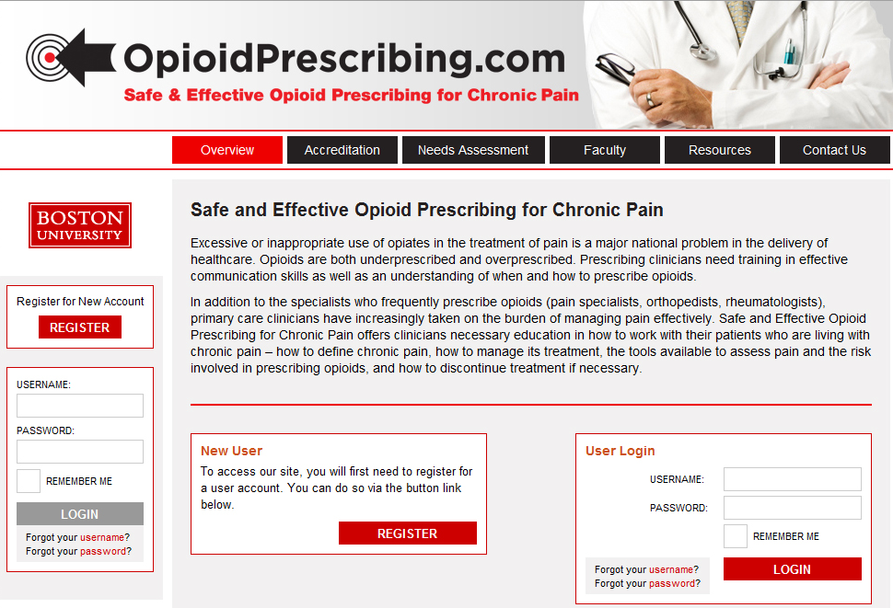
www.opioidprescribing.com
4 AMA PRA Category 1 Credits™ available, plus risk management and opioid education credits
Notes:
Karen

Slide 49
Other Approaches
Health systems can apply currently guidelines for pain management
Medical educators can increase the intensity and frequency of training on opioids, pain, and addiction
Researchers can develop new technologies with improved risk-benefit profiles
Volkow, N. D., & McLellan, A. T. (2016). Opioid abuse in chronic pain—misconceptions and mitigation strategies. New England Journal of Medicine, 374(13), 1253-1263.
Notes:
Karen

Slide 50
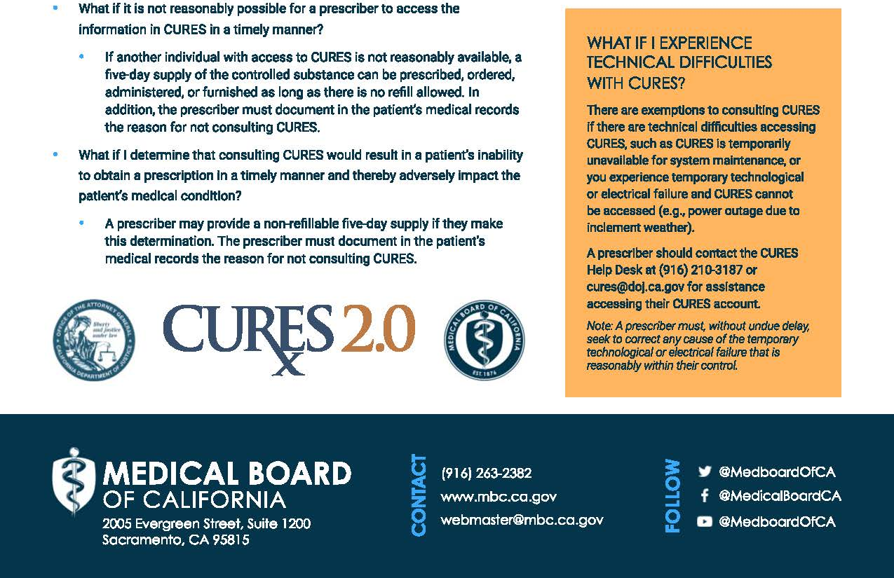
CURES 2.0 Mandatory Use Begins October 2, 2018
Notes:
Karen

Slide 51
CURES 2.0
Must be checked the first time a patient is prescribed, ordered, administered, or furnished a controlled substance (*unless an exception applies)
Within the 24–hour period, or the previous business day, before prescribing, ordering, administering, or furnishing a controlled substance*
Before subsequently prescribing a controlled substance, if previously exempt.
At least once every four months if the controlled substance remains a part of the patient’s treatment plan.
Notes:
Karen

Slide 52
https://oag.ca.gov/cures
Notes:
Karen

Slide 53
https://cures.doj.ca.gov/registration/confirmEmailPnDRegistration.xhtml
Notes:
Karen

Slide 54
CURES continued
https://oag.ca.gov/cures
Notes:
Karen

Slide 55
https://cures.doj.ca.gov
Notes:
Karen

Slide 56
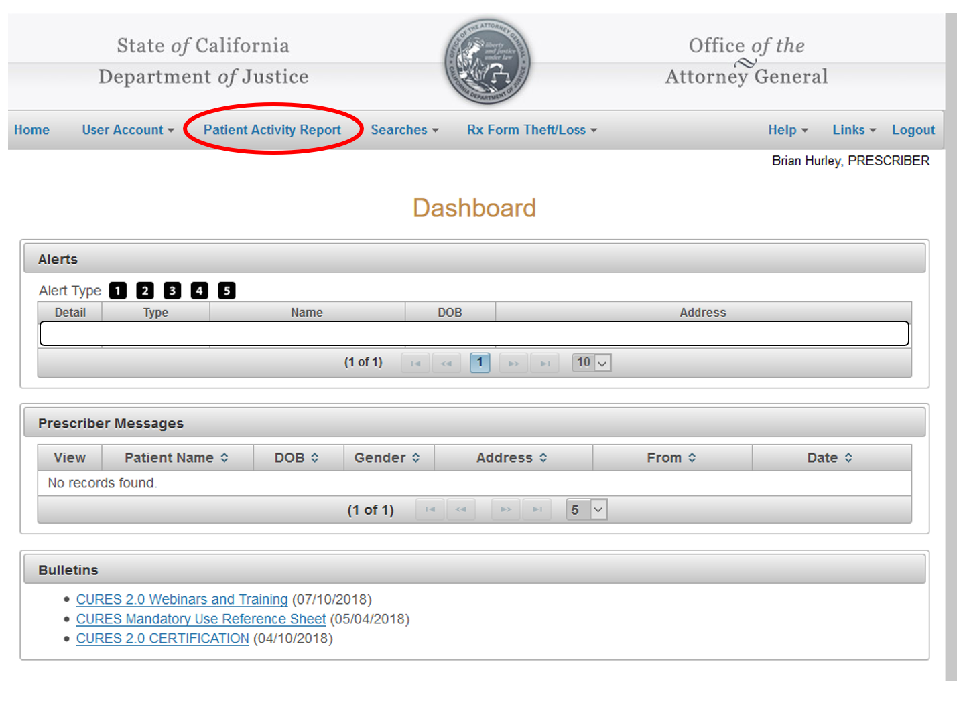
Dashboard
Notes:
Karen

Slide 57
Patient Activity
Notes:
Karen

Slide 58
Case Presentation
Ms. Brown is a 47 year-old school teacher with chronic painful diabetic neuropathy and has been in the primary care practice for a year.
Ran out of oxycodone after she doubled her dose without consulting her physician.
She was prescribed 30 tablets of oxycodone 30mg by the ER physician which she did not disclose to her primary care physician during the visit.
Has controlled substances agreement in place.
Stock Photo
Notes:
Brian

Slide 59
Lack of Adequate Benefit
Stress how much you believe / empathize with patient’s pain severity and impact
Express frustration re: lack of good pill to fix it
Encourage therapies for “coping with” pain
Show commitment to continue caring for patient, even without opioids… you are abandoning an ineffective treatment, not the patient
Schedule close follow-ups during and after taper
Notes:
Brian

Slide 60
Apparent Harm
Give specific and timely feedback why patient’s behaviors raise your concern for possible addiction
Benefits no longer outweighing risks
“I cannot responsibly continue prescribing opioids as I feel it would cause you more harm than good.”
Will likely have to “agree to disagree”
Always offer addiction treatment, including office-based buprenorphine if clinically appropriate, or referral to a different and appropriate level of care
Stay 100% in “Risk/Benefit” mindset
Notes:
Brian

Slide 61
Case Presentation (Part 2)
Ms. Brown is a 47 year-old school teacher with chronic painful diabetic neuropathy and has been in the primary care practice for a year. Ran out of oxycodone after she doubled her dose without consulting her physician.
Stock Photo
Taper off (discontinue) the oxycodone
Notes:
Brian

Slide 62
Take Home Points
Chronic pain is complicated
Opioids can help and are not perfect
Not all chronic pain responds to opioids
Judge opioid treatment (risk/benefit), not the patient
Universal Precautions for Safe Opiate Prescribing:
Agreement
Risk Assessment
Frequent visits
Monitoring (Urine, pill counts, CURES)
Notes:
Brian

Slide 63
Questions / Feedback
Brian Hurley: bhurley@ucla.edu
Rebecca Trotzky: rebecca@ed-bridge.org
Interested in more?
Come to:
ASAM Annual Meeting (Orlando in April!)
AAAP Annual Meeting (Bonita Springs, FL in Dec!)

