Slide 1
Pacific Behavioral Health Collaborating Council
Alcohol and Drug Counselor (ADC) Academy, Day 1
Introduction to the IC&RC ADC Performance Domains and Review of Psychoactive Drugs
Enter location here
Enter dates here
Enter trainer names and credentials here
Notes:
INSTRUCTIONS
Welcome participants to the training
Orient participants to the training room/facility and to the nearest bathroom
Introduce all trainers
Be prepared to project the Center for Substance Abuse Treatment (2006) Technical Assistance Publication 21
Briefly orient participants to the various handouts and resources they have received
RESOURCES
All participants should receive the following:
Flash drive or link to:
PDF copies of all slide decks
CSAT Technical Assistance Publications
Center for Substance Abuse Treatment. (2006). Addiction Counseling Competencies: The Knowledge, Skills, and Attitudes of Professional Practice. Technical Assistance Publication (TAP) Series 21 (HHS Publication No. (SMA) 15-4171). Rockville, MD: Substance Abuse and Mental Health Services Administration.
Center for Substance Abuse Treatment. (2015). Comprehensive Case Management for Substance Abuse Treatment. Technical Assistance Publication (TAP) Series 27 (HHS Publication No. (SMA) 15-4215). Rockville, MD: Substance Abuse and Mental Health Services Administration.
CSAT Treatment Improvement Protocol
Center for Substance Abuse Treatment. (2015). Addressing Suicidal Thoughts and Behaviors in Substance Abuse Treatment. Treatment Improvement Protocol (TIP) Series 50 (HHS Publication No. (SMA) 15-4318). Rockville, MD: Substance Abuse and Mental Health Services Administration.
Center for Substance Abuse Treatment. (2015). Substance Abuse Treatment and Family Therapy. Treatment Improvement Protocol (TIP) Series No. 39 (HHS Publication No. (SMA) 15-4219). Rockville, MD: Substance Abuse and Mental Health Services Administration.
Substance Abuse Mental Health Services Administration. (2015). Substance Abuse Treatment for Persons with Co-Occurring Disorders. Treatment Improvement Protocol (TIP) Series 42 (HHS Publication No. (SMA) 13-3992). Rockville, MD: Substance Abuse and Mental Health Services Administration
Paper copies of the following:
Candidate Guide for the International Certification and Reciprocity Consortium (IC&RC) Alcohol and Drug Counselor (ADC) Examination

Slide 2
Acknowledgments
This training was developed by Dr. Thomas E. Freese, PhD (Director of Training of UCLA ISAP and Director of the Pacific Southwest ATTC), Alex R. Ngiraingas, MEd, CSAC II, ICADC, ICPS, and Dr. Christopher C. C. Rocchio, PhD, LCSW, CSAC, ICADC (Clinical Specialist, UCLA) in August of 2018 under contract number 2018-002 by the University of California Los Angeles, Integrated Substance Abuse Programs (UCLA ISAP) and the Pacific Southwest Addiction Technology Center (PSATTC) for the Pacific Behavioral Health Collaborating Council (PBHCC). Additional resource provided by SAMHSA, grant number UR1TI080211.
Notes:
TRAINER NOTES
This training was developed by Drs. Thomas Freese and Christopher Rocchio from the University of California Los Angeles, Integrated Substance Abuse Programs (UCLA ISAP) and with Alex Ngiraingas, an addictions counselor and educator from the Republic of Palau. We would like to acknowledge and thank the Pacific Behavioral Health Collaborating Council (PBHCC) for their commitment to train individuals across the Pacific to effectively prevent, treat, and support individuals in their own recovery from substance use disorders, and for their financial support for the development and delivery of this curriculum. Additional resource provided by SAMHSA, grant number UR1TI080211.

Slide 3
Disclaimer
The UCLA, its employees, contractors, and affiliates shall not be liable for any damages, claims, liabilities, costs, or obligations arising from the use or misuse of materials or information contained in this presentation. Any use, copying, or distribution without written permission from the UCLA and the PBHCC is prohibited.
Notes:
INSTRUCTIONS
[READ THE SLIDE]

Slide 4
Agenda for Day One
Introductions
Review of week’s agenda
IC&RC Performance Domains and the 12 Core Functions
TAP 21 Transdisciplinary Foundations and Practice Domains
Addiction as a brain disease
Science of addiction
Psychoactive Drugs: Alcohol, Opioids, Cannabis, Stimulants, Hallucinogens, and Inhalants
4
Notes:
INSTRUCTIONS
Orient participants to the agenda
[ASK PARTICIPANTS] What questions do you have regarding today’s agenda?
[ASK PARTICIPANTS] What is missing from this agenda that you were hoping to get?

Slide 5
Introductions
What is your name?
Where are you from?
What do you hope to learn in this training?
5
Notes:
INSTRUCTIONS
[ASK PARTICIPANTS] Please introduce yourself, where are you from, what do you hope to learn, and what were some of your expectations coming into this training?

Slide 6
Agenda (1)
Introductions
Review of week’s agenda
IC&RC Performance Domains and the 12 Core Functions
TAP 21 Transdisciplinary Foundations and Practice Domains
Addiction as a brain disease
Science of addiction
Psychoactive Drugs: Alcohol, Opioids, Cannabis , Stimulants, Hallucinogens, and Inhalants
6
Notes:
TRAINER NOTES
We will now review this week’s agenda.

Slide 7
Agenda for Day Two
12 Core Functions
Screening
Intake
Orientation
Assessment
Treatment Planning
Counseling
7
Notes:
INSTRUCTIONS
Orient participants to the agenda for day 2.

Slide 8
Agenda for Day Three
Twelve core functions (continued)
Case Management
Crisis Intervention
Client Education
Referral
Report and record keeping
Consultation
8
Notes:
INSTRUCTIONS
Orient participants to the agenda for day 3.

Slide 9
Agenda for Day Four
HIV and Infectious Diseases
What is HIV and AIDS?
Learning objectives
HIV Histories (World, US, Local, Personal)
HIV Medical Update
  Modes of Transmission
  Acute HIV Infection
  Testing/Screening
  Medications for HIV
  HIV Prevention
Sexually Transmitted Infections
9
Notes:
INSTRUCTIONS
Orient participants to the agenda for day 4.

Slide 10
Agenda for Day Five
Review practice exam
Test-taking strategies
Course review
10
Notes:
INSTRUCTIONS
Orient participants to the agenda for day 5.

Slide 11
Agenda (2) - 2
Introductions
Review of week’s agenda
IC&RC Performance Domains and the 12 Core Functions
TAP 21 Transdisciplinary Foundations and Practice Domains
Addiction as a brain disease
Science of addiction
Psychoactive Drugs: Alcohol, Opioids, Cannabis , Stimulants, Hallucinogens, and Inhalants
11
Notes:
INSTRUCTIONS
[ASK PARTICIPANTS] What questions do you have regarding this week’s agenda?
[ASK PARTICIPANTS] What is missing in today’s agenda that you were hoping to get?

Slide 12
IC&RC Alcohol and Drug
Counselor (ADC) Exam
Format and length
  150 multiple choice questions
  125 scored
  25 pretest items
  3 hours
Each test is different
Scaled scoring (200 – 800)
Passing score is 500
Reference
International Certification and Reciprocity Consortium. (2017). Candidate guide for the IC&RC alcohol and drug counselor examination. Retrieved from https://www.internationalcredentialing.org/resources/Candidate%20Guides/ADC_Candidate_Guide.pdf, February 4, 2020.
12
Notes:
INSTRUCTIONS
Ask participants to retrieve the Candidate Guide for the IC&RC ADC examination from their training packet.
TRAINER NOTES
Please closely review the candidate guide for the International Certification and Reciprocity Consortium (IC&RC) Alcohol and Drug Counselor (ADC) Examination later today and prior to taking the exam. Besides the paper copy you are being provided today, we have also included an electronic copy of the candidate guide in your resource folder. The IC&RC ADC exam tests for competency of entry-level counselors.
The ADC exam is comprised of 150 multiple choice questions. 125 of the test items are scored, and the other 25 are unweighted. These questions are referred to as pre-test items. Pretest items appear randomly throughout the examination. They are not identified and do not influence your final score.
You are given three hours to complete the test. Carefully read each question and choose the single best answer.
REFERENCE
International Certification and Reciprocity Consortium. (2017). Candidate Guide for the IC&RC Alcohol and Drug Counselor Examination. Retrieved from https://www.internationalcredentialing.org/resources/Candidate%20Guides/ADC_Candidate_Guide.pdf, February 4, 2020.

Slide 13
ADC Performance Domains
Standards for entry-level counselors
Four Domains
  Screening, Assessment, and Engagement (23%)
  Treatment Planning, Collaboration, and Referral (27%)
  Counseling (28%)
  Professional and Ethical Responsibilities (22%)
Each performance domain has corresponding tasks
Tasks include knowledge and skills for each performance domain
Assessment of counselor competence
References
Herdman, J.W. (2018). Global criteria: The 12 core functions of the substance abuse counselor (7th ed.). Lincoln, NE: Parallels: Pathways to Change.
International Certification and Reciprocity Consortium. (2017). Candidate guide for the IC&RC alcohol and drug counselor examination. Retrieved from https://www.internationalcredentialing.org/resources/Candidate%20Guides/ADC_Candidate_Guide.pdf, February 4, 2020.
13
Notes:
TRAINER NOTES
Questions asked on the exam are based on the 2013 IC&RC job-task analysis. Results from the analysis identified specific tasks of entry-level counselors. Using factor analysis, tasks were organized into four factors known as performance domains. The 4 performance domains are:
Screening, Assessment, and Engagement;
Treatment Planning, Collaboration, and Referral;
Counseling; and
Professional and Ethical Responsibilities
The percentages following each performance domain refer to their relative weight on the exam.
Each performance domain is comprised of specific tasks.
Eight tasks are associated with screening, assessment, and engagement, 10 tasks associated with treatment planning, collaboration, and referral, 8 tasks associated with professional and ethical responsibilities, and 7 tasks associated with professional and ethical responsibilities.
The exam evaluates candidates’ proficiency and competence in the necessary knowledge and skills needed to perform specific tasks associated with each performance domain in the role of an entry-level addictions counselor.
Please open the candidate guide and turn to page 11.
Beginning on page 11, the four performance domains and their corresponding tasks can be found.
Please only review the first task for screening, assessment, and engagement.
[ASK PARTICIPANTS] What knowledge and skills would you need to perform this task?
The 2013 Job-Task Analysis found and subject matter experts in addictions counseling agreed that the ability to demonstrate verbal and nonverbal communication to establish rapport and promote engagement requires knowledge of best practices for interviewing others, self-awareness, the stages of change, and how culture affects communication. Demonstration of this task would be evident in the counselor’s ability to engage and build trust with clients, and the ability and use of stage-appropriate interventions.
REFERENCES
Herdman, J.W. (2018). Global Criteria: The 12 Core Functions of the Substance Abuse Counselor (7th ed.). Lincoln, NE: Parallels: Pathways to Change.
International Certification and Reciprocity Consortium. (2017). Candidate Guide for the IC&RC Alcohol and Drug Counselor Examination. Retrieved from https://www.internationalcredentialing.org/resources/Candidate%20Guides/ADC_Candidate_Guide.pdf , February 4, 2020.

Slide 14
The 12 Core Functions
Screening, Intake, Orientation, Assessment, Treatment Planning, Counseling, Case Management, Crisis Intervention, Client Education, Referral, Report and record keeping, and Consultation
Standards for certification to ensure competence of entry-level alcohol and drug counselors
Critical for protecting the individual clients, their families and other supporters, and the larger community
46 Global Criteria
Reference
Herdman, J.W. (2018). Global criteria: The 12 core functions of the substance abuse counselor (7th ed.). Lincoln, NE: Parallels: Pathways to Change.
14
Notes:
TRAINER NOTES
The four performance domains are a consolidated version of the IC&RC’s 12 core functions. Similar to tasks for each performance domain, the historic 12 core functions include a set of global criteria for each core function. As Herdman (2018) explains, global criteria are the necessary skills needed to perform a specific core function. Altogether, there are 46 global criteria. In days 2 and 3, we will review the 12 core functions.
REFERENCE
Herdman, J.W. (2018). Global Criteria: The 12 Core Functions of the Substance Abuse Counselor (7th ed.). Lincoln, NE: Parallels: Pathways to Change.

Slide 15
Cross-walk of the Performance Domains and 12 Core Functions
Screening, Assessment and Engagement
  Core Functions: Screening, Intake, Orientation, Assessment, Report and Record Keeping (all 4)
Treatment Planning, Collaboration, and Referral
  Core Functions: Treatment Planning, Case Management, Referral, and Consultation
Counseling
  Core Functions: Counseling, Crisis Intervention, and Client Education
Professional and Ethical Responsibilities
Reference
Herdman, J.W. (2018). Global criteria: The 12 core functions of the substance abuse counselor (7th ed.). Lincoln, NE: Parallels: Pathways to Change.
15
Notes:
TRAINER NOTES
Herdman (2018) organized a crosswalk of the four performance domains to the 12 core functions. It is important to highlight here that the original core function of report and record keeping is applicable across all four performance domains. Herdman (2018) highlights that the original 12 core functions did not include a core function specific to ethics. He and others agree that this was a welcome addition to the IC&RC exam.
REFERENCE
Herdman, J.W. (2018). Global Criteria: The 12 Core Functions of the Substance Abuse Counselor (7th ed.). Lincoln, NE: Parallels: Pathways to Change.

Slide 16
Agenda (3)- 3
Introductions
Review of week’s agenda
IC&RC Performance Domains and the 12 Core Functions
TAP 21 Transdisciplinary Foundations and Practice Domains
Addiction as a brain disease
Science of addiction
Psychoactive Drugs: Alcohol, Opioids, Cannabis , Stimulants, Hallucinogens, and Inhalants
16
Notes:
INSTRUCTIONS
[ASK PARTICIPANTS] Do you have any questions regarding the 12 core functions of the 4 performance domains?

Slide 17
Technical Assistance Publication 21
The Center for Substance Abuse Treatment (2006) Technical Assistance Publication (TAP) 21 identifies 123 addiction counseling competencies essential to the effective practice of counseling individuals in recovery from substance use disorders.
Knowledge, skills, and attitudes (KSAs) for each competency
Four transdisciplinary foundations
Eight practice domains
Reference
Center for Substance Abuse Treatment. (2006). Addiction counseling competencies: the knowledge, skills, and attitudes or professional practice. Technical Assistance Publication (TAP) Series 21 (HHS Publication No. [SMA] 15-4171). Rockville, MD: Center for Substance Abuse Treatment.
Notes:
TRAINER NOTES
Since it was first published in 1998, the Substance Abuse and Mental Health Services Administration (SAMHSA), Center for Substance Abuse Treatment (CSAT), Addiction Counseling Competencies, Technical Assistance Publication (TAP) 21 has become a “benchmark by which curricula are developed and educational programs and professional standards are measured for the field of substance abuse treatment in the United States” (CSAT, 2006, p. 1).
TAP 21 identifies 123 competencies that are essential to the effective practice of counseling individuals in different stages of recovery from substance use disorders. In addition to the 123 competencies, “TAP 21 presents the knowledge, skills, and attitudes counselors need to become proficient in each competency.” Similar to the IC&RC performance domains, the core competencies were consolidated and organized into 4 transdisciplinary foundations and 8 practice dimensions. The four transdisciplinary foundations are comprised of discrete building blocks that are applicable to all disciplines working with individuals with substance use disorders. The eight practice domains are similar to the IC&RC’s 12 core functions and 4 performance domains. Each practice dimension specially addresses the professional practice needs and competencies of addiction counselors.
REFERENCE
Center for Substance Abuse Treatment. (2006). Addiction Counseling Competencies: The Knowledge, Skills, and Attitudes of Professional Practice. Technical Assistance Publication (TAP) Series 21 (HHS Publication No. [SMA] 15-4171). Rockville, MD: Center for Substance Abuse Treatment.

Slide 18
Four Transdisciplinary Foundations
Understanding Addiction
Treatment Knowledge
Application to Practice
Professional Readiness
Reference
Center for Substance Abuse Treatment. (2006). Addiction counseling competencies: the knowledge, skills, and attitudes or professional practice. Technical Assistance Publication (TAP) Series 21 (HHS Publication No. [SMA] 15-4171). Rockville, MD: Center for Substance Abuse Treatment.
18
Notes:
INSTRUCTIONS
After reviewing this slide, project page 9 of TAP 21 on screen. Review one or more competencies from each of the four foundations.
TRAINER NOTES
The transdisciplinary foundations are comprised of the following four sets of competencies: understanding addiction, treatment knowledge, application to practice, and professional readiness. The 23 competencies identified within these four foundations should be considered as prerequisites to the remaining 100 competencies identified in the 8 practice dimensions.
REFERENCE
Center for Substance Abuse Treatment. (2006). Addiction Counseling Competencies: The Knowledge, Skills, and Attitudes of Professional Practice. Technical Assistance Publication (TAP) Series 21 (HHS Publication No. [SMA] 15-4171). Rockville, MD: Center for Substance Abuse Treatment.

Slide 19
Eight Practice Dimensions
Clinical Evaluation
Treatment Planning
Referral
Service Coordination
Counseling
Client, Family, and Community Education
Documentation
Professional and Ethical Responsibilities
Reference
Center for Substance Abuse Treatment. (2006). Addiction counseling competencies: the knowledge, skills, and attitudes or professional practice. Technical Assistance Publication (TAP) Series 21 (HHS Publication No. [SMA] 15-4171). Rockville, MD: Center for Substance Abuse Treatment.
19
Notes:
INSTRUCTIONS
After reviewing this slide, project page 39 of TAP 21 onto the screen. Review one or more competencies from each of the eight practice dimensions.
TRAINER NOTES
The eight practice dimensions include: clinical evaluation; treatment planning; referral; service coordination; counseling; client, family, and community education; documentation; and professional and ethical responsibilities. Three of the eight practice dimensions (i.e., clinical evaluation, service coordination, and counseling) are subdivided into elements.
The CSAT asserts that knowledge effective performance in these competencies are necessary for counseling individuals in recovery from substance use disorders.
REFERENCE
Center for Substance Abuse Treatment. (2006). Addiction Counseling Competencies: The Knowledge, Skills, and Attitudes of Professional Practice. Technical Assistance Publication (TAP) Series 21 (HHS Publication No. [SMA] 15-4171). Rockville, MD: Center for Substance Abuse Treatment.

Slide 20
Agenda (4) - 4
Introductions
Review of week’s agenda
IC&RC Performance Domains and the 12 Core Functions
TAP 21 Transdisciplinary Foundations and Practice Domains
Addiction as a brain disease
Science of addiction
Psychoactive Drugs: Alcohol, Opioids, Cannabis , Stimulants, Hallucinogens, and Inhalants
20
Notes:
INSTRUCTIONS
[ASK PARTICIPANTS] What questions do you have about the IC&RC 12 core functions and 4 performance domains or the TAP 21 addiction counselor competencies?

Slide 21
Clarifying Terms
Substance Use Disorder (SUD)
  A diagnostic term referring to recurrent use of alcohol or other drugs (AOD) that causes “clinically and functionally significant” impairment, i.e. work, school, home, health
Addiction
  A term used to indicate the most severe, chronic stage of SUD, when there is substantial loss of self-control, indicated by compulsive drug-taking despite the desire to stop using the substance
21
Notes:
TRAINER NOTES
All treatment providers, as highlighted in TAP 21 “must have a basic understanding of addiction that includes knowledge of current models and theories, appreciation of the multiple contexts within which substance use occurs, and awareness of the effects of psychoactive drug use” (CSAT, 2006, p.5).
We would like to establish and clarify terms that will be used throughout this training.
[READ BULLETED LIST ON SLIDE]
[ASK PARTICIPANTS]: What thoughts or comments do you have regarding these 2 definitions?
REFERENCE
Center for Substance Abuse Treatment. (2006). Addiction Counseling Competencies: The Knowledge, Skills, and Attitudes of Professional Practice. Technical Assistance Publication (TAP) Series 21 (HHS Publication No. [SMA] 15-4171). Rockville, MD: Center for Substance Abuse Treatment.

Slide 22
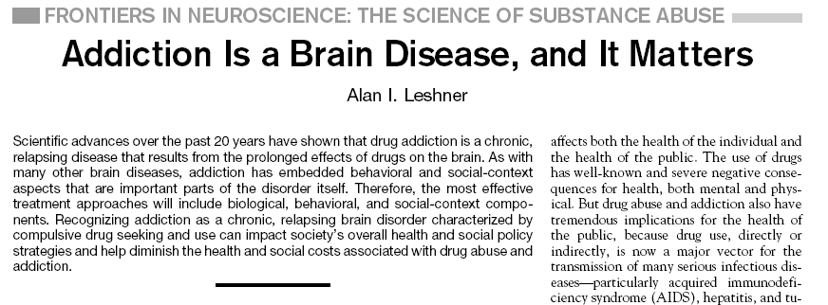

Science Vol. 278 , October 1997
22
Notes:
TRAINER NOTES
In the late 1990s Dr. Alan Leschner, former Director of the National Institute on Drug Abuse (NIDA), did a review of the research of substance related conditions and began an education campaign about substance use disorders, demonstrating that, based on the best science, substance use disorders were best characterized as a brain disease. In this articles he demonstrated that like other chronic diseases (e.g., diabetes, hypertension), this chornic brain diseases needed ongoing care and support.
[ADVANCE ANIMATION] Read quote from Alan Leschner.
[ASK PARTICIPANTS]: What thoughts or comments do you have regarding these 2 definitions?

Slide 23
How Do We Conceptualize “Addiction”?
Not everyone accepts neurobiological framework
Addiction as a brain disease “challenges deeply ingrained values about self-determination and personal responsibility”
Appears to some people to be making excuses for someone’s irresponsible, destructive actions instead of punishing harmful and often illegal behavior
If it’s a disease of the brain, why can some people stop on their own, with no treatment at all? If some people can do that, why can’t everyone with an addiction
23
Notes:
TRAINER NOTES
The conceptualization of substance use disorders as a chronic brain disease is controversial.
[SUMMARIZE/READ BULLETED LIST ON SLIDE]
[ASK PARTICIPANTS]: What thoughts or comments do you have regarding this “brain disease” concept?

Slide 24


Why do people take drugs?
To feel good
To have novel:
Feelings
Sensations
Experiences
AND
To share them
To feel better
To lessen:
Anxiety
Worries
Fears
Depression
Hopelessness
Withdrawal
24
Notes:
TRAINER NOTES
[ASK PARTICIPANTS]: Why do people take drugs?
[CLICK TO ADVANCE ANIMATION]
[READ BULLETED LIST UNDER “To Feel Good.”]
[CLICK TO ADVANCE ANIMATION]
[READ BULLETED LIST UNDER “To Feel Better.”]
IMAGE CREDIT
Purchased image.

Slide 25
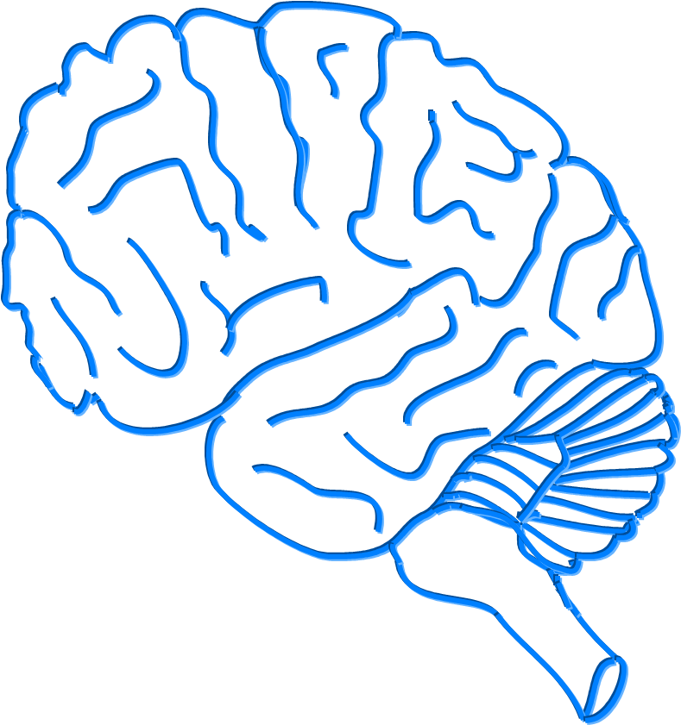
In other words:
A Major Reason People
Take a Drug is they Like
What It Does to Their Brains
25
Notes:
TRAINER NOTES
[READ SLIDE]

Slide 26
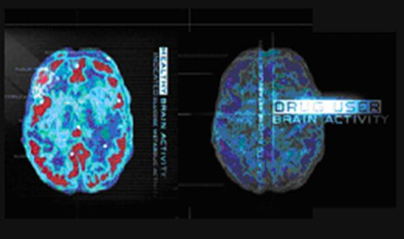
What is Addiction?
Addiction is A Brain Disease
Characterized by:
Compulsive Behavior
Continued abuse of drugs despite negative consequences
Persistent changes in the brain’s structure and function
Notes:
TRAINER NOTES
Decades of research have revealed addiction to be a disease that alters the brain. We now know that while the initial decision to use drugs is voluntary, drug addiction is a disease of the brain that compels a person to become singularly obsessed with obtaining and abusing drugs despite their many adverse health and life consequences.
REFERENCE
National Institute on Drug Abuse. (2010). Drugs, Brain, and Behavior: The Science of Addition. Retrieved from https://safercommunity.net/wp-content/uploads/NIDA-Drugs_Brain_and_Behavior.pdf, January 23, 2020.
IMAGE CREDIT
NIDA website.

Slide 27
Addiction is Like Other Diseases…
It is preventable
It is treatable
It changes biology
If untreated, it can last a lifetime
27
Notes:
TRAINER NOTES
[READ BULLETED LIST ON SLIDE]

Slide 28
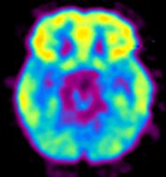
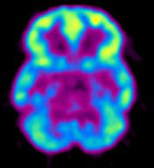

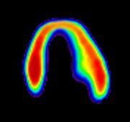
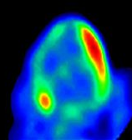
Imaging Chronic Disease
Decreased Brain Metabolism
in Drug Abuser
Decreased Heart Metabolism in Heart Disease Patient
High
Low
Healthy Brain
Diseased Brain/
Cocaine Abuser
Healthy Heart
Diseased Heart
Notes:
TRAINER NOTES
Addiction is similar to other chronic diseases. Using imaging technology to measure metabolism (in this case, glucose uptake) in the brain and heart, one can see that both addiction and heart disease produce observable changes in organ function. In each pair of images shown above, the healthy organ shows greater activity (reds and yellows) than the diseased organ. In addiction, the frontal cortex, which is a part of the brain associated with judgment and decision-making, is significantly affected. Like heart disease, drug addiction can be prevented and treated successfully. If left untreated, however, its effects can last a lifetime.
REFERENCE
National Institute on Drug Abuse. (2010). Drugs, Brain, and Behavior: The Science of Addition. Retrieved from https://safercommunity.net/wp-content/uploads/NIDA-Drugs_Brain_and_Behavior.pdf, January 23, 2020.
IMAGE CREDIT
NIDA website.

Slide 29
Agenda (5)
Introductions
Review of week’s agenda
IC&RC Performance Domains and the 12 Core Functions
TAP 21 Transdisciplinary Foundations and Practice Domains
Addiction as a brain disease
Science of addiction
Psychoactive Drugs: Alcohol, Opioids, Cannabis , Stimulants, Hallucinogens, and Inhalants
29
Notes:
INSTRUCTIONS
[ASK PARTICIPANTS] Are there any questions regarding addiction as a brain disease?

Slide 30
Science of Addiction
Advances in medicine and scientific techniques have given researchers a clearer idea of what addiction is:
  Magnetic resonance imaging (MRI)
  Positron emission tomography (PET) scan
  Advanced genetic research
30
Notes:
TRAINER NOTES
[SUMMARIZE/READ SLIDE CONTENT]

Slide 31
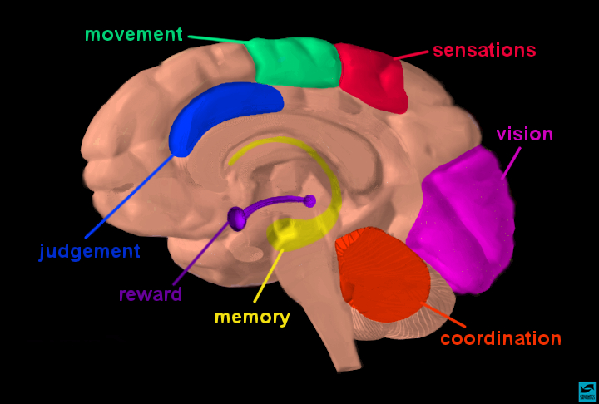
Brain Areas Affected by Drugs
Notes:
TRAINER NOTES
This slide depicts a cartoon image of the human brain
The Prefrontal Cortex is associated with our judgement/executive level decision making
The Nucleus accumbens is associated with our cognitive processing of aversion, motivation, pleasure, reward, and reinforcement learning
The Limbic system is associated with our center of emotions, learning, and memory; cingulate gyri, hypothalamus, amygdala (emotional reactions), and hippocampus (memory)
The Cerebellum is associated with coordination
REFERENCE
National Institute on Drug Abuse. (2017). Understanding Drug Abuse and Addiction: What Science Says: 3: Brain Regions and Their Functions. Retrieved from https://www.drugabuse.gov/publications/teaching-packets/understanding-drug-abuse-addiction/section-i/3-brain-regions-their-functions, January 23, 2020.
IMAGE CREDIT
NIDA website.

Slide 32
Neurotransmitters Definition
a chemical substance that is released at the end of a nerve fiber by the arrival of a nerve impulse and, by diffusing across the synapse or junction, causes the transfer of the impulse to another nerve fiber, a muscle fiber, or some other structure.
32
Notes:
TRAINER NOTES
[READ DEFINITION]
REFERENCE
Retrieved from https://www.lexico.com/en/definition/neurotransmitter, January 23, 2020.

Slide 33
Major Neurotransmitters
Involved in SUD
Dopamine
Serotonin
Norepinephrine
GABA
Glutamate
33
Notes:
TRAINER NOTES
[READ BULLETED LIST] Note: This is to introduce the neurotransmitters. Do not review here as the full definitions come in the following slides.

Slide 34
Basic Neurotransmitters
Norepinephrine
Dopamine
Serotonin
Glutamate
Gamma-aminobutyric acid or GABA
Enkephalins or Endorphins
34
Notes:
TRAINER NOTES
[READ BULLETED LIST] Note: This is to introduce the neurotransmitters. Do not review here as the full definitions come in the following slides.

Slide 35
Neurotransmitters
Norepinephrine, a neurotransmitter found in the brain, associated with arousal reactions & moods
Dopamine – a neurotransmitter found in the brain associated with body movement and pleasure
Serotonin is normally involved in temperature regulation, sensory perception, and mood control. However, it plays a major role in emotional disorders such as depression, suicide, impulsive behavior, and aggression. The hallucinogenic drug LSD acts on Serotonin receptors; so do some antidepressant drugs.
35
Notes:
TRAINER NOTES
[SUMMARIZE/READ EACH BULLET]

Slide 36
Neurotransmitters (continued)
Glutamate and GABA (gamma-amino butyric acid) are amino acids that act as neurotransmitters. The majority of synapses within the brain use glutamate or GABA. They also have other functions in the body such as making energy-rich molecules in cells. The fact that GABA and glutamate are so widely present makes it likely that they will be altered during drug addiction. This also makes it difficult to treat addiction with drug therapy without causing side effects
Enkephalins and Endorphins – first discovered in 1975, both compounds have pain killing properties that are more powerful than morphine, with endorphins being 40 times more powerful than enkephalins , and 100 times more powerful than morphine
36
Notes:
TRAINER NOTES
[SUMMARIZE/READ EACH BULLET]

Slide 37
Neurotransmitters (continued 2)
Current research seems to suggest that the presence or absence of such compounds as endorphins & especially dopamine may explain several conditions including compulsive drug abuse, chemical dependence, pain management, sexual activity, schizophrenia, and the natural “high” of exercise that many people experience.
Further research is needed to help us identify exactly how this knowledge may be applied to successful treatment and recovery issues.
37
Notes:
TRAINER NOTES
Research demonstrates that these neurotransmitters are important in many behaviors and conditions. Changes in levels can impact bot experience and expression of disease. But we need more research in order to understand how we can use this in providing treatment and recovery to an individual client/patient.

Slide 38

Normal Dopamine Transmission
Notes:
TRAINER NOTES
This slide shows how neurotransmission works specifically for dopamine. What is schematically illustrated in this slide is a nerve terminal (top), the synaptic cleft or space between the neurons, and the post-synaptic or receiving portion of a dendrite on a neighboring neuron. Dopamine is contained in vesicles (round storage sites) in the nerve terminal; dopamine receptors are present on the receiving (bottom) neuron.
When a signal comes down the axon, dopamine (shown in orange) is released into the synapse. It then crosses the synaptic cleft to the second neuron, where it binds to and stimulates dopamine receptors (shown in blue), generating a signal in the second neuron. The dopamine is then released from the receptor and crosses back to the first neuron where it is picked up by dopamine transporters (reuptake molecules; shown in purple) for re-use.
[ADVANCE SLIDE TO PLAY VIDEO]
REFERENCE
Meth Project. (2011, November 7). Brain and Behavior [Video File]. Retrieved from https://www.youtube.com/watch?v=T-duk-PiIXo.

Slide 39
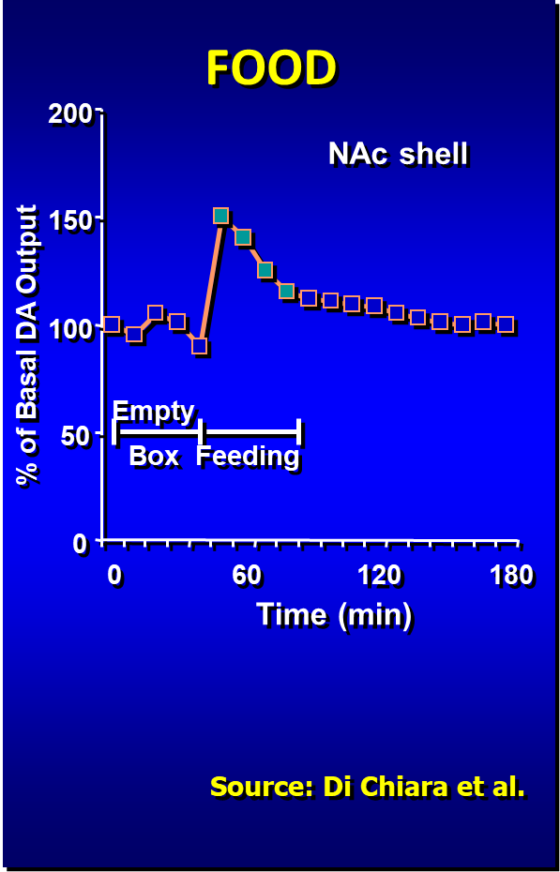
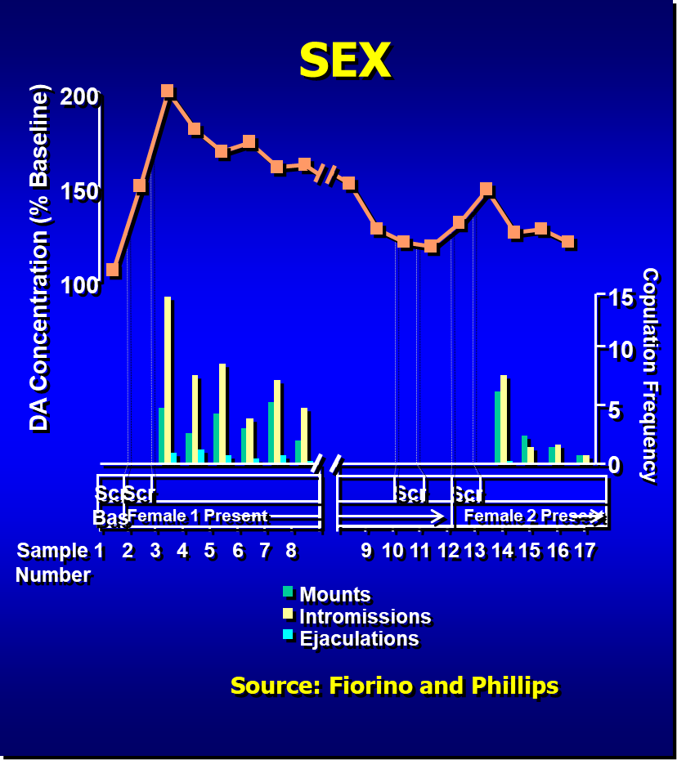
Natural Rewards Elevate Dopamine Levels
Notes:
TRAINER NOTES
Natural rewards stimulate dopamine neurotransmission. Eating something that you enjoy or being stimulated sexually can cause dopamine levels to increase. In these graphs, dopamine is being measured inside the brains of animals. Its increase is shown in response to food or sex cues. This basic mechanism of controlled dopamine release and reuptake has been carefully shaped and calibrated by evolution to reward normal activities critical for our survival.
REFERENCE
Di Chiara. G., & Imperato, A. (1988). Drugs abused by humans preferentially increase synaptic dopamine concentrations in the mesolimbic system of freely moving rats. Proceedings of the National Academy of Sciences of the United States of America, 85, 5274–5278. PMID: 2899326

Slide 40
Methamphetamine and
Dopamine Transmission
Notes:
INSTRUCTIONS
[ADVANCE SLIDE TO PLAY VIDEO]
TRAINER NOTES
When meth is added to the system, in pushes dopamine from the descending neuron into the synapse, causing a flood of dopamine.
Meth then blocks the reuptake transporters so that it remains in the synapse for an extended period of time. This is what causes the intense euphoric feelings that meth produces. This can go on for an extended time with a single dose of methamphetamine producing this effect for 10+ hours.
REFERENCE
Meth Project (2011, November 7). Brain and Behavior [video file]. Retrieved from https://www.youtube.com/watch?v=T-duk-PiIXo.

Slide 41
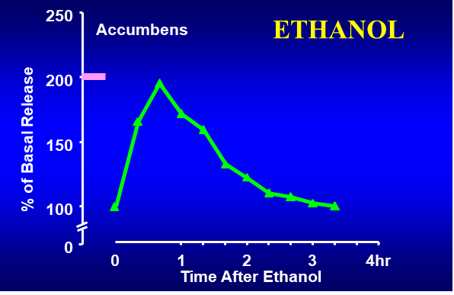
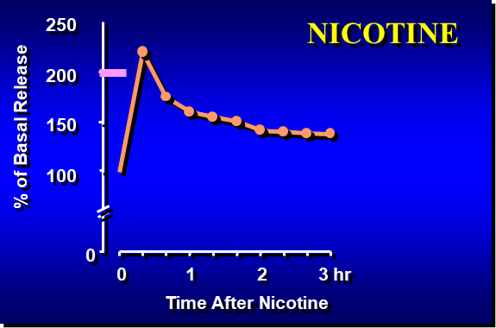
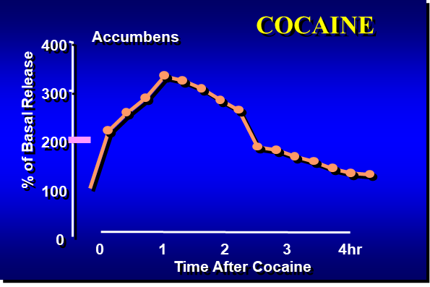
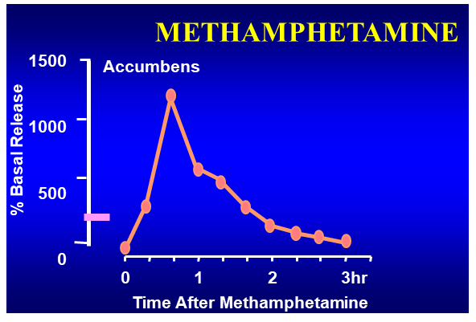
Effects of Drugs on Dopamine Release
Source: Shoblock and Sullivan; Di Chiara and Imperato
41
Notes:
TRAINER NOTES
When scientists looked at the impact of drugs used by humans on dopamine output in rats, they found that all of them had a direct impact.
With alcohol, also called ethanol, dopamine output doubled from baseline; a spike similar to what was seen with the sex response.
With nicotine, a similar spike was seen.
With cocaine, dopamine output increased about 3.5 times over baseline.
With methamphetamine the increase was about 1200 times baseline.
REFERENCE
Di Chiara, G., & Imperato, A. (1988). Drugs abused by humans preferentially increase synaptic dopamine concentrations in the mesolimbic system of freely moving rats. Proceedings of the National Academy of Sciences of the United States of America, 85, 5274–5278. PMID: 2899326.

Slide 42
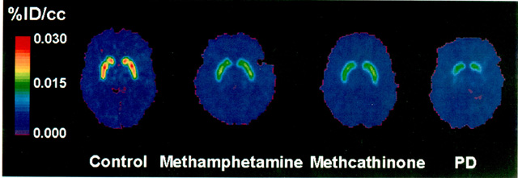
Decreased dopamine transporter binding in METH users
Control Meth
Reference
McCann U.D.. et al., Journal of Neuroscience, 18, pp. 8417-8422, October 15, 1998.
Notes:
TRAINER NOTES
The scan on the far left of the screen depicts the brain of a non-methamphetamine using control. Notice the bright colors in the reward center. The center scan is the brain of a methamphetamine user who has been matched to the control in terms of age, race, etc. Notice that there are no bright red and orange colors in the reward center. This indicates far less dopamine activity in the meth brain.
REFERENCE
National Institute on Drug Abuse (2002). Methamphetamine Abuse Linked to Impaired Cognitive and Motor Skills Despite Recovery of Dopamine Transporters. Retrieved from https://archives.drugabuse.gov/news-events/nida-notes/2002/04/methamphetamine-abuse-linked-to-impaired-cognitive-motor-skills-despite-recovery-dopamine, January 23, 2020.

Slide 43
But Dopamine is only Part of the Story
Scientific research has shown that other neurotransmitter systems are also affected:
  Serotonin
    Regulates mood and sleep
  Glutamate
    Regulates learning and memory
43
Notes:
TRAINER NOTES
[SUMMARIZE/READ BULLETED LIST]

Slide 44
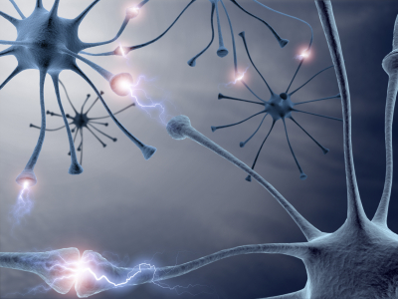
Prolonged Drug Use Changes
The Brain In Fundamental and
Long-Lasting Ways
Notes:
TRAINER NOTES
[READ/PARAPHRASE CONTENT]
IMAGE CREDIT
NIDA website.

Slide 45
AND…
We Have Evidence That
These Changes Can Be Both
Structural and Functional
Notes:
TRAINER NOTES
[READ/PARAPHRASE CONTENT]
IMAGE CREDIT
NIDA website.

Slide 46
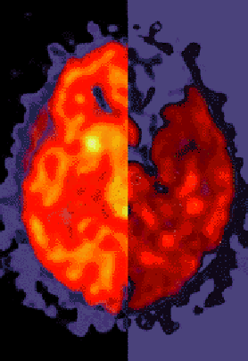
Brain Changes in Substance Use
BRAIN CHANGES appear prominently in PET scans of current and past drug users
Drug users have far less dopamine activity (right), as is indicated by the depletion (dark red shows disruption), compared to the controls (left)
Studies show that this difference contributes to dependence and a diseased brain
46
Notes:
TRAINER NOTES
While in the short term, dopamine output is enhanced through use of drugs/alcohol, long-term use of substances can contribute to depletions and deficits in activity in the brain. This slide shows what normal activity looks like in a PET scan (left half of brain image), as compared to the activity of a chronic substance user (right half of brain image).
IMAGE CREDIT
NIDA website.

Slide 47
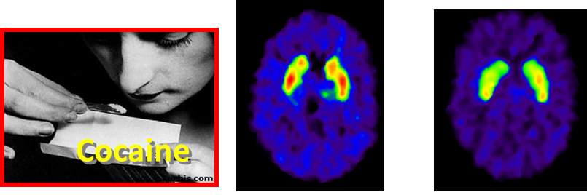
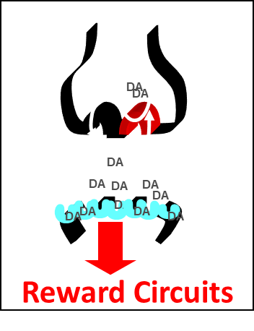

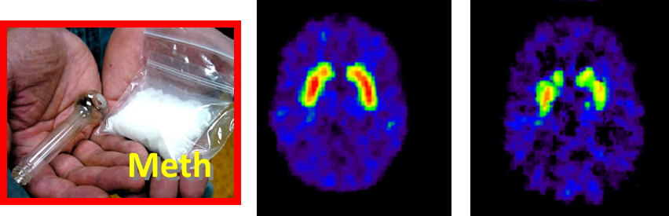
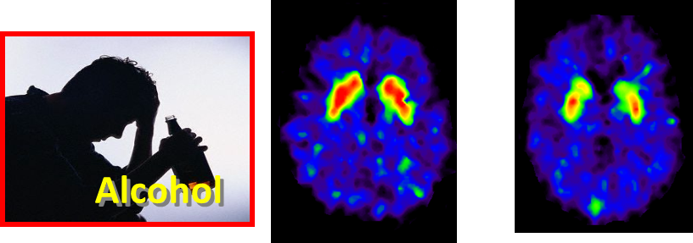
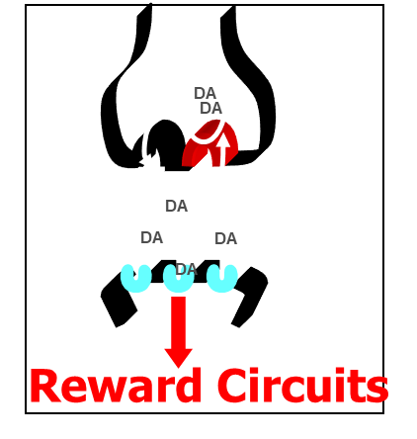
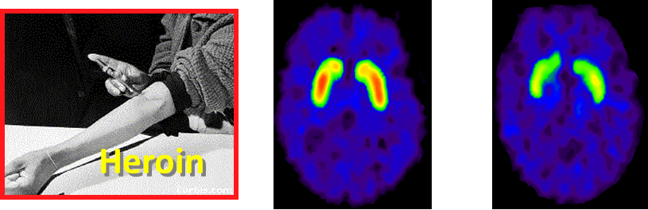
Dopamine D2 Receptors are Lower in Addiction
DA D2 Receptor Availability
Non-Drug Abuser
control
addicted
Drug Abuser
Notes:
TRAINER NOTES
Repeated drug exposure also changes brain function. Positron emission tomography (PET) images show similar changes in brain dopamine receptors resulting from addiction to different substances. Dopamine D2 receptors are one of five types of receptors that bind dopamine in the brain. The brain images on the left are those of controls, while those on the right are from individuals addicted to cocaine, methamphetamine, alcohol, or heroin. The striatum (which contains the reward and motor circuitry) shows up as bright red and yellow in the controls (in the left column), indicating numerous D2 receptors. Conversely, the brains of addicted individuals (in the right column) show a less intense signal, indicating lower levels of D2 receptors. This reduction likely stems from repeated over-stimulation of the dopamine receptors. Brain adaptations such as this contribute to the compulsion to abuse drugs.
REFERENCE
Volkow, N. (2018) Demystifying Medicine: The Opioid Epidemic: How, Where, and What Can Be Done? Retrieved from https://www.youtube.com/watch?v=Y7HrbWkpX6o&feature=emb_title, January 23, 2020.

Slide 48
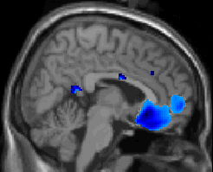
Changes in the Prefrontal Cortes
Notes:
TRAINER NOTES
The limbic system lies between the brain stem and the cerebral cortex. It is involved with learning, motivation, memory, and emotion. Methamphetamine does much of its work in two key structures in the limbic system: the amygdala and the hippocampus.
In this comparative scan of a control and methamphetamine abuser, you see a deactivation in the prefrontal cortex of the meth abuser, the part of the brain responsible for high-order decision making. This means that methamphetamine abusers are less able to make higher-order decisions (like stopping their drug use).

Slide 49
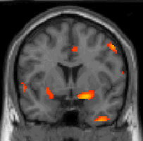
Changes in the Amygdala
Notes:
TRAINER NOTES
In this comparative scan of a control and methamphetamine abuser, you see a hyper-activation in the amygdala of the methamphetamine abuser, the part of the brain responsible for emotional processing (and the fight or flight reaction). Stimulation of the amygdala is associated with increased emotionality – specifically fear, anxiety, irritability, and anger. Methamphetamine stimulation of this brain area would explain the extreme emotionality and occasionally violent reactions that chronic methamphetamine users sometimes exhibit.

Slide 50
“Go” and “Stop” Circuits
Reward/Control pathway = 2 parts”
  GO pathway (old brain) – survival driven
  STOP pathway (new brain) – shut down the “do it more” messages
For substance users who have altered their brain chemistry, the “GO” circuit becomes overactive and he “STOP” circuit becomes dysfunctional.
50
Notes:
TRAINER NOTES
GO pathway – ventral tegmental area, nucleus accumbens, the lateral hypothalamus, and the amygdala
STOP pathway – prefrontal and orbitofrontal cortexes, and the connective fibers: fasciculus retro-flexus and lateral habenula

Slide 51
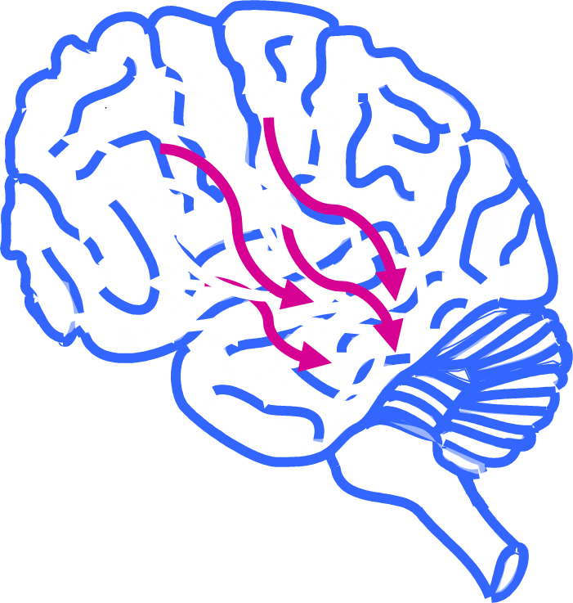
Cognitive and Memory Effects
Notes:
TRAINER NOTES
The next portion of the training reviews the cognitive and memory effects of psychoactive substances on the user.

Slide 52
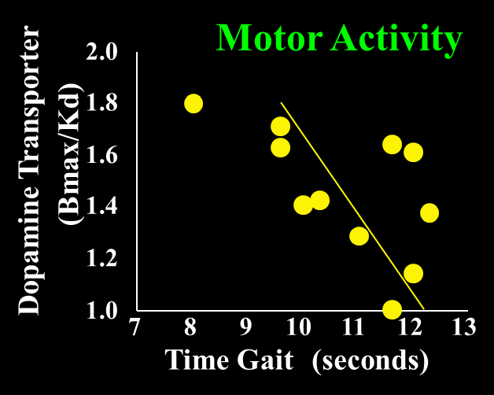
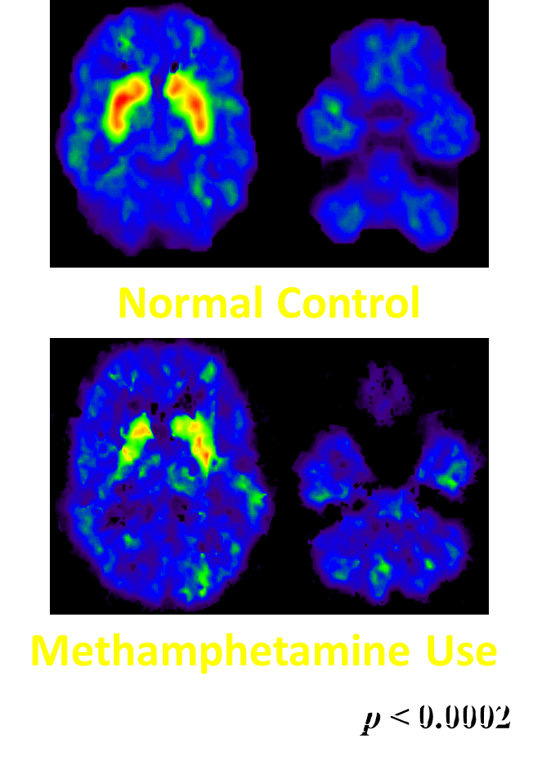
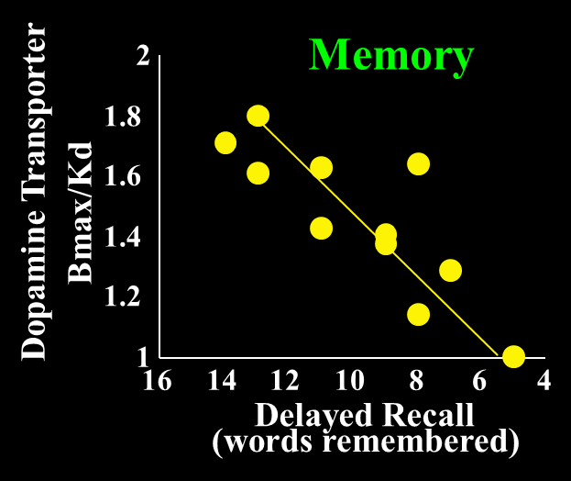
Dopamine Transporters in
Methamphetamine Abusers
Volkow et al., Am. J. Psychiatry, 2001.
Notes:
TRAINER NOTES
Methamphetamine use decreases dopamine transporter activity and compromises mental function. The brain image at the top left is a PET image from a normal control subject. The striatum is brightly lit in red and yellow, indicating the presence of many dopamine transporters, which contrasts with the brain of a methamphetamine abuser (bottom left). What does this mean functionally? The graphs on the right show the relationship between performance on a motor (upper right) and a memory task (lower right) and methamphetamine-driven decreases in dopamine transporters. The magnitude of the decline in the dopamine transporter binding is positively correlated with the extent of motor and memory impairment; thus the greater the decline, the greater the impairment in memory and motor reaction time.
REFERENCE
Volkow, N.D., Chang, L., Wang, G.J., Fowler, J.S., Leonido-Yee, M., Franceschi, D., Sedler, M.J., et al. (2001). Association of dopamine transporter reduction with psychomotor impairment in methamphetamine abusers. American Journal of Psychiatry, 158, 377-82. PMID: 11229977.

Slide 53
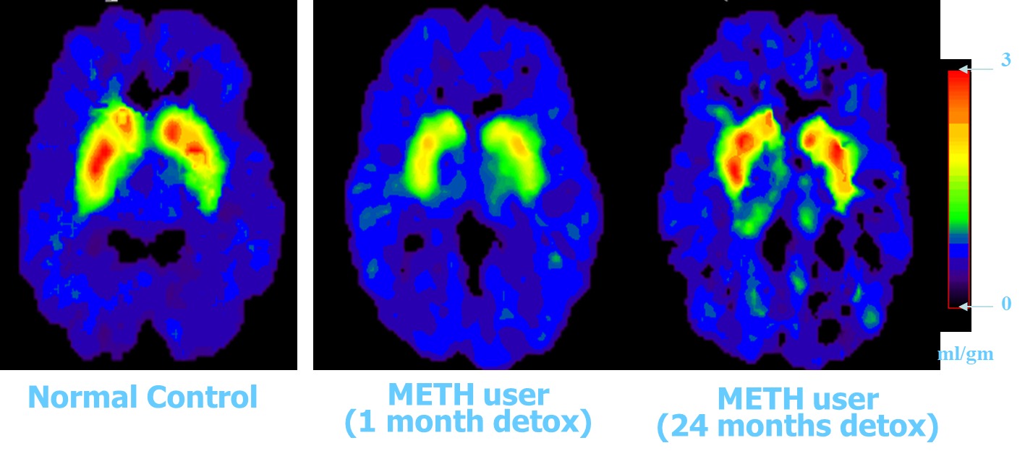
Partial Recovery of Brain Dopamine Transporters in Methamphetamine Abuser After Protracted Abstinence
Source: Volkow, ND et al., Journal of Neuroscience 21, 9414-9418, 2001.
Notes:
TRAINER NOTES
In this study, researchers examined the PET scans of chronic methamphetamine users who had achieved two years of abstinence from methamphetamine. The scans showed a return to virtually normal dopamine levels. While this is good news, and suggests that the brain has an amazing ability to repair itself, the subjects in the study did not regain all of the lost cognitive function associated with the damage, which could suggest an incomplete recovery.
While the fact that the brain recovers is good news, the not-so-good news is that the recovery takes months, not days. Treatment and recovery are long-term processes.
REFERENCE
Volkow, N.D., Chang, L., Wang, G.J., Fowler, J.S., Franceschi, D., Sedler, M., Gatley, S.J., et al. (2001). Loss of dopamine transporters in methamphetamine abusers recovers with protracted abstinence. Journal of Neuroscience, 21, 9414-9418. PMID: 11717374.

Slide 54
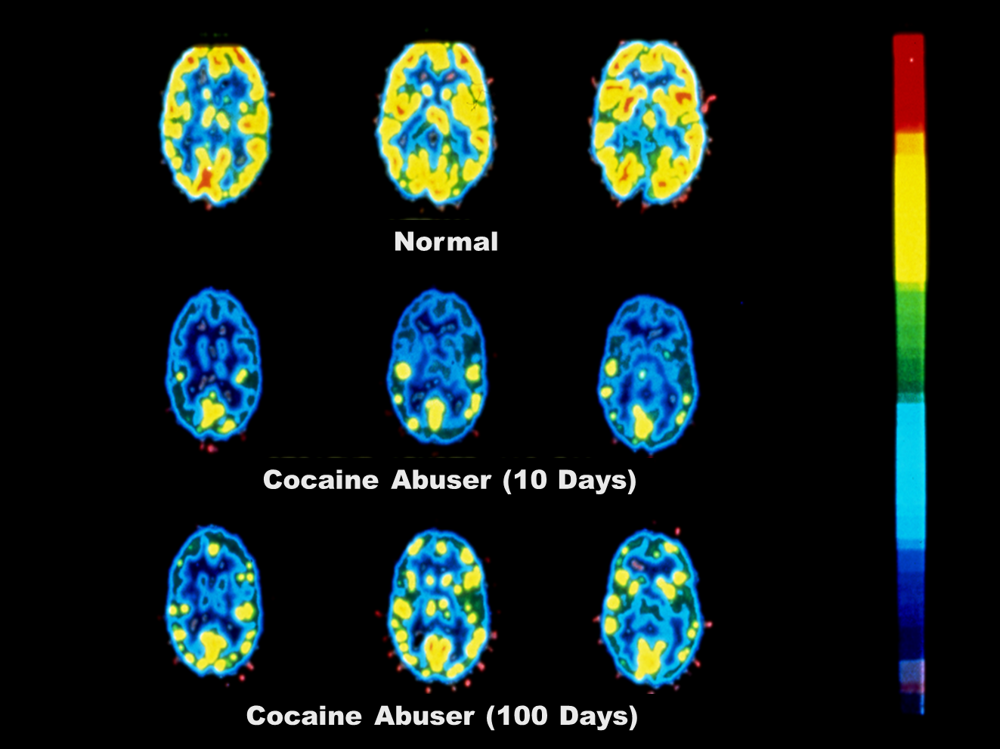
Cocaine Impact on Glucose Metabolism
54
Sources: Volkow, et al., Synapse, 11:184-190, 1992
& Volkow, et al., Synapse, 14:169-177, 1993
Notes:
TRAINER NOTES
Brain glucose metabolism with PET – chronic cocaine abusers vs. normal controls; chronic cocaine abusers were test 1-6 weeks after last use of cocaine and again after 3-month drug-free period.
Cocaine abusers had significantly lower metabolic activity in 16 of the 21 left frontal regions and 8 of the 21 right frontal regions. These decreases persisted after 3-4 months of detoxification and were correlated with dose and years of use.
Conclusion – reduced frontal metabolism in neurologically intact cocaine abusers that persist even after 3-4 months of detoxification.
REFERENCE
Volkow, N.D., Fowler, J.S., Wang, G.J., Hitzemann, R., Logan, J., Schlyer, D.J., Dewey, S.L., et al. (1993). Decreased dopamine D2 receptor availability is associated with reduced frontal metabolism in cocaine abusers. Synapse, 14(2), 169-77. PMID: 8101394.

Slide 55

What does this mean for clients?
Notes:
TRAINER NOTES
This next portion of the training reviews discusses addiction as a brain disease.
IMAGE CREDIT
Purchased image.

Slide 56
Addiction is, Fundamentally, a Brain Disease
...BUT
It’s Not Just a Brain Disease
Notes:
TRAINER NOTES
[READ SLIDE]

Slide 57
Environmental factors
(e.g., conditions at home, at school, and in the neighborhood) also play a role
Notes:
TRAINER NOTES
“No single factor determines whether a person will become addicted to drugs. The overall risk for addiction is impacted by the biological makeup of the individual – it can even be influenced by gender or ethnicity, his or her developmental stage, and the surrounding social environment (e.g., conditions at home, at school, and in the neighborhood (NIDA, 2010).”
REFERENCE
National Institute on Drug Abuse. (2018). Drugs, Brains, and Behavior: The Science of Addiction: Drug Misuse and Addiction. Retrieved from https://www.drugabuse.gov/publications/drugs-brains-behavior-science-addiction/drug-misuse-addiction, January 23, 2020.

Slide 58

Vulnerability to addiction differs from person to person
Between 40 and 60 percent of a person’s vulnerability to alcohol and tobacco addiction is due to genetic influences
Notes:
58
TRAINER NOTES
“As with any other disease, vulnerability to addiction differs from person to person. In general, the more risk factors an individual has, the greater the change that taking drugs will lead to abuse and addiction. ‘Protective’ factors reduce a person’s risk of developing addiction. Scientists estimate that genetic factors account for between 40 and 60 percent of a person’s vulnerability to addiction, including the effects of environment on gene expression and function (NIDA, 2010).”
REFERENCE
Mayfield, R.D., Harris, R.A., & Schuckit, M.A. (2008). Genetic factors influencing alcohol dependence. British Journal of Pharmacology, 154(2), 275–287. PMID: 18362899.
IMAGE CREDIT
Purchased image.

Slide 59
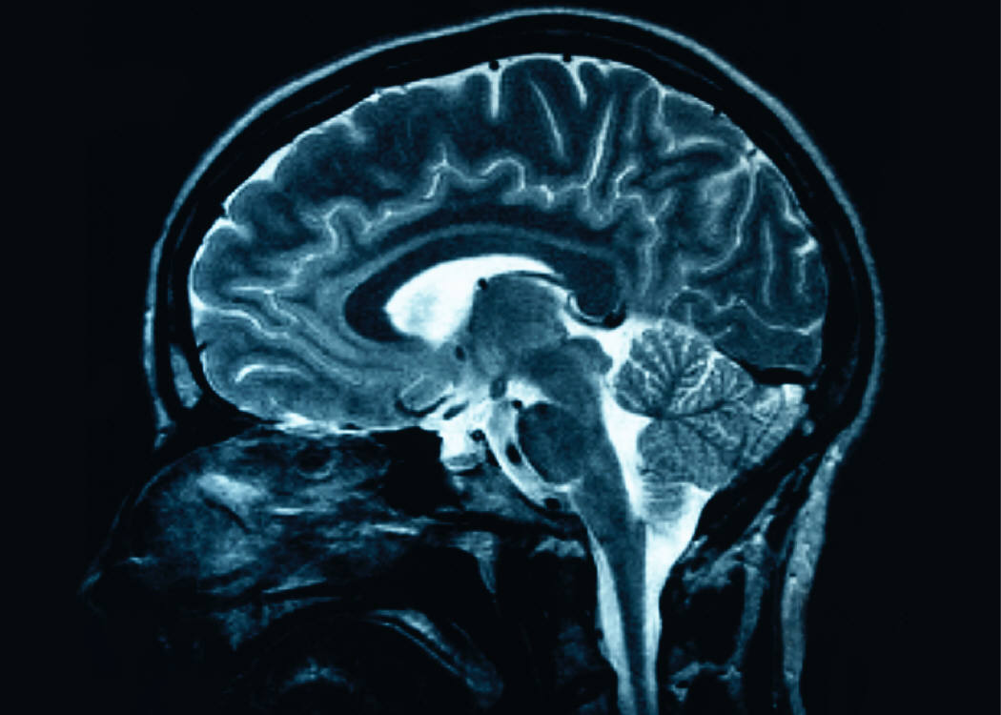
Drug addiction is a chronic brain disorder
The brain shows distinct changes after drug use that can persist long after the drug use has stopped
59
Notes:
59
TRAINER NOTES
The brain changes that occur as a result of ongoing drug use can be long lasting, and can persist long after the user has stopped using drugs. Studies show the brain can recover and return towards normal, but this recovery process takes time (exact time depends upon a number of factors).
IMAGE CREDIT
Purchased image.

Slide 60
Cognitive Effects of
Chronic Substance Use
General effects of most substances:
  Episodic memory
  Emotional processing
  Executive functions
Notes:
TRAINER NOTES
[SUMMARIZE/READ BULLETED LIST]

Slide 61
Cognitive Effects of
Chronic Substance Use (continued)
Specific effects:
  Alcohol and Psychostimulants: impulsive action and cognitive flexibility
  Alcohol and MDMA: spatial processing, perceptual speed, and selective attention
  Cannabis and Methamphetamine: prospective memory
  Cannabis and MDMA: processing speed and decision making)
Notes:
TRAINER NOTES
[SUMMARIZE/READ BULLETED LIST]
REFERENCE
Cadet,, J.L., & Bisagno, V. (2015). Neuropsychological consequences of chronic drug use: relevance to treatment approaches. Frontiers in Psychiatry, 6, 189. PMID: 26834649.

Slide 62
Strategies for Cognitive Impairment
Reducing substance use may be more acceptable than total abstinence
  Any reduction in use is progress
  Affirm early successes to enhance self-efficacy
When beginning treatment and during early recovery, clients often feel worse before they feel better
  Educate client to anticipate changes in mood, symptoms, lifestyle, and peer relations
REFERENCE
Carey, KB., 1996.
62
Notes:
TRAINER NOTES
[SUMMARIZE/READ BULLETED LIST]
REFERENCE
Carey, K.B. (1996). Substance use reduction in the context of outpatient psychiatric treatment: a collaborative, motivational, harm reduction approach. Community Mental Health Journal, 32, 291-306. PMID: 8790970.

Slide 63
Strategies for Cognitive Impairment 2
MODIFY TREATMENT PROTOCOLS
Decrease length of sessions (attention, memory)
Take structured breaks (attention, focus, memory)
Increase session frequency (practice)
Repeat presentations of therapeutic information (detox, 2 weeks, 4 weeks, 1 month, 3 months, etc.)
Multi-modal presentations—audio, visual, experiential, verbal, hot/cold situations, etc.
How could you do this at your clinic?
References
Bates, et al., 2013; Huckans, et al., 2013.
Grohman, K. & Fals-Stewart, W., 2003, 2012; Medalia, A. & Revheim, N., 2003; & Aharonovich, E., et al., 2003, 2005, 2011
63
Notes:
TRAINER NOTES
[SUMMARIZE/READ BULLETED LIST]
REFERENCES
Bates, M.E., Buckman, J.F., & Nguyen, T.T. (2013). A role for cognitive rehabilitation in increasing the effectiveness of treatment for alcohol use disorders. Neuropsychological Review, 23, 27-47. PMID: 23412885.
Grohman, K., & Fals-Stewart, W. 2003. Computer-assisted cognitive rehabilitation with substance-abusing patients: effects on treatment response. The Journal of Cognitive Rehabilitation, 21, 2-9.

Slide 64
Strategies for Cognitive Impairment 3
Use memory aids— calendars, planners, phone apps, diagrams
Teach stress management, breathing, relaxation, and mindfulness meditation skills
Provide immediate feedback and corrective experiences
Repeat instructions, put things in writing, provide short/direct instructions
64
Notes:
TRAINER NOTES
[SUMMARIZE/READ BULLETED LIST]

Slide 65

Impact of Alcohol and Other Drugs on Adolescent Brain Development
Notes:
TRAINER NOTES
This next portion of the training reviews the impact that alcohol and other drugs have on adolescent brain development.
IMAGE CREDIT
Purchased image.

Slide 66
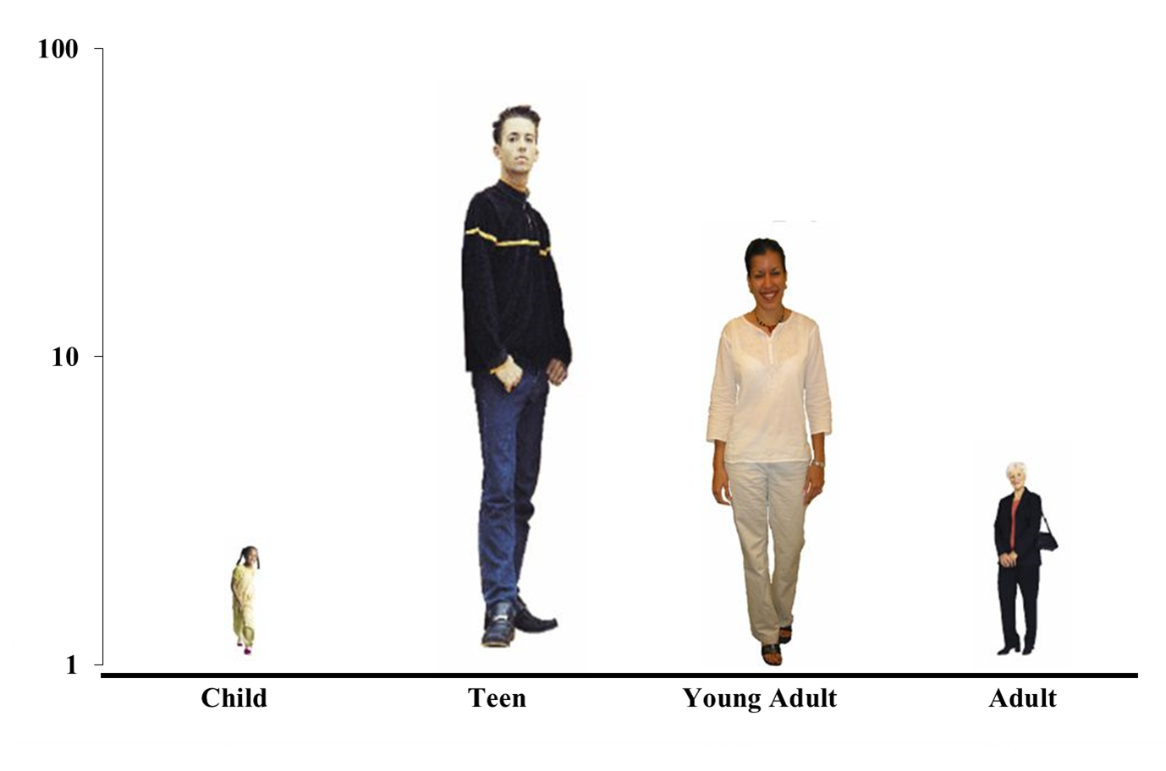
Addiction is a Developmental Disease:
It Starts Early
66
Notes:
TRAINER NOTES
Addiction is a developmental disease that usually begins in adolescence. If a person can make it through young adulthood without being diagnosed with and SUD, they are very unlikely to develop one. For example, 67 percent of those who try marijuana for the first time are between the ages of 12 and 17. Prevention efforts are therefore of primary importance—to stop drug abuse before it ever starts.

Slide 67
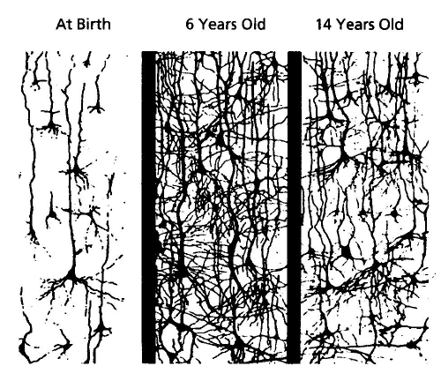
Continuing Brain Development
Early in development, synapses are rapidly created and then pruned back. Children’s brains have twice as many synapses as the brains of adults.
Notes:
TRAINER NOTES
This drawing illustrates the pruning process.
Between birth and 6 years of age…
…there is a tremendous proliferation of neural connections.
This is followed by sustained thinning starting around puberty. Scientists think this process reflects greater organization of the brain as it prunes redundant connections, and increases in myelin, which enhance transmission of brain messages.
REFERENCE
Shore, R. (1997). Rethinking the Brain. New York: Families and Work Institute.

Slide 68
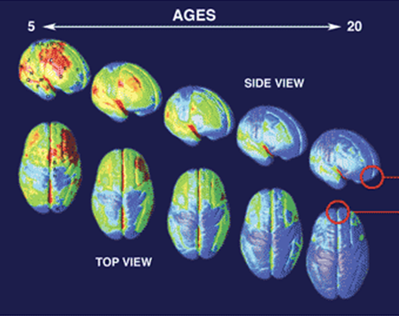
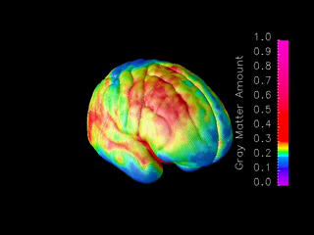
Brain Development
Ages 5-20 years
MRI scans of healthy children and teens compressing
15 years of brain development (ages 5–20).
Red indicates more gray matter, blue less gray matter.
Neural connections are pruned back-to-front.
The prefrontal cortex ("executive" functions), is last to mature.
Information taken from NIDA’s Science of Addiction
http://www.drugabuse.gov/ScienceofAddiction/
SOURCE: Gagtay, et al., 2004.
Notes:
68
TRAINER NOTES
Constructed from MRI scans of healthy children and teens, the time-lapse movie, from which the above images were extracted, compresses 15 years of brain development (ages 5–20) into just a few seconds. Red indicates more gray matter, blue less gray matter. Gray matter wanes in a back-to-front wave as the brain matures and neural connections are pruned. Areas performing more basic functions mature earlier; areas for higher order functions mature later. The prefrontal cortex, which handles reasoning and other "executive" functions, emerged late in evolution and is among the last to mature. Studies in twins are showing that development of such late-maturing areas is less influenced by heredity than areas that mature earlier.
[ANIMATION: This slide has complex animations and the trainer should practice prior to training. A step-by-step guide is provided below]
[The first bullet comes in automatically at the beginning of the slide. Provide the following description]
This slide demonstrates the neural pruning through animations. This is a series of MRI scans from healthy children showing brain development as they age from 5 to 20 years.
[Move forward to reveal the next bullet, and present the information]
Red indicates more gray matter and blue indicates less gray matter.
[Move forward and a small brain image will briefly appear on the lower right and then a short movie will automatically play full screen showing brain maturation. Once it stops, the small image of the brain will appear again on the lower right of the slide. Move forward to reveal the next bullet]
As you can see, the pruning occurs from the back of the brain toward the front.
[Move forward to reveal the last bullet]
This means that the prefrontal cortex (responsible for executive functioning, like decision-making) is the last to mature.
REFERENCE
NIDA. (2007). Drugs Brains, and Behavior: The Science of Addiction (NIH Pub No. 07-5605). Retrieved from http://www.drugabuse.gov/ScienceofAddiction.
Gogtay, N., et. al. (2004). Dynamic mapping of human cortical development during childhood through early adulthood. Proceedings of the National Academy of Sciences, 101. PMID 8174-8179.
68

Slide 69

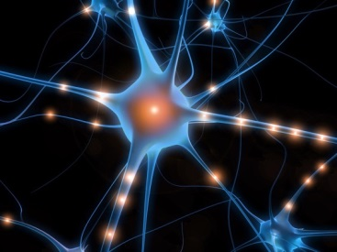
Interaction between the developing nervous system and drugs
Difficulty in decision making
Difficulty understanding the
consequences of behavior
Increased vulnerability to memory
and attention problems
This can lead to:
Increased experimentation
Opioid (and other substance) addiction
Feillin, 2013
Notes:
TRAINER NOTES
In reality, the exact impact of substance use on the developing brain is not known. However, when we look at the impact on the adult brain and understand normal development, several things seems true about this interaction, including that it may lead to difficulties in decision making and understanding the consequences of behavior (Fiellin, 2013). Additionally, it may increase the risk of memory and attention problems. These impairments, in turn, may lead to increased experimentation across a variety of behaviors; and increase the risk of addiction to a variety of substances (Fiellin, 2013).
REFERENCE
Fiellin, D.A. (2008). Treatment of adolescent opioid dependence: No quick fix. Journal of the American Medical Association, 300(17), 2057-2059.

Slide 70
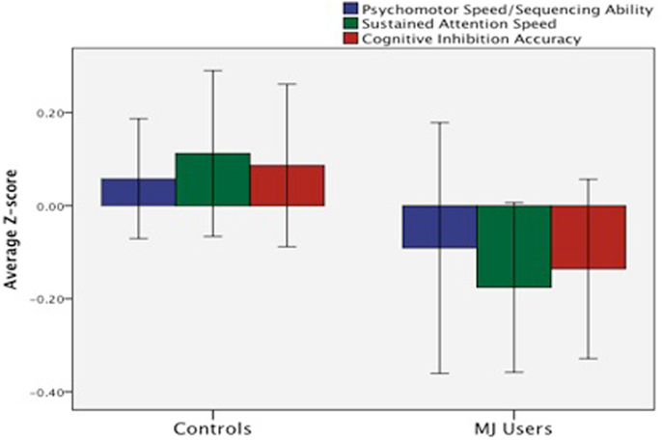
Marijuana and the Adolescent Brain (1)
Human studies suggest early onset (prior to 16-18 yo) associated with more severe cognitive consequences.
  Poorer attention
  (Ehrenriech et al., 1999)
  Executive functioning
  (sustained attention,
  cognitive inhibition,
  abstract reasoning)
  (Fontes et al., 2011)
70
Notes:
TRAINER NOTES
A variety of studies have been conducted to examine the impact of marijuana on the adolescent brain. The following are descriptions of the three such studies:
Lisdahl & Price, 2011: Increased MJ use was associated with slower psychomotor speed/sequencing ability (p < .01), less efficient sustained attention (p < .05), and increased cognitive inhibition errors (p < .03). Gender significantly moderated the effects of MJ on psychomotor speed/sequencing ability (p < .003) in that males had a more robust negative relationship. The current study demonstrated that MJ exposure was associated with poorer psychomotor speed, sustained attention and cognitive inhibition in a dose-dependent manner in young adults, findings that are consistent with other samples of adolescent MJ users. Male MJ users demonstrated greater cognitive slowing than females.
Ehrenriech et al, 1999: Of the potential predictors of test performance within the user group, including present age, age of onset of cannabis use, degree of acute intoxication (THC+THCOH plasma levels), and cumulative toxicity (estimated total life dose), an early age of onset turned out to be the only predictor, predicting impaired reaction times exclusively in visual scanning. Early-onset users (onset before age 16; n = 48) showed a significant impairment in reaction times in this function, whereas late-onset users (onset after age 16; n = 51) did not differ from controls (n = 49). These data suggest that beginning cannabis use during early adolescence may lead to enduring effects on specific attentional functions in adulthood. Apparently, vulnerable periods during brain development exist that are subject to persistent alterations by interfering exogenous cannabinoids.
Fontes et al., 2011: The early-onset group showed significantly poorer performance compared with the controls and the late-onset group on tasks assessing sustained attention, impulse control and executive functioning. Early-onset chronic cannabis users exhibited poorer cognitive performance than controls and late-onset users in executive functioning. Chronic cannabis use, when started before age 15, may have more deleterious effects on neurocognitive functioning.
REFERENCES
Lisdahl, K.M., & Price, J.S. (2012). Increased marijuana use and gender predict poorer cognitive functioning in adolescents and emerging adults. J Int Neuropsychol Soc, 18(4), 678-688.
Ehrenreich, H., Rinn, T., Kunert, H.J., et al. (1999). Specific attentional dysfunction in adults following early start of cannabis use. Psychopharmacology (Berl), 142(3), 295-301.
Fontes, M.A., Bolla, K.I., Cunha, P.J., et al. (2011). Cannabis use before age 15 and subsequent executive functioning. British Journal of Psychiatry, 198(6), 442-447.

Slide 71
Marijuana and the Adolescent Brain (2)
Longitudinal research demonstrates that early onset marijuana use associated with lower IQ
    Drop from childhood “average” to adult low “average”
    Never achieved predicted adult IQ trajectory even with sustained abstinence in adulthood (Meier et at., 2012)
Notes:
TRAINER NOTES
People who began using marijuana in their teenage years and then continued to use marijuana for many years lost about 8 IQ points from childhood to adulthood, whereas those who never used marijuana did not lose any IQ points. The amount people smoked also made a difference. Those who smoked the most – at least every day – saw the greatest drop in IQ, the full 8 points. And the younger they were when they started using cannabis, the greater the IQ decline. It wasn’t just IQ. Adults who smoked marijuana as teenagers did worse in tests of memory and decision-making than adults who hadn’t smoked yet.
New research makes this finding more controversial as there may be confounding variables associated with socioeconomics.
REFERENCES
Meier, M.H., Caspi, A., Ambler, A., Harrington, H., Houts, R., Keefe, R.S.E., McDonald, K., et al. (2012). Persistent cannabis users show neuropsychological decline from childhood to midlife. Proceedings of the National Academy of Science of the United States of America, 109 (40), E2657-2664. PMID: 22927402.
Rogeberg, O. (2013). Correlations between cannabis use and IQ change in the dunedin cohort are consistent with confounding from socioeconomic status. Proceedings of the National Academy of Science of the United States of America, 110 (11), 4251-4254. PMID: 23319626.

Slide 72
Marijuana and the Adolescent Brain (3)
  Overall studies suggest that regular adolescent MJ use may cause brain structural changes associated with
    poor neuronal efficiency
    poorer cognitive functioning (psychomotor speed, executive functioning, emotional control, and learning and memory) (Lisdahl et al., 2013)
  This may indelicate a large proportion of youth are experiencing cognitive difficulties that may negatively impact their performance, leading to increased school difficulty and reduced grades (Medina et al., 2007)
Notes:
TRAINER NOTES
Summarize bulleted list
Neuronal efficiency is a measure of the level of activation of the brain in a particular situation. Poor neuronal efficiency is associated with increased difficulty in memory recall.
Poorer cognitive functioning factors are listed on the slide.
REFERENCES
Lisdahl, K.M., Gilbart, E.R., Wright, N.E., & Shollenbarger, S. (2013). Dare to delay? The impacts of adolescent alcohol and marijuana use onset on cognition, brain structure, and function. Frontiers in Psychiatry, 4. PMID: 23847550.
Medina, K.L., Schweinsburg, A.D., Cohen-Zion, M., Nagel, B.J., & Tapert, S.F. (2007). Effects of alcohol and combined marijuana and alcohol use during adolescence on hippocampal volume and asymmetry. Neurotoxicol Teratol, 29 (1), 141-152 PMID: 17169528.

Slide 73
Drug addiction is a chronic relapsing disorder similar to other chronic diseases
such as
diabetes, asthma, arthritis and cardiovascular disease.
Notes:
TRAINER NOTES
Transition slide
[SUMMARIZE/READ CONTENT]

Slide 74
Why are we comparing SUD to these particular illnesses?
No Doubt They Are Illnesses
All Chronic Conditions
Influenced by Genetic, Metabolic and Behavioral Factors
No Cures - But Effective Treatments Are Available
Notes:
TRAINER NOTES
[SUMMARIZE/READ CONTENT]

Slide 75
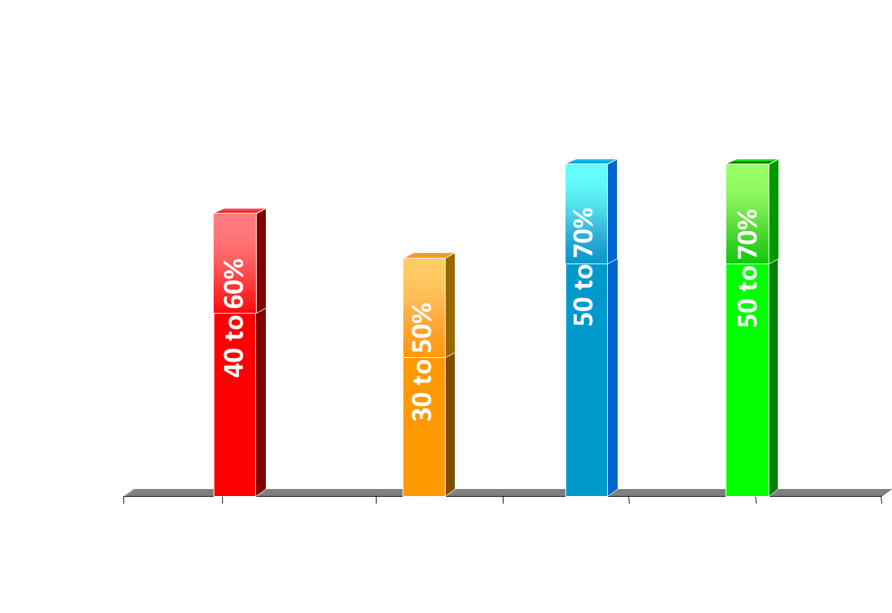
Relapse Rates Are Similar for Drug Dependence and Other Chronic Illnesses
Reference: McLellan, A.T. et al., JAMA, Vol 284(13), October 4, 2000.
Notes:
Graph: Percent of Relapse by Chronic Condition
Graph shows Percentage of people who relapse on the Y axis. In this case relapse indicates return to behaviors that negatively impact cognition.
TRAINER NOTES
Chronic disease management requires both medical and behavioral interventions to manage them successfully. Relapse in these conditions could be define as cessation/inconsistent medication adherence, lack of monitoring of the condition (e.g., not monitoring blood sugar in diabetes), and/or return of behaviors that negatively impact the chronic condition.
If we compare relapse across these chronic conditions, we see rates of 30-50% for Type 1 Diabetes, 50-70% for Hypertension and Asthma, and 40-60% for Substance Use Disorders (called drug dependence here according to DSM-IV guidelines).
In other words, individuals with substance use disorders relapse at about the same rate as people with other chronic diseases, supporting the idea that we should be managing substance use disorders in ways that are similar to other chronic conditions.
REFERENCE
McLellan, A.T., Lewis, D.C., O'Brien, C.P., & Kleber, H.D. (2000). Drug dependence, a chronic medical illness: implications for treatment, insurance, and outcomes evaluation. Journal of the American Medical Association, 284 (13), 1689-1695. PMID: 11015800.

Slide 76

Treating a Biobehavioral Disorder Must Go Beyond Just Fixing the Chemistry
We Need to Treat the
Whole Person!
Pharmacological Treatments
(Medications)
Behavioral Therapies
Spiritual Guidance
Medical Services
Social Services
In Social Context
Notes:
TRAINER NOTES
Addiction requires treatment that addresses its complexity. Substance abuse treatment should address the whole person and can include medications, health care services, behavioral therapies, spiritual wellbeing, and ancillary support services.
IMAGE CREDIT
Purchased image.

Slide 77
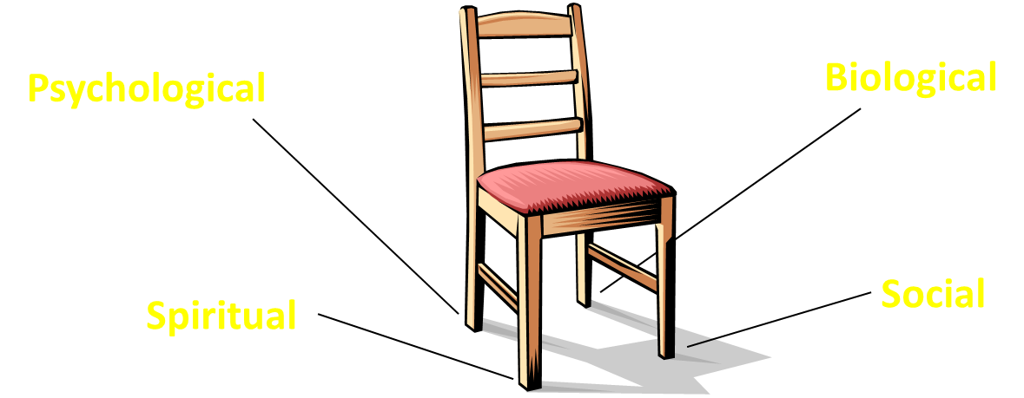
Four Legs of Addiction Treatment
Think of this concept as a chair, with each leg representing a component of a patient’s treatment plan.
All four legs are required to “support” the patient, and if one leg is missing, the chair will be unstable and unable to accomplish its goal.
Notes:
TRAINER NOTES
Alcohol and drug addiction is affected by many factors, including development, physiology, genetics, social influence, personality, coping discrepancies, spiritual values, reinforcement, conditioning, abuse, self-regulated use, and dependence. All of these factors point to initial use, and can be linked to one or more other factors. A person’s treatment plan should be holistic in nature and address the multiple needs of the individual, such as sexual orientation, gender differences, homelessness, family dynamics, children/prenatal care, legal issues, disabilities, employment issues, developmental needs, co-occurring disorders, and cultural, racial/ethnic, and religious norms.

Slide 78
Full recovery is a challenge but it is possible …
Notes:
TRAINER NOTES
[READ SLIDE]
People do recover from addiction. Research bears this out.

Slide 79
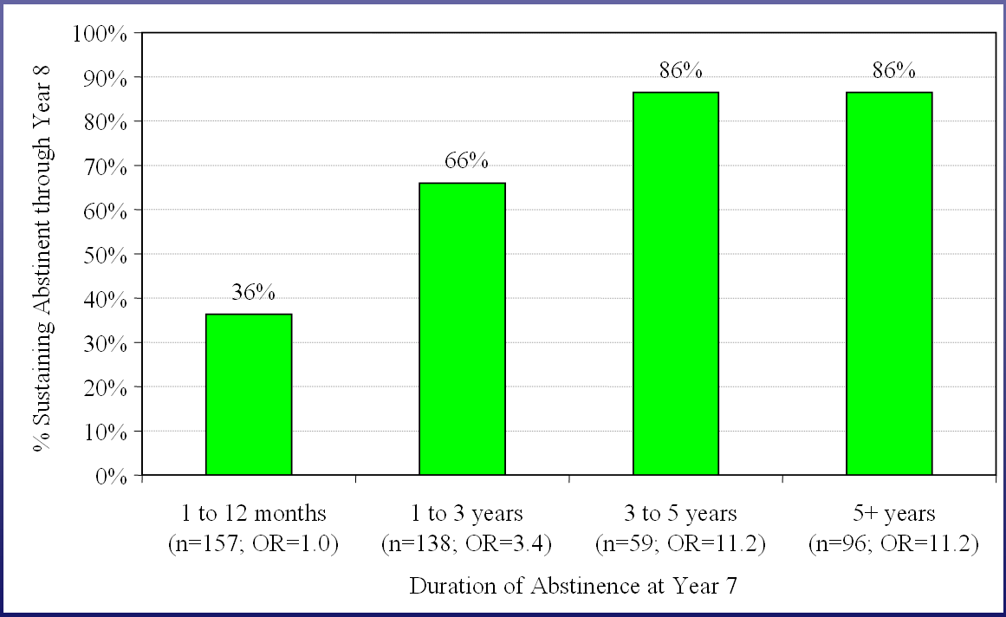
Extended Abstinence is Predictive of Sustained Recovery
After 5 years – if you are sober, you probably will stay that way.
It takes a year of abstinence before less than half relapse
Reference: Dennis et al, Eval Rev, 2007.
Notes:
TRAINER NOTES
Extended abstinence is predictive of sustained recovery. The odds of remaining abstinent rise if patients have been abstinent for 1 to 3 years. After 3 years, the recovery odds remain high and stable. Therefore, as with other chronic diseases, addiction requires an ongoing and active disease management strategy.
REFERENCE
Dennis, M.L., Foss, M.A., & Scott, C.K. (2007). An eight-year perspective on the relationship between the duration of abstinence and other aspects of recovery. Evaluation Review, 31, 585-612.

Slide 80
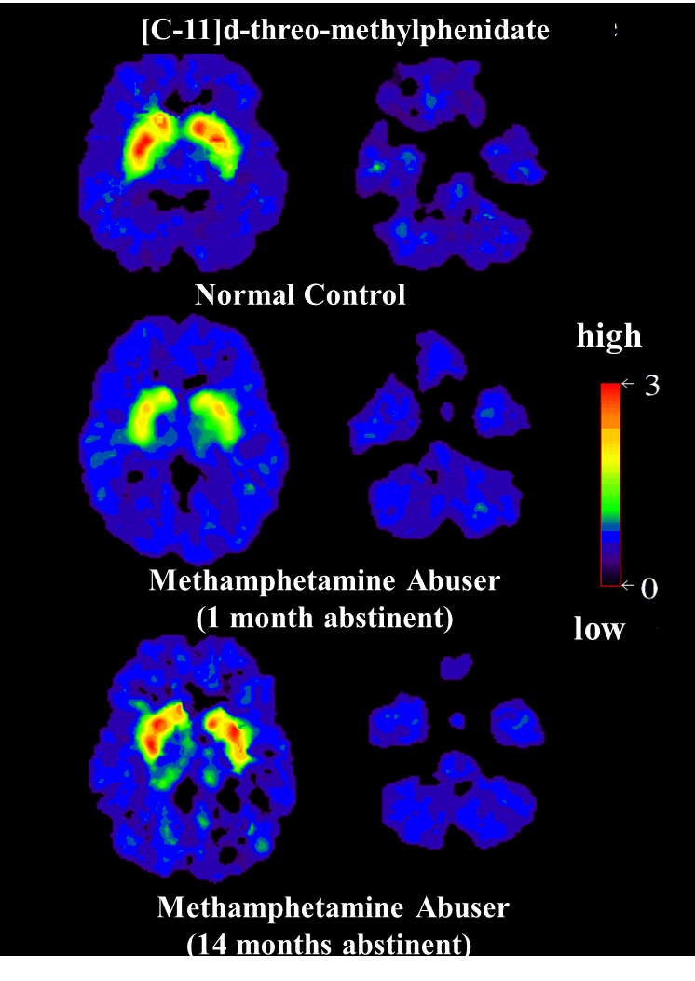
Dopamine Transporeter Recovery with Prolonged
Abstinence from
Methamphetamine
Reference: Volkow et al., J. Neuroscience, 2001.
Notes:
TRAINER NOTES
It takes time, but the brain can recover. This slide shows images of dopamine transporter (DAT) binding in three brains: (1) a healthy control (top); (2) a methamphetamine abuser one month after discontinuing drug abuse (middle); and (3) a methamphetamine abuser after 14 months of abstinence (bottom). The control brain shows a robust concentration of dopamine transporters in the striatum (red and yellow), while the methamphetamine abuser has a dramatic drop in DAT binding, even a month after drug abuse has stopped. Sustained abstinence, however, allows a near-full return of DAT binding to normal levels. Still, some of the behavioral effects of methamphetamine do not completely return to normal (not shown). This means that it can take a long time to recover from methamphetamine abuse, but recovery is possible.
REFERENCE
Volkow, N.D., Chang, L., Wang, G.J., Fowler, J.S., Franceschi, D, Sedler, M, Gatley, S.J., et al. (2001). Loss of dopamine transporters in methamphetamine abusers recovers With protracted abstinence. Journal of Neuroscience, 21(23), 9414-9418. PMID: 11717374.

Slide 81
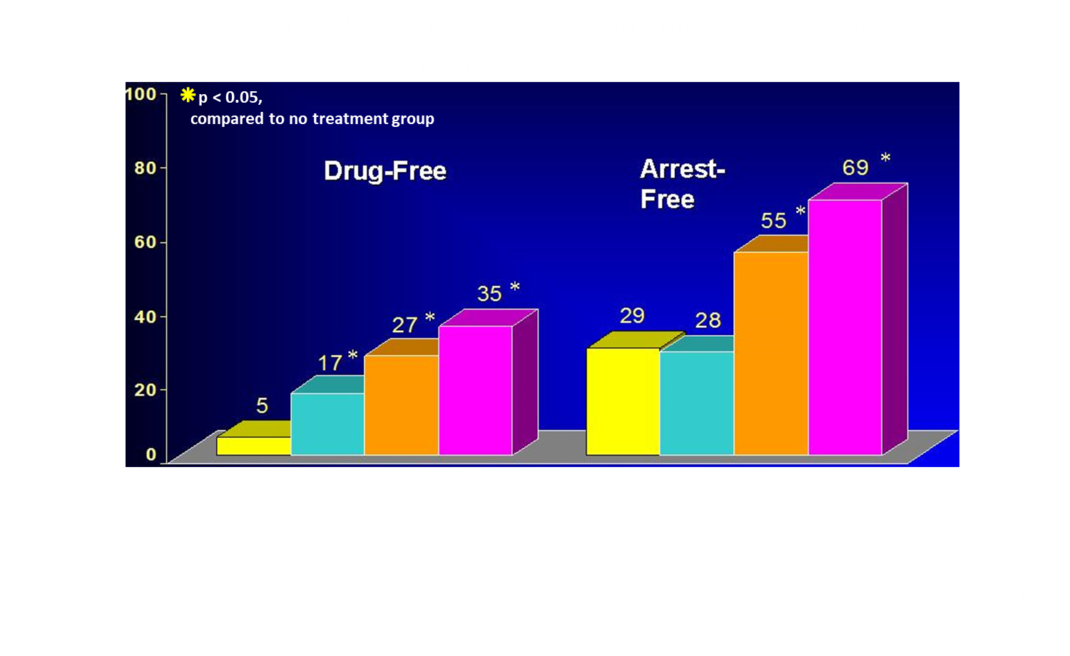
Treatment Reduces
Drug Use and Recidivism
81
Notes:
TRAINER NOTES
SUD treatment works and brings about reductions not just in drug use, but also in criminal recidivism. A therapeutic community approach (CREST) was tested in prison and continued during participants’ transition back to the community. Among those who completed treatment and aftercare programs, 35% remained drug free, and 69% were not arrested within three years of release from incarceration. These reductions in turn yield significant cost savings and provide hope for families and communities devastated by addiction.
REFERENCE
Nielsen, A.I., Scarpitti, F.R., & Inciardi, J.A. (1996). Integrating the therapeutic community and work release for drug-involved offenders. The CREST program. Journal of Substance Abuse Treatment, 13(4), 349-358. PMID: 9076653.

Slide 82
Lessons from Chronic Illness
Treatment effects usually don’t last very long after treatment stops.
Medications relieve symptoms but…behavioral change is necessary for sustained benefit.
Some form of monitoring, support and ongoing treatment is needed.
This could include monitoring or self-help groups such as AA/NA
Notes:
TRAINER NOTES
[SUMMARIZE/READ CONTENT]

Slide 83
Lessons from Chronic Care
Patient retention is critical
Make treatment attractive
Offer options/alternatives
Increase monitoring/management
Notes:
TRAINER NOTES
[SUMMARIZE/READ CONTENT]
Yellow words are most important points in this slide

Slide 84
Summary
Drugs affect the brain in ways that are long term, but reversible.
These brain changes profoundly influence cognition, emotions and behavior.
There are multiple forms of treatment that can be effective in treating addicted individuals.
Addiction and many psychiatric illnesses are chronic illnesses and like other chronic disorders, require ongoing treatment and support.
Notes:
TRAINER NOTES
[SUMMARIZE/READ CONTENT]
Yellow words are most important points in this slide

Slide 85
Agenda (6) - 6
Introductions
Review of week’s agenda
IC&RC Performance Domains and the 12 Core Functions
TAP 21 Transdisciplinary Foundations and Practice Domains
Addiction as a brain disease
Science of addiction
Psychoactive Drugs: Alcohol, Opioids, Cannabis , Stimulants, Hallucinogens, and Inhalants
85
Notes:
INSTRUCTIONS
Yellow bullet is the current agenda item
Check-in with participants to see if they have any questions.

Slide 86
Classifying Psychoactive Drugs
Depressants | Stimulants | Hallucinogens
Alcohol | Amphetamines | LSD, DMT
Benzodiazepines | Methamphetamine | Mescaline
Opioids | Cocaine | PCP
Solvents | Nicotine | Ketamine
Barbiturates | Khat | Cannabis (high doses)
Cannabis (low) | Caffeine | Magic mushrooms
 | MDMA | MDMA
Notes:
INSTRUCTIONS
Explain that drug classifications provide a useful reference tool for approximating relative drug effects, possible harms, and potential withdrawal features.
Explain that there are limitations to classifications and that classifications are intended as a general guide only, as variations in effects and intensity may occur for drugs within the same class, e.g., although ecstasy produces similar effects to amphetamines, it is not as intense and may have additional hallucinogenic effects for some people.
Explain that for the purposes of this training, cannabis has been placed in the central nervous system (CNS) depressants category because of its primary effects as a CNS depressant, and in the hallucinogens category because at high doses, cannabis may produce hallucinogenic effects. Opioids have been classified as CNS depressants as a result of their primary effect on the CNS.
GENERAL NOTES FOR TRAINERS
Abbreviations in slide
DMT: N,N-dimethyltryptamine
PCP: phencyclidine
MDMA: 3,4 methylenedioxymethamphetamine
REFERENCE
Victoria Police, (2002) Custodial Drug Guide: Medical Management of People in Custody with Alcohol and Drug Problems, Custodial Medicine Unit, Victoria Police, Mornington, Victoria, and NCETA, (2004).

Slide 87
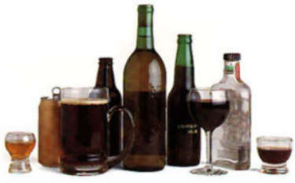
Alcohol
Notes:
TRAINER NOTES
Now we’re going to talk about alcohol.
IMAGE CREDIT
Purchased image.

Slide 88
Alcohol: Basic facts
Description: Alcohol or ethylalcohol (ethanol) is present in varying amounts in beer, wine, and liquors
Route of administration: Oral
Acute Effects: Sedation, euphoria, lower heart rate and respiration, slowed reaction time, impaired coordination, coma, death
Notes:
INSTRUCTIONS
[READ THE BULLETED LIST ON SLIDE]
[ASK PARTICIPANTS] What are some examples of the acute effects of alcohol?

Slide 89
Alcohol: More Basic facts
Withdrawal Symptoms:
  - Tremors, chills
  - Cramps
  - Hallucinations
  - Convulsions
  - Delirium tremens
  - Death
Reference: NCETA, 2004.
Notes:
INSTRUCTIONS
[READ THE BULLETED LIST ON SLIDE]
GENERAL NOTES FOR TRAINERS
Delirium tremens is a medical emergency associated with untreated alcohol withdrawal. It occurs 3-14 days after drinking is stopped. Delirium tremens include agitation, restlessness, gross tremor, disorientation, fluid and electrolyte imbalance, sweating and high fevers, visual hallucinations, and paranoia. The prevalence is < 5% of patients, and it may lead to death.
REFERENCE
National Centre for Education and Training on Addiction (NCETA) Consortium. (2004), Alcohol and Other Drugs: A Handbook for Health Professionals. Australian Government Department of Health and Ageing. Retrieved from http://nceta.flinders.edu.au/files/3012/5548/2429/EN199.pdf, February 4, 2020.

Slide 90
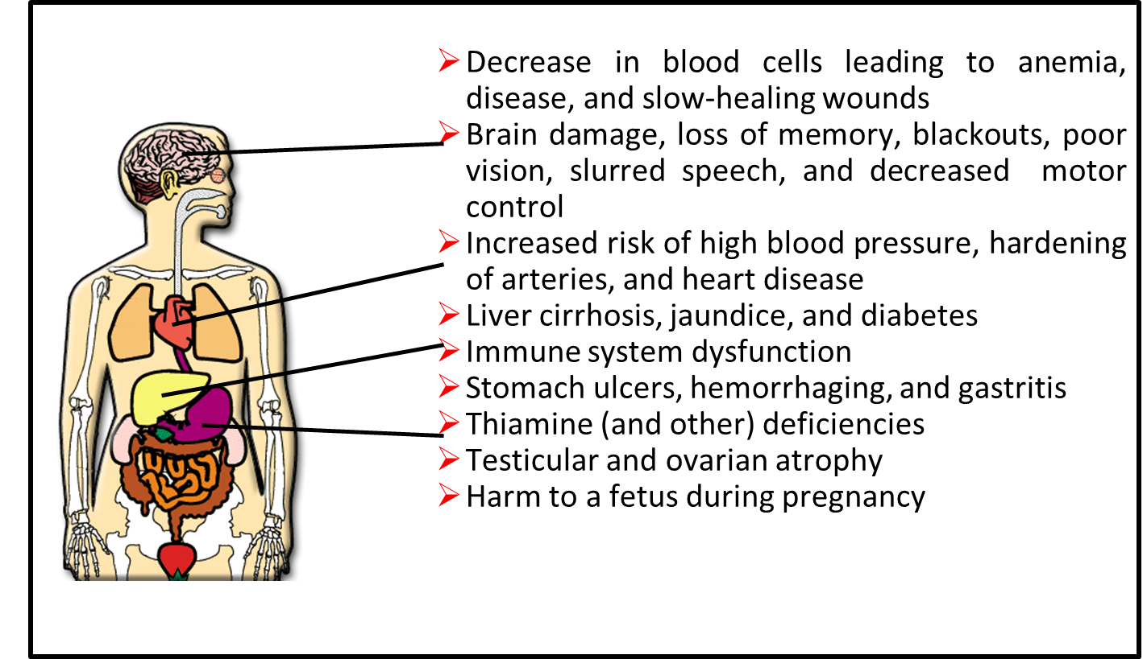
Long-term effects of alcohol use
Notes:
INSTRUCTIONS
[READ THE BULLETED LIST ON SLIDE]
Point to the areas of the body that are affected by the use of alcohol when reading the content to participants.
REFERENCE
Healthline. (2020). The Effects of Alcohol on Your Body. Retrieved form https://www.healthline.com/health/alcohol/effects-on-body#1, February 4, 2020.

Slide 91
Important terminology
Psychological craving
Tolerance
Withdrawal symptoms
Notes:
INSTRUCTIONS
Explain to your audience that you will review 3 important concepts related to addiction.
Read these important terms, but do not explain them at this point.

Slide 92
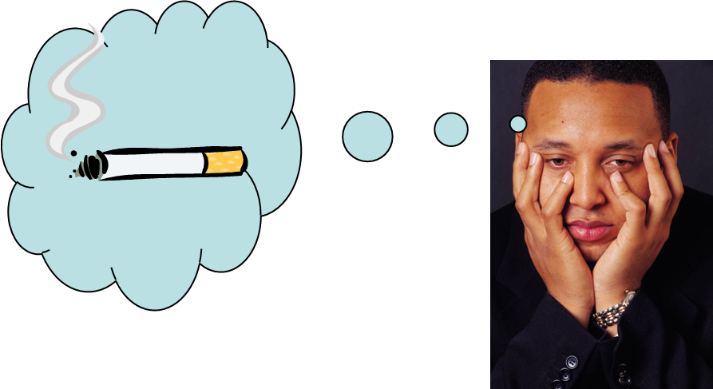
Psychological craving
Psychological craving is a strong desire or urge to use drugs. Cravings are most apparent during drug withdrawal.
Notes:
INSTRUCTIONS
Explain to your audience what psychological craving is by reading the slide.
Provide some examples. For instance, a woman who quit smoking years ago, but who still feels cravings when exposed to certain situations (friends who smoke, parties, coffee time).
IMAGE CREDIT
Purchased image.

Slide 93




For our purposes, there are four main neurotransmitters relevant to alcohol:
endogenous opioids
Deadens pain and causes euphoria
glutamate
excitatory neurotransmitter…
speeds you up
dopamine makes you happy
GABA
inhibitory neurotransmitter… slows you down
93
Notes:
93
TRAINER NOTES
Two processes occur simultaneously when alcohol is consumed. One process acts on the naturally occurring opioids in the brain (which deaden pain and cause feelings of euphoria), and dopamine (which makes things feel good). The other process operates on glutamate (the excitatory neurotransmitter that wakes you up) and GABA (the inhibitory neurotransmitter that slows you down).
Let’s look at each separately.
REFERENCE
Banerjee, N. (2014). Neurotransmitters in alcoholism: A review of neurobiological and genetic studies. Indian Journal of Human Genetics, 20(1), 20-31. PMID: 24959010.
IMAGE CREDITS
Purchased images.

Slide 94



Alcohol Neuronal Activity #1: The Party
    Alcohol is used.
    The endogenous opioids are released into the pleasure centers of the brain.
    In response to this increased endogenous opioid activity, dopamine is released.
    Dopamine make the drinker feel good. This reinforces the behavior and increased the likelihood that it will recur.
94
Notes:
TRAINER NOTES
In the first process, a person drinks alcohol.
This causes the release of the endogenous, or naturally occurring, opioids to be released in the pleasure centers of the brain.
This in turn, caused the release of dopamine.
Since dopamine makes the person feel good, drinking is reinforced and this increases the likelihood of repeated use.
As we will see later, two medications used to treat alcohol directly addresses these pleasurable effects of alcohol.
IMAGE CREDITS
Purchased images.

Slide 95
Tolerance
täl(ə)rəns noun
a condition of cellular adaptation to a
pharmacologically active substance so that
increasingly larger doses are required to
produce the same physiologic or psychological effect obtained earlier with smaller doses.
95
Notes:
TRAINER NOTES
[READ DEFINITION]

Slide 96


At the same time…
Alcohol Neuronal Activity #2
    GABA is increased, slowing the brain down
    Over time, the brain reacts to the over-abundance of GABA, by creating more receptors for Glutamate—increasing the effect of Glutamate, energizing the system and restoring balance
96
96
Notes:
96
TRAINER NOTES
At the same time that alcohol is making the person feel good, a second process occurs.
When the person drinks, GABA (the inhibitory neurotransmitter) is released and this slows the brain down. This results in the symptoms of intoxication from alcohol like difficulty with coordination, drowsiness, slurring speech, etc.
With repeated use, the brain attempts to correct for the overabundance of GABA by creating more receptors for Glutamate. This increases the effectives of glutamate, the system is energized and balance is restored.
IMAGE CREDITS
Purchased images.

Slide 97
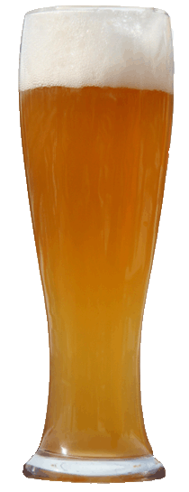

Alcohol Neuronal Activity #2, continued
As the brain desired, the up-regulation works, and the imbalance is corrected.
Now, if the individual drinks, it takes more alcohol to override the glutamate system again and feel the same level of intoxication
Tolerance.
97
Notes:
97
TRAINER NOTES
Now if the person drinks the same amount of alcohol, the intoxicating effects are not seen. It takes more alcohol in order to overcome the newly upregulated glutamate system. As this process occurs again and again, the individual must drink more and more to get the intoxicating effect. This process is known as tolerance.
IMAGE CREDITS
Purchased images.

Slide 98
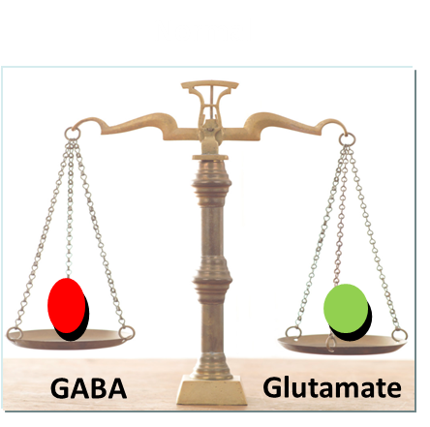
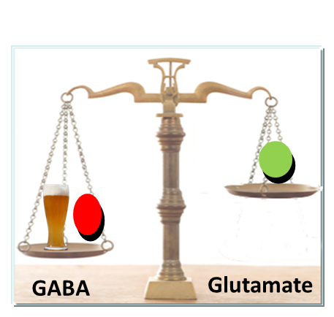
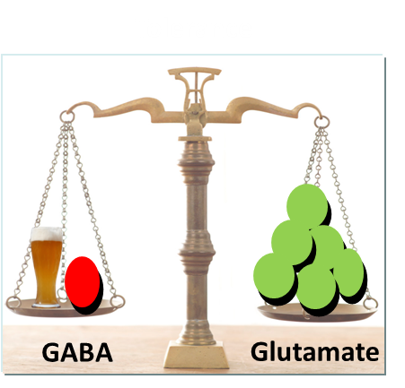
Another Neuronal Activity
So now the brain has fully adapted to constant presence of alcohol. What do you think will happen once alcohol is taken away?
98
Notes:
TRAINER NOTES
To Review…
Normally, GABA and Glutamate are well balanced. Each takes precedence as required for normal functioning throughout the day.
Repeated alcohol use overwhelms the glutamate system.
The brain responds by making more receptors for glutamate, making it more effective.
Once the brain has made this adaptation to the regular presence of alcohol, what do you think will happen if the person, abruptly stops drinking?

Slide 99

Neuronal Activity #2 continued
What do you think will happen once alcohol is taken away?
WITHDRAWAL
99
Notes:
TRAINER NOTES
The answer is, of course, withdrawal.
Withdrawal is dangerous (potentially fatal) for the individual and the person should get medical support using medications (often with benzodiazepines and others) to assist with this process. Once the acute crisis is over, however, the glutamate system continues to be overactive since it takes time for the receptor levels to go back to normal. This “post acute withdrawal” often leads to the individual to feel anxious and agitated—a frequent cause of relapse.
One of the medications that we will explore in module 2 directly addresses this post acute withdrawal issues to assist the individual in maintaining abstinence.

Slide 100
Withdrawal Definition
Abnormal physical or psychological features that follow the abrupt discontinuation of a drug that has the capability of producing physical dependence.
For example, common opioid withdrawal symptoms include sweating, goosebumps, vomiting, anxiety, insomnia, and muscle pain.
100
Notes:
TRAINER NOTES
[ASK PARTICIPANTS] What are some examples of withdrawal symptoms?
[READ THE BULLETED LIST ON THE SLIDE]

Slide 101

Withdrawal
The following symptoms may occur when drug use is reduced or discontinued:
Tremors, chills
Cramps
Emotional problems
Cognitive and attention deficits
Hallucinations
Convulsions
Death
Notes:
INSTRUCTIONS
[READ THE SLIDE]

Slide 102







Opioids – What Are They?
Notes:
INSTRUCTIONS
Point to the different pictures showing the various forms of opioids, including prescription drugs.
IMAGE CREDITS
Abbot Laboratories website.

Slide 103

What are Opioids?
Opiate: derivative of opium poppy
    Morphine
    Codeine
Opioid: any compound
that binds to opioid
receptors
    Semisynthetic
    (including heroin)
    Synthetic
    Oral, transdermal and intravenous formulations
Narcotic: legal designation
Route of administration: Intravenous, smoked, intranasal, oral, and intrarectal
103
Notes:
TRAINER NOTES
Heroin is a semisynthetic derived from morphine. Semisynthetic is derived by altering chemicals contained in opium.
IMAGE CREDIT
Purchased image, Adobe Stock, 2020.

Slide 104
Opioids
Semi-synthetic:
    Oxycodone (Percocet, Oxycontin)
    Hydrocodone (Vicoden, Norco)
    Hydromorphone (Dilaudid)
    Oxymorphone (Opana)
Synthetic:
    Meperidine (Demerol)
    Methadone
    Fentanyl
    Buprenorphine (Subutex/Suboxone)
104
Notes:
TRAINER NOTES
[SUMMARIZE/READ CONTENT]
REFERENCE
National Institute on Drug Abuse. (2019). Commonly Abused Drugs Charts. Retrieved from https://www.drugabuse.gov/drugs-abuse/commonly-abused-drugs-charts, February 4, 2020.

Slide 105
Effects of Opioids
Euphoria
Pain relief
Suppresses cough reflex
Histamine release
Warm flushing of the skin
Dry mouth
Sense of well-being
105
Notes:
TRAINER NOTES
[SUMMARIZE/READ CONTENT]
REFERENCE
National Institute on Drug Abuse. (2019). Commonly Abused Drugs Charts. Retrieved from https://www.drugabuse.gov/drugs-abuse/commonly-abused-drugs-charts, February 4, 2020.

Slide 106
Effects of Opioids (continued)
Sedation
Pupil constriction
Slurred speech
Impaired attention/memory
Constipation, urinary retention
Nausea
Confusion, delirium
Seizures
Slowed heart rate
Respiratory depression
106
Notes:
TRAINER NOTES
[SUMMARIZE/READ CONTENT]
REFERENCE
National Institute on Drug Abuse. (2019). Commonly Abused Drugs Charts. Retrieved from https://www.drugabuse.gov/drugs-abuse/commonly-abused-drugs-charts, February 4, 2020.

Slide 107
Opioids: Long-term Effects
Addiction
Infectious diseases, for example, HIV/AIDS and hepatitis B and C
Collapsed veins
Bacterial infections
Abscesses
Infection of heart lining and valves
Arthritis and other rheumatologic problems
107
Notes:
TRAINER NOTES
[SUMMARIZE/READ CONTENT]
REFERENCE
National Institute on Drug Abuse. (2019). Commonly Abused Drugs Charts. Retrieved from https://www.drugabuse.gov/drugs-abuse/commonly-abused-drugs-charts, February 4, 2020.

Slide 108


Opioids: Heroin
Heroin is an opioid drug that is synthesized from morphine, a naturally occurring substance extracted from the seed pod of the Asian opium poppy plant. Heroin usually appears as a white or brown powder or as a black sticky substance, known as “black tar heroin.”
108
Notes:
TRAINER NOTES
[SUMMARIZE/READ CONTENT]
REFERENCE
National Institute on Drug Abuse. (2019). Commonly Abused Drugs Charts. Retrieved from https://www.drugabuse.gov/drugs-abuse/commonly-abused-drugs-charts, February 4, 2020.
IMAGE CREDITS
NIDA website.

Slide 109
Opioids: Heroin
Patterns of Use
May inject up to four times a day
Intravenous injection provides the greatest intensity and most rapid onset of euphoria
(7 to 8 seconds)
Intramuscular injection produces a relatively slow onset of euphoria (5 to 8 minutes)
When sniffed or smoked, peak effects are usually felt within 10 to 15 minutes
Stays in system 1-2 days
109
Notes:
TRAINER NOTES
[SUMMARIZE/READ CONTENT]
REFERENCE
National Institute on Drug Abuse. (2019). Commonly Abused Drugs Charts. Retrieved from https://www.drugabuse.gov/drugs-abuse/commonly-abused-drugs-charts, February 4, 2020.

Slide 110
Opioids: Prescription Drugs
Fentanyl (Duragesic®)
Hydrocodone (Vicodin®)
Oxycodone (OxyContin®)
Oxymorphone (Opana®)
Propoxyphene (Darvon®)
Hydromorphone (Dilaudid®)
Meperidine (Demerol®)
Diphenoxylate (Lomotil®)
110
Notes:
TRAINER NOTES
[SUMMARIZE/READ CONTENT]
REFERENCE
National Institute on Drug Abuse. (2019). Commonly Abused Drugs Charts. Retrieved from https://www.drugabuse.gov/drugs-abuse/commonly-abused-drugs-charts, February 4, 2020.

Slide 111
Opioids: Basic facts
Withdrawal symptoms:
Intensity of withdrawal varies with level and chronicity of use
Cessation of opioids causes a rebound in functions depressed by chronic use
First signs occur shortly before next scheduled dose
For short-acting opioids (e.g., heroin), peak of withdrawal occurs 36 to 72 hours after last dose
Acute symptoms subside over 3 to 7 days
Ongoing symptoms may linger for weeks or months
111
Notes:
TRAINER NOTES
[SUMMARIZE/READ CONTENT]
REFERENCE
National Institute on Drug Abuse. (2019). Commonly Abused Drugs Charts. Retrieved from https://www.drugabuse.gov/drugs-abuse/commonly-abused-drugs-charts, February 4, 2020.

Slide 112
What Causes Overdose?
Patient deliberately misuses a prescription opioid or takes an illicit drug such as heroin
Miscalculation in dose or error in dispensing
Patient did not follow prescription directions
Person takes someone else’s prescription, or combines opioid with alcohol
Person uses an opioid analgesic as directed and experiences an unintentional overdose
Most deaths involve polysubstance use
112
Notes:
TRAINER NOTES
[SUMMARIZE/READ CONTENT]
REFERENCE
National Institute on Drug Abuse. (2019). Commonly Abused Drugs Charts. Retrieved from https://www.drugabuse.gov/drugs-abuse/commonly-abused-drugs-charts, February 4, 2020.

Slide 113
Who is at Risk?
Others at risk for overdose include those who:
  Have a legitimate medical need for analgesia along with a suspected/confirmed history of substance abuse, dependence, or non-medical/recreational use of prescription or illicit opioids
  Are completing mandatory opioid detoxification
  Were recently released from incarceration and have a history of opioid use or abuse
113
Notes:
TRAINER NOTES
[SUMMARIZE/READ CONTENT]
REFERENCE
National Institute on Drug Abuse. (2019). Commonly Abused Drugs Charts. Retrieved from https://www.drugabuse.gov/drugs-abuse/commonly-abused-drugs-charts, February 4, 2020.

Slide 114



Sedative-Hypnotics
114
Notes:
TRAINER NOTES
[SUMMARIZE/READ CONTENT]
REFERENCE
National Institute on Drug Abuse. (2019). Commonly Abused Drugs Charts. Retrieved from https://www.drugabuse.gov/drugs-abuse/commonly-abused-drugs-charts, February 4, 2020.
IMAGE CREDITS
Purchased images.

Slide 115

Sedative-Hypnotics (continued)
Used to treat anxiety and sleep disorders
Mechanism: enhances GABA
  act to slow normal brain function
Barbiturates
  Phenobarbital
  Pentobarbital
  Fioricet (butalbital/acetaminophen/caffeine)
115
Notes:
TRAINER NOTES
[SUMMARIZE/READ CONTENT]
REFERENCE
National Institute on Drug Abuse. (2019). Commonly Abused Drugs Charts. Retrieved from https://www.drugabuse.gov/drugs-abuse/commonly-abused-drugs-charts, February 4, 2020.
IMAGE CREDIT
Purchased image.

Slide 116
Sedative-Hypnotics
Benzodiazepines
  Librium (chlordiazepoxide HCL)
  Valium (diazepam)
  Restoril (tempazepam)
  Klonopin (clonazepam)
  Ativan (lorazepam
  Xanax (alprazolam)
Non-benzo hypnotics
  Ambien (zolpidem)
  Sonata (zaleplon)
  Lunesta (eszopiclone)
Carisoprodol (Soma)
Cross-tolerance with alcohol (GABA-related)
116
Notes:
TRAINER NOTES
[SUMMARIZE/READ CONTENT]
Soma is muscle relaxant, metabolized to mebprobamate (Miltown)
Non-benzo hypnotics bind to alpha 1 subunit of GABA-A receptor; thus sedating without anxiolytic or anticonvulsant properties
REFERENCE
National Institute on Drug Abuse. (2019). Commonly Abused Drugs Charts. Retrieved from https://www.drugabuse.gov/drugs-abuse/commonly-abused-drugs-charts, February 4, 2020.

Slide 117

Sedative-Hypnotic Effects
Sedation
Slurred speech
Uncoordination
Unsteady gait
Impaired attention or memory
Stupor or coma
Overdose risk increased with barbiturates or in combination with other sedatives, including opioids and alcohol
117
Notes:
TRAINER NOTES
[SUMMARIZE/READ CONTENT]
REFERENCE
National Institute on Drug Abuse. (2019). Commonly Abused Drugs Charts. Retrieved from https://www.drugabuse.gov/drugs-abuse/commonly-abused-drugs-charts, February 4, 2020.
IMAGE CREDIT
Purchased image.

Slide 118

Sedating Drugs and Overdose
118
Notes:
TRAINER NOTES
[SUMMARIZE/READ CONTENT]
REFERENCE
National Institute on Drug Abuse. (2019). Commonly Abused Drugs Charts. Retrieved from https://www.drugabuse.gov/drugs-abuse/commonly-abused-drugs-charts, February 4, 2020.

Slide 119
Other Sedative-Hypnotic Risks
No significant adverse medical consequences of long-term use
Amnesia
Difficulty with recent memory
Tolerance, physiological dependence, addiction
Addiction risk factors same as for other drugs of abuse
119
Notes:
TRAINER NOTES
[SUMMARIZE/READ CONTENT]
REFERENCE
National Institute on Drug Abuse. (2019). Commonly Abused Drugs Charts. Retrieved from https://www.drugabuse.gov/drugs-abuse/commonly-abused-drugs-charts, February 4, 2020.

Slide 120





Cannabinoids
Marijuana
Hashish
120
Notes:
TRAINER NOTES
[ASK PARTICIPANTS] Do you have any questions regarding sedative hypnotics.
We are now transitioning to cannabinoids.
IMAGE CREDITS
Purchased images.

Slide 121
Cannabis: Basic facts
Description: The active ingredient in cannabis is delta-9-tetrahydrocannabinol (THC)
  - Marijuana: tops and leaves of the plant Cannabis sativa
  - Hashish: more concentrated resinous form of the plant
Route of administration:
  Smoked as a cigarette or in a pipe
  More recently, “vaping”
  - Oral, brewed as a tea or (more recently) made into a food product (“edibles” - cookies, candies, etc)
Notes:
INSTRUCTIONS
[SUMMARIZE/READ CONTENT]
Marijuana is a dry, shredded green/brown mix of flowers, stems, seeds, and leaves of the hemp plant Cannabis sativa. It is usually smoked as a cigarette (joint, nail) or in a pipe (bong). It also is smoked in blunts, which are cigars that have been emptied of tobacco and refilled with marijuana, often in combination with another drug. It might also be mixed in food or brewed as a tea. As a more concentrated, resinous form it is called hashish, and as a sticky black liquid, it is called hash oil. Marijuana smoke has a pungent and distinctive, usually sweet-and-sour odor.
The main active chemical in marijuana is THC (delta-9-tetrahydrocannabinol). The membranes of certain nerve cells in the brain contain protein receptors that bind to THC. Once securely in place, THC sets off a series of cellular reactions.
Ask participants for examples of the acute effects of marijuana.
REFERENCE
National Institute on Drug Abuse. (2019). Commonly Abused Drugs Charts. Retrieved from https://www.drugabuse.gov/drugs-abuse/commonly-abused-drugs-charts, February 4, 2020.
National Academies of Sciences, Engineering, and Medicine. (2017). The Health Effects of Cannabis and Cannabinoids: The Current State of Evidence and Recommendations for Research. Washington, DC: The National Academies Press. http://nap.edu/24625.

Slide 122

Marijuana: Neurotransmitter System
122
Notes:
TRAINER NOTES
THC works by acting on specialized cells called neurons in the brain (refer to illustration). Neurons do not touch each other, and the gap between them—called the synaptic space—needs to be bridged for messages to get from one neuron to the next. To get messages across the space, neurons release chemicals, or neurotransmitters. The receiving neuron contains special proteins called receptors that neurotransmitters will bind to, similar to the way a key fits into a lock. After a neurotransmitter has bound to a receptor, proteins called transporters or reuptake pumps will carry neurotransmitters back to the neurons that released them. The reason this process is important is that certain neurotransmitters and receptors are associated with specific emotional and functions. Any changes to these steps—the way neurotransmitters are released, the way receptors work, or the way transporters or reuptake pumps work—can have profound effects on sensation, perception, thought, mood, and behavior. When people take drugs, these processes are altered, leading to changes in the way they feel and behave.
REFERENCE
National Institute on Drug Abuse. (2019). The Brain & the Actions of Cocaine, Opioids, and Marijuana: 12: THC Binding to THC Receptors in the Nucleus Accumbens: Increased Dopamine Release. Retrieved from https://www.drugabuse.gov/publications/teaching-packets/brain-actions-cocaine-opiates-marijuana/section-iii-introduction-to-drugs-abuse-cocaine-opia-11, February 5, 2020.

Slide 123
Marijuana: How Does it Work?
Contains over 60 cannabinoids: main active chemical is ∆-9-tetrahydrocannabinol (THC)
Stimulates “high” by triggering receptors in parts of brain that influence pleasure, memory, thinking, concentration, coordination
THC’s molecular structure is similar to that of neurotransmitters that affect cannabinoid receptors (affect pain, appetite, vomiting reflex)
Effects generally last 1-4 hours
123
Notes:
TRAINER NOTES
Marijuana gets its effects because it contains over 60 chemicals called cannabinoids. The main active chemical is a cannabinoid called delta-9-tetrahydorocannabinol, often referred to as THC. Cannabinoids trigger cannabinoid receptors, which are particularly dense in parts of the brain that affect pleasure, memory, thinking, concentration, and coordination. The effects of marijuana generally last 1-4 hours.
REFERENCE
Zerrin, A. (2012). Cannabis, a complex plant: different compounds and different effects on individuals. Therapeutic Advances in Psychopharmacology, 2(6), 241-254. PMID: 23983983.

Slide 124

Marijuana and the Brain
https://www.youtube.com/watch?v=oeF6rFN9org
124
Notes:
TRAINER NOTES
[ADVANCE SLIDE TO PLAY VIDEO]
REFERENCE
AsapSCIENCE (2012, October 3). Your Brain on Drugs: Marijuana [Video File]. Retrieved from https://www.youtube.com/watch?v=oeF6rFN9org.

Slide 125
Cannabis: Basic facts (2)
Effects begin almost immediately when smoked
Effects of smoked marijuana can last from 1 to 3 hours
If consumed in foods or beverages, the effects appear later—usually in 30 minutes to 1 hour—but can last up to 4 hours
Stays in system from a few days to much longer
125
Notes:
TRAINER NOTES
[SUMMARIZE/READ CONTENT]
REFERENCE
National Institute on Drug Abuse. (2019). Commonly Abused Drugs Charts. Retrieved from https://www.drugabuse.gov/drugs-abuse/commonly-abused-drugs-charts, February 4, 2020.

Slide 126
Neurologic Impact of
Marijuana in Adults
Administered neuropsychological tests to 63 current heavy cannabis users who had smoked cannabis at least 5,000 times in their lives and to 72 control subjects who had smoked no more than 50 times in their lives.
Differences between the groups after 7 days of supervised abstinence were reported. However, no deficits were found after 28 days abstinence, after adjusting for various potentially confounding variables.
Reference
Pope HG, et al. (2001). Arch Gen Psychiatry. 2001 Oct; 58(10):909-15.
126
Notes:
TRAINER NOTES
[SUMMARIZE/READ CONTENT]
REFERENCE
Pope HG, et al. (2001). Neuropsychological performance in long-term cannabis users. Archives of General Psychiatry, 58(10), 909-15. PMID: 11576028.

Slide 127
Neurologic Impact of
Marijuana in Adults (continued)
Suggest that cognitive deficits associated with long-term cannabis use are reversible and related to recent cannabis exposure.
Reference
Pope HG, et al. (2001). Arch Gen Psychiatry. 2001 Oct; 58(10):909-15.
127
Notes:
TRAINER NOTES
[SUMMARIZE/READ CONTENT]
REFERENCE
Pope HG, et al. (2001). Neuropsychological performance in long-term cannabis users. Archives of General Psychiatry, 58(10), 909-15. PMID: 11576028.

Slide 128
Cannabis: Basic facts (3)
Acute Effects
Relaxation
Increased appetite
Dry mouth
Altered time sense
Mood changes
Bloodshot eyes
Impaired memory
Reduced nausea
Increased blood pressure
Reduced cognitive capacity
Paranoid ideation
128
Notes:
INSTRUCTIONS
[SUMMARIZE/READ CONTENT]
Explain that the negative short-term effects of marijuana may include problems with memory and learning; distorted perception; difficulty in thinking and problem solving; loss of coordination; and increased heart rate.
Ask participants to provide examples of the acute effects of cannabis from their professional experience.
REFERENCE
National Institute on Drug Abuse. (2019). Commonly Abused Drugs Charts. Retrieved from https://www.drugabuse.gov/drugs-abuse/commonly-abused-drugs-charts, February 4, 2020.

Slide 129

Cannabis: Basic facts (4)
Withdrawal Symptoms:
Insomnia
Restlessness
Loss of appetite
Irritability
Sweating
Tremors
Nausea
Diarrhea
Notes:
INSTRUCTIONS
Explain to participants that many people have believed that marijuana is not physically addictive. However, there appears to be a characteristic withdrawal profile indicating that physical dependence does actually occur.
IMAGE CREDIT
Purchased image.

Slide 130
Negative Effects on Behavior and Mental Health
Similar to alcohol/other drugs if misused (impairment)
Long term use has negative impact on learning and memory
Long term use reduces motivation (“amotivational syndrome”)
Associated with mental health problems
  Unclear if marijuana use is cause or effect
  Heavy use is highly associated with serious mental illness – particularly among those with high risk (e.g., family history)
REFERENCE
Ben Amar, 2006; Bostwick, 2012; NIDA, 2012a, 2012b (reference list).
130
Notes:
INSTRUCTIONS
The purpose of this slide and the two slides that follow is to highlight that marijuana use can have serious negative effects. Introduce these slides by saying that people often say that marijuana is “harmless.” The information presented on these slides highlights that it is not at all a “harmless” drug.
TRAINER NOTES
Marijuana use can have very negative effects on behavior and mental health. Since marijuana is a psychoactive drug, it causes significant impairment, just like alcohol and other drugs. This means that when experiencing a marijuana “high” people are impaired, both physically and mentally. It is unsafe to drive, operate heavy machinery, or do other things that require concentration and physical coordination when under the influence of marijuana. Long-term marijuana use has a negative impact on learning and memory. Long-term marijuana use also causes amotivational syndrome, as it makes regular users less motivated to do things. Marijuana use is also associated with mental health problems and mental illness, particularly mood disorders. It is unclear if marijuana is what causes these problems, or if people who have mood disorders are more likely to use marijuana to self-medicate. Research also shows that heavy marijuana use is associated with serious mental illness, particularly among people who are at risk for serious mental illness because of family history.
Additional Information for the Trainer(s)
Serious mental illness differs from “mental illness” in general in that it lasts longer and is more disabling, often preventing people from working or functioning in their day to day lives. Among individuals who meet diagnostic criteria for marijuana abuse, 36% have had a mood disorder in their life, and 25% have had an anxiety disorder in their life. Among individuals who meet diagnostic criteria for marijuana dependence, 60.5% have had a mood disorder in their life, and 48.5% have had an anxiety disorder in their lifetime. Overall, marijuana dependence increases the odds of a co-occurring mood disorder by 6.5 times, and of an anxiety disorder by 4.6 times. Further, there is a significant gender difference with regard to major depression, with marijuana dependence increasing the odds for men by 4.6 times and 7.2 times for women.
REFERENCE
Conway, K.P., Compton, W., Stinson, F.S., & Grant, B.F. (2006). Lifetime comorbidity of DSM-IV mood and anxiety disorders and specific drug use disorders: Results from the national epidemiological survey on alcohol and related conditions. Journal of Clinical Psychiatry, 67, 247-257.

Slide 131

Long-term effects of cannabis use
Notes:
INSTRUCTIONS
[SUMMARIZE/READ CONTENT]
Point to the areas of the body that are affected by the use of this drug.
GENERAL NOTES FOR TRAINERS
Research findings on long-term marijuana abuse indicate some changes in the brain similar to those seen after long-term abuse of other major drugs. For example, cannabinoid (THC or synthetic forms of THC) withdrawal in chronically exposed animals leads to an increase in the activation of the stress-response system and changes in the activity of nerve cells containing dopamine. Dopamine neurons are involved in the regulation of motivation and reward, and are directly or indirectly affected by all drugs of abuse.
REFERENCE
National Institute on Drug Abuse. (2019). Commonly Abused Drugs Charts. Retrieved from https://www.drugabuse.gov/drugs-abuse/commonly-abused-drugs-charts, February 4, 2020.

Slide 132

Butane Hash Oil
Description: a resinous matrix of cannabinoids obtained from the cannabis plant by solvent extraction
Hash oil is the most potent of three main cannabis products, which are herb (marijuana), resin (hashish), and oil (hash oil).
Dabs, honey oil, shatter, wax, or earwax
Route of administration: smoking, vaporization, orally or topically Typically, it is vaporized in what is known as a "rig", a small water pipe designed for hash oil vaporization
132
Notes:
TRAINER NOTES
[SUMMARIZE/READ CONTENT]
REFERENCE
Al-Zouabi, I., Stogner, J.M., Miller, B.L., & Lane, ES. (2018). Butane hash oil and dabbing: insights into use, amateur production techniques, and potential harm mitigation. Substance Abuse and Rehabilitation, 9, 91-101. PMID: 30464676.
IMAGE CREDIT
Purchased image.

Slide 133

Butane Hash Oil (continued)
Very little smell, either in its solid form or when vaporized
Portable
Intense effects with small amounts
133
Notes:
TRAINER NOTES
[SUMMARIZE/READ CONTENT]
REFERENCE
Al-Zouabi, I., Stogner, J.M., Miller, B.L., & Lane, E.S. (2018). Butane hash oil and dabbing: insights into use, amateur production techniques, and potential harm mitigation. Substance Abuse and Rehabilitation, 9, 91-101. PMID: 30464676.
IMAGE CREDIT
Purchased image.

Slide 134


Synthetic Drugs
Not really “Spice,” “Bath Salts,” or “Incense”
Chemically-based; not plant derived
Complex chemistry
Constantly changing to “stay legal”
Need to prove “intended to use” to convict in some areas
134
Notes:
TRAINER NOTES
This slide summarizes the dilemma we are faced with because these drugs have many different “names” that are given to mask the fact they are chemical substances that have been created to produce some sort of a “high.” Although the chemical composition of some of them is known, the rogue chemists producing them are constantly changing the formulations so they can stay ahead of the latest federal and state legal definitions and laws to avoid prosecution.
Synthetic cannabinoids in herbal incense products were first detected in the United States in November 2008, by the Drug Enforcement Administration’s (DEA) forensic laboratory. These products were first encountered by U.S. Customs and Border Protection. Spice and Bath Salts are advertised as being “all natural,” safe to use, and legal but, in fact, they are none of those things. The packages often say “not for human consumption,” “for novelty use,” or “use as directed” (but without any directions for use on the package). The colorful and professional packaging and wording often changes as the laws are amended. In some jurisdictions, depending on how the laws are written, the prosecutor must prove the person intended to use the product (not just possess it), which makes it even more difficult to reduce availability of these substances.
REFERENCE
German, C.L., Fleckenstein, A.E., & Hanson, G.R. (2014). Bath salts and synthetic cathinones: An emerging designer drug phenomenon. Life Sciences, 97(1), 2-8. PMID: 23911668.
IMAGE CREDIT
Purchased images.

Slide 135

Spice vs. “Spice”
Notes:
TRAINER NOTES
Spices that we cook with have nothing to do with Spice the drug.
Spice the drug are synthetic chemicals that are highly toxic and dangerous.
Calling them Spice is a marketing strategy.
IMAGE CREDITS
Purchased images.

Slide 136

Synthetic Cannabinoids (a.k.a. Spice)
Wide variety of herbal mixtures
Marketed as “safe” alternatives to marijuana
Brand names include: K2, fake weed, Yucatan Fire, Skunk, Moon Rocks
Labeled “not for human consumption”
Contain dried, shredded plant material and chemical additives that are responsible for their psychoactive effects.
REFERENCE
NIDA. (2012). NIDA DrugFacts: Spice (Synthetic Marijuana).
Notes:
TRAINER NOTES
Spice, sometimes known as an “herbal marijuana alternative,” looks like plant material or potpourri and is similarly coated in chemicals that mimic the effects of marijuana when it is smoked or steeped for a hot drink. These synthetic drugs are attractive to users because the chemicals used to create them defy detection in traditional drug tests. Labels on Spice products often claim that they contain “natural” psychoactive material taken from a variety of plants. Spice products do contain dried plant material, but chemical analyses show that their active ingredients are synthetic (or designer) cannabinoid compounds.
Spice and K2 is known by a variety of brand names, including: Zohai, Genie, K3, Bliss, Nice, Black Mamba, Incense, Yucatan Fire, Skunk, Smoke, ChillX, Highdi’s Almdröhner, Sence, Earth Impact, Gorillaz, Galaxy Gold, Space Truckin, Solar Flare, Moon Rocks, Blue Lotus, Aroma, Scope, Sky, OG, Potpourri, Bombay Blue, and even fake weed. Spice is sold in colorful three-ounce plastic pouches decorated with psychedelic designs. Experts point out that due to the variation in chemical additives used in Spice, K2, and other synthetics, users don’t know exactly what they’re getting in each packet and the effects can therefore be unpredictable. (SOURCE: Logan et al., 2012, Journal of Forensic Sciences). According to the U.S. Drug Testing Laboratories (2011), over 250 synthetic cannabis compounds have been identified to date.
REFERENCE
Logan, B.K., Reinhold, L.E., Xu, A., Diamond, F.X. (2012). Identification of synthetic cannabinoids in herbal incense blends in the United States. Journal of Forensic Sciences, 57(5), 1168-1180.
IMAGE CREDIT
Purchased image.

Slide 137
Synthetic Cannabinoids (Spice)
Mainly abused by smoking (alone or with marijuana); may also be prepared as an herbal infusion for drinking.
The five active chemicals most frequently found in “Spice” products have been classified by the DEA as Schedule I controlled substances, making them illegal to buy, sell, or possess.
Reference
NIDA. (2012). NIDA DrugFacts: Spice (Synthetic Marijuana).
Notes:
TRAINER NOTES
Manufacturers of Spice products attempt to evade legal restrictions by substituting different chemicals in their mixtures. The DEA continues to monitor the situation and evaluate the need for updating the list of banned cannabinoids. The five banned active chemicals are JWH-018, JWH-073, JWH-200, CP-47, 497, and CP-47, 497-C8. Most states have also banned the products, but the list of banned substances varies by state and the states keep revising the lists to try to control new products that are developed to get around the current laws. Toxicology laboratories are developing tests for these drugs, but as of September 2012, only 17 of all the synthetic cannabis variations can be identified in urine tests developed by one lab and most of the blood and oral fluid tests only identify 12.
REFERENCE
NIDA. (2012). NIDA DrugFacts: Spice (Synthetic Marijuana). Retrieved from https://www.drugabuse.gov/sites/default/files/spice_1.pdf, February 5, 2020.

Slide 138
Factors Associated with
Spice Products’ Popularity
They induce psychoactive effects
They are readily available in retail stores and online
The packaging is highly attractive
They are perceived as safe drugs
They are not easily detectable in urine and blood samples
Reference
Fattore & Fratta. (2011). Frontiers in Behavioral Neuroscience, 5(60), 1-12.
Notes:
TRAINER NOTES
Many factors are associated with the recent popularity of Spice products, especially among younger users. Spice smokers find the effects similar to those of marijuana; Spice is often referred to as a “legal high;” regulatory mechanisms are difficult to enforce when products are available on the Internet; and Spice is marketed as a natural herb and intuitive language on packaging makes it attractive to young and drug-naïve individuals.
REFERENCE
Fattore, L. and Fratta, W. Beyond THC: the new generation of cannabinoid designer drugs. Frontiers in Behavioral Neuroscience, 60(5), 1–12.

Slide 139
Short-Term Effects of
Synthetic Cannabinoids
Loss of control
Lack of pain response
Increased agitation
Pale skin
Seizures
Vomiting
Profuse sweating
Uncontrolled spastic body movements
Elevated blood pressure
Elevated heart rate
Heart palpitations
In addition to physical signs of use, users may experience severe paranoia, delusions, and hallucinations.
Notes:
TRAINER NOTES
Short term effects include loss of control, lack of pain response, increased agitation, pale skin, seizures, vomiting, profuse sweating, uncontrolled spastic body movements, elevated blood pressure, heart rate and palpitations. In addition to physical signs of use, users may experience severe paranoia, delusions, hallucinations and increased agitation.
REFERENCE
Cooper, Z.D. (2016). Adverse effects of synthetic cannabinoids: management of acute toxicity and withdrawal. Current Psychiatry Reports, 18(5), 52. PMID: 27074934.

Slide 140
Cannabis vs. Cannabinoids:
Effects Seen in Clinical Cases
Most symptoms are similar to cannabis intoxication:
  - Tachycardia (high HR)
  - Reddened eyes
  - Anxiousness
  - Mild sedation
  - Hallucinations
  - Acute psychosis
  - Memory deficits
Symptoms not typically seen after cannabis intoxication:
  - Seizures
  - Hypokalemia (lower potassium in blood)
  - Hypertension
  - Nausea/vomiting
  - Agitation
  - Violent behavior
  - Coma
Reference
Hermanns-Clausen et al. (In Press), Addiction; Rosenbaum et al. (2012). Journal of Medical Toxicology; Forrester et al. (2011). Journal of Addictive Disease; Schneir et al. (2011). Journal of Emergency Medicine.
Notes:
TRAINER NOTES
Due to the paucity of medical literature and research regarding synthetic cannabinoids, the clinical effects are primarily known from case reports and case series. Effects of synthetic cannabinoids are similar to those produced by marijuana, such as: elevated mood, relaxation, and altered perception. In some cases, the effects are even stronger than those reported for marijuana. Some users have reported psychotic effects, including extreme anxiety, paranoia, and hallucinations.
So far, there have been no scientific studies of Spice’s effects on the human brain, but it is known that the cannabinoid compounds found in Spice products act on the same cell receptors as THC, the primary psychoactive component of marijuana. Some compounds found in Spice, however, bind more strongly to those receptors, which could lead to a much more powerful and unpredictable effect. Because the chemical composition of many products sold as Spice is unknown, it is likely that some varieties also contain substances that could cause dramatically different effects than the user might expect.
Spice abusers who have been taken to Poison Control Centers report symptoms that include rapid heart rate, vomiting, agitation, confusion, and hallucinations. Spice can also raise blood pressure and cause reduced blood supply to the heart (myocardial ischemia), and in a few cases it has been associated with heart attacks. Regular users may experience withdrawal and addiction symptoms. Based on the more unpleasant effects of cannabinoid intoxication, one would wonder why anyone would voluntarily ingest any of these substances, except perhaps to avoid testing positive for cannabis (1-5).
GENERAL NOTES FOR TRAINERS
Tachycardia = heart rate that exceeds the normal range
Hypokalemia = a lower than normal amount of potassium in the blood
REFERENCES
(1) Hermanns-Clausen, M., Kneisel, S., Szabo, B., Auwater, V. (In Press). Acute toxicity due to the confirmed consumption of synthetic cannabinoids: Clinical and laboratory findings. Addiction.
(2) Rosenbaum, C.D., Carreiro, S.P., & Babu, K.M. (2012). Here today, gone tomorrow…and back again? A review of herbal marijuana alternatives (K2, Spice), synthetic cathinones (Bath Salts), Kratom, Salvia divinorum, methoxetamine, and piperazines. Journal of Medical Toxicology, 8(1), 15-32.
(3) Forrester, M.B., Kleinschmidt, K., Schwarz, E., & Young, A. (2011). Synthetic cannabinoid exposures reported to Texas poison centers. Journal of Addictive Disease, 30(4), 351-358.
(4) Schneir, A.B., Cullen, J., & Ly, B.T. (2011). “Spice” girls: Synthetic cannabinoid intoxication. Journal of Emergency Medicine, 40(3), 269-299.
(5) National Institute on Drug Abuse (NIDA). (2012). Drug Facts: Spice (Synthetic Marijuana). Rockville, MD: U.S. Department of Health and Human Services, National Institutes of Health.

Slide 141

Bath Salts vs. “Bath Salts”
Notes:
TRAINER NOTES
Bath salts that are used as a soothing addition a bath have nothing to do with “bath salts” the drug.
Bath salts the drug are synthetic chemicals that are highly toxic and dangerous.
Calling them bath salts is another marketing strategy.
IMAGE CREDITS
Purchased images.

Slide 142
Synthetic Cathinones: “Bath Salts”
Could be MDPV, 4-MMC, mephedrone, or methylone
Sold on-line with little information on ingredients, dosage, etc.
Advertised as legal highs, legal meth, cocaine, or ecstasy
Taken orally or by inhaling
Serious side effects include tachycardia, hypertension, confusion or psychosis, nausea, convulsions
Labeled “not for human consumption” to get around laws prohibiting sales or possession
Reference
Wood & Dargan. (2012). Therapeutic Drug Monitoring, 34, 363-367.
142
Notes:
TRAINER NOTES
Synthetic cathinones known as Bath Salts are one of the latest additions to a growing list of substances young people can use to get high. Bath Salts is a powder laced with a cocktail of chemicals that comes in either capsules or in loose form. A user can either swallow the capsule whole or use the powder, mixed with liquid, and injected. Sometimes it is snorted directly up the nose. It is said to replicate a cocaine or ecstasy high (1).
Synthetic cathinones are related to the parent compound cathinone, one of the psychoactive principals in khat. The synthetic powder is sold legally online and in drug paraphernalia stores under a variety of names, such as Ivory Wave, Purple Wave, Red Dove, Blue Silk, Zoom, Bloom, Cloud Nine, Ocean Snow, Lunar Wave, Vanilla Sky, White Lightning, Scarface, and Hurricane Charlie. Because these products are relatively new to the drug abuse scene, knowledge about their precise chemical composition and short- and long-term effects is limited, yet the known information warrants a proactive stance to understand and minimize any potential dangers to the public’s health.
These products often contain various amphetamine-like chemicals, such as methylenedioxypyrovalerone (MPDV), mephedrone and pyrovalerone. These drugs are typically administered orally, by inhalation, or by injection, with the worst outcomes apparently associated with snorting or intravenous administration. Mephedrone is of particular concern because, according to the United Kingdom experience, it presents a high risk for overdose. These chemicals act in the brain like stimulant drugs (indeed they are sometimes touted as cocaine substitutes); thus they present a high abuse and addiction liability. Consistent with this notion, these products have been reported to trigger intense cravings not unlike those experienced by methamphetamine users, and clinical reports from other countries appear to corroborate their addictiveness. They can also confer a high risk for other medical adverse effects. Some of these may be linked to the fact that, beyond their known psychoactive ingredients, the contents of "bath salts" are largely unknown, which makes the practice of abusing them, by any route, that much more dangerous (2).
GENERAL NOTES FOR TRAINERS
The list of synthetic cathinones is long: butylone, dimethylcathinone, ethcathinone, ethylone, 3- and 4- flouromethcathinone, methadone, mephedrone, methlenedioxypyrovalerone (MDPV), methylone and pyrovalerone, among others. Bupropion is the only cathinone derivative that has a medical indication in the U.S. and Europe. The first synthetic cathinone, methcathinone, was produced in 1928.
REFERENCES
(1) Wood, D.M. & Dargan, P.I. (2012). Use and acute toxicity associated with the novel psychoactive substances diphenylprolinol (D2PM) and desoxypipradrol (2-DPMP). Clinical Toxicology, 50, 727-732.
(2) Volkow, N. (2011). Message from the Director: “Bath Salts” – Emerging and Dangerous Products. Rockville, MD: National Institute on Drug Abuse.

Slide 143
Bath Salts: Acute Effects
Acute symptoms:
  Euphoria
  Alertness/energy
  Talkativeness
  Increased sexual arousal
  Compulsion to re-dose frequently
Some case reports describe extremely aggressive and psychotic behavior with increased physical strength, as sometimes described in PCP intoxication
143
Notes:
TRAINER NOTES
[SUMMARIZE/READ CONTENT]
REFERENCE
National Institute on Drug Abuse. (2018). Drug Facts: Synthetic Cathinones ("Bath Salts"). Retrieved from https://www.drugabuse.gov/publications/drugfacts/synthetic-cathinones-bath-salts, February 5, 2020.

Slide 144




Stimulants
METHAMPHETAMINE
COCAINE
CRACK
144
Notes:
INSTRUCTIONS
Tell participants that you will now discuss stimulants, and point out the photographs of methamphetamine and cocaine.
IMAGE CREDITS
Drug Enforcement Administration website.

Slide 145
Types of Stimulants:
Methamphetamine
Description
A synthetic drug (ATS) that affects the central nervous system. It takes the form of a white, odorless, bitter-tasting crystalline powder that easily dissolves in water or alcohol
Route of administration:
Smoked, injected, snorted, or administered by mouth or rectum
145
Notes:
INSTRUCTIONS
[SUMMARIZE/READ CONTENT]
Cocaine is a strong central nervous system stimulant that interferes with the re-absorption process of dopamine, a chemical messenger associated with pleasure and movement. The build-up of dopamine causes continuous stimulation of receiving neurons, which is associated with the euphoria commonly reported by cocaine users.
Methamphetamine has strong effects on the central nervous system, even when small amounts of the drug are used.
REFERENCE
National Institute on Drug Abuse. (2019). Commonly Abused Drugs Charts. Retrieved from https://www.drugabuse.gov/drugs-abuse/commonly-abused-drugs-charts, February 4, 2020.

Slide 146

Types of Stimulants:
Methamphetamine (continued)
Amphetamine Type Stimulants (ATS)
Methamphetamine
  Speed, crystal, ice, yaba, shabu, tina
Amphetamine
Pharmaceutical products used for ADD and ADHD
Methamphetamine half-life: 8-10 hours
50% of drug is removed from the body within 8 hours
146
Notes:
INSTRUCTIONS
[SUMMARIZE/READ CONTENT]
Methamphetamine is an addictive stimulant drug that strongly activates certain systems in the brain. Methamphetamine is chemically related to amphetamine, but the effects of methamphetamine on the central nervous system are greater. Both drugs have some limited therapeutic uses, primarily in the treatment of obesity.
Methamphetamine is made in illegal laboratories and has a high potential for abuse and addiction.
Methamphetamine is taken orally or intranasally (snorting the powder), by intravenous injection, and by smoking. Immediately after smoking or intravenous injection, the methamphetamine user experiences an intense sensation, called a “rush” or “flash,” that lasts only a few minutes and is described as extremely pleasurable. Oral or intranasal use produces euphoria—a high, but not a rush. Users may become addicted quickly and use the drug with increasing frequency and in increasing doses.
GENERAL NOTES FOR TRAINERS
Abbreviations in slide: ADD – Attention Deficit Disorder; ADHD-Attention Deficit and Hyperactivity Disorder
REFERENCE
National Institute on Drug Abuse. (2019). Commonly Abused Drugs Charts. Retrieved from https://www.drugabuse.gov/drugs-abuse/commonly-abused-drugs-charts, February 4, 2020.
IMAGE CREDITS
Drug Enforcement Administration website.

Slide 147
Methamphetamine: Patterns of Use
Smoking or injecting causes an immediate, intense “rush” which lasts a few minutes
Snorting or oral ingestion produces euphoria—a high, but not an intense rush.
  Snorting produces effects within 3 to 5 minutes
  Oral ingestion produces effects within 15 to 20 minutes
Often abused in “binge & crash” pattern
  “Run”: foregoing food and sleep while continuing to take the drug for up to several days
147
Notes:
TRAINER NOTES
[SUMMARIZE/READ CONTENT]
REFERENCE
National Institute on Drug Abuse. (2019). Drug Facts: Methamphetamine. Retrieved from https://www.drugabuse.gov/publications/drugfacts/methamphetamine, February 5, 2020.

Slide 148
Methamphetamine: Acute effects
Increased attention and decreased fatigue
Increased activity and wakefulness
Decreased appetite
Euphoria and rush
Increased respiration
Rapid/irregular heartbeat
Hyperthermia
148
Notes:
INSTRUCTIONS
[SUMMARIZE/READ CONTENT]
Explain that effects in the central nervous system (CNS) of methamphetamine include increased wakefulness, increased physical activity, decreased appetite, increased respiration, hyperthermia, and euphoria. Other CNS effects include irritability, insomnia, confusion, tremors, convulsions, anxiety, paranoia, and aggressiveness. Hyperthermia and convulsions can result in death.
REFERENCE
National Institute on Drug Abuse. (2019). Drug Facts: Methamphetamine. Retrieved from https://www.drugabuse.gov/publications/drugfacts/methamphetamine, February 5, 2020.

Slide 149
Methamphetamine: Long-term Effects
Psychosis, including:
  paranoia
  hallucinations
  repetitive motor activity
Changes in brain structure and function
Deficits in thinking and motor skills
Increased distractibility
Memory loss
Aggressive or violent behavior
Mood disturbances
Severe dental problems
Weight loss
149
Notes:
TRAINER NOTES
[SUMMARIZE/READ CONTENT]
REFERENCE
National Institute on Drug Abuse. (2019). Drug Facts: Methamphetamine. Retrieved from https://www.drugabuse.gov/publications/drugfacts/methamphetamine, February 5, 2020.

Slide 150

Types of Stimulants: Cocaine
Cocaine
Powder cocaine (Hydrochloride salt)
Smokeable cocaine (crack, rock, freebase)
Cocaine half-life: 1-2 hours
50% of the drug is removed from the body in 1 hour
150
Notes:
INSTRUCTIONS
[SUMMARIZE/READ CONTENT]
Cocaine is a powerfully addictive stimulant drug. The powdered hydrochloride salt form of cocaine can be snorted or dissolved in water and injected.
“Crack” is cocaine that has not been neutralized by an acid to make the hydrochloride salt. This form of cocaine comes in a rock crystal that can be heated and its vapours smoked. The term “crack” refers to the crackling sound that is made when it is heated.
REFERENCE
National Institute on Drug Abuse. (2018). Drug Facts: Cocaine. Retrieved from https://www.drugabuse.gov/publications/drugfacts/cocaine, February 5, 2020.
IMAGE CREDITS
Drug Enforcement Administration website.

Slide 151
Types of Stimulants
Cocaine: Basic facts
Description:
A plant-derived compound that increases alertness and arousal by stimulating the central nervous system
Route of administration:
Smoked, injected, snorted, or administered by mouth or rectum
Route of administration:
Smoked, injected, snorted, or administered by mouth or rectum
151
Notes:
INSTRUCTIONS
[SUMMARIZE/READ CONTENT]
Cocaine is a strong central nervous system stimulant that interferes with the re-absorption process of dopamine, a chemical messenger associated with pleasure and movement. The build-up of dopamine causes continuous stimulation of receiving neurons, which is associated with the euphoria commonly reported by cocaine users.
Methamphetamine has strong effects on the central nervous system, even when small amounts of the drug are used.
REFERENCE
National Institute on Drug Abuse. (2018). Drug Facts: Cocaine. Retrieved from https://www.drugabuse.gov/publications/drugfacts/cocaine, February 5, 2020.

Slide 152
Cocaine: Patterns of Use
Injecting or smoking cocaine delivers the drug rapidly into the bloodstream and brain, producing a quicker and stronger but shorter-lasting high than snorting
  The high from snorting cocaine may last 15 to 30 minutes
  The high from smoking may last 5 to 10 minutes
Often used in a binge pattern—taking the drug repeatedly within a relatively short period of time, at increasingly higher doses
Stays in system for 1-2 days
152
Notes:
INSTRUCTIONS
[SUMMARIZE/READ CONTENT]
REFERENCE
National Institute on Drug Abuse. (2018). Drug Facts: Cocaine. Retrieved from https://www.drugabuse.gov/publications/drugfacts/cocaine, February 5, 2020.

Slide 153
Cocaine: Acute effects
Constricted blood vessels
Dilated pupils
Increased body temperature, HR, and blood pressure
Bizarre, erratic, and violent behavior
Restlessness
Irritability
Anxiety, panic
Paranoia
Tremors, vertigo, and muscle twitches
Cardiovascular effects (heart rhythm and heart attacks)
Neurological effects (stroke, seizures, headaches, coma)
153
Notes:
INSTRUCTIONS
[SUMMARIZE/READ CONTENT]
The physical effects of cocaine use include constricted blood vessels, dilated pupils, and increased temperature, heart rate, and blood pressure. The duration of cocaine’s immediate euphoric effects, which include hyperstimulation, reduced fatigue, and mental alertness, depends on the route of administration. The faster the absorption, the more intense the high. On the other hand, the faster the absorption, the shorter the duration of action. The high from snorting may last 15 to 30 minutes, while that from smoking may last 5 to 10 minutes. Increased use can reduce the period of time a user feels high and increases the risk of addiction.
REFERENCE
National Institute on Drug Abuse. (2018). Drug Facts: Cocaine. Retrieved from https://www.drugabuse.gov/publications/drugfacts/cocaine, February 5, 2020.

Slide 154
Cocaine: Long-term Effects
Tolerance
Sensitization to cocaine's anxiety-producing, convulsant, and other toxic effects
Increased irritability, restlessness, panic attacks, and paranoia
Psychosis (lose of touch with reality/auditory hallucinations
Appetite lose
Significant weight loss
Malnourishment
154
Notes:
TRAINER NOTES
[SUMMARIZE/READ CONTENT]
REFERENCE
National Institute on Drug Abuse. (2018). Drug Facts: Prescription Stimulants. Retrieved from https://www.drugabuse.gov/publications/drugfacts/prescription-stimulants, February 5, 2020.

Slide 155
Types of Stimulants:
Prescription Stimulants
Stimulant medications (e.g., amphetamines) are often prescribed to treat individuals diagnosed with attention-deficit hyperactivity disorder (ADHD)
Stimulants enhance alertness and concentration
May be diverted from medical use to non-prescription use
Amphetamines increase wakefulness and have been misused by military, pilots, truck drivers, and other workers to keep functioning past their normal limits
155
Notes:
TRAINER NOTES
[SUMMARIZE/READ CONTENT]
Common amphetamines include Dexedrine (d-amphetamine), methamphetamine, Ritalin, and Adderall (dl-amphetamine).
REFERENCE
National Institute on Drug Abuse. (2018). Drug Facts: Prescription Stimulants. Retrieved from https://www.drugabuse.gov/publications/drugfacts/prescription-stimulants, February 5, 2020.

Slide 156
Street Names for Stimulants
Dex
Dexamphetamine
Bennies, Minibennies
Dexies
Copilots
Crank
Eye OpenersUppers
Wake Ups
Black Beauties
Whizz
Ups
Pep Pills
Lid Poppers
156
Notes:
TRAINER NOTES
[SUMMARIZE/READ CONTENT]
REFERENCE
National Institute on Drug Abuse. (2018). Drug Facts: Prescription Stimulants. Retrieved from https://www.drugabuse.gov/publications/drugfacts/prescription-stimulants, February 5, 2020.

Slide 157
Short-Term Effects
Euphoria
Increased energy/productivity
Increased concentration
Decreased appetite
Increased libido
Decreased sleep
157
Notes:
TRAINER NOTES
[SUMMARIZE/READ CONTENT]
The short-term effects plus ease of manufacture and less stigma are what makes meth appealing to use among different groups. Also used to self-medicate depression/ADHD.
Risk of HIV/Hepatitis B&C transmission is increased with increased libido/impulsivity.
REFERENCES
National Institute on Drug Abuse. (2019). Drug Facts: Methamphetamine. Retrieved from https://www.drugabuse.gov/publications/drugfacts/methamphetamine, February 5, 2020.
National Institute on Drug Abuse. (2018). Drug Facts: Cocaine. Retrieved from https://www.drugabuse.gov/publications/drugfacts/cocaine, February 5, 2020.
National Institute on Drug Abuse. (2018). Drug Facts: Prescription Stimulants. Retrieved from https://www.drugabuse.gov/publications/drugfacts/prescription-stimulants, February 5, 2020.

Slide 158

Methylphenidate (Ritalin, Concerta)
When used to treat ADHD, patients may experience increased attention, decreased impulsiveness, and decreased hyperactivity
Milder stimulant that works by affecting the levels of chemicals (neurotransmitters) in the nervous system.
May also be used to augment treatment of depression in some cases
158
Notes:
TRAINER NOTES
[SUMMARIZE/READ CONTENT]
REFERENCE
National Institute on Drug Abuse. (2018). Drug Facts: Prescription Stimulants. Retrieved from https://www.drugabuse.gov/publications/drugfacts/prescription-stimulants, February 5, 2020.
IMAGE CREDIT
Purchased image.

Slide 159

Amphetamine/dextroamphetamine (Adderall)
Used for attention deficit hyperactivity disorder (ADHD)
Increases ability to concentrate and reduces hyperactivity
May also be used to treat certain sleep
disorders (narcolepsy)
Original form taken 2-3 x/day
Adderall XR taken once/day
159
Notes:
TRAINER NOTES
[SUMMARIZE/READ CONTENT]
REFERENCE
National Institute on Drug Abuse. (2018). Drug Facts: Prescription Stimulants. Retrieved from https://www.drugabuse.gov/publications/drugfacts/prescription-stimulants, February 5, 2020.
IMAGE CREDIT
Purchased image.

Slide 160

Lisdexamphetamine (Vyvanse)
Dextroamphetamine prodrug
Enters the body in an inactive form
As digested, slowly converts into active form Effects can last for up to 14 hours
Lower abuse potential
Also approved for binge eating disorder
Capsule dose 30-70 mg per day
160
Notes:
TRAINER NOTES
[SUMMARIZE/READ CONTENT]
REFERENCE
National Institute on Drug Abuse. (2018). Drug Facts: Prescription Stimulants. Retrieved from https://www.drugabuse.gov/publications/drugfacts/prescription-stimulants, February 5, 2020.
IMAGE CREDIT
Purchased image.

Slide 161

Medical Risks
Norepinephrine release causes constriction of blood vessels, elevated blood pressure and rapid heart rate
Increased activity levels
Elevated body temperatures
Increased risk of seizures
Potentially fatal arrhythmias, heart attack, or stroke
161
Notes:
TRAINER NOTES
[SUMMARIZE/READ CONTENT]
REFERENCE
National Institute on Drug Abuse. (2018). Drug Facts: Prescription Stimulants. Retrieved from https://www.drugabuse.gov/publications/drugfacts/prescription-stimulants, February 5, 2020.
IMAGE CREDIT
Purchased image.

Slide 162
Psychiatric Symptoms
Psychiatric symptoms associated with use of larger doses of amphetamines include depression, anxiety, psychosis, and suicidal ideation
Symptoms may depend on differences in sensitivity, frequency and quantity of use, and method of administration
Abstinence syndrome may occur (dysphoria, anhedonia, irritability, insomnia/hypersomnia, anxiety, low energy)
162
Notes:
TRAINER NOTES
[SUMMARIZE/READ CONTENT]
Users may appear manic (grandiosity, psychomotor agitation)
Stimulant users: up to 60% with affective d/os, 40-50% with anxiety disorders
REFERENCE
National Institute on Drug Abuse. (2018). Drug Facts: Prescription Stimulants. Retrieved from https://www.drugabuse.gov/publications/drugfacts/prescription-stimulants, February 5, 2020.

Slide 163
Stimulants: Basic facts
Withdrawal symptoms:
Dysphoric mood (sadness, anhedonia)
Fatigue
Insomnia or hypersomnia
Psychomotor agitation or retardation
Craving
Increased appetite
Vivid, unpleasant dreams
163
Notes:
INSTRUCTIONS
[SUMMARIZE/READ CONTENT]
REFERENCE
National Institute on Drug Abuse. (2018). Drug Facts: Prescription Stimulants. Retrieved from https://www.drugabuse.gov/publications/drugfacts/prescription-stimulants, February 5, 2020.

Slide 164

Long-term effects of stimulants
164
Notes:
INSTRUCTIONS
[SUMMARIZE/READ CONTENT]
Explain the long-term effects of cocaine: Regardless of how cocaine is used or how frequently, a user can experience acute cardiovascular or cerebrovascular emergencies, such as a heart attack or stroke, which could result in sudden death. Cocaine-related deaths are often a result of cardiac arrest or seizure followed by respiratory arrest. Use of cocaine in a binge, during which the drug is taken repeatedly and at increasingly high doses, may lead to a state of increasing irritability, restlessness, and paranoia. This can result in a period of full-blown paranoid psychosis, in which the user loses touch with reality and experiences auditory hallucinations. Other complications associated with cocaine use include disturbances in heart rhythm and heart attacks, chest pain, respiratory failure, strokes, seizures, and headaches, as well as gastrointestinal complications such as abdominal pain and nausea. Because cocaine has a tendency to decrease appetite, many chronic users can become malnourished.
Explain the long-term effects of methamphetamine: Methamphetamine releases high levels of the neurotransmitter dopamine, which stimulates brain cells, enhancing mood and body movement. It also appears to have a neurotoxic effect, damaging brain cells that contain dopamine as well as serotonin, another neurotransmitter. Over time, methamphetamine appears to cause reduced levels of dopamine, which can result in symptoms like those of Parkinson’s disease, a severe movement disorder.
REFERENCES
National Institute on Drug Abuse. (2019). Drug Facts: Methamphetamine. Retrieved from https://www.drugabuse.gov/publications/drugfacts/methamphetamine, February 5, 2020.
National Institute on Drug Abuse. (2018). Drug Facts: Cocaine. Retrieved from https://www.drugabuse.gov/publications/drugfacts/cocaine, February 5, 2020.
National Institute on Drug Abuse. (2018). Drug Facts: Prescription Stimulants. Retrieved from https://www.drugabuse.gov/publications/drugfacts/prescription-stimulants, February 5, 2020.

Slide 165

Tobacco
165
Notes:
TRAINER NOTES
Now we’re going to transition to talking about tobacco.
REFERENCE
National Institute on Drug Abuse. (2020). Cigarettes and Other Tobacco Products. Retrieved from https://www.drugabuse.gov/publications/drugfacts/cigarettes-other-tobacco-products, February 5, 2020.
IMAGE CREDITS
Purchased images.

Slide 166
Tobacco: Basic facts (1)
Description:
Tobacco products contain nicotine plus more than 4,000 chemicals and a dozen gases (mainly carbon monoxide)
Route of administration:
Smoking, chewing
Acute Effects:
Pleasure; relaxation; concentration; release of glucose; increased blood pressure, respiration, and heart rate
166
Notes:
INSTRUCTIONS
[SUMMARIZE/READ CONTENT]
In addition to nicotine, cigarette smoke is primarily composed of a dozen gases (mainly carbon monoxide) and tar. The tar in a cigarette, which varies from about 15 mg for a regular cigarette to 7 mg in a low-tar cigarette, exposes the user to an increased risk of lung cancer, emphysema, and bronchial disorders.
Nicotine is absorbed readily from tobacco smoke in the lungs, and it does not matter whether the tobacco smoke is from cigarettes, cigars, or pipes. Nicotine also is absorbed readily when tobacco is chewed. With regular use of tobacco, levels of nicotine accumulate in the body during the day and persist overnight. Thus, daily smokers or chewers are exposed to the effects of nicotine for 24 hours each day. Adolescents who chew tobacco are more likely than nonusers to eventually become cigarette smokers.
Nicotine provides an almost immediate “kick” because it causes a discharge of epinephrine from the adrenal cortex. This stimulates the central nervous system and endocrine glands, which causes a sudden release of glucose. Stimulation is then followed by depression and fatigue, leading the user to seek more nicotine.
Ask participants for examples of the acute effects of tobacco.
REFERENCE
National Institute on Drug Abuse. (2020). Cigarettes and Other Tobacco Products. Retrieved from https://www.drugabuse.gov/publications/drugfacts/cigarettes-other-tobacco-products, February 5, 2020.

Slide 167

Tobacco: Basic facts (2)
Withdrawal Symptoms:
Cognitive / attention deficits
Sleep disturbance
Increased appetite
Hostility
Irritability
Low energy
Headaches
167
Notes:
INSTRUCTIONS
[SUMMARIZE/READ CONTENT]
Explain that research has found that when chronic smokers are deprived of cigarettes for 24 hours, they have increased anger, hostility, and aggression, and loss of social cooperation. Persons suffering from withdrawal also take longer to regain emotional equilibrium following stress. During periods of abstinence and/or craving, smokers have shown impairment across a wide range of psychomotor and cognitive functions, such as language comprehension.
REFERENCE
National Institute on Drug Abuse. (2020). Cigarettes and Other Tobacco Products. Retrieved from https://www.drugabuse.gov/publications/drugfacts/cigarettes-other-tobacco-products, February 5, 2020.
IMAGE CREDIT
Purchased image.

Slide 168

Long-term effects of tobacco use
Notes:
INSTRUCTIONS
[SUMMARIZE/READ CONTENT]
Point to the areas of the body that are affected by the use of tobacco when reading the content to your audience.
Explain that some of the long-term effects of tobacco use are an increased risk of lung cancer, emphysema, and bronchial disorders. The carbon monoxide in tobacco smoke increases the chance of cardiovascular diseases. The U.S. Environmental Protection Agency has concluded that secondhand smoke causes lung cancer in adults and greatly increases the risk of respiratory illnesses in children and sudden infant death.
GENERAL NOTES FOR TRAINERS
Emphysema is a lung disease in which tissue deterioration results in increased air retention and reduced exchange of gases. The result is breathing difficulties and shortness of breath.
REFERENCE
National Institute on Drug Abuse. (2020). Cigarettes and Other Tobacco Products. Retrieved from https://www.drugabuse.gov/publications/drugfacts/cigarettes-other-tobacco-products, February 5, 2020.

Slide 169

Khat
Pronounced “cot”
Stimulant drug derived from a shrub (Catha edulis) native to the Middle East
Induces euphoria/elation, increased alertness/arousal
Use is considered illegal, because one of its chemical constituents, cathinone, is a Schedule I drug
Khat found in the U.S. often comes by mail from Africa
Leaves usually chewed
Lasts 90 minutes to 3 hours, up to 24 hours
Reference
NIDA. (2011). NIDA DrugFacts: Khat.
169
Notes:
TRAINER NOTES
The main psychoactive ingredients in khat are cathine and cathinone, chemicals that are structurally similar to, but less potent than amphetamine, yet result in similar psychomotor stimulant effects. Chewing khat leaves can induce a state of euphoria and elation as well as feelings of increased alertness and arousal. The user can also experience an increase in blood pressure and heart rate. The effects begin to subside after about 90 minutes to 3 hours, but can last 24 hours. At the end of a khat session, the user may experience a depressive mood, irritability, loss of appetite, and difficulty sleeping. Chewing the leaves and twigs of the plant produces amphetamine-like euphoric effects. In 2006, there were 10 million khat users worldwide.
REFERENCE
National Institute on Drug Abuse. (2019). NIDA Drug Facts: Khat. Retrieved from https://www.drugabuse.gov/drugs-abuse/commonly-abused-drugs-charts#khat, February 5, 2020.
IMAGE CREDIT
Purchased image.

Slide 170




Hallucinogens
Description:
Hallucinogens cause hallucinations, which are profound distortions in a person’s perception of reality. People see images, hear sounds, and feel sensations that seem real but are not. May also produce rapid, intense emotional swings
170
Notes:
INSTRUCTIONS
[SUMMARIZE/READ CONTENT]
REFERENCE
National Institute on Drug Abuse. (2018). Drug Facts: Hallucinogens. Retrieved from https://www.drugabuse.gov/publications/drugfacts/hallucinogens, February 5, 2020.
IMAGE CREDITS
Purchased images.

Slide 171
Hallucinogens: Basic facts
LSD: (d-lysergic acid diethylamide); manufactured from lysergic acid, which is found in ergot, a fungus that grows on rye and other grains.
Peyote: small, spineless cactus in which the principal active ingredient is mescaline
Psilocybin (mushrooms): obtained from certain types of mushrooms that are indigenous to tropical and subtropical regions of S. America, Mexico, and the US
PCP (phencyclidine): a “dissociative drug,” that distorts perceptions of sight and sound and produces feelings of detachment (dissociation) from the environment and self
171
Notes:
INSTRUCTIONS
[SUMMARIZE/READ CONTENT]
REFERENCE
National Institute on Drug Abuse. (2018). Drug Facts: Hallucinogens. Retrieved from https://www.drugabuse.gov/publications/drugfacts/hallucinogens, February 5, 2020.

Slide 172
Hallucinogens: More Basic facts
Route of administration:
LSD: tablets, capsules, and, occasionally, liquid form; trips last for about 12 hours
Peyote: chewed or soaked in water to produce an intoxicating liquid (brewed into tea); 12 hours
Mushrooms: fresh or dried and are typically taken orally; 6 hours
PCP: white crystalline powder that is readily soluble in water or alcohol. Often sold as tablet, capsule, or colored powder forms that are normally snorted, smoked, or orally ingested; 4-6 hours
172
Notes:
INSTRUCTIONS
[SUMMARIZE/READ CONTENT]
REFERENCE
National Institute on Drug Abuse. (2018). Drug Facts: Hallucinogens. Retrieved from https://www.drugabuse.gov/publications/drugfacts/hallucinogens, February 5, 2020.

Slide 173
Hallucinogens: Acute effects
Feel several different emotions at once
Swing rapidly from one emotion to another
Delusions and visual hallucinations
Sense of time and self is altered
Experiences may seem to “cross over” different senses, giving the user the feeling of hearing colors and seeing sounds
Dilated pupils
Raised body temperature
Increased heart rate and blood pressure
Profuse sweating
Loss of appetite
173
Notes:
INSTRUCTIONS
[SUMMARIZE/READ CONTENT]
REFERENCE
National Institute on Drug Abuse. (2018). Drug Facts: Hallucinogens. Retrieved from https://www.drugabuse.gov/publications/drugfacts/hallucinogens, February 5, 2020.

Slide 174
Hallucinogens: Acute effects (continued)
Sleeplessness
Dry mouth
Tremors
Uncoordinated movements (ataxia)
174
Notes:
INSTRUCTIONS
[SUMMARIZE/READ CONTENT]
REFERENCE
National Institute on Drug Abuse. (2018). Drug Facts: Hallucinogens. Retrieved from https://www.drugabuse.gov/publications/drugfacts/hallucinogens, February 5, 2020.

Slide 175
Hallucinogens: Long-term Effects
Flashbacks, or recurrences of certain aspects of the drug experience
Risk of psychiatric illness
Impaired memory
Tolerance
175
Notes:
INSTRUCTIONS
[SUMMARIZE/READ CONTENT]
REFERENCE
National Institute on Drug Abuse. (2018). Drug Facts: Hallucinogens. Retrieved from https://www.drugabuse.gov/publications/drugfacts/hallucinogens, February 5, 2020.

Slide 176
Inhalants
Deliberate inhalation of fumes, vapors or gases to “get high”
“Sniffing” or “Huffing”
More than 1,400 household products
Not a specific drug--but a method of drug delivery
Whippets, Poppers
176
Notes:
INSTRUCTIONS
[SUMMARIZE/READ CONTENT]
REFERENCE
National Institute on Drug Abuse. (2018). Drug Facts: Hallucinogens. Retrieved from https://www.drugabuse.gov/publications/drugfacts/inhalants, February 5, 2020.

Slide 177
More on Inhalants
Route of administration:
Huffing (breathe them in through the nose or mouth)
Sniff or snort fumes from a container or dispenser (such as a glue bottle or a marking pen)
Spray aerosols (such as computer cleaning dusters) directly into nose or mouth
Place a chemical-soaked rag in mouth
Inhale fumes from a balloon or a plastic or paper bag
177
Notes:
INSTRUCTIONS
[SUMMARIZE/READ CONTENT]
REFERENCE
National Institute on Drug Abuse. (2018). Drug Facts: Hallucinogens. Recieved from https://www.drugabuse.gov/publications/drugfacts/inhalants , February 5, 2020.

Slide 178
Commonly Abused Inhalants - Solvents
Volatile solvents—liquids that vaporize at room temperature
  Industrial or household products, including paint thinners or removers, degreasers, dry-cleaning fluids, gasoline, and lighter fluid
  Art or office supply solvents, including correction fluids, felt-tip marker fluid, electronic contact cleaners, and glue
178
Notes:
INSTRUCTIONS
[SUMMARIZE/READ CONTENT]
REFERENCE
National Institute on Drug Abuse. (2018). Drug Facts: Hallucinogens. Retrieved from https://www.drugabuse.gov/publications/drugfacts/inhalants, February 5, 2020.

Slide 179
Commonly Abused Inhalants - Aerosols
Aerosols—sprays that contain propellants and solvents
  Household aerosol propellants in items such as spray paints, hair or deodorant sprays, fabric protector sprays, aerosol computer cleaning products, and vegetable oil sprays
179
Notes:
INSTRUCTIONS
[SUMMARIZE/READ CONTENT]
REFERENCE
National Institute on Drug Abuse. (2018). Drug Facts: Hallucinogens. Retrieved from https://www.drugabuse.gov/publications/drugfacts/inhalants, February 5, 2020.

Slide 180
Commonly Abused Inhalants - Gases
Gases—found in household or commercial products and used as medical anesthetics
  Household or commercial products, including butane lighters and propane tanks, whipped cream aerosols or dispensers (whippets), and refrigerant gases
  Medical anesthetics, such as ether, chloroform, halothane, and nitrous oxide (“laughing gas”)
180
Notes:
INSTRUCTIONS
[SUMMARIZE/READ CONTENT]
REFERENCE
National Institute on Drug Abuse. (2018). Drug Facts: Hallucinogens. Retrieved from https://www.drugabuse.gov/publications/drugfacts/inhalants, February 5, 2020.

Slide 181
Commonly Abused Inhalants - Nitrites
Nitrites—used primarily as sexual enhancers
  Organic nitrites are volatiles that include cyclohexyl, butyl, and amyl nitrites, commonly known as “poppers.”
  Amyl nitrite is still used in certain diagnostic medical procedures.
  When marketed for illicit use, organic nitrites are often sold in small brown bottles labeled as “video head cleaner,” “room odorizer,” “leather cleaner,” or “liquid aroma.”
181
Notes:
INSTRUCTIONS
[SUMMARIZE/READ CONTENT]
REFERENCE
National Institute on Drug Abuse. (2018). Drug Facts: Hallucinogens. Retrieved from https://www.drugabuse.gov/publications/drugfacts/inhalants, February 5, 2020.

Slide 182
Inhalants
Patterns of Use
Effects last a few minutes
Often continue to inhale repeatedly to prolong high
Dangerous to mix with alcohol
Stays in system for 1-2 days
“Sudden sniffing death”
Death from suffocation, especially when inhaled from a paper or plastic bag or in a closed area
182
Notes:
TRAINER NOTES
[SUMMARIZE/READ CONTENT]
“Sudden sniffing death” sniffing highly concentrated amounts of the chemicals in solvents or aerosol sprays can directly cause heart failure within minutes.
High concentrations of inhalants may also cause death from suffocation, especially when inhaled from a paper or plastic bag or in a closed area.
REFERENCE
National Institute on Drug Abuse. (2018). Drug Facts: Hallucinogens. Retrieved from https://www.drugabuse.gov/publications/drugfacts/inhalants, February 5, 2020.

Slide 183
Inhalants: Acute Effects
Headache
Muscle weakness
Abdominal pain
Severe mood swings
Violent behavior
Slurred speech
Numbness, tingling in hands and feet
Visual disturbances
183
Notes:
INSTRUCTIONS
[SUMMARIZE/READ CONTENT]
REFERENCE
National Institute on Drug Abuse. (2018). Drug Facts: Hallucinogens. Retrieved from https://www.drugabuse.gov/publications/drugfacts/inhalants, February 5, 2020.

Slide 184
Inhalants: Acute Effects (continued)
Fatigue
Lack of coordination
Apathy
Impaired judgment
Dizziness
Lethargy
Stupor
Loss of consciousness
Limb spasms
184
Notes:
INSTRUCTIONS
[SUMMARIZE/READ CONTENT]
REFERENCE
National Institute on Drug Abuse. (2018). Drug Facts: Hallucinogens. Retrieved from https://www.drugabuse.gov/publications/drugfacts/inhalants, February 5, 2020.

Slide 185
Inhalants
Long-Term Effects
Weight loss
Muscle weakness
Disorientation
Inattentiveness
Lack of coordination
Irritability
Depression
185
Notes:
INSTRUCTIONS
[SUMMARIZE/READ CONTENT]
REFERENCE
National Institute on Drug Abuse. (2018). Drug Facts: Hallucinogens. Retrieved from https://www.drugabuse.gov/publications/drugfacts/inhalants, February 5, 2020.

Slide 186
Questions
Notes:
INSTRUCTIONS
Ask participants if they have any final questions.

