Slide 1
Part 3. Burnout and Organizational Response
Compassion Fatigue Curriculum Infusion Package (CIP)
Pacific Southwest Addiction Technology Transfer Center, HHS Region 9
Notes:
This is the third part in the 5-part Curriculum Infusion Package (CIP) on Compassion Fatigue and the Behavioral Health Workforce, developed in 2020 by the Pacific Southwest Addiction Technology Transfer Center (PSATTC). The main developers included Nancy Roget, MS, Joyce Hartje, PhD, and Terra Hamblin, MA, with additional guidance and editing support provided by Beth Rutkowski, MPH, Thomas E. Freese, PhD, and Michael Shafer, PhD.
The Compassion Fatigue CIP was created to help college and university faculty infuse brief, science-based content into existing substance use disorder-related course syllabi (e.g., foundation of addiction courses, ethics, counseling courses, etc.). Instructors can select the specific content to infuse throughout the duration of the course depending on specific needs of the learners. Each slide contains notes for the instructor to provide guidance as necessary. References are included for each slide and handouts when possible.
Part 3 provides a brief overview of how organizations can help individuals avoid experiencing burnout. If you require further information on this topic, please do not hesitate to contact the PSATTC (http://www.psattc.org). You are free to use these slides and pictures, but please give credit to the PSATTC when using them by referencing PSATTC at the beginning of your presentation. The PSATTC (HHS Region 9) is part of the SAMHSA-funded ATTC network that offers training/technical assistance (TA) services through a partnership with UCLA Integrated Substance Abuse Programs, Arizona State University School of Social Work, and University of Nevada-Reno Center for the Application of Substance Abuse Technologies. HHS Region 9 is comprised of Arizona, California, Hawaii, Nevada, and the six US-affiliated Pacific Jurisdictions (American Samoa, Commonwealth of the Northern Mariana Islands, Federated States of Micronesia, Guam, Republic of the Marshall Islands, and Republic of Palau). For additional information, please access its website at http://www.psattc.org. Additional resources are available to enhance and support the information provided in this brief presentation.
IMAGE CREDIT: Logo created by CASAT using a purchased image from Getty Images.

Slide 2
Burnout
The concept of professional burnout actually introduced a new orientation to the influence of the stress associated with working with difficult clients… to one that accounted for both the interpersonal relationship between the human service professional and the client and also the relationship between the professional and the social service agency.
Maslach, 2001
Notes:
The term compassion fatigue is a kinder term than burnout and less pejorative. Currently, many researchers are suggesting to avoid the term burnout. However, in more recent literature the term burnout references the relationship between the professional and the organization. The next two slides provide definitions of burnout and the third slide offers some new thinking about burnout.
Reference:
Maslach, C. (2001). What have we learned about burnout and health? Psychology and Health, 16, 607-611.
IMAGE CREDIT: Shutterstock (purchased image).

Slide 3
Part 3 Outline
Definition of burnout and examples
New thoughts about burnout
How organizations can help prevent burnout
Organizations that treat individuals with Opioid Use Disorders (OUDs) and recommendations regarding burnout
Notes:
Review the outline for Part 3 of the CIP with students and answer questions regarding what will or will not be covered in this section.
Please inform students (as some may currently be working in behavioral health settings) that if any of the information presented or class discussions causes them to feel ‘triggered’ (e.g. upset, reacting to the material presented with strong emotions, etc.) that they can leave the classroom at any time to take a break with no explanation needed. This is an example of self-care- recognizing stress and taking a break to manage/decrease reactivity.
IMAGE CREDIT: Shutterstock (purchased image).

Slide 4
Burnout has three distinct domains:
emotional exhaustion
depersonalization
reduced sense of personal accomplishment
Maslach, 1982, 2001; Maslach & Jackson, 1981; Maslach & Leiter, 1997
Notes:
According to Maslach, burnout has three distinct domains. The next slide provides more details regarding these domains.
References:
Maslach, C., & Jackson, S. E. (1981). The measurement of experienced burnout. Journal of Occupational Behavior, 2, 99-113.
Maslach, C. (1982). Understanding Burnout: Definitional Issues in Analyzing a Complex Phenomenon. In W. S. Paine (Ed.), Job Stress and Burnout (pp. 29-40). Beverly Hills, CA: Sage.
Maslach, C. (1998). A Multidimensional Theory of Burnout. In C.L. Cooper (Ed.), Theories of Organizational Stress (pp. 68085). Oxford, England: Oxford University Press.
Maslach, C. (2001). What have we learned about burnout and health? Psychology and Health, 16, 607-611.
Maslach, C. (2003). Burnout: The Cost of Caring. Cambridge, MA: Malor Book.
Maslach, C. & Leiter, M.P. (1997). The Truth about Burnout. San Francisco, CA: Jossey-Bass.
Maslach, C. & Schaufeli, W. B. (1993). Historical and Conceptual Development of Burnout. In W. B. Schaufeli, C. Maslach, & T. Marek, (Eds.). Professional Burnout: Recent Developments in
Theory and Research (pp. 1-16). Washington, DC: Taylor & Francis.
IMAGE CREDIT: Shutterstock (purchased image).

Slide 5
Domains
Emotional exhaustion:
a practitioner’s emotional resources become depleted by the chronic needs, demands, and expectations of clients, supervisors, and organizations
Depersonalization (also referred to as cynicism):
the negative, cynical, or excessively detached responses to coworkers or clients and their situations. This domain is a representation of the change in interpersonal thoughts and feelings regarding practice with clients that may occur in the process of professional burnout.
Reduction in one’s sense of personal accomplishment:
professional helpers feel inadequate when clients do not respond to intervention, despite efforts to help them. This domain of the burnout phenomenon may also occur in response to bureaucratic constraints and administrative demands that often accompany social service practice, such as dictating client records or completing required administrative documentation.
Maslach, 1998; 2001
Notes:
Review these definitions of the three domains of burnout with students. Note the inclusion of organizational/administrative issues related to burnout.
References:
Maslach, C., & Jackson, S. E. (1981). The measurement of experienced burnout. Journal of Occupational Behavior, 2, 99-113.
Maslach, C. (1982). Understanding Burnout: Definitional Issues in Analyzing a Complex Phenomenon. In W. S. Paine (Ed.), Job Stress and Burnout (pp. 29-40). Beverly Hills, CA: Sage.
Maslach, C. (1998). A Multidimensional Theory of Burnout. In C.L. Cooper (Ed.), Theories of Organizational Stress (pp. 68–85). Oxford, England: Oxford University Press.
Maslach, C. (2001). What have we learned about burnout and health? Psychology and Health, 16, 607-611.
Maslach, C. (2003). Burnout: The Cost of Caring. Cambridge, MA: Malor Book.
Maslach, C. & Leiter, M.P. (1997). The Truth about Burnout. San Francisco, CA: Jossey-Bass.
Maslach, C. & Schaufeli, W. B. (1993). Historical and Conceptual Development of Burnout. In W. B. Schaufeli, C. Maslach, & T. Marek, (Eds.). Professional Burnout: Recent Developments in
Theory and Research (pp. 1-16). Washington, DC: Taylor & Francis.
IMAGE CREDIT: Shutterstock (purchased image).

Slide 6
Some New Thoughts on Burnout…
Some people will thrive, no matter what.
Modern life – not just working in healthcare – is stressful.
Symptoms differ among individuals, including within the three domains: emotional exhaustion, de-personalization, and loss of self-worth.
Burnout may manifest as cynicism, anger, meanness, withdrawal, silence, or may go undetected by individuals and those around them.
What is commonly understood as burnout can affect new practitioners – not just those with years of exposure – especially if those professionals have an imbalance between expectations and reality.
Burnout is not a binary or dichotomous condition. In other words, burnout is not merely present or absent, but describes a lower emotional state on a continuum that incorporates the three aforementioned subdomains.
Brindley et al., 2019
Notes:
These new thoughts on burnout can be helpful to students to explain different reactions that professionals may have to burnout (e.g., cynicism versus withdrawal). In addition, burnout symptoms can affect new practitioners, not just seasoned practitioners. For a classroom exercise, divide participants into five groups and have each group discuss one of the bulleted points on the slide (combine the first two bulleted points into one). Ask each group to report back on the important issues they discussed in relationship to the bulleted point.
Reference:
Brindley, P.G., Olusanya, S., Wong, A., Crowe, L., & Hawryluck, L. (2019). Psychological ‘burnout’ in healthcare professionals: Updating our understanding, and not making it worse. Journal of the Intensive Care Society, 20(4), 358-362. https://doi.org/10.1177/1751143719842794.
IMAGE CREDIT: Shutterstock (purchased image).

Slide 7
Factors contributing to professional burnout may occur at the individual, organizational, or client levels (or in combination).
Notes:
This slide provides a summary of the important point that a professional can suffer from burnout at the individual level, the organizational level, or the client level or in combination. Once again, the term burnout expands the role organizations play in increasing or decreasing stress.
Reference:
Maslach, C. (2001). What have we learned about burnout and health? Psychology and Health, 16, 607-611.
IMAGE CREDIT: Shutterstock (purchased image).

Slide 8
Organizations Can be Helpful
Important that staff members feel the organization
values their opinion
shows concern for their well-being
cares for their satisfaction at work
Agencies should acknowledge and normalize
the challenges of working with traumatized populations
helps to alleviate stigma and discomfort for staff experiencing symptoms
Other activities agencies can do:
Make discussion of self-care a regular and accepted topic
model self-care by supervisors and leaders
offering regular trainings that describe the warning signs and symptoms associated with STS and possible coping strategies may help both with prevention and early intervention Newell & MacNeil, 2010; Rienks, 2020
Notes:
This slide introduces the organization’s role in preventing compassion fatigue and helping staff members who have been impacted by working with patients with behavioral health disorders. This slide and the next four discuss how organizations’ roles and specific recommendations to assist staff. Specifically, the last two slides highlight recommendations for organizations that provide services to individuals with opioid use disorders and those that serve patients that have experienced overdose.
References:
Newell, J.M., & MacNeil, G.A. (2010). Professional burnout, vicarious trauma, secondary traumatic stress, and compassion fatigue: A review of theoretical terms, risk factors, and preventive methods for clinicians and researchers. Best Practices in Mental Health, 6(2), 57-68.
Rienks, S.L. (2020). An exploration of child welfare caseworkers’ experience of secondary trauma and strategies for coping. Child Abuse & Neglect, 104355, ISSN 0145-2134, https://doi.org/10.1016/j.chiabu.2020.104355.
IMAGE CREDIT: Shutterstock (purchased image).

Slide 9
Behavioral Health Organizations, Hotlines, and Healthcare Providers Should:
Educate Personnel about Compassion Fatigue
Help Personnel Understand that Distress is a Normal Part of Experiencing Another’s Crises
Assist Staff in Managing Their Emotions
Recognize the Importance of Cultural Competence and Respect
Address Organizational Health
Make Regulations and Expectations Explicit
Notes:
These suggestions were written for organizations that run suicide prevention hotlines but are considered appropriate for behavior health organizations and health care providers. Both education/training and explicit policies and regulations are recommended.
Reference:
Stamm, B.H. (2012). Helping the Helpers: Compassion Satisfaction and Compassion Fatigue in Self-Care, Management, and Policy. In A.D. Kirkwood & B.H. Stamm, Resources for Community Suicide Prevention. [CD]. Meridian and Pocatello, ID: Idaho State University.
IMAGE CREDIT: Shutterstock (purchased image).

Slide 10
A study specific to substance abuse counselors found that organizational support does provide some protection from negative consequences of job frustration.
human service organizations should encourage their supervisors and the organization to be supportive of the workers under their care by providing opportunities for:
Continuing education
Clinical supervision
Debriefings
Team building
Important to create an organizational climate where the worker can feel comfortable approaching their supervisor and/or co-workers with any concerns or requests for assistance
Perkins & Oser, 2014
Notes:
This study compared substance abuse counselors that worked in community organizations with substance abuse counselors working in prisons. While differences were noted based on settings, study results found that job frustration could be mediated by organizational support. Review the recommendations the researchers highlighted from the study regarding what organizations should do to create an organizational climate that supports staff.
Reference:
Perkins, E.B., & Oser, C.B. (2014). Job frustration in substance abuse counselors working with offenders in prisons versus community settings. International Journal of Offender Therapy and Comparative Criminology, 58(6), 718-734. doi:10.1177/0306624X13479347.

Slide 11
A recent study of counselors working at an Opioid Treatment Program (OTP) suggested these activities could decrease work place stress.
More staff-wide encounters
Improved communication
Accessible paid time off
More clinical supervision
Notes:
A more recent study found similar suggestions for organizations regarding how to decrease workplace stress. Please note for students that clinical supervision was listed in both slides.
Reference:
Beitel, M., Oberleitner, L., Muthulingam, D., Oberleitner, D., Madden, L.M., Marcus, R., Eller, A., Bono, A.H., & , Barry, D.T. (2018) Experiences of burnout among drug counselors in a large opioid treatment program: A qualitative investigation. Substance Abuse, 39(2), 211-217. doi: 10.1080/08897077.2018.1449051.
IMAGE CREDIT: Shutterstock (purchased image).

Slide 12
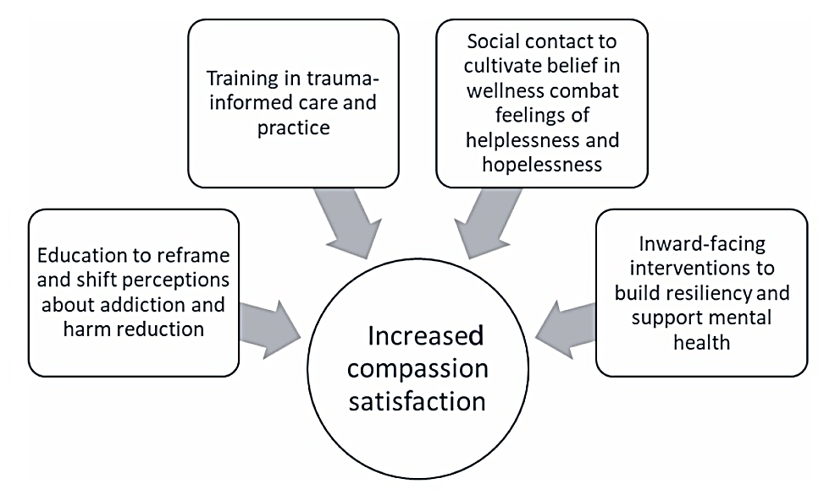
Proposed solutions for combatting stigmatization among providers on the front lines of the opioid crisis
Knaack et al., 2019
Notes:
Review these proposed solutions for dealing with staff stigma regarding individuals with opioid use disorders. Negative beliefs about addiction and ambivalence about harm reduction; Burnout, compassion fatigue, and vicarious trauma; and Low belief in the possibility of wellness and associate feelings of helplessness and hopelessness regarding patients with opioid use disorders (OUDs) were all found to be related to stigmatization of patients with OUDs. In order to decrease compassion fatigue, Knaack and colleagues proposed the strategies listed in the diagram above for healthcare providers on the frontline of the opioid crisis.
These four strategies are designed to combat provider stigmatization of individuals with OUDs and help organizations decrease workplace stress.
Review these strategies with students reminding them that this article is specific to Canada’s opioid crisis. However, similar strategies are certainly applicable to the US.
Reference:
Knaak, S., Christie, R., Mercer, S., & Stuart, H. (2019). Harm reduction, stigma and the problem of low compassion satisfaction. Journal of Mental Health and Addiction Nursing, 3(1), e8-e21.
IMAGE CREDIT: Image copied from the cited reference.

Slide 13
This ends Part 3 of the five-part Compassion Fatigue and the Behavioral Health Workforce Curriculum Infusion Package (CIP)
Other parts of this CIP can be found in the Products & Resources Catalog on the Pacific Southwest ATTC website: http://www.psattc.org
Notes:
This slide contains links to additional resources for continued learning. Encourage students to explore issues related to being part of the behavioral health workforce in more detail.
Additional components of the PSATTC’s Compassion Fatigue Curriculum Infusion Package (CIP) include the following:
Part 1: Defining Compassion Fatigue and Its Impact on the Behavioral Health Workforce
Part 2: The Behavioral Health Workforce
Part 4: Compassion Satisfaction/Wellness and Self Care Plans
Part 5: Self Care and Ethical Issues
The full Compassion Fatigue CIP is available for viewing and downloading from http://www.psattc.org.
This product was created by the Pacific Southwest Addiction Technology Transfer Center (PSATTC) under a cooperative agreement (5UR1TI080211) from the Substance Abuse and Mental Health Services Administration (SAMHSA). The opinions expressed are the views of the presentation developers and do not reflect the official position of the Department of Health and Human Services (DHHS), SAMHSA or CSAT. No official support or endorsement of DHHS, SAMHSA, or CSAT for the opinions described in this program is intended or should be inferred.
IMAGE CREDIT: Shutterstock (purchased image).

