Slide 1
Dialectical Behavioral Therapy (DBT) in Substance Use Disorder (SUD) Treatment
Welcome to today's virtual training. As we wait for others to join, kindly enter your name and agency into the chat box to document your attendance.
Notes:
Trainer Notes: Introduce yourself (trainer), then, you can add – "If you haven't already done so, go ahead and enter your name and agency into the chat box to document your attendance."

Slide 2
Dialectical Behavioral Therapy in Substance Use Disorder Treatment
[INSERT TRAINER NAME & CREDENTIALS]
Integrated Substance Abuse Programs (ISAP)
Dept. of Psychiatry & Biobehavioral Sciences,
David Geffen School of Medicine at UCLA
Pacific Southwest Addiction Technology Transfer Center
www.uclaisap.org www.psattc.org
Notes:
Trainer Notes: You can re-introduce yourself (trainer), then, you can add – "Today's training is scheduled to be approximately three hours, which can be a long time to sit at your computer. So, before we get started, I'll note that we will be taking a 15-minute break approximately halfway through our time together. This activity is eligible for Continuing Education credit. You will need a start and end code. The start code will be given on the next slide so take a moment to prepare yourself to document the start code." [give a few moments].

Slide 3
START CODE
XXXX
You will be asked to enter the start and end codes in the CE Evaluation.
Notes:
Trainer Notes: "As stated, this activity eligible for Continuing Education credit. You will need a start and end code when you complete the CE evaluation. Here is the start code [say and repeat start code]."

Slide 4
Notice: AI Features in Trainings
Per University of California policy, the use of artificial intelligence (AI) features, such as meeting summaries, are not allowed in virtual meetings and webinars.
Attendees who enable AI features will be asked to turn them off or they may be removed from the training.
Thank you for your understanding as we navigate this new frontier!
Notes:
Trainer Notes:
"The University of California prohibits the use of AI features (including meeting summaries) in virtual meetings and webinars, so if you enable these features, you’ll be asked to turn them off.“
Photo Credit:
Purchased Image, Adobe Stock.

Slide 5
Thank you for joining us today!
Today's session is an INTERACTIVE TRAINING!
To fully participate, please ensure that your camera is on and you are connected to audio prior to the start of the training
If you require assistance, you can send a chat to UCLA TECH SUPPORT
Notes:
Trainer Notes:
"We'd like this to be an interactive training as much as possible, so there will be several ways in which you can actively participate today."
"We'll ask you to contribute to various discussions by entering into the chat and may also ask you to un-mute yourself to contribute to a discussion throughout this training. You will also have the opportunity to put questions/thoughts/observations into the chat. We won't necessarily address your question or comment immediately, but we'll usually get to it when we finish presenting a slide."
"Later in this training, we’ll also be doing various activities together. It's especially important to be on camera with a working microphone at those times.“
Photo Credit:
Purchased Image, Adobe Stock.

Slide 6
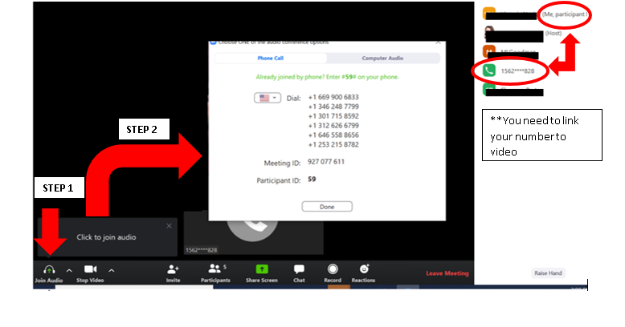
Linking Your Audio and Video:
If you joined by phone and your phone is not connected to your video, follow these steps:
STEP 1: Click on Join Audio (located bottom left)
STEP 2: enter #participant ID# on your phone.
Example above #59#
Notes:
Trainer Notes:
"These instructions will not apply to most of you, BUT if you joined by phone today, there are the instructions for linking your audio and video."
"Essentially, you'll want to click on the Join Audio button located on the bottom left portion of your Zoom window (on the tool bar). This will pull up instructions for you to dial in on your phone in addition to your participant ID – when you dial in on your phone, you'll need to enter pound, your participant ID, and then pound again."

Slide 7
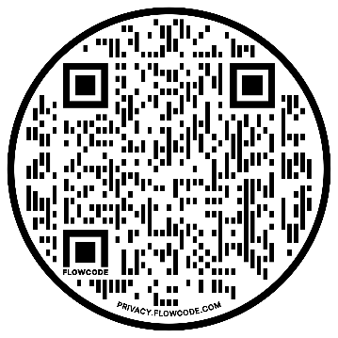
Indigenous Land Acknowledgement
We respectfully acknowledge that we live and work in territories where Indigenous nations and Tribal groups are traditional stewards of the land.
Please join us in supporting efforts to affirm Tribal sovereignty across what is now known as California and in displaying respect, honor and gratitude for all Indigenous people.
Whose land are you on?
Option 1: Text your zip code to 1-855-917-5263
Option 2: Enter your location at https://native-land.ca
Option 3: Access Native Land website via QR Code:
Notes:
Trainer Notes: "We respectfully acknowledge that we live and work in territories where Indigenous nations and Tribal groups are traditional stewards of the land. Please join us in supporting efforts to affirm Tribal sovereignty across what is now known as California and in displaying respect, honor and gratitude for all Indigenous people. If you don't know what Native land you are on, use the resource on the slide to find out. I am on [insert what land you're on]" (note: the UCLA campus is on Chumash and Tongva land).
Photo Credit:
Purchased Image, Adobe Stock.

Slide 8
PEOPLE FIRST
What we say and how we say it inspires the hope and belief that recovery is possible for everyone.
Affirming, respectful, and culturally-informed language promotes evidence-based care.
Language Matters
in treatment, in conversation, in connection.
Notes:
Trainer Notes: "Language matters. What we say and how we say it inspires the hope and belief that recovery is possible for everyone. We use affirming, respectful, person-first language that promotes evidence-based care. For example, instead of saying alcoholic, we say 'person with an alcohol use d/o' or you may hear us use the term 'person with a substance use disorder' rather than the terms 'addict' or 'junkie' – in this way we are recovery-oriented and person-centered in our work."
Photo Credit:
Purchased Image, Adobe Stock.

Slide 9
[INSERT MONTH RECOGNITIONS SLIDE]

Slide 10
Learning Objectives
At the end of this training, participants will be able to:
Distinguish two (2) specific behaviors that DBT is designed to treat and the origins of DBT
Describe the four (4) groups of skills utilized in DBT (Mindfulness, Interpersonal Effectiveness, Emotion Regulation, and Distress Tolerance)
Identify two (2) ways in which DBT skills can be useful for substance use disorders
Apply one (1) specific DBT Skill pertaining to one of the four (4) DBT skills
Explain two (2) specific ways in which DBT can be integrated into an SUD treatment setting
Notes:
Trainer Notes: Review the learning objectives with participants.

Slide 11
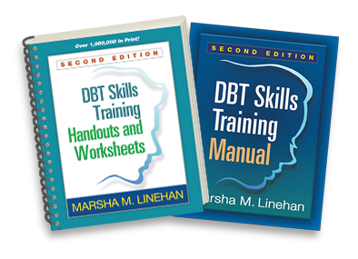
Reference Materials
SOURCES: Linehan, 2014a; Linehan, 2014b
Notes:
Trainer Notes: "All of the materials that are provided and referenced throughout this training are taken from these two resources. These were created by the developer of DBT herself – Marsha Linehan."
---
Reference:
Linehan, M. M. (2014a). DBT (R) skills training handouts and worksheets, second edition (2nd ed.). New York, NY: Guilford Publications.
Linehan, M. M. (2014b). DBT (R) Skills Training Manual, Second Edition (2nd ed.). New York, NY: Guilford Publications.

Slide 12
Disclosure
The use of photocopied materials from the DBT Skills Training Manual and DBT Skills Training Handouts and Worksheets in this training does not grant training participants permission to photocopy or otherwise reproduce these materials.
If you wish to use these resources for personal use or use with clients after this training, you will need to purchase a copy of the DBT Skills Training Manual and/or DBT Skills Training Handouts and Worksheets.
Notes:
Trainer Notes: [read bullets].

Slide 13
Agenda
Opening Mindfulness Exercise
An Overview of DBT
The Basics of DBT
Fundamentals of DBT
Dialectics
The Biosocial Model
The Role of Validation in DBT
How is DBT Helpful?
Benefits of DBT
Using DBT in SUD Treatment
Foundations of DBT in SUD Treatment
The Role of Emotion Dysregulation in SUDs
Benefits of DBT in SUD Treatment
The DBT Skills
Mindfulness
Interpersonal Effectiveness
LUNCH BREAK
Emotion Regulation
Distress Tolerance
Modes of DBT Delivery
Components of DBT Skills Group Training
Group Activity
Closing Mindfulness Exercise
Notes:
Trainer Notes: "We have a lot of ground to cover today. We'll start our training by reviewing [list bullets 1, 2, 3, and 4]. Then, mid-way through our training, we'll take a 30-minute lunch break, followed by a review of [list bullets 5, 6, 7, and 8]."

Slide 14
Opening Mindfulness Exercise
Notes:
Trainer Notes:
"We're going to start today's training with a mindfulness exercise, which is one of the four core skill areas involved in DBT. It's also common practice to begin and end DBT sessions with a mindfulness exercise (specifically DBT Skills Group Training sessions) as we'll review later in this training."
"Mindfulness exercises serve to help us focus our awareness on the present moment, while calmly acknowledging and accepting one's feelings, thoughts, and bodily sensations."
Trainer can also add: "We'll explore the practice of Mindfulness in more detail later in this training.“
Photo Credit:
Purchased Image, Adobe Stock.

Slide 15
Deep Breathing Mindful Relaxation Exercise
Source: Nicklaus Children's Hospital Psychology Department, 2020
Notes:
Trainer Notes:
"This is a 5 minutes mindfulness exercise that involves taking slow, deep breaths while focusing your attention on the sensations of the breath. This practice can help us calm our minds, reduce stress, and promote relaxation within a short time frame."
Closed captioning is available for this video.
Trainer begins exercise.
---
Reference:
YouTube. (2020, August 17). Mindful meditation: 5-minute deep breathing mindful relaxation. YouTube. https://www.youtube.com/watch?v=he-tQOnDCWw

Slide 16
An Overview of DBT
Notes:
Trainer Notes:
"Let's start diving into today's training content by asking the question, what is DBT? In this section, we'll explore the origins of DBT and what DBT is used for."
Ask participants to share any words or phrases that come up for them when asked, "What is DBT?“
Photo Credit:
Purchased Image, Adobe Stock.

Slide 17
The Basics of DBT
Notes:
Trainer Notes:
"Let’s start with the basics.“
Photo Credit:
Purchased Image, Adobe Stock.

Slide 18
History of DBT
Created in the 1970s by Psychologist Dr. Marcia Linehan
An evidence-based treatment model that emphasizes skills-building
A modified form of cognitive behavior therapy that integrates emotion regulation and distress tolerance skill-building with a focus on acceptance and mindful awareness
Originally developed to reduce suicide attempts and non-suicidal self-injury behaviors
Further adapted to treat Borderline Personality Disorder (BPD)
DBT has since proven to be effective for treating and managing a wide range of mental health conditions, including Substance Use Disorders
Notes:
Trainer Notes:
"Let's briefly look at the history of DBT."
Read bullets; for Bullet 2's sub-bullet, you can add – "CBT focuses on identifying and challenging negative thought patterns and beliefs that contribute to emotional distress; while DBT incorporates elements of CBT, it adds a specific emphasis on emotional regulation and acceptance."
---
Additional Notes:
Other ways that DBT and CBT differ –
Focus on Emotional Regulation: While CBT addresses emotions, it doesn't have the same level of emphasis on teaching clients specific skills for emotional regulation as DBT does. DBT places a strong emphasis on teaching clients skills to manage intense emotions, tolerate distress, and improve interpersonal relationships
Incorporation of Mindfulness: CBT may incorporate mindfulness techniques, but it is not a core component of the therapy. Mindfulness is a central component of DBT, and clients are taught mindfulness skills to help them stay grounded, observe their thoughts and feelings without judgment, and reduce emotional reactivity.
Dialectical Approach: DBT introduces the dialectical philosophy, which encourages the synthesis of opposing viewpoints or ideas. This approach helps clients find a balance between acceptance and change, acknowledging their strengths and limitations. CBT is more focused on identifying and changing irrational or negative thought patterns.
Therapeutic Strategies: CBT primarily employs cognitive restructuring techniques to challenge and change irrational or negative thought patterns. It also involves behavioral strategies to modify actions and reactions. DBT includes a combination of cognitive and behavioral strategies, along with mindfulness techniques and validation strategies to help clients better regulate their emotions and develop healthier behaviors.
Treatment Structure: CBT is typically structured in a standard format with weekly sessions and a specific number of sessions planned based on the client's needs. DBT often includes individual therapy, group therapy, phone coaching between sessions, and skills training. It can be more intensive and structured, particularly for clients with severe emotional dysregulation.
Photo Credit:
Purchased Image, Adobe Stock.

Slide 19
The Overarching Goal of DBT
To increase resilience and develop coping skills to manage negative situations and emotions on our own
This is done by changing patterns that cause problems in our daily lives
Acceptance is necessary for change to occur
To learn adaptive, effective ways to live in the present moment, regulate emotions, improve interpersonal relationships, and cope with di/stress
Individuals learn and build mastery of new skills to replace the old skills that are ineffective
SOURCE: Linehan, 2014b
Notes:
Trainer Notes:
Bullet 1 – "The goal of DBT is to help individuals increase their resilience and develop coping skills to manage negative situations and emotions on their own."
Sub-Bullet – "This is done through helping individuals change patterns (behavioral, emotional, cognitive, and interpersonal) that cause problems in their daily life (e.g., an inability to manage strong emotions - which can lead to substance use, unhealthy or problematic relationships, etc.)."
Sub-sub-Bullet – "Acceptance is key for change. Before making changes, we must acknowledge the need for change. It goes beyond recognizing flaws; accepting ourselves and our judgmental thoughts is the first step to positive transformation.."
Bullet 2 – "More specifically, the goal of DBT is to teach adaptive, effective ways to live in the present moment, regulate emotions, improve interpersonal relationships, and cope with di/stress (versus using maladaptive or impulsive behaviors). Ultimately, we meet the goals of DBT through DBT skills development."
Sub-Bullet – DBT is a skills-based intervention. Essentially, we learn, and build mastery of, new skills to replace the old skills because the old skills and behaviors are causing problems with how we’re functioning (at work, with family, in interpersonal relationships)."
"The basic premise of DBT is that people who exhibit behaviors and tendencies (e.g., substance use) do not have the skills to be able to solve the problems that were leading to these behaviors. So, by helping someone build skills that have proven to promote positive change, these harmful behaviors will decrease."

Slide 20
The Goals of the DBT Skills
Mindfulness
Live in the Moment
Distress Tolerance
Develop Coping Mechanisms for Stress
Emotion Regulation
Regulate Emotions
Interpersonal Effectiveness
Improve Interpersonal Relationships
SOURCE: Linehan, 2014b
Notes:
Trainer Notes:
"The goal of mindfulness skills is to live in the moment. Mindfulness helps us slow down and choose how we want to respond in any given situation with the goal of leading you to a more adaptive resolution."
"The goal of interpersonal effectiveness skills is to improve interpersonal relationships."
"The goal of emotion regulation skills is to develop adaptive ways to regulate our emotions. We can use these skills when we observe that responding from emotions can potentially create more misery or turmoil in a situation."
"The goal of distress tolerance skills is to give people a new pattern – a new way of coping with intense emotional experiences and distressing/stressful situations."
"Remember that DBT is skills-based. So, in practicing these skills we can continually ask ourselves – 'Was I skillful in that situation? In what ways could I have been more skillful in that situation?'"
"This can really help people take accountability for their actions and provides a pathway for improvement."

Slide 21
Balancing Acceptance and Change
Notes:
Trainer Notes:
"In DBT, acceptance and change are integrated to help individuals effectively manage their emotions and improve their lives. This approach helps individuals find a harmonious path toward emotional regulation and personal growth."
"Acceptance involves acknowledging and validating one's current experiences without judgment, fostering self-compassion, and reducing the struggle against distressing emotions. Acceptance, however, does not mean that you agree or approve (more on this to come)."
"Change focuses on developing new coping skills and behaviors to create positive improvements in one's life while recognizing that change is a gradual process."
"DBT emphasizes the importance of balancing these two principles, as clients are encouraged to accept themselves and their circumstances while actively working toward meaningful changes."
"One analogy involves that of a flat tire – if we don’t first accept that a tire is flat, we’re never going to change the flat tire."
"Another analogy – when sailing a sailboat, if we don’t first accept the conditions of the wind, how are we going to change our sails to set ourselves on the course that we want?"
"It’s important to address the ways in which we resist the circumstances of a current situation (this includes accepting our current limitations – emotional, relational, etc.) so that we can accept what needs to be changed and then make changes where needed."
Photo Credits:
Purchased Images, Adobe Stock.

Slide 22
General Concepts and Focus of DBT
DBT is guided by the concepts of dialectics and the biosocial theory
The focus is on the need to learn skills to modulate behaviors that are ineffective
Essential to address problems that interfere with how we function in life
Emphasis on the practitioner having an accepting, nonjudgmental, and validating approach
SOURCE: Linehan, 2014b
Notes:
Trainer Notes:
Bullet 1 – "DBT is guided by the concepts of dialectics and the biosocial theory, which we will review shortly."
Bullet 2 – "In general, the focus of DBT is on the need to learn skills to change behaviors that don't work (i.e., we’re working to identify the maladaptive behaviors and patterns in one’s life and replace those with adaptive behaviors based on different skills), which is essential to address problems that interfere with how we function in life (sub-bullet)."
Bullet 3 – "DBT emphasizes the practitioner having an accepting, nonjudgmental, and validating approach – it’s important for us to understand the world that people are coming from and understand that their thoughts, feelings, and behaviors make sense given their current situation/experience without necessarily agreeing or approving of the person’s actions.“
Photo Credits:
Purchased Images, Adobe Stock.

Slide 23
Visualizing the Goal of DBT
Mindfulness lets you decide how to respond
"A Life Worth Living"
New Coping Skills
Challenge
Continued Misery
Misery
Challenge
Brief Relief
Brief Relief
Usual Coping
Usual Coping
SOURCE: Adapted from https://dbtproviders.com
Notes:
Trainer Notes:
"This image provides a visual conceptualization of the goal of DBT."
"Often times a pattern exists if someone has ineffective skills for facing challenges."
A "challenge" could be a situation (workplace stress, family conflict, etc.), a person, feeling invalidated, feeling that something isn’t fair, having strong feelings without knowing what precipitated them, etc.).
"Upon facing a challenge, a person will turn to their usual coping (e.g., self-harm, ghosting ppl, substance use, yelling at a family member). This coping may provide some short-term relief, but it’s not a lasting way to cope or act. Someone may feel miserable about the way that they handled that challenge."
"Responding from a place of emotional dysregulation can create more misery or turmoil in a situation."
"Without recognizing and accepting that a change needs to happen, no change is made, and so the cycle goes on to continued misery."
"DBT helps people develop a new pattern – a new way of coping with challenges that arise."
"In this new pattern, we use the skills of mindfulness to help us slow down and choose how we want to respond in any given situation. This approach can lead you to a more adaptive resolution and allows you to be able to choose the more adaptive skills that we learn in DBT (e.g., distress tolerance, emotion regulation, interpersonal effectiveness)."
"In this new way of coping with challenges, we can then move forward toward "A life worth living" – a phrase coined by the developer of DBT (Marsha Linehan)."
"This idea of a ’life worth living‘ – which refers to a state in which someone can experience joy and satisfaction in their life, despite facing difficult challenges – is central to the foundation of DBT."
---
Reference:
WHAT IS DIALECTICAL BEHAVIOR THERAPY (DBT)?. What is DBT? - the DBT provider directory. (n.d.). https://dbtproviders.com/what_is_dbt.php?51

Slide 24
The Characteristics of DBT
Cognitive-Based
Support-Oriented
Collaborative
Notes:
Trainer Notes: "There are specific characteristics of DBT that act as themes that you will see woven throughout various aspects of DBT. Let’s briefly review those.“
Photo Credits:
Purchased Images, Adobe Stock.

Slide 25
Cognitive-Based
Individuals are assisted through the process of identifying thoughts and beliefs that make life harder, such as:
"I have to be perfect."
"I'm never going to be good at anything."
"I'm a failure so why even try?"
This process can help them develop new ways of thinking that can make it easier to cope through difficult circumstances
SOURCE: Linehan, 2014b
Notes:
Trainer Notes:
Bullet 1 – "DBT works to help people examine their cognitive processes, or their ways of thinking (mental processes). Part of this involves helping individuals identify thoughts and beliefs that make life inherently harder, such as [read sub-bullets]."
Bullet 2 – "In engaging in this process, individuals can begin to develop new ways of thinking that make it easier to cope through difficult circumstances. The cognitive component that we're reviewing here, you may notice, represents DBT's overlap with CBT."
Additional Note: "Like CBT, DBT focuses on helping people change unhelpful ways of thinking and behaving, but it differs from CBT in that it also focuses on self-acceptance (and accepting the reality of your life). DBT also usually involves more group work than CBT."
Photo Credit:
Purchased Image, Adobe Stock.

Slide 26
Support-Oriented
DBT treatment helps individuals identify their personal strengths
DBT can also assist someone to build their self-esteem and improve their self-image
SOURCE: Linehan, 2014b
Notes:
Trainer Notes:
Bullet 1 – "As you may have noticed already, DBT is focused on shifting focus away from people’s deficits, or weaknesses, by taking a no-blame and no-shame approach."
Bullet 2 – "Another way that DBT is support-oriented is that it helps individuals identify their personal strengths."
"DBT also aims to build up those strengths to improve a person’s self-esteem and self-image. This also helps the individual accept their feelings as a valid part of their lived day-to-day experiences, but not to let those feelings take over."
Photo Credit:
Purchased Image, Adobe Stock.

Slide 27
Collaborative
DBT fosters a relationship between practitioner and client
Clients are encouraged to address any problems that may arise in their relationship with the practitioner
"Consultation to the client" approach
Shifts the practitioner away from directly intervening in the environment
DBT can involve homework assignments, role-playing tasks, and practice opportunities for coping skills
All of this is done through close collaboration
SOURCE: Linehan, 2014b
Notes:
Trainer Notes:
Bullet 1 – "DBT is also collaborative. One of the ways that this manifests in DBT treatment is that people are encouraged to address any problems that may arise in the relationship with the DBT practitioner. DBT therapy is a bit different than more traditional talk therapy d/t the high amount of collaboration."
Bullet 2 – "Another way that DBT is collaborative is that, as practitioners, we agree to not treat clients as fragile. We understand that we need treat them with the belief that they can speak on their own behalf and are the experts of their own lives. We also don't always try to directly change things in a person's environment."
"For example, instead of telling someone what to do or feel right away, you might first listen and understand the person's feelings without immediately trying to fix everything. This way, the person feels heard before figuring out what to do next."
"In DBT, practitioners avoid directly changing things in a person's surroundings unless there's a really good reason. They step in only if the short-term benefit is more important than the long-term learning for the client. This intervention happens only when there's a clear and urgent need to prioritize the client's immediate safety or well-being over their long-term growth, like in situations of suicidal thoughts, self-harm, abuse, immediate risk of losing basic needs like housing, and so on.
"In all other circumstances the practitioner coaches the client on how to intervene in the environment to solve the problem themselves (this is the 'consultation to the client' approach)."
Bullet 3 – "Finally, through close collaboration with the client, DBT treatment can involve homework assignments, role-playing tasks, and practice opportunities for coping skills.“
Photo Credit:
Purchased Image, Adobe Stock.

Slide 28
In Summary
DBT is…
Skills-based and involves four specific skill sets
Practice and repetition of the DBT skills is essential
Focused on helping people understand and accept their difficult feelings and unhelpful behaviors, and learn skills to manage these feelings and behaviors so that they can make positive changes in their life
Cognitive-based, support-oriented, and collaborative
Especially effective for people who have difficulty managing and regulating their emotions
Standard DBT Treatment Delivery: Individual Sessions, Intersession Contact, Group Sessions
SOURCE: Linehan, 2014b
Notes:
Trainer Notes:
Introduce slide – "Let’s summarize what DBT is here."
Sub-Bullet 1 – read bullet and, then, add: "Again, these skills sets are: Mindfulness, Interpersonal Effectiveness, Emotion Regulation, Distress Tolerance. Practice of these skills is essential to make lasting positive changes (sub-bullet)."
"We’ll talk about these four DBT skill sets in more depth later in this training."
Sub-Bullet 2 – read bullet and, then, add: "DBT is focused on finding the balance between acceptance with change."
Sub-Bullet 3 – read bullet and, then, add: "DBT focuses on helping people change unhelpful ways of thinking and behaving; it’s also oriented toward helping individuals identify and cultivate support and learning through collaboration."
Sub-Bullet 4 – read bullet and, then, add: "This is why DBT was initially developed for people with borderline personality disorder, but has since been shown to be effective for other mental health conditions as well, such as substance use disorders."
Bullet 2 – "Standard delivery of DBT involves: individual sessions, intersession contact, and group sessions focused on skills training. However, DBT is very adaptable in its delivery."

Slide 29
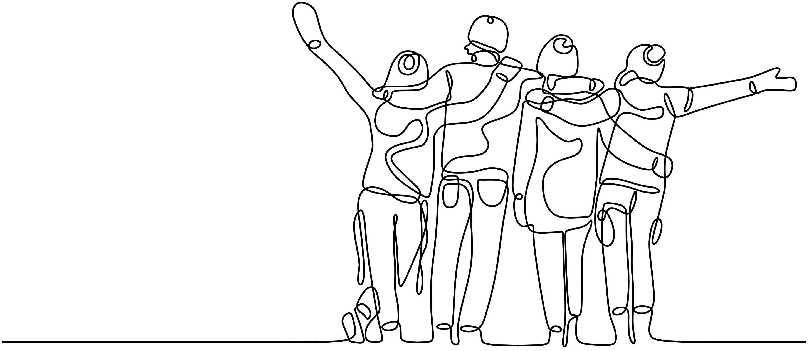
Why Choose DBT?
Applicable and adaptable across various settings and populations
There are a variety of therapeutic techniques/interventions to choose from (the four DBT skill sets)
DBT is teachable and practical
DBT is accessible to all levels of clinicians/non-clinicians
Notes:
Trainer Notes:
Bullet 1 – "The intervention is very adaptable and can be used in a variety of settings."
Bullet 2 – "There are a variety of interventions that you can use (i.e., four different skill sets)."
Bullet 3 – "DBT is teachable and practical (especially because it’s skills-based) – it’s easy for clients to understand – you can introduce the skills to clients and see results quickly."
Bullet 4 – "DBT is accessible to all levels of clinicians and non-clinicians; you don’t have to be a licensed clinician (e.g., case managers and SUD counselors can use it).“
Photo Credit:
Purchased Image, Adobe Stock.

Slide 30
Fundamentals of DBT
Notes:
Trainer Notes:
"There are some fundamental concepts that provide the framework for understanding and addressing emotional dysregulation and related challenges. We’ll review those next.“
Photo Credit:
Purchased Image, Adobe Stock.

Slide 31
Concepts/Theories Involved in DBT
Biosocial Model
Dialectics
Notes:
Trainer Notes:
"Dialectics is a crucial idea in DBT. It's really important because it forms the basis of the whole therapy approach. It helps us understand emotions better and find a balance between accepting ourselves and making positive changes. This is key to dealing with emotional struggles and improving our overall emotional well-being."
"The Biosocial Model in DBT is a way of explaining why emotional struggles happen. It helps us see how things like biology and life experiences can lead to emotional challenges. Understanding this model guides therapists in helping people and sets the path for recovery."
"Putting together dialectics and the biosocial model, DBT gives us a complete plan to boost emotional well-being and overall functioning."

Slide 32
Dialectics
Notes:
Trainer Notes: "Let’s start by exploring dialectics.“
Photo Credit:
Purchased Image, Adobe Stock.

Slide 33
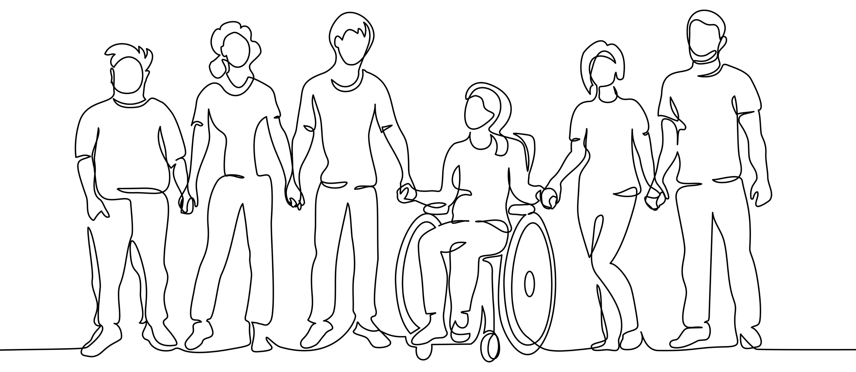
What is Dialectics?
DBT is based on a philosophical idea called "dialectics"
Dialectics in DBT refers to a synthesis or integration of opposing ideas or concepts
Dialectics acknowledges that contradictions and tensions are inherent and can emerge within us and in our surroundings, including between people, in the world, and within various situations
SOURCE: Linehan, 2014b
Notes:
Trainer Notes:
Bullet 1 & Sub-Bullet – "Dialectics is a philosophical idea and, in DBT, it refers to the integration of opposing ideas or concepts."
Bullet 2 – read bullet and, then, add: "Dialectics seeks to find a middle ground between these inherent contradictions that are all around us."
Examples of how we apply dialectics in our everyday life:
Dialectics in DBT is like a balancing act in real life, where you try to juggle your job and personal time to have a successful career and a happy personal life.
When it comes to our finances, we practice dialectics when figuring out how to save money for the future while still enjoying life in the present.
When it comes to dealing with people, it's a bit like finding the right mix between being social and having some time alone – you need both to feel good.
Handling a difficult family member involves finding a balance between setting boundaries to take care of yourself and keeping communication open to understand each other and solve problems.
Photo Credit:
Purchased Image, Adobe Stock.

Slide 34
Dialectical Thinking in DBT
Two opposing ideas can coexist simultaneously, acknowledging how they potentially overlap or don’t overlap, with each viewpoint holding valuable truths
Dialectics help us find a way of bringing together and balancing acceptance and change
According to dialectics, everything is composed of opposites; therefore, change happens when we accept the co-existence of these opposites
While change is often desired, there are times when acceptance of the present moment or one's emotions is more helpful
SOURCE: Linehan, 2014b
Notes:
Trainer Notes:
Bullet 1 – "Dialectical thinking encourages individuals to hold and reconcile two opposing ideas or viewpoints rather than thinking in black-and-white terms, acknowledging the ways in which these viewpoints potentially overlap or don’t overlap, and recognizing that each viewpoint holds valuable truths."
"For example, a person could be trying their best AND, at the same time, they could be working to do better."
"Interpersonal conflicts are incredibly difficult and, at the same time, they can present important opportunities for growth or improvement."
Bullet 2 – "One of the central dialectics in DBT is the balance between acceptance and change. In DBT, we highlight the need to balance acceptance of the present moment with the pursuit of change and growth. This balance between acceptance and change is at the core of DBT."
"For example, in DBT, clients are encouraged to simultaneously accept themselves, their emotions, and their current circumstances (acceptance) while also actively working on making positive changes in their lives or changing their perceptions or ideas about how things should be (change)."
Sub-Bullet 1 – “In addition, according to dialectics, everything is composed of opposites; therefore, change happens when we accept the co-existence of these opposites."
Sub-Bullet 2 – “Lasty, while change is often desired, there are times when acceptance of the present moment or one's emotions is more helpful."
---
Additional Notes:
These examples illustrate how dialectical situations are common in various aspects of life and how finding a balance between opposing forces or needs can lead to more effective decision-making and problem-solving:
Balancing Autonomy and Interdependence in Relationships: In a healthy romantic relationship, individuals must balance their need for autonomy and independence with their need for emotional connection and interdependence.
Acceptance and Change in Therapy: In therapy, clients often grapple with the dialectic of accepting themselves as they are while simultaneously working toward personal growth and change.
Freedom and Responsibility in Parenting: Parents must navigate the dialectic of granting their children the freedom to make choices and learn from their mistakes while also ensuring their safety and well-being.
Managing Urges and Maintaining Recovery in Addiction: Individuals in recovery from addiction face the dialectic of managing strong urges to use substances while maintaining their commitment to abstinence.
Work-Life Balance: Balancing the demands of a career (often involving long hours and high stress) with a desire for a fulfilling personal life and leisure time presents a dialectical challenge.

Slide 35
Applying Dialectics in DBT
In DBT, clients learn that truth and reality can be reached when opposing thoughts and feelings come together
DBT also allows clients to discuss and explore the truth about the negative emotions they may be feeling in a particular moment
DBT helps clients strike a balance between acceptance of:
1) Who they are and the challenges they face and
2) the benefits of change
SOURCE: Linehan, 2014b
Notes:
Trainer Notes:
Read bullets and, then, add – "Imagine a person struggling with depression who often experiences intense self-criticism and a pervasive sense of hopelessness. Dialectical thinking in therapy might involve demonstrating acceptance by acknowledging both the person's pain and suffering (acceptance) while at the same time also encouraging them to work towards change and finding ways to improve their mental well-being (change).“
Another example to consider: "Consider an individual who has been struggling with alcohol use for many years. Dialectical thinking might involve recognizing the individual's desire for immediate relief and escape through alcohol (acceptance of the coping mechanism) while also emphasizing the importance of long-term sobriety and improved health (change). The therapist works with the person to validate the need for relief and stress reduction while introducing strategies for managing cravings, developing healthier coping mechanisms, and setting goals for a substance-free life.“
For many in SUD treatment, dialectical thinking will involve acknowledge the role of substances as a coping mechanism and the challenges they face in giving it up, all while promoting the long-term goal of recovery and improved well-being. It encourages a balanced approach that validates the immediate need for relief while working toward lasting change.“
Photo Credit:
Purchased Image, Adobe Stock.

Slide 36
The Dialectical Approach
The goal of taking a dialectical approach is to find balance and flow rather than opposition
A dialectical approach assists us in acknowledging that change is an ongoing process, and new contradictions can emerge
This approach involves validating our experiences and emotions (and those of others), even when those experiences seem contradictory
It emphasizes that emotions and perspectives are valid, regardless of their apparent contradictions
Notes:
Trainer Notes:
Bullet 1 – "The goal of taking a dialectical approach is to find balance and flow rather than opposition. This involves understanding that what is effective in this moment might not be effective in the next."
Bullet 2 – "A dialectical approach assists us in acknowledging that change is an ongoing process, and new contradictions can emerge. In this way, we are better able to move through difficult situations with fluidity, or movement, and through collaboration. This requires us to pay attention to the moment and reorient ourselves towards the context of the moment."
Bullet 3 and Sub-Bullet– "This approach involves validating our experiences and emotions (and those of others), even when those experiences seem contradictory. It emphasizes that emotions and perspectives are valid, regardless of their apparent contradictions. " (more about validation in a few moments)
"Dialectical thinking encourages individuals to act in a way that is consistent with their long-term goals and values while acknowledging and addressing immediate emotional needs and distress.“
"In relationships, dialectics promote finding common ground and resolving conflicts by understanding and validating both sides of an issue.“
"In therapy, dialectics guide the therapeutic process, allowing for the validation of the client's experiences and emotions while also working toward behavioral change and emotional regulation."
One way to begin incorporating dialectics in our day-to-day life is by making an intentional shift between using "but" and "and" in our language (which can, in turn, create a shift in our thinking).
The word "BUT" makes us pay more attention to the second part of a sentence, usually because it says something different or opposite to what came before the "BUT.“
Photo Credit:
Purchased Image, Adobe Stock.

Slide 37
The Biosocial Model of DBT
Notes:
Trainer Notes:
"The Biosocial model in DBT is a theoretical framework that helps explain the development of emotional dysregulation and related challenges. According to the biosocial model, emotional dysregulation results from the interaction between biological vulnerabilities and an invalidating environment. "
"In this way, the biosocial model is a 'no-blame' model – we are not blaming people for having the symptoms that they're living with but, rather, we understand that these symptoms often have underlying biological and environmental causes that a person did not have control over.“
Photo Credit:
Purchased Image, Adobe Stock.

Slide 38
The Biosocial Model of DBT (1)
DBT's biosocial model is the theory of how behaviors emerge and are maintained through the life span
Pervasive emotional dysregulation is caused by:
Inborn emotional sensitivity
There are biological causes for different levels of emotional sensitivity
Being raised in an invalidating environment
An environment in which someone receives the message that their way of being does not "fit in " or make sense
When someone expresses their experiences, they're not validated; instead, their experiences are often punished and/or trivialized
SOURCE: Linehan, 2014b
Notes:
Trainer Notes:
Bullet 1 – "Again, [read Bullet 1]. In other words, behaviors are caused by BOTH biological and social/environmental factors."
Bullet 2 – "In the case of pervasive emotional dysregulation, the biosocial model asserts that there are two causes for this."
“The first is emotional sensitivity shaped by biology. Namely, there are biological causes for different levels of emotional sensitivity.“
"Because of this, some people come into the world genetically predisposed to feel things more strongly than others. Some can shrug things off easily while others feel hurts deeply."
"Ultimately, biological factors can influence your sensitivity even before you are born (emotional sensitivity is inborn)."
"The second cause of pervasive emotional dysregulation is one that is social/environmental in nature. Namely, the person was brought up in an invalidating environment – an environment in which a person did not 'fit in' (i.e., the environment did not necessarily have to be abusive). It means that when someone expressed their experiences, they were not validated; instead, their experiences were often punished and/or trivialized. Invalidation can also be expressed by telling someone that their feelings are wrong or incorrect, by minimizing their feelings, or by ignoring their experiences."
"Invalidating environments communicate to a child that there are two ways to express emotions:
1) Suppress your emotions – individuals learn that they shouldn't trust themselves, there's a fear of emotions and no means to regulate emotions because they didn't learn how to do this.
2) Express your emotions in extreme ways – the message is that expressing emotions in an extreme way will help you (and is the only way to) get your needs met. When adults exhibit these behaviors, they are often learned behaviors from childhood.“
Photo Credit:
Purchased Image, Adobe Stock.

Slide 39
The Biosocial Model Equation
Biologically-Based Emotional Sensitivity & Impulsivity
Pervasively Invalidating Environment
Severe & Pervasive Emotional Dysregulation
SOURCE: Linehan, 2014b
Notes:
Trainer Notes: "Here is a visual representation where we see that biologically-based emotional sensitivity plus a pervasively invalidating environment equals pervasive emotional dysregulation."
"According to the biosocial model of DBT, behaviors are a natural reaction that occur in response to environmental reinforcers that take place over time. Behaviors are not simply caused completely by their environment or completely by a person’s emotional predispositions."
"By addressing both the biological vulnerabilities and the impact of an invalidating environment, DBT aims to help individuals develop effective coping strategies and emotional regulation skills."

Slide 40
The Role of Validation in DBT
Notes:
Trainer Notes:
"Let’s now talk about the role of validation in DBT.“
Photo Credit:
Purchased Image, Adobe Stock.

Slide 41
Validation in DBT
Validation is a fundamental practice in DBT that involves acknowledging and accepting an individual's thoughts, feelings, and behaviors as valid and understandable, given their unique experiences and perspectives
Validation is an essential component of creating a supportive and nonjudgmental therapeutic environment
Validation does not mean you agree or approve
SOURCE: Linehan, 2014b
Notes:
Trainer Notes:
Bullet 1 – [read Bullet ].
Sub-Bullet: "Validation is very important to DBT because it helps create a supportive and nonjudgmental therapeutic environment for our clients. Validation strategies can involve supportive communication, reflective listening, cheerleading, and accepting a person's perception of reality (accepting that this perception makes sense given their current situation/experience without necessarily agreeing or approving of the person’s perception of reality)."
Bullet 2 – "People often resist the idea of validation because they think it involves admitting that you agree or approve (which is untrue). Validation simply means that you're hearing the person and that you see them."
Photo Credits:
Purchased Images, Adobe Stock.

Slide 42
Why Validate Others?
We validate others because it helps improve our relationships and calms intense situations so that we can problem-solve
Validating others requires that we:
Show interest and “be awake”
Accurately reflect
Put yourself in their position
Consider and validate based on the person’s history
Consider and validate based on the person’s current circumstances
Express “Radical Genuineness”
SOURCE: Linehan, 2014b
Notes:
Trainer Notes:
Introduce slide – "Validation can be practiced externally (toward others), but what is the use of validating others?"
Bullet 1 – [read bullet].
"All of us know what it feels like to be invalidated and some of us grew up in environments where we were invalidated frequently. We can use these experiences to encourage ourselves to take the time to learn about others’ lived experiences and realities (how they experience their lives), which can help us more easily accept them and validate them."
"In engaging in this process with clients, we can help them identify the skills that will be most helpful to them and, when they're struggling to develop these skills and we feel frustrated by this, we can return to a place of acceptance and validation."
Bullet 2 – Validating others requires that we:
Show interest and be awake
Give people the respect of listening to them
Be mindful of our body language
Not checking our phone or just taking notes intensely
Accurately reflect
Reflect what the person is saying in combination with other forms of validation (i.e. body language that communicates you are present and listening)
Check for accuracy
Put yourself in their position
Imagine what it is like to be that person
Read their expressed emotions and thoughts
Check for accuracy
Accurately reflecting looks like summarizing with genuine care and understanding what you've heard from the other person regarding their emotions (be aware and avoid sarcasm)
Consider and validate based on the person’s history
Understand the behavior within the context of the client's experience
We know about our client (we’ve listened to them during the intake and sessions leading up to this moment) and taking all this into account, how can we then best respond?
Taking extra steps to understand the context of the person's situation, emotions, circumstances, etc.
Consider and validate based on the person’s current circumstances
We can validate that the behavior makes sense given the circumstances
We communicate empathy and understanding
Express Radical Genuineness
Involves the therapist demonstrating themselves as a human and an equal with the client
It involves engaging in an authentic manner and not taking themselves to seriously or ignoring the obvious
We communicate from an open and non-defensive place
Be a human, not a robot

Slide 43
Why Self-Validate?
We self-validate because it quiets defensive/fearful emotions, enabling us to problem-solve and let go of pain and exhaustion
Self-validation is helpful when we invalidate ourselves or others invalidate us
When we invalidate ourselves:
Let go of self-judgement
Notice shame
Describe the situation (with facts)
How to manage invalidation from others:
Remember that judgments are judgments and not facts
Remember that others are not in our shoes
Acknowledge that it is difficult and painful to be invalidated by others
SOURCE: Linehan, 2014b
Notes:
Trainer Notes:
Introduce slide – "Validation can also be practiced internally (toward ourselves)."
Bullet 1 – [read bullet].
Bullet 2 – [read bullet].
"Invalidating ourselves can involve statements like, 'I shouldn’t feel this way; My feelings are stupid; I’m crazy for feeling this way; etc.’”
"Often, when we frequently invalidate ourselves, we tend to look to others to figure out what we feel (and if it’s valid) and how we should respond."
"When someone invalidates you, it can involve statements like, 'YOU shouldn’t feel this way; YOUR feelings are stupid; YOU’RE crazy for feeling this way; etc.'"
"Experiencing frequent invalidation from others can lead someone to believe that they can’t trust themselves (they tend to trust others more than they trust themselves). When everything you feel gets blamed, shamed, or minimized you learn that your internal world doesn’t make sense and you can't trust it, so you need to look to others to figure out what's happening (for validation)."
"When others invalidate us, we also spend a lot of time/energy trying to prove to others that our experiences are real and make sense (which can result in crises and conflict)."
Bullet 3 – "When we invalidate ourselves, we can:
Let go of self-judgment (which typically leads to shame)
Notice shame (if you haven’t truly gone against your values then let go of the shame by finding an alternative, primary emotion)
Describe the situation with facts.
When in doubt, imagine that someone you care about and respect is in your situation - how would you respond to them? Respond that way to yourself."
Bullet 4 – "When we experience invalidation from others we can:
Remember that judgments are judgments and not facts
Recall that just because others don’t understand our experiences does not make our experiences invalid
Practice self-validation and acknowledge that it is difficult and painful to be invalidated by someone else."
"All of us know what it feels like to be invalidated and some of us grew up in environments where we were invalidated frequently. We can use these experiences to encourage ourselves to take the time to learn about others’ lived experiences and realities (how they experience their lives), which can help us more easily accept them and validate them."
"In engaging in this process with clients, we can help them identify the skills that will be most helpful to them and, when they're struggling to develop these skills and we feel frustrated by this, we can return to a place of acceptance and validation."

Slide 44
How is DBT Helpful?
Notes:
Trainer Notes: "Let's take a look at how DBT is helpful.“
Photo Credit:
Purchased Image, Adobe Stock.

Slide 45
Mental Health Conditions
DBT has proven to be effective for treating and managing a wide range of mental health conditions, including:
Borderline Personality Disorder
Substance use disorders
Suicidal behavior
PTSD
Self-harm
Depression
Anxiety
Eating disorders (specifically binge eating disorder and bulimia)
Effective for both adolescents and adults
SOURCE: Linehan, 2014b
Notes:
Trainer Notes: "Here is a list of mental health conditions for which DBT has been proven to be effective [read bullets]. DBT has also been shown to be effective for adolescents and adults. So, here you can see DBT’s potential for being effective for those who may be experiencing more than one of these conditions.“
Photo Credits:
Purchased Images, Adobe Stock.

Slide 46
Treatment of Dysregulated Behaviors
Emotion Dysregulation
Affective lability, irritability, and intense anger
Interpersonal Dysregulation
Fear of abandonment, splitting, idealization and devaluation
Behavior Dysregulation
Suicidal behaviors, other self-injurious behaviors, and impulsivity
Self Dysregulation
Emptiness, identity disturbance
Cognitive Dysregulation
Dissociation and paranoia, distortions in thinking
SOURCE: Linehan, 2014b
Notes:
Trainer Notes:
Introduce slide – "There are specific behaviors – known as dysregulated behaviors – that DBT is specifically beneficial for. Let's review those."
Bullet 1 – "Emotion dysregulation refers to difficulties in effectively recognizing, managing, and responding to one's own emotions. It may manifest in various ways, such as experiencing intense emotional reactions, struggling to modulate emotions, or having difficulty returning to a baseline emotional state after a distressing event. It can involve many emotions, including sadness, intense anger, irritability, and frustration."
Example: Mark's wife canceled their dinner plans at the last minute, and he responded by angrily slamming doors and shouting. Later, he felt intense guilt and shame for his outburst, but couldn't shake his mood swings throughout the evening.
Bullet 2 – "Interpersonal dysregulation refers to difficulties in managing and maintaining stable and healthy relationships with others. It involves challenges in regulating one's emotions, reactions, and behaviors in social interactions and can lead to issues such as frequent conflicts, unstable relationships, and difficulty forming and maintaining connections with others. It can involve splitting (e.g., viewing everything and everyone in black and white, 'absolute' terms such as good/bad, right/wrong) or alternating between idealizing and devaluing close relationships (e.g., sometimes hating people who are close to you and wanting distance but feeling dependent on them at other times).“
Example: Sara, who struggles with interpersonal dysregulation, got into a heated argument with her best friend over a minor disagreement, causing a rift in their friendship. The next day, she desperately tried to reconcile, alternating between excessively apologizing and becoming defensive, further straining the relationship.
Bullet 3 – "Behavior dysregulation refers to difficulties in controlling or managing one's behaviors in a way that is consistent with social norms and personal goals. It often involves impulsive or maladaptive actions and can manifest as behaviors that are extreme, unpredictable, or inconsistent with a person's values or intentions (such as self-injury, substance use, and risky sexual activity)."
Example 1: John, struggling with behavior dysregulation, impulsively quit his job in a fit of frustration after a minor disagreement with his supervisor, even though he had been planning to discuss the issue calmly later that day. This impulsive action led to financial strain and further distress for John.
Example 2: After a particularly stressful day, Mark, struggling with behavior dysregulation, impulsively purchased and consumed a large quantity of alcohol despite being committed to abstinence for several months. This impulsive act not only jeopardized his recovery but also led to significant personal and legal consequences.
Bullet 4 – "Self dysregulation refers to an unstable sense of self, a lack of identity, and a sense of emptiness. It can affect someone’s ability to form and maintain a consistent sense of self-identity which may lead them to adopt different roles or personas in different situations or with different people, making it challenging to establish a stable self-concept.“
Example 1: In the midst of an argument with her partner, Emily rapidly shifted from feeling intense anger to sudden self-loathing, berating herself for being a terrible person and threatening harmful behaviors. Her inability to maintain a stable self-identity and manage her emotional responses strained her relationship and heightened her emotional distress.
Example 2: Jason constantly seeks validation and approval from his friends, often adopting their interests, values, and opinions as his own to gain their acceptance. This chronic instability in self-identity and an overwhelming need for external validation has led to confusion in his relationships and a persistent sense of emptiness within himself.
Bullet 5 – "Cognitive dysregulation refers to difficulties in regulating and managing cognitive processes, including thinking, perception, and attention. It involves disruptions in the ability to control one's thoughts and cognitive functions in a way that is adaptive, organized, and aligned with one's goals and the demands of a situation. Cognitive dysregulation can manifest in various forms including distortions in thinking, paranoia, and dissociative responses that are made worse by stressful situations.“
Photo Credits:
Purchased Images, Adobe Stock.

Slide 47
Benefits of DBT
Notes:
Trainer Notes: "DBT can really be beneficial for everyone – let's review some general benefits of DBT.“
Photo Credit:
Purchased Image, Adobe Stock.

Slide 48
DBT Benefits (1)
DBT Skills are Applicable in Many Areas of Life
Mindfulness, when mastered, is associated with overall health and well-being, extending its benefits to various facets of life, including work, home, and social interactions.
DBT Can Help Improve Relationships
In DBT, the importance of our social connections in facing challenges is crucial. Building positive relationships with mutual respect and trust can profoundly impact your overall health and well-being.
DBT Can Improve One's Quality of Life
DBT aims to improve your life by helping you make positive changes. It also emphasizes that facing challenges is normal and okay during this journey.
SOURCE: Linehan, 2014b
Notes:
Trainer Notes:
Bullet 1 – "A good support network is key when dealing with mental health challenges. Many types of therapy don't put an emphasis on teaching skills to interact interpersonally. DBT takes a different approach by helping you improve relationships, thereby helping the whole person (bullet 1 & sub-bullet)."
Bullet 2 – "Although the aim of DBT is to improve the symptoms of people living with mental health conditions, it doesn't end there. The skills learned through DBT can be applied to many other areas of life too — including in one's work, home and social life (bullet 2 and sub-bullet)."
Bullet 3 – "One of the main focuses of DBT is to improve a person's quality of life. The truth is, we can't always change what happens to us. For some, mental health challenges will be a part of life forever — and acceptance of this fact is, therefore, key to moving forward. For those experiencing intense and disruptive emotions, quality of life can be impacted quite severely. Here, the distress tolerance and emotion regulation skills really come into their own (we'll review those momentarily)."

Slide 49
DBT Benefits (2)
Acceptance and change: Discover techniques to accept and handle different life situations, emotions, and yourself, and develop skills for positive change in your actions and interactions
Behavioral: Analyze and replace destructive behavior patterns
Cognitive: Shift focus towards changing unhelpful thoughts and beliefs.
Collaboration: Foster collaboration by communicating effectively and working as a team
Skill sets: Learn new skills to enhance your capabilities
Support: Be encouraged to recognize one's positive strengths and attributes and develop and use them
SOURCE: Linehan, 2014b
Notes:
Trainer Notes: "Other general benefits of DBT include [read bullets].“
Bullet 2 – "The behavioral components of DBT involve distress tolerance, emotion regulation, and interpersonal effectiveness skills."
Bullets 3 – "The cognitive components of DBT involve mindfulness and dialectical thinking."

Slide 50
Typical DBT Outcomes
Suicidal attempts, self-injury
Substance misuse, binge-eating disorder
Hospitalizations, emergency-care
Drop-out from treatment
Anger & hopelessness
Social adjustment & self-esteem
Costs of treatment
SOURCE: Linehan, 2014b
Notes:
Trainer Notes: "Lastly, these are the outcomes that are typically observed and experienced by those who apply DBT in their lives [read list]."
*NOTE: the downward facing arrows indicate a decrease, while the upward-facing arrows represent an increase*
Photo Credit:
Purchased Image, Adobe Stock.

Slide 51
Limitations of DBT
DBT involves homework and worksheets that may not be well-suited for everyone
There is no formal trauma processing in DBT
DBT requires a strong level of commitment to treatment
Clients are expected to put into practice what they have learned
Clients may possess excellent skills, but they can still find themselves in situations with exceptionally challenging individuals and circumstances
Notes:
Trainer Notes:
Introduce slide – "Let's look at the limitations of DBT, which are important to be aware of:"
Bullet 1 – [read bullet].
Bullet 2 – read bullet and, then, add: "for some clients, trauma processing may be a necessary component of treatment to recover from a traumatic experience(s) entirely."
Bullet 3 – read bullet and, then, add: "Unfortunately, this can be difficult to do when a person is feeling very low and downhearted (or is actively using substances).“
Bullet 4 – "Lastly, clients may possess excellent skills, but they can still find themselves in situations with exceptionally challenging individuals and circumstances."
---
Additional Notes:
Other limitations of DBT –
Certain facets of DBT are derived from Eastern religious philosophies; therefore, some clients whose religious values are Western (e.g., Christianity, Judaism, and Islam) may object to Zen Buddhist teachings.
Photo Credit:
Purchased Image, Adobe Stock.

Slide 52
Using DBT in SUD Treatment
Notes:
Trainer Notes:
Ask participants to share any words or phrases that come up when asked, "How can DBT be useful for those in SUD treatment?“
Photo Credit:
Purchased Image, Adobe Stock.

Slide 53
Foundations of DBT in SUD Treatment
Notes:
Trainer Notes: "Let’s review the foundations of DBT in SUD treatment.“
Photo Credit:
Purchased Image, Adobe Stock.

Slide 54
Rationale for DBT in SUD Treatment
DBT identifies substance use as a maladaptive coping behavior
DBT involves developing and practicing adaptive skills in the areas of Mindfulness, Interpersonal Effectiveness, Emotion Regulation, Distress Tolerance
Goal: These new skills function to reduce the need to engage in substance use as a coping behavior
DBT has shown favorable outcomes in treating addiction and substance use by reducing cravings and curbing impulsive and harmful behaviors
DBT can, thus, be an effective therapeutic intervention in substance use disorder treatment
SOURCE: Dimeff & Linehan, 2008
Notes:
Trainer Notes:
Bullet 1 – "The main idea behind using DBT for substance use disorders is that individuals lack the skills needed to cope with or solve the problems that were causing them to turn to substances. So, by helping someone build skills that have proven to promote positive change, substance use can decrease."
Bullet 2 – "In learning the adaptive skills of DBT in the areas of Mindfulness, Interpersonal Effectiveness, Emotion Regulation, Distress Tolerance, a person can reduce their need to engage in substance use as a maladaptive coping behavior."
Bullet 3 – "Research has shown that DBT has shown favorable outcomes in treating addiction and substance use by diminishing cravings and mitigating impulsive and harmful behaviors."
Bullet 4 – "As such, DBT can, thus, be an effective therapeutic intervention in substance use disorder treatment."
---
Reference:
Dimeff, & Linehan, M. M. (2008). Dialectical Behavior Therapy for Substance Abusers. Addiction Science & Clinical Practice, 4(2), 39–47. https://doi.org/10.1151/ascp084239

Slide 55
Dialectical Abstinence (1)
Abstinence
A concept in DBT that emphasizes finding a balanced approach to abstinence in the context of SUD treatment
Dialectical Abstinence
Harm Reduction
SOURCE: Dimeff & Linehan,2008
Notes:
Trainer Notes:
Introduce slide – "DBT anchors its approach to the treatment of SUDs in Dialectical Abstinence."
"Dialectical Abstinence is a concept in DBT that emphasizes finding a balanced approach to abstinence in the context of SUD treatment. It's based on the idea that people with SUDs often struggle with the concept of abstinence, and a one-size-fits-all approach may not be effective for everyone."
"The traditional notion of "abstinence" in SUD treatment refers to completely ceasing substance use. Many SUD treatment programs emphasize that lasting recovery requires a life entirely free of substances."
"DBT for SUDs also values the concept of abstinence but acknowledges that lapses can occur. In this context, dialectical abstinence incorporates a harm reduction approach, which removes the expectation of absolute perfection and minimizes the negative consequences of substance use. Harm reduction strategies may include education on safer substance use practices, access to clean needles, or overdose prevention strategies."
"By blending abstinence with harm reduction, dialectical abstinence aims to minimize harm when setbacks happen and guides individuals back toward the path of abstinence."

Slide 56
Dialectical Abstinence (2)
Dialectical Abstinence acknowledges the complex and personalized nature of substance use disorder recovery
Dialectical Abstinence promotes a balance between complete substance abstinence and harm reduction strategies
Instead of viewing abstinence as an all-or-nothing goal, Dialectical Abstinence acknowledges that some individuals may need to start with harm reduction and work toward abstinence over time
SOURCE: Dimeff & Linehan,2008
Notes:
Trainer Notes:
Bullet 1 – read bullet and, then, add: "Dialectical Abstinence acknowledges that complete abstinence may not be immediately achievable or appropriate for everyone, and that harm reduction strategies can play a valuable role in improving an individual's health and well-being while working toward their recovery goals. This approach is rooted in the dialectical philosophy of finding a balance between opposing forces and adapting to the client's unique needs."
---
Additional Notes:
Other key points of Dialectical Abstinence in DBT include:
Meeting the Client Where They Are – Practicing Dialectical Abstinence involves meeting clients where they are in their recovery journey. This means acknowledging the client's current level of readiness for change and working with them to set realistic goals. For some, this might mean reducing the frequency or quantity of substance use initially, with the ultimate goal of abstinence.
Individualized Treatment Plans – Dialectical Abstinence emphasizes the importance of tailoring treatment plans to the individual's unique needs and circumstances. Treatment plans are not rigidly defined but are flexible and adaptable to the client's progress and changing goals.
Photo Credits:
Purchased Images, Adobe Stock.

Slide 57
Walking the Middle Path
In DBT, Walking the Middle Path involves balancing opposing positions and avoiding black-and-white thinking
It encourages a flexible and adaptive approach to situations and relationships
Practicing Walking the Middle Path in DBT when addressing SUDs is crucial for individuals striving to find a balanced and effective approach to recovery
In SUD treatment, the Walking the Middle Path refers to finding a balance between abstinence and continued substance use
SOURCE: Linehan, 2014a
Notes:
Trainer Notes:
Bullet 1 & Sub-Bullet – [read bullets].
Bullet 2 & Sub-Bullet – [read bullets].
Photo Credits:
Purchased Images, Adobe Stock.

Slide 58
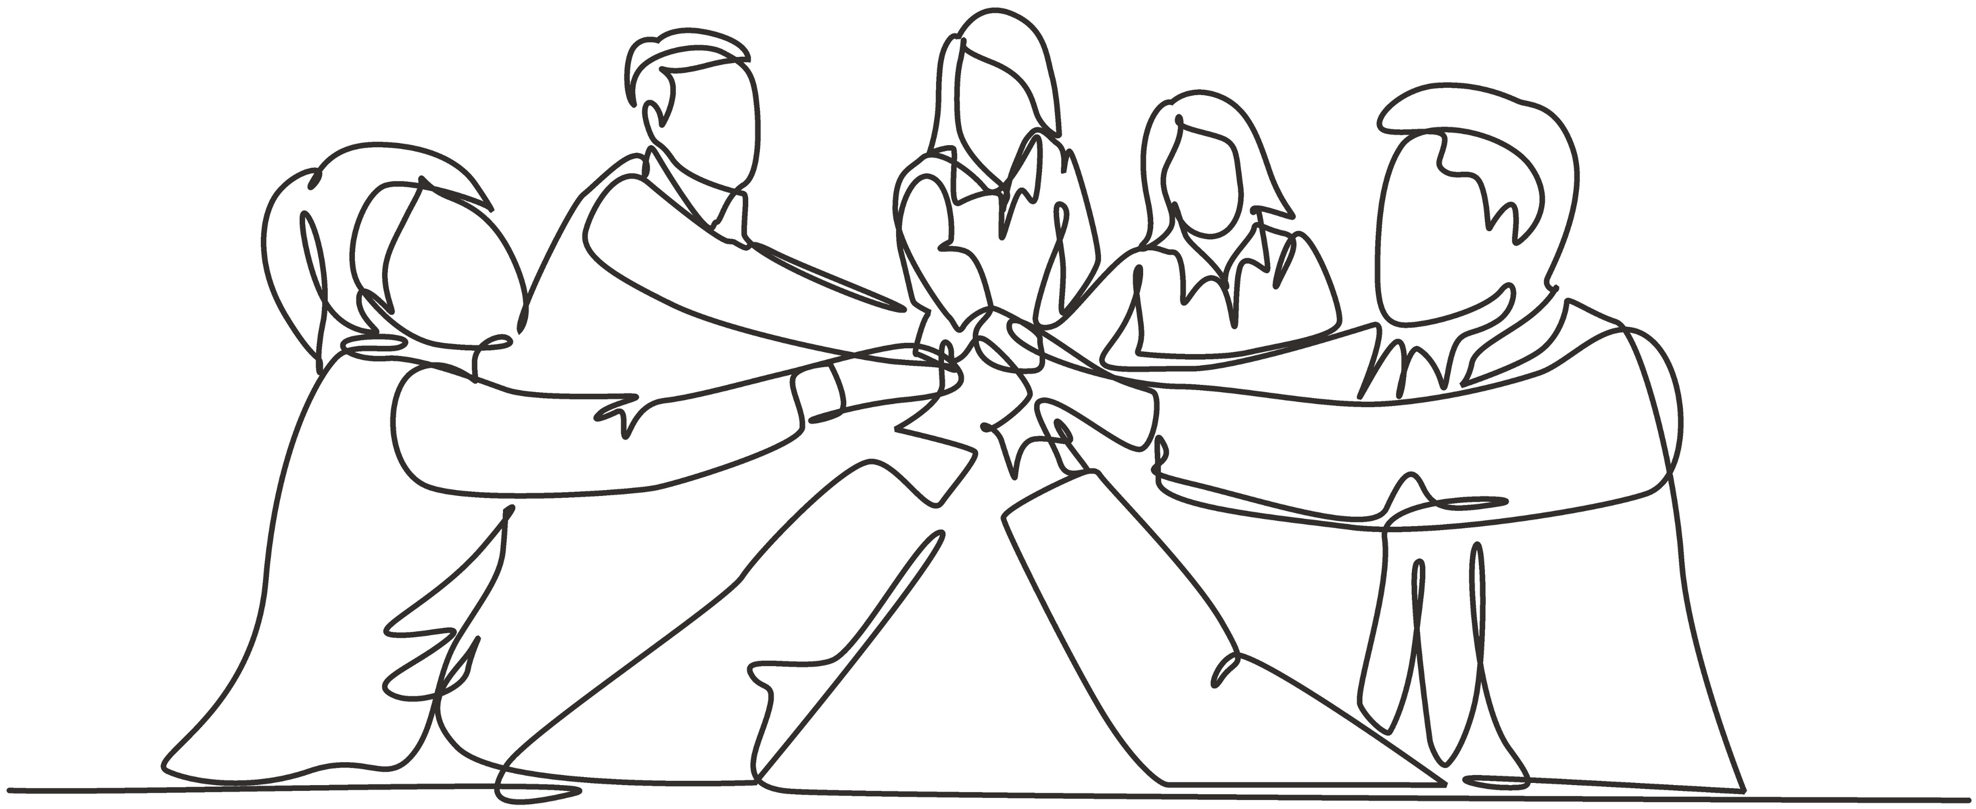
Walking the Middle Path & SUDs
Here are some strategies to practice Walking the Middle Path in SUD treatment:
Acknowledge ambivalence
Practice mindfulness
Set realistic goals
Explore harm reduction strategies
Seek support
Build coping skills
Walking the Middle Path in SUD treatment means finding a personalized recovery journey, whether it leads to abstinence or harm reduction, recognizing that each person's recovery is unique
SOURCE: Linehan, 2014a
Notes:
Trainer Notes:
Bullet 1 – "These are some strategies to practice walking the middle path in SUD treatment."
Acknowledge Ambivalence: Recognize that ambivalence about change is normal in the recovery process. It's okay to have mixed feelings about quitting substances. Understand that you may have both a desire to quit AND a desire to continue using (or a craving to use).
Practice Mindfulness: Utilize mindfulness skills to stay present in the moment when experiencing cravings or urges. Instead of giving in to the urge or suppressing it, observe the craving without judgment. This allows you to make a more conscious choice.
Set Realistic Goals: Consider setting small, achievable goals for yourself rather than focusing solely on abstinence. For example, you might start by reducing your substance use or creating a harm reduction plan. The key is to make gradual progress.
Harm Reduction Strategies: Explore harm reduction strategies that prioritize reducing the negative consequences of substance use while working toward abstinence. This might include safe injection practices, using clean needles, or setting limits on use.
Seek Support: Engage with a support network that understands your goals and can provide non-judgmental encouragement. This could include a therapist, a support group, or close friends and family who support your recovery journey.
Build Coping Skills: Focus on developing healthier coping skills to manage stress, emotional pain, and triggers. DBT skills such as distress tolerance, emotion regulation, and interpersonal effectiveness can be particularly useful.
---
Additional Notes:
Other strategies to practice Walking the Middle Path in SUD treatment:
Identify Triggers: Work with a therapist or counselor to identify your specific triggers for substance use. These could be emotional triggers, environmental cues, or certain people. Understanding your triggers helps you prepare for potential challenges.
Create a Safety Plan: Develop a safety plan that outlines what to do in case of relapse or intense cravings. Having a plan in place can prevent full-blown relapse and help you get back on track more quickly.
Monitor Progress: Keep a journal to track your substance use patterns, triggers, and emotions. Regularly reviewing your progress can help you make informed decisions about your treatment plan.
Therapeutic Guidance: Consider seeking DBT or other evidence-based therapy specifically tailored to substance use disorders. A trained therapist can help you navigate the challenges of walking the middle path in recovery.
Photo Credit:
Purchased Image, Adobe Stock.

Slide 59
The Role of Emotion Dysregulation in SUDs
Notes:
Trainer Notes:
"Emotion regulation is one's ability to influence their emotional experiences using both internal and external processes."
"Research suggests that people with substance use disorders have greater difficulties in emotion regulation than people without substance use disorders. Further, deficits in emotion regulation are linked to substance use disorders and other addictive behaviors."
"Let’s take a look at how DBT conceptualizes emotion dysregulation in the context of SUDs.“
Photo Credit:
Purchased Image, Adobe Stock.

Slide 60
Emotion Regulation Vs Dysregulation
Emotion regulation refers to the ability to effectively monitor, evaluate, and modify one's emotional responses in a way that is adaptive and conducive to well-being
Emotion dysregulation refers to the inability to effectively recognize, manage and respond to one's own emotions
It involves a lack of adaptive emotional regulation skills
SOURCE: Dimeff & Linehan,2008
Notes:
Trainer Notes:
Bullet 1 – [read bullet].
Bullet 2 – read bullet and sub-bullet and, then, add:
"Individuals with emotion dysregulation may experience emotions more intensely than others. They may become overwhelmed by their feelings, leading to impulsive behaviors or emotional outbursts."
"Some individuals with emotion dysregulation might attempt to suppress or avoid their emotions altogether, which can lead to emotional numbness or detachment."
"People with emotion dysregulation may also struggle to use healthy coping strategies to regulate their emotions. They might not know how to calm themselves down when upset or how to soothe themselves when distressed."
---
Additional Notes:
Other common features of emotion dysregulation include:
Difficulty in Identifying Emotions: People with emotion dysregulation may have trouble accurately identifying and labeling their emotions. They might use vague terms like "feeling bad" rather than specific emotional words like "angry" or "anxious."
Impulsive Behavior: Emotion dysregulation can lead to impulsive actions as individuals struggle to cope with their emotions. This might involve impulsive spending, substance use, self-harm, or other risky behaviors.
Quick Emotional Shifts: Emotional states can change rapidly, often in response to external triggers or perceived threats. This volatility can make it challenging to maintain stable emotional well-being.
Relationship Problems: Difficulty regulating emotions can strain interpersonal relationships. Frequent mood swings, emotional outbursts, or a lack of emotional responsiveness can make it hard for others to connect with or understand the individual.
Photo Credits:
Purchased Images, Adobe Stock.

Slide 61
Emotion Dysregulation and Impulsivity
Emotion dysregulation is central to the impulsivity that operates in maladaptive behaviors such as substance use
Difficulties with impulse control underlie substance use
Substance use is most often a coping strategy for emotion dysregulation
In DBT, individuals engage in skills training to regulate their emotions and thereby decrease the motivation to use substances.
SOURCE: Dimeff & Linehan,2008
Notes:
Trainer Notes:
Introduce slide – "The premise of DBT is that…. [read Bullet 1 & Sub-Bullet]."
"In other words, emotion dysregulation can lead to impulsive actions as individuals struggle to cope with their emotions. This might involve substance use or other behaviors such as impulsive spending, self-harm, or other risky behaviors.“
"Emotion dysregulation operates like a powerful emotional engine in a car, with no brakes – DBT works to help people build that brake system."
Bullet 2 – Read Bullet 2 and, then, add: "As such, DBT targets substance use as a symptom of emotion dysregulation."
Bullet 3 – Read Bullet 3 and, then, add: "Skills also serve to help people regulate their behavior, environment, physiology, and cognitions.“
Photo Credits:
Purchased Images, Adobe Stock.

Slide 62
Emotion Dysregulation and the DBT Skills
Mindfulness skills promote emotional awareness and acceptance, allowing individuals to recognize and navigate their emotions without judgment
Interpersonal Effectiveness teach individuals how to communicate their needs and boundaries effectively in relationships, reducing conflicts and emotional triggers
Emotion Regulation skills provide individuals with the tools and strategies to manage and modulate their emotional responses effectively
Distress Tolerance skills are valuable for managing emotion dysregulation by teaching individuals how to cope with intense and distressing emotions without resorting to impulsive or harmful behaviors
Notes:
Trainer Notes:
Bullet 1 – read bullet and, then, add: "Individuals learn to respond to emotions more skillfully, reducing impulsive reactions and fostering emotional balance and resilience."
Bullet 2 – read bullet and, then, add: "These skills empower individuals to engage in healthier, more satisfying interactions, which can mitigate emotional distress and contribute to emotional regulation."
Bullet 3 – read bullet and, then, add: "By learning techniques to reduce emotional intensity, cope with distressing emotions, and respond adaptively to triggers, individuals can gain greater control over their emotional experiences and reduce instances of emotion dysregulation."
Bullet 4 – read bullet and, then, add: "These skills enable individuals to endure emotional discomfort, ride out emotional storms, and make healthier choices in response to challenging emotions."

Slide 63
Benefits of DBT in SUD Treatment
Notes:
Trainer Notes: "Let’s review the benefits of DBT in SUD treatment.“
Photo Credit:
Purchased Image, Adobe Stock.

Slide 64
Benefits of DBT for SUD (1)
Mindfulness skills and practices assist individuals in finding peace in the present moment, aiding them in recognizing and tolerating negative emotions that may trigger cravings
Interpersonal Effectiveness and communication skills help people to more effectively communicate their experiences, needs, and boundaries, among other things
Building healthy interpersonal relationships is essential in maintaining long-term recovery
Emotion Regulation skills help people cope with difficult emotions in healthy ways and can decrease the need to use substances to cope
Distress Tolerance skills give people a greater capacity to manage intense emotional experiences and stressors, thereby lessening the need to manage or escape them with substances
SOURCE: Dimeff & Linehan, 2008
Notes:
Trainer Notes:
Introduce slide – "Research has shown that the function of the DBT skills overlap to address both the etiology and function of substance misuse. As such, DBT can help those with substance use disorders in several ways."
Bullet 1 – "Mindfulness skills allow clients to recognize and tolerate the negative emotions that can cause cravings."
Bullet 2 – "Interpersonal effectiveness helps clients build healthy interpersonal relationships which are essential in maintaining long-term recovery from SU; these skills can also help clients foster community and social supports to aid in their recovery."
Bullet 3 – "Emotional regulation skills have a general mitigating effect on the need to use substances to cope with difficult emotions."
Bullet 4 – "Distress tolerance skills can help lessen one’s need to manage or escape intense emotional experiences and stressors with substances."

Slide 65
Benefits of DBT for SUD (2)
DBT can also help those with Substance Use Disorders by:
Fostering a positive self-image and confidence in personal strengths for sustained recovery
Supporting behavior and environment changes to reduce (re)lapse risks
Guiding individuals in removing relapse triggers, like unhealthy relationships or drug-associated places
Identifying, challenging, and addressing black-and-white thinking and catastrophizing to promote nuanced thinking in stressful situations
SOURCE: Dimeff & Linehan, 2008
Notes:
Trainer Notes:
[Read bullets].

Slide 66
The DBT Skills
Notes:
Trainer Notes: "Let’s now dive into the Four DBT skill sets.“
Photo Credits:
Purchased Images, Adobe Stock.

Slide 67
The DBT Skills (1)
At its core, DBT helps people build skills in four key areas:
Mindfulness
Interpersonal Effectiveness
Emotion Regulation
Distress Tolerance
Notes:
Trainer Notes: Read bullets and, then, you can add: "There is a visually-helpful infographic on the next slide.“
Photo Credit:
Purchased Image, Adobe Stock.

Slide 68
The DBT Skills (2)
Mindfulness
Non-judgmental awareness of the present moment
Distress Tolerance
Manage an emotional incident with greater calm and acceptance
Emotion Regulation
Understand, manage, and change intense emotions and reduce vulnerability to them
Interpersonal Effectiveness
Communicate assertively while strengthening relationships and maintaining self-respect
Notes:
Trainer Notes:
"Mindfulness skills help us to develop non-judgmental awareness of the present moment which can improve our ability to non-judgmentally observe and accept whatever is occurring (both internally and externally) in the moment."
"Interpersonal effectiveness skills help us develop techniques to communicate with others in a way that is assertive, maintains our self-respect, and strengthens our relationships."
"Emotion regulation skills involve strategies to understand, manage, and change intense emotions and reduce our vulnerability to them. These skills can help to reduce the intensity of painful feelings that are experienced in response to painful events and can help decrease the ways in which emotion dysregulation may be contributing to problems in our life."
"Distress tolerance skills are aimed at helping us manage an emotional incident with greater calm and acceptance and increase our tolerance of negative emotions rather than trying to escape from them with harmful behavior. These skills can help give someone more control over urges to engage in impulsive behaviors (such as substance use)."

Slide 69
Mindfulness
Notes:
Trainer Notes: "Let's start by reviewing the skills involved in the area of mindfulness.“
Photo Credit:
Purchased Image, Adobe Stock.

Slide 70
Mindfulness Overview
Mindfulness is the intentional focus on the present moment without judgment or attachment to the moment
Mindfulness involves finding peace in the present moment, directing attention to the current experience, and staying grounded without dwelling on the past or worrying about the future
Mindfulness is a helpful tool that helps people take a step back from intense feelings if they feel overwhelmed by their emotions
SOURCE: Linehan, 2014a
Notes:
Trainer Notes:
Introduce slide – "Mindfulness as a practice has gained popularity over the last few years. In fact, there are now many popular 'mindfulness apps' that you can use to help you practice mindfulness in your day-to-day life."
Bullets 1 & 2 – read bullets and, then, add:
"Mindfulness is sometimes equated with meditation, but there is a difference between the two."
"Meditation is a skill usually practiced for a specific amount of time. It is also often practiced in a seated position–but not always–and involves focusing or clearing your mind using a combination of mental and physical techniques – like paced breathing."
"Mindfulness can be practiced both informally (at any time/place) and formally (i.e., during meditation). Some examples of mindfulness include mindful eating (i.e., focusing on your body-related sensations when you eat and the taste/texture/temperature of the food), mindful walking (i.e., noticing your bodily movements and your surroundings while walking), and doing one thing at a time, taking time to take in and notice your individual lived experience with a single task."
Bullet 3 – read bullet and, then, add: "Mindfulness ultimately enables us to take notice of the fleeting, brief nature of emotions, and this can diminish the power that emotions can have in directing our actions. Through this process, we learn that we don’t have to identify with our emotions, and we can choose how our emotions will influence the way we respond in any given situation."

Slide 71
Callback - Visualizing the Goal of DBT
Mindfulness lets you decide how to respond
"A Life Worth Living"
New Coping Skills
Challenge
Continued Misery
Misery
Challenge
Brief Relief
Brief Relief
Usual Coping
Usual Coping
SOURCE: Adapted from https://dbtproviders.com
Notes:
Trainer Notes: "Here’s a review of the goal of Mindfulness to enable us to be able to choose how to respond in any given situation."
"This image provides a visual conceptualization of the goal of DBT."
"Often times a pattern exists if someone has ineffective skills for facing challenges."
"Upon facing a challenge, a person will turn to their usual coping (e.g., self-harm, ghosting ppl, substance use, yelling at a family member). This coping may provide some short-term relief, but it’s not a lasting way to cope or act. Someone may feel miserable about the way that they handled that challenge."
"Responding from a place of emotional dysregulation can create more misery or turmoil in a situation."
"Without recognizing and accepting that a change needs to happen, no change is made, and so the cycle continued to continued misery."
"DBT helps people develop a new pattern – a new way of coping with challenges that arise."
"In this new pattern, we use the skills of mindfulness to help us slow down and choose how we want to respond in any given situation. This approach can lead you to a more adaptive resolution and allows you to be able to choose the more adaptive skills that we learn in DBT (e.g., distress tolerance, emotion regulation, interpersonal effectiveness)."
"In this new way of coping with challenges, we can then move forward toward "A life worth living" – a phrase coined by the developer of DBT (Marsha Linehan)."
"This idea of a ’life worth living‘ – which refers to a state in which someone can experience joy and satisfaction in their life, despite facing difficult challenges – is central to the foundation of DBT. "
---
Reference:
WHAT IS DIALECTICAL BEHAVIOR THERAPY (DBT)?. What is DBT? - the DBT provider directory. (n.d.). https://dbtproviders.com/what_is_dbt.php?51

Slide 72
Origins of Mindfulness
Mindfulness is derived from Eastern religious philosophies
Specifically based on Zen Buddhist teachings
Practiced in various religious and secular traditions—from Hinduism to yoga — and in other spiritual practices
Also practiced among indigenous communities
Notes:
Trainer Notes:
Bullets 1, 2, & 3 – "People from various communities (including indigenous groups) have practiced mindfulness for thousands of years, often as part of a spiritual practice (such as in Zen Buddhism)."
"The application of mindfulness to psychological health in Western medical and mental health contexts is a more recent phenomenon that has popularized mindfulness as a practice that can help people manage their stress and improve their overall well-being — and a wealth of research shows it's effective."
"In fact, psychologists and neuroscientists have found that practicing mindfulness changes our brain and biology in positive ways, improving mental and physical health."
---
Additional Notes:
Of note: "Studies that investigated the effects of mindfulness have shown that it can lead to higher levels of self-compassion and overall sense of well-being, and significantly lower levels of psychological symptoms, rumination, thought suppression, fear of emotion, and difficulties with emotion regulation." (Article cited below) Additionally, neuroscientists have shown through various studies that practicing mindfulness affects brain areas related to perception, body awareness, pain tolerance, emotion regulation, introspection, complex thinking, and sense of self." (Article cited below)
Mindfulness is a construct that originates in Buddhism but has been integrated into Western medicine and psychology (there is now a psychological conceptualization of mindfulness).
Reference:
Keng SL, Smoski MJ, Robins CJ. Effects of mindfulness on psychological health: a review of empirical studies. Clin Psychol Rev. 2011 Aug;31(6):1041-56. doi: 10.1016/j.cpr.2011.04.006. Epub 2011 May 13. PMID: 21802619; PMCID: PMC3679190.
Wheeler, M.S., Arnkoff, D.B. & Glass, C.R. The Neuroscience of Mindfulness: How Mindfulness Alters the Brain and Facilitates Emotion Regulation. Mindfulness 8, 1471–1487 (2017). https://doi.org/10.1007/s12671-017-0742-x
Photo Credits:
Purchased Images, Adobe Stock.

Slide 73
Goals of Mindfulness
Reduce suffering
Increase happiness and joy
Help us experience reality as it is
Reduce pain and stress
Improve physical health
Improve relationships
Decrease reactivity
SOURCE: Linehan, 2014a
Notes:
Trainer Notes:
Introduce slide – "Each skill area involved in DBT has a series of goals associated with them. In the case of mindfulness, the goals are to [read bullets].“
Photo Credit:
Purchased Image, Adobe Stock.

Slide 74
Mindfulness Skills
Mindfulness skills are typically the first skills introduced, and they serve as a foundation for the rest of the DBT skills
Mindfulness skills teach how to:
Observe and experience reality as it is
Be less judgmental
Live in this moment effectively
Based on a blend of Eastern and Western spiritual traditions
SOURCE: Linehan, 2014a
Notes:
Trainer Notes:
Bullet 1 – "Mindfulness skills serve as a foundation for many of the other skills taught in DBT. Mindfulness helps individuals develop the awareness and attention needed to effectively practice other skills like emotion regulation, distress tolerance, and interpersonal effectiveness.“
Bullet 2 – "Mindfulness skills teach us how to [read sub-bullets].“
Bullet 3 – "As we reviewed earlier, mindfulness is based on a blend of Eastern and Western spiritual traditions."
Photo Credits:
Purchased Images, Adobe Stock.

Slide 75
Foundational Mindfulness Skills
The States of Mind
The “What” Skills
The “How” Skills
SOURCE: Linehan, 2014a
Notes:
Trainer Notes:
"We will be reviewing foundational skills in each skill set in this training. For mindfulness, the foundational skills are [read bubbles]."

Slide 76
The States of Mind
Reasonable Mind
Emotional Mind
Wise
Mind
SOURCE: Linehan, 2014a
Notes:
Trainer Notes:
Introduce slide – "Let’s start by reviewing The States of Mind."
"In DBT, the concept of "states of mind" is used to describe different emotional and cognitive states that individuals may experience. These states of mind can influence a person's thoughts, emotions, and behaviors. DBT identifies three primary states of mind. These are the Reasonable Mind, the Emotional Mind, and Wise Mind – the state of mind that combines both the Reasonable and Emotional Mind."
"When operating with our Reasonable Mind, our thoughts and behaviors are ruled by facts, reason, logic, and pragmatics; emotions take a back-seat. In Reasonable Mind, individuals are more likely to make decisions based on facts, evidence, and objective analysis."
"A good example of someone who is very often operating with their Reasonable Mind is Sheldon from the TV series The Big Bang Theory. He presents as very factual, analytical, dry, and emotionally-detached."
"There are times in our lives when we want to be operating with our Reasonable Mind; one example is when we are completing tasks at work or managing our finances."
"At the same time, overreliance on "reasonable mind" may lead to emotional suppression."
Optional Interactive Activity: In your own words – what are some of the pros and cons of operating fully with our Reasonable Mind?
"When fully operating with our Emotional Mind, we are ruled by our moods, feelings, and we may be impulsive or have urges to do things that don't feel like us or say things that we may not mean due to intense feelings and a sense of urgency. Facts, reason, and logic take the back-seat. Some examples of when we operate fully with our Emotional Mind could be when we've said something hurtful to a loved one in the heat of the moment.
"One TV character who emulates the characteristics of Emotional Mind is Ted Mosby from the TV series How I Met Your Mother. Ted's character frequently experiences intense emotional reactions to breakups and romantic disappointments. He can be emotionally reactive during conflicts and disagreements with his friends and his career choices and aspirations are often influenced by his emotional desires."
"Our emotions are important, and they can be beneficial. For example, emotions can help us foster connection with others and a sense of belonging. Emotions also motivate us to act (e.g., you may seek out social activities or hobbies that provide you with a sense of joy if you feel sad)."
"At the same time, operating fully with our Emotional Mind can really cloud our judgement and lead to impulsive reactions or decisions."
Optional Interactive Activity: In your own words – what some of the pros and cons could be of operating fully with our Emotional Mind?
"Our Wise Mind involves seeing the value of both reason and emotion; thinking about things by considering both emotions and rationality and striving for this balance."
"It's a natural human tendency to operate from a place of pure reason or pure emotion. However, when we are viewing the world through either lens, we miss out on the big picture."
"In order to live the most effective and balanced lives possible, it is advantageous to learn how to integrate reason with emotion. This integration is what Wise Mind is all about."
"An important goal of mindfulness in DBT is to activate Wise Mind."
A TV character who emulates the concept of Wise Mind is Dr. Temperance Brennan from the TV series Bones, portrayed by Emily Deschanel. Dr. Brennan is a forensic anthropologist known for her exceptional logical and scientific reasoning skills, but she also demonstrates a balanced and thoughtful approach to solving complex cases.
---
Additional Notes:
More on the benefits of emotions –
Emotions can signal to us what our values are. Emotions can also help us avoid danger – they can prepare the body to take action. The amygdala, in particular, is responsible for triggering emotional responses that prepare your body to cope with things like fear and anger. Sometimes this fear can trigger the body's fight-or-flight response, which leads to several physiological responses that prepare the body to either stay and face the danger or flee to safety. Additionally, emotions can help us make decisions (emotions have a major influence on the decisions we make, from what we decide to have for breakfast to which candidates we choose to vote for in political elections). Moreover, emotional intelligence, or your ability to understand and manage emotions, has been shown to play an important role in decision-making.
Photo Credits:
Purchased Images, Adobe Stock.

Slide 77
The “What” Skill
Participate
Describe
Observe
SOURCE: Linehan, 2014a
Notes:
Trainer Notes:
"The What Skill is a crucial aspect of developing mindfulness skills. This skill guides individuals on what to focus on when practicing mindfulness. It helps you focus your attention and practice being fully present in the moment and is designed to increase your awareness and understanding of your experience (switching off 'autopilot' mode). This skill can help you access Wise Mind."
"The What Skill stands for 'Observe,' 'Describe,' and 'Participate'. The steps in this skill are meant to be done, in order, one at a time."
Observe: "Observe involves paying attention to your internal and external experiences in the present moment (the opposite of multitasking) without judgment. It involves attending to your external experiences or internal experiences (e.g., emotional responses) without trying to escape them when they feel painful or staying in them when they feel good."
"It's about noticing sensory experiences, thoughts, and emotions as they occur. For example, observing the colors, shapes, and textures of objects in your environment or noticing the sensations in your body during a specific activity."
Describe: "Describe is about putting your observations into words. It involves labeling what you observe in a non-judgmental and factual way. For instance, you might describe your feelings as 'anxious' or 'excited' without adding judgments or interpretations."
"The ability to describe our emotions is important for how we communicate them and for our sense of self-control."
"When we take the time to observe and describe what's happening, it can help us recognize if we are experiencing emotional distress or other things that are coming up for us (e.g., confusion, sadness, etc.)."
"This process helps us to avoid mistaking our emotions for absolute truths and responding from this place."
Participate: "After you’ve observed your experiences and described your observations, you can then participate fully in the present moment which means immersing yourself in the activity you're engaged in without distraction or judgment (this represents the ultimate goal of mindfulness). It's about being completely present in your actions and experiences. It means being actively involved in the task or situation at hand rather than going through the motions passively. This process fosters a sense of connection to the moment."

Slide 78
The “How” Skill
Non-Judgmentally
One-Mindfully
Effectively
SOURCE: Linehan, 2014a
Notes:
Trainer Notes:
"The How Skill for mindfulness is an essential component of practicing mindfulness effectively. This skill provides a framework for engaging in mindfulness activities and cultivating a state of mindful awareness."
"The How Skill involves steps for practicing mindfulness Non-Judgmentally, One-Mindfully, and Effectively."
Non-Judgmentally: "This means we observe our experiences without judgment. It involves letting go of evaluations such as 'good' or 'bad' and instead adopting a neutral and accepting attitude toward the present moment."
One-Mindfully: "This means we focus our attention on one thing at a time. It involves giving our full concentration to the task or experience at hand, avoiding multitasking or distractions. This skill helps us stay fully engaged in the present moment."
Effectively: "Effectiveness in mindfulness refers to using mindfulness skills that are most appropriate for the situation. It involves doing what works to achieve your goals while maintaining mindfulness. Effectiveness in mindfulness helps individuals choose the right mindfulness technique for the situation."
"These How Skill complements the What Skill in DBT, which are focused on observing, describing, and participating in the present moment. By incorporating the "How Skills," individuals can deepen their mindfulness practice and approach their experiences with a non-judgmental, focused, and effective mindset, which can lead to improved emotional regulation and well-being."

Slide 79
Activity –Wise Mind
Stone flake on the lake. Imagine that you are by a clear blue lake on a beautiful sunny day. Then imagine that you are a small flake of stone, flat and light. Imagine that you have been tossed out onto the lake and are now gently, slowly, floating through the calm, clear blue water to the lake's smooth, sandy bottom.
Notice what you see, what you feel as you float down, perhaps in slow circles, floating toward the bottom. As you reach the bottom of the lake, settle your attention there within yourself.
Notice the serenity of the lake; become aware of the calmness and quiet deep within.
As you reach the center of your self, settle your attention there.
SOURCE: Linehan, 2014a
Notes:
Trainer Notes: "This is an activity to practice mindfulness and activate Wise Mind. We will discuss our observations afterwards.“
Trainer – read through the mindfulness visualization exercise.
---
Reference:
Linehan, M. M. (2014a). DBT (R) skills training handouts and worksheets, second edition (2nd ed.). New York, NY: Guilford Publications.

Slide 80
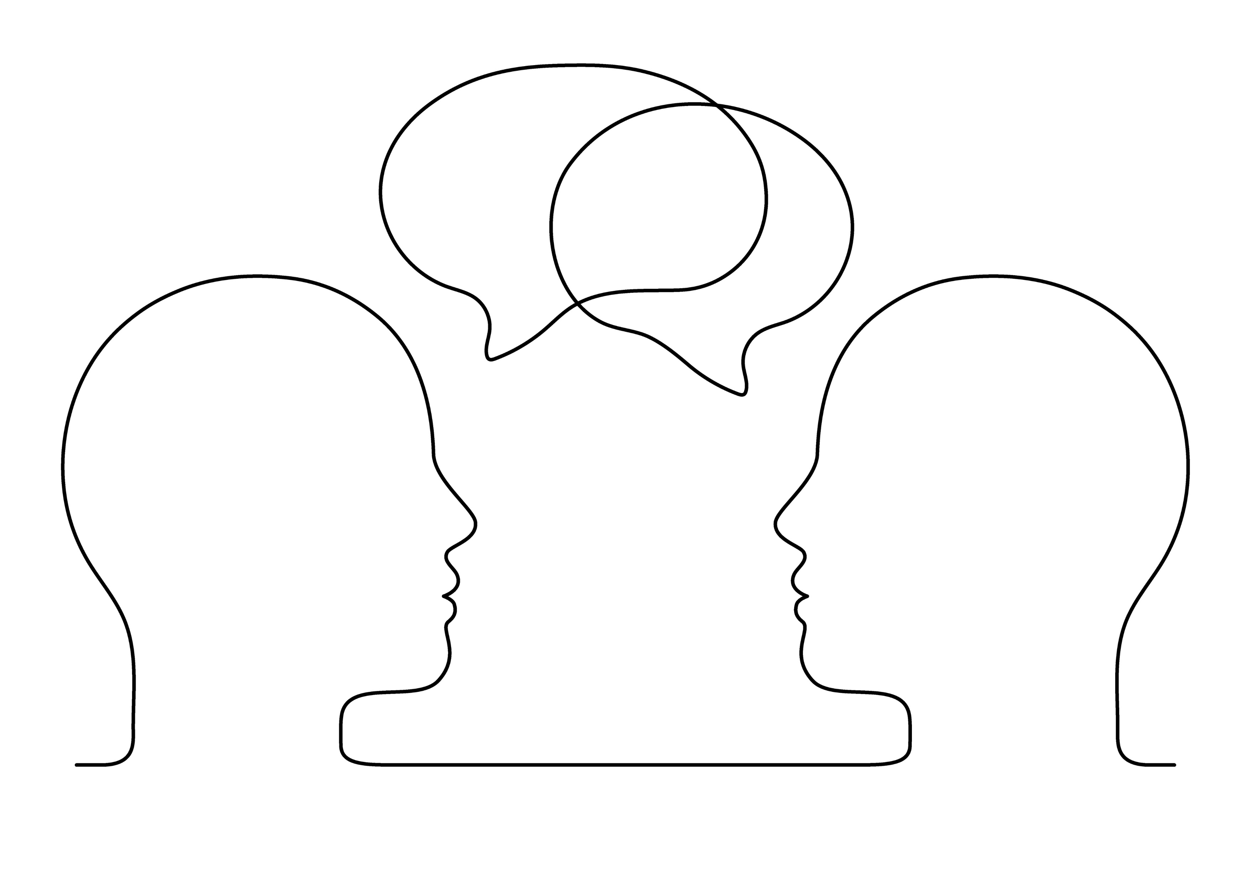
Wise Mind Activity – Discussion
How does your body feel and what's going on in your mind/thoughts when you’re in Wise Mind? What do you notice there or not there?
How does Wise Mind differ from Emotional Mind and Reasonable Mind, and why is it crucial in the recovery from substance use disorders?
Notes:
Trainer Notes:
Trainer – engage the group in a discussion based on the preceding activity, using these questions as a framework for discussion.
Note: People often find mindfulness exercises challenging, especially when first learning, and it's common to feel more anxious instead of feeling calmer or accessing wise mind. Learning mindfulness can be tough, especially for people with trauma histories. It might bring up uncomfortable memories or overwhelming thoughts. Take it slow and be patient, understanding that it takes time to get the hang of it. Remember, it's okay to find it hard; the point is to observe without judging. You can also make it more comfortable by moving around or changing how you sit.

Slide 81
Practicing Mindfulness
Mindfulness practice involves the transition from a state of mindlessness to a state of mindfulness (this is not an easy process!)
When challenges arise:
Step back
Notice
Let go
Repeat
Notes:
Trainer Notes:
Bullet 1 – "Practicing mindfulness is challenging. It involves the transition from a state of mindlessness to a state of mindfulness which is not an easy process!"
"The more we practice being mindful, the easier it becomes, but it requires repeated practice."
"When we're not focused on the present, we're not being mindful – this is a good cue to ourselves to step in and practice mindfulness."
Bullet 2 & Sub-Bullet – "When difficult emotions or challenges arise: step back, notice what’s happening, let go, bring yourself back, and repeat as needed.“
Photo Credit:
Purchased Image, Adobe Stock.

Slide 82
Interpersonal Effectiveness
Notes:
Trainer Notes: "Let's now review the skills involved in the area of interpersonal effectiveness. These skills are truly applicable to everyone because we all navigate relationships that require good communication and social skills.“
Photo Credit:
Purchased Image, Adobe Stock.

Slide 83
Interpersonal Effectiveness Overview
Interpersonal effectiveness fosters healthier and more satisfying connections, reducing distress and conflict in relationships
Interpersonal effectiveness equips individuals to tackle communication challenges, enhancing their skills in navigating social interactions and resolving conflicts more adeptly
SOURCE: Linehan, 2014a
Notes:
Trainer Notes:
Bullet 1 – [read bullet].
Bullet 2 – [read bullet].
Photo Credits:
Purchased Images, Adobe Stock.

Slide 84
Goals of Interpersonal Effectiveness
Be skillful in meeting our objectives with others
Making requests of others effectively
Saying no to requests effectively
Achieve relationship effectiveness
Obtaining or maintaining positive relationships
Strengthening current relationships and ending destructive ones
Maintaining or improving self-respect/liking for self
Walking the Middle Path
SOURCE: Linehan, 2014a
Notes:
Trainer Notes:
Bullet 1 & Sub-Bullets – "Ultimately, the goals of interpersonal effectiveness involve achieving effectiveness in meeting our objectives (e.g., needs) or goals in any given situation. This involves making requests of others and saying no to requests effectively."
Bullet 2 & Sub-Bullets – "Interpersonal effectiveness also involves achieving effectiveness in our relationships by obtaining or maintaining positive relationships, strengthening current relationships and ending destructive ones, and maintaining or improving self-respect/liking for self."
Bullet 3 – "Lastly, interpersonal effectiveness entails helping us achieve what is referred to as Walking the Middle Path – this means recognizing the extremes in any given situation and making an effort to take the Middle Path (a more balanced stance). In other words, Walking the Middle Path involves avoiding thinking in terms of black and white and instead look for the grey."
"Another way of thinking about Walking the Middle Path is that it describes reaching a place where we replace 'either-or' thinking with collaborative 'both-and' thinking.“
Photo Credits:
Purchased Images, Adobe Stock.

Slide 85
Interpersonal Effectiveness Skills
These skills teach us how to:
Manage conflict in relationships effectively
Maintain and improve relationships
Set boundaries and limits
End destructive relationships
Maintain positive relationships
Interpersonal Effectiveness skills also teach us how to balance acceptance and change in ourselves and others by Walking the Middle Path
SOURCE: Linehan, 2014a
Notes:
Trainer Notes: "Interpersonal effectiveness skills ultimately teach us how to [read bullets]."
"These skills ultimately help people to develop assertiveness skills."
"These are NOT skills to get people to agree with how we feel. They are skills that reinforce that our viewpoints deserve validation. We can express how we feel, and another person may not agree with it, and this is ok."
Validation refers to the act of acknowledging and accepting another person's thoughts, feelings, experiences, or perspective as valid, genuine, and real. Validation does not mean you agree or approve."
"Validation is a fundamental component of effective communication and building positive relationships. Validation communicates to the other person that their thoughts and emotions are understood and respected, even if they may differ from your own."
"Our goal in teaching interpersonal effectiveness skills is to help clients become more comfortable with these skills and give them opportunities to practice these skills (these opportunities could be with us – the practitioner – with other clients, in group, with their therapist, psychiatrist, etc.).“
Photo Credit:
Purchased Image, Adobe Stock.

Slide 86
Foundational Interpersonal Effectiveness Skills
DEAR MAN
GIVE
FAST
SOURCE: Linehan, 2014a
Notes:
Trainer Notes:
"Here are the foundational interpersonal effectiveness skills."
"They are the DEAR MAN skill, the GIVE skill, and the FAST skill."

Slide 87
The DEAR MAN Skill
D | Describe – the current situation
E | Express – your feelings and opinions about the situation
A | Assert – yourself by asking for what you want or saying "No" clearly
R | Reinforce – (reward) the person ahead of time (so to speak) by explaining positive effects of getting what you want or need
M | Mindful – keep your focus on your goals
A | Appear – confident, effective, and competent
N | Negotiate – be willing to give to get
Available for Reference – Handout #1
SOURCE: Linehan, 2014a
Notes:
Trainer Notes:
"The DEAR MAN skill is a mnemonic device that teaches a strategy for effective communication. Using this skill, clients learn to express their needs and wants in a way that is respectful to themselves and others, increasing the likelihood of positive outcomes. You can use the DEAR MAN skill in a variety of situations when you need to assert yourself, express your needs, or address a concern with someone.
"DEAR MAN stands for Describe, Express, Assert, Reinforce; and Mindful, Appear confident, and Negotiate."
DEAR MAN –
Describe – the current situation (if necessary). Stick to the facts. Tell the person exactly what you are reacting to.
Express – your feelings and opinions about the situation. Don't assume that the other person knows how you feel.
Assert – yourself by asking for what you want or saying "No" clearly. Do not assume that others will figure out what you want. Remember that others cannot read your mind.
Reinforce – (reward) the person ahead of time (so to speak) by explaining positive effects of getting what you want or need. If necessary, also clarify the negative consequences of not getting what you want or need.
Mindful – keep your focus on your goals. Maintain your position. Don't be distracted. Don't get off the topic. Speak like a "Broken record." Keep asking for what you want. Or say "No" and express your opinion over and over and over. Just keep replaying the same thing again and again. Ignore attacks. If the other person attacks, threatens, or tries to change the subject, ignore the threats, comments, or attempts to divert you. Do not respond to attacks. Ignore distractions. Just keep making your point.
Appear – confident, effective, and competent. Use a confident voice tone and physical manner; make good eye contact. No stammering, whispering, staring at the floor, retreating.
Negotiate – be willing to give to get. Offer and ask for other solutions to the problem. Reduce your request. Say no, but offer to do something else or to solve the problem another way. Focus on what will work.
Reminder – The "R" for "Reinforce" can be confusing for people. It can sometimes be interpreted by clients as threatening someone if they don’t get what they want. But Reinforce doesn't mean threatening; it's about recognizing and rewarding positive behavior. It's like giving a thumbs up to encourage more good stuff.
Explanation: When you're using DEAR MAN to talk about what you need or stand up for yourself, reinforcing is about saying something positive to make the other person feel good and keep the positivity going.
Example: Picture this - You're working with a classmate on a project, and you want them to help out more. You might say:
"Hey, I noticed when we worked together before, our project turned out awesome. I really liked how both of us brought our strengths to the table. I think if we team up again on this new project, we can make something great. Your ideas are valuable, and I believe we make a great team."
Here, you're giving a pat on the back, saying good things about how well you worked together before. It's all about making the other person feel good and more likely to help out again. Remember, it's about being positive, not threatening.
---
Reference:
Linehan, M. M. (2014a). DBT (R) skills training handouts and worksheets, second edition (2nd ed.). New York, NY: Guilford Publications.

Slide 88
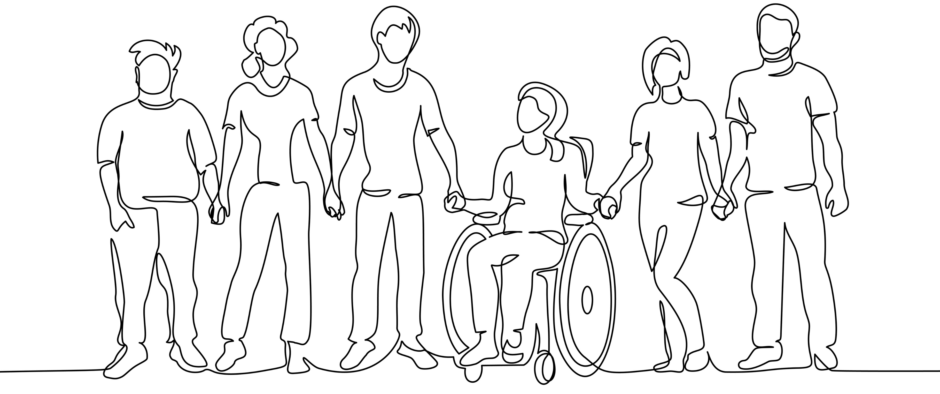
Assumptions & Guidelines of DEAR MAN
Others cannot read your mind
Effective communication of your wants and needs requires work, time, and practice
DEAR MAN does not always work even when done effectively
Consider your objectives carefully when using DEAR MAN
SOURCE: Linehan, 2014a
Notes:
Trainer Notes:
Bullet 1 – "When we use DEAR MAN, we’re assuming that others cannot read our mind and it’s our responsibility to communicate our needs to others."
Bullet 2 – "In using DEAR MAN, we also recognize the fact that effective communication of our wants and needs requires work, time, and practice."
Ideas for practicing DEAR MAN:
Go to the store and ask for help finding something
Ask a person to stop doing something that bothers you
Disagree with someone's opinion
Bullet 3 – "We also acknowledge that sometimes we will use DEAR MAN (and use it effectively) and we still may be in a situation where we may not get our requests or needs met."
Bullet 4 – "It is also essential to consider your objectives carefully when using the DEAR MAN skill because doing so ensures that your communication is purposeful and effective. Taking the time to clarify your goals helps you express your needs and boundaries more clearly, increasing the likelihood of a positive outcome in your interactions with others.“
Photo Credit:
Purchased Image, Adobe Stock.

Slide 89
Using DEAR MAN
DEAR MAN is particularly helpful in situations where you want to:
Establish boundaries when needed
Seek assistance or behavioral changes from someone
Articulate feelings and concerns
Handle conflicts calmly and assertively
Communicate needs with respect and openness for constructive dialogue
SOURCE: Linehan, 2014a
Notes:
Trainer Notes:
Bullet 1 & Sub-Bullets – [read bullets].
Photo Credits:
Purchased Images, Adobe Stock.

Slide 90
The GIVE Skill
G | (Be) Gentle – Be nice and respectful (no attacks, no threats, no judging, and no sneering).
I | (Act) Interested – Listen and appear interested in the other person (listen to the other person’s point of view).
V | Validate – With words and actions, show that you understand the other person’s feelings and thoughts about the situation.
E | (Use an) Easy manner – Use a little humor, smile, ease the person along, and be light-hearted.
SOURCE: Linehan, 2014a
Notes:
Trainer Notes:
"The GIVE skill is a mnemonic device designed to help individuals improve their communication and maintain healthy relationships. The GIVE skill is particularly valuable in situations where you need to address sensitive topics, communicate assertively, or navigate challenging interpersonal dynamics. It helps create a more positive and effective communication style, enhancing your ability to maintain healthy relationships and resolve conflicts constructively."
"GIVE stands for Gentle, (act) Interested, Validate, and Easy manner."
GIVE –
Gentle – be gentle in your communication, both in your words and your demeanor. Avoid harshness, criticism, or hostility. Instead, approach the conversation with kindness and respect.
Act Interested – listen and don't interrupt, don't talk over them, don't make assumptions about what the person is going to say. Choose to have a positive interaction with them even if you're not interested in what they're saying.
Validate – validation is a key component of effective communication. Acknowledge the other person's emotions and experiences, even if you don't agree with them. Repeat what the other person is saying. Validate both verbally and non-verbally.
Easy manner – maintain an easygoing and non-confrontational manner. Avoid being defensive, argumentative, or confrontational. Use humor, be easy-going, watch your demeanor.
---
Reference:
Linehan, M. M. (2014a). DBT (R) skills training handouts and worksheets, second edition (2nd ed.). New York, NY: Guilford Publications.

Slide 91
Using GIVE
You can use the GIVE skill in a variety of interpersonal situations, especially when you want to:
Address conflicts positively and respectfully
Express thoughts and needs for understanding
Enhance relationships through open and empathetic communication
Prevent escalation or defensiveness in challenging discussions
Cultivate rapport and trust with kindness and respect
SOURCE: Linehan, 2014a
Notes:
Trainer Notes:
Bullet 1 & Sub-Bullets – [read bullets].
Photo Credits:
Purchased Images, Adobe Stock.

Slide 92
The FAST Skill
F | (Be) Fair – Be fair to yourself and to the other person. Remember to validate your own feelings and wishes, as well as the other person’s.
A | (No) Apologies – Don’t over-apologize. No apologizing for being alive or for making a request at all. No apologies for having an opinion, for disagreeing.
S | Stick to Values – Stick to your own values. Don’t sell out your values or integrity for reasons that aren’t very important.
T | (Be) Truthful – Don’t lie. Don’t act helpless when you are not. Don’t exaggerate or make up excuses.
SOURCE: Linehan, 2014a
Notes:
Trainer Notes:
"The FAST skill is a mnemonic device that provides a structured approach for maintaining your self-respect and sticking to your values while communicating assertively in difficult or challenging situations. FAST is especially useful in situations where you want to assert your boundaries, make requests, or communicate your needs effectively without compromising your self-respect or values. It promotes healthy and assertive communication while helping you maintain a balanced and respectful approach in your interactions with others."
"FAST stands for (be) Fair, (no) Apologies, Stick to values, and (be) Truthful."
FAST –
Fair – be fair in your communication. This means treating the other person with respect and considering their perspective and needs, even as you assert your own.
(No) Apologies – don't apologize unless it's necessary. Avoid over-apologizing or apologizing for asserting yourself or stating your needs. Save apologies for when you genuinely need to take responsibility for something.
Stick to Values – stick to your values and priorities. Stay true to what is important to you, even in the face of pressure or criticism.
(Be) Truthful – be truthful and honest in your communication. Speak the truth but do so with kindness and respect.
---
Reference:
Linehan, M. M. (2014a). DBT (R) skills training handouts and worksheets, second edition (2nd ed.). New York, NY: Guilford Publications.

Slide 93
Using FAST
You can use the FAST skill in various interpersonal situations when you need to:
Communicate assertively while maintaining respect for yourself and the other person
Stick to your values and priorities, even in challenging conversations
Avoid excessive apologizing, especially when it's not warranted
Express yourself honestly and openly, without being aggressive or confrontational
SOURCE: Linehan, 2014a
Notes:
Trainer Notes:
Bullet 1 & Sub-Bullets – [read bullets].
Photo Credits:
Purchased Images, Adobe Stock.

Slide 94
Activity – DEAR MAN (1)
Sarah: (Taking a deep breath to prepare herself) Hey Alex, do you got a second to chat about our apartment cleaning?
Alex: (Looking a bit distracted) Oh, yeah, sure. What's up?
Sarah: (Using DEAR MAN) I've been feeling a bit stressed about the cleanliness of our place lately. Can we chat about coming up with a better plan to keep things in order?
Alex: (Nods) Sure.
Sarah: (Continuing with DEAR MAN) What do you think about taking turns with specific chores each week? It'll keep the apartment in check, be fair for both of us and hopefully cut down on any future issues and prevent future conflict.
DEAR MAN Available for Reference – Handout #1
Notes:
Trainer Notes:
This is a role-playing activity designed to help participants gain a deeper understanding of how interpersonal effectiveness skills can be used (specifically the DEAR MAN skill).
Trainer – ask two volunteers to play the roles in this scenario (Alex and Sarah). Inform participants that the context of this scenario is as follows: Sarah is talking to her roommate, Alex, about their shared responsibility for cleaning the apartment.

Slide 95
Activity –DEAR MAN (2)
Alex: (Pauses to think) That sounds reasonable.
Sarah: (Continuing with DEAR MAN) I also think it’s important for us to be open about any cleaning issues or concerns. If we see something isn't working with the schedule, let's talk about it and make adjustments together. What do you think?
Alex: (Nods again) Yeah, that makes sense.
Sarah: (Finishing DEAR MAN) Thanks for being open to discussing this, Alex. Having a clean and comfy living space is important to me, and I think this plan could make a real difference. What are your thoughts on it?
Alex: (Smiles) I agree, Sarah. Let's give it a try. Thanks for bringing this up.
DEAR MAN Available for Reference – Handout #1
Notes:
Trainer Notes:
This is a role-playing activity designed to help participants gain a deeper understanding of how interpersonal effectiveness skills can be used (specifically the DEAR MAN skill).
"Sarah effectively uses the DEAR MAN skill to share her concerns about the apartment cleaning schedule. This approach ensures a respectful and assertive tone, increasing the likelihood of a productive conversation and reaching an agreement with Alex."

Slide 96
DEAR MAN Activity – Discussion
How does teaching DEAR MAN benefit clients in substance use treatment, and how does it support their recovery?
What kind of challenges can arise when introducing DEAR MAN to clients who are new to the skill, and how do you create a safe and supportive environment for them to learn and use DEAR MAN, especially if they're hesitant or resistant?
DEAR MAN Available for Reference – Handout #1
Notes:
Trainer Notes:
Trainer – engage the group in a discussion based on the preceding activity, using these questions as a framework for discussion.
Photo Credit:
Purchased Image, Adobe Stock.

Slide 97
LUNCH BREAK
Up Next:
The DBT Skills (cont'd)
Distress Tolerance
Emotion Regulation
Modes of DBT Delivery
Components of DBT Skills Group Training
Closing Mindfulness Exercise
Notes:
Trainer Notes:
"We'll start back in 30 minutes" [note exact time participants should return].
For virtual trainings - "Feel free to turn off your webcam, but don't disconnect from the meeting."
Photo Credit:
Purchased Image, Adobe Stock.

Slide 98
Emotion Regulation
Notes:
Trainer Notes:
"Let's move on to reviewing the skills involved in the area of emotion regulation.“
Photo Credit:
Purchased Image, Adobe Stock.

Slide 99
Emotion Regulation Overview
Emotion regulation involves reducing our emotional vulnerability and suffering by better regulating our emotions
This is done through understanding and naming emotions
Identify emotions (observe and describe)
Understand the function of emotions
Identify obstacles to changing emotions
Through emotion regulation, we can change our responses to unpleasant and undesired emotions
SOURCE: Linehan, 2014a
Notes:
Trainer Notes:
Bullet 1 – "Emotion Regulation skills serve to help us reduce emotional vulnerability and suffering by better regulating our emotions."
Bullet 2 – "This is done by understanding and naming emotions. This process involves [read corresponding sub-bullets]."
Bullet 3 – "Ultimately, through exercising Emotion Regulation skills, we can change our responses to unpleasant and undesired emotions."
Photo Credits:
Purchased Images, Adobe Stock.

Slide 100
Goals of Emotion Regulation
Reduce emotional suffering
Understand and name emotions
Decrease the frequency of unwanted emotions
Reduce emotional vulnerability
Decrease emotional suffering
SOURCE: Linehan, 2014a
Notes:
Trainer Notes:
All Bullets – "The goals of emotion regulation are to reduce emotional suffering, understand and name emotions, decrease the frequency of unwanted emotions, decrease emotional vulnerability, and decrease emotional suffering."
"The goal is not to eliminate emotions entirely, but to learn how to regulate them."
"In doing this, we recognize that emotional responses can be automatic (e.g., if we see a bear, we'll have an automatic emotion - fear) and that emotions are not wholly good or bad. In fact, some emotions are helpful to us, specifically when they align with our goals or our interests (e.g., working on personal growth goals in areas that matter to us can align our emotions with feelings of satisfaction, self-confidence, and accomplishment.)."
Photo Credits:
Purchased Images, Adobe Stock.

Slide 101
Emotion Regulation Skills
These skills teach us how to:
Manage our emotions
Accept that emotions are part of the human experience
Identify the function of emotions
Reduce the intensity of our emotions
Reduce our vulnerability to Emotion Mind
SOURCE: Linehan, 2014a
Notes:
Trainer Notes:
"Emotion regulation skills ultimately teach us how to [read bullets]."
"Emotion mind refers to a state characterized by intense emotions, where thoughts and actions are heavily influenced by one's emotional experiences rather than rational thinking.“
Photo Credits:
Purchased Images, Adobe Stock.

Slide 102
Foundational Emotion Regulation Skills
Understand Emotional Experiences
Change Emotional Reponses
Check the Facts
Opposite Action
Problem Solving
ABC PLEASE
SOURCE: Linehan, 2014a
Notes:
Trainer Notes:
"Here are the foundational emotion regulation skills."
"First, there’s learning how to Understand Emotional Experiences – this is important because we must be able to label and understand our emotions to be able to cope with our emotions."
"Then, there’s learning how to Change Emotional Responses – we do this through tools such as Checking the Facts, Opposite Action, and Problem-Solving."
"Lastly, there’s ABC PLEASE which is a skill that helps us manage difficult emotions."

Slide 103
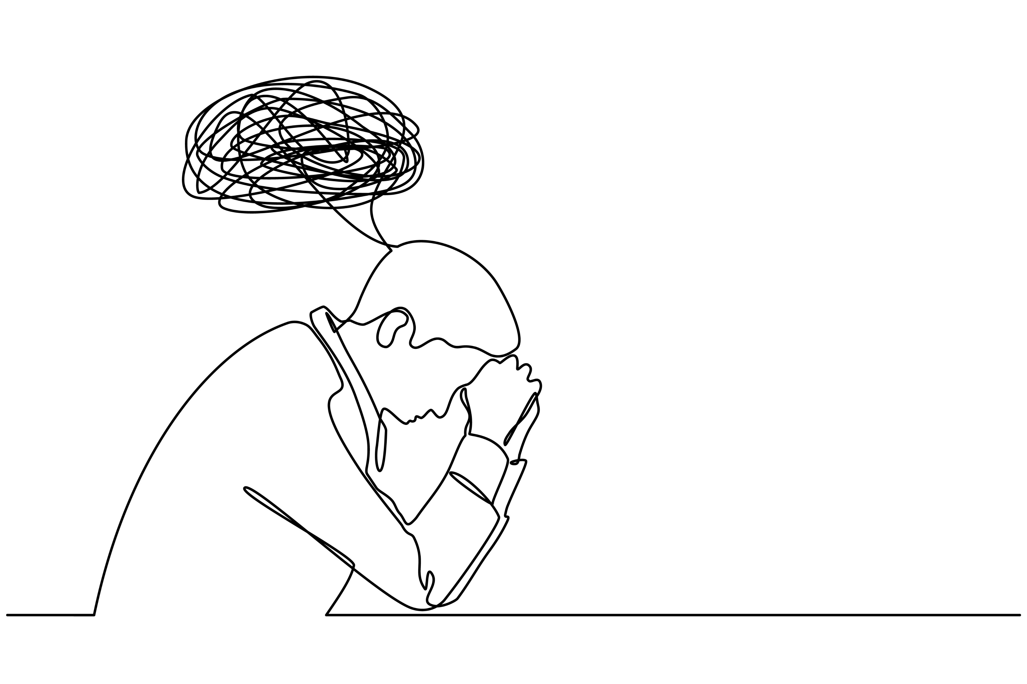
Understand Emotional Experiences
This skill focuses on helping individuals gain a deeper understanding of their emotions, including how to identify, label, and interpret them accurately
Understanding emotional experiences involves several key aspects:
Emotion Identification
Identifying Emotional Triggers
Validation of Emotions
SOURCE: Linehan, 2014a
Notes:
Trainer Notes:
Bullet 1 – "The skill of Understanding Emotional Experiences involves helping individuals gain a deeper understanding of their emotions, including how to identify, label, and interpret them accurately."
Bullet 2 – "This involves several key aspects such as emotion identification, identifying emotional triggers, validating emotions."
Sub-Bullet 1 – "Emotion identification involves learning how to recognize, label, and communicate different emotions, including primary and secondary emotions and their function. It’s important to be able to identify and label our emotions because we can't regulate emotions if we don't know what it is that we're trying to regulate."
Sub-Bullet 2 – "Through the process of identifying emotional triggers, we can determine what our specific triggers are and situations that lead to emotional reactions."
Sub-Bullet 3 – "Through validation of emotions, we practice validating our own emotions, acknowledging that emotions are real and valid, even if they may not always be based on accurate interpretations of a situation.“
Photo Credit:
Purchased Image, Adobe Stock.

Slide 104
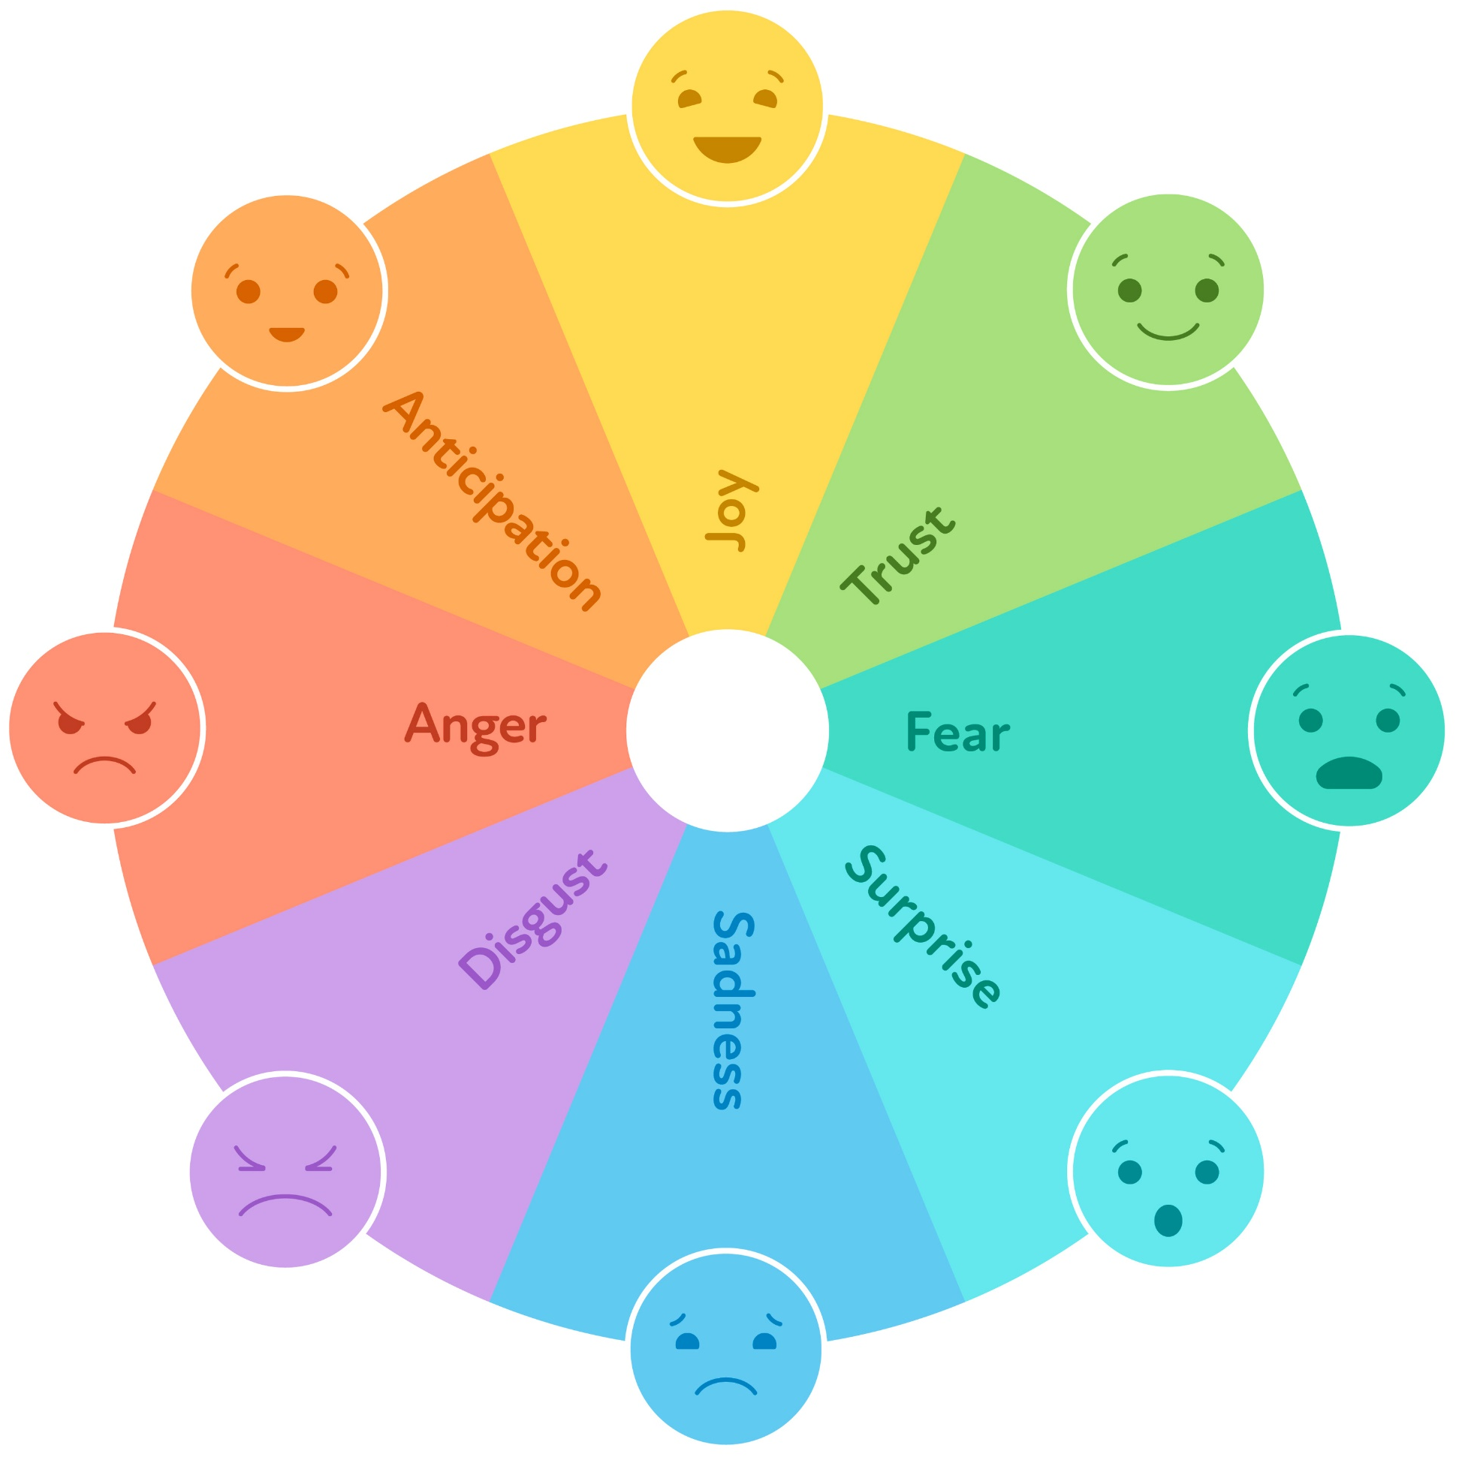
Understand Emotional Experiences – Emotion Identification
Recognizing and labeling emotions requires us to expand our emotional vocabulary
This includes primary emotions and secondary emotions
Three major functions of emotions
To motivate us toward action
To help us communicate to others
To help us communicate to ourselves
SOURCE: Linehan, 2014a
Notes:
Trainer Notes:
Introduce slide – "Again, emotion identification means learning to recognize, name, and express various feelings, including both primary and secondary emotions, and understanding why we feel them. Identifying and naming our emotions is crucial because we can’t influence our feelings if we're not sure which ones we're dealing with."
Bullet 1 – "The process of recognizing, labeling, and communicating different emotions involves developing a deeper vocabulary of emotions – you can use an emotion wheel (such as the one pictured) which can help someone expand their emotion vocabulary."
Sub-Bullet – "We also learn how to identify and label primary and secondary emotions – primary emotions are our first reaction (e.g., happiness, sadness, anger, fear) and secondary emotions represent a reaction to our primary emotion(s) that sometimes cover up the primary emotion(s) and make it difficult for us to know what the primary emotions is (i.e., complex emotions that arise in response to primary emotions, such as guilt or shame)."
Example: "Consider a situation where someone's friend cancels plans at the last minute (primary emotion: disappointment) and then realizes they won't be able to spend time with their friend for several weeks due to conflicting schedules (secondary emotion: anger). In this scenario, the primary emotion is the initial response to the canceled plans, while the secondary emotion (anger) emerges when they perceive a longer-term impact on their relationship."
Bullet 2 – "We also learn the functions of emotions."
"In DBT, we learn that there are three major functions of emotions:
1) to motivate us toward action (e.g., our emotions make us do things, like protecting us when we're scared, making us happy when we enjoy something, or helping us solve problems when we're frustrated.)
2) to help us communicate to others (e.g., our emotions show others how we feel, both with our faces and our words, so they can understand us better and feel close to us).
3) to help us communicate to ourselves (e.g., our emotions make us stop and think about why we feel a certain way, and they help us figure out if our actions match our beliefs and values).
Without proper emotional regulation, emotions cannot fully function as they are intended.
Mindfulness techniques are used to enhance emotional awareness, which helps us to be able to observe our own responses and help us to describe the context of our emotions without judgment or avoidance. Through this process, we can then regulate our emotions.“
Photo Credit:
Purchased Image, Adobe Stock.

Slide 105
Understand Emotional Experiences – Identifying Emotional Triggers
Understanding our emotions also helps us identify patterns and reflect on past experiences to discern the triggers of specific feelings
We can also become more aware of subtle signs that tell us when our emotions might flare up, so we can manage our reactions better
Knowing why we feel the way we do helps us handle situations more thoughtfully and manage our responses
SOURCE: Linehan, 2014a
Notes:
Trainer Notes:
All Bullets – "Understanding and recognizing our emotions helps us figure out patterns and reflect on past experiences to find out what makes us feel a certain way. It also makes us more aware of subtle signs that tell us when our emotions might flare up, so we can manage our reactions better. Knowing why we feel the way we do helps us handle situations more thoughtfully and control our responses.“
Photo Credit:
Purchased Image, Adobe Stock.

Slide 106
Understand Emotional Experiences – Validation of Emotions
Identifying our emotions and their triggers is akin to giving our feelings a name and understanding why they happen
This process helps us validate our emotions by acknowledging that what we feel is real and has a reason
In recognizing emotional triggers, we can connect our feelings to specific situations
This reinforces the legitimacy of our emotional responses and provides a basis for self-acceptance and understanding
SOURCE: Linehan, 2014a
Notes:
Trainer Notes:
All Bullets – "Identifying emotions and their triggers is like giving our feelings a name and understanding why they happen. This process helps us validate our emotions by acknowledging that what we feel is real and has a reason. Recognizing emotional triggers allows us to connect our feelings to specific situations, reinforcing the legitimacy of our emotional responses and providing a basis for self-acceptance and understanding.“
Photo Credit:
Purchased Image, Adobe Stock.

Slide 107
Change Emotional Responses
Designed to help individuals learn how to effectively manage and modify their emotional reactions when they experience intense or distressing emotions
The goal is to empower individuals to respond to their emotions in ways that are healthier and more adaptive
Check the Facts
Problem Solving
OR
Opposite Action
SOURCE: Linehan, 2014a
Notes:
Trainer Notes:
Bullets 1 & 2 – "The Change Emotional Responses skill set in DBT provides individuals with a toolkit of strategies to address emotions in a constructive way. By learning these skills, individuals can reduce emotional suffering, avoid impulsive or harmful behaviors, and increase their emotional resilience. Ultimately, the goal is to empower individuals to respond to their emotions in ways that are healthier and more adaptive."
"This skill set typically includes the following components:
You start with Check the Facts. After you check the facts, you move on to choosing between Problem-Solving or Opposite Action."

Slide 108
Change Emotional Responses –Check the Facts
What is the emotion I want to change?
What is the event promoting my emotion?
What are my interpretations, thoughts, and assumptions about the event?
Am I assuming a threat?
What’s the catastrophe?
Does my emotion and/or its intensity fit the actual events?
SOURCE: Linehan, 2014a
Notes:
Trainer Notes:
Introduce slide – "When you want to change an emotional response, you start with Check the Facts. This is a skill that involves examining and evaluating thoughts and emotions in response to a situation objectively. It helps us challenge distorted thinking patterns and make more rational and evidence-based decisions, ultimately reducing emotional distress and improving their responses to challenging situations."
All Bullets – "Questions you would ask yourself to check the facts include [read bullets]."
"Why is it important to check the facts?"
Beliefs about reality can cause powerful emotions
Faulty beliefs about reality can lead to emotional misery
Faulty beliefs about events can cause new problems
Thinking in absolutes can set off extreme emotions“
Photo Credits:
Purchased Images, Adobe Stock.

Slide 109
Change Emotional Responses – Problem Solving vs. Opposite Action
Engage in Problem Solving when your emotions are appropriate for that situation and the situation itself is causing the issue
OR
Take the Opposite Action when your feelings don't match what's really happening, and even knowing the facts doesn't make you feel better or change how you feel
SOURCE: Linehan, 2014a
Notes:
Trainer Notes:
Introduce slide – "After we’ve checked the facts, we move on to choosing between Problem-Solving or Opposite Action."
Bullet 1 – "You would engage in Problem Solving when the situation itself is causing the issue, and your emotions are appropriate for that situation."
Example: "Suppose you're having frequent conflicts with a close friend due to miscommunications and misunderstandings. You use problem-solving in DBT by initiating an open and honest conversation with your friend to identify the root causes of the conflicts and work together to find constructive solutions, improving your relationship."
Bullet 2 – "You would take the Opposite Action when the emotion is mismatched with the facts, and having knowledge of the facts doesn't lead to a reduction in emotional distress or alter the emotion itself."
Example: "Suppose you're in a romantic relationship and you feel the urge to be critical and distant when you're upset with your partner, which is causing strain in the relationship. In DBT, you would use opposite action by choosing to express your feelings calmly, show affection, and work on resolving conflicts constructively, thus improving the quality of your relationship.“
Photo Credits:
Purchased Images, Adobe Stock.

Slide 110
Change Emotional Responses – Problem Solving
Figure out and describe the problem/situation
Review the facts of the problem/situation
Identify your goals
Brainstorm solutions
Choose a solution that fits the goals and is likely to work
Put the solution into action
Evaluate the results of using the solution
SOURCE: Linehan, 2014a
Notes:
Trainer Notes:
Introduce slide – "Problem Solving skills help us address the underlying issues or triggers of their emotional distress. This can involve identifying solutions to the problems contributing to our emotions or taking steps to change their circumstances."
All Bullets – "There are various steps involved in problem solving which include [read bullets]."
---
Additional Notes:
Scenario that applies the problem-solving steps:
You've been consistently arriving late to work, and it's affecting your job performance and causing tension with your supervisor. You recognize that this is a problem that needs to be addressed.
Figure out and describe the problem/situation: The problem is your chronic lateness to work, which is jeopardizing your job and causing stress.
Review the facts of the problem/situation: You've been consistently late by at least 20 minutes, your supervisor has spoken to you about it, and you've received warnings.
Identify your goals: Your primary goal is to improve your punctuality and maintain a positive working relationship with your supervisor.
Brainstorm solutions: You consider various options, including setting multiple alarms, adjusting your morning routine, using public transportation with more reliable schedules, and speaking with your supervisor to discuss flexible work hours.
Choose a solution that fits the goals and is likely to work: After weighing the pros and cons of each solution, you decide to set multiple alarms, adjust your morning routine to allow for unforeseen delays, and communicate your commitment to improving your punctuality to your supervisor.
Put the solution into action: You start implementing your chosen solution by setting three alarms at different intervals, preparing your work items the night before, and being more mindful of your morning routine.
Evaluate the results of using the solution: Over the course of a few weeks, you consistently arrive on time to work. Your supervisor acknowledges your improvement, and the tension between you two subsides. Your job performance and overall job satisfaction also improve as a result of your increased punctuality and effective problem-solving.
Photo Credit:
Purchased Image, Adobe Stock.

Slide 111
Change Emotional Responses – Opposite Action
Identify and name the emotion you want to change
Review the facts – are your emotions justified by the facts? Does the intensity of your emotion fit the facts?
Identify the action urged by emotion
Ask your Wise Mind – is it effective to act on or express this emotion?
Consider the Opposite Action
Implement the Opposite Action
Practice mindfulness
Repeat as needed
SOURCE: Linehan, 2014a
Notes:
Trainer Notes:
Introduce slide – "Opposite Action involves deliberately acting in a way that is opposite to the emotional urge or impulse that arises in response to a particular emotion. For example, if someone is feeling the urge to withdraw and isolate themselves due to sadness, Opposite Action might involve engaging in social activities or seeking support from others. Taking opposite action is a valuable DBT skill for individuals to use when their emotional responses are not serving their best interests or are out of proportion to the situation. It empowers individuals to respond in a way that aligns with their goals and values, ultimately improving their emotional well-being and relationships."
All Bullets – "There are various guidelines involved in opposite action which include [read bullets]."
Identify the Emotion: Recognize and acknowledge the emotion you are experiencing. It's essential to be aware of the specific emotion you want to address.
Review the Facts: Examine the situation objectively and determine whether your emotional response is appropriate or disproportionate to the facts of the situation. Consider whether your emotional reaction aligns with reality.
Identify the Action Urged by Emotion: Emotions often come with urges or impulses to behave in specific ways. Identify the action or behavior that your emotion is prompting you to take. For example, if you're feeling anger, the urge might be to yell or argue.
Consider the Opposite Action: Deliberately choose to take an action that is opposite to the one urged by your emotion. This action should be consistent with the facts and in line with your overall goals and values. It may involve suppressing or altering your initial impulse.
Implement the Opposite Action: Act on the opposite action you've identified. This can be challenging, as it requires going against your emotional instincts. However, it can be helpful to remind yourself of your goals and the potential benefits of taking this opposite action.
Practice Mindfulness: As you engage in the opposite action, use mindfulness skills to stay present and aware of your thoughts, emotions, and bodily sensations. Observe any changes in your emotional intensity as you take the opposite action.
Repeat as Needed: Sometimes, taking opposite action may need to be repeated multiple times to effectively manage your emotional response. Consistent practice can lead to a shift in your emotional experience.
Additional Steps:
Evaluate the Results: After taking opposite action, assess the impact on your emotions and the situation. Consider whether the emotional intensity has decreased, whether the situation has improved, and whether your chosen action aligns with your long-term goals and values.
Adjust as Necessary: Depending on the outcomes and your ongoing emotional experience, be open to adjusting your approach. You may need to refine your opposite action or seek additional support or skills to manage your emotions effectively.
---
Additional Notes:
Scenario that applies the Opposite Action steps:
You're in a romantic relationship, and you've recently had an argument with your partner. You're feeling hurt and upset, and the emotion is urging you to withdraw and give your partner the silent treatment.
Identify the Emotion: You recognize that you are experiencing hurt and anger in response to the argument.
Check the Facts: You objectively assess the situation and remind yourself that despite the argument, you value your relationship with your partner and want to maintain a healthy connection.
Identify the Action Urged by Emotion: The emotions of hurt and anger are urging you to withdraw, ignore your partner, and avoid resolving the issue.
Consider the Opposite Action: You choose to take the opposite action by approaching your partner, expressing your feelings calmly and honestly, and actively working together to resolve the conflict.
Implement the Opposite Action: Despite the initial emotional discomfort, you initiate a conversation with your partner, explaining how you feel and expressing your desire to find a resolution. You actively engage in active listening and problem-solving.
Photo Credits:
Purchased Images, Adobe Stock.

Slide 112
Activity –Change Emotional Responses (1)
Meet Alex, a 28-year-old who experiences social anxiety and often copes with his social anxiety by drinking alcohol. He has been invited to a networking event for professionals in his industry, but he’s feeling extremely anxious about attending and knows that alcohol will be provided at the event. Alex knows that socializing and networking can be beneficial for his career, but his anxiety is making him want to decline the invitation and he is concerned that he won’t be able to overcome his urge to drink alcohol to cope with this social anxiety.
“Meet Alex” Available for Reference – Handout #2
Notes:
Trainer Notes: "This is an activity to examine how we can change our emotional responses using the tools we just discussed. We will discuss our observations afterwards."
Trainer – read through the vignette or ask for a volunteer – or two volunteers – to read (7 slides):
"Meet Alex, a 28-year-old who experiences social anxiety and often copes with his social anxiety by drinking alcohol. He has been invited to a networking event for professionals in his industry, but he's feeling extremely anxious about attending and knows that alcohol will be provided at the event. Alex knows that socializing and networking can be beneficial for his career, but his anxiety is making him want to decline the invitation and he is concerned that he won’t be able to overcome his urge to drink alcohol to cope with this social anxiety.“
Photo Credit:
Purchased Image, Adobe Stock.

Slide 113
Activity –Change Emotional Responses (2)
Emotional Response: Alex's initial emotional response is overwhelming anxiety. He's worried about being judged, saying something embarrassing, or not fitting in at the event. He’s also concerned that this anxiety would lead him to drink. He's inclined to decline the invitation and avoid the situation altogether.
“Meet Alex” Available for Reference – Handout #2
Notes:
Trainer Notes:
Trainer – read through the vignette or ask for a volunteer to read:
Emotional Response: "Alex's initial emotional response is overwhelming anxiety. He's worried about being judged, saying something embarrassing, or not fitting in at the event. He’s also concerned that this anxiety would lead him to drink. He's inclined to decline the invitation and avoid the situation altogether.“
Photo Credit:
Purchased Image, Adobe Stock.

Slide 114
Activity –Change Emotional Responses (3)
Thought 1: "People will judge me."
Fact: Alex has attended similar events before and hasn't faced harsh judgment or negative experiences.
Thought 2: "I'll say something embarrassing."
Fact: While everyone makes occasional social blunders, most people are forgiving and understanding.
Thought 3: "I won't fit in."
Fact: Alex has interests and experiences related to his industry, which can provide common ground for conversation.
“Meet Alex” Available for Reference – Handout #2
Notes:
Trainer Notes:
Trainer – read through the vignette or ask for a volunteer to read:
Checking the Facts: "Alex remembers the emotion regulation skills he learned. He decides to "check the facts" by examining the evidence for and against his anxiety-driven thoughts."
Thought 1: "People will judge me."
Fact: Alex has attended similar events before and hasn't faced harsh judgment or negative experiences.
Thought 2: "I'll say something embarrassing."
Fact: While everyone makes occasional social blunders, most people are forgiving and understanding.
Thought 3: "I won't fit in."
Fact: Alex has interests and experiences related to his industry, which can provide common ground for conversation.
Photo Credit:
Purchased Image, Adobe Stock.

Slide 115
Activity –Change Emotional Responses (4)
Opposite Action: After checking the facts, Alex recognizes that his anxiety-driven thoughts are largely based on cognitive distortions. To change his emotional response, he decides to apply the DBT skill of "opposite action." Instead of avoiding the networking event, he chooses to accept the invitation and actively engage in the experience.
“Meet Alex” Available for Reference – Handout #2
Notes:
Trainer Notes:
Trainer – read through the vignette or ask for a volunteer to read:
Opposite Action: "After checking the facts, Alex recognizes that his anxiety-driven thoughts are largely based on cognitive distortions. To change his emotional response, he decides to apply the DBT skill of "opposite action." Instead of avoiding the networking event, he chooses to accept the invitation and actively engage in the experience.“
Photo Credit:
Purchased Image, Adobe Stock.

Slide 116
Activity –Change Emotional Responses (5)
Alex decides to plan ahead and identify some strategies to help him navigate his social anxiety and resist drinking while still enjoying social interactions:
Alex makes a list of conversation starters related to his industry to help him initiate discussions
He practices deep, calming breaths and positive
self-talk to boost his confidence before attending
He decides to bring his own non-alcoholic
beverages that he enjoys
He plans to acknowledge his achievement and reward himself with something enjoyable that doesn’t involve alcohol after the event
“Meet Alex” Available for Reference – Handout #2
Notes:
Trainer Notes:
Trainer – read through the vignette or ask for a volunteer to read:
"Alex decides to plan ahead and identify some strategies to help him navigate his social anxiety and resist drinking while still enjoying social interactions:
Alex makes a list of conversation starters related to his industry to help him initiate discussions.
He practices deep, calming breaths and positive self-talk to boost his confidence before attending.
He decides to bring his own non-alcoholic beverages that he enjoys.
He plans to acknowledge his achievement and reward himself with something enjoyable that doesn’t involve alcohol after the event."
"At the event, when he feels the urge to withdraw, he makes an effort to approach others, introduce himself, and actively listen to their conversations. When he feels the urge to drink, he practices opposite action and other emotion regulation strategies that he’s learned to manage and cope with the emotions and triggers that often leads to these urges.“
Photo Credit:
Purchased Image, Adobe Stock.

Slide 117
Activity –Change Emotional Responses (6)
At the event, when Alex feels the urge to withdraw, he makes an effort to approach others, introduce himself, and actively listen to their conversations. When he feels the urge to drink, he practices "opposite action" and other emotion regulation strategies that he’s learned to manage and cope with the emotions and triggers that often lead to these urges
“Meet Alex” Available for Reference – Handout #2
Notes:
Trainer Notes:
Trainer – read through the vignette or ask for a volunteer to read:
Opposite Action: "At the event, when Alex feels the urge to withdraw, he makes an effort to approach others, introduce himself, and actively listen to their conversations. When he feels the urge to drink, he practices "opposite action" and other emotion regulation strategies that he’s learned to manage and cope with the emotions and triggers that often lead to these urges.“
Photo Credit:
Purchased Image, Adobe Stock.

Slide 118
Activity –Change Emotional Responses (7)
Changed Emotion Response: As Alex actively participates in the networking event and engages with others, he starts to feel more relaxed and less anxious. His initial anxiety gradually diminishes as he realizes that most people are friendly and open to conversation. By the end of the event, he even feels a sense of accomplishment and connection with some of the professionals he met.
“Meet Alex” Available for Reference – Handout #2
Notes:
Trainer Notes:
Trainer – read through the vignette or ask for a volunteer to read:
Changed Emotion Response: "As Alex actively participates in the networking event and engages with others, he starts to feel more relaxed and less anxious. His initial anxiety gradually diminishes as he realizes that most people are friendly and open to conversation. By the end of the event, he even feels a sense of accomplishment and connection with some of the professionals he met."
From script handout: "In this scenario, Alex effectively changes his emotional response from overwhelming anxiety to increased comfort and confidence by first checking the facts to challenge his distorted thoughts and then practicing "opposite action" by actively engaging in the situation he initially wanted to avoid. This demonstrates how DBT skills can help individuals manage and regulate their emotions in challenging social situations.“
"Here, Alex shifts from overwhelming anxiety to increased comfort and confidence by "checking" the facts and practicing "opposite action." This showcases how DBT skills can help us manage emotions during challenging situations."
Photo Credit:
Purchased Image, Adobe Stock.

Slide 119
Change an Emotional Response Activity – Discussion
What does "checking the facts" and "opposite action" mean in your own words?
How could these skills be beneficial to those in SUD treatment?
“Meet Alex” Available for Reference – Handout #2
Notes:
Trainer Notes:
Trainer – engage the group in a discussion based on the preceding activity, using these questions as a framework for discussion.
Photo Credit:
Purchased Image, Adobe Stock.

Slide 120
The ABC PLEASE Skill
A | Accumulate positive emotions
B | Build mastery
C | Cope ahead of time with emotional situations
PLEASE | Treat PhysicaL illness, balance Eating, avoid mood-Altering substances, maintain good Sleep, and get Exercise
SOURCE: Linehan, 2014a
Notes:
Trainer Notes: "The ABC PLEASE skill is another mnemonic device that enables us to manage our emotional well-being by attending to our physical health and self-care. When we take good care of ourselves, we are less likely to be vulnerable to disease and emotional crisis. Use this skill when you want to improve your overall well-being. This skill is particularly helpful in moments when you're feeling overwhelmed by emotions, as it encourages you to take proactive steps to care for yourself physically and emotionally. By incorporating these self-care practices into your routine, you can enhance your ability to cope with emotional challenges and maintain better emotional balance."
"ABC PLEASE stands for Accumulate positives, Build mastery, Cope ahead of time, treat PhysicaL illness, balanced Eating, avoid mood-Altering substances, maintain good Sleep, and get Exercise."
ABC –
Accumulate positive emotions by doing things that are pleasant. This includes increasing pleasant events in the present that lead to positive emotions in the short-term (e.g., having lunch with a friend, expressing to someone how much you love them, playing with animals, shooting pool, etc.). Focusing your attention on positive moments when they are happening is also important (i.e., avoid multitasking). Accumulating positive emotions for the long-term involves making changes in your life so that positive events will occur in the future; this can include avoiding the act of avoiding in addition to identifying values that are important to you and creating goals based on those values.
Build mastery by doing things we enjoy. Whether it is reading, cooking, cleaning, fixing a car, working a cross word puzzle, or playing a musical instrument. Practice these things to build master and in time we feel competent.
Cope Ahead by rehearsing a plan ahead of time so that we can be prepared to cope skillfully.
PLEASE –
Treat PhysicaL Illness and take medications as prescribed.
Balance Eating in order to avoid mood swings.
Avoid mood-Altering substances and have mood control.
Maintain good Sleep so you can enjoy your life.
Get Exercise to maintain high spirits.
---
Reference:
Linehan, M. M. (2014a). DBT (R) skills training handouts and worksheets, second edition (2nd ed.). New York, NY: Guilford Publications.

Slide 121
Distress Tolerance
Notes:
Trainer Notes:
"Let's review the last skill set in DBT, which relates to distress tolerance."
"While emotion regulation is the ability to effectively manage and respond to emotions, distress tolerance refers to the ability to manage distress or crises that can arise from states of dysregulated emotion.“
Photo Credit:
Purchased Image, Adobe Stock.

Slide 122
Distress Tolerance Overview
Distress tolerance involves learning how to cope with intense emotions and crises in a healthy way when you can't control the source of distress
It helps us handle crises calmly, improving outcomes through greater acceptance
Distress tolerance empowers us to face challenges with resilience and adaptive responses, enabling us to avoid impulsive reactions
SOURCE: Linehan, 2014a
Notes:
Trainer Notes:
Bullet 1 – Read bullet and, then ,add – "Distress tolerance also refers to the ability of someone to navigate through an emotional incident without making it worse on themselves – such as relying on a substance. Individuals with low distress tolerance are easily overwhelmed by situations and turn to unhealthy ways of coping or reacting."
Bullet 2 – Read bullet and, then ,add – A crisis is a critical and often intense situation or event characterized by a high level of uncertainty, stress, and difficulty with the potential for negative outcomes. A crisis can be a situation that is inherently stressful or one that an individual perceives as highly stressful."
Bullet 3 – [read bullet].
Photo Credits:
Purchased Images, Adobe Stock.

Slide 123
Goals of Distress Tolerance
Survive crisis situations and get through painful moments without making them worse
Accept reality as it is in the moment
Become more aware of how emotions influence our responses to distressing situations
Differentiate between addressing a problem and distracting from reality
Recognize that pain and distress are a part of life
Trying to avoid or suppress pain/distress can increase suffering
SOURCE: Linehan, 2014a
Notes:
Trainer Notes:
Bullets 1 & 2 – "The goal of distress tolerance skills is to help us survive crisis situations and get through painful moments without making them worse. This involves accepting reality as it is in the present moment (bullet 2)."
Bullet 3 – "This process also involves becoming more aware of how our emotions influence how we respond to distressing situations. These skills also help us cope with our feelings when we don't know exactly what we want or need at that moment."
Bullet 4 – "Ultimately, practicing distress tolerance skills involves coming to terms with the fact that pain and distress are a part of life and understanding that our attempts to avoid or suppress pain and distress can merely increase our suffering (corresponding sub-bullet)."

Slide 124
Distress Tolerance Skills
These skills teach:
Techniques for tolerating painful events
Techniques for managing painful urges and emotions
Distress tolerance skills are applicable when we either cannot solve a problem OR we can solve it, but the timing isn't right to problem-solve
Distress tolerance skills are helpful when:
Intense physical and/or emotional pain is present
Emotional pain is too strong, and it feels overwhelming
Strong urges to engage in impulsive behaviors are present
SOURCE: Linehan, 2014a
Notes:
Trainer Notes:
"Distress tolerance skills ultimately teach us how to [read bullets]."
"Ultimately, we use distress tolerance skills during intense emotional or physical pain, when facing urges for harmful actions, or when we need to be productive but feel emotionally overwhelmed. These skills provide brief relief from pain and reduce the chances of impulsive actions to ease suffering.“
Photo Credits:
Purchased Images, Adobe Stock.

Slide 125
Foundational Distress Tolerance Skills
STOP
ACCEPTS
Pros & Cons
Self-Soothing
TIPP
IMPROVE
SOURCE: Linehan, 2014a
Notes:
Trainer Notes:
"Here are the foundational distress tolerance skills."
"There’s the STOP skill, the Pros & Cons skill and the TIPP skill."
"There’s also the ACCEPTS skill, the Self-Soothing skill, and the IMPROVE skill."

Slide 126
The STOP Skill
S | Stop – immediately stop any impulsive or harmful actions or reactions; hit the "pause" button and interrupt the automatic response to distress
T | Take a Step Back – take a physical or mental step back from the situation; this can involve physically moving away from the triggering environment or simply mentally distancing themselves from the intensity of the emotions or situation
O | Observe – observe and describe the situation without judgment; notice the facts of the situation, your own emotional and physical responses, and any thoughts or urges that arise
P | Proceed Mindfully – proceed with mindfulness and intention; make a deliberate choice about how to respond to the situation rather than reacting impulsively
SOURCE: Linehan, 2014a
Notes:
Trainer Notes:
"The STOP skill is a mnemonic device that stands for Stop, Take a Step Back, Observe, and Proceed Mindfully. The purpose of the STOP skill is to help individuals pause and gain control over impulsive or emotionally charged reactions when facing distressing situations or strong emotions. It can help break the cycle of impulsive reactions to distress and gives us the opportunity to respond more skillfully and consciously. It's a valuable tool for managing intense emotions, preventing impulsive behaviors, and promoting greater self-control and emotional regulation."
Stop: The first step involves immediately stopping any impulsive or harmful actions or reactions. It's about hitting the "pause" button and interrupting the automatic response to distress.
Take a Step Back: After stopping, individuals are encouraged to take a physical or mental step back from the situation. This can involve physically moving away from the triggering environment or simply mentally distancing themselves from the intensity of the emotions or situation.
Observe: Once they've created some space, individuals are instructed to observe and describe the situation without judgment. This step involves noticing the facts of the situation, their own emotional and physical responses, and any thoughts or urges that arise.
Proceed Mindfully: After observing, individuals are encouraged to proceed with mindfulness and intention. This means making a deliberate choice about how to respond to the situation rather than reacting impulsively. It involves using other distress tolerance skills or coping strategies to navigate the situation more effectively.
---
Reference:
Linehan, M. M. (2014a). DBT (R) skills training handouts and worksheets, second edition (2nd ed.). New York, NY: Guilford Publications.

Slide 127
The Pros & Cons Skill
The purpose of this skill is to encourage individuals to:
Take a step back
Think rationally
Make more balanced and reasoned decisions
This is especially important in situations where emotions may be running high
 | Using Substances | Not Using Substances
Pros | Temporary Relief Enhanced Mood | Improved self-esteem Financial stability
Cons | Loss of Control Withdrawal Symptoms | Initial Discomfort Emotional Challenges
SOURCE: Linehan, 2014a
Notes:
Trainer Notes:
"The Pros and Cons skill is a decision-making and problem-solving tool that helps individuals weigh the advantages and disadvantages of a particular choice or course of action. It is particularly useful for making informed decisions and avoiding impulsive or emotionally driven choices."
"The purpose of this skill is to encourage individuals to take a step back, think rationally, and make more balanced and reasoned decisions, especially in situations where emotions may be running high."
"Overall, the Pros and Cons skill in DBT is a valuable tool for helping individuals make more informed, balanced, and rational decisions in their lives. It can be particularly helpful in reducing impulsivity and promoting better problem-solving skills. However, like any skill, it may require practice to become proficient in its use."
The steps of the Pros and Cons skill involve:
Identify the Decision: First, the individual identifies the specific decision or choice they are facing. This could be related to any aspect of their life, from relationships and work to personal goals and behaviors.
List the Pros: The individual then makes a list of all the potential positive outcomes or benefits associated with making the choice in question. These are the "pros" or advantages.
List the Cons: Next, the individual lists all the potential negative outcomes or drawbacks associated with making the choice. These are the "cons" or disadvantages.
Weigh the Pros and Cons: Once the lists are complete, the individual objectively evaluates the relative importance and significance of each pro and con. Some factors may carry more weight than others in the decision-making process.
Make an Informed Decision: After thoroughly considering the pros and cons, the individual can make a more informed and balanced decision based on a rational assessment of the potential outcomes.
There are pros and cons involved in using the Pros and Cons skill that include:
Pros:
Encourages rational decision-making: It helps individuals avoid impulsive, emotionally driven choices and instead make decisions based on careful consideration.
Promotes self-awareness: The skill encourages individuals to explore their values, priorities, and goals, fostering greater self-awareness.
Reduces impulsivity: By weighing the pros and cons, individuals are less likely to engage in impulsive or risky behaviors.
Enhances problem-solving skills: It provides a structured framework for solving problems and making decisions in various life situations.
Cons:
May require practice: Some individuals may initially find it challenging to identify and evaluate pros and cons objectively.
Doesn't address all decision factors: While it's a valuable tool, the Pros and Cons skill may not consider all factors influencing a decision, such as emotional considerations or ethical dilemmas.
May not be suitable for every decision: It's more effective for straightforward decisions and may not be as applicable for complex choices involving multiple variables.
---
Additional Notes:
The Pros and Cons skill in substance use recovery can be applied as such:
Substance Use - Pros and Cons:
Pros (Advantages):
Temporary Relief: Using substances may provide temporary relief from stress, anxiety, or emotional pain.
Social Interaction: Substance use can facilitate social interaction in certain settings, making it easier to connect with others.
Enhanced Mood: Some substances can lead to feelings of euphoria and increased confidence.
Creative Expression: In some cases, individuals may believe that substance use enhances their creativity or artistic expression.
Escapism: Substance use may serve as a way to escape from challenging life circumstances or problems temporarily.
Cons (Disadvantages):
Health Risks: Substance use is associated with a range of physical and mental health risks, including addiction, overdose, and long-term health issues.
Financial Burden: Maintaining a substance use habit can be costly, leading to financial strain and potential debt.
Legal Consequences: Depending on the substance and local laws, substance use can result in legal troubles, including arrests and convictions.
Damage to Relationships: Substance use can strain relationships with family, friends, and colleagues due to erratic behavior, neglect, or conflict.
Impaired Decision-Making: Under the influence of substances, individuals may make poor decisions that have lasting negative consequences.
Decline in Functionality: Substance use often leads to a decline in overall functionality, impacting work, education, and daily life responsibilities.
Tolerance and Dependence: Over time, tolerance and dependence can develop, leading to a need for increasing amounts of the substance to achieve the desired effect.
Withdrawal Symptoms: Discontinuing substance use can result in uncomfortable and sometimes severe withdrawal symptoms.
Emotional and Mental Health Issues: Substance use can exacerbate or contribute to mental health disorders, such as depression, anxiety, and psychosis.
Loss of Control: Individuals may find it challenging to control or limit their substance use, even when they want to quit or cut back.
Substance Use Abstinence - Pros and Cons:
Pros (Advantages) of Substance Use Abstinence:
Improved Health: Abstaining from substance use leads to better physical and mental health, reducing the risk of addiction-related diseases and mental health disorders.
Clarity and Focus: Abstinence allows for improved cognitive function, better decision-making, and increased focus and productivity.
Financial Stability: Not spending money on substances leads to financial stability and less economic stress.
Legal Compliance: Abiding by laws related to substance use prevents legal troubles, including arrests and convictions.
Strengthened Relationships: Abstinence fosters healthier relationships with family, friends, and colleagues due to more reliable and responsible behavior.
Improved Self-Esteem: Abstaining from substances often leads to increased self-esteem and self-worth as individuals regain control over their lives.
Emotional Stability: Abstinence can result in improved emotional regulation and reduced mood swings.
Enhanced Physical Fitness: Sobriety allows individuals to engage in healthier lifestyle choices, leading to better physical fitness and overall well-being.
Personal Growth: Abstinence provides opportunities for personal growth, self-discovery, and the pursuit of life goals and aspirations.
Decreased Risk: Reduces the risk of accidents, injuries, and overdose associated with substance use.
Cons (Challenges) of Substance Use Abstinence:
Initial Discomfort: The early stages of abstinence can be challenging, with withdrawal symptoms and cravings for the substance.
Social Pressures: Abstinence may require navigating social situations where substance use is prevalent, potentially leading to feelings of isolation.
Emotional Challenges: Dealing with underlying emotional issues that were previously masked by substance use can be difficult.
Relapse Risk: Maintaining abstinence can be an ongoing struggle, with the risk of relapse always present.
Coping Mechanism Replacement: Individuals need to find alternative healthy coping mechanisms to replace the use of substances in managing stress and emotions.
Peer Relationships: Abstinence may strain relationships with friends who continue to use substances.
Stigma: Some individuals may experience stigma or judgment from others regarding their choice to remain abstinent.
Long-Term Commitment: Abstinence often requires a lifelong commitment, which can be challenging to maintain.

Slide 128
The TIPP Skill
T | Temperature – using temperature to create a sudden and intense physical sensation that can help regulate emotions
I | Intense Exercise – engage in short bursts of intense physical activity can release endorphins and provide immediate relief from emotional distress
P | Paced Breathing – Controlled breathing techniques can help regulate emotions by slowing down the heart rate and calming the nervous system
P | Paired Muscle Relaxation – intentionally tense and then relax different muscle groups in the body to release physical tension
SOURCE: Linehan, 2014a
Notes:
Trainer Notes:
"The TIPP skill is a mnemonic device that can help individuals quickly and effectively reduce intense emotional distress, especially in crisis situations. The TIPP skill is designed to be used briefly and in the moment when emotional distress is acute. It is not a long-term solution but can help individuals regain enough emotional equilibrium to engage in further distress tolerance or problem-solving skills effectively."
"TIPP stands for Temperature, Intense Exercise, Paced Breathing, and Paired Muscle Relaxation."
Temperature: This component involves using temperature to create a sudden and intense physical sensation that can help regulate emotions. These temperature-related techniques activate the body's "diving reflex," which can help reduce emotional arousal and bring a sense of calm. It includes methods like:
Cold Water: Plunging your face into a bowl of ice water for a few seconds.
Cold Pack: Placing a cold pack (or a bag of frozen peas) on your eyes or cheeks for a brief period.
Hold Your Breath and Submerge: Holding your breath and immersing your face in cold water for a few moments.
Intense Exercise: Engaging in short bursts of intense physical activity can release endorphins and provide immediate relief from emotional distress. These activities can also help shift focus away from distressing thoughts and create a physical release of tension. Examples of intense exercises include:
Sprinting: Running or jogging as fast as you can for a brief period.
Jumping Jacks: Performing a quick set of jumping jacks to increase heart rate.
Push-Ups or Burpees: Doing a series of push-ups or burpees in quick succession.
Paced Breathing: Paced breathing encourages deep and controlled breaths, promoting relaxation. Controlled breathing techniques can also help regulate emotions by slowing down the heart rate and calming the nervous system. The specific technique for paced breathing involves:
Breathing In: Inhaling deeply for a count of four seconds.
Holding Breath: Holding your breath for four seconds.
Breathing Out: Exhaling slowly and completely for a count of six seconds.
Repeat: Continuing this pattern for several cycles until you feel more relaxed.
Paired Muscle Relaxation: This component involves intentionally tensing and then relaxing different muscle groups in the body to release physical tension. Paired muscle relaxation can help individuals become more aware of and release physical tension associated with emotional distress. The process includes:
Muscle Tension: Tightly contracting a muscle group (e.g., fists, arms, shoulders) for several seconds.
Release: Suddenly letting go and allowing the muscle group to relax completely.
Repeat: Moving through various muscle groups, repeating the tension and release process.
---
Reference:
Linehan, M. M. (2014a). DBT (R) skills training handouts and worksheets, second edition (2nd ed.). New York, NY: Guilford Publications.

Slide 129
The ACCEPTS Skill
A | Activities – Do an activity that requires thought and concentration
C | Contributing – Do something that allows you to focus on another person
C | Comparisons – Put your situation in perspective by comparing it to something more painful or distressing
E | Emotions – Do something to create a new emotion that will compete with your distressing emotion
P | Push Away – Avoid a painful situation or block it from your mind using a technique such as imagery
T | Thoughts – Use a mental strategy or an activity to shift your thoughts to something neutral
S | Sensations – Find safe physical sensations to distract you from distressing emotions
SOURCES: Linehan, 2014a
Notes:
Trainer Notes: "ACCEPTS outlines strategies for distracting oneself from distressing emotions, giving them time to lessen in intensity, or fade away. It’s designed to help individuals cope with overwhelming emotions and situations without resorting to harmful or impulsive behaviors and offers a range of healthy coping strategies to manage distress and reduce the risk of impulsive or self-destructive behaviors when facing challenging emotions or situations."
"ACCEPTS stands for Activities, Contributing, Comparisons, Emotions, Push away, Thoughts, and Sensations."
ACCEPTS–
A stands for engaging in activities. Do an activity that requires thought and concentration. Engage in any healthy activity. Some ideas: Read a book, exercise, call a friend, clean, cook a new recipe.
The first C is for contributing or doing something for someone else. Do something kind for someone. For example, cook food for a friend or relative, mow the neighbor's lawn, send an encouraging text.
The second C stands for comparisons which entails either 1) juxtaposing a previous period of your life with your current one, or 2) juxtaposing a previous period of your life that was much worse with the one that you're in. Put your life in perspective. Ask yourself: Am I safe? Am I fed? Is there someone who cares about me?
E is for emotions which entails generating different emotions than the ones that you're feeling. Invoke the opposire emotion of your current feeling to reduce its intensity. If anxious, practice meditation. If sad, watch a funny video.
P is for pushing away, sort of like putting the problem on a shelf. Push the problem out of your mind temporarily and set a time to come back to it. Distract yourself with other activities and get present.
T is for thoughts and involves engaging in thinking about something like math problems, making a grocery list, making a holiday list, any thoughts that compete with the thoughts and emotions that are present during the time of the crisis. Replace negative, anxious thoughts with activities that keep the mind busy. For example, say the alphabet backwards or do a puzzle.
And S is for sensations which involves using the five senses in order to ground yourself. Use your 5 senses to self-sooth. Some ideas: Take a warm bath, light a candle, play relaxing music, eat a comforting snack.
Reminder – These ideas might not work for everyone. You can try them all and see which ones you like and which ones work best for you. For example, with C(omparisons), when it comes to comparing yourself to others, some people find it hard because it makes things worse. Thinking about your own suffering or the suffering of others can also be upsetting or unsettling for some people. It's important to figure out what works for you and what you're comfortable with.
---
Reference:
Linehan, M. M. (2014a). DBT (R) skills training handouts and worksheets, second edition (2nd ed.). New York, NY: Guilford Publications.

Slide 130
The Self-Soothing Skill
This skill helps individuals in self-comfort and emotional relief during distress by engaging in calming activities or practices
Components of self-soothing include:
Sensations: Engaging in activities that involve pleasurable sensations, such as touch, taste, smell, sight, or sound
Distraction: Using distractions to shift focus away from distressing thoughts or emotions temporarily
Nurturing and Comfort: Providing oneself with the care, kindness, and comfort that one would offer to a friend in distress
Encourages individuals to develop a toolbox of comforting and nurturing activities that they can turn to in times of distress
SOURCE: Linehan, 2014a
Notes:
Trainer Notes:
"The Self-Soothing skill helps individuals comfort themselves and find emotional relief during moments of distress. It involves engaging in activities or practices that provide a sense of calm, comfort, and emotional regulation. This skill also encourages individuals to develop a toolbox of comforting and nurturing activities that they can turn to in times of distress. It helps us regain emotional equilibrium and resilience, allowing us to face challenging situations with greater ease. Self-soothing is particularly valuable when we cannot change the source of our distress and need to cope effectively with our emotions."
Components of Self-Soothing:
Sensations: Engaging in activities that involve pleasurable sensations, such as touch, taste, smell, or sound, to calm the nervous system and evoke positive emotions.
Distraction: Using distractions to shift focus away from distressing thoughts or emotions temporarily, allowing for emotional regulation.
Nurturing and Comfort: Providing oneself with the care, kindness, and comfort that one would offer to a friend in distress, fostering self-compassion.
Nurturing and Comfort: Providing oneself with the care, kindness, and comfort that one would offer to a friend in distress, fostering self-compassion.
Examples of Self-Soothing Activities:
Sensory Pleasures: Engaging in activities that provide pleasurable sensations and engage the 5 senses (sight, hearing, taste, smell, and touch), such as taking a warm bath, savoring a favorite food, using scented candles or essential oils, or listening to soothing music.
Comforting Objects: Holding onto or cuddling with a soft or comforting object, such as a stuffed animal or a cozy blanket.
Nature Connection: Spending time in nature, whether it's going for a walk in the park, sitting in a garden, or simply gazing at the sky.
Self-Massage: Using gentle self-massage techniques, like rubbing your temples or massaging your own hands or feet, to relax and release tension.
Breathing Exercises: Practicing deep-breathing exercises or guided imagery to promote relaxation and reduce stress.
Mindful Eating: Savoring the taste and texture of a favorite food or beverage mindfully, paying attention to each bite or sip.
Visualization: Engaging in guided imagery exercises that transport you to a peaceful and calming mental place.
Positive Affirmations: Repeating positive affirmations or comforting statements to yourself, such as "I am safe," "I can handle this," or "This too shall pass."
Grounding Techniques: Using grounding exercises to stay connected to the present moment, like the 5-4-3-2-1 technique where you identify five things you can see, four things you can touch, three things you can hear, two things you can smell, and one thing you can taste.
Caring Gestures: Treating yourself with care and kindness by engaging in self-care activities like taking a warm shower, practicing good hygiene, or giving yourself a gentle hug.
Reminder – For the Sensations skill: Engaging in activities that feel good, like touching, tasting, smelling, seeing, or hearing things, can be harmful for people with substance use issues or eating disorders. For example, it may bring back cravings (doing things that feel good can remind people of using substances or specific eating habits, bringing back the strong desire to do those things again).
Photo Credits:
Purchased Images, Adobe Stock.

Slide 131
The IMPROVE Skill
I | Imagery – use your imagination to visualize a calming or peaceful place or situation
M | Meaning – find meaning or purpose in the distressing situation
P | Prayer – engage in a prayer or spiritual practice if you have a belief system that supports this
R | Relaxation – practice relaxation techniques, such as deep breathing, progressive muscle relaxation, or guided imagery exercises
O | One Thing in the Moment – focus on doing one thing at a time and being fully present in the moment.
V | Vacation (Brief) – take a brief mental vacation by intentionally distracting yourself from distressing thoughts and emotions
E | Encouragement – provide yourself with self-encouragement and positive self-talk
SOURCE: Linehan, 2014a
Notes:
Trainer Notes: "The IMPROVE skill can be used to improve one’s mood and cope more effectively with emotional distress. It’s a valuable tool for individuals to use when they are experiencing intense emotional distress and need immediate relief. It encourages individuals to take active steps to improve their emotional state and regain a sense of control over their emotions."
IMPROVE stands for:
Imagery: This component involves using your imagination to visualize a calming or peaceful place or situation. Close your eyes and imagine yourself in a serene environment, focusing on the sensory details, such as the sights, sounds, smells, and physical sensations. This can help shift your focus away from distressing thoughts and emotions.
Meaning: Find meaning or purpose in the distressing situation. Ask yourself what lessons or personal growth opportunities can be gained from the experience. This can help reframe the situation in a more positive light.
Prayer: Engage in a prayer or spiritual practice if you have a belief system that supports this. For some individuals, prayer can provide comfort and a sense of connection during times of distress.
Relaxation: Practice relaxation techniques, such as deep breathing, progressive muscle relaxation, or guided imagery exercises. These techniques can help reduce physical tension and promote relaxation.
One Thing in the Moment: Focus on doing one thing at a time and being fully present in the moment. Avoid multitasking or getting overwhelmed by thinking about the past or future. Stay grounded in the present.
Vacation (Brief): Take a brief mental vacation by intentionally distracting yourself from distressing thoughts and emotions. Engage in an activity or hobby that you enjoy or that requires your full attention, even if it's just for a short time.
Encouragement: Provide yourself with self-encouragement and positive self-talk. Use supportive and motivating statements to counteract negative or self-critical thoughts.
---
Reference:
Linehan, M. M. (2014a). DBT (R) skills training handouts and worksheets, second edition (2nd ed.). New York, NY: Guilford Publications.

Slide 132
Activity – Distress Tolerance Skills
Background: You have been in recovery for several weeks and have been making good progress.
You have just left work, and you suddenly experience an overwhelming craving for your substance of choice. The craving is so intense that it's difficult to focus on anything else.
You have 1 minute to manage this intense craving using the distress tolerance skills you've learned such as STOP, TIPP, ACCEPTS, STOP, self-soothing, etc.
Consider what you would do given your specific preferences and what would be possible for you to do given your specific commute from work
Notes:
Trainer Notes:
"We are now going to engage in an activity that provides you with an opportunity to use the distress tolerance skills we just reviewed. This activity is a simulation exercise where you are going to put yourself in the shoes of someone experiencing an intense craving during their commute from work."
Ask participants to take a few moments to recall the details of their commute from work (if you don’t commute to/from work, think of another regular commute that you take (commute to the grocery store, to a family member’s home or a friend’s home, to church, etc.) – what route do they take? What is their form of transportation? What routines do they engage in? What are landmarks that you would recognize on this route.
Begin activity:
Background: You have been in recovery for several weeks and have been making good progress. You have just left work (departure point), and you suddenly experience an overwhelming craving for your substance of choice. The craving is so intense that it's difficult to focus on anything else.
You have 1 minute (simulating a sense of urgency and emotional intensity) to manage this intense craving using the distress tolerance skills you've learned such as STOP, TIPP, ACCEPTS, STOP, self-soothing, etc.
Consider what you would do given your specific preferences and what would be possible for you to do given your specific commute from work
TRAINER SETS A TIMER FOR 3 MINS.

Slide 133
Distress Tolerance Skills Activity – Discussion
Which distress tolerance skills did you choose to use during the simulation, and why did you select them?
How might you help your clients apply distress tolerance skills to cope with cravings and difficult moments in their recovery journey?
Notes:
Trainer Notes:
Trainer – engage the group in a discussion based on the preceding activity, using these questions as a framework for discussion.
Photo Credit:
Purchased Image, Adobe Stock.

Slide 134
Radical Acceptance (1)
Radical Acceptance is one of the four options we all have for handling any challenge
In addition to 1) solving the problem, 2) finding ways to feel better about the problem, 3) or staying miserable
Radical Acceptance does not equate to approval, agreement, or endorsement
"Radical acceptance rests on letting go the illusion of control and a willingness to notice and accept things as they are right now, without judging."
— Marsha Linehan
SOURCES: Linehan, 2014a
Notes:
Trainer Notes:
Introduce slide – "Radical Acceptance is one other principle involved in the Distress Tolerance skill set."
Bullet 1 & Sub-Bullet – "DBT offers four basic options for handling any challenge: stay miserable about the problem, solve the problem, find ways to feel better about the problem, or learn to accept the problem or situation (i.e., radical acceptance). As one of the four options we all have for handling any challenge, radical acceptance involves not resisting what you cannot change."
"Radical acceptance involves fully acknowledging and accepting the reality of a situation, even when it's painful or distressing. It doesn't mean condoning or agreeing with the situation, but rather acknowledging that it exists and letting go of resistance."
"As such, Radical Acceptance, as described by the creator of DBT herself (Marsha Linehan) [read quote in box].“
Bullet 2 – "Radical Acceptance does not refer to the idea of liking, agreeing with or approving of painful or distressing situations, emotions, or experiences. It also does not imply a passive resignation to difficult circumstances or a lack of effort to change things for the better.
Instead, Radical Acceptance involves acknowledging the reality of the present moment without judgment, even if it's painful, and from that place of acceptance, making informed and intentional choices about how to respond and navigate those challenges.“
"Moreover, Radical Acceptance does not mean accepting abuse or mistreatment from others. It encourages individuals to come to terms with difficult circumstances in order to effectively respond to them, but it does not condone or justify abusive behavior."

Slide 135
Radical Acceptance (2)
Suffering can arise from your response to pain and the way you interpret it, whereas pain itself is an unavoidable experience that cannot be chosen or avoided.
Radical acceptance is the acknowledgement of reality as it is – not as we wish it were nor as we think it should be – but as it is in the present moment with all its flaws
SOURCES: Linehan, 2014a
Notes:
Trainer Notes:
Bullet 1 – "Radical Acceptance is about acknowledging and accepting the reality of a situation, including painful or distressing aspects, without judgment."
"Radical Acceptance centers on the reality that pain is unavoidable. Pain is nature's way of signaling that something is wrong, and pain can turn into suffering when we reject or deny reality. Moreover, refusing to accept reality can keep you stuck in painful emotions (such as unhappiness, bitterness, anger, sadness, or shame), which makes Radical Acceptance an essential feature of building distress tolerance."
Ways to Apply Radical Acceptance – "Radical Acceptance can be applied in many ways. For example, observing when you're questioning or fighting reality ("it shouldn't be this way") and reminding yourself that an unpleasant reality is just as it is and cannot be changed."
"Attend to body sensations as you think about what you need to accept and allow disappointment, sadness or grief to arise within you during this process."
"You can also use accepting self-talk, relaxation techniques, mindfulness and acknowledge that life can be worth living even when there is pain."
"Finally, you can remind yourself that 'it is what it is' for now, and 'it won't last forever.'"
---
Reference:
Linehan, M. M. (2014a). DBT (R) skills training handouts and worksheets, second edition (2nd ed.). New York, NY: Guilford Publications.
Photo Credit:
Purchased Image, Adobe Stock.

Slide 136
Modes of DBT Delivery
Notes:
Trainer Notes:
"In standard, manualized DBT treatment, there are various modes of treatment delivery. For the purposes of this training, we'll provide an overview of the standard modes of delivery and focus more closely on DBT Skills Groups. This is because skills training is so central to DBT."
"In any case, you can incorporate DBT into your treatment in whatever way works for you, your organization, and your clients' needs. YOU DON’T NEED TO FOLLOW THE STANDARD APPROACH.“
Photo Credit:
Purchased Image, Adobe Stock.

Slide 137
Components of Standard DBT Treatment Delivery
Standard (outpatient) DBT Treatment is typically delivered through the following modes:
Individual Sessions
Intersession Contact
Group Sessions
Standard DBT Treatment also involves an important component called Pre-Treatment
SOURCE: Linehan, 2014a
Notes:
Trainer Notes:
Bullet 1 – "These are the components of STANDARD, manualized DBT treatment. Delivery of treatment (ideal for outpatient settings but can be adapted for other settings). In this approach, DBT treatment is provided in three modes – Individual Sessions, Intersession Contact, and Group Sessions (sub-bullets). Again, you do not need to follow this standard approach if you want to apply DBT in your setting. You can choose to incorporate DBT in your individual sessions without implementing group sessions, or vice versa."
"There aren’t a lot of agencies or people that deliver standard DBT treatment. For the typical clinician wanting to learn this intervention and these skills, it’s important that you know that you can apply the DBT skills in individual or group sessions, without intersession contact, for example."
Bullet 2 – "Standard DBT treatment also involves an important component called Pre-Treatment (designed to be delivered before anything else), which we'll review first.“
Photo Credits:
Purchased Images, Adobe Stock.

Slide 138
Pre-Treatment
Notes:
Trainer Notes: "Standard, manualized DBT treatment involves a period called Pre-Treatment.“
Photo Credit:
Purchased Image, Adobe Stock.

Slide 139
The Goals of Pre-Treatment
The structure of standard DBT Treatment involves a Pre-Treatment component
The goals of Pre-Treatment are for practitioner and client to:
Determine that they can work together
Assess whether DBT will be an effective and appropriate treatment for the client
Pre-Treatment goals are aimed at reducing the risk of the client leaving treatment prematurely
SOURCE: Linehan, 2014a
Notes:
Trainer Notes:
Bullet 1 – "In the standard version of DBT, there is a component called Pre-Treatment. "
Bullet 2 – "The goals of Pre-Treatment are two-fold; they involve determining whether you and the client can work together (bullet 2, sub-bullet 1) and whether DBT will be an effective and appropriate treatment for the client (bullet 2, sub-bullet 2). We will review more about what it looks like to assess whether DBT will be an effective and appropriate treatment for the client in the coming slides."
Bullet 3 – "Ultimately, these goals serve to reduce the risk of a client leaving DBT Treatment prematurely (bullet 3).“
Photo Credits:
Purchased Images, Adobe Stock.

Slide 140
Objectives Involved in Pre-Treatment
During Pre-Treatment*, practitioners:
Orient the client to the structure and philosophy of DBT
Create values-based goals with the client
Provide information that informs the client's expectations about DBT Treatment
Establish a therapy agreement with the client
Assess history, current behaviors, and client's targets for behavior change
*Up to 4 Pre-Treatment sessions in the standard DBT Treatment model
SOURCE: Linehan, 2014a
Notes:
Trainer Notes:
Bullet 1 – "There are several objectives involved in Pre-Treatment; they include:
Sub-Bullet 1 – Orienting the client to the structure and philosophy of DBT, which involves reviewing what dialectical means
Sub-Bullet 2 – Create values-based goals with the client, which can serve to unlock motivation for the client
Sub-Bullet 3 – Provide information that informs the client's expectations about DBT Treatment, which involves being clear about the fact that DBT requires that you commit to practicing the skills learned in DBT outside of sessions
Sub-Bullet 4 – Establish a therapy agreement with the client; this is similar to an agreement for services that clients often have to complete before receiving services and serves to provide the parameters of treatment and sets forth expectations of practitioner and client in a tangible format
Sub-Bullet 5 – Assess history, current behaviors, and client's targets for behavior change; this is similar to assessments that are commonly done with clients prior to receiving services to help practitioners get a sense of the client's background, needs, risk and protective factors, etc. We'll review some questions that can inform your assessment approach and how to prioritize treatment target in your assessment on the next few slides."
"It's important to note that, in standard DBT, you can do up to 4 pre-treatment sessions but, again, you can adapt to your needs and the needs of your organization/client."
"Ultimately, these objectives help practitioner and client assess whether DBT will be an effective and appropriate treatment for the client."
---
Additional Notes:
Pre-treatment was defined as being up to four sessions because of research needs, so this has become the standard, but it can vary.
Photo Credits:
Purchased Images, Adobe Stock.

Slide 141
Assessing Motivation and Commitment for DBT Treatment
Questions that can inform your assessment of the client's motivation and commitment include:
Can we agree on what the focus will be?
Can we agree to work together?
Why does the client want to do this work? Why not? What will get in the way?
What are the client's goals? Are the client's goals within my own limits?
SOURCE: Linehan, 2014a
Notes:
Trainer Notes:
Introduce slide – "In conducting your assessment of the client's suitability for DBT, it's important to assess their motivation and commitment to DBT Treatment; this is important, for example, because DBT is most effective if the client commits to practicing the skills they learn through DBT."
Bullet 1 – "As such, questions that can inform your assessment of the client's motivation and commitment for treatment include [read sub-bullets].“
Photo Credits:
Purchased Images, Adobe Stock.

Slide 142
Prioritizing Treatment Targets
In DBT, there are 3 categories of treatment targets (i.e., target behaviors the client wants to change):
Life-Threatening Behavior (e.g., Self-harm)
Therapy-Interfering Behavior (e.g., Arriving late to a session)
Quality-of-Life-Interfering Behavior (e.g., Not adhering to prescribed medication regimen)
Attention to multiple problems at once is possible using the DBT Target Hierarchy to guide intervention
Homework can begin in Pre-Treatment by introducing the diary card
SOURCE: Linehan, 2014a
Notes:
Trainer Notes:
Introduce slide – "In your assessment of the client's suitability for DBT, you'll also work to prioritize treatment targets (identifying the exact behaviors that the client wants to change). In prioritizing treatment targets, the client can begin to increase behavioral skills that they'll learn (in individual sessions and groups) to address these target behaviors and increase their adaptive functioning."
Bullet 1 – "There are three categories of target behaviors that are described as the 'target hierarchy' in DBT. The DBT Target Hierarchy will help you prioritize which target behaviors to address and manage your treatment time accordingly. For example, life-threatening behavior takes precedence for discussion over quality-of-life-interfering behavior, and imminent or forthcoming life-threatening behaviors take precedence for discussion over past patient self-harming behavior and urges. These treatment targets are hierarchically categorized as follows:
Sub-Bullet 1 – Life-threatening behavior, which can include self-harm
Sub-Bullet 2 – Therapy-interfering behavior, which can include arriving late to a session (also missing sessions, not doing homework)
Sub-Bullet 3 – Quality-of-life-interfering behavior such as not adhering to a prescribed medication regiment (also risky sexual behavior, binge-eating, oversleeping, substance use)."
Bullet 2 – "Attention to multiple problems at once is possible using the DBT Target Hierarchy to guide intervention."
Bullet 3 – " Homework can begin in Pre-Treatment by introducing the diary card, which we'll review next.“
Photo Credits:
Purchased Images, Adobe Stock.

Slide 143
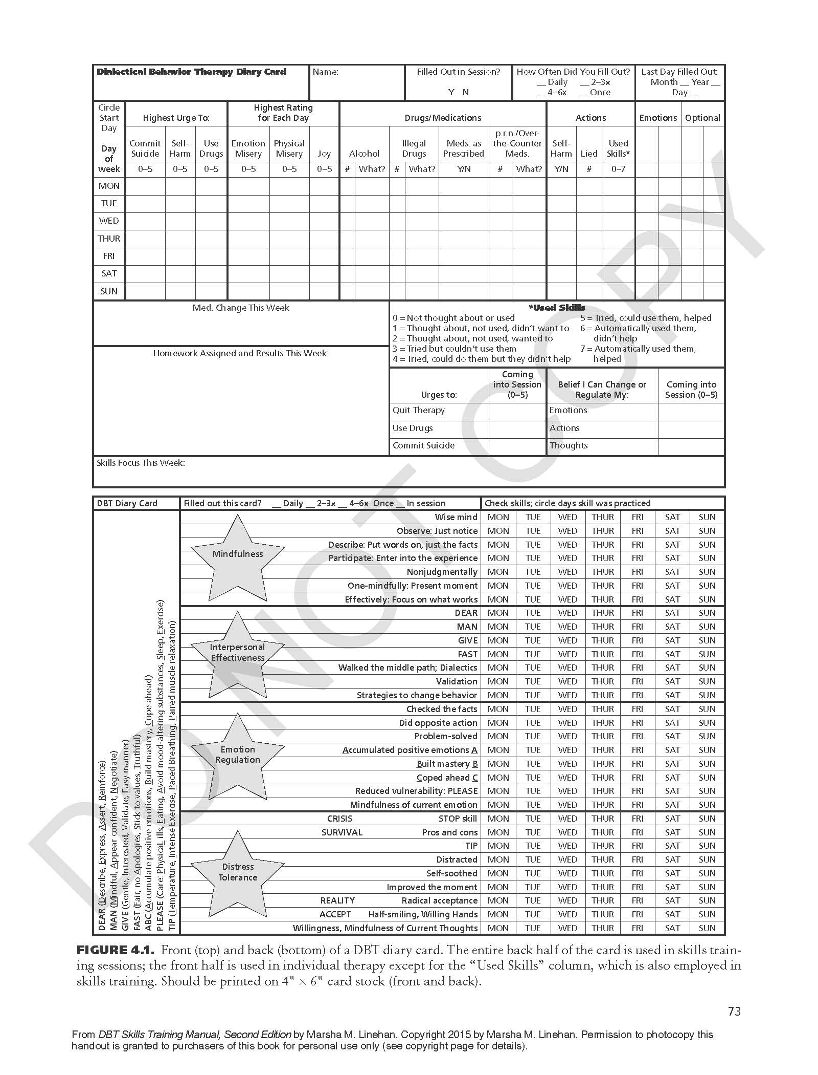
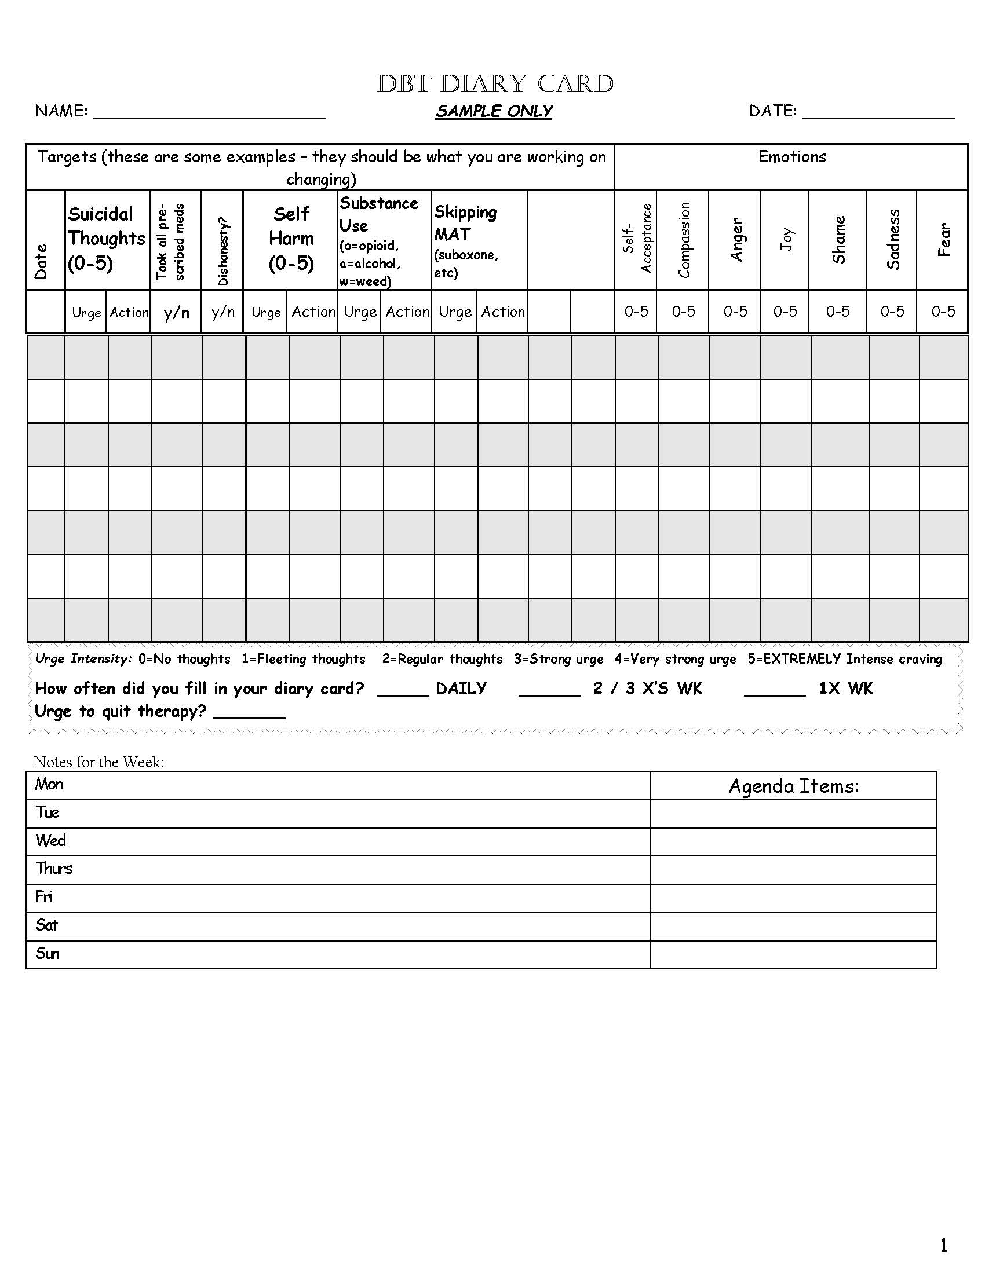
Diary Card
Available for Reference – Handout #3
SOURCE: Linehan, 2014a
Notes:
Trainer Notes:
"Diary cards in DBT are structured self-monitoring tools that individuals use to track their emotions, behaviors, and the use of DBT skills. These cards are typically used as a part of the DBT program to enhance self-awareness, identify patterns of behavior, and measure progress in managing emotions and behaviors.“
"The use of diary cards is an essential aspect of DBT, as it promotes self-awareness, skill development, and accountability. They can be a valuable tool for individuals seeking to manage their emotions, reduce impulsive behaviors, and work towards their therapeutic goals."
Here's what diary cards typically include and when you should use them:
Components of a Diary Card:
Emotions: Individuals are asked to list and rate their emotions throughout the day. Emotions are typically categorized as primary emotions (e.g., anger, sadness, happiness) and secondary emotions (emotions that arise in response to primary emotions).
Behaviors: People track their behaviors, both positive and negative, and record any impulsive or problematic actions.
Skills Use: Diary cards include a section where individuals record their use of DBT skills. They note which skills they practiced and how effective they were in managing their emotions and behaviors.
Daily Events: Individuals describe significant events or triggers that occurred during the day, as well as any life events or stressors.
Targets: These are specific problematic behaviors or emotions that individuals are working on in therapy. Diary cards track progress in addressing these targets.
Ratings: Some diary cards include space for individuals to rate their overall emotional intensity or distress level at different times of the day.
When to Use Diary Cards:
You should use diary cards as part of your ongoing DBT practice, and the frequency of use may vary depending on your treatment plan. Here are common situations when you might use diary cards:
Daily Practice: Many individuals in DBT are encouraged to fill out a diary card daily. This helps develop a routine for self-monitoring and skill practice.
Between Therapy Sessions: Diary cards provide a way to track your emotions, behaviors, and skill usage between therapy sessions, giving you and your therapist valuable information to discuss during sessions.
During Crises: Diary cards can be especially useful during crises or challenging emotional situations. They help you identify which skills to use and track their effectiveness.
Working on Specific Targets: If you have specific emotional or behavioral targets you're working on in therapy, diary cards help you monitor progress and setbacks in those areas.
As Needed: You can use diary cards as needed, depending on your treatment goals and the guidance of your therapist.
---
Reference:
Linehan, M. M. (2014a). DBT (R) skills training handouts and worksheets, second edition (2nd ed.). New York, NY: Guilford Publications.

Slide 144
DBT Psychoeducation
During Pre-Treatment, it's important to provide psychoeducation about:
DBT: what, why, how
Problematic behaviors: why do they develop, what keeps them active
Refer to the Biosocial Model of DBT
SOURCE: Linehan, 2014a
Notes:
Trainer Notes:
Bullet 1 – "Providing psychoeducation about DBT in Pre-Treatment really serves to inform the client's expectations about treatment and their buy-in to treatment."
Sub-Bullet 1 – "Psychoeducation efforts should cover the what, why, and how of DBT(like what we reviewed earlier in the training)."
Sub-Bullet 2 – "Psychoeducation efforts should also cover why problematic behaviors develop and what keeps them active by referring to the Biosocial Model of DBT.“
Photo Credit:
Purchased Image, Adobe Stock.

Slide 145
Contraindications for DBT Treatment
DBT will not work for someone who 100% does not believe that they have behaviors that need to change
Clients will get the most out of this treatment if they:
Want to develop new skills
Are willing to acknowledge and work towards improving unhealthy behaviors
Are committed to practice, practice, practice
SOURCE: Linehan, 2014a
Notes:
Trainer Notes:
Introduce slide – "There are some factors that would make DBT a not-so-effective treatment for someone."
Bullet 1 – "Overall, DBT will not be effective for someone who does not believe that they have behaviors that need to change."
Sub-Bullets – "Ultimately, clients will get the most out of DBT treatment if they 1) want to develop new skills, 2) are willing to acknowledge and work towards improving unhealthy behaviors, and 3) are committed to practice, practice, practice (sub-sub-bullets). If they are not willing to do these things, then DBT will not be an effective treatment for them.“
Photo Credits:
Purchased Images, Adobe Stock.

Slide 146
Individual Sessions
Notes:
Trainer Notes: "In standard, manualized DBT treatment, there are various modes of treatment delivery, which include individual sessions. We'll review a summary of what these sessions look like for if you decide to provide DBT treatment in individual sessions.“
Photo Credit:
Purchased Image, Adobe Stock.

Slide 147
DBT Treatment in Individual Sessions
Individual sessions are a mode of DBT Treatment delivery that serve two functions:
Enhance Motivation: Clients can learn to apply the DBT skills to specific challenges and events in their lives
​Structure the Environment with Case Management Strategies: Clients can manage their own life, such as their physical and social environments, by applying case management strategies to learn how to be their own case manager
Problem-solving skills
Dialectics
Validation
SOURCE: Linehan, 2014a
Notes:
Trainer Notes:
Bullet 1 – "Individual sessions in standard, manualized DBT treatment serve two functions."
Sub-Bullet 1 – "First, clients can learn to apply the DBT skills to specific challenges and events in their lives which can, in turn, enhance motivation."
Sub-Bullet 2 – "Second, in individual sessions, clients can learn strategies that can help them manage their own lives (these strategies are much like case management strategies that are used in treatment settings). In learning these strategies, clients can begin to be like their own case manager and can become more skilled in managing their physical and social environments."
"These strategies include helping the client develop problem-solving skills."
"This strategies can also involve recognizing dialectics (opposites) in our daily lives and finding a balance with them (in essence, recognizing that two apparent opposites can be true at the same time). This is a helpful strategy for all of us and can serve to help us better manage our lives."
"Another skill entails practicing validation as a means of exercising acceptance of others and ourselves.“
Photo Credit:
Purchased Image, Adobe Stock.

Slide 148
The Structure of DBT Individual Sessions (1)
In the standard DBT Treatment model, individual sessions take place once a week for as long as the client is in DBT treatment, and they run concurrently with DBT group skills training
Sessions can last approximately 1 hour
The tone set in sessions should be that of warmth and hope in a straightforward manner
Remember the Characteristics of DBT:
Support-Oriented
Collaborative
SOURCE: Linehan, 2014a
Notes:
Trainer Notes:
Bullet 1 – [read bullet].
Bullet 2 – [read bullet].
Bullet 3 – [read bullet and corresponding sub-bullets].
Photo Credit:
Purchased Image, Adobe Stock.

Slide 149
The Structure of DBT Individual Sessions (2)
Review Diary Card
Notice, while using target hierarchy:
What is the most distressing experience this week?
Teach DBT skills/tools
Provide homework
SOURCE: Linehan, 2014a
Notes:
Trainer Notes:
Introduce slide – "Here is a template for what individual sessions can look like."
Bullet 1 – "You can start the session by reviewing the diary card. Diary cards enable the client to share some of the experiences that came up for them during the preceding week and allows the client to discuss them in detail."
Sub-Bullet – "Now, it's likely that the client will have lots of experiences to share. So, you'll want to use the target hierarchy (that we reviewed earlier)."
"As a refresher, the DBT Target Hierarchy helps you prioritize which target behaviors to address and manage your treatment time accordingly. For example, life-threatening behavior takes precedence for discussion over quality-of-life-interfering behavior, and imminent or forthcoming life-threatening behaviors takes precedence for discussion over past patient self-harming behavior and urges."
Bullet 2 – "Then, you'll want to teach the client a new DBT skill or tool, or you can re-teach a previous skill that was taught if the client wants a refresher."
Bullet 3 – "Lastly, you'll want to provide the client with homework – give them the means to practice the skills that they're learning in treatment outside in their day-to-day life.“
Photo Credit:
Purchased Image, Adobe Stock.

Slide 150
Demonstration – DBT Individual Session
Source: Florida Atlantic University School of Social Work, 2016
Notes:
Trainer Notes:
Trainer – no need to play more than ~7.5 mins of the video demonstration.
Closed captioning is available for this video.
---
Reference:
YouTube. (2016, October 31). Behavior theory: DBT clinical demonstration. YouTube. https://www.youtube.com/watch?v=_gPcDRVALVo

Slide 151
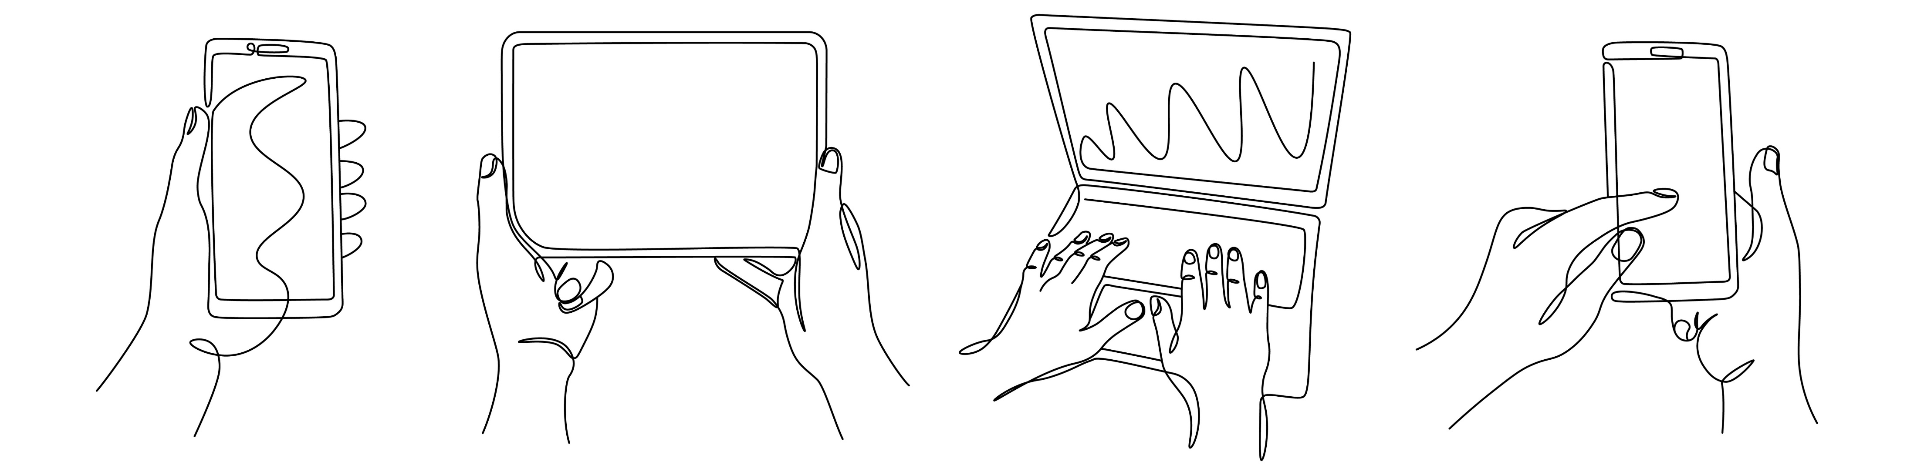
Intersession Contact
Notes:
Trainer Notes: "Intersession contact is another way that DBT treatment is delivered in the standard protocol.“
Photo Credit:
Purchased Image, Adobe Stock.

Slide 152
What is Intersession Contact?
Intersession Contact:
Includes any communication between practitioner and client other than that which occurs during designated individual and group sessions
These sessions primarily focus on:
Helping the client identify skills to use
Exploring how to use identified skills to navigate challenging everyday situations
Intersession Contact can also sometimes involve helping a client through a crisis
SOURCE: Linehan, 2014a
Notes:
Trainer Notes:
Bullet 1 – "Intersession contact involves any communication between practitioner and client other than that which takes place during designated individual sessions and group sessions (sub-bullet)."
Bullet 2 – "The content of intersession contact sessions primarily involves generalizing the skills clients are learning in individual and/or group sessions to their everyday lives by helping the them 1) identify specific skills to use and 2) exploring how to use these identified skills to navigate challenging everyday situations (sub-bullets)."
E.g., For example, when a client is overwhelmed following a difficult conversation with a loved one (or leading up to a difficult conversation).
Bullet 3 – "Intersession contact sessions can also sometimes focus on helping the client get through a crisis."
E.g., Clients can contact the practitioner when they are at their wit's end and at risk of harming themselves.
"However, clients should be encouraged to get into the habit of contacting practitioners well before a suicidal crisis emerges. That way, you and the client can (a) focus on how to use skills to avert rather than simply how to manage a crisis, and (b) to avoid getting into a pattern of repeated crisis calls."
"As is the case with any model of psychotherapy, there may be times when a practitioner will need to fully assess a client for life-threatening behavior and potentially for hospitalization during an intersession contact session."
"This being said, there are limits that we want to set around intersession contact sessions that we'll get into shortly.“
Photo Credit:
Purchased Image, Adobe Stock.

Slide 153
Structure of Intersession Contact
Intersession Contact can occur in different forms:
Telephone coaching
Text messaging
Video conference
In a residential program, clients would have access to someone between group/individual sessions
Sessions are brief (max: 10 mins)
Sessions can be scheduled or spontaneous
A client does not have to be in crisis in order to contact the practitioner
SOURCE: Linehan, 2014a
Notes:
Trainer Notes:
Bullet 1 – "Intersession contact can take place in different forms. It can be through telephone coaching, text message, or video conference, for example (sub-bullets)."
"This can be adapted, for example, in a residential program where it would be more appropriate for clients to have access to someone between group/individual sessions."
These sessions can also be adapted for adolescents (text messaging, for example).
With any logistical barrier, it's important to work with one's team in order to come up with a plan for addressing this component of the standard DBT protocol.
Bullet 2 – "Intersession contact is meant to be brief – it should not be treated as a full therapy session – and should take a maximum of 10 minutes."
Bullet 3 – "Sessions can be scheduled or spontaneous."
E.g., You can make Wednesdays from 1-2pm the timeframe that clients can contact you or you can have scheduled sessions per client."
Bullet 4 – "The other thing to note is that a client does not have to be in crisis in order to contact the practitioner for an intersession contact session."
Photo Credit:
Purchased Image, Adobe Stock.

Slide 154
Setting Limits Around Intersession Contact
Intersession Contact does not involve full individual sessions and should not be treated as such
Being able to manage and set limits around this is a key feature in DBT
Any violation or problems that arise related to this would be treated as Therapy-Interfering Behavior
SOURCE: Linehan, 2014a
Notes:
Trainer Notes:
Introduce slide – "Clients' preferences and tendencies related to intersession contact sessions will vary. Some will want to be in contact with you more than others. Some may not want to be in contact with you at all. It will also vary according to the practitioner's limits, and those limits will also vary based on their personality or may just vary day to day. Some practitioners may be more willing than others to receive calls while others may be more willing to engage via texting than via email, for example. In any case, it's vital to set limits around these sessions.“
"Some clinicians, especially those with less experience may feel the need to be readily available for DBT clients and this is a sure recipe for burnout. This work can also be taxing on the clinician and it’s really important that you have your own regular supervision or consultation to help you."
Bullet 1 – "As mentioned, intersession contact sessions should not be treated as full individual sessions (they are only meant to be a maximum of 10 minutes)."
Bullet 2 – "An essential process in DBT involves managing and setting limits around intersession contact sessions with clients. In other words, we must set boundaries around these sessions. This will involves setting expectations about these sessions before your first session."
"Any boundary or limit-crossing would be considered a Therapy-Interfering Behavior. We reviewed this when we discussed prioritizing treatment targets in DBT (i.e., the DBT Target Hierarchy).“
Photo Credit:
Purchased Image, Adobe Stock.

Slide 155
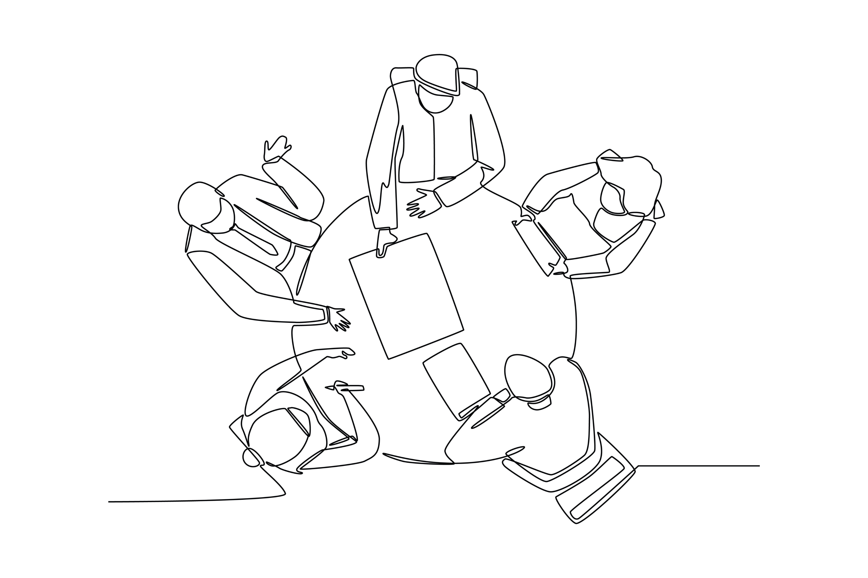
Group Sessions
Notes:
Trainer Notes:
"The last component in the standard DBT protocol involves Group Sessions (AKA Group Skills Training). DBT skills training in a group setting teaches skills across the four main skill sets involved in DBT: mindfulness, interpersonal effectiveness, emotion regulation, and distress tolerance. We’ll provide an overview here but focus more closely on groups in a few moments because skills group training is so central to DBT."
"DBT skills group training functions to enable participants to practice the skills in a group setting. This group format allows participants to see reflections of themselves from the perspectives of others. It can also help clients practice interacting with other people in a safe space and enables them to learn about the effects that their way of communicating has on others.“
Photo Credit:
Purchased Image, Adobe Stock.

Slide 156
DBT Treatment in Group Skills Training Sessions
DBT Group Skills training focuses entirely on skills acquisition and practice and functions as a weekly group, run like a class, during which the four DBT Skills are taught and practiced
Group skills training typically occurs over 1 ½ hour to 2 ½ hours
Group size can vary (between 3 to 10 participants) which can determine the length of group sessions
During group sessions, clients are provided homework assignments in which they practice the skills taught during the weekly group lesson
SOURCE: Linehan, 2014a
Notes:
Trainer Notes:
Bullet 1 – "DBT Group Skills training focuses entirely on skills acquisition and is provided in a weekly group, run like a class."
Bullet 2 – "These groups typically take place over1 ½ hour to 2 ½ hour sessions."
Bullet 3 – "The length of group sessions can also depend on the size of the group itself which can vary between 3 to 10 participants."
Bullet 4 – "One component of group sessions is that clients are provided homework assignments in which they practice the skills that are taught during the weekly group lesson."
"Research suggests that group skills training is helpful in and of itself – independent of individual DBT Treatment..“
Photo Credit:
Purchased Image, Adobe Stock.

Slide 157
General Structure of Group Skills Training Sessions
Each class is structured similarly:
Mindfulness exercise
Homework review
Teach new skill(s)
Assignment of homework
SOURCE: Linehan, 2014a
Notes:
Trainer Notes:
Introduce slide – "There is a general structure involved in Group Skills Training sessions, which we'll review here. We'll get into greater detail about the structure of groups shortly."
"In general, you want to start the group with a mindfulness exercise (like we did at the start of this training). This serves to help group members transition into a frame of mind ready for group."
"Then, you want to review the homework from the previous week (this won't necessarily be the case for the group orientation session)."
"Then, you'll go into reviewing the new skill that you want to introduce for the session – this will typically involve incorporating the use of handouts which provide information about the skill. You can end your lesson with a summary of the skill you just reviewed (repetition facilitates retention)."
"Finally, you'll close the session by assigning homework (in the form of a worksheet). You also have the option to close with another mindfulness activity.“
Photo Credits:
Purchased Images, Adobe Stock.

Slide 158
Components of DBT Skills Group Training
Notes:
Trainer Notes: "DBT Group Skills Training is a very common form of DBT treatment delivery. We're going to review the details that are involved in running groups of this kind next.“
Photo Credit:
Purchased Image, Adobe Stock.

Slide 159
Setting Up The Group
Every client should have a notebook
Binders for handouts/worksheets
Have extra pen and paper available
Use a white board, black board or flip chart
Copies of handouts and worksheets
Sit in a circle or around a table
Model behavior appropriate for a classroom setting
SOURCE: Linehan, 2014a
Notes:
Trainer Notes:
Introduce slide – "In preparing to run DBT group skills training, there are some physical materials that will be needed."
"These materials include notebooks which each client should have for note-taking. A binder is also helpful for members to collect the handouts and worksheets distributed in group in one place. Extra pen and paper also comes in handy. A whiteboard, blackboard, or flip chart would also be helpful. It's also important to have copies of the handouts that you will be distributing to group members during group, in addition to copies of worksheets that you will assign to group members as homework at the end of the session."
"Like with many other group models, you should have group participants sit in a circle or around a table."
"Now, what you really want to do is model behavior that you would find in a classroom setting. This means setting boundaries for how people contribute to the discussion (i.e., we don't want people talking over each other)."
Photo Credits:
Purchased Images, Adobe Stock.

Slide 160
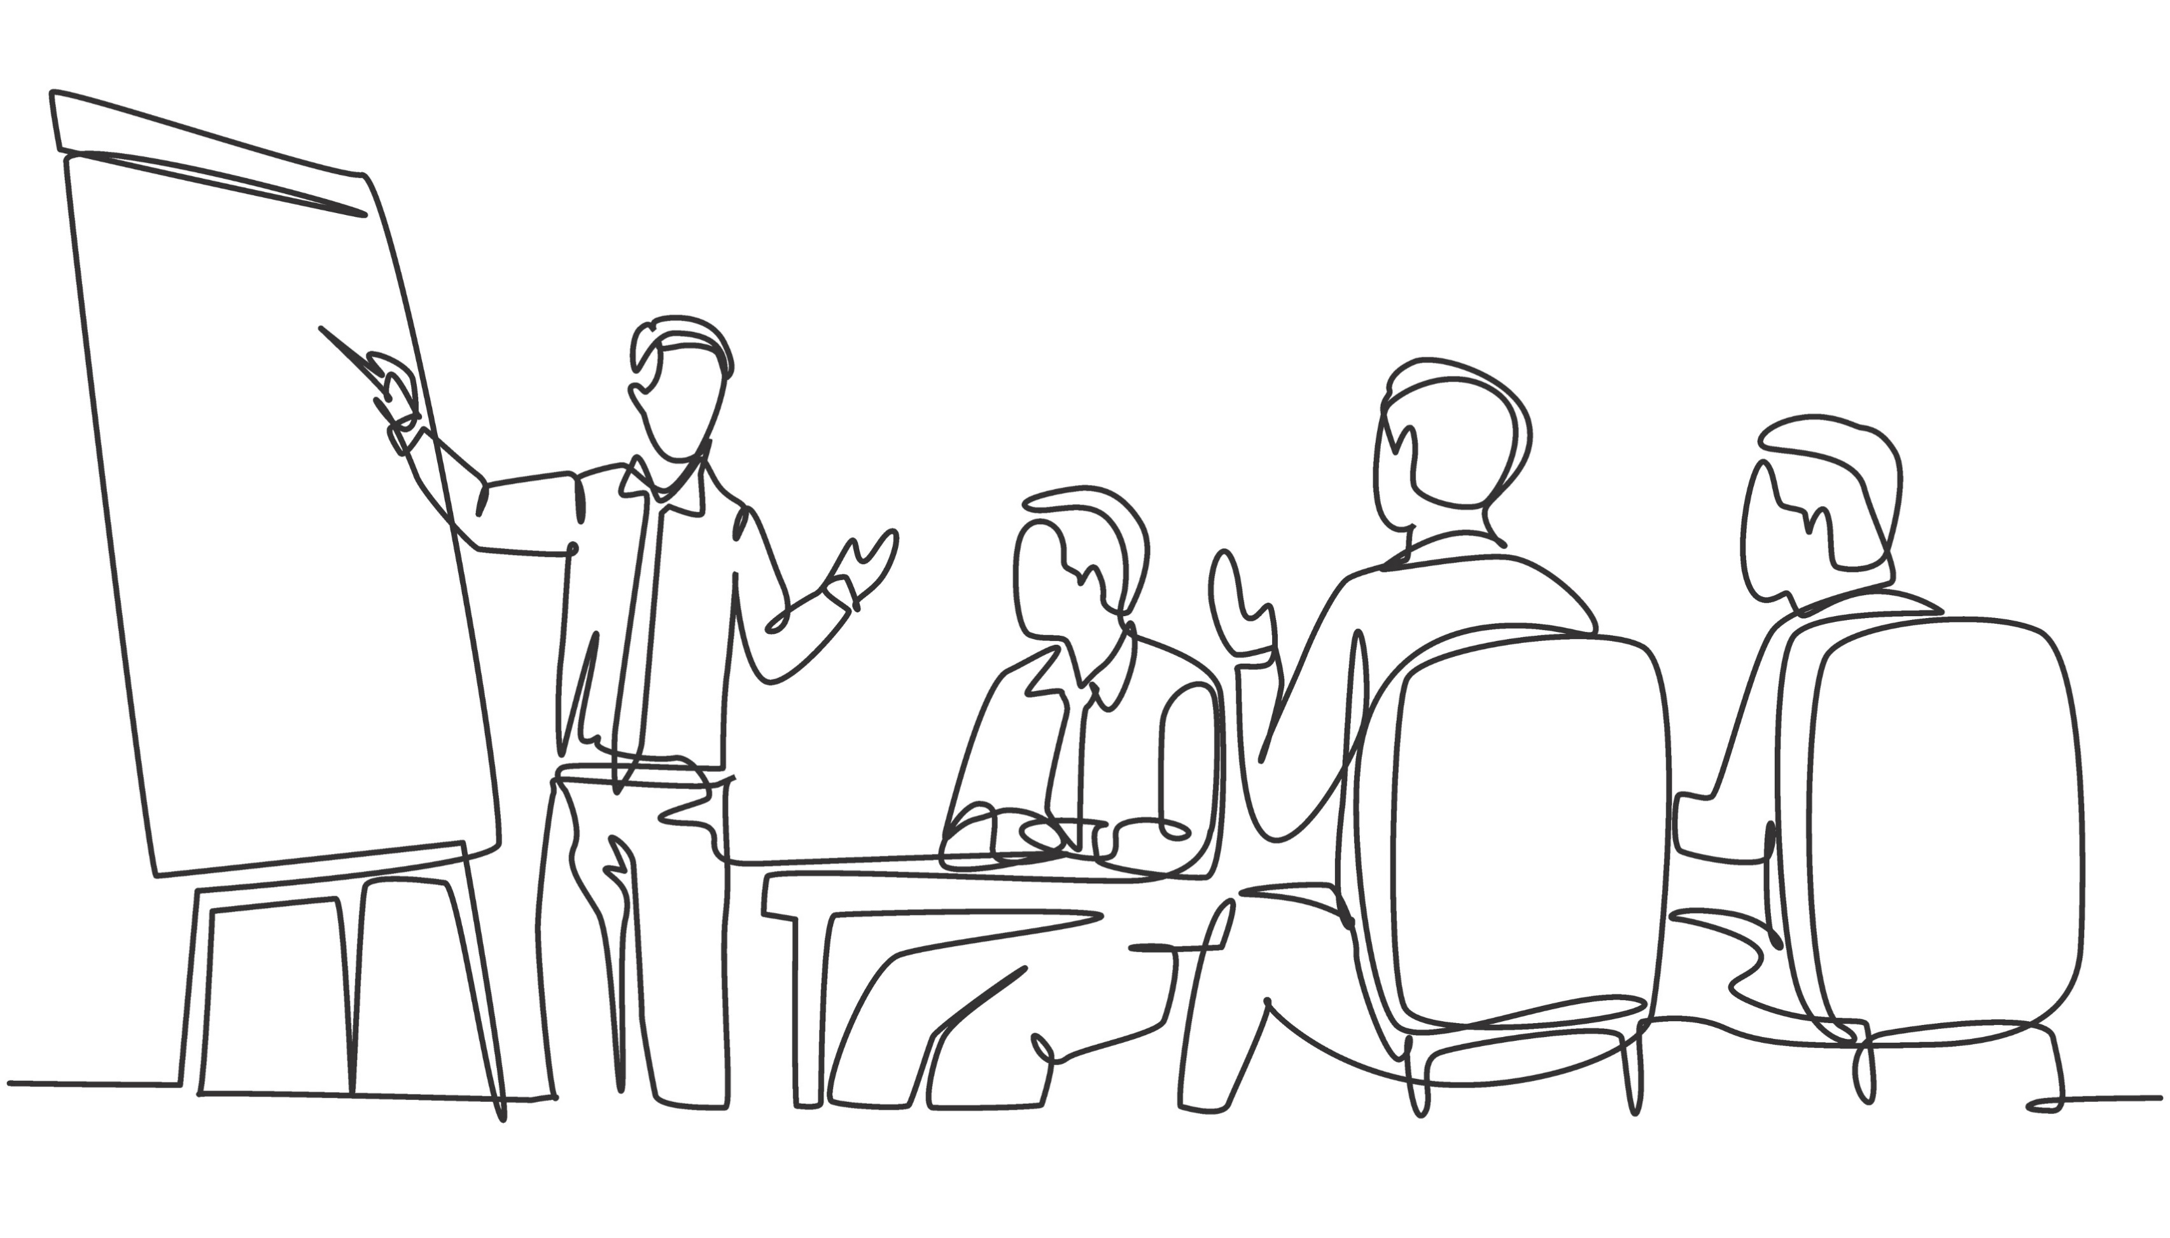
Orientation to Group Skills Training
Notes:
Trainer Notes: "Prior to beginning participation in group skills training, participants should engage in an orientation.“
Photo Credit:
Purchased Image, Adobe Stock.

Slide 161
Purpose of Orientation
To introduce members to one another and to the group leaders, and to orient group members to the structure of groups
Each participant should introduce themselves with their name and provide a statement about why they are there
Leaders: introduce yourself and give information about yourself
Orient members to the structural aspects of group (e.g., format, meeting times, and ground rules)
SOURCE: Linehan, 2014a
Notes:
Trainer Notes:
Bullet 1 – "During orientation, you should review the purpose of orientation itself. Namely, orientation allows an opportunity for group members to introduce themselves to one another and to the group leaders, and to orient group members to the structure of groups."
Bullet 2 – "One way you can orient group members toward introductions is to ask each participant to introduce themselves with their name and a statement of why they are there."
Bullet 3 – "During orientation, group leaders should introduce themselves and give information about why they are leading skills training."
Bullet 4 – "In orientation, you'll also orient members to the structural aspects of group such as the format of group (we'll review that more in depth shortly), the meeting times of group, and ground rules for group (which will likely include that members should avoid talking over each other)."
"Group skills training is structured for group members to initiate training by completing an orientation together. That being said, it's up to you whether you want to allow people to join as members later and if you want to do a 1:1 orientation with them to orient them to skills training.“
Photo Credits:
Purchased Images, Adobe Stock.

Slide 162
Setting Boundaries During Orientation
Describe order and length of modules
Review structure of group/use of session time (half is for reviewing homework and half is for learning new skills)
Make it clear that neither the time nor the structure of group allow for discussion of personal problems unrelated to using behavioral skills
Discuss use of intersession contact
Establish operational group rules/guidelines (AKA Group Ground Rules/Guidelines or Community Guidelines)
Review Skills Training Guidelines and Assumptions
SOURCE: Linehan, 2014a
Notes:
Trainer Notes:
Introduce slide – "As is the case for any group, it's important to set boundaries for your group from the get-go (i.e., during orientation). We'll review those here."
Bullet 1 – "In the standardized DBT protocol, the average length of time to review each module is roughly 6 weeks (but, of course, this can be adapted). The order of the modules in the manual is Mindfulness, Interpersonal Effectiveness, Emotion Regulation, and Distress Tolerance."
Bullet 2 – "Other than the mindfulness exercise that takes place at beginning of sessions and the assignment of homework at the end of the sessions, session time is really split into two parts – half of the session time is for reviewing homework and the other half is for learning new skills. It's important to review this with group members during orientation."
Bullet 3 – "You'll also want to make it clear that neither the time nor the structure of group allow for discussion of personal problems unrelated to using the DBT skills."
Bullet 4 – "You can also discuss the use of intersession contact, specifying the boundaries and expectations involved."
Bullet 5 – "You'll then want to establish operational group rules (AKA group ground rules) with the group. These ground rules can be developed together with group members and reiterated at the start of every group."
Common ground rules include:
Come prepared and on time
Respect fellow group members – critique ideas, not people
Be an active listener; let people finish talking
Bullet 6 – "And then, finally, during orientation you should review skills training guidelines and assumptions, which we'll review shortly."
Photo Credit:
Purchased Image, Adobe Stock.

Slide 163
The Structure of DBT Group Sessions
Begin by presenting an opening activity (e.g., a mindfulness exercise) to help members transition into a frame of mind ready for group
Discuss homework assignments from previous session
Review Diary Cards
What worked best and what didn't work so well?
BREAK
A new skill or concept is taught, and discussions or group activities related to practicing the new skill can ensue
Provide handouts
Homework is assigned related to the newly-taught skill
Provide worksheets
Wind-down activity such as a mindfulness exercise (if time permits)
SOURCE: Linehan, 2014a
Notes:
Trainer Notes:
Introduce slide – "We reviewed the general structure involved in Group Skills Training sessions, but here we'll review the structure in greater detail. You'll want to review this structure with members over orientation so that members know what to expect at each session."
"Ongoing group sessions will begin with an activity. Often this is a mindfulness exercise, but you can also use another activity that promotes a positive experience or positive thought process, like writing an affirmation or an appreciation. This ultimately serves to help participants transition into a frame of mind ready for group."
"You'll then want to discuss the homework that was assigned from the previous session. Homework review also involves some troubleshooting to help members maximize their chances of being effective when practicing the skills they're learning."
"One reason for troubleshooting is that it provides each group member the chance to get input from all the other members and from the leaders. This process can be incredibly validating and supportive. Another reason is that group members get to share what worked and can inspire each other."
"Members can also review their Diary Cards as part of this process (engaging in a troubleshooting process such as asking, 'what worked best and what didn't work so well?')."The practitioner can ask general questions or make comments such as, "It looks like this was a hard week for you." By doing this, they allow participants to choose how much they want to talk about or disclose in group. The practitioner can also look for patterns of distress and ineffective coping."
"For orientation, you can ask members to use their diary cards throughout the week so that those can be reviewed during your first session as the homework assigned from the previous week."
"Then, you can have a break (the length of the break can vary depending on your needs)."
"You'll then transition into teaching new skill or concept after which a discussion or group activity related to practicing the new skill can ensue. You'll also provide handouts related to the new skill (we'll take a look an example of a handout later in this training)."
"After the lesson, you will assign homework related to the newly-taught skill and provide a worksheet for the homework (we'll take a look an example of a worksheet later in this training)."
"And, if time allows, you can facilitate a wind-down activity (similar to an opening activity)."

Slide 164
Matters of Emphasis During Orientation
Goals of Skills Training*
Practice commitment (practice, practice, practice)
*Available for Reference – Handout #4
SOURCE: Linehan, 2014a
Notes:
Trainer Notes:
Introduce slide – "There are a few things that you'll want to emphasize during orientation."
Bullet 1 – "You'll want to emphasize the goals of skill training; you can refer to handout 4 to review these goals [briefly review handout]."
Bullet 2 – "You'll also want to emphasize that DBT treatment is only as effective as the amount of practice that you're willing to put in."
"You can refer to Handout #4 for additional review.“
Photo Credits:
Purchased Images, Adobe Stock.

Slide 165
Skills Training Guidelines
Notes:
Trainer Notes: "There are some guidelines involved in skills training that would be important to not only review during the orientation but to also refer to throughout group sessions.“
Photo Credit:
Purchased Image, Adobe Stock.

Slide 166
Skills Training Guidelines (1)
In a DBT group, members are asked to adhere to a number of group guidelines
Guidelines cover the requirements and expectations for skills training
You can briefly review group guidelines at the beginning of each session
Reiterating group guidelines serves to maintain boundaries
SOURCE: Linehan, 2014a
Notes:
Trainer Notes:
Bullet 1 – "Skills training guidelines cover the requirements and expectations for skills training."
Bullet 2 – "You can briefly review group guidelines at the beginning of each session OR you can just have members refer to the handout when you refer to the group guidelines."
"As you may have gleaned up until this point that there are a lot of handouts and worksheets distributed in group – a binder is helpful for members to collect these materials in one place and have them for easy reference."
Bullet 3 – "Finally, reiterating group guidelines can really serve to help maintain boundaries in group.“
Photo Credits:
Purchased Images, Adobe Stock.

Slide 167
Skills Training Guidelines (2)
Participants who drop out of skills training are not out of skills training (the only way out is to miss four scheduled sessions of skills training in a row)
Participants who join the skills training group support each other
Participants who join the skills training group call ahead of time if they are going to be late or miss a session
Participants do not tempt others to engage in "problem behaviors"
Participants do not form confidential relationships with each other outside of skills training sessions
Available for Reference – Handout #5
SOURCE: Linehan, 2014a
Notes:
Trainer Notes: "Here are the Skills Training Guidelines. This information is also included in handout 5. [Then, list bullets]."
Note - People can return to skills training. The only way out is to miss four scheduled sessions of skills training in a row (in this case, you've missed a large chunk of the content).
"You can refer to Handout #5 for additional review."

Slide 168
Skills Training Assumptions
Notes:
Trainer Notes: "There are some Assumptions – or beliefs that cannot be proved, but we agree to abide by anyway – involved in skills training that form the foundation of DBT skills training.“
Photo Credits:
Purchased Images, Adobe Stock.

Slide 169
Skills Training Assumptions (1)
Skills training assumptions should be introduced during orientation and reintroduced/reviewed in ongoing group skills training sessions
There are seven assumptions
These assumptions underpin DBT skills training
SOURCE: Linehan, 2014a
Notes:
Trainer Notes:
Bullet 1 – "It's important to not only review these Assumptions during orientation but to also refer to them throughout group sessions."
Bullets 2 & 3 – "There are 7 Assumptions, and these underpin DBT skills training.“
Photo Credits:
Purchased Images, Adobe Stock.

Slide 170
Skills Training Assumptions (2)
People are doing the best they can
People want to improve
People need to be better, try harder, and be more motivated to change
People may not have caused all of their own problems, but they have to solve them anyway
New behaviors must be learned in all relevant contexts
All behaviors (actions, thoughts, emotions) are caused
Figuring out and changing the causes of behaviors work better than judging and blaming
Available for Reference – Handout #6
SOURCE: Linehan, 2014a
Notes:
Trainer Notes: "Here are the Assumptions [read list]."
People are doing the best they can. People are doing the best that they can in this moment with the tools that they have. Each of us is a complex individual in this moment and we're all just doing the best that we can.
People want to improve. The common characteristic of all people is that they want to improve their lives and be happy. All people at any given point in time are doing the best they can. Clients come to us because they want to improve/feel better. People use substances to feel good or to feel better; if substance use is a way of coping, how can we add to a person’s toolbox of skills to cope/how can DBT skills be integrated into their skill set to help them?
People need to do better, try harder, and be more motivated to change. The fact that people are doing the best they can, and want to do even better, does not mean that these things are enough to solve the problem.
People may not have caused all of our own problems, but they have to solve them anyway. People have to change their own behavioral responses and alter their environment for their life to change. We can provide people with more tools and alternative tools in their toolbox to make these changes.
New behavior has to be learned in all relevant contexts. New behavioral skills have to be practiced in the situations where the skills are needed, not just in the situation where the skills are first learned. Interpersonal effectiveness skills can be practiced in various contexts. We can give clients opportunities to use skills and generalize them – they can practice interpersonal effectiveness skills by communicating with customer service even if they don't need to as a way to practice (clients can also address conflict with the practitioner a means to practice interpersonal effectiveness skills).
All behaviors (actions, thoughts, emotions) are caused. There is always a cause or set of causes for our actions, thoughts, and emotions, even if we do not know what the causes are.
Figuring out and changing the causes of behavior work better than judging and blaming. Judging and blaming are easier, but if we want to create change, we have to change the chains of events that cause unwanted behaviors and events.
"You can refer to Handout #6 for additional review."

Slide 171
Modules for Skills Training
Notes:
Trainer Notes: "As we've reviewed, there are four skill sets involved in DBT skills training. These are Mindfulness, Interpersonal Effectiveness, Emotion Regulation, and Distress Tolerance. These skills sets are comprised of various modules that have a structure.“
Photo Credits:
Purchased Images, Adobe Stock.

Slide 172
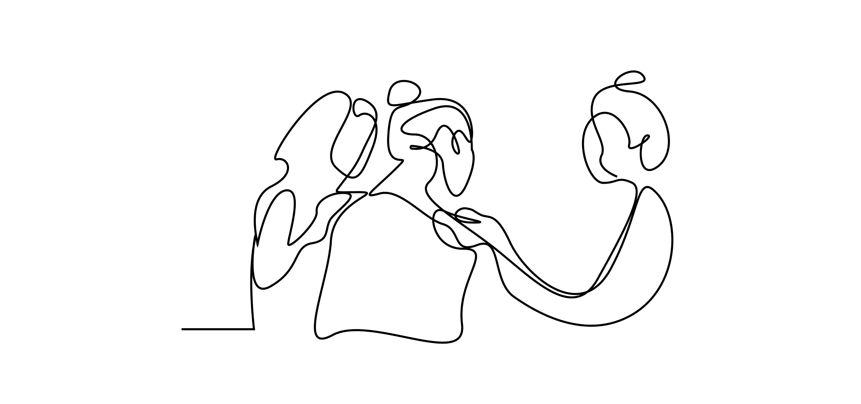
Modules Structure
Teaching Notes (for group leaders only)
Client Handouts (for learning)
Client Worksheets (for homework)
SOURCE: Linehan, 2014a
Notes:
Trainer Notes: "This is the structure of the modules – they include [read list]."
Photo Credit:
Purchased Image, Adobe Stock.

Slide 173
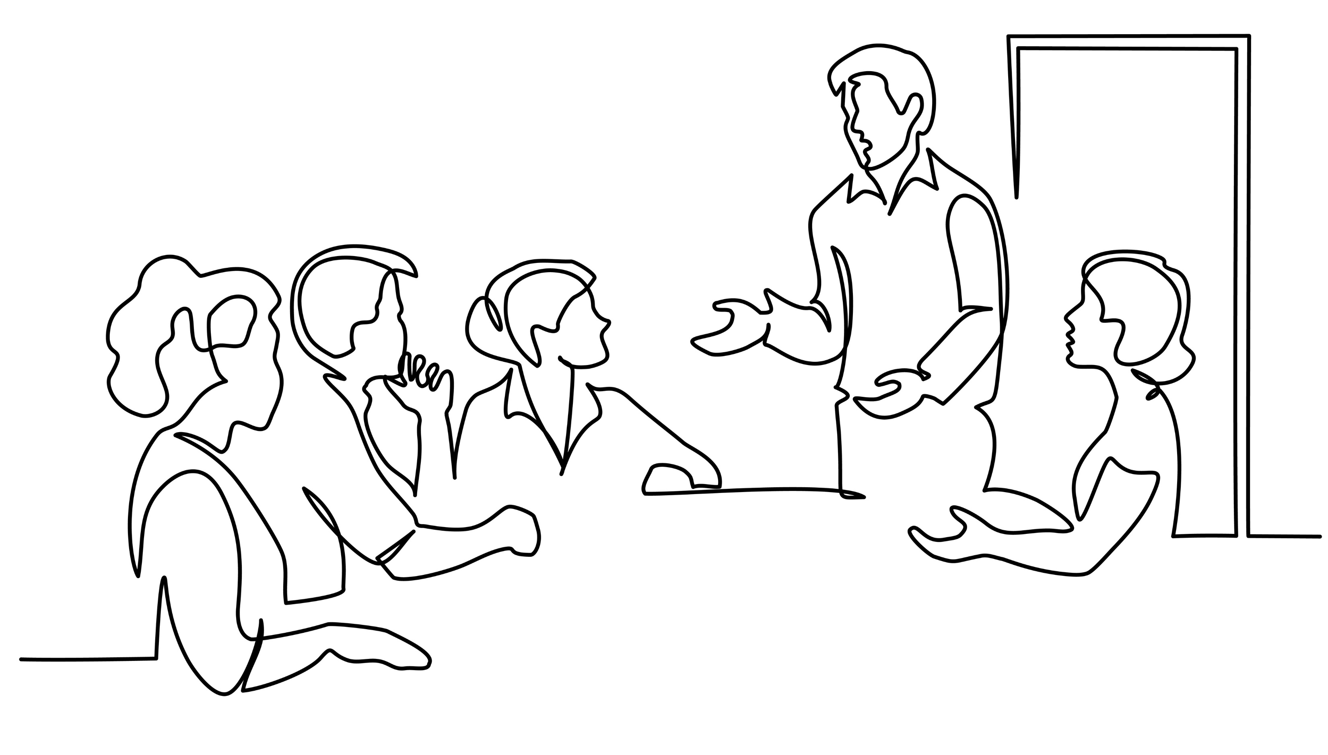
Teaching Notes
Created for consultation in teaching DBT skills
Organized by skill
Teaching notes have corresponding handouts and worksheets
Essential to review and refer to when teaching skills
SOURCE: Linehan, 2014a
Notes:
Trainer Notes:
Bullet 1 – "Teaching notes serve as your tool as group leaders to lead the groups and lessons with fidelity. They are meant for you to consult before your group sessions."
Bullet 2 – "These teaching notes are organized by skill so each module in each skills set has teaching notes that correspond to them."
Bullet 3 – "Teaching notes also have corresponding handouts and worksheets for clients so you know when and how to introduce these materials."
Bullet 4 – "It's essential to review and refer to these teaching notes when you teach skill sets to ensure fidelity and to help you prepare for group sessions.“
Photo Credit:
Purchased Image, Adobe Stock.

Slide 174
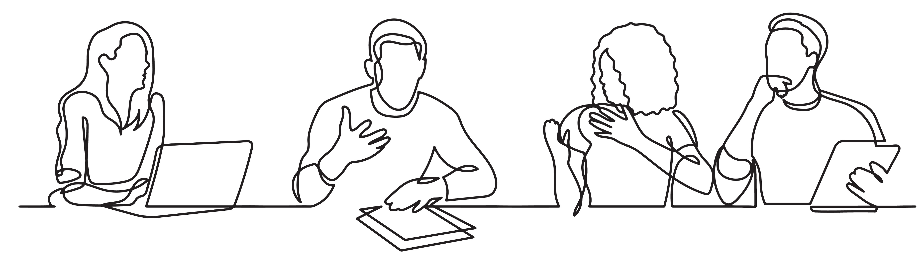
Client Handouts
Good tool for group leaders to refer to during sessions
Handouts can be referred to by group members when not in group sessions
SOURCE: Linehan, 2014a
Notes:
Trainer Notes:
Introduce slide – "Handouts are meant to aid group members' learning when you teach a new skill."
Bullet 1 – "They can be given to clients when you're going to teach them a new skill and they can refer to them during your lesson."
Bullet 2 – "Group members can also take these handouts home with them, and they can refer to them outside of training which helps aid retention and enables them to practice the skill outside of group sessions."
"There are many handouts available for group members throughout skills training (remember that each skill module has corresponding handouts). You may want to consider providing group members with binders so that they can collect handouts in a single place for easy reference."
Photo Credit:
Purchased Image, Adobe Stock.

Slide 175
Client Worksheets
Provide an opportunity for members to practice the skills they're learning in group
SOURCE: Linehan, 2014a
Notes:
Trainer Notes:
Bullet 1 – "Worksheets are provided at the end of group sessions as homework for members to practice the skill they just learned in session outside of session.“
Photo Credit:
Purchased Image, Adobe Stock.

Slide 176
Group Activity
Notes:
Trainer Notes: "We are going to transition into a group activity.“
Photo Credit:
Purchased Image, Adobe Stock.

Slide 177
Group Activity Instructions
You will be divided into small groups of approximately 4-6 people (take note of which breakout group you're in)
Take a moment to introduce yourselves to each other
Identify a volunteer in your break-out group who will be the notetaker and spokesperson – this person will take notes of what's discussed and share the break-out group's ideas in the larger group format following the activity​
Groups will have 10 minutes to address a list of discussion questions on the following slide
Notes:
Trainer Notes:
Emphasize that participants will need to identify a volunteer in their group who will be their notetaker and spokesperson – this volunteer will take notes of what's discussed and share the group's ideas in the larger group format following the break-out groups.

Slide 178
Group Activity Discussion Questions
How might DBT be beneficial to the individuals that you work with or the community you serve?
How might you integrate DBT into your existing treatment setting?
Notes:
Trainer Notes:
Trainer – engage the group in a discussion based on the preceding activity, using these questions as a framework for discussion.
In individual DBT sessions without group training, therapists focus on imparting the four specific skills that are central to DBT. These skills are practiced in sessions and applied to real-life situations. Therapists employ techniques such as role-playing and problem-solving to integrate DBT skills into the individual's daily life. While the absence of a group setting means that interpersonal dynamics are less emphasized, these sessions are personalized to address the unique challenges and goals of the individual.
Implementing a DBT group without individual sessions involves structured group activities focused on mindfulness, distress tolerance, and interpersonal skills. Members participate in skill-building exercises within the group setting, with limited individual check-ins for progress monitoring. However, without dedicated one-on-one sessions, the depth of personalized intervention for individual challenges may be constrained.
Supporting someone in individual therapy who is also participating in a DBT skills training group involves reinforcing and personalizing the skills learned in the group setting. The therapist collaborates with the individual to apply DBT skills to their specific life challenges and goals. They may delve deeper into individualized concerns, provide additional guidance, and address any difficulties encountered during the group sessions. This approach ensures that the individual receives tailored support and reinforcement for incorporating DBT skills into their personal journey outside the group context.
Photo Credit:
Purchased Image, Adobe Stock.

Slide 179
Resources for Continued Learning
Linehan, M. M. (2014a). DBT (R) Skills Training Handouts and Worksheets, Second Edition (2nd ed.). New York, NY: Guilford Publications.
Linehan, M. M. (2014b). DBT (R) Skills Training Manual, Second Edition (2nd ed.). New York, NY: Guilford Publications.
Dimeff, & Linehan, M. M. (2008). Dialectical Behavior Therapy for Substance Abusers. Addiction Science & Clinical Practice, 4(2), 39–47. https://doi.org/10.1151/ascp084239
Notes:
Trainer Notes:
"If you are going to run a group or implement any of the DBT skills into your work, you really need to purchase the manual."

Slide 180
Closing Mindfulness Exercise
Notes:
Trainer Notes:
"We're going to end today's training in the same way that we started it – with a mindfulness exercise. As we reviewed, it’s a common practice to begin and end DBT sessions, specifically DBT Skills Group Training sessions, with a mindfulness exercise.“
Photo Credit:
Purchased Image, Adobe Stock.

Slide 181
Mindfulness Meditation Exercise
Source: Great Meditation, 2021
Notes:
Trainer Notes: "This is a 5-minute exercise.“
Trainer begins exercise.
Closed captioning is available for this video.
---
Reference:
YouTube. (2021, March 7). 5 minute mindfulness meditation. YouTube. https://www.youtube.com/watch?v=ssss7V1_eyA

Slide 182
Mindfulness Meditation Exercise (2)
Source: JigsawYMH, 2020
Notes:
Trainer Notes:
If running out of time, this is a 1-minute exercise – trainer begins exercise.
Closed captioning is available for this video.
---
Reference:
YouTube. (2020a, March 29). One minute relaxation. YouTube. https://www.youtube.com/watch?v=4vDxcUK9v9k

Slide 183
Evaluation

Slide 184
Continuing Education (CE) Credit

Slide 185
END CODE
XXXX
You will be asked to enter the start and end codes in the CE Evaluation.
Notes:
Trainer Notes: "Here is the end code for today's training [say and repeat end code]. You will need the end code when you complete the CE evaluation "

