Slide 1
UCLA ISAP CME Health Equity Slide Compendium Background and Instructions
California requires that all continuing medical education includes information about cultural linguistic competency and implicit bias. In our ongoing efforts to meet those requirements, UCLA ISAP CME developed these slides for training planners and presenters to include in CME learning activities.
Use one or all that are relevant to your presentation.
The opening section includes general slides that can be used to address issues of language and stigma, as well as an introduction to racial equity through a lens of antiracism.
Following sections include specific data on racial disparities in opioid, stimulant, and cannabis use, disorder, treatment access, and other relevant topics. Slides include minimal formatting for ease of use in presentations. References and trainer are included in the Notes section of each slide.
Slide data will be updated annually. Additional sections may become available.
Funding for this product was made possible (in part) by the Substance Abuse and Mental Health Services Administration. The views expressed in written conference materials or publications and by speakers and moderators do not necessarily reflect the official policies of the Department of Health and Human Services, nor does the mention of trade names, commercial practices, or organizations imply endorsement by the U.S. Government.

Slide 2
Attribution
This resource is in the public domain and available to use in presentations in a variety of settings. Please consider adding the following attribution on materials.
UCLA Integrated Substance Use and Addiction Programs Continuing Medical Education Committee (UCLA ISAP CME), Health Equity Slide Compendium, 2024.

Slide 3
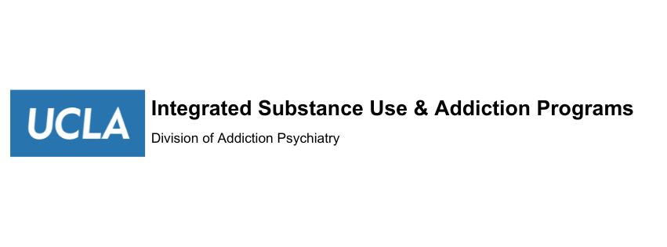
Health Equity Slide Compendium
UCLA Integrated Substance Use and Addiction Programs (ISAP) Continuing Medical Education
Fall 2024
Notes:
California requires that all continuing medical education includes cultural linguisitic competency and implicit bias. In order to meet those requirements, UCLA ISAP CME developed these slides for training planners and presenters to include in CME learning activities.
The opening section includes general slides that can be used to address issues of language and stigma, as well as an indigenous land acknowledgment. This section also includes an introduction to racial equity through a lens of antiracism to address
1. Antiracist policies and practices are essential to achieving true “access to care.”
ANTIRACISM = TRUE ACCESS
2. Anti Racist programs result in a higher standard of care for all patients.
ANTIRACISM => Higher standards
3. Antiracist programs form from policies and practices incorporated in all levels and functions of an organization.

Slide 4
Contributors, UCLA ISAP CME Program
Rosana Trivino-Perez LCSW (she/her/ella) Clinical Specialist
Francesca Villarreal, MSW, MBA (Osage, Quapaw, she/her) Clinical Specialist
Charles Hawthorne, MPH (they/them) Consultant
Gloria Miele, PhD (she/her) CME Chair
Beth Rutkowski, MPH (she/her) Training Director
Thomas Freese, PhD (he/him) Director
Notes:
Partially funded by the Substance Abuse and Mental Health Services Administration (SAMHSA) State Opioid Response SOR 3 Grant to the California Department of Health Care Services (DHCS).

Slide 5
Contents
Land acknowledgement and opening slide on language
Introduction to Racial Equity in Substance Use Treatment
Topic Specific Slides
Opioids
Stimulants
Cannabis

Slide 6
Indigenous Land Acknowledgement
We acknowledge the land and labor of the Indigenous people, whose connection to this land we remember, and whose presence—past, present, and future—we respect. We begin by acknowledging that we gather today on ancestral lands of Indigenous peoples who were removed unjustly, and that we in our various communities across the nation are the beneficiaries of that removal.
We honor them as we live and work within their lands.
Notes:
Land acknowledgement sample. Revise for individual needs and locations if desired.

Slide 7
Language Matters
Notes:
This slide can be used to increase awareness of the power of language when talking about people with a substance use disorder.
Facilitator can ask: What are some of the language issues that arise in your field? What are the stigmatizing terms people use to refer to patients? What are the more positive terms you can use?

Slide 8
Stigmatizing vs. Affirming Language
Stigmatizing | Affirming Alternative
Abuser, Addict, Junkie, Alcoholic | Person with a substance use disorder
Clean | Tested negative for substances; expected result
Dirty | Tested positive for substances; unexpected result
Drug abuse | Substance use
Relapse/lapse | Recurrence, resume
Substance Abuse/misuse | Substance Use Disorder

Slide 9
Cultural Humility Respects Differences
Bridging perspectives between ourselves and the people in our care
“Lifelong process of learning, self-examination & refinement of one’s own awareness, knowledge, behavior and attitudes on the interplay of power, privilege and social contexts.”
Tervalon, M. & Murray-Garcia, J. (1998, Journal of Health Care for the Poor and Underserved, 9(2), 117
Notes:
“Lifelong process of learning, self-examination & refinement of one’s own awareness, knowledge, behavior and attitudes on the interplay of power, privilege and social contexts.”
Tervalon, M. & Murray-Garcia, J. (1998, Journal of Health Care for the Poor and Underserved, 9(2), 117
Understanding equity requires a stance of cultural humility to respect differences, bridge perspectives, and continue to engage in self-reflection and empathy when connecting with other.

Slide 10
Introduction to Racial Equity in Substance Use Treatment

Slide 11
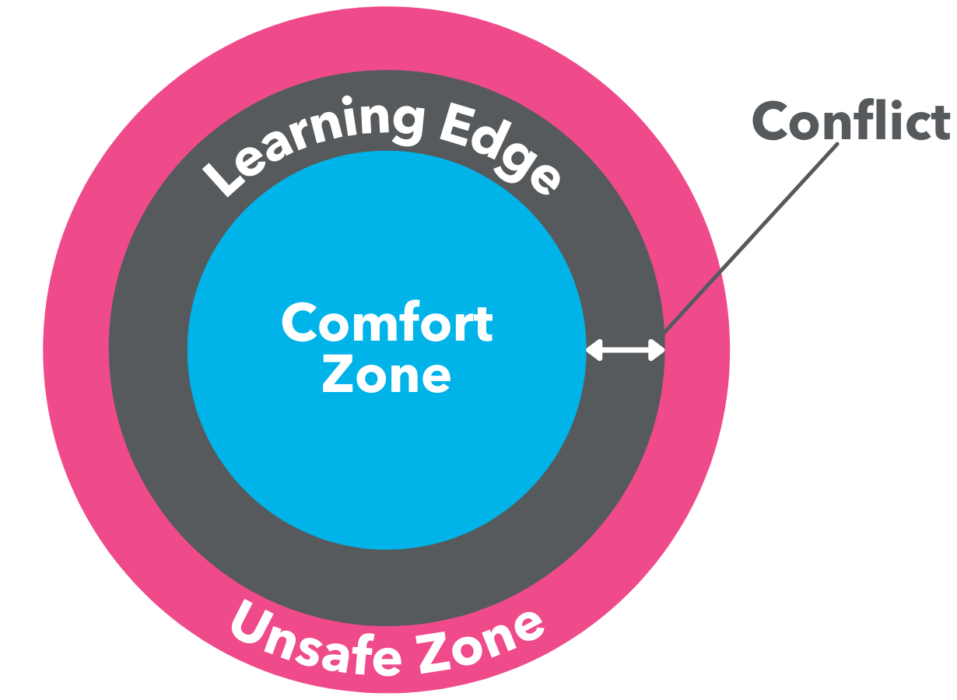
Establishing a Brave Space for Dialogue
“Learning necessarily involves not merely risk, but the pain of giving up a former condition in favor of a new way of seeing things.”
-(RB Rom 1998)
Notes:
5 min
A way to frame the dialogue around social justice. Guidelines for difficult conversations. The edge of the comfort zone is where learning is maximized.
Trying to keep everyone in a place of learning.
Examples: Engage with honesty, sensitivity, respect, authenticity. Acknowledging your privilege, biases. Active listening & critical reflection. Willingness to challenge oneself, dominant norms. Different views expected and honored, with commitment to understanding sources of disagreement. Accountability for your intentions & your impact
What helps you feel safe leaving your comfort zone to enter your learning edge? (Type into chat,
Arao, B., & Clemens,K.From safe spaces to brave spaces: A new way to frame dialogue around diversity and social justice. The Art of Effective Facilitation

Slide 12
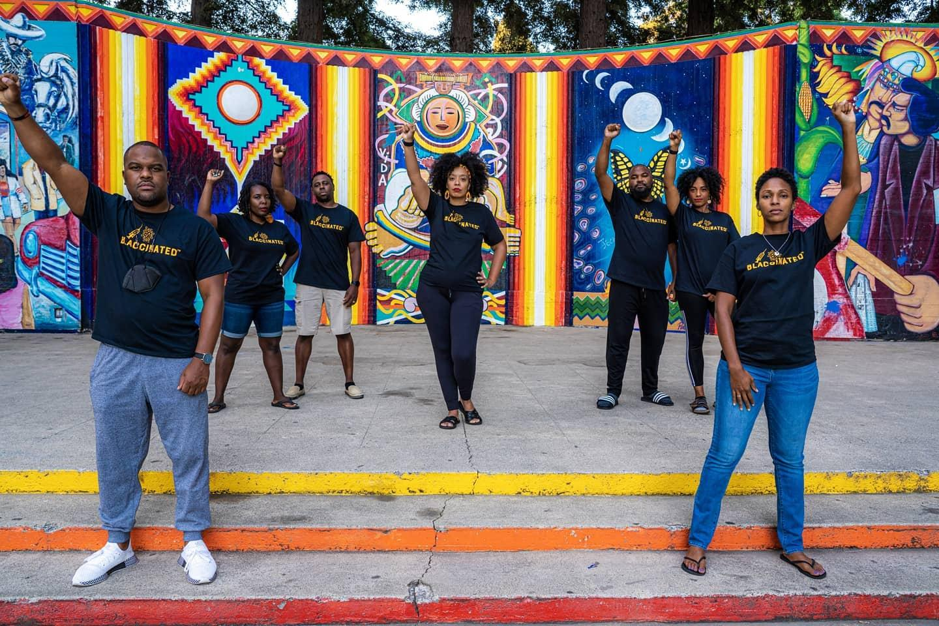
Racial Equity
In a racially equitable society, the distribution of society’s benefits and burdens would not be skewed by race. This would be a reality in which a person is no more or less likely to experience society’s benefits or burdens just because of the color of their skin..
Institute Staff. (2021, February 10). 11 terms you should know to better understand structural racism. The Aspen Institute. Retrieved August 19, 2022,
Photo credit: DeAngelo Mack
Notes:
5 min
https://www.aspeninstitute.org/blog-posts/structural-racism-definition/
Race is acknowledged, celebrated, and doesn’t impact your chance of survival

Slide 13
Foundations of Racial Equity
Our world is steeped in racism
Dismantling racism is everyone’s work
We have been socialized not to talk about social injustice
The problem (and solution) is in policies, not people
Complex emotions (guilt, shame, anger, resentment, defensiveness, denial)
Health professionals have not been taught about the connection between injustice, oppression, and health
Notes:
5 min
Examples of racism
Red-lining, Japanese internment, racist drug policy/harm to communities of color/mass incarceration, Bup access in communities of color (Helena Hansen), rising rates of opioid OD deaths in AA communities
Not talking about racism serves white supremacy, not able to undo these impacts, maintains the status quo
Complex emotions may come up->avoidance
Key necessity for opioid OD prevention. POC disproportionately impacted. Everyone has potential to cause harm, so we all have to be engaged in dismantling.
Everyone’s work, but not any person’s fault.
Ibram Kendi: “The only way to undo racism is to consistently identify and describe it-and then dismantle it”
“Denial is the heartbeat of racism, beating across ideologies, races, and nations. It is beating within us.”

Slide 14
Antiracism
A system in which we create policies, practices, and procedures to promote racial equity. It generates anti-racist ideas which uplift the innate humanity and individuality of Black, Indigenous, and People of Color (BIPOC). It forces us to analyze the role of systems and institutions in the racial inequities we see, rather than blaming people.
Focus on the role that systems and policies and people can play in creating more equity in health care.
National League of Cities. (2022, August 10). What does it mean to be an anti-racist? National League of Cities. Retrieved August 19, 2022,
Notes:
5 min
To achieve health equity, being “not racist” is not enough. Ibram Kendi’s book describes what is meant by “antiracist,’ specifically creating policies and practices that promote racial equity. Instead of blaming people, focus on the role that systems and policies play in creating more equity.
Being “not racist” is not enough; it is passive; it does not require action; it allows the inequitable systems to thrive.
To achieve health equity requires an anti-racist approach in health care

Slide 15
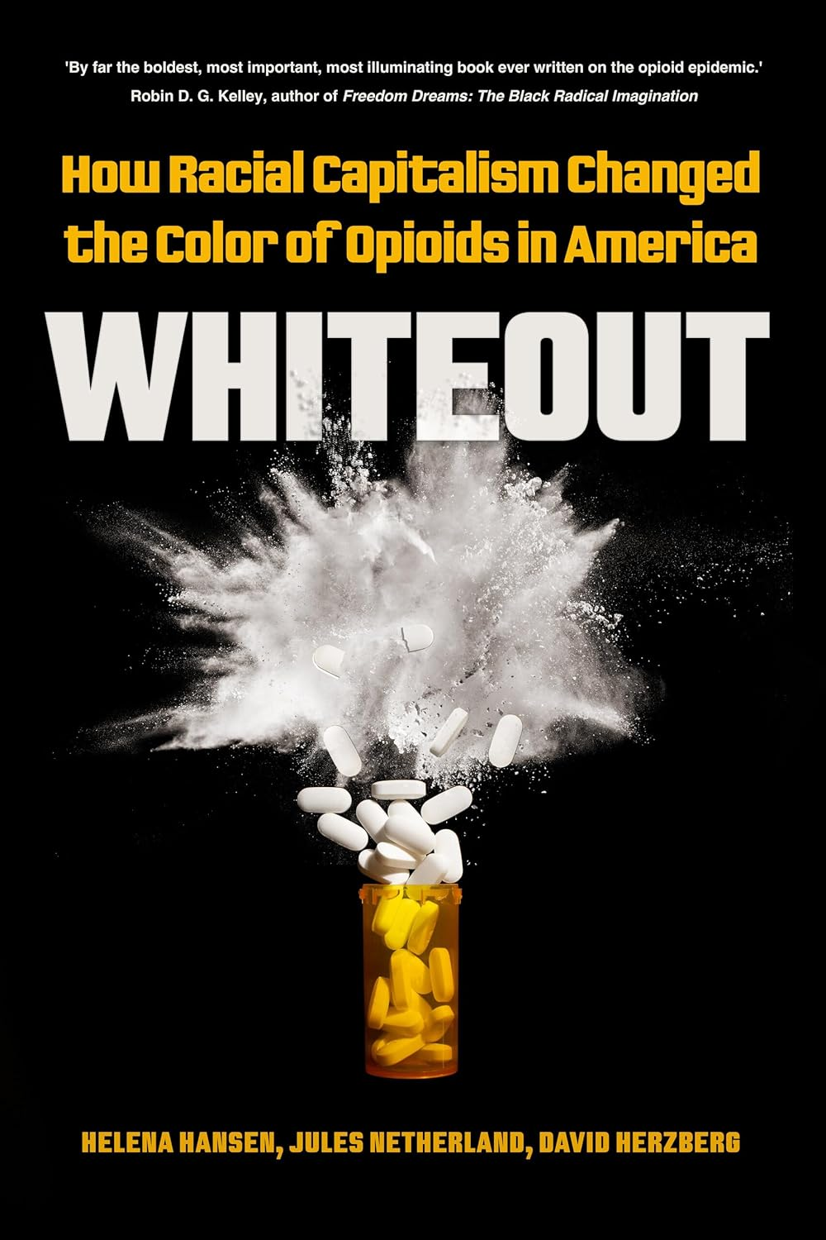
Recommended Reading
Notes:
A host of papers are written about racial disparities and SUD treatment. These books provide a deeper understanding of racial disparities in medicine, the opioid epidemic, and the policies that can be addressed to improve health access for all.

Slide 16
Racial Disparities in Opioid Overdose and Treatment Access

Slide 17
Racial Disparities in Overdose Deaths are Worsening Over Time in California
Notes:
Data compiled from the California Opioid Overdose Dashboard.
TRAINERS NOTES: Relative overdose death rates are continuing to increase for Black and AI/AN (Native American) people in California. This chart, compiled from publicly available data from the California Opioid Overdose Dashboard, shows that Black and AI/AN (Native American) people are experiencing disproportionately higher increased in OD deaths as compared to White people in California. While there was a general “leveling off” in OD death rates for White, Latinx, and API populations around 2021, Black and AI/AN populations continue to experience increased death rates.
This data is age-adjusted per 100,000 residents and shows data from Q1 2017 - Q1 2023

Slide 18
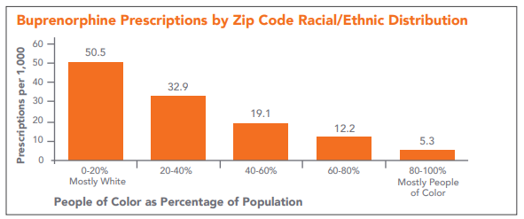
Racial Disparities in Access to Buprenorphine Persist Due To Limited Access Based On Geographical Location
Notes:
SOURCE: “Racial Disparities in Access to Medication for Addiction Treatment, ” (CA Bridge)
THE BIG IDEA: More bup prescriptions were written in CA Zip Codes with higher proportions of White residents, while Zip codes with more people of color had the least written. Given that buprenorphine is a gold standard for substance use treatment, this disparity is concerning.
WHAT WE FOUND Buprenorphine prescription rates decrease as the proportion of people of color in a zip code increases. Prescription rates in the zip codes with the highest percentage of White residents are almost ten times higher than the rates for zip codes with the highest percentage of people of color.
Income does not explain the lower rates of buprenorphine prescriptions in communities of color. When lower-income areas and higher-income areas are compared, the overall levels of buprenorphine prescriptions across both groups are similar (21.7 vs. 21.4). However, within both lower and higher-income communities, there are significant differences by race/ethnicity. These differences also persist for urban vs rural areas of the state.

Slide 19
Substance use disorder treatment is not provided equitably to people of color
A 2019 study found that Black patients were 77% less likely to receive buprenorphine than White patients in the outpatient setting.
A 2024 study found that disparities in distance to travel to access substance use treatment persist, with residents in American Indian/Alaska Native-majority areas traveling the longest distances to access treatment.
Notes:
Lagisetty PA, Ross R, Bohnert A, Clay M, Maust DT. Buprenorphine Treatment Divide by Race/Ethnicity and Payment. JAMA Psychiatry. 2019;76(9):979–981. doi:10.1001/jamapsychiatry.2019.0876
Amiri, S., Panwala, V., & Amram, O. (2024). Disparities in access to opioid treatment programs and buprenorphine providers by race and ethnicity in the contiguous US. Journal of substance use and addiction treatment, 156, 209193.
TRAINER’S NOTES
Advancing Equity and Reducing Harm to Communities of Color from Drug Use"
Treatment of opioid use in 2002, allowed treatment for opioid use disorder to be available for the first time in regular medical settings. However, primarily White patients have benefited from this newer, more convenient treatment
Disparities in bup access were also found in a national study of 3,142 counties where counties with high
concentrations of African American and Latinx residents had more facilities to provide methadone per capita,
while counties with high concentrations of White residents had more facilities to provide bup.13 These disparities
are significant because methadone is highly stigmatized,14 and it requires patients to line up, often in noticable
public spaces, to receive daily doses from specialized clinics.
This history affects our work
The opioid epidemic, which initially affected more White Americans, changed the national conversation about
substance use and brought more recognition to substance use as a medical condition, in need of treatment
rather than incarceration. This is a positive shift; however, as medical professionals, we should anticipate the
understandable cynicism or mistrust in communities of color when we offer treatment for drug use while many
people in these communities were, and still are, in jail for the same behaviors.

Slide 20
Reducing Racial Barriers to OUD Treatment
Educate and train providers on the importance of discussing treatment options with all patients, especially patients of color
Work with providers that offer services to BIPOC populations to offer treatment options (Hospital-based EDs, FQHCs, Community Health Centers, etc.)
Use data to understand and address local disparities
Support whole-person care approaches that can integrate substance use treatment as part of a larger health plan

Slide 21
Racial Disparities in Stimulant Overdose and Treatment Access

Slide 22
Stim Stimulant-involved Overdose Stimulant-involved Overdose Deaths
From 2016 to 2022, all racial and ethnic groups experienced increases in rates of overdoses involving both cocaine and opioids and rates of overdoses involving both psychostimulants and opioids
Drivers of this increase include:
Increase availability and quality in supply of methamphetamine
Intentional co-use of stimulants and opioids together
Unintentional co-use due to cross-contamination in supply or tools for consumption (i.e. pipes)
These increases are disproportionately impacting people of color
Notes:
TRAINER NOTES;
Drug overdose deaths involving stimulants like cocaine and, methamphetamine have increased significantly. These increases are disproportionately affecting racial and ethnic minority populations.
Why are stimulant-involved overdose deaths increasing? Why are racial and ethnic minority populations more affected than others?
The disproportionate increase in stimulant-involved death rates among Black and AI/AN persons may partly be due to health inequities like unequal access to substance use treatment and treatment biases.
Overall factors that may be influencing the surge in stimulant-involved death rates include increases of:
Supply of methamphetamine
Use of stimulants and opioids together
Presence of fentanyl in other illicit drugs, also known as “contamination” or “lacing” of other drugs
While these factors may have contributed to the increase of stimulant-involved overdose deaths, disparities in stimulant-involved overdose deaths among Black and AI/AN persons are not fully explained by substance use patterns. For instance, recent data show that while rates of past-year cocaine use among Black and White persons are not significantly different, cocaine-involved overdose death rates among Black persons were more than twice as high as those among White persons in 2019.
REFERENCE
Source: Charting the Stimulant Overdose Crisis & the Influence of Fentanyl (Nov 17 2022) The National Institute for Health Care Management (NIHCM) Foundation (https://nihcm.org/publications/stimulant-drug-overdose-deaths-2022-update)

Slide 23
Stimulant-involved Overdose Deaths Disproportionately Affect Racial and Ethnic Minority Groups
Death rates for overdoses involving psychostimulants were generally higher among American Indian/Alaska Native (AI/AN) persons than among other racial and ethnic groups.
From 2004 to 2019, death rates for overdoses involving cocaine were generally higher among Black persons than other racial and ethnic groups.
From 2013 to 2019, most racial and ethnic groups experienced increases in rates of overdoses involving both cocaine and opioids and rates of overdoses involving both psychostimulants and opioids.
Notes:
TRAINER NOTES;
Drug overdose deaths involving stimulants like cocaine and, methamphetamine have increased significantly. These increases are disproportionately affecting racial and ethnic minority populations.
Why are stimulant-involved overdose deaths increasing? Why are racial and ethnic minority populations more affected than others?
The disproportionate increase in stimulant-involved death rates among Black and AI/AN persons may partly be due to health inequities like unequal access to substance use treatment and treatment biases.
REFERENCE
Source: Charting the Stimulant Overdose Crisis & the Influence of Fentanyl (Nov 17 2022) The National Institute for Health Care Management (NIHCM) Foundation (https://nihcm.org/publications/stimulant-drug-overdose-deaths-2022-update)

Slide 24
Cocaine Involved Overdoses by Race and Ethnicity
Notes:
TRAINER NOTES:
Fig. 1. a-c. Age-adjusted rates of drug overdose deaths involving cocaine overall and with or without opioid co-involvement by race and ethnicity -- United States, 2004–2019.
Unlike other racial and ethnic groups, the rate of cocaine-involved overdose deaths among White persons remained stable from 2017 to 2019 (4.6 per 100,000 persons in each of these three years). Cocaine-involved overdose death rates were consistently highest for Black persons compared to other racial and ethnic groups. Rates among Black persons decreased from 2004 to 2012 (4.3–3.0) and then increased from 2012 to 2019 (3.0–10.7) (Fig. 1a).
Drug overdose deaths involving stimulants, including cocaine and psychostimulants with abuse potential (e.g., methamphetamine), have been increasing, partly because of co-involvement with opioids. Stimulant-involved overdose deaths have disproportionately increased among non-Hispanic Black (Black) and non-Hispanic American Indian/Alaskan Native (AI/AN) persons
Index: stimulant, cocaine, overdose
REFERENCE
Kariisa, M., Seth, P., Scholl, L., Wilson, N., & Davis, N. L. (2021). Drug overdose deaths involving cocaine and psychostimulants with abuse potential among racial and ethnic groups–United States, 2004–2019. Drug and alcohol dependence, 227, 109001. Chicago

Slide 25
Decreasing Racial Disparities in Stimulant-Involved Overdose Deaths
Train and educate providers discuss overdose with patients of color that are co-using stimulants and opioids, as well as the risks for accidental cross-contamination
Discuss harm reduction-based options with patients to reduce the risk of stimulant overdose with a special focus on supporting patients that use cocaine, crack, and methamphetamine
Offer tools and resources that serve patients that are using stimulants, not just opioids. These include pipes and other smoking materials
Notes:
TRAINERS NOTES:
Overdose deaths involving stimulants have increased significantly in recent years, with racial and ethnic minority groups disproportionately affected. Our study aimed to better understand differences between racial and ethnic groups that could inform prevention efforts. During 2004–2019, death rates for overdoses involving cocaine and psychostimulants were consistently higher among Black and AI/AN persons, respectively. Between 2013 and 2019, most racial and ethnic groups had increases in rates of overdoses co-involving cocaine and opioids as well as psychostimulants and opioids
However, overdoses during 2004–2019 also reveal a disproportionate impact on certain racial and ethnic minority groups, as cocaine- and opioid co-involved rates plateaued in 2019 among White persons but continued to increase among Black and Hispanic persons. Among Black persons, from 2016 to 2019, the death rates co-involving cocaine and opioids surpassed cocaine-involved death rates that did not co-involve opioids. Between 2018 and 2019, deaths co-involving cocaine and synthetic opioids increased slightly for White persons but increased by over 30 % for Black and Hispanic persons. Furthermore, White persons were the only group to experience decreases in cocaine-involved overdoses in the absence of synthetic opioid co-involvement. Lastly, from 2018 to 2019, increases in rates co-involving psychostimulants and opioids were greater than those without opioid co-involvement for White, Black, AI/AN, and Hispanic persons, suggesting that opioids, specifically synthetic opioids, may play a larger role in driving recent increases in deaths among these populations. These analyses support findings from previous studies indicating a disproportionate impact of cocaine-involved overdoses among Black persons and psychostimulant-involved overdoses among AI/AN persons (Cano, 2021; Kariisa et al., 2019; Mustaquim et al., 2021)
cocaine-involved overdose death rates among Black persons were more than twice as high as those among White persons in 2019. During 2016–2018, reported use of methamphetamine was more than three times as high as the national average for AI/AN persons aged 26 years old and older (2.6 % vs 0.7 %) (Center for Behavioral Health Statistics and Quality, 2019). However, despite a decline in reported methamphetamine use in 2019, increases continued in psychostimulant-involved mortality among AI/AN persons (Center for Behavioral Health Statistics and Quality, 2020). These increases in disproportionate stimulant-involved mortality rates among Black and AI/AN persons may partly result from unequal access to substance use treatment, and treatment biases that may result in disparities in healthcare quality and services (Lagisetty et al., 2019)
Index: stimulant, treatment, overdose, CM, cocaine, crack, harm reduction
REFERENCE
Drug overdose deaths involving cocaine and psychostimulants with abuse potential among racial and ethnic groups – United States, 2004–2019 - ScienceDirect
Mbabazi Kariisa, Puja Seth, Lawrence Scholl, Nana Wilson, Nicole L. Davis,
Drug overdose deaths involving cocaine and psychostimulants with abuse potential among racial and ethnic groups – United States, 2004–2019,
Drug and Alcohol Dependence, Volume 227, 2021, 109001,ISSN 0376-8716,
https://doi.org/10.1016/j.drugalcdep.2021.109001.
(https://www.sciencedirect.com/science/article/pii/S0376871621004968)

Slide 26
Racial Disparities in Cannabis Consumption and Consequences

Slide 27
Language Matters: “Cannabis” vs. “Marijuana”
Harry Anslinger: first director of newly-created Federal Bureau of Narcotics in 1930
Engaged in crusade against cannabis and demonized Mexican immigrants who smoked cannabis; intentionally used the word “marijuana” to associate the drug with them
Made statements like “Marijuana is the most violence-causing drug in the history of mankind… Most marijuana smokers are Negroes, Hispanics, Filipinos and entertainers. Their satanic music, jazz and swing, results from marijuana usage.”
Involved in making of the film “Reefer Madness”, which demonized cannabis users as members of “degenerate races”
“Marijuana” thus now considered a racist term by many
Adopt change in terminology except when citing existing research
Notes:
Additional history for trainer: Cannabis was being imported by pharmaceutical companies in the early 1900s and it wasn’t until Prohibition and a shift towards Progressive(at the time)-era regulation of substances like cannabis and opioids that the negative connotations took hold. In fact, there are records of smuggling going INTO Mexico during Prohibition due to the Mexican government banning cannabis in 1920. Immigrants were noted to rarely use cannabis. This was a systemic campaign designed to associate “foreign-ness” of cannabis and Mexican-Americans at a time of high rates of immigration among Mexicans escaping civil war. Author and scholar Isaac Campos has noted, “When drugs are seen as foreign, they’re seen as more dangerous.”

Slide 28
Marijuana Use in the Past Month by Racial and Ethnic Group: People Aged 12 and Older
Notes:
REFERENCE: 2022 National Survey on Drug Use and Health: Among the Multiracial Population Aged 12 or Older. (2024). https://www.samhsa.gov/data/sites/default/files/reports/rpt44472/2022-nsduh-pop-slides-multiracial.pdf
‌
‌
TRAINER NOTES
According to the 2022 National Survey on Drug Use and Health conducted by SAMHSA, the percentage of people aged 12 or older who used marijuana in the past year was higher among Multiracial people (24.6%) than among Black (16.8%), White (15.6%), Hispanic (13.5%), or Asian people (6.2%). American Indian/Alaska Native people had the 2nd highest rate at 18.0%
Index: Cannabis, NSDUH

Slide 29
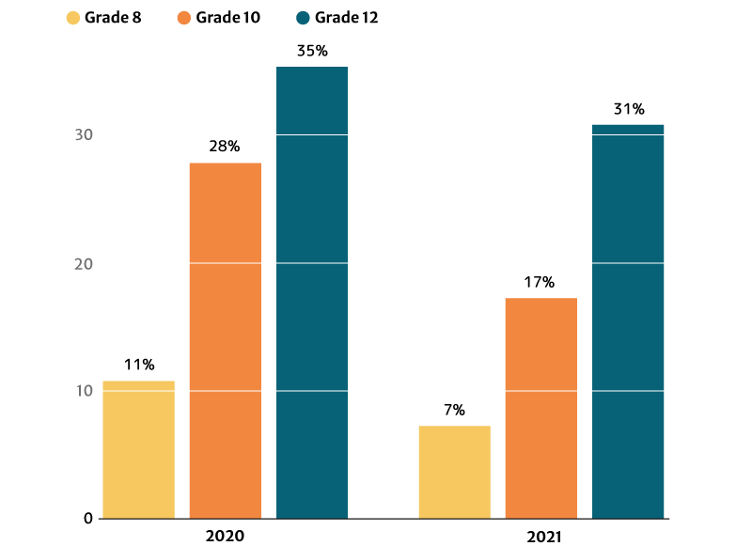
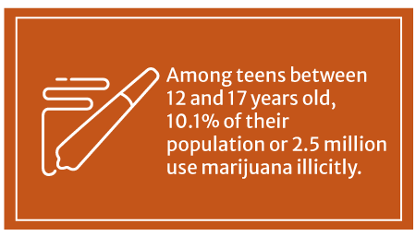
Cannabis Use Among Youth
Notes:
REFERENCE: Julia, N. (2022, July 29). Marijuana Statistics in the US: Cannabis Use & Abuse (2024 Data Update). CFAH. https://cfah.org/marijuana-statistics/#:~:text=12%25%20of%20American%20adults%20have%20smoked%20marijuana%20in
‌
TRAINER NOTES
10.1% or 2.5 million American teens between 12 and 17 years old use marijuana illicitly, says the Substance Abuse and Mental Health Services Administration’s (SAMHSA) 2020 survey.
The 2021 report published on the National Institute on Drug Abuse website (NIDA) also notes that marijuana use is highest among 12th graders at 30.5%. However, this percentage has decreased from 2020’s 35.2%.
10th graders ranked second in marijuana users at 17.3%, a decrease in percentage from the 2020s at 28%.
Marijuana users among 8th graders also decreased from 11.4% in 2020 to 7.1% in 2021.
Marijuana legalization, licensed dispensaries replacing drug dealers, and teens having a harder time obtaining illegal weed played a part in reducing their number, says a 2019 study published in Jama Psychiatry.
In states that have legalized recreational weed, there has already been an 8% decrease in the likelihood of minors trying marijuana.
Index: cannabis, youth, demographics

Slide 30
Overall arrest rates decreased, but racial disparities in arrest persisted after legalization in California
A tale of two countries: Racially targeted arrests in the era of marijuana reform. American Civil Liberties Union. (2020).
Notes:
Decriminalization and legalization have greatly reduced overall arrest rates for cannabis possession in CA, but racial disparities have continued to negatively impact Black people in cA
A tale of two countries: Racially targeted arrests in the era of marijuana reform. American Civil Liberties Union. (2020). https://www.aclu.org/report/tale-two-countries-racially-targeted-arrests-era-marijuana-reform
Index: cannabis, legalization, arrests

Slide 31
Treatments for Cannabis Use Disorder
Currently, the FDA has not approved any medications for the treatment of cannabis use disorder, but research is active in this area.
The following behavioral treatments have shown promise
Cognitive Behavioral Therapy
Contingency Management
Motivational Enhancement Therapy
Notes:
REFERENCE: National Institute on Drug Abuse. (2020, July). Available treatments for marijuana use disorders. National Institute on Drug Abuse. https://nida.nih.gov/publications/research-reports/marijuana/available-treatments-marijuana-use-disorders
‌
TRAINER NOTES
On average, adults seeking treatment for marijuana use disorders have used marijuana nearly every day for more than 10 years and have attempted to quit more than six times.
Currently, the FDA has not approved any medications for the treatment of marijuana use disorder, but research is active in this area.
The following behavioral treatments have shown promise:
Cognitive-behavioral therapy: A form of psychotherapy that teaches people strategies to identify and correct problematic behaviors in order to enhance self-control, stop drug use, and address a range of other problems that often co-occur with them.
Contingency management: A therapeutic management approach based on frequent monitoring of the target behavior and the provision (or removal) of tangible, positive rewards when the target behavior occurs (or does not).
Motivational enhancement therapy: A systematic form of intervention designed to produce rapid, internally motivated change; the therapy does not attempt to treat the person, but rather mobilize his or her own internal resources for change and engagement in treatment.
Index: cannabis, treatment, medications
Treatments for cannabis abuse and dependence are behavioral, generally involving the use of talk to restructure the way people approach cannabis use and the role that cannabis plays in their lives. Some of the common treatments include motivational enhancement therapies (motivating behavior change by highlighting how cannabis may be inhibiting the achievement of life goals), cognitive behavioral therapy (changing individuals’ beliefs and thought processes surrounding drug use), contingency management (using incentives and behavioral psychology techniques to motivate drug use behavior change), and family-based treatment. Though these approaches are successful, it is very difficult for people who abuse or are dependent on cannabis to stop using; only 10-30% of people who receive treatment for cannabis use disorders are able to remain abstinent from the drug one year later. There are currently no medications available to treat or manage cannabis dependence, though there are drugs currently being developed to help treat cannabis withdrawal symptoms.
Additional Information for the Trainer(s)
Currently, research with the following medications is being conducted to see if any of them have effects on cannabis abuse/dependence and cannabis withdrawal symptoms: Buspirone, diazepam, quetiapine, dronabinol + clonidine, lofexidine, Gabapentin, vilazodone, N-acetylcystein, zolpidem, nicotine patch, guanfacine, aprepitant, citicoline, tiagabine, escitalopram, oxytocin, H-coil Deep TMS. SOURCE: www.clinicaltrials.gov.

