Slide 1
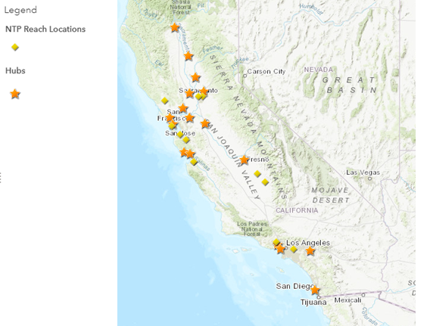
H&SS and NTP REACH Locations in California

Slide 2
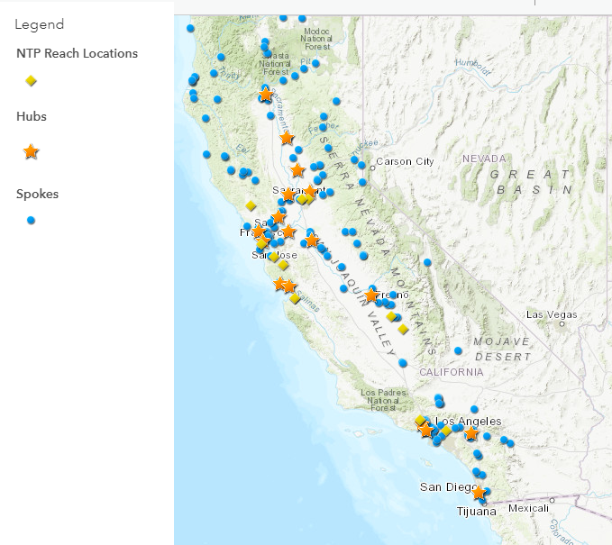
H&SS Locations in California

