Slide 1
Pacific Behavioral Health Collaborating Council
Alcohol and Drug Counselor (ADC) Academy, Day 4
Core Competencies of Addiction Counselors: Prevention and Treatment of HIV/AIDS and Sexually Transmitted Infections
Enter location here
Enter dates here
Enter trainer names and credentials here
1
Notes:
INSTRUCTIONS
Welcome participants to day 4.
Ask participants if they have any questions from day 3.

Slide 2
Acknowledgements
This training was developed by Dr. Thomas E. Freese, PhD (Director of Training of UCLA ISAP and Director of the Pacific Southwest ATTC), Alex R. Ngiraingas, MEd, CSAC II, ICADC, ICPS, and Dr. Christopher C. C. Rocchio, PhD, LCSW, CSAC, ICADC (Clinical Specialist, UCLA) in August of 2018 under contract number 2018-002 by the University of California Los Angeles, Integrated Substance Abuse Programs (UCLA ISAP) and the Pacific Southwest Addiction Technology Center (PSATTC) for the Pacific Behavioral Health Collaborating Council (PBHCC). Additional resource provided by SAMHSA, grant number UR1TI080211.
Notes:
TRAINER NOTES
This training was developed by Drs. Thomas Freese and Christopher Rocchio from the University of California Los Angeles, Integrated Substance Abuse Programs (UCLA ISAP) and with Alex Ngiraingas, an addictions counselor and educator from the Republic of Palau. We would like to acknowledge and thank the Pacific Behavioral Health Collaborating Council (PBHCC) for their commitment to train individuals across the Pacific to effectively prevent, treat, and support individuals in their own recovery from substance use disorders, and for their financial support for the development and delivery of this curriculum. We would also like to acknowledge Thomas Donohoe, MBA, from the Pacific AIDS Education and Training Center, who provided many of the slides that appear in the Day 4 curriculum. Additional resource provided by SAMHSA, grant number UR1TI080211.

Slide 3
Disclaimer
The UCLA, its employees, contractors, and affiliates shall not be liable for any damages, claims, liabilities, costs, or obligations arising from the use or misuse of materials or information contained in this presentation. Any use, copying, or distribution without written permission from the UCLA and the PBHCC is prohibited.
Notes:
INSTRUCTIONS
[READ THE SLIDE]

Slide 4
Today’s Agenda (1)
Review and check-in
What is HIV and AIDS?
Learning objectives
HIV Histories (World, US, Local, Personal)
HIV Medical Update
  Modes of Transmission
  Acute HIV Infection
  Testing/Screening
  Medications for HIV
  HIV Prevention
Sexually Transmitted Infections
Notes:
INSTRUCTIONS
Be prepared to distribute paper copies of the practice exam. Participants are expected to complete the practice exam on their own after class.
[ASK PARTICIPANTS] Do you have any questions regarding the 12 core functions?
[ASK PARTICIPANTS] Do you have any questions regarding any of the materials we had covered the first three days of this training?
Orient participants to the day’s agenda.

Slide 5
HIV and AIDS (1)
Review and check-in
What is HIV and AIDS?
Learning objectives
HIV Histories (World, US, Local, Personal)
HIV Medical Update
  Modes of Transmission
  Acute HIV Infection
  Testing/Screening
  Medications for HIV
  HIV Prevention
Sexually Transmitted Infections
Notes:
PEDAGOLOGICAL SUGGESTIONS
[ASK PARTICIPANTS] What do you know about HIV and AIDS?
[ASK PARTICIPANTS] What do you hope to learn in today’s session?

Slide 6
What is HIV?
H – Human
I – Immuno-deficiency
V – Virus
Notes:
TRAINER NOTES
HIV stands for “human immunodeficiency virus.”

Slide 7
Definition of
Human Immunodeficiency Virus
This is the virus that weakens the immune system.
The immune system defends the body against infections or diseases.
Once a person is infected with HIV, they are infected for life.
There is no cure for HIV.
Notes:
TRAINER NOTES
[READ THE BULLETED LIST ON THE SLIDE]

Slide 8
What is AIDS?
AIDS is an acronym for acquired immunodeficiency syndrome
A - acquired, because it is not inherited
I - immuno, because it affects the immune system
D - deficiency, because the body lacks immunity
S - syndrome, because the symptoms occur as a group
Notes:
TRAINER NOTES
Acquired means that you catch it even though you may be a very healthy person. Immune refers to one of the body systems called the immune system. The job of the immune system is to protect the body against sickness and disease. Deficiency refers to “a lack of.” Immunodeficiency means that the body’s natural defence system does not work properly. Syndrome refers to a set of symptoms. For example, some of the symptoms for the common cold include a runny nose, sore throat, and cough. When a person contracts AIDS, there is a common set of symptoms.

Slide 9
Definition of AIDS
AIDS occurs when HIV has completely destroyed the immune system of an infected person, over a period of time.
Most people infected with HIV look and feel healthy most of the time, however the virus slowly damages the persons immune system.
This mean they are less able to resist and recover from infections
Notes:
TRAINER NOTES
In short, AIDS is a disease that attacks the human immune system so that when a person dies of AIDS the direct cause of death includes such things as pneumonia, tuberculosis, and cancer.
[READ THE BULLETED LIST ON THE SLIDE]

Slide 10
Question 1
What body fluid can NOT transmit HIV?
Blood
Saliva
Breast milk
Semen
Pre-ejaculatory fluid
Notes:
TRAINER NOTES
Before getting started, let’s see what you already know about HIV and AIDS.
[ASK PARTICIPANTS] What body fluid can NOT transmit HIV?
The correct answer is saliva. All others can transmit HIV.

Slide 11
Question 2
An HIV-positive person is defined as having progressed to AIDS, when they get an AIDS-defining illness or if their CD4 cells fall below…
1,500
1,000
500
200
50
Notes:
TRAINER NOTES
[ASK PARTICIPANTS] An HIV-positive person is defined as having progressed to AIDS, when they get an AIDS-defining illness or if their CD4 cells fall below…
The correct answer is 200. Once a person living with HIV has their CD4 cells or T cells drop below 200 they are defined as having AIDS.

Slide 12
Question 3
If someone has an “undetectable” viral load, it means there is no virus in their blood.
True
False
Notes:
TRAINER NOTES
[ASK PARTICIPANTS] If someone has an “undetectable” viral load, it means there is no virus in their blood.
The correct answer is false. Someone is “undetectable” because the test (often called a viral load test) cannot detect any virus. Usually it means they have fewer than 200 or even 20 copies of virus per microliter of blood. However, if they stop taking their medications the HIV virus will rebound.

Slide 13
Question 4
Which group has the highest rate of HIV-infection in the U.S. (choose 1)?
1. Men who have sex with men (any age)
2. Women over 65
3. Married women under 65
4. Heterosexual men (any age)
5. Single women (any age)
Notes:
TRAINER NOTES
[ASK PARTICIPANTS] Which group has the highest rate of HIV-infection in the US?
The correct answer is number 1: men who have sex with men.

Slide 14
Question 5
In 2017, which medication is approved for PrEP (Pre Exposure Prophylaxis) for HIV?
1. Nuvada
2. Malvida
3. Anvida
4. Truvada
5. I don’t know what PrEP is.
Notes:
TRAINER NOTES
[ASK PARTICIPANTS] In 2017, which medication is approved for PrEP (Pre Exposure Prophylaxis) for HIV?
The correct answer is Truvada.

Slide 15
Question 6
What year was PrEP for HIV approved in the US?
1. 2017
2. 2016
3. 2015
4. 2014
5. 2013
6. 2012
7. I don’t know what PrEP is.
Notes:
TRAINER NOTES
[ASK PARTICIPANTS] What year was PrEP for HIV approved in the US?
The correct answer is 2012. It was approved for adults 18 years of age and older. In 2018, the FDA approved it for adolescents between the ages of 13-18.

Slide 16
Question 7
If someone takes their PrEP medication everyday as prescribed, what is the percentage protection against HIV?
1. 80%
2. 85%
3. 90%
4. 95%
5. 99%
6. More than 99%
Notes:
TRAINER NOTES
[ASK PARTICIPANTS] If someone takes their PrEP medication everyday as prescribed, what is the percentage protection against HIV?
The correct answer is more than 99%. However, this is if they take the medication everyday. If you don’t take, it can’t protect you. It also does not protect against sexually transmitted infections.
[ASK PARTICIPANTS] How many of the seven questions did you get correct?

Slide 17
Review of Learning Objectives
Review and check-in
What is HIV and AIDS?
Learning objectives
HIV Histories (World, US, Local, Personal)
HIV Medical Update
  Modes of Transmission
  Acute HIV Infection
  Testing/Screening
  Medications for HIV
  HIV Prevention
Sexually Transmitted Infections
Notes:
INSTRUCTIONS
Orient participants to the day’s agenda.

Slide 18
Learning Objectives for Today’s Training
At the end of today’s training, you will be able to:
Review the epidemiology of HIV/AIDS.
Discuss current treatments for HIV.
Examine latest approaches for HIV prevention.
Analyze changes in HIV testing/screening.
Answer your questions about HIV.
Name HIV transmission risk factors and prevention methods.
Describe the pathogenesis and clinical manifestations of HIV infection.
Notes:
TRAINER NOTES
[READ THE SLIDE]

Slide 19
Learning Objectives (continued)
Describe basic HIV/AIDS epidemiology.
Review opt-out HIV testing.
Identify key laboratory evaluations for patients with HIV-infection.
Consider affective issues in learning
Notes:
TRAINER NOTES
[READ THE SLIDE]

Slide 20
Discussing HIV
Find a partner.
In three minutes, explain to your partner as much as they about HIV (What is it? How do you get it? Who is most likely to get it? What happens if you get it?)
What was challenging? Why?
How did you feel as you were having this discussion?
Question
I feel comfortable explaining HIV infection to a friend.
No
Somewhat
Yes
Notes:
INSTRUCTIONS
This slide uses animation.
TRAINER NOTES
[READ THE FIRST TWO BULLETS]
After participants had an opportunity to complete the activity, [CLICK] and [ASK PARTICIPANTS] What was challenging about this activity? How did you feel as you were having to answer these questions?
After, [ASK PARTICIPANTS] How do you feel explaining HIV infection or HIV disease even to a friend? Please raise your hand if (1) you are comfortable, (2) you are somewhat comfortable, and (3) you are not comfortable.

Slide 21
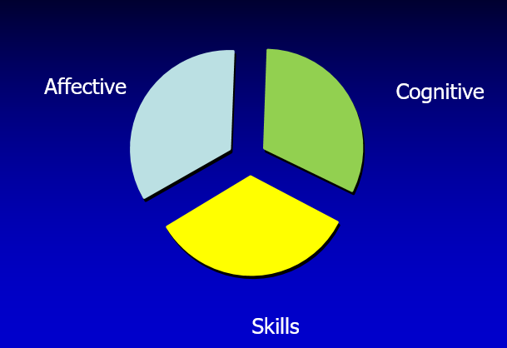
How Adults Learn
Notes:
TRAINER NOTES
As adults, we learn in 3 broad domains. The first domain is cognitive – our ability in how we process information. The second domain is skill – our ability to do something. The third domain is affective – how we feel about it and our attitudes towards particular subjects. This is perhaps the most important domain of the three. We all have feelings. As healthcare providers and addictions counselors, however, we can’t let our feelings get in the way of providing good information or services, especially when discussing HIV, AIDS, and sexually transmitted infections or STIs. We invite you to focus and reflect on your feelings today. Hopefully at the end of today, you will feel more comfortable talking about HIV concepts and about sexually transmitted infections.

Slide 22
When was your last HIV training?
My last HIV training was
In the past 3 months
In the past 6 months
1 year ago
More than 1 year ago
Never before. This is my first
Notes:
TRAINER NOTES
[ASK PARTICIPANTS] Please raise your hand if your last HIV trainings was (1) in the past 3 months, (2) in the past 6 months, (3) 1 year ago, (4) More than 1 year ago or (5) This is my first training.

Slide 23
Your History Learning about HIV
What was the FIRST thing you ever heard/read about HIV? When was it?
What was the LAST thing you heard/read about HIV? When was it?
Notes:
TRAINER NOTES
[ASK PARTICIPANTS] What was the FIRST thing that you ever heard/read about HIV? When was it?
[ASK PARTICIPANTS] What was the LAST thing you heard/read about HIV? When was it?

Slide 24
Today’s Agenda (2)
Review and check-in
What is HIV and AIDS?
Learning objectives
HIV Histories (World, US, Local, Personal)
HIV Medical Update
  Modes of Transmission
  Acute HIV Infection
  Testing/Screening
  Medications for HIV
  HIV Prevention
Sexually Transmitted Infections
Notes:
INSTRUCTIONS
[ASK PARTICIPANTS] Are there any questions or comments before we move forward with discussing the history of HIV and AIDS?

Slide 25
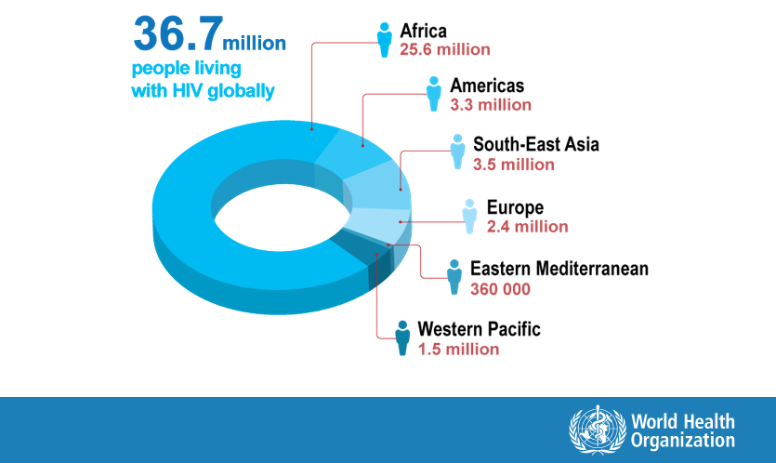
People living with HIV by
WHO Region (2016)
Notes:
TRAINER NOTES
Now let’s look at the Global Epidemic. In 2016, the World Health Organization estimated that there were 36.7 million people living with HIV in the world. About 1.1 million in the U.S.
[ASK PARTICIPANTS] Where do most of the people who have HIV live?
The answer is Africa

Slide 26
Global estimates for adults and children
People living with HIV in 2016
  36.7 million (30.8 million - 42.9 million)
New HIV infections in 2016
  1.8 million (1.6 million to 2.1 million)
AIDS-related deaths in 2016
  1.0 million (830,000 to 1.2 million)
Notes:
TRAINER NOTES
[READ THE BULLETED LIST ON THE SLIDE]
Of these 36.7 million total, the United Nation’s Program on AIDS estimates that 1.8 million were infected that same year and approximately 1 million died that year.

Slide 27
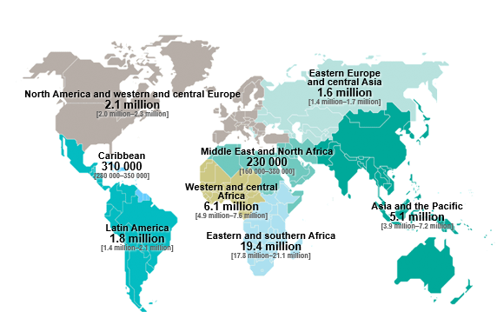
Adults and children estimated to be living with HIV in 2016
Total: 36.7 million [30.8 million–42.9 million]
Notes:
TRAINER NOTES
Here is a map of where people living with HIV live.

Slide 28
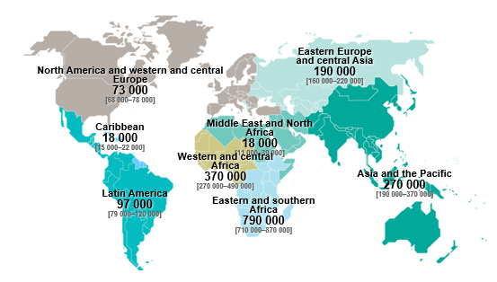
Estimated number of adults and children newly infected with HIV in 2016
Total: 1.8 million [1.6 million–2.1 million]
Notes:
TRAINER NOTES
And the new infections in 2016 by region.

Slide 29
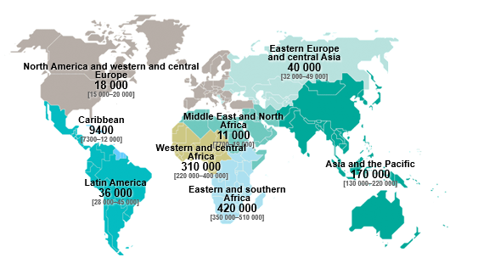
Estimated adult and child deaths from AIDS in 2016
Total: 1.0 million [830 000–1.2 million]
Notes:
TRAINER NOTES
And the deaths in 2016 by region.

Slide 30
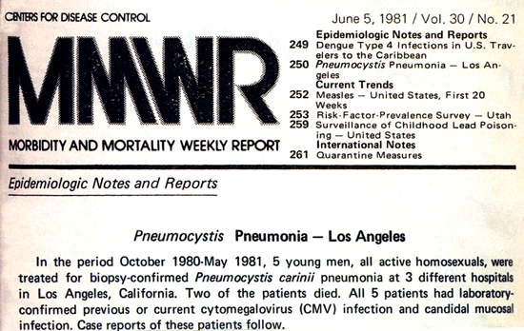
HIV in 1981
Notes:
TRAINER NOTES
The first scientific report of HIV in the US was in the Centers for Disease Control and Prevention’s Morbidity and Mortality weekly report on June 5, 1981 when a doctor at the University of California, Los Angeles reported on 5 young men who were diagnosed with pneumocystis carinii pneumonia, a form of pneumonia normally seen in older men in the Mediterranean. All 5 young men had sex with other men. We didn’t have a word for what was happening yet. We didn’t know what was happening. Was this an infection? A virus? It would take years until we knew their answers.

Slide 31
Tracking the HIV Epidemic…1983
31
Notes:
TRAINER NOTES
In February of 1983, there were approximately 1,000 AIDS cases in the US. The next few slides are maps of the US. Each dot represent 30 cases of AIDS. At this time, the physician who filed the report in the MMWR used the term “Acquired Immune Deficiency Syndrome – AIDS.” In the East Coast, many individuals and health care providers are using the term G.R.I.D.
[ASK PARTICIPANTS] Does anyone know what that stand for?
Gay Related Immune Deficiency.
At this point, the Center for Disease Control and Prevention and others knew that people were getting sick very quickly and there were risk groups, including:
Men who have sex with men (and their partners including women)
Sex workers
Hemophiliacs
Haitians
People who share needles – IDUs – injection drug use
Children of infected women

Slide 32
Tracking the HIV Epidemic…1985
32
Notes:
TRAINER NOTES
By May of 1985, there were10,000 cases and major epicenters. At this point, the CDC knows it’s a viral disease and have HIV antibody test.
[ASK PARTICIPANTS] Why would a smart, rational, brave person in 1985 chose not to take the HIV antibody despite having risks for HIV?
First, there were no laws to protect people from discrimination. Second, there was no medical treatment that could improve one’s health. So many people chose to “not know” even if they had risks.
[ASK PARTICIPANTS] What reason can someone give today for not knowing their HIV status?
Discrimination and stigma.

Slide 33
Tracking the HIV Epidemic…1989
33
Notes:
TRAINER NOTES
In July of 1989, there were 100,000 cases of AIDS in the US. The epidemic on the east coast was now increasingly one of IDUs and therefore heterosexual transmission and therefore women. Indeed, half of all new HIV cases at this time in Newark, New Jersey are among women.

Slide 34
Tracking the HIV Epidemic…1995
34
Notes:
TRAINER NOTES
In December of 1995, there were more than 500,000 cases of AIDS in the US.

Slide 35
Tracking the HIV Epidemic…1997
35
Notes:
TRAINER NOTES
In September of 1997, there were 626,334 AIDS cases in the US. This map highlights that HIV moved from urban centers to rural regions. It is increasingly a disease of poor people and people of color.

Slide 36
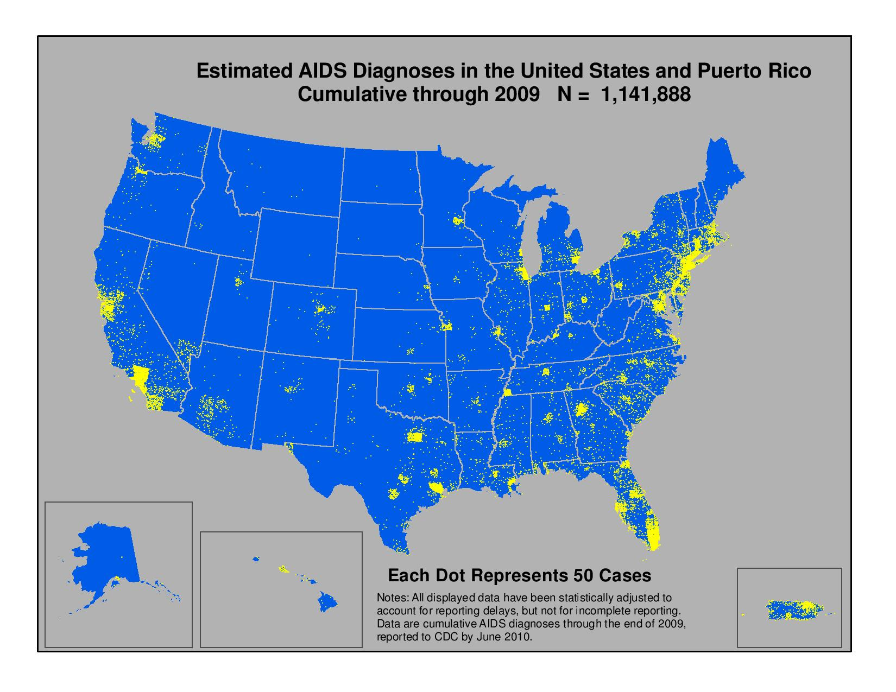
AIDS Diagnoses, 2009
36
Notes:
TRAINER NOTES
In 2009, there were 1,141,888 cases of AIDS in the US. In this map, each dot represents 50 cases of AIDS.

Slide 37
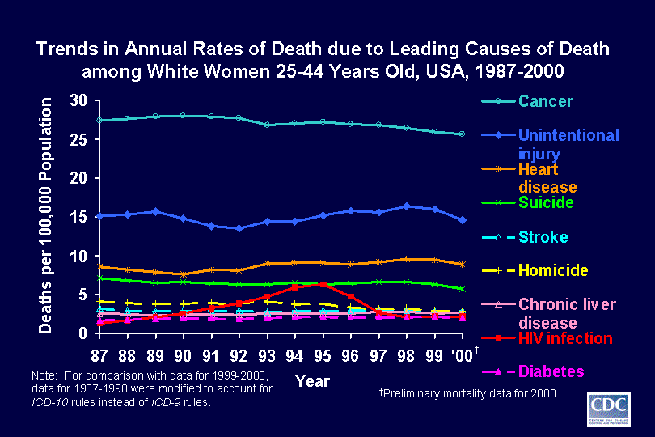
Trends in Annual Death Rates among White Women, 1987-2000
37
Notes:
TRAINER NOTES
How did HIV impact different US populations during these years? Let’s look at the US population by gender, race, and ethnicity from 1987-2000 for 25-44 years olds. These are usually very healthy/productive years where not much can kill us. Here you can see for white women HIV infection was the 4th or 5th leading cause of death, but starts to drop off when effective anti-retrovirals were introduced in the mid 1990s.

Slide 38
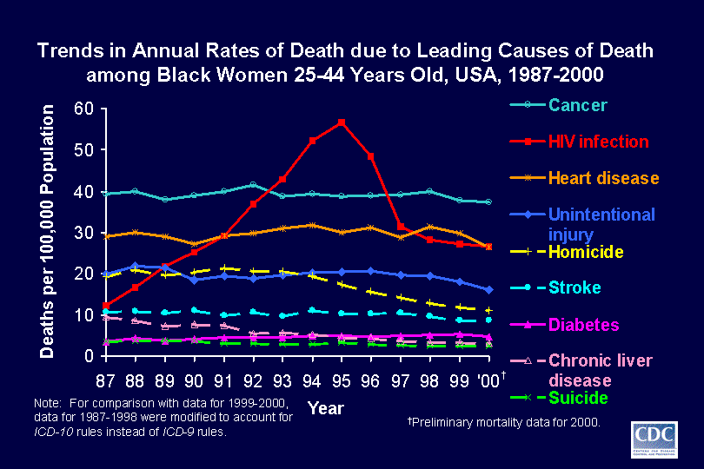
Trends in Annual Death Rates among Black Women, 1987-2000
38
Notes:
TRAINER NOTES
For Black women, however, HIV infections was the leading cause of death and was rising dramatically until the mid 1990s when HIV medications became widely available through the Ryan White Emergency Care Act. See how fast deaths came down when anti-retroviral medications were made available.

Slide 39
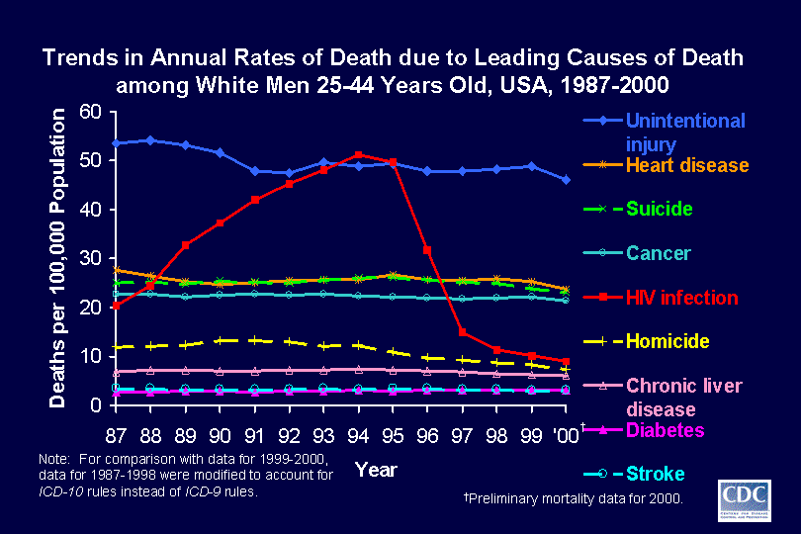
Trends in Annual Death Rates among White Men, 1987-2000
39
Notes:
TRAINER NOTES
However, for white men, you can see the decline is even more dramatic and sharp.
[ASK PARTICIPANTS] Why? Do the medications work better in white men?
No. It’s because white men in the US have better access to and trust in the healthcare system in general. Think about what access to and trust in the healthcare system is like here? What’s it like for different populations?

Slide 40
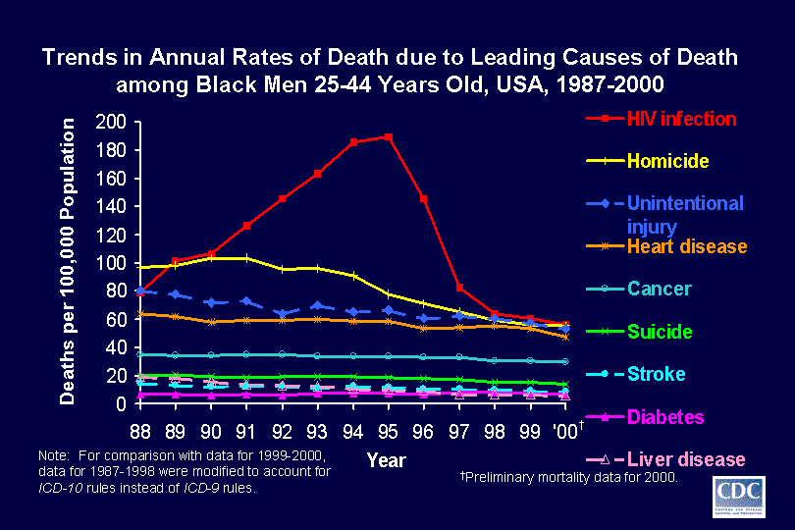
Trends in Annual Death Rates among Black Men, 1987-2000
40
Notes:
TRAINER NOTES
Finally for black men you can see the sharpest increase. It was by far the leading case of death until medications became available. What was #2? Homicide. Many young black men at this time thought they were at more risk from violence yet the #4 risk at this was time was HIV – especially for young black men who have sex with other men. These slides highlight social disparities in healthcare in the US.

Slide 41
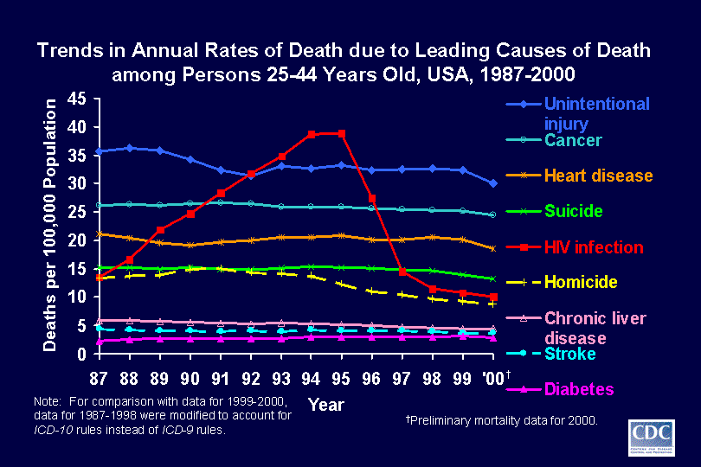
Trends in Annual Death Rates among Persons 25-44, 1987-2000
41
Notes:
TRAINER NOTES
When you look at all Americans, regardless of gender or ethnicity, you can see a rapid drop in deaths thanks to the widespread availability of HIV medications through the Ryan White Program, which provides medications even when someone can not afford these medications or they cannot afford health insurance. Ryan White is considered a “payer of last resort.”

Slide 42
How many individuals have HIV?
According to the Centers for Disease Control and Prevention, approximately how many individuals in the US were living with HIV in 2015?
1.6 million
1.1 million
890,000
550,000
Not sure
Notes:
TRAINER NOTES
[ASK PARTICIPANTS] Approximately how many individuals in the US were living with HIV in 2015?
The correct answer is 1.1 million.

Slide 43

HIV in the US by Geography (2014)
Five states accounted for half of persons living with HIV (PLWH), undiagnosed infections, and new infections
Southern states accounted for
  45% of PLWH
  50% of undiagnosed HIV infections
  51% of annual HIV infections
43
Notes:
TRAINER NOTES
So, where do these people live? 5 states account for half of all cases and southern states for about the other half.

Slide 44
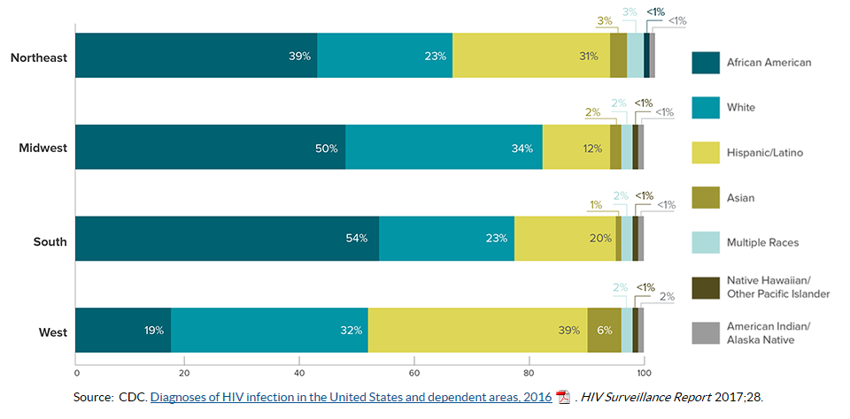
New Diagnoses in the US by
Race/Ethnicity & Region of Residence, 2016
44
Notes:
TRAINER NOTES
Here you can see new cases in 2016 by region by race and ethnicity.

Slide 45
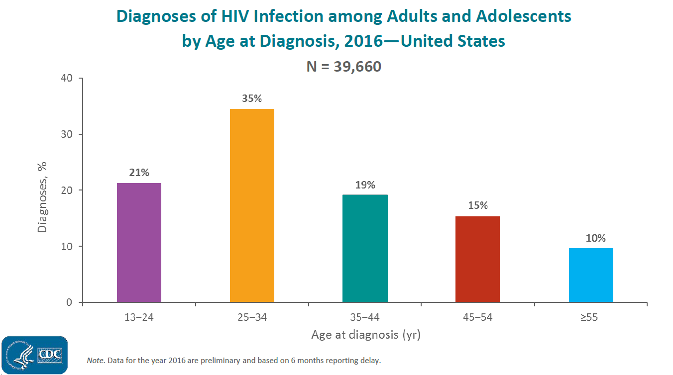
HIV Diagnoses by Age, 2016
45
Notes:
TRAINER NOTES
Here is a vertical bar chart of new cases of HIV across different age groups.

Slide 46
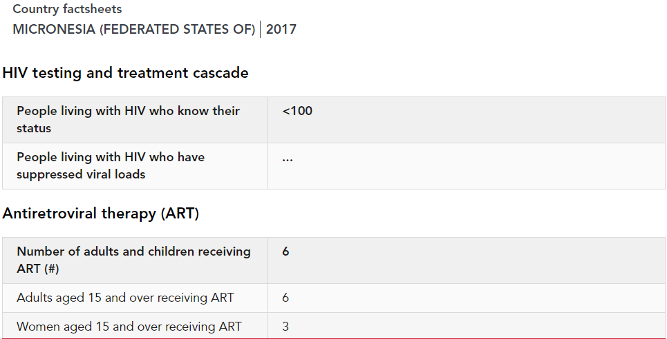
HIV in FSM
Notes:
TRAINER NOTES
Here is regional data on HIV cases in the Federated States of Micronesia.

Slide 47
Cumulative Number of HIV/AIDS cases in Pacific Island Territories
(as of May 2003)
American Samoa, 1 HIV case, 1 AIDS case
FSM, 14 HIV cases, 7 AIDS cases
Guam, 173 HIV cases, 75 AIDS cases
Northern Mariana Islands, 25 HIV cases, 15 AIDS cases
Marshall Islands, 9 HIV cases, 2 AIDS cases
Palau, 5 HIV cases, 0 AIDS cases
Notes:
TRAINER NOTES
Here is the most current data on HIV and AIDS cases in the Pacific Island Territories. As you can see, this data is very old.
[READ THE FIRST SIX BULLETS ON THE SLIDE]
[ASK PARTICIPANTS] What are your thoughts about this data?

Slide 48
Today’s Agenda (3)
Review and check-in
What is HIV and AIDS?
Learning objectives
HIV Histories (World, US, Local, Personal)
HIV Medical Update
  Modes of Transmission
  Acute HIV Infection
  Testing/Screening
  Medications for HIV
  HIV Prevention
Sexually Transmitted Infections
Notes:
TRAINER NOTES
[ASK PARTICIPANTS] What questions or comments do you have regarding the material we just covered?
Now let’s talk about HIV and the difference between HIV infection (everyone living with HIV has the HIV virus) and an AIDS diagnosis (those people who have advanced HIV disease – or fewer than 200 CD4 cells or an AIDS defining condition).

Slide 49
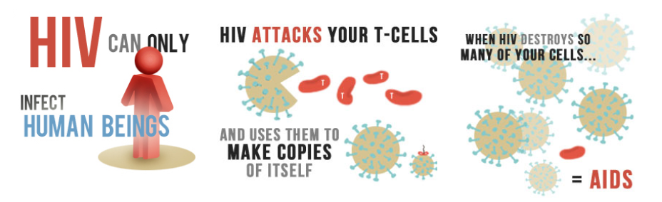
HIV and AIDS (2)
HIV attacks CD4 or T-cells and causes immunodeficiency
  Lowering CD4 count and percent (%)
  Increasing amount of HIV (viral load or HIV RNA) in the blood, body fluids, and lymph nodes
CD4 <200 and/or <14% = AIDS
http://www.aids.gov/hiv-aids-basics/hiv-aids-101/what-is-hiv-aids/
Notes:
TRAINER NOTES
HIV is a virus that infects the body’s immune system. As soon as a person is infected with HIV, the virus begins attacking the immune system. CD4 cells are white blood cells that normally protect us from infections. However, HIV is a virus that infects these cells billions of times each day and uses these cells to replicate and make billions of new virus. Without medication to stop replications a person will eventually lose the number of their CD4 cells and their viral load (#’s of virus in the blood) will increase. When CD4 cells drop (a healthy individual has 800-1200 CD4 cells) below 200 (or 14% of total white blood cells) a person is defined as having AIDS. AIDS is the word used to describe an HIV infected person who’s immune system has been greatly damaged by HIV.

Slide 50
How does HIV Impact a
Person’s Health?
Untreated, people with HIV can develop opportunistic infections (OIs) and other illnesses
Over time (years), the immune is weakened, leaving the body susceptible to infections
Some people do not know they have HIV because they may feel well for years
Currently, there is no cure for HIV infection
Notes:
TRAINER NOTES
It’s important to remember that someone infected with HIV may have some immediate symptoms during acute infection, but most people will go many years – often more than a decade – before they get sick or are given an AIDS diagnosis. However some are individuals are considered “rapid progressors” and can have their CD4 levels drop quickly and progress to AIDS after just 1-2 years.

Slide 51
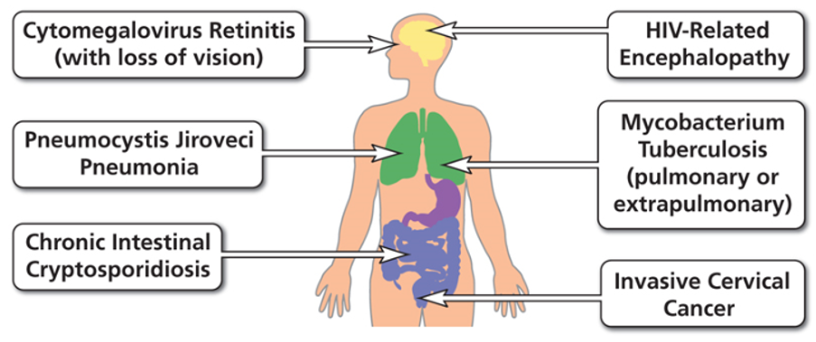
Examples of AIDS-Defining Conditions
51
https://aidsinfo.nih.gov/understanding-hiv-aids/glossary/784/aids-defining-condition
Notes:
TRAINER NOTES
So there are two ways an HIV infected person progresses to an AIDS diagnosis: 1) their CD4 cells fall below 200 or 2) they get an AIDS defining condition. These are opportunistic infections, cancers --- things that happen because the individual’s immune system is compromised. Here are some examples of AIDS – defining conditions.

Slide 52
Question 8
Which of the following is false?
You will get infected with HIV from kissing someone who is HIV positive
An HIV positive woman can give birth to an HIV negative baby
You could have HIV and not know it
You can get infected with HIV by having unprotected oral sex with someone who is HIV positive
Notes:
TRAINER NOTES
[ASK PARTICIPANTS] Which of the following is false?
The correct answer is 1: You will get infected with HIV from kissing someone who is HIV positive.
Although unprotected oral sex is far less likely to transmit HIV than unprotected vaginal or anal sex, it is possible. Let’s look at how HIV is transmitted.

Slide 53
Today’s Agenda (3a)
Review and check-in
What is HIV and AIDS?
Learning objectives
HIV Histories (World, US, Local, Personal)
HIV Medical Update
  Modes of Transmission
  Acute HIV Infection
  Testing/Screening
  Medications for HIV
  HIV Prevention
Sexually Transmitted Infections
Notes:
TRAINER NOTES
[ASK PARTICIPANTS] What questions or comments do you have regarding the material we just covered?

Slide 54
How is HIV Transmitted?
Exposure to HIV-infected body fluids
Blood, vaginal fluids, semen, and breast milk (not urine/saliva)
HIV has to enter non-intact skin or mucous membrane to infect
  Having unprotected sex (oral, anal, vaginal) with someone who has HIV
  Sharing a needle (injection drug use, tattoos, piercings, etc.) with someone who has HIV
Notes:
INSTRUCTIONS
Review the slide.

Slide 55
How is HIV Transmitted (continued)
Being born to an HIV positive mother or drinking breast milk from an HIV positive woman
Receiving blood transfusions that are not screened
  Risk is low as blood donations are routinely screened for HIV & Hepatitis in the USA, higher in other countries
Notes:
INSTRUCTIONS
Review the slide.

Slide 56
HIV is NOT Spread by:
Air
Hugging or closed mouth kissing
Sharing clothes, food, water, utensils
Toilets, showers, swimming pools
Insect bites
Mosquitoes do not inject own or previously bitten person’s blood into next person
Feces, saliva, sweat, tears, urine, or vomit unless visibly contaminated with blood
Notes:
TRAINER NOTES
[READ THE BULLETED LIST ON THE SLIDE]
[ASK PARTICIPANTS] What are some local thoughts, myths about how HIV can be transmitted?

Slide 57
HIV Transmission: Yes
Blood
Semen
Pre-seminal fluid
Rectal fluids
Vaginal fluids
Breast milk
Notes:
TRAINER NOTES
So let’s review the ways HIV can be transmitted and ways it can’t be --- The HIV virus is actually pretty weak and cannot survive in light or air. HIV can be transmitted by [READ THE BULLETED LIST ON THE SLIDE]

Slide 58
HIV Transmission: No
Water
Sweat
Insects
Pets
Toilets
Food
Drinks
Saliva,
Kissing
Coughing
Swimming in the same water
Sharing food, towels, utensils, cups
Notes:
TRAINER NOTES
The HIV virus cannot be transmitted by [READ THE BULLETED LIST ON THE SLIDE]

Slide 59
Question 9
Which one of the following has the highest risk of acquiring HIV from an infected source?
Needle-sharing injection drug use
Receptive anal intercourse
Receptive penile-vaginal intercourse
Mother-to-child transmission
Notes:
TRAINER NOTES
[ASK PARTICIPANTS] Which one of the following has the highest risk of acquiring HIV from an infected source?
The correct answer is 4 - mother to child transmission.
Mother to child transmission is the highest but remember all of these assume there is a viral load high enough to transmit. Remember if the HIV positive person has an undetectable viral load they can not transmit the virus (U=U, undetectable = untransmittable). Now let’s look at the relative risks.

Slide 60
Risk of HIV Transmission with Single Exposure from HIV+ Source
Exposure Risk/10,000 exposures
Blood transfusion 9,250
Mother-to-child transmission 2,260
Receptive anal intercourse (“bottom”)* 138
Needle-sharing injection-drug use 63
Percutaneous needle stick 23
Insertive anal intercourse (“top”) * 11
Receptive penile-vaginal intercourse* 8
Insertive penile-vaginal intercourse* 4
Receptive oral intercourse* low
Insertive oral intercourse* low
* Assumes no condom use
Notes:
TRAINER NOTES
Here you can see relative risks per 10,000 exposures. Remember if the HIV-infected mom has an undetectable viral load because she is taking medications the risk is essentially zero. We will talk more about that later. Also for sexual contact, if the HIV positive person has an undetectable viral load because they are taking medications they are not transmittable (U=U). Does anything surprise people here? Remember these assume no condom use – and also is someone has a very high viral load (like during acute infection) they are much more infectious.
[REVIEW THE BULLETED LIST ON THE SLIDE]

Slide 61
Who is at risk for HIV?
Sex
  Any unprotected sex
  More than one sex partner ever
  Hx of any sexually transmitted infection
  Pregnant
Receive Blood
  Receive blood or other blood products before 1985 or from areas without secure blood supply
  Handled blood or body fluids as a routine parts of their job
  Infants whose mothers are infected with HIV
Notes:
TRAINER NOTES
All these are risk factors for HIV. But the CDC recommends everyone between the ages of 13-64 be tested for HIV regardless of their risk.

Slide 62
Who is at risk for HIV (continued)
Exposure to Injection / Piercing
  Unclean needles, particularly if shared (ex. injected steroids, hormones, drugs)
  Unclean drug equipment
  Tattoos inked with needles not properly cleaned and sterilized
  Piercing of ears or body parts with needles not properly cleaned and sterilized
Other
  A sex partner with one or more of the above risk factors
Notes:
INSTRUCTIONS
Review the slide.

Slide 63
Routes of Transmission of HIV
Sexual
  Sex between men (MSM)
  Sex between men and women
  Sex between women (WSW)
Exposure to blood
  Drug user needle sharing (IDU)
  Transmission of blood, plasma, packed cells, platelets or factor concentrates
  Occupational needle stick injury or other blood exposure
Perinatal
  During pregnancy, intrapartum, and postpartum (via breastfeeding)
Notes:
TRAINER NOTES
So let’s review some routes of transmission of HIV. While there have no documented cases of transmission of sex between women it is possible, however there are many lesbians with HIV, but they were infected through sex with men or when using drugs. Lets talk a bit about mother to child transmission.

Slide 64
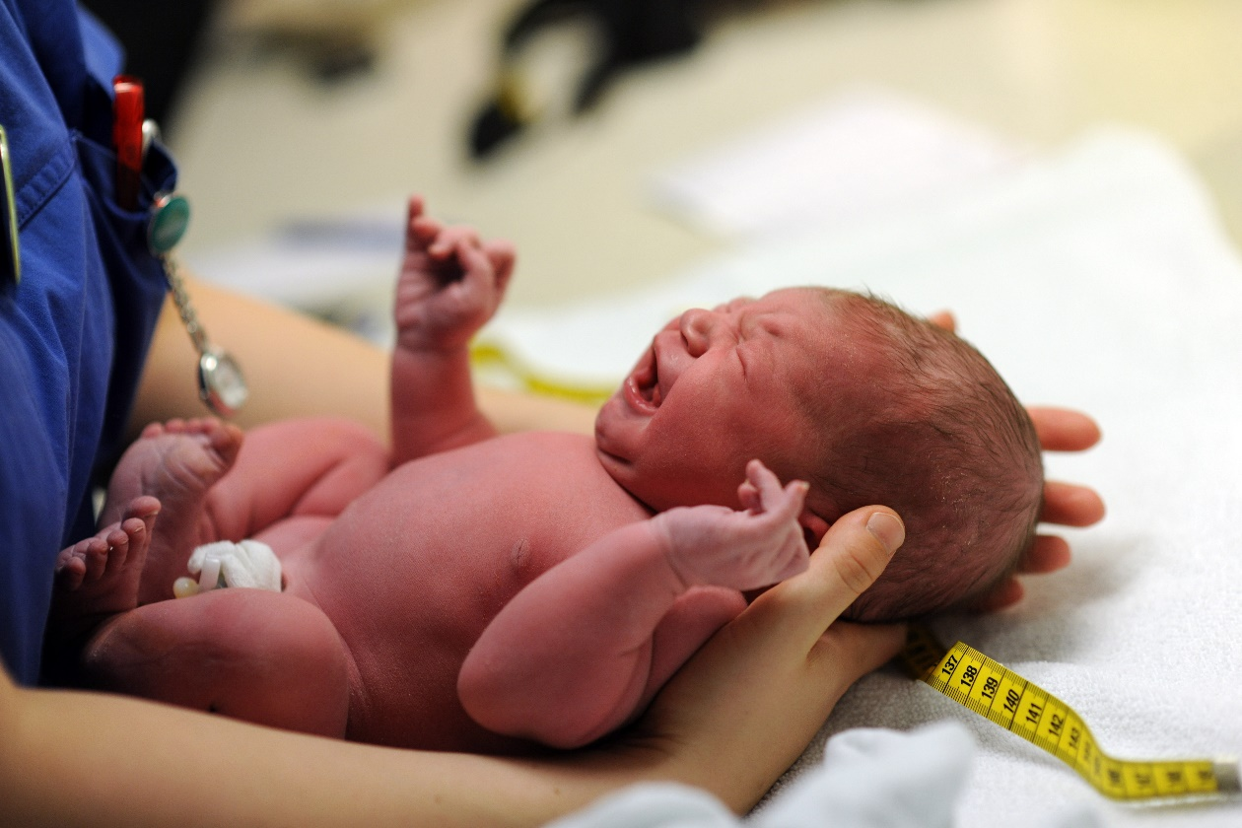
That’s why all women of child bearing age need to know their HIV status and all pregnant mom are tested for HIV.
64
Notes:
TRAINER NOTES
In 1994, one of the first successes in HIV treatment came from a famous study that showed an HIV-infected mom reduced her chance of transmitting HIV to her newborn from about 20 – 25% down to 7% with the use of just one anti-retroviral drug. Today, with much better medications, that chance is almost zero. In Los Angeles over the past decade we have delivered more than 300 babies to HIV-infected mom and guess how many HIV infected babies we have? From 300 births? Zero. That’s why all women of child bearing age need to know their HIV status and all pregnant mom are tested for HIV.
IMAGE CREDIT: Adobe Stock, purchased image, 2019.

Slide 65
Perinatal Maternal –
Child Transmission (PMTCT)
Prenatal anti-retroviral (ART) in mom to viral suppression (PrEP for Baby)
ART intrapartum (prep for baby)
ART in baby post partum
Notes:
TRAINER NOTES
If a mom is living with HIV, and in cases where she continues with treatment during pregnancy, the baby can also be given anti-retroviral medications after birth to protect it in case of any exposure during birth. If a mom doesn’t know she is infected (usually because she is out of medical care completely) and shows up at the hospital to deliver, a rapid HIV test can administered. If the test indicates positive, both the mother and child can be administered HIV medication to lower chances of transmission.

Slide 66
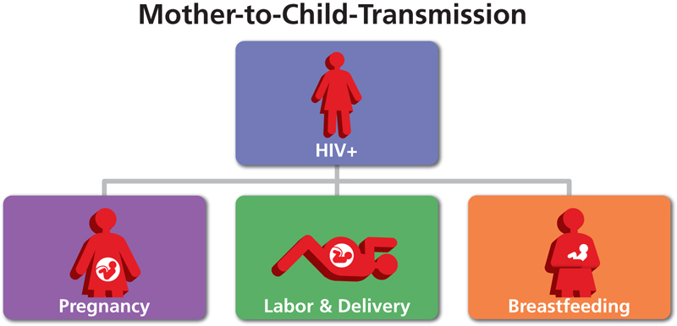
PMTCT Routes
66
Slide with image courtesy of Thomas Donohoe, PAETC.
Notes:
TRAINER NOTES
So mother to child transmission can be greatly reduced from the mother being on medications, medications being administered during delivery, and from mom not breast feeding after delivery. Remember breast feeding often involves blood and not just breast milk.
IMAGE CREDIT
Slide with image courtesy of Thomas Donohoe, PAETC.

Slide 67
Today’s Agenda (3b)
Review and check-in
What is HIV and AIDS?
Learning objectives
HIV Histories (World, US, Local, Personal)
HIV Medical Update
  Modes of Transmission
  Acute HIV Infection
  Testing/Screening
  Medications for HIV
  HIV Prevention
Sexually Transmitted Infections
Notes:
TRAINER NOTES
[ASK PARTICIPANTS] Are there any questions before we discuss the period of early or acute infection.

Slide 68
Question 10
Which of the following statements is TRUE in regards to acute HIV infection?
Symptoms are rare with acute HIV infection (<25%) as most people are asymptomatic
Signs and symptoms usually occur after a month post-initial exposure
Symptoms are nonspecific and may mimic other viral infections
The diagnosis is made with a routine HIV antibody test
Do not know
Notes:
TRAINER NOTES
[ASK PARTICIPANTS] Which of the following statements are TRUE in regards to acute HIV infection?
The correct answer is 3) Symptoms are nonspecific and may mimic other viral infections.
The flu-like symptoms can indicate so many things. That’s why everyone needs to know their HIV status – not just people who have flu – like symptoms.

Slide 69
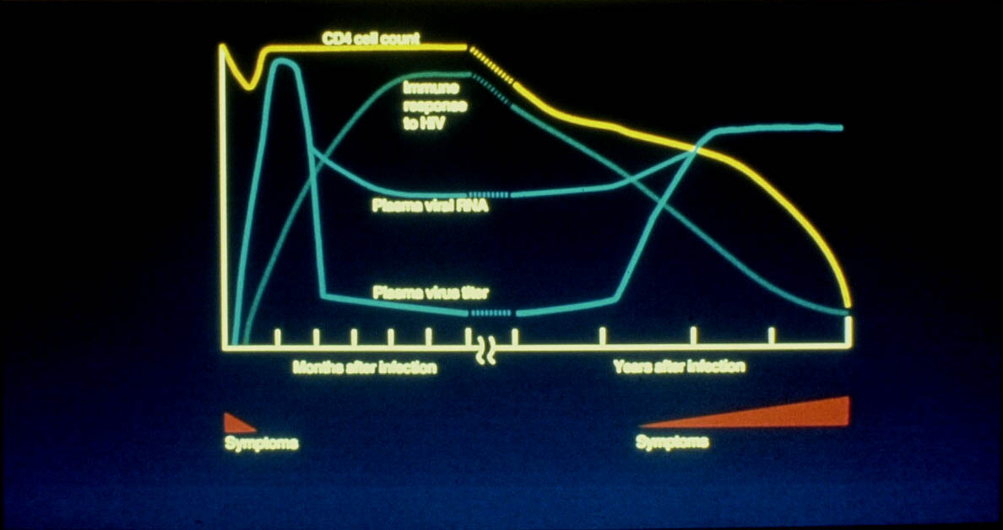
Hypothetical Course of
HIV Infection in Adults
69
Notes:
TRAINER NOTES
Here is a hypothetical course of infection as it starts and then progresses over years. Lets follow the gold line first, that’s the # of CD4 cells. You can see when someone is first infected with HIV there is an immediate reduction in CD4 cells as the virus explodes (viremia – the blue line shoots up --- this is a huge surge in viral load during acute infection). Then the immune system kicks in (green line) and starts controlling the virus, bringing it down and bringing CD4 back to baseline. It’s during this acute infection period that people often experience flu-like and other symptoms like rashes. So everything return to a sort of baseline. But HIV is still there and using CD4 cells to replicate over time – years and years – the # of CD4 cells declines and someone’s immune system becomes compromised. Once they go below 200, they receive an AIDS diagnosis. Some peoples’ bodies control the virus better than others (even without medications) and these people will lose CD4 cells less quickly but today we know that all people need to start HIV antiretroviral medications as soon as they learn they are infected with HIV.

Slide 70
Acute HIV Infection (1)
Early stage of HIV infection
Signs and symptoms typically occurs ~1-4 weeks after HIV acquisition
Coincident with peak viremia
Symptoms occur in 40-90% of patients
Similar to influenza, mononucleosis or other viral symptoms
Hyperinfectiousness
Frequently missed by health care providers
Symptoms mimic other viral infections
Some individuals asymptomatic
High index of suspicion is critical
Notes:
TRAINER NOTES
So acute HIV infection causes symptoms in most patients but they pass quickly and mimic other things like Strep throat or the flu. And remember in the first 1-2 weeks the person will test negative as they have not yet produced antibodies yet they are very infectious as they have a very high viral load. This is why the CDC recommends everyone receive an HIV test. If the patient suspect they may be HIV infected (because of recent risk) the provider can order an HIV viral load test in addition to the HIV antibody test.

Slide 71
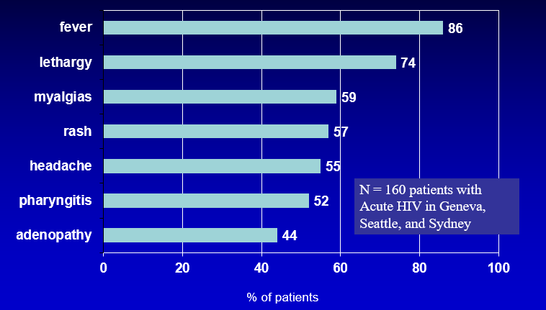
Acute HIV Infection:
Common Signs & Symptoms
Vanhems P et al. AIDS 2000; 14:0375-0381.
71
Notes:
TRAINER NOTES
Here are some examples of symptoms that were present during acute infection in this one study in 2000 in Geneva, Seattle, and Sydney.
[READ THE COMMON SIGNS AND SYMPTOMS]

Slide 72
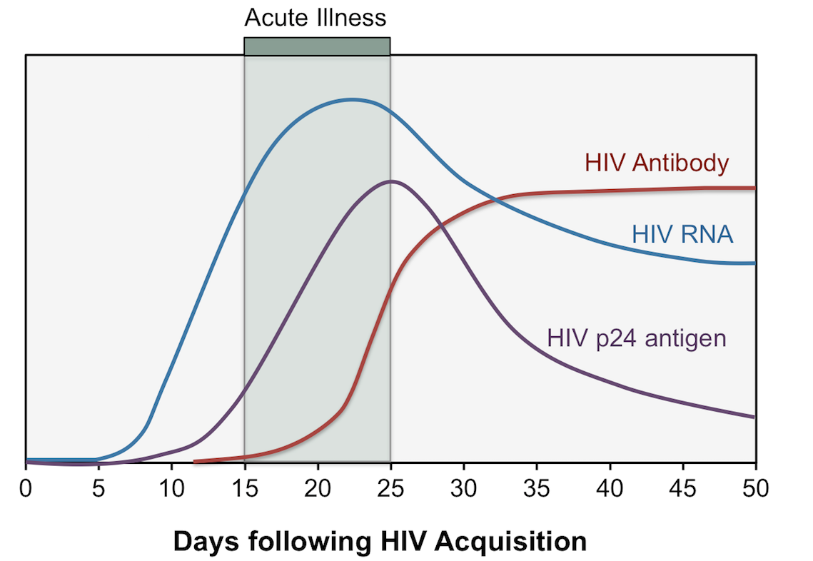
Acute HIV Infection (2)
72
Notes:
TRAINER NOTES
These are the different indicators that can show up days after infection. You can see HIV RNA (viral load) will show up before HIV antibody or P24 antigen. Newer HIV tests are both anti-body antigen tests and can detect HIV as early as 7-10 days after infection. These tests are often called “4th generation” or “antigen-antibody tests.”

Slide 73
Common Symptoms of
Undiagnosed HIV/AIDS
“bad case of the flu”
Lymphadenopathy (swollen lymph nodes)
Shingles at young age
Thrush (fungal infection ususall of mouth but also possible in other areas—e.g., diaper rash, vaginal infection)
Unexplained weight loss
Persistent headaches, diarrhea, fatigue, rashes
Sexually transmitted infections
Associated diseases: TB, HCV, HBV
Recurrent pneumonia
Notes:
TRAINER NOTES
Here are some other symptoms that can occur at any time in an HIV infected patient.
[READ THE BULLETED LIST ON THE SLIDE]
Hopefully today more physicians can “think HIV” and order HIV test or just order one automatically as part of every patients annual physical.

Slide 74
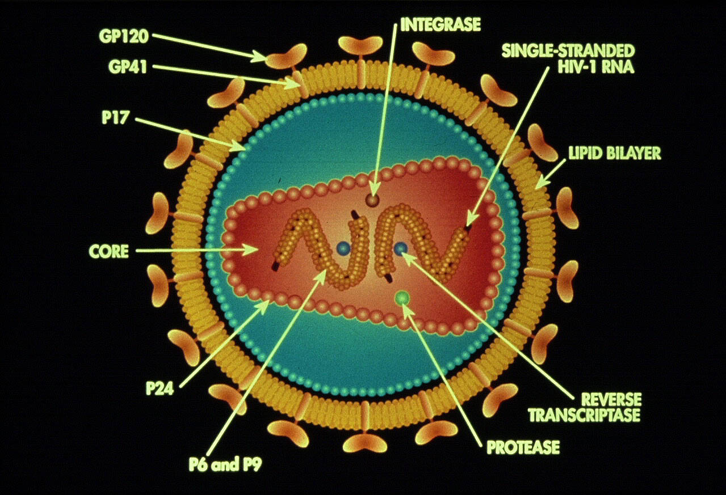
The HIV Virus
74
Slide with image courtesy of Thomas Donohoe, PAETC.
Notes:
TRAINER NOTES
Let’s take a quick look at the virus itself. Doing so will help us understand how current HIV medication work to help block viral replication. Here is a cartoon of the virus. Remember HIV is a retro-virus so the genetic material in the core is RNA, not DNA. The outer envelope of the virus is made up of glycol – proteins which antibodies attack, for example. So this virus is searching out those white blood cells – CD4 cells – to insert itself and make new copies. The very thing that would attack it, it uses to make copies of itself. Let’s talk a closer look at that process, as it actually causes the reduction in CD4 cells, so blocking it keeps people healthy.
IMAGE CREDIT
Slide with image courtesy of Thomas Donohoe, PAETC.

Slide 75
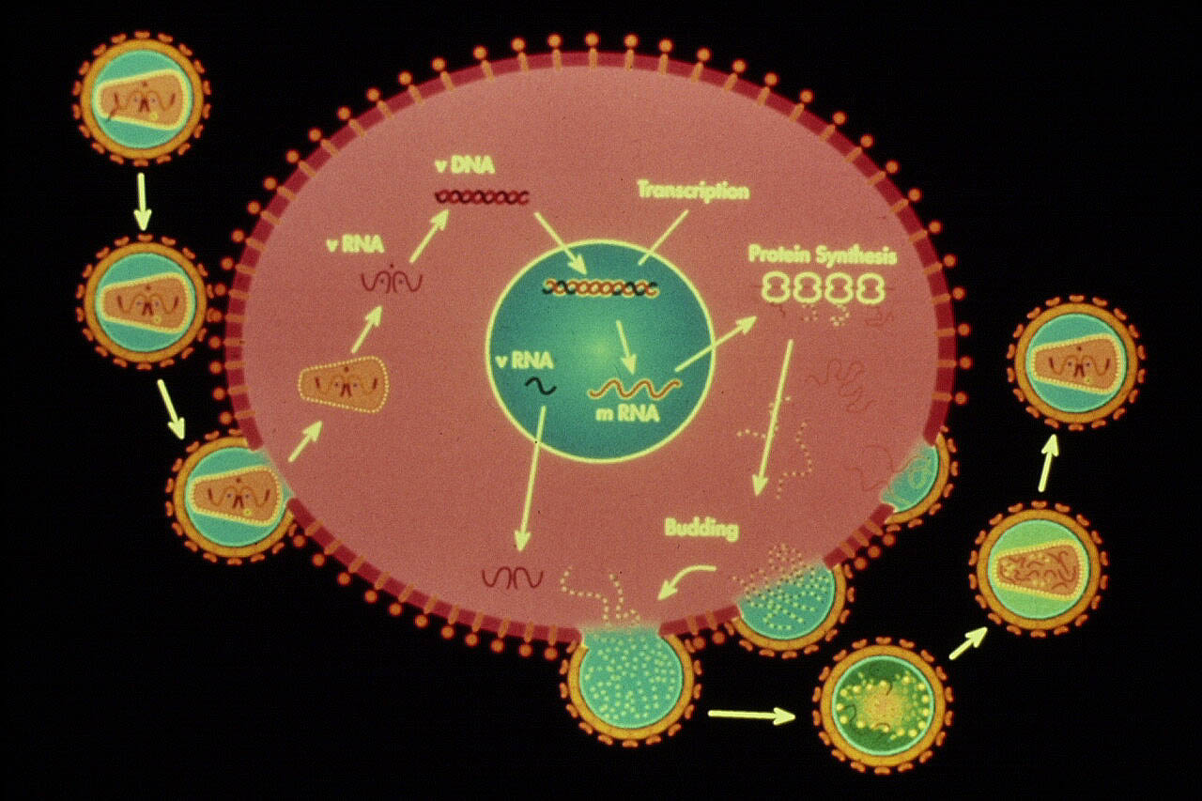
HIV Virus Connecting to CD4 Cell
75
Slide with image courtesy of Thomas Donohoe, PAETC.
Notes:
TRAINER NOTES
So here is a cartoon of HIV connecting to a CD4 cell. A cell is not infected until it’s nucleus is infected (the inner circle). HIV connects to the cells and inserts its genetic material into the cell then the cell swaps it’s RNA for the cells DNA. This is called “reverse transcriptase.” So the drugs that block this stage are called “reverse transcriptase inhibitors.” These are also HIV medications that block HIV from connecting/entering called “entry inhibitors” and “fusion inhibitors.” Once the virus enters the nucleus it “integrates” itself into the cells DNA so we have drugs to block that process called “integrase inhibitors.” After HIV leaves nucleus it goes through a later stage called protein synthesis. HIV antiretroviral medication to block this stage are called “protease inhibitors.” So you can see we have many different HIV medications meant to inhibit replication all these different stages. Today these different medications can be combines into 1 pill that can be taken once a day that is extremely effective with few – if any- side effects. Most people who take their medications every day will be able to achieve an undetectable viral load in weeks or a month or two.
IMAGE CREDIT
Slide with image courtesy of Thomas Donohoe, PAETC.

Slide 76
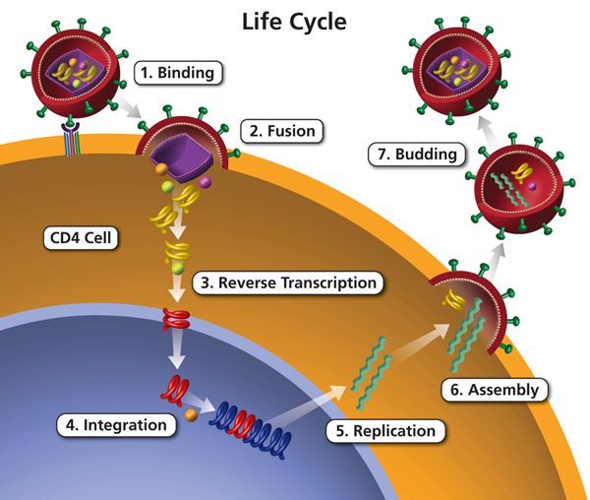
HIV Life Cycle
76
Slide with image courtesy of Thomas Donohoe, PAETC.
Notes:
TRAINER NOTES
So here is good look at the steps:
Binding
Fusions
Reverse transcription
Integration
Replication (protein synthesis)
Assembly and budding
Now let’s look at each one.
IMAGE CREDIT
Slide with image courtesy of Thomas Donohoe, PAETC.

Slide 77
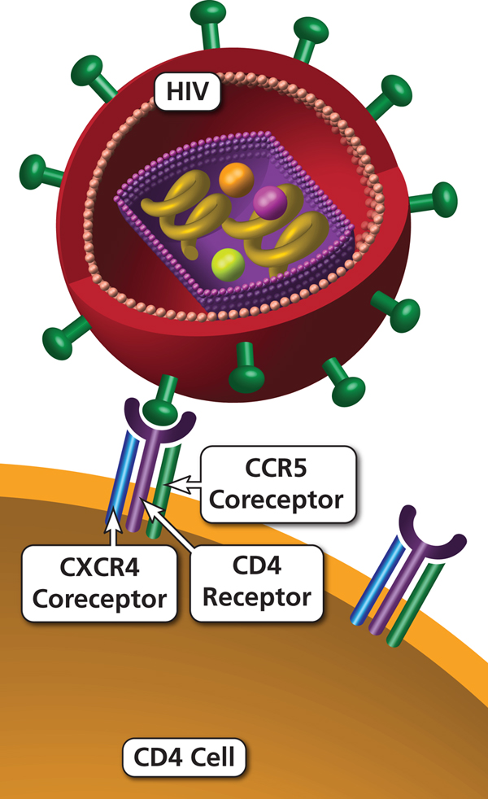
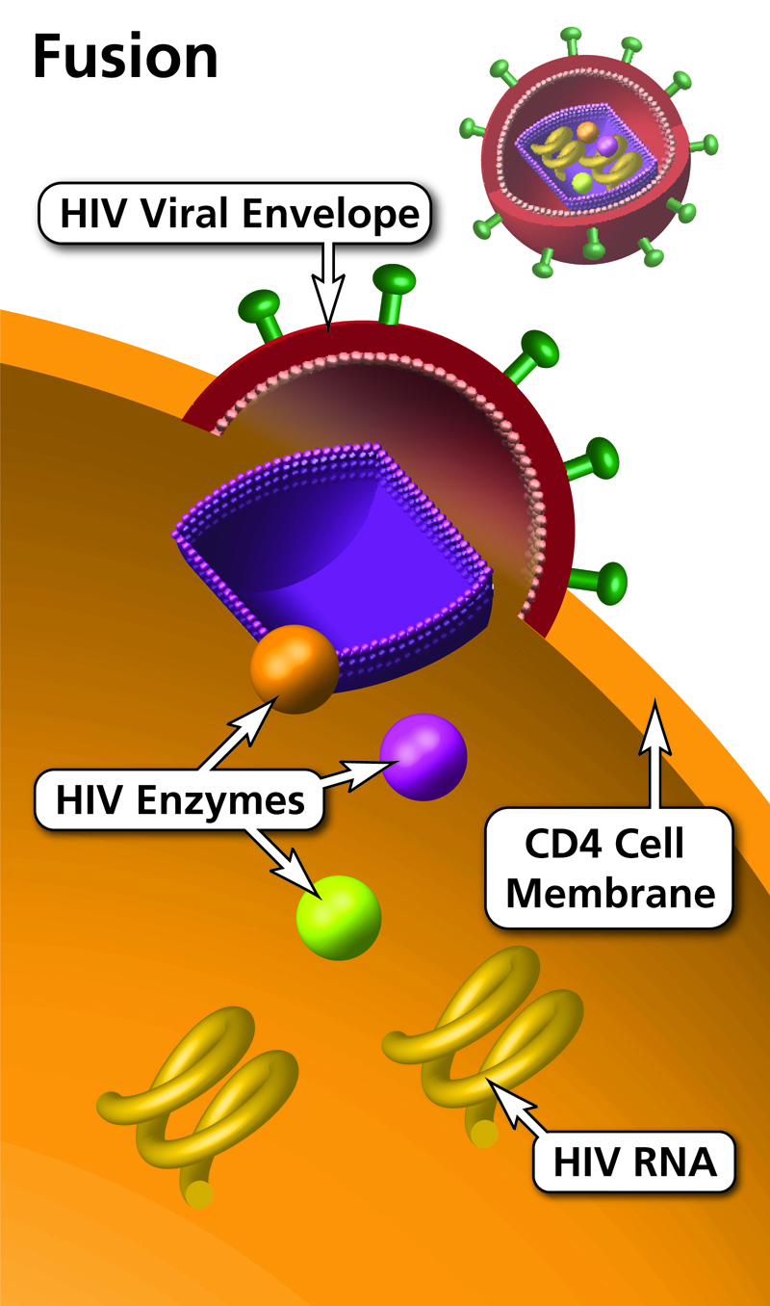
HIV Attachment to CD4 Cells
77
Slide with image courtesy of Thomas Donohoe, PAETC.
Notes:
TRAINER NOTES
There are receptors on the virus (CCR5) that connect to co-receptors on the CD4 cell. Some people (less than 1%) don’t have this CCR5 receptor and are naturally somewhat protected from HIV. I’m showing you all this to show you how many different avenues we have to develop new and even better drugs than the very good ones we have today.
IMAGE CREDIT
Slide with image courtesy of Thomas Donohoe, PAETC.

Slide 78
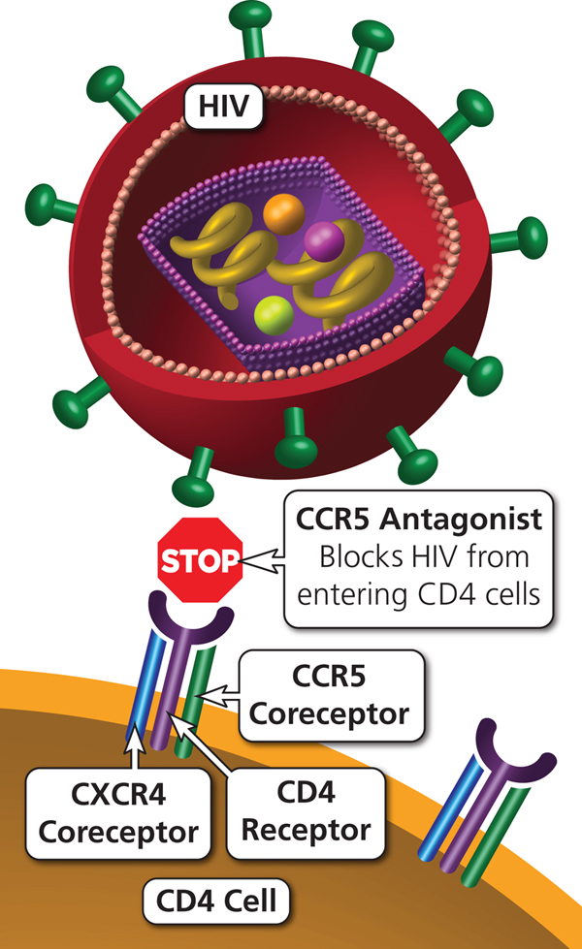
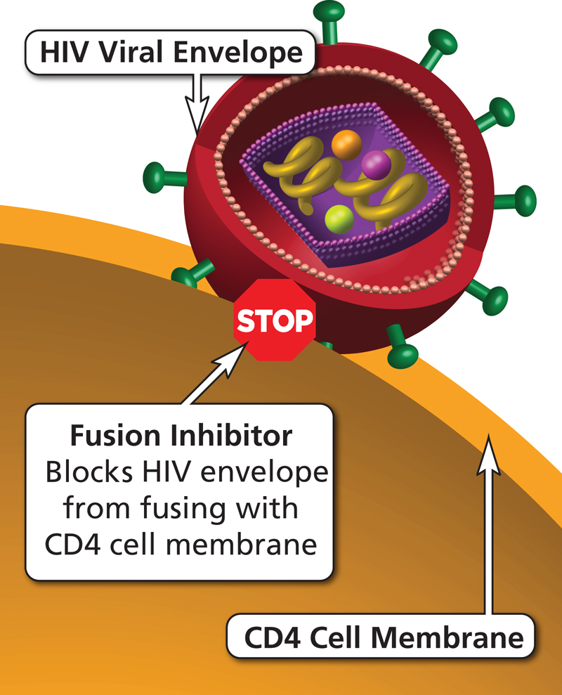
Entry Inhibitors
78
Slide with image courtesy of Thomas Donohoe, PAETC.
Notes:
TRAINER NOTES
So today we have a class of drugs called entry inhibitors or fusion inhibitors.
IMAGE CREDIT
Slide with image courtesy of Thomas Donohoe, PAETC.

Slide 79
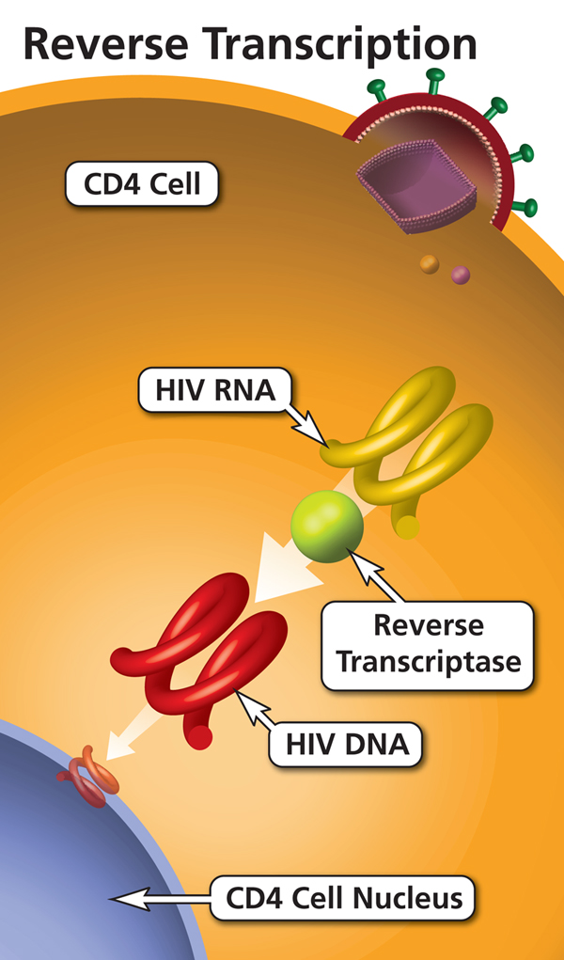
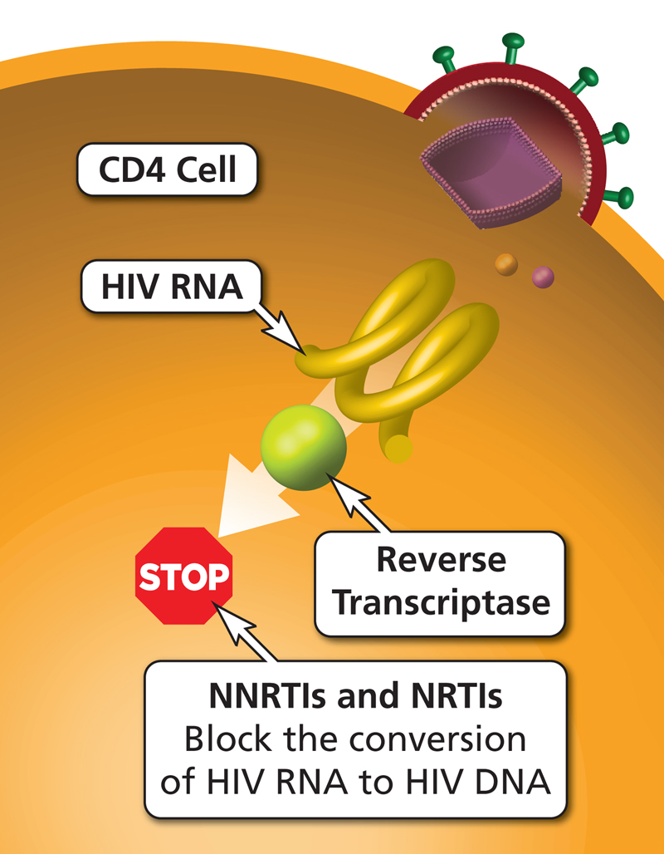
HIV Reverse Transcription
79
Slide with image courtesy of Thomas Donohoe, PAETC.
Notes:
TRAINER NOTES
And reverse transcriptase inhibitors (like AZT).
IMAGE CREDIT
Slide with image courtesy of Thomas Donohoe, PAETC.

Slide 80
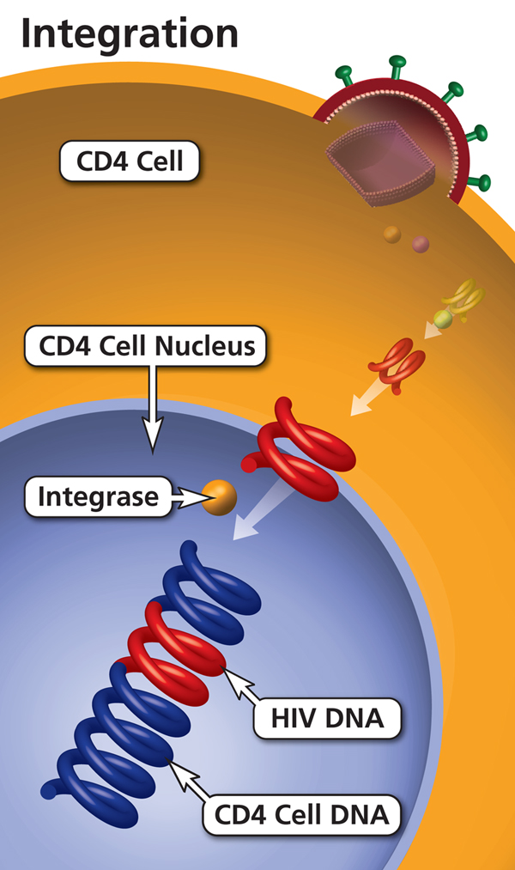
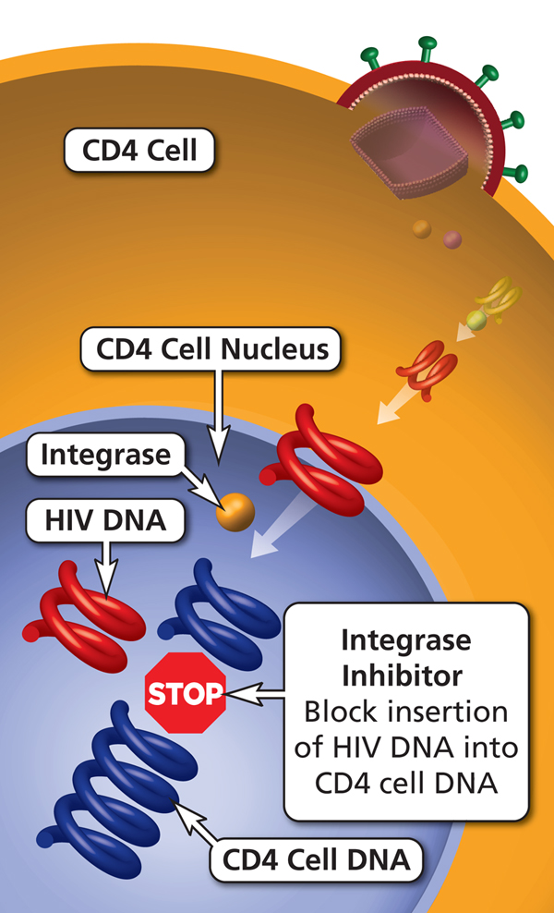
HIV Integration
80
Slide with image courtesy of Thomas Donohoe, PAETC.
Notes:
TRAINER NOTES
And integrase inhibitors.
IMAGE CREDIT
Slide with image courtesy of Thomas Donohoe, PAETC.

Slide 81
Today’s Agenda (3c)
Review and check-in
What is HIV and AIDS?
Learning objectives
HIV Histories (World, US, Local, Personal)
HIV Medical Update
  Modes of Transmission
  Acute HIV Infection
  Testing/Screening
  Medications for HIV
  HIV Prevention
Sexually Transmitted Infections
Notes:
TRAINER NOTES
[ASK PARTICIPANTS] Do you have any questions regarding transmission or acute HIV infection.

Slide 82
Tests to Monitor HIV-Positive
Patient’s Progress
CD4 absolute count (“T cell count”)
  Measures how one’s immune system is doing
  The higher the CD4 count the better
  These counts can vary from day to day and may decline with stress and illness acutely
CD4 percentage (CD4%)
  Percent of lymphocytes that are CD4 cells
  More accurate marker of one’s immune system
  Do not vary as much with outside factors
  CD4% of ~14-15% is approximately = CD4 ~ 200
Notes:
TRAINER NOTES
So what monitoring tests do people living with HIV receive. When they are first diagnosed they’ll get a resistance test to see if their virus is already resistant to any current antiretroviral medications. After, the two measures every HIV patient will know are their CD4 cell count and viral load. CD4 can be expressed as a # or as a % (percent of lymphocytes). Remember CD4 < 200 = AIDS.

Slide 83
Tests Used to Monitor HIV-Positive Patient’s Progress
HIV Viral load (HIV VL or HIV RNA)
  Tells us how much virus is in the blood
  Goal of therapy is to reach an undetectable viral load
  Standard viral load testing
  Undetectable <40
  Ultrasensitive (US) viral load testing
  Undetectable <20
Notes:
TRAINER NOTES
The other test – which is increasingly more important than CD4 cell count/percentage– is a HIV patient’s viral load. When a patient’s viral load is “undetectable” they can not transmit the virus. We have had viral load tests for more than 20 years.

Slide 84
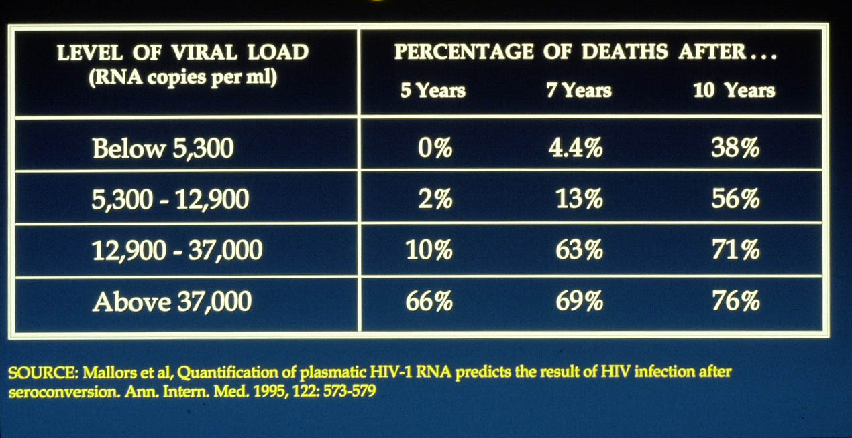
How Viral Load Affects Disease Progression
Notes:
TRAINER NOTES
So, let’s look back to 1995 at one of the first studies to see if this new viral load test was showing us something important. This researcher actually had frozen blood samples going back 10 years on his HIV positive patients and measured their viral load. He divided these more than 700 patients into 4 quantiles, the 25% who had less than 5,300 copies, the 25% who had 12-37,000, and 25% over 37,000. You can see the direct line relationship between viral load and (in this case) progression to death. Nobody with a viral load below 5,300 had died after 5 years. With todays HIV medications we can get it to less than 20 fairly quickly.

Slide 85
Testing Measures - Description
What is the HIV test?
  The HIV antibody test is a simple blood test. A small amount of blood is taken and sent to the laboratory where it is tested for antibodies to HIV. The test looks for antibodies not the virus itself. Antibodies are produced by the immune system when a person gets infected.
  It can take up to six months for antibodies to be detected in the test so during this time a person can still infect someone else because they do not know that they are infected with HIV.
Notes:
TRAINER NOTES
A simple blood test allows us to test whether someone has been infected with HIV. It can take up to 6 months for detection, so it is important that we endorse harm reduction strategies to prevent that person from infecting others.

Slide 86
Testing Measures – Counseling
Pre-test counseling is important
This is an opportunity for the person to discuss with a health care professional or counselor what might have put them at risk for contracting HIV. It is also a chance to learn ways to stay safe, whether you have been infected or not.
Notes:
TRAINER NOTES
Counseling is critical to preventing the spread of HIV. We use counseling as an opportunity to discuss risk factors and strategies for preventing transmission of HIV.

Slide 87
Testing Measures - Meaning
The HIV Antibody Test
  It is important to understand something about the HIV ANTIBODY TEST, and to have thought about it carefully.
The HIV antibody test is a simple blood test which is easy and painless to have. The test looks for antibodies to the Human Immunodeficiency Virus (HIV). Antibodies are made as part of our immune system’s response to the infection by a virus and are easier to detect than the virus itself.
Notes:
TRAINER NOTES
As mentioned in a previous slide, the HIV antibody test is a simple blood test that looks for antibodies of HIV.

Slide 88
Testing Measures – Antibodies
What is an Antibody?
The immune system makes antibodies. Antibodies generally protect against infections, but unfortunately they don’t protect against HIV. Usually a person will make antibodies against HIV from 2 weeks to 3 months after becoming infected. The antibody test checks for these antibodies in the blood. A positive test result means that the person is infected with HIV.
Notes:
TRAINER NOTES
Antibodies protect us against infection, but not against HIV. The test looks for antibodies for HIV.

Slide 89
Testing Measures – Results
Negative test results:
  This means that HIV antibodies were not detected in the blood because:
    The person has not been infected with HIV OR
    The person has been infected so recently that HIV antibodies have not yet been produced by the immune system. It can take up to six months from the point of infection for antibodies to show up in a blood test.
Notes:
TRAINER NOTES
Although someone may test negative for antibodies, it is possible that the infection was recent and that antibodies have yet to be produced in the immune system.

Slide 90
Activity #1
Discuss - Myths about HIV/AIDS
Discuss - How many people do you think are infected with HIV/AIDS in your home jurisdiction?
Discuss – What is the connection between HIV and other STIs (Chlamydia, Syphilis, Hepatitis, Genital Warts, Gonorrhea)
Discuss – In your home jurisdiction:
  Who is most at risk for HIV and/or STIs?
  What recommendations would you make regarding testing and treatment for someone in these risk groups.
  What recommendations would you make regarding testing and treatment for someone in NOT these risk groups.
Notes:
INSTRUCTIONS
Organize participants into groups of 5.
Distribute paper and pens to each group.
Instruct participants to discuss the four topics and answer questions for each topic.
Instruct participants to select a group recorder and to have one member from each group be prepared to report out to the larger group.
Allow groups to meet for 20 -25 minutes.
Report out should take approximately 15 – 30 minutes.

Slide 91
Today’s Agenda (3d)
Review and check-in
What is HIV and AIDS?
Learning objectives
HIV Histories (World, US, Local, Personal)
HIV Medical Update
  Modes of Transmission
  Acute HIV Infection
  Testing/Screening
  Medications for HIV
  HIV Prevention
Sexually Transmitted Infections
Notes:
TRAINER NOTES
[ASK PARTICIPANTS] Are there any questions regarding testing or screening for HIV?
Before moving on to discuss some of the medications for HIV, I want to highlight that some of the biggest challenges are getting people tested, linked to medical care, retained in care, and taking medications. If all that can happen, people can have a normal life. HIV, like other chronic disease, is manageable. However, individuals with HIV must take their medications as prescribed and take care of themselves as they should with other chronic, medical disorders. We can also prevent and treat complications (like if someone does have <200 CD4 cells they receive Bactrim to prevent PCP pneumonia) and know that people with HIV are more likely to thrive when they receive emotional support and employ self care.

Slide 92
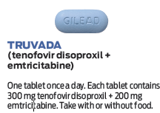
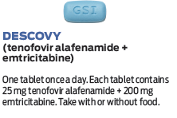
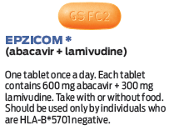
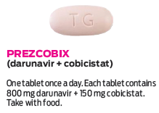
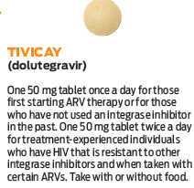
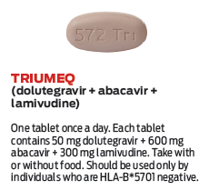
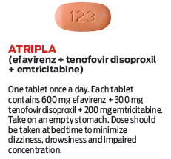
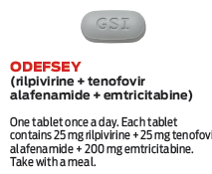
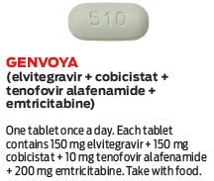
Common Antiretrovirals
92
Notes:
TRAINER NOTES
Here are some of the common HIV medication used today. You can see that all are combinations of different compounds that have synergies that make them exponentially better than the “very good” medication we had 15-20 years ago.
IMAGE CREDIT
Slide with image courtesy of Thomas Donohoe, PAETC.

Slide 93
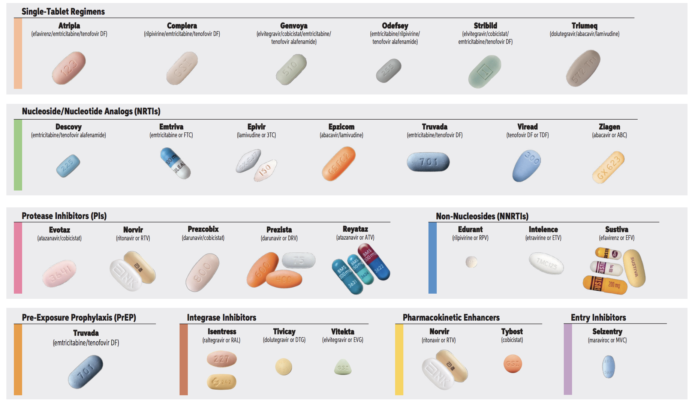
Common Antiretrovirals, by Class
93
Notes:
TRAINER NOTES
Here is another look at them by medication class.
IMAGE CREDIT
Slide with image courtesy of Thomas Donohoe, PAETC.

Slide 94
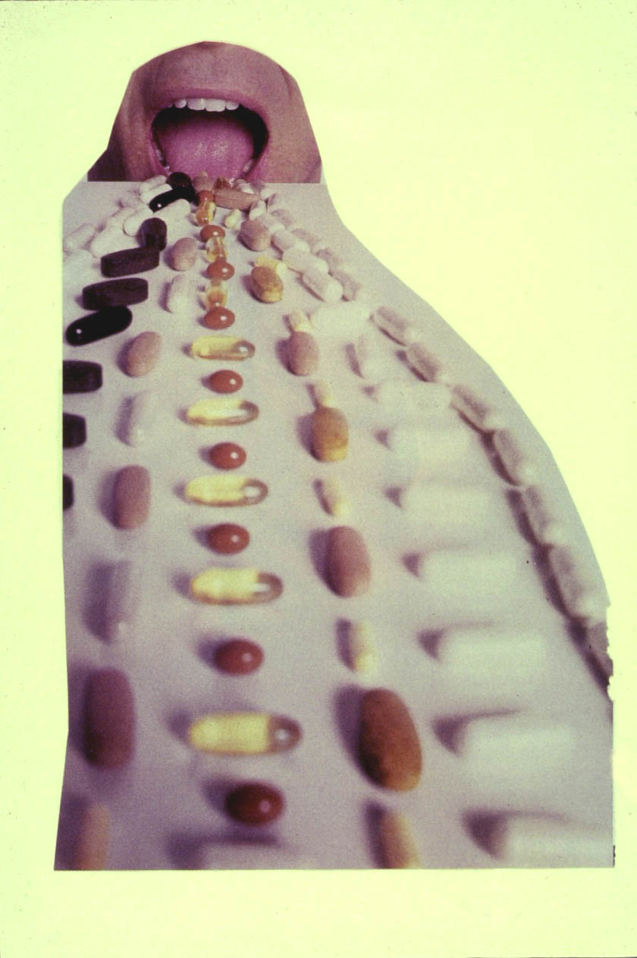
What did an ART Regimen Look Like
20+ Years Ago?
94
Notes:
TRAINER NOTES
So 20+ years ago, people were faced taking several pills several times a day.
IMAGE CREDIT
Slide with image courtesy of Thomas Donohoe, PAETC.

Slide 95

What does an ART Regimen
Look Like Today?
Notes:
TRAINER NOTES
Today, there are a variety of treatment options and most people who chose to use medications only have to take the medication once a day and anticipate few if any side effects.
IMAGE CREDIT
Slide with image courtesy of Thomas Donohoe, PAETC.

Slide 96
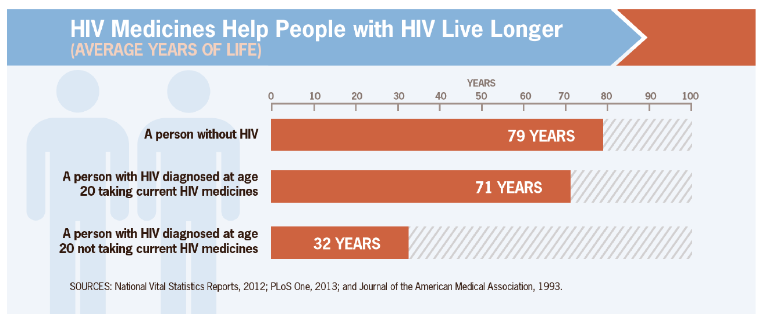
Effective Treatment Saves Lives
96
Notes:
TRAINER NOTES
As mentioned previously, a person with HIV can lead a normal lifespan. This study from 6 years ago looked at predicted lifespan for someone living with HIV and taking their medications as prescribed. Since this time we now recommend that people start taking HIV medication as soon as diagnosed with HIV (no waiting for a drop in CD4 cells) so the lifespan is even closer to someone not living with HIV.

Slide 97
Today’s Agenda (3e)
Review and check-in
What is HIV and AIDS?
Learning objectives
HIV Histories (World, US, Local, Personal)
HIV Medical Update
  Modes of Transmission
  Acute HIV Infection
  Testing/Screening
  Medications for HIV
  HIV Prevention
Sexually Transmitted Infections
Notes:
TRAINER NOTES
[ASK PARTICIPANTS] Are there any question regarding medication for HIV?

Slide 98
Prevention
Be aware that alcohol and drug use increases risky behaviors
Develop communication skills to be able to discuss risks and prevention
Be aware of information on HIV testing
Become familiar with condoms
Notes:
TRAINER NOTES
As counselors, we need to remain vigilant that alcohol and drug use increases risk of contracting HIV.
We need to develop skills to facilitate nonjudgmental conversations to discuss risk factors and prevention.
We should encourage regular testing for our client actively using alcohol or drugs. We should always emphasize in our conversations that the health and safety of our clients and of our staff/colleagues are our primary concern.
Despite our personal beliefs and values, we must endorse the use of condoms and regularly encourage our clients who are sexually active to use condoms. We should also endorse clean needle exchange and other harm reduction strategies. Remember, harm reduction is a public health alternative to abstinence based interventions. Harm reduction protects the community.

Slide 99
Education about HIV/AIDS
Obstacles to education: blame and denial
HIV/AIDS education in schools
Outreach programs
  Heterosexual adults
  Men who have sex with men
  Youths
  Drug users
Notes:
TRAINER NOTES
Education about HIV and AIDS is critical in a variety of programs, including SUD programs, primary care and other healthcare settings, social service agencies and in schools. If we cannot have the conversation, we must find someone who can and will. This conversation should happen with ALL of our clients. We also need to be careful not to allow biases and other beliefs prevent us from sharing information with our clients and their loved ones. For example, in 2018, there has been an increasing trend in sexually transmitted diseases in retirement communities across the State of Florida. Physicians are not talking to residents about sex, and many are not talking about STI’s or HIV.
[ASK PARTICIPANTS] Besides older adults, what other biases do people have about different populations and sex?

Slide 100
Cures
Currently there are no cures for the AIDS virus. However, we do know that household bleach can kill it and that the virus can not live outside the body to more than a few seconds.
Notes:
TRAINER NOTES
No cure currently exists for AIDS.
As highlighted here, bleach can kill the virus and that the virus does not live for more than a few seconds outside the body.

Slide 101
Treatments
Therapies to treat symptoms and infections
Drugs that affect virus in some way
Treatments designed to bolster immune system’s natural responses
Notes:
TRAINER NOTES
It is critical that we encourage our clients who are HIV positive to take their medications as prescribed.

Slide 102
Risk Behaviors Among Adolescents (1)
Percentage of Students who had been taught about HIV/AIDS in School
1999 ……………………. 65.8%
2001 ……………………. 70%
2003 ……………………. 74.3%
Notes:
TRAINER NOTES
Not all students are taught about HIV/AIDS in school settings.
[ASK PARTICIPANTS] What are your thoughts about these numbers?

Slide 103
Risk Behaviors Among Adolescents (2)
Percentage of Students who had sexual intercourse in the past 3 months and those who used condom in the last Sexual Intercourse
1999 ……………………… 51.9%
2001 ……………………… 35.8%
2003 ……………………… 44.6%
Notes:
TRAINER NOTES
One of the biggest concerns is less than 50% of young adults who had sexual intercourse in the past three months used a condom.
[ASK PARTICIPANTS] What are your thoughts about this trend? How many young adults in your community have been tested for HIV/AIDS? Does your community provide abstinence-based education on sex? Does the curriculum include information about HIV/AIDS and other STI’s?

Slide 104
Activity #2
How do you feel about HIV/AIDS Personally & Professionally
How do you feel about the STD’s that are getting to be a bigger problem in Pacific Jurisdictions?
What do you think we should do with people infected with STD’s and HIV?
How is these infections and diseases dealt with in your culture?
Notes:
INSTRUCTIONS
Organize participants into groups of 5.
Distribute paper and pens to each group.
Instruct participants to answer the four questions.
Instruct participants to select a group recorder and to have one member from each group be prepared to report out to the larger group.
Allow groups to meet for 20 -25 minutes.
Report out should take approximately 15 – 30 minutes.

Slide 105
Today’s Agenda (4)
Review and check-in
What is HIV and AIDS?
Learning objectives
HIV Histories (World, US, Local, Personal)
HIV Medical Update
  Modes of Transmission
  Acute HIV Infection
  Testing/Screening
  Medications for HIV
  HIV Prevention
Sexually Transmitted Infections
Notes:
TRAINER NOTES
[ASK PARTICIPANTS] Are there any questions regarding HIV modes of transmission, acute infection, testing and screening, medications or prevention of HIV?
We will now transition to discuss sexually transmitted infection or STI’s

Slide 106
Session Agenda:
Sexually Transmitted Infections
Chlamydia
Syphilis
Hepatitis
Hepatitis A
Hepatitis B
Hepatitis C
Genital Warts
Gonorrhea
Notes:
INSTRUCTIONS
Orient the participants to the agenda.

Slide 107
Chlamydia
Chlamydia
  Is caused by bacteria which can infect the cervix, uterus, urethra, rectum/anus and less commonly the throat
How is it transmitted?
  The bacteria that causes Chlamydia can be transmitted during:
    Vaginal sex without a condom
    Anal sex without a condom
    Oral sex without a condom
Notes:
TRAINER NOTES
We will begin by discussing chlamydia, an STI that is caused by bacteria transmitted through unprotected sex.

Slide 108
Chlamydia (continued)
Symptoms:
Commonly there are no or only very mild symptoms so screening is important if at risk
  Men – Unusual fluid from penis, pain when urinating
  Women – flow of unusual fluid, abnormal bleeding, burning sensation when peeing, pain in the lower stomach area and during sex
Treatment
  Simple treatment with antibiotics
Notes:
TRAINER NOTES
Often there are no or only very mild symptoms for chlamydia infection, but it is still transmittable even if there are no symptoms.
The symptoms for men include unusual fluid from the penis and pain when they urinate. For women, symptoms include unusual fluid, abnormal bleeding, pain when urinating, and pain in the lower stomach when engaging in sex. Chlamydia can be treated with antibiotics.

Slide 109
Syphilis
Syphilis
  Is spread during sex if one of the partners is already infected
How is it transmitted?
  Genital sex without a condom
  Anal sex without a condom
  Oral sex without a condom
  From an infected mother to her unborn baby
  Blood transfusion (very rare)
Notes:
TRAINER NOTES
Syphilis is transmitted through unprotected sex and from an infected mother to her unborn child.

Slide 110
Symptoms of Syphilis
At first there is usually a painless sore on the sexual organs of the body
This sore usually goes away without any treatment but the infection stays and if its not treated can lead to:
  Rash developing on the hands, feet, and body
  Hair falling off (bald patches)
  Blindness, deafness
  Swollen joints, confusion
  Infertility
  Mental retardation
Notes:
TRAINER NOTES
A painless sore on sexual organs of the body are the first sign of syphilis. Here are a list of other symptoms when untreated.
[READ THE LIST]

Slide 111
Symptoms of Syphilis (continued)
Pregnancy
  Syphilis can be very dangerous to an unborn baby if the women does not get treated. It is in the blood and can be passed onto the baby. The baby can be born deaf, blind, very tiny, and sick or the baby can be still born
Notes:
TRAINER NOTES
It is critical that mothers receive ongoing prenatal care and are screened for syphilis to protect the unborn baby.

Slide 112
Treatment for Syphilis
Syphilis can be simply & effectively treated with antibiotics prescribed by a doctor.
Partners should also be treated
Notes:
TRAINER NOTES
Antibiotics are used to treat syphilis.

Slide 113
Hepatitis
The word “hepatitis” means inflammation of the liver.
Hepatitis is caused by viruses.
A virus is a tiny microscopic “germ” which can cause infection.
Notes:
TRAINER NOTES
We will now move on to discuss hepatitis.

Slide 114
Hepatitis A
Causes inflammation of the liver which will get better and have no long term effects on the infected person. Can have mild to severe symptoms.
How is it transmitted?
  Hepatitis A is present in the bowel motion of infected people and is spread by eating or drinking contaminated food or fluids.
  An infected person who does not wash their hands after going to the toilet and handles food, may pass the virus to others.
  Can be spread by sexual practices which involve oral-anal contact
Notes:
TRAINER NOTES
Hepatitis is transmitted through unprotected sex and from consuming contaminated foods and fluids. The virus can be transmitted from an infected person who does not wash their hands after passing a bowel. It is important, especially for those in the food and beverage industry, to wash their hands and to use gloves as a precautionary measure.

Slide 115
Hepatitis A Symptoms
Loss of appetite
Nausea & vomiting
Soreness in the upper right part of abdomen
Fever
Pain in the joints
Jaundice
Prevention:
  Thoroughly washing hands after using the toilet
  Using latex dams for oral/anal sex
  Immunization
Notes:
TRAINER NOTES
Here are a list of different symptoms for persons who have been infected with hepatitis A.

Slide 116
Hepatitis B
Is more serious than hep A, because in some people the virus remains in the body and these people can not only become very sick but also can infect others
Occurs in two stages:
  Acute – a short lived infection
  Chronic – an infection which may persist for many years
How is it transmitted?
  Is present in blood and other bodily fluids, especially sexual fluids.
  Is transmitted through saliva if infectious levels are high
Notes:
TRAINER NOTES
Hepatitis B is transmitted through bodily fluids, including saliva.

Slide 117
Hepatitis B Transmission
Schoolyard or classroom accidents
Body contact sports
Unprotected sexual contact
Tattooing, ear or body piercing with unsterilized needles
Sharing needles and injection drugs
Sharing of items such as toothbrushes/razors with a person carrying the virus
It can survive outside the body for a week or more in dried blood on clothing or other surfaces, such as a discarded syringe.
Hepatitis B virus is very infectious – 100 times more infectious than HIV
Notes:
TRAINER NOTES
Here are common scenarios/situations where hepatitis B is transmitted from one person to another.
[READ THE LIST]

Slide 118
Hepatitis B Symptoms
More often, acute hepatitis B infection causes only mild flu-like illness.
  Nausea
  Loss of appetite
  Aches & pains
One in four infections progress to include:
  Jaundice
  Fever
  Weight loss
  Fatigue
Notes:
TRAINER NOTES
Here are the most common symptoms of hepatitis B.

Slide 119
Hepatitis B Prevention
Practicing safe sex
Never sharing needles/syringes or any injecting equipment
Using infection control precautions when giving someone first aid (using latex gloves)
Never share toothbrushes/razors
Immunization
Blood test to see if you have the infection
Notes:
TRAINER NOTES
Let’s discuss prevention measures,
[READ THE LIST]

Slide 120
Hepatitis C
Is similar to hepatitis B but the virus is stronger and more likely to stay in the body, more likely to cause serious illness and the virus can survive outside the body for example in dried up blood for many months
Does not appear to be spread by sexual contact but is easily spread with infected blood
Not yet an immunization for hepatitis C as with hepatitis A & B
Prevention
  Same as hepatitis B
Notes:
TRAINER NOTES
Hepatitis B and C are serious. The primary mode of transmission for hepatitis B is through infected blood. The virus can survive outside the body. As counselors, we must take advantage of available engineering controls and work practices to prevent exposure to blood and other body fluids.

Slide 121
Genital Warts
Caused by transmission of the Human Papilloma Virus
Is one of the most common sexually transmitted infections. They look like groups of raised lumps. They usually appear around the anus, penis, vagina.
How is it transmitted?
  The virus that causes genital warts can be transmitted during:
    Genital sex without a condom
    Anal sex without a condom
    The virus can be transmitted to the area not covered by the condom
Notes:
TRAINER NOTES
Genital warts are caused by the Human Papilloma Virus (HPV) and are transmitted through unprotected sex, but also to areas not covered by a condom.

Slide 122
Genital Warts Symptoms
Warts you can see:
  There are growths that appear around the penis, vagina, or anus
  These growths look like raised lumps, may be single or groups
  They are painless and rarely cause discomfort although may occasionally be itchy or sore
Warts you cannot see:
  They are extremely common but are not seen
  Usually present on the vagina, in the cervix, penis, testicles, around the anus and inside the rectum
  If women have genital warts, they will have a high risk of the virus also being present in the cervix
  Anal or cervical infection may lead to cancer
Notes:
TRAINER NOTES
Here are the symptoms, both what you can and cannot see.
[READ THE LIST]

Slide 123
Genital Warts Treatment
The only sure way to find out if you have it is a medical check up.
Women are advised to have regular pap smears 1-2 yearly
Anyone with history of anal intercourse advised to have regular anal pap smears
Discuss with your doctor ways of treating warts
Warts may sometimes disappear as a result of body’s own defenses
Notes:
TRAINER NOTES
There are different treatments available for genital warts. It’s important that we have honest conversations with our doctors and for women to have regular pap smears.

Slide 124
Gonorrhea
Is a serious sexually transmitted infection that may cause lifelong complications if not diagnosed and treated early
How is it transmitted?
  Sexually transmitted by oral, anal, or genital sex.
  Infection may occur in the urethra, cervix, throat and rectum
  Gonorrhea is sometimes detected in the rectum of women who have not had anal intercourse. This could be from infection in the genital area
  Can be passed from a women to her baby during birth
Notes:
TRAINER NOTES
Gonorrhea, like other STI’s is very serious. It is transmitted through unprotected sex and from an infected mother to her baby.

Slide 125
Gonorrhea Symptoms
Both men & women may have gonorrhea without symptoms, so you can be infected without knowing that anything is wrong
Men
  Milky yellow pus-like fluid/discharge
  Pain or burning when urinating
  Bad smell from penis
Women:
  No symptoms
  Yellow pus-like fluid/discharge
  Burning sensation in the genitals when urinating
  Bad or unusual smell from the genitals
  Pain in lower abdominal area
  Pain during sex
Notes:
TRAINER NOTES
Here are the most common symptoms of gonorrhea.
[READ THE LIST]

Slide 126
Gonorrhea (continued)
Diagnosis
  Diagnosis requires laboratory tests to look for bacteria under an electron microscope and grow them in culture
Treatment
  Most gonorrhea can be simply & effectively treated with antibiotics
  Medication resistant strains are being seen with increasing frequency
Prevention
  Use condoms each time you have sexual contact
  Stay with one partner
  If sexually active – have regular check ups
Notes:
TRAINER NOTES
A laboratory test is needed to confirm presence of Gonorrhea.
Different treatments exist for Gonorrhea; however, the best treatment is prevention.
Always use protection and schedule regular medical evaluations if you are sexually active.

Slide 127
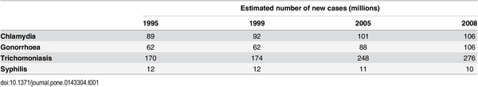
WHO estimates of new cases of sexually transmitted infections among adults
Reference
Newman L, Rowley J, Vander Hoorn S, Wijesooriya NS, Unemo M, et al. (2015) Global Estimates of the Prevalence and Incidence of Four Curable Sexually Transmitted Infections in 2012 Based on Systematic Review and Global Reporting. PLOS ONE 10(12): e0143304. http://journals.plos.org/plosone/article?id=10.1371/journal.pone.0143304
127
Notes:
TRAINER NOTES
With the exception of syphilis, the trend appears that more people are being infected with STI’s.

Slide 128
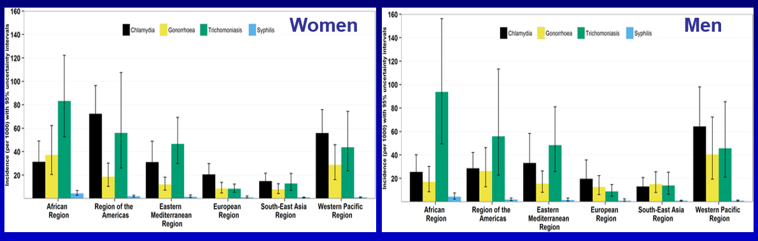
Incidence of STIs in women and men aged 15–49 years by WHO region
(2005 to 2012 data)
Newman L, Rowley J, Vander Hoorn S, Wijesooriya NS, Unemo M, et al. (2015) Global Estimates of the Prevalence and Incidence of Four Curable Sexually Transmitted Infections in 2012 Based on Systematic Review and Global Reporting. PLOS ONE 10(12): e0143304. https://doi.org/10.1371/journal.pone.0143304 http://journals.plos.org/plosone/article?id=10.1371/journal.pone.0143304
128
Notes:
TRAINER NOTES
This graph shows the incidence of sexually transmitted infections in women and men aged 15-40.

Slide 129
Questions?
Notes:
TRAINER NOTES
[ASK PARTICIPANTS] Are there any questions about the prevention or treatment of STIs?

Slide 130
Homework
Please complete the practice test on your own
This is a closed book exam!
Do not use your notes from the training.
Do not look information to answer any of the questions being asked on the practice exam.
We will review the answers to the practice exam on day 5.
Do not share your answers with your classmates
This practice exam provides some insight on your readiness to take the IC&RC ADC exam
Notes:
TRAINER NOTES
Distribute copies of the sample test 3
[READ INSTRUCTIONS]
[ASK PARTICIPANTS] Are there any questions before we conclude?

