Slide 1

Changing Minds, Changing Systems:
Promoting Compassionate Care for Opioid Use Disorder and HIV
Presenter Name(s) and Degrees
Presenter Title, Organization
Date
Notes:
TITLE SLIDE
Negative attitudes and perceptions toward people who use alcohol and drugs and/or people with HIV can create structural and clinical barriers that impact engagement in care. The fear of judgment associated with talking about and seeking help for HIV and/or a substance use disorder can discourage someone from engaging in available treatment and recovery services. This training workshop will address strategies for open, judgment-free conversations that promote mutual understanding and respect, thereby increasing treatment engagement and success. Participants will engage in discussion about how to decrease negative bias and increase engagement in their programs and communities.
The duration of the training is approximately 180 minutes (3 hours), depending on whether the trainer chooses to present all the slides, or a selection of slides. A series of Test Your Knowledge/What Did You Learn questions have been inserted at the beginning and end of the presentation to assess a change in the audience’s level of knowledge after the information has been presented. An answer key is provided in the Trainer’s notes on slides 125-129.
This training package is the latest in a series of curricula focused on the intersection of HIV and opioids. Previously training packages developed by the PAETC/PSATTC collaboration include: Prescription Opioids 101: What HIV Clinicians Need to Know (2011); Heroin and HIV: What Clinicians Need to Know (2015); and Heroin, Prescription Opioids, and HIV: What Clinicians Need to Know (2018).
AI Disclaimer: Non-generative AI (ChatGPT) was used to summarize slide content for trainer notes for select slides. All information and references/citations were independently verified by the training developers.

Slide 2
Disclaimer
The views and opinions expressed in this presentation are not necessarily those of the Pacific AIDS Education & Training Center (Pacific AETC) or its eight local partner sites in HRSA Region 9, the Regents of the University of California or its San Francisco campus (UCSF or collectively, University) , nor of our funder, the Health Resources and Services Administration (HRSA). Neither Pacific AETC, University, HRSA nor any of their officers, board members, agents, employees, students, or volunteers make any warranty, express or implied, including the warranties of merchantability and fitness for a particular purpose; nor assume any legal liability or responsibility for the accuracy, completeness or usefulness of information, product or process assessed or described; nor represent that its use would not infringe privately owned rights.
HRSA Acknowledgement Statement
The Pacific AETC is supported by the Health Resources and Services Administration (HRSA) of the U.S. Department of Health and Human Services (HHS) through a partial award of $2,071,973 for FY25/26. The contents are those of the author(s) and do not necessarily represent the official views of, nor an endorsement by, HRSA, HHS, or the U.S. Government. For more information, please visit HRSA.gov.
Trade Name Disclosure Statement
Funding for this presentation was made possible by 6 TR7HA53196‐01‐01 from the Human Resources and Services Administration HIV/AIDS Bureau. The views expressed do not necessarily reflect the official policies of the Department of Health and Human Services nor does mention of trade names, commercial practices, or organizations imply endorsement by the U.S. Government. Any trade/brand names for products mentioned during this presentation are for training and identification purposes only.
Notes:
TRAINER NOTES:
The disclaimer is provided to clarify funding for the project and distinguish the Pacific AIDS Education and Training Center’s role in promoting views and opinions contained in the training.
This PowerPoint presentation and companion 2-page fact sheet was developed by Beth A. Rutkowski, MPH (UCLA Integrated Substance Use and Addiction Programs/Pacific Southwest Addiction Technology Transfer Center (ATTC)), through supplemental funding provided by the Pacific AIDS Education and Training Center. We wish to acknowledge Thomas E. Freese, PhD, from the Pacific Southwest ATTC, and Sandra M. Cuevas from the PAETC – Los Angeles Area.

Slide 3
Disclosures
Speakers: please select the appropriate disclosure statement and delete the other statement and this text.
If there are no disclosures, use this statement:
All presenters of this continuing medical education activity have indicated that neither they nor their spouse/legally recognized domestic partner has any financial relationships with commercial interests related to the content of this activity.
If there are relationships to disclose, use this statement (you must include your role in the activity if there is a disclosure), and then erase this line:
The following presenter has disclosed the following relationship with a commercial interest.
Presenter name – Type of relationship: Company Name
Resolution: This presentation has been reviewed by the PAETC Clinical Director, who reports that the above disclosures have had no effect on the content of this presentation.
All other presenters of this continuing medical education activity have indicated that neither they nor their spouse/legally recognized domestic partner has any financial relationships with commercial interests related to the content of this activity.
Notes:
INSTRUCTIONS:
This Disclosures slide should be customized based upon whether the presenter has disclosures.

Slide 4
Learning Objectives
At the completion of this presentation, participants will be able to:
Specify at least three (3) ways that negative attitudes towards people who use drugs and people with HIV can impact treatment engagement.
Describe at least two (2) actions to decrease negative attitudes and increase treatment engagement in your program.
List at least three (3) guiding principles that are similar for treating HIV and opioid use disorder (OUD) .
Explain at least three (3) treatment strategies to treat OUD.
Notes:
INSTRUCTIONS:
Briefly review each of the four learning objectives with attendees.

Slide 5
Test Your Knowledge – Question #1
Approximately _____ people in the U.S. have HIV.
900,000
1.2 million
1.8 million
10 million
Notes:
INSTRUCTIONS:
Program the Test Your Knowledge question and responses as a virtual poll. Allow training participants approximately 30 seconds to respond and then close the poll and display the results. Do not provide the correct answer.

Slide 6
Test Your Knowledge – Question #2
Engagement in care can be improved by all the following except for _____.
High-barrier care
Peer support
Extended clinic hours
Outreach
Notes:
INSTRUCTIONS:
Program the Test Your Knowledge question and responses as a virtual poll. Allow training participants approximately 30 seconds to respond and then close the poll and display the results. Do not provide the correct answer.

Slide 7
Test Your Knowledge – Question #3
Which of the following outcomes is not associated with bias against people in treatment for a substance use disorder (SUD)?
Delays in seeking treatment
Lower quality of life
Increased self-esteem
Greater likelihood to drop out of treatment early
Notes:
INSTRUCTIONS:
Program the Test Your Knowledge question and responses as a virtual poll. Allow training participants approximately 30 seconds to respond and then close the poll and display the results. Do not provide the correct answer.

Slide 8
Test Your Knowledge – Question #4
Which of the following is not an FDA-approved medication to treat opioid use disorder?
Naltrexone
Acamprosate
Buprenorphine
Methadone
Notes:
INSTRUCTIONS:
Program the Test Your Knowledge question and responses as a virtual poll. Allow training participants approximately 30 seconds to respond and then close the poll and display the results. Do not provide the correct answer.

Slide 9
Test Your Knowledge – Question #5
Which of the following is not a step in the Brief Negotiated Interview (BNI)?
Engage the patient
Assess readiness for change
Negotiate a plan
Tell the patient what to do
Notes:
INSTRUCTIONS:
Program the Test Your Knowledge question and responses as a virtual poll. Allow training participants approximately 30 seconds to respond and then close the poll and display the results. Do not provide the correct answer.

Slide 10
Let’s get some initial thoughts into the room
TRUE OR FALSE?
Attitudes and judgment can be expressed through body language
and looks as well as verbally.
Notes:
**ACTIVITY**
This slide provides an opportunity for a group discussion with the folks in the room. The purpose of this discussion is to normalize both positive and negative feelings about this population. They are often a challenge, and it is normal to have some emotional reaction. Read the statement and ask attendees to type TRUE or FALSE in the chat.

Slide 11
TRUE
Patients often indicate that they felt judged by providers based on looks, body language, and the way they were treated, in addition to the things providers say.
Notes:
TRAINER NOTES/INSTRUCTIONS:
The statement on the previous slide is true. Engage in a brief verbal/chat discussion with attendees.

Slide 12
Let’s get some more thoughts into the room
TRUE OR FALSE?
Negative attitudes among healthcare provider are not very prevalent and do not make a significant difference in patient engagement. If the patient cares about their own health, they will engage in care.
Notes:
**ACTIVITY**
This slide provides an opportunity for a group discussion with the folks in the room. The purpose of this discussion is to normalize both positive and negative feelings about this population. They are often a challenge, and it is normal to have some emotional reaction. Read the statement and ask attendees to type TRUE or FALSE in the chat.

Slide 13
FALSE
When patients have positive experiences with healthcare providers, it leads to increased levels of involvement in care. tic and other negative encounters can affect future experiences and the patient’s willingness to engage in care.
Notes:
TRAINER NOTES/INSTRUCTIONS:
The statement on the previous slide is false. Engage in a brief verbal/chat discussion with attendees.

Slide 14
A Changing Landscape:
Shifting patterns in HIV/AIDS, drug poisoning deaths, new analogs
Notes:
TRANSITION SLIDE:
This section of the training will review shifting patterns in HIV/AIDS, drug poisoning/overdose deaths, and new drug analogs showing up in local drug supplies across the United States.

Slide 15
HIV Fast Facts (U.S., Individuals aged 13 and older)
Approximately 1.2 million people in the U.S. have HIV; about 13% do not know it and need testing.
HIV continues to have disproportionate impact on certain populations (racial/ethnic minorities and gay, bisexual, and other men who have sex with men)
In 2022, 37,981 people aged 13 and older received an HIV diagnosis in the U.S. and six territories and freely associated states
Notes:
TRAINER NOTES:
Of the approximately 1.2 million people in the US living with HIV, 1 in 8 people (156,000, 13%) do not know their HIV status. Some parts of the country face a higher burden of HIV than others, and the highest rate of new diagnoses occur in the South.
REFERENCE:
HIV.gov. (2025). [Webpage]. U.S. Statistics. Accessed May 1, 2026, from: https://www.hiv.gov/hiv-basics/overview/data-and-trends/statistics.

Slide 16
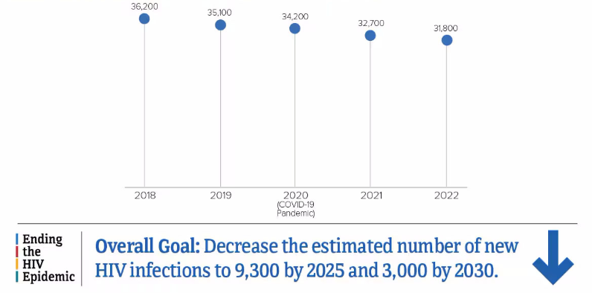
Progress in HIV Prevention Continues
Notes:
TRAINER NOTES:
CDC estimates show new HIV infections decreased 12% from 2018 (36,200) to 2022 (31,800). The decline was driven by a 30% decrease among young people aged 13-24 years. Increases in pre-exposure prophylaxis (PrEP) prescriptions, viral suppression, and HIV testing likely contributed to the decline. Additionally, in the jurisdictions prioritized in the Ending the HIV Epidemic in the U.S.(EHE) initiative HIV incidence decreased by 21% among people aged ≥ 13 years in 2022, compared with 2017 (EHE baseline year).
Official final statistics tracking the exact number of new U.S. HIV infections for the year 2025 are not yet published by the CDC, as public health surveillance data typically requires and extensive reporting and analysis lag.
REFERENCE:
Centers for Disease Control and Prevention. (2025). [Webpage]. Estimated HIV Incidence and Prevalence. Accessed May 1, 2026, from: https://www.cdc.gov/hiv-data/nhss/estimated-hiv-incidence-and-prevalence.html.

Slide 17
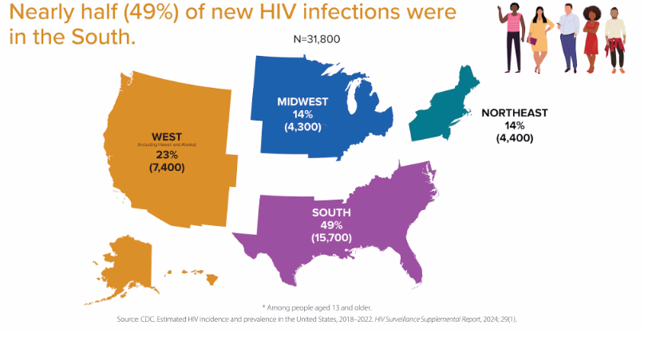
Estimated HIV Infections in the U.S. by Region, 2022
Notes:
TRAINER NOTES:
By region, in 2022, the South accounted for approximately half (49%) of the 31,800 estimated new HIV infections. The annual number of infections in the South in 2022, compared in 2018, decreased 18%.
REFERENCE:
Centers for Disease Control and Prevention. (2025). [Webpage]. Estimated HIV Incidence and Prevalence. Accessed May 1, 2026, from: https://www.cdc.gov/hiv-data/nhss/estimated-hiv-incidence-and-prevalence.html.

Slide 18
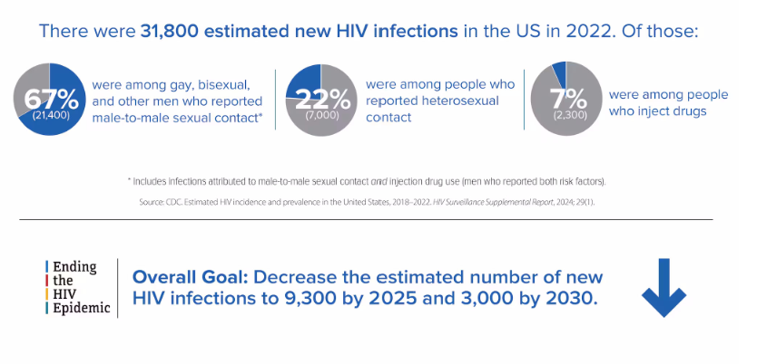
Estimated HIV Infections in the U.S., by Transmission Category, 2022
Notes:
TRAINER NOTES:
In 2022, there were 31,800 estimated new HIV infections in the U.S. and the rate was 11.3 (per 100,000 people). This represents a 12% decrease from 2018 to 2022. Official final statistics tracking the exact number of new U.S. HIV infections for the year 2025 are not yet published by the CDC, as public health surveillance data typically requires and extensive reporting and analysis lag.
Male-to-Male Sexual Contact accounted for 67% (21,400) of the 31,800 estimated new HIV infections in 2022 and 87% of estimated infections among all males. In 2022, as compared to 2018, the annual number of HIV infections among MSM decreased 10%.
People who acquired HIV through heterosexual contact accounted for 22% (7,000) of the 31,800 estimated new HIV infections in 2022. Men reporting heterosexual contact accounted for 6% (2,100) of estimated new HIV infections, while women reporting heterosexual contact accounted for 15% (4,900) of estimated new HIV infections. In 2022, as compared to 2018, the annual number of HIV infections among people who acquired HIV through heterosexual contact decreased 11%.
People who inject drugs accounted for 7% (2,300) of the 31,800 estimated new HIV infections in 2022. Men who inject drugs accounted for 4% (1,300) of estimated new HIV infections, while women who inject drugs accounted for 3% (1,000) of estimated new HIV infections. Among people who inject drugs, no changes were detected in the estimated annual number of HIV infections in 2022, compared with 2018.
By age group, the largest number of new HIV infections (12,700) occurred among people aged 25-34. People aged 13 to 24 accounted for 20% (6,400) of the estimated 31,800 new HIV infections in 2022. In 2022, as compared with 2018, the annual number of HIV infections among persons aged 13 to 24 decreased 30%.
By race/ethnicity, according to CDC, in 2022, Black/African American^{d} persons made up approximately 12% of the population of the United States but accounted for 37% (11,900) of the estimated 31,800 new HIV infections. White persons made up 61% of the population of the United States but accounted for 24% (7,600) of new HIV infections, and Hispanic/Latino^{e} persons made up 18% of the population of the United States but accounted for 33% (10,500) of HIV infections. Together, Black/African Americans and Hispanic/Latino people made up more than half (70%) of estimated new HIV infections in 2022.
REFERENCE:
Centers for Disease Control and Prevention. (2025). [Webpage]. Estimated HIV Incidence and Prevalence. Accessed May 1, 2026, from: https://www.cdc.gov/hiv-data/nhss/estimated-hiv-incidence-and-prevalence.html.

Slide 19
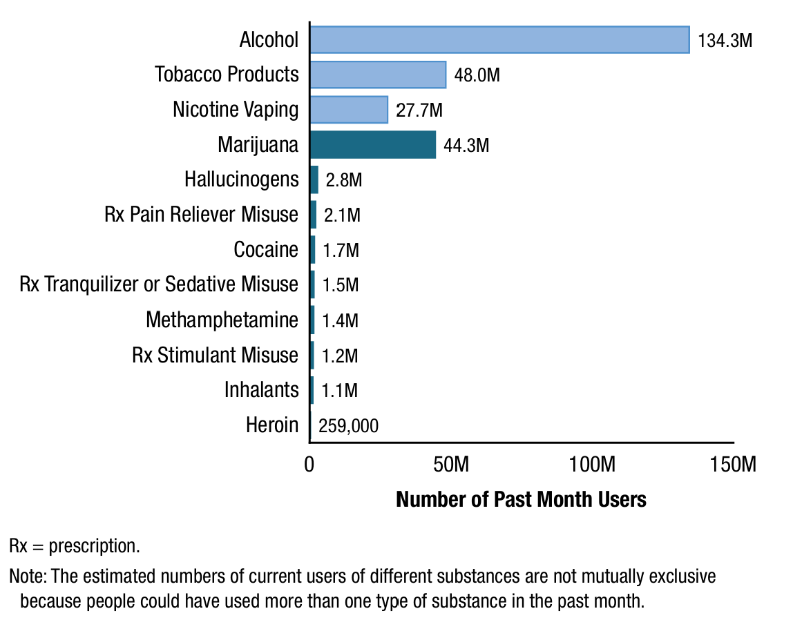
Past Month Substance Use among People Aged 12 or Older, 2024
Notes:
TRAINER NOTES:
Among people aged 12 or older in 2024, 58.3% (or 168.0 million people) used tobacco, vaped nicotine, used alcohol, or used an illicit drug in the past month; 46.6% (or 134.3 million people) drank alcohol in the past month; 16.7% (or 48.0 million people) used a tobacco product in the past month; 9.6% (or 27.7 million people) vaped nicotine in the past month; and 16.7% (or 48.2 million people) used an illicit drug in the past month. Estimates for tobacco use, nicotine vaping, alcohol use, or illicit drug use are not mutually exclusive because respondents could have used more than one type of substance (e.g., tobacco products and alcohol) in the past month.
REFERENCE:
Substance Abuse and Mental Health Services Administration. (2025). Key substance use and mental health indicators in the United States: Results from the 2024 National Survey on Drug Use and Health (HHS Publication No. PEP25-07-007, NSDUH Series H-60). Center for Behavioral Health Statistics and Quality, Substance Abuse and Mental Health Services Administration. https://www.samhsa.gov/data/data-we-collect/nsduh-national-surveydrug-use-and-health/national-releases.

Slide 20
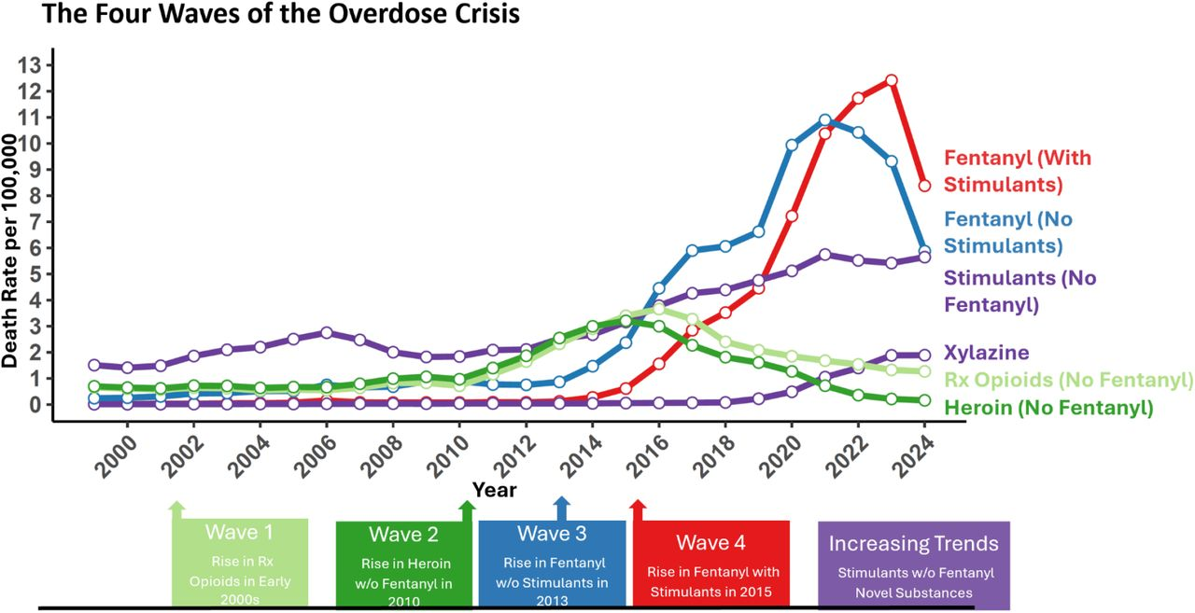
The Four Waves of the Overdose Crisis
Notes:
TRAINER NOTES:
After multiple waves of the overdose crisis and many years of increases, the US overdose death rate dropped more than 24% between 2023 and 2024. Decreases reflected declining illicit fentanyl-involved deaths (with and without stimulant involvement). The 4th wave of the US overdose crisis, defined by deaths involving fentanyl and stimulants, declined for the first time in 2024. Despite overall decreases, deaths involving stimulants without fentanyl, and xylazine, continued to represent a growing proportion of overdose deaths in the US.
REFERENCE:
Friedman, J. R., Palamar, J. J., Ciccarone, D., Gaines, T. L., Borquez, A., Shover, C. L., & Strathdee, S. A. (2025). Characterizing declines in US overdose deaths compared to exponential predictions. medRxiv. https://doi.org/10.1101/2025.10.24.25338732
Note: This article is a preprint and has not been peer-reviewed. It reports new medical research that has yet to be evaluated and so should not be used to guide clinical practice.

Slide 21
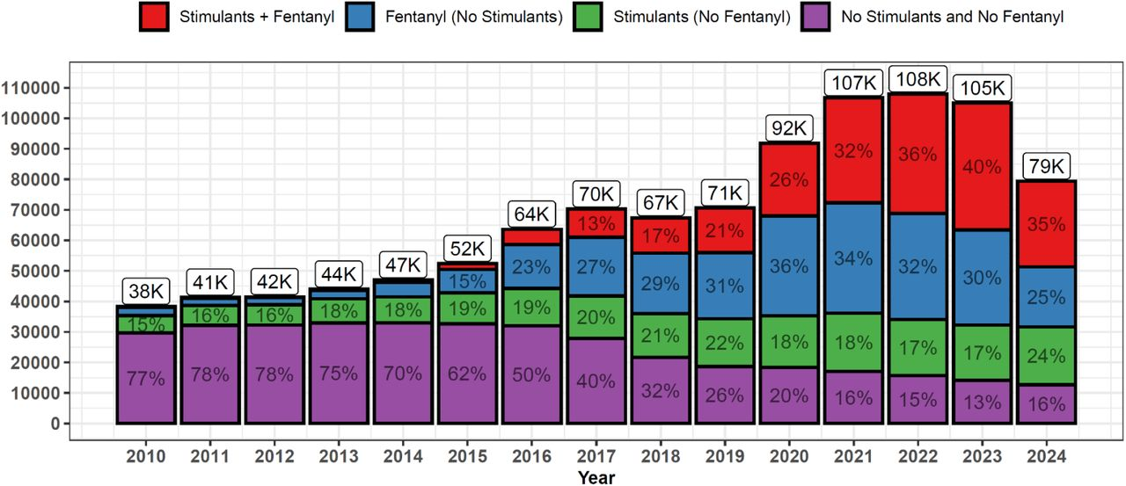
The Four Waves of the Overdose Crisis (cont’d)
Notes:
TRAINER NOTES:
This bar chart displays the total number of overdose deaths each year by categories of fentanyl and stimulant involvement. The overall decrease in overdose deaths between 2023 and 2024 has been largely driven by declines in fentanyl-involved deaths. In contrast, the number of deaths involving stimulants without fentanyl grew in proportion from 17% of deaths in 2023 to 24% in 2024. In 2024, the percentage of fentanyl only and stimulant only deaths were nearly identical (25% and 24%, respectively), and stimulants alone or with fentanyl were involved in nearly 60% of overdose deaths in 2024. In order to adequately address the evolving overdose crisis, we must continue providing lifesaving medical treatments for opioid use disorder and expand the use of effective behavioral interventions like contingency management, to treat stimulant use disorder.
REFERENCE:
Friedman, J. R., Palamar, J. J., Ciccarone, D., Gaines, T. L., Borquez, A., Shover, C. L., & Strathdee, S. A. (2025). Characterizing declines in US overdose deaths compared to exponential predictions. medRxiv. https://doi.org/10.1101/2025.10.24.25338732
Note: This article is a preprint and has not been peer-reviewed. It reports new medical research that has yet to be evaluated and so should not be used to guide clinical practice.

Slide 22
Opioids
What are they and how do they impact brain and body?
Notes:
TRANSITION SLIDE:
The next section of the training focuses on the acute and chronic effects of opioids, opioid withdrawal, and an overview of fentanyl and other novel synthetic opioids showing up in the drug supply across the United States.

Slide 23
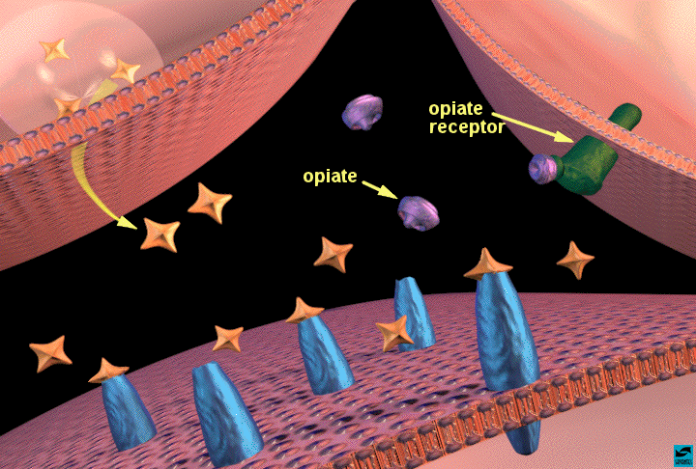
Opioids and Reward
Notes:
TRAINER NOTES:
After they are taken, opioids enter the bloodstream and travel through the body and to the brain. They bind to specific molecules called opioid receptors on certain nerve cells in the brain, the spinal cord, and throughout the body.
These receptors normally interact with naturally occurring molecules in the body to regulate essential functions. They help control pain, regulate breathing (respiration), and help with stress responses. For example, opioid receptors are found on nerve cells that send pain signals from the body to the brain. When opioid drugs bind to these receptors, they trigger changes in nerve cells that can stop the transmission of pain signals in the spinal cord. They also dull the perception of pain in the brain.⁵ That’s why opioids are effective pain medications.
Additionally, opioid receptors are found in brain regions collectively called the reward system. The body’s own opioid-like signaling molecules bind to those receptors. In response to natural rewards, such as food and social interactions, they trigger brain processes that make us feel good and make us want to repeat the healthy behaviors that help us survive.
REFERENCE:
National Institute on Drug Abuse. (2024). [Webpage]. Opioids. Accessed December 15, 2025, from: https://nida.nih.gov/research-topics/opioids.

Slide 24
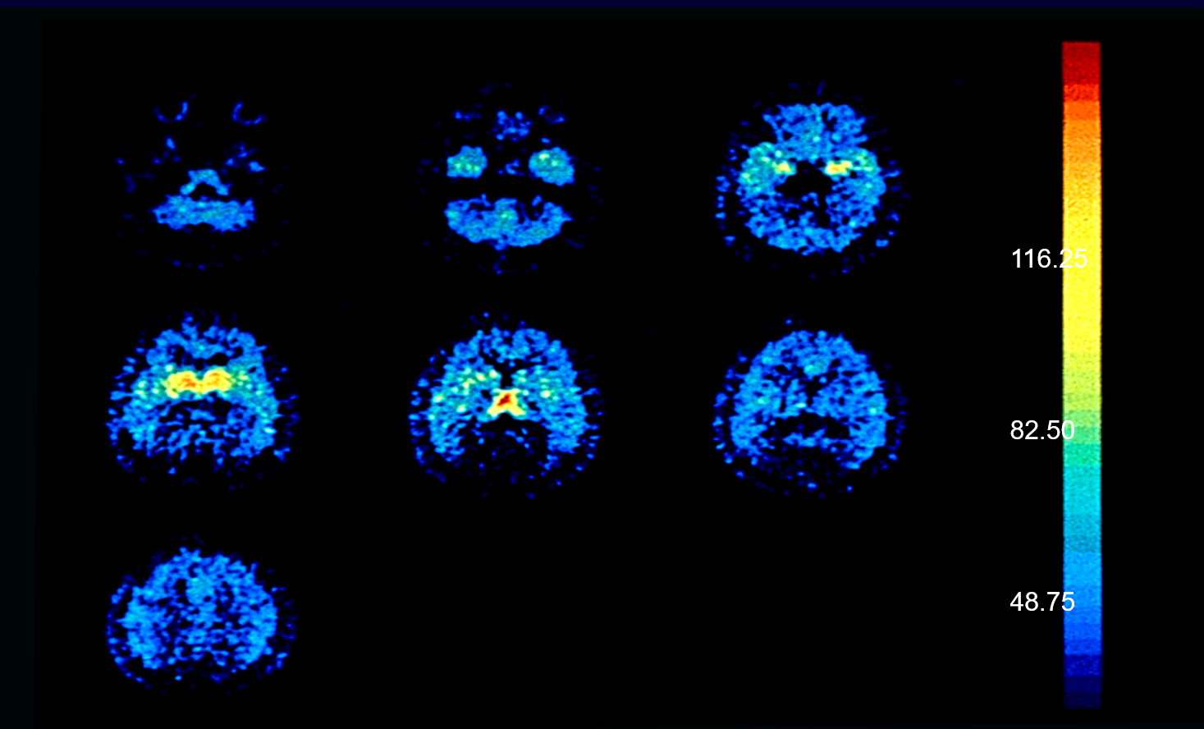
[18F] Cyclofoxy (a Selective Opioid Antagonist) Binding in Human Brain: Normal Volunteer PET Study - NIH
Notes:
TRAINER NOTES:
This figure presents a series of axial positron emission tomography (PET) brain images acquired with the radiotracer [(18)F]cyclofoxy, which binds to μ-opioid receptors, in a long-term methadone-treated former heroin addict. The sequential slices, displayed from superior to inferior brain regions, use a pseudocolor scale in which warmer colors (yellow to red) indicate higher radiotracer binding (greater opioid receptor availability) and cooler colors (blue) indicate lower binding. The images demonstrate heterogeneous regional distribution of opioid receptor binding, with relatively high uptake in subcortical and limbic structures, including areas such as the thalamus and basal ganglia, consistent with the known anatomical distribution of μ-opioid receptors. In the context of Kling et al. (2000), these PET images illustrate how opioid receptor imaging can be used to assess receptor availability in individuals maintained on long-term methadone therapy, providing evidence that chronic methadone treatment does not uniformly eliminate measurable receptor binding and offering insights into neurobiological adaptations associated with prolonged opioid dependence and maintenance treatment.
REFERENCE:
Kling, M. A., Carson, R. E., Borg, L., Zametkin, A., Matochik, J. A., Schluger, J., Herscovitch, P., Rice, K. C., Ho, A., Eckelman, W. C., & Kreek, M. J. (2000). Opioid receptor imaging with positron emission tomography and [(18)F]cyclofoxy in long-term, methadone-treated former heroin addicts. J Pharmacol Exp Ther, 295(3), 1070-1076. PMID: 11082442.

Slide 25
Acute Effects of Opioids
Euphoria
Pain relief
Suppresses cough reflex
Histamine release
Warm flushing of the skin
Dry mouth
Drowsiness and lethargy
Sense of well-being
Respiratory depression
Sedation
Pupil constriction
Slurred speech
Impaired attention/memory
Constipation, urinary retention
Nausea
Confusion, delirium
Seizures
Slowed heart rate
Notes:
People who use heroin report feeling a "rush" (a surge of pleasure, or euphoria). However, there are other common effects, including:
dry mouth
warm flushing of the skin
heavy feeling in the arms and legs
nausea and vomiting
severe itching
clouded mental functioning
going "on the nod," a back-and-forth state of being conscious and semiconscious
Heroin often contains additives, such as sugar, starch, or powdered milk, that can clog blood vessels leading to the lungs, liver, kidneys, or brain, causing permanent damage. Also, sharing drug injection equipment and having impaired judgment from drug use can increase the risk of contracting infectious diseases such as HIV and hepatitis (see "Injection Drug Use, HIV, and Hepatitis").
REFERENCE:
National Institute on Drug Abuse. (2011). Heroin Research Report: Overview. Accessed July 8, 2026, from https://nida.nih.gov/publications/research-reports/heroin/overview.

Slide 26
Long-Term Effects of Opioids
Fatal overdose
Infectious diseases
Infection of heart lining and valves
Pulmonary complications and pneumonia
Respiratory problems
Liver disease
Constipation
Pregnancy-related complications
Collapsed veins, abscesses, and cellulitis
Notes:
People who inject drugs such as heroin are at high risk of contracting the HIV and hepatitis C (HCV) virus. These diseases are transmitted through contact with blood or other bodily fluids, which can occur when sharing needles or other injection drug use equipment. HCV is the most common blood born infection in the United States. HIV (and less often HCV) can also be contracted during unprotected sex, which drug use makes more likely.
REFERENCE:
National Institute on Drug Abuse. (2011). Heroin Research Report: Overview. Accessed July 8, 2026, from https://nida.nih.gov/publications/research-reports/heroin/overview.

Slide 27
Opioid Withdrawal (1)
Intensity varies with level and chronicity of use
Cessation of opioids causes a rebound in functions depressed by use
First signs occur shortly before next scheduled dose
For short-acting opioids (e.g., heroin) peak of withdrawal occurs 36-72 hours after last dose
Acute symptoms subside over 3 to 7 days
Ongoing symptoms may linger for weeks or months
Symptoms include dysphoric mood, nausea or vomiting, diarrhea, tearing
or runny nose, dilated pupils, muscle aches, goosebumps, sweating, yawning,
fever, and insomnia
Notes:
Continued use of the drug causes issues, such as health problems and failure to meet responsibilities at work, school, or home. An SUD can range from mild to severe, the most severe form being addiction.
Those who are addicted to heroin and stop using the drug abruptly may have severe withdrawal. Withdrawal symptoms—which can begin as early as a few hours after the drug was last taken—include:
restlessness
severe muscle and bone pain
sleep problems
diarrhea and vomiting
cold flashes with goose bumps ("cold turkey")
uncontrollable leg movements ("kicking the habit")
severe heroin cravings
Once the body becomes accustomed to an opioid being present, it may react if the opioid is removed. The intensity of the withdrawal symptoms will depend on the level of use (dose and type of opioid) and the frequency and duration of use (chronicity). Withdrawal symptoms are basically a rebound effect; those functions that have been depressed or altered by the opioid suddenly emerge again. Withdrawal symptoms are often the opposite of symptoms seen when actively using the opioid (e.g., people get constipated when taking opioids and have diarrhea when withdrawing). The length of withdrawal depends upon the half-life of the opioid. Opioids with short half-lives (e.g., heroin) have acute withdrawal symptoms that peak at 3-4 days and then subside by days 3-7. Opioids with longer half-lives have longer acute withdrawal periods. Regardless of the length of the acute withdrawal, there are protracted withdrawal symptoms (e.g., aches and pains, general malaise) that persist for weeks or months after use ceases. Protracted withdrawal symptoms are less severe than the acute symptoms, but are still experienced as extremely disruptive and uncomfortable.
REFERENCES:
Li, W., Li, Q., Zhu, J., et al. (2013). White matter impairment in chronic heroin dependence: a quantitative DTI study. Brain Res, 1531, 58-64. https://doi.org/10.1016/j.brainres.2013.07.036
Liu, J., Qin, W., Yuan, K., et al. (2011). Interaction between dysfunctional connectivity at rest and heroin cues-induced brain responses in male abstinent heroin-dependent individuals. PloS One, 6(10), e23098. https://doi.org/10.1371/journal.pone.0023098
Qiu, Y., Jiang, G., Su, H., et al. (2013). Progressive white matter microstructure damage in male chronic heroin dependent individuals: a DTI and TBSS study. PloS One, 8(5), e63212. https://doi.org/10.1371/journal.pone.0063212
National Institute on Drug Abuse. (2011). Heroin Research Report: Overview. Accessed July 8, 2026, from https://nida.nih.gov/publications/research-reports/heroin/overview.

Slide 28
Opioid Withdrawal (2)
All opioids produce similar withdrawal symptoms when stopped abruptly
  Severity varies with the amount and duration of use
  Timing of withdrawal symptoms depends on the type of opioid used
opioids used | onset of withdrawal | symptoms peak | duration of withdrawal
Short-acting opioids (e.g., heroin, oxycodone) | 6-12 hours | 36-72 hours | about 5 days
Long-acting opioids (e.g., methadone) | 36-48 hours | ~ 72 hours | up to 3 weeks
SOURCE: Shah & Huecker, 2023
Notes:
Opioid use disorder is a complex, chronic, and treatable medical condition. A person who has been diagnosed with opioid use disorder or another substance use disorder has a pattern of two or more symptoms and behaviors related to their substance use. The Diagnostic and Statistical Manual of Mental Disorders, Fifth Edition (DSM-5)—a reference text professionals use to diagnose substance use disorders—lists these as:
Consuming the drug in larger amounts or for longer than intended.
Persistently wanting to cut down or regulate drug use.
Spending a great deal of time obtaining, using, or recovering from the effects of the drug.
Experiencing a strong desire to use the drug (craving).
Failing to fulfill major obligations at work, school, or home because of drug use.
Continuing drug use even if it causes significant social or interpersonal problems.
Reducing or stopping other activities because of drug use.
Repeatedly using the drug in situations when it is unsafe.
Continuing drug use even when knowing that it causes physical or psychological problems.
Developing tolerance.
Experiencing withdrawal symptoms when stopping drug use.
In 2023, about 5.7 million people in the United States had opioid use disorder.
REFERENCE:
Shah M, & Huecker, M. R. (2023). Opioid Withdrawal. [Updated 2023 Jul 21]. In: StatPearls [Internet]. Treasure Island, FL: StatPearls Publishing. Available from: https://www.ncbi.nlm.nih.gov/books/NBK526012/

Slide 29
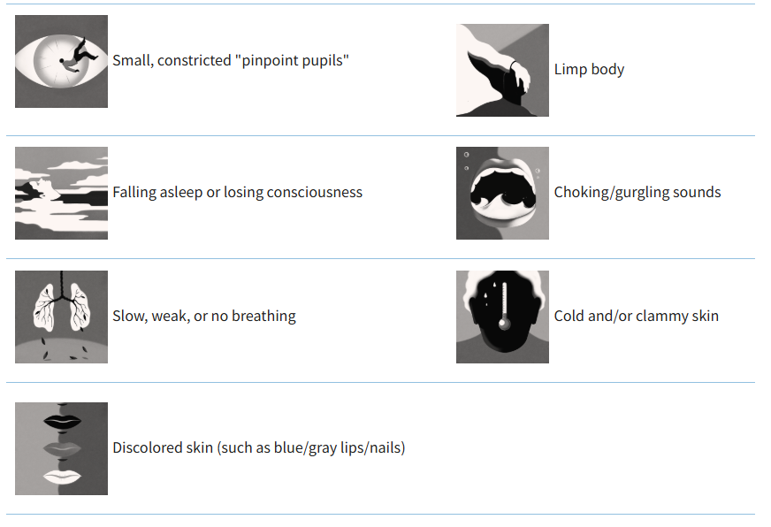
Signs of an Opioid Overdose
SOURCE: CDPH, 2025
Notes:
A drug-related overdose happens when someone takes too much of a drug – or a mix of drugs – and it overwhelms the body. This can be very dangerous or even deadly. Overdoses can happen with many types of drugs, including prescription drugs, illicit drugs,* or alcohol.​ Many drug overdose deaths involve opioids (such as fentanyl and heroin) or stimulants (such as cocaine or methamphetamine), taken alone or together. Illicit drugs may contain unknown or unexpected ingredients. For example, a pill sold as Xanax might contain fentanyl. An opioid overdose usually involves trouble breathing or not breathing at all. The person may be unconscious or not responding. Signs of an opioid overdose are detailed on the slide.
*The term illicit drug refers to drugs that are illegal (e.g., heroin, cocaine, etc.) or prescription medications obtained from a pharmacy or doctor (e.g., counterfeit opioids, counterfeit benzodiazepines, counterfeit stimulants, etc.).
REFERENCE:
California Department of Public Health. (2025). [Webpage]. Signs of a Drug-Related Overdose. Accessed December 15, 2025, from: https://www.cdph.ca.gov/Programs/CCDPHP/sapb/Pages/Signs-of-overdose.aspx.

Slide 30
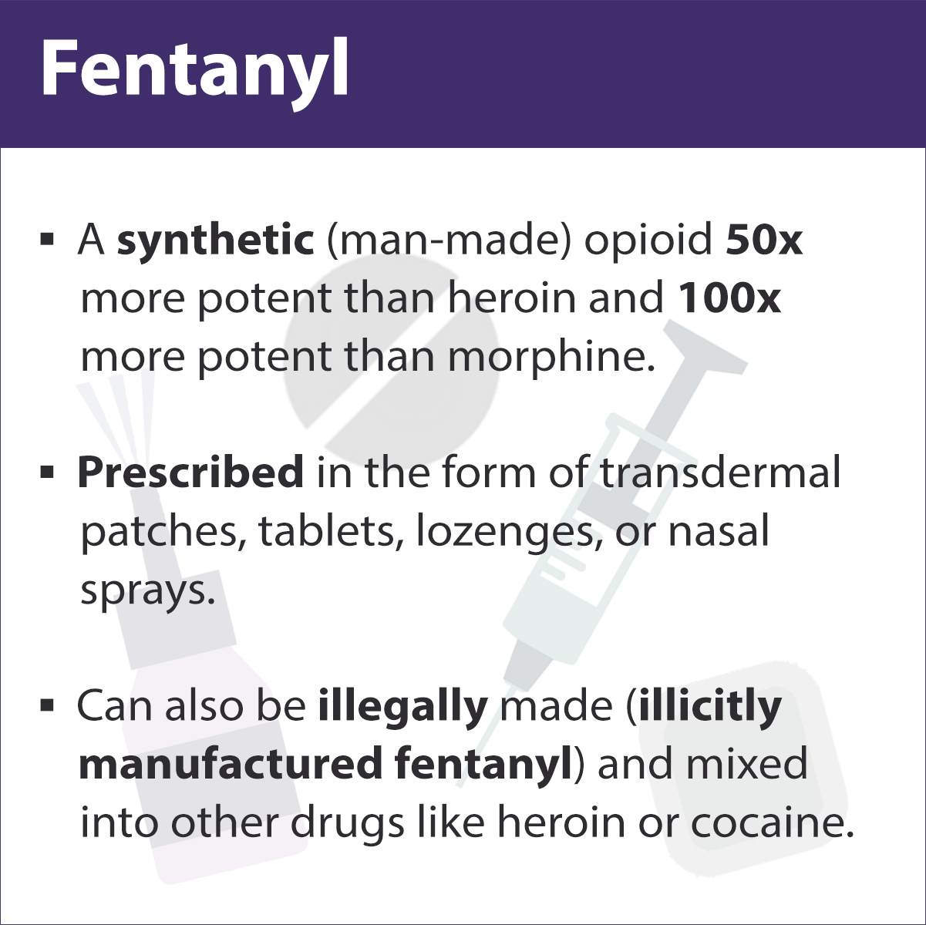
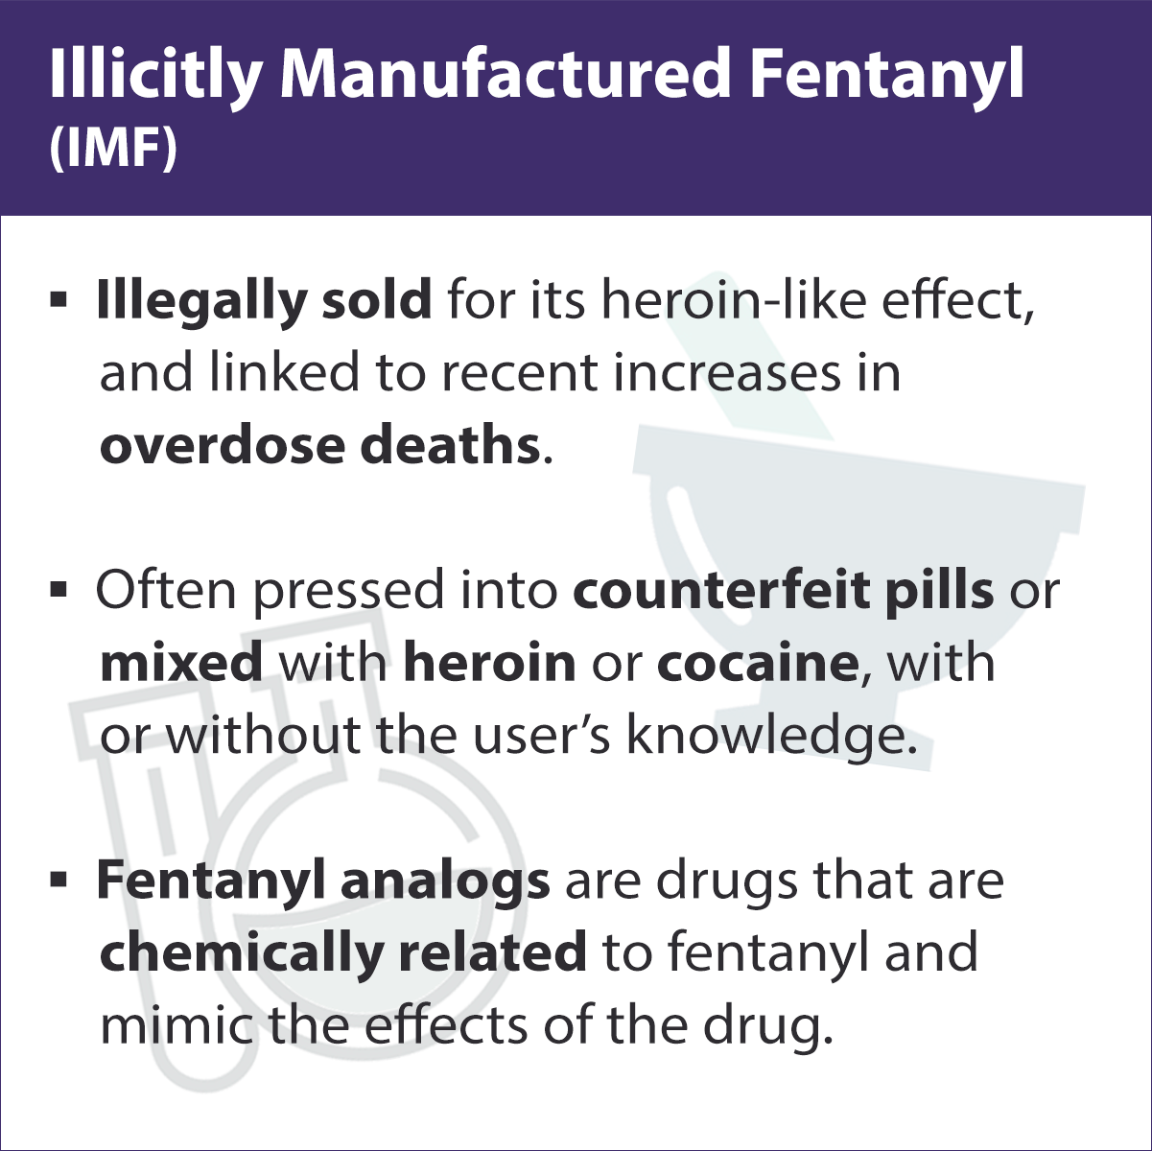
Fentanyl vs. Illicitly Manufactured Fentanyl (IMF)
SOURCE: CDC, 2024
Notes:
Fentanyl is a potent synthetic opioid manufactured in laboratories. It is approved by the FDA for treating severe pain associated with surgery or complex pain conditions. In recent years, illegally produced fentanyl, often termed "illicitly manufactured fentanyl (IMF)," along with other illicitly made synthetic opioids, has become increasingly prevalent in the drug market. This surge in availability has corresponded with a sharp uptick in drug overdose fatalities in the United States.
Individuals may ingest fentanyl and other synthetic opioids knowingly or unknowingly when these substances are mixed into or sold as alternative drugs like heroin, cocaine, or counterfeit pills. Given fentanyl's potency, being 50 to 100 times stronger than morphine, even minute quantities can be lethal. Thus, consuming a drug contaminated with or substituted by fentanyl significantly heightens the risk of overdose.
REFERENCE:
Centers for Disease Control and Prevention. (2024). [Webpage]. Fentanyl Facts. Accessed July 15, 2026, from: https://www.cdc.gov/stop-overdose/caring/fentanyl-facts.html.

Slide 31
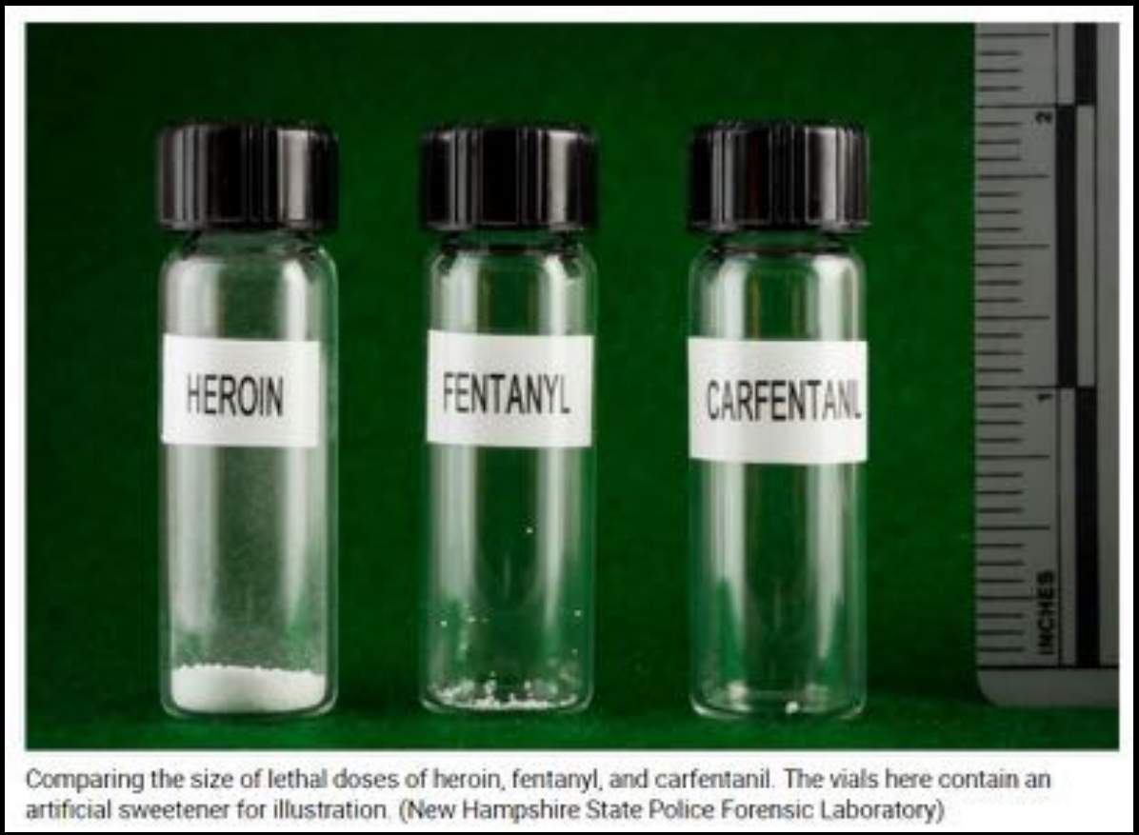
Potential Lethal Dose of Heroin, Fentanyl, and Carfentanil
Notes:
This photo is from the New Hampshire State Police Forensic Laboratory and illustrates the potential lethal dose of heroin on the left, fentanyl in the middle, and carfentanil on the right. The visual comparison features:
Left: A lethal dose of heroin, shown as a small pile of powder.
Middle: A lethal dose of fentanyl, which is a significantly smaller amount than the heroin.
Right: A lethal dose of carfentanil, representing a mere trace amount—roughly the size of a single snowflake.
The photograph serves as a critical warning for the public and first responders regarding the extreme potency of these synthetic substances.
PHOTO CREDIT:
New Hampshire State Police Forensic Laboratory, n.d.

Slide 32
New Opioid Class
Benzimidazole was developed in the 1950’s as a new opioid analgesic and is now showing up as a heroin adulterant.
Metonitazene, an opioid in the benzimidazole class, is also showing up more frequently.
Notes:
Trecki and colleagues reported on data from the Knox County Regional Forensic Center (KCRFC) in Knoxville, Tennessee, the medical examiner for Knox and Anderson counties. KCRFC conducts autopsies when requested from 21 surrounding counties, and first identified para-fluorofentanyl in toxicology results of victims of drug overdoses in November 2020, and metonitazene, either alone or in combination with fentanyl and para-fluorofentanyl, in January 2021. During November 2020–August 2021, KCRFC reported 770 total unintentional drug overdose deaths. Among these deaths, 562 (73.0%) cases received postmortem positive test results for fentanyl, including 192 fentanyl-positive cases reported in the absence of other substances (i.e., fentanyl only), 188 that involved fentanyl and methamphetamine, 48 that involved para-fluorofentanyl, and 26 that involved metonitazene.
REFERENCE:
Trecki, J., Gerona, R. R., Ellison, R., Thomas, C., & Mileusnic-Polchan, D. (2022). Notes from the Field: Increased Incidence of Fentanyl-Related Deaths Involving Para-fluorofentanyl or Metonitazene — Knox County, Tennessee, November 2020–August 2021. MMWR Morb Mortal Wkly Rep, 71, 153–155. https://doi.org/10.15585/mmwr.mm7104a3

Slide 33
Medical Providers Should be Aware
Both para-fluorofentanyl and the benzimidazole opioid, metonitazene contributed to unintentional overdose deaths in eastern Tennessee.
These substances alone can cause respiratory depression leading to death.
Naloxone can reverse overdose caused by these substances, though additional doses may be necessary when fentanyl and these new substances are involved.
Notes:
These findings demonstrate the contribution of both para-fluorofentanyl and the benzimidazole-opioid metonitazene to unintentional overdose deaths in eastern Tennessee. NFLIS data indicate a sharp increase in law enforcement encounters with para-fluorofentanyl and metonitazene from 2020 to 2021; reporting from late 2021 is in process. Although the percentage of law enforcement encounters with these substances in Tennessee decreased relative to the national total percentage within this time frame, the increase in encounters both within Tennessee and nationally reflect an increased distribution of para-fluorofentanyl and metonitazene throughout the United States. With para-fluorofentanyl and metonitazene each alone being capable of producing respiratory depression leading to death, the various combinations of these substances, in addition to possible other opioids including fentanyl-related compounds or adulterants included in each drug exhibit that could cause or exacerbate serious adverse effects, pose an even greater potential harm to the patient than that previously observed. Naloxone still serves as an effective drug to reverse opioid overdose; however, additional doses of naloxone might be required when stronger opioids like fentanyl, para-fluorofentanyl, metonitazene, or other benzimidazoles are involved or combined (4).
Physicians, medical examiners, and toxicology laboratories should be aware of the increased presence of para-fluorofentanyl and the benzimidazole class of opioids when treating patients in the emergency department or identifying these substances postmortem. Increasing public awareness regarding the fatal consequences after the ingestion of fentanyl, para-fluorofentanyl, metonitazene, and other opioids in addition to expanded naloxone availability should be prioritized to reduce opioid-related deaths both in Tennessee and throughout the United States.
REFERENCE:
Trecki, J., Gerona, R. R., Ellison, R., Thomas, C., & Mileusnic-Polchan, D. (2022). Notes from the Field: Increased Incidence of Fentanyl-Related Deaths Involving Para-fluorofentanyl or Metonitazene — Knox County, Tennessee, November 2020–August 2021. MMWR Morb Mortal Wkly Rep, 71, 153–155. DOI: http://dx.doi.org/10.15585/mmwr.mm7104a3

Slide 34
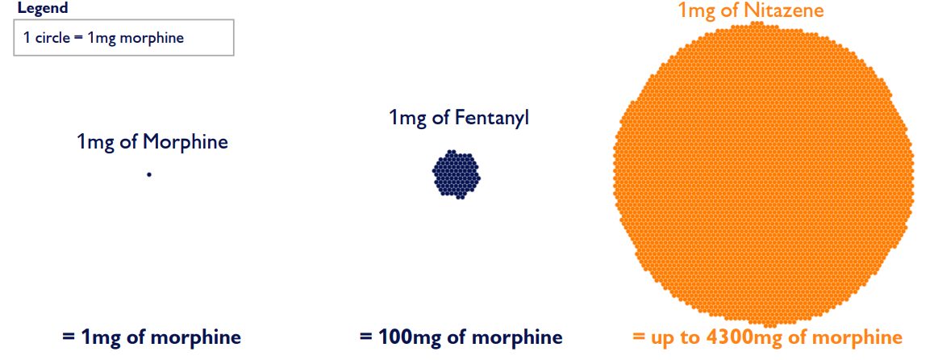
Nitazene Potency Relative to Fentanyl and Morphine
Notes:
Nitazenes are the latest synthetic opioid to emerge as part of the ongoing opioid epidemic. They represent a dramatic increase in potency, even when compared with fentanyl. There are at least 13 different types of nitazenes, the most powerful of which are up to 43 times stronger than fentanyl. The most widely available nitazene, isotonitazene or “ISO”, is approximately five to nine times stronger than fentanyl. Fentanyl is roughly 100 times stronger than morphine — meaning that nitazenes can be up to 4,300 times stronger than morphine.
Nitazenes were first identified in the U.S. illicit drug market in 2019. They are most commonly co-mingled within other substances, particularly other opioids and benzodiazepines, much as fentanyl is most often found within other opioids and stimulants. Nitazenes identified by the DEA are classified as Schedule I controlled substances. Comprehensive nitazene prevalence data are unavailable. The standard consumer surveys do not ask about nitazenes, and laboratories and drug screenings do not commonly test for them.
Comprehensive overdose data are also not available, but limited data from several states point to nitazene use as an emerging trend. Tennessee reported a large increase in nitazene-involved fatal overdoses, from 0 in 2019 to 42 in 2021. Limited wastewater testing also confirms use in Washington and Illinois. Additionally, law enforcement seizures point to growing nitazene prevalence in the illicit drug supply, with nitazenes found in at least 4,300 seizures since 2019.
REFERENCE:
Carnevale Associates LLC. (2025). Info Brief: Emerging Drug Trends – Nitazenes, Tianeptine, and Synthetic Benzodiazepines. Available at: https://www.carnevaleassociates.com/our-work/emerging-drug-trends-nitazenes-tianeptine-and-synthetic-benzodiazepines.html.

Slide 35
New Adulterants: What is Xylazine?
Veterinary analgesic, sedative, and muscle relaxant designed for large animals (horses and cattle)
As heroin adulterant, first detected in the 2000s in rural Puerto Rican drug markets
Puerto Rican public health literature first to identify link between xylazine adulteration, extended periods of sedation/sleep, and novel types of skin wounds (Rodriguez et al., 2008; Reyes et al., 2012; Torruella, 2011)
Notes:
Xylazine is not an opioid. It is, however, a synthetic sedative. Xylazine is an alpha-2 adrenergic agonist that has long been used in veterinary contexts to treat large animals such as horses and cattle. As an opioid adulterant, it was first detected in rural Puerto Rican towns and villages where thoroughbred horses are bred for the US racehorse market. Xylazine has long been used in the treatment of these horses as well as to facilitate the transportation of the horses from Puerto Rico to the US mainland. Much of our understanding of xylazine use and its public health impact derives from the Puerto Rican public health literature published in the late 2000s and early 2010s. This body of literature was the first to identify a novel type of skin wound among PWUDs distinct from traditional abscesses. This Puerto Rican literature insisted that this novel type of skin wound could more accurately be described as an “ulcer” instead of an “abscess”. In one study, over 35% of xylazine users exhibited widespread skin wounds throughout the body, primarily on limbs (Reyes at al. 2008:519). This study was also the first to hypothesize that xylazine wounds were caused by a lack of oxygenation to the skin: “The continued consumption of xylazine at unknown doses could progress skin oxygenation deficit contributing to chronic skin ulceration.” (Reyes et al. 2008:524). These Puerto Rican studies were also the first to suggest that xylazine skin wounds sometimes appear extra-locally, i.e. far from the sites of injection.
REFERENCES:
RodrÍguez, N., Vargas Vidot, J., Panelli, J., Colón, H., Ritchie, B., & Yamamura, Y. (2008). GC-MS confirmation of xylazine (Rompun), a veterinary sedative, in exchanged needles. Drug and Alcohol Dependence, 96(3), 290–293. https://doi.org/10.1016/j.drugalcdep.2008.03.005
Reyes, J. C., Negrón, J. L., Colón, H. M., Padilla, A. M., & Millán, M. Y. (2012). The emerging of xylazine as a new drug of abuse and its health consequences among drug users in Puerto Rico. Journal of Urban Health, 89(3), 519–526. https://doi.org/10.1007/s11524-011-9662-6
Torruella, R. A. (2011). Xylazine (veterinary sedative) use in Puerto Rico. Subst Abuse Treat Prev Policy, 6, 7. https://doi.org/10.1186/1747-597X-6-7

Slide 36
Xylazine’s Transformations to Overdose Prevention Landscape
Xylazine has introduced new problems:
  Not an opioid (need for new overdose reversal agents to complement, not replace, naloxone)
  Ulcers/extensive skin wounds
  Risk of sexual assault and muggings
  Not just overdose; withdrawal challenges
Notes:
While xylazine compensates for many of fentanyl’s weaknesses, it has also introduced a new set of problems and novel public health challenges:
1. It is not an opioid, but an alpha-2 adrenergic agonist. While the likelihood of a xylazine overdose remains to be studied carefully by public health scholars and clinicians, new overdose reversal agents will need to be invented to serve as antidotes for xylazine overdoses in those cases when they occur. Reversal agents for xylazine have been used in veterinary contexts for decades, but they have yet to be tested for use among humans. These existing reversal agents are alpha-2 adrenergic antagonists. That said, naloxone remains the standard of treatment for suspected overdoses, as fentanyl/opioid overdoses remain much more common than xylazine overdoses. Also, as mentioned previously, xylazine is almost never sold on its own. It is almost always sold as “dope” in combination with fentanyl, and public health research currently suggests that the great majority of suspected overdoses are caused by fentanyl, not xylazine (see Love et al. 2023).
2. New varieties of skin lesions that are distinct from abscesses.
3. New gendered public health risks: Unhoused female PWUD in cities like Philadelphia report that they increasingly seek out private places to inject because xylazine often causes them to fall into a deep sleep (Reed et al. 2022). Injecting alone helps to prevent sexual assault and theft, but it also increases the risk of a fatal overdose.
4. In a growing number of localities, PWUD are developing a combined dependence on fentanyl and xylazine. Widespread physical dependence on these two different substances will require public health practitioners to fundamentally reformulate their best practices for the treatment of withdrawal and detoxification. It also will necessitate an expansion of the currently available arsenal of testing technologies that might allow users to detect the presence and concentration of fentanyl and xylazine in their drug supply.
REFERENCE:
Reed, M. K., Imperato, N. S., Bowles, J. M., Salcedo, V. J. Guth, A., & Rising, K. L. (2022). Perspectives of people in Philadelphia who use fentanyl/heroin adulterated with the animal tranquilizer xylazine; Making a case for xylazine test strips. Drug Alcohol Depend Rep, 4, 100074. https://doi.org/10.1016/dadr.2022.100074

Slide 37
Short- and Long-Term Effects of Xylazine
Acute (immediate, short-term) effects:
  Profound sedation
  Low blood pressure
  Slow heart rate
  Weak or absent reflexes
Chronic (gradual, long-term) effects
  Anemia
  Dysglycemia (abnormal blood glucose levels, usually hyper)
  Severe skin wounds
Notes:
Xylazine has both immediate and long-term health effects. In the short term, it acts as a powerful central nervous system depressant, causing profound sedation, low blood pressure, a slow heart rate, and decreased or absent reflexes. These effects can increase the risk of overdose, especially when xylazine is combined with opioids. With repeated or chronic use, xylazine can lead to serious complications. People may develop anemia, abnormal blood glucose levels, and severe skin wounds or ulcers. These wounds can occur even in areas that were not used for injection and often require extensive medical treatment. Recognizing these effects is important so that individuals can receive appropriate medical care and harm reduction support."
REFERENCE:
Papudesi, B. N., Malayala, S. V., & Regina, A. C. (2023). Xylazine Toxicity. [Updated 2023 Jul 17]. In: StatPearls [Internet]. Treasure Island (FL): StatPearls Publishing; 2026 Jan. Available from: https://www.ncbi.nlm.nih.gov/books/NBK594271/.

Slide 38
Xylazine-Related Skin Wounds
  Biological mechanisms contributing to the wounds is not understood
  Forms a thick scabs (eschar) as they heal
  Develop in areas other than where the patient injected
  Necrotic areas are commonly reported
  Granular (burn-like or “cobblestone-like” tissue that fills in wound when the edges don’t match up)
  Can also involve loss of fingers/toes
  Appears vascular, but we don’t really know
  Secondary bacterial infection all but guaranteed for people experiencing homelessness
Notes:
Fear of withdrawal and negative attitudes and perceptions towards substance use in hospital settings prevents patients from seeking care, compounding wound severity. Contrary to pre-xylazine abscesses, wounds do not start as an infection. However, superimposed infections are common, especially among unhoused PWUD in structurally underserved neighborhoods. Service providers and peer navigators will often encounter PWUD on the floor amid xylazine-induced sleep. It is important to move these persons somewhat regularly to prevent “bed sores”/concrete bruises that could trigger or compound xylazine-related wounds. In overdose prevention settings, it is important to involve wound care specialists early and often to prevent wound superinfection.
REFERENCES:
Tosti, R., Hozack, B. A., Tulipan, J. E., Criner-Woozley, K. T., & Ilyas, A. M. (2024). Xylazine-associated wounds of the upper extremity: Evaluation and algorithmic surgical strategy. Journal of Hand Surgery Global Online, 6(5), 605–609. https://doi.org/10.1016/j.jhsg.2024.05.003
Ilyas, A. M., Ramtin, S., Ilyas, E. N., Solarz, M. K., Miller, A., Rae, L., Wink, J., Haroz, R., Weinstein, L., & Criner-Woozley, K. T. (2025). Philadelphia Consensus on the Surgical Management of Xylazine-Associated Wounds in People Who Use Drugs. SurgiColl. https://doi.org/10.58616/001c.140602

Slide 39
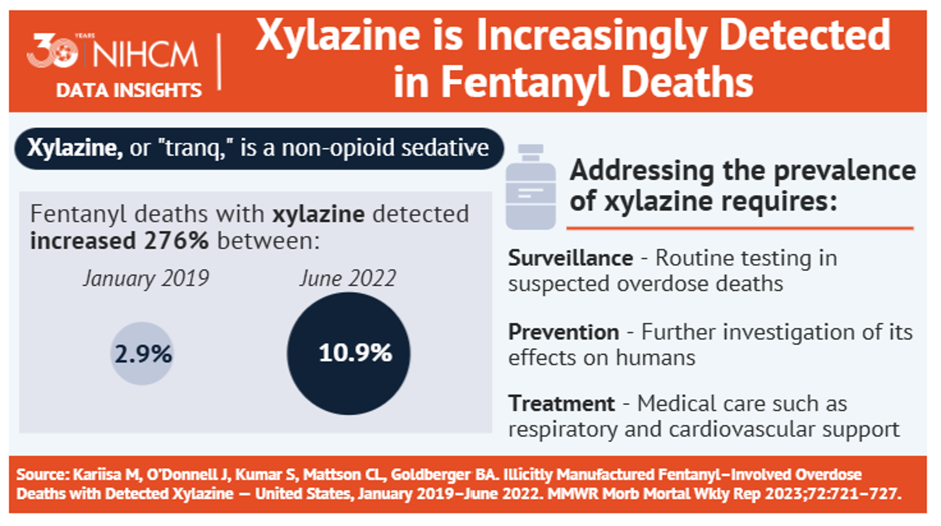
Xylazine is Increasingly Detected in Fentanyl Deaths
Notes:
Drug overdoses are continuing to increase, largely driven by fentanyl. A recent study shows medication for treating opioid use disorder is underprescribed in the United States, particularly for Black patients. Additionally, xylazine, or “tranq,” is increasingly being mixed with fentanyl. Addiction treatment centers don’t have the expertise to treat the severe wounds xylazine causes, limiting treatment options for people who are addicted.
Xylazine has no known antidote, though naloxone should be administered even if it is suspected to be present because xylazine is usually found in synthetic opioids, which do respond to naloxone. There is a new dual drug test strip that can detect fentanyl and xylazine.
REFERENCE:
National Institute for Health Care Management (NIHCM) Foundation. (2023). Mini-Infographics: Xylazine in Fentanyl Deaths. Washington, DC: Author. Accessed July 15, 2026, from : https://nihcm.org/publications/xylazine-in-fentanyl-deaths.

Slide 40
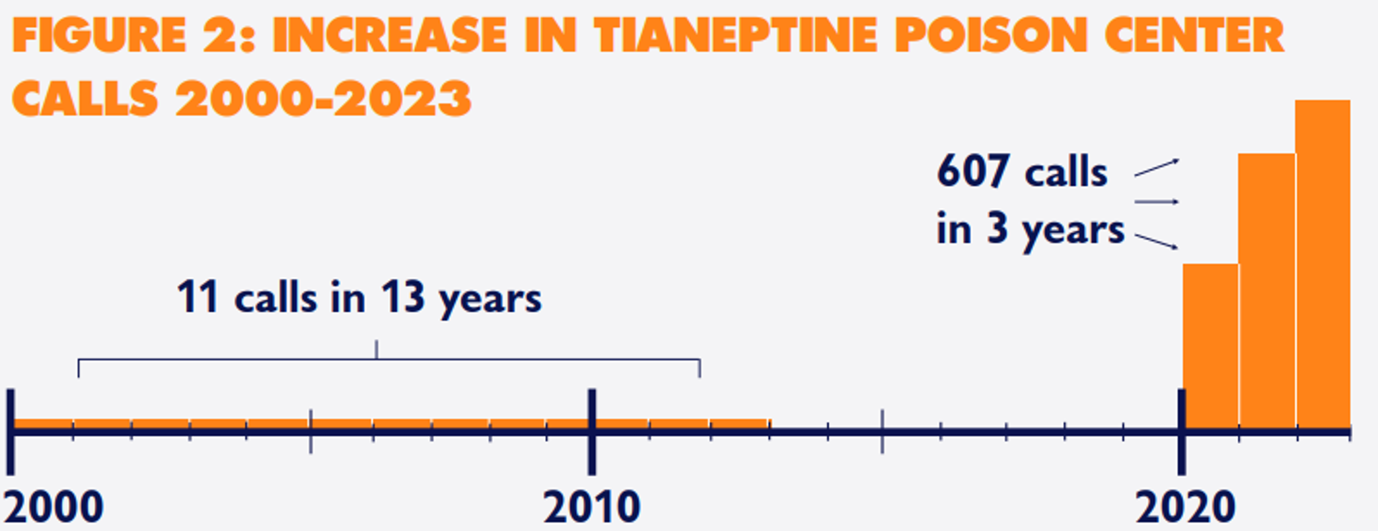
Tianeptine-Related Poison Control Center Calls
Notes:
First developed in the 1980s, tianeptine is used medically as an antidepressant and dietary supplement in some countries. Tianeptine is not approved by the U.S. Food and Drug Administration and is not currently federally controlled. At least 12 states have banned tianeptine, and Congress is considering legislation to classify it as a Schedule III drug. Although not an opioid, tianeptine acts as an agonist at the brain’s mu opioid receptors.7 When taken in large enough doses, it mimics the effects of opioids and poses a risk of addiction and overdose.8
Tianeptine is colloquially known as “gas station heroin” because of its widespread availability at gas stations and convenience stores. Formal prevalence data are scarce, but calls to national poison centers have increased dramatically, from 11 in the 13-year period from 2000 to 2012 to 607 calls in the three years from 2020 to 2022.9 Growing numbers of published case reports also point to rising tianeptine use, as does tianeptine’s rising prominence on social media – a newer surveillance tool for emerging trends.
REFERENCE:
Carnevale Associates LLC. (2025). Info Brief: Emerging Drug Trends – Nitazenes, Tianeptine, and Synthetic Benzodiazepines. Available at: https://www.carnevaleassociates.com/our-work/emerging-drug-trends-nitazenes-tianeptine-and-synthetic-benzodiazepines.html.

Slide 41
What are they and why should we care?
The Issue of Negative Attitudes and Perceptions of Substance Use and HIV
Notes:
The next section of the training focuses on the negative attitudes and perceptions of substance use and HIV – what are they and why should we care?

Slide 42

The Mark
Notes:
A stigma is a mark of disgrace, shame, or negative judgment that society or a group attaches to a person, condition, or trait. It often leads to prejudice, exclusion, or negative attitudes and perceptions against the affected person.
While people are no longer branded, as a society we often see the addiction first and foremost when we see people who are impacted by substance use-related conditions. This shapes how we interact with them and how they feel as an individual.
IMAGE CREDIT:
Purchased image, UCLA ISAP, (n.d.).
REFERENCES:
Hankir, A. K., Northall, A., & Zaman, R. (2014). Stigma and mental health challenges in medical students. BMJ Case Rep, 2014, bcr2014205226.
Oxford Learner’s Dictionaries. (2026). [Webpage]. Stigma. Accessed May 1, 2026, from: https://www.oxfordlearnersdictionaries.com/us/definition/english/stigma.

Slide 43
Language Matters
Notes:
In a study by Kelly and his colleagues, participants were asked to rate scenarios on a variety of characteristics related to the individual and their use of substances. Varied the scenarios so that half the time, the individual was identified as a substance abuse and the other half they were identified as having a substance use disorder. Otherwise, the scenarios were identical.
Participant felt that the “Substance Abuser” was:
Less likely to benefit from treatment.
More likely to benefit from punishment.
More likely to be socially threatening.
More likely to be blamed for their difficulties.
More likely to be able to control their substance without help.
REFERENCE:
Kelly, J. F., & Westerhoff, C. M. (2010). Does it matter how we refer to individuals with substance-related conditions? A randomized study of two commonly used terms. International Journal of Drug Policy, 21(3), 202–207. https://doi.org/10.1016/j.drugpo.2009.10.010

Slide 44
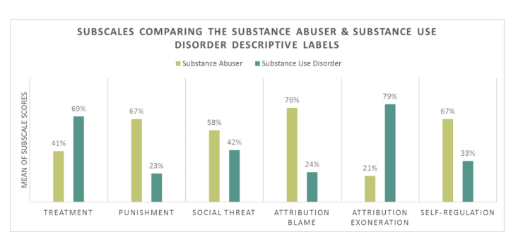
Substance Abuser vs. Substance Use Disorder
SOURCES: Kelly, Dow, & Westerhoff, 2010; Kelly & Westerhoff, 2010
Notes:
This slide shows how when members of the general public are exposed to the term “substance abuser” vs. “a person with a substance use disorder” they are less likely to view treatment as necessary, more likely to view punishment as warranted, that the person is a greater social threat, that they are more to blame for their behavior, and that they can really control their behavior (and therefore are more to blame).
REFERENCES:
Kelly, J. F., Dow, S. J., & Westerhoff, C. (2010). Does our choice of substance-related terms influence perceptions of treatment need? An empirical investigation with two commonly used terms. Journal of Drug Issues, 40(4), 805–818. https://doi.org/10.1177/002204261004000403
Kelly, J. F., & Westerhoff, C. M. (2010). Does it matter how we refer to individuals with substance-related conditions? A randomized study of two commonly used terms. International Journal of Drug Policy, 21(3), 202–207. https://doi.org/10.1016/j.drugpo.2009.10.010

Slide 45
“Bad” and “Good”
Ashford used an implicit bias test to capture the automatic thoughts that may not be in awareness related to people who use drugs
Both “addict” and “substance use disorder” are more associated with “bad” than “good;” “addict” more strongly
Did not vary by whether someone is in recovery or has worked in behavioral health
Even people with lived and living experience have internalized these attitudes
SOURCE: Ashford, Brown, & Curtis, 2018
Notes:
Background: The general public, treatment professionals, and healthcare professionals have been found to exhibit an explicit negative bias towards substance use and individuals with a substance use disorder (SUD). Terms such as "substance abuser" and "opioid addict" have shown to elicit greater negative explicit bias.
Results: The terms "substance abuser", "addict", "alcoholic", and "opioid addict", were strongly associated with the negative and significantly different from the positive counter terms. "Relapse" and "Recurrence of Use" were strongly associated with the negative; however, the strength of the "recurrence of use" positive association was higher and significantly different from the "relapse" positive association.
REFERENCE:
Ashford, R. D., Brown, A. M., & Curtis, B. (2018). The Language of Substance Use and Recovery: Novel Use of the Go/No–Go Association Task to Measure Implicit Bias. Health communication, 1-7.

Slide 46
Do These Negative Attitudes Really Harm Patients?
Less likely to access care
More likely to drop out of care prematurely.
providers holding these beliefs were less likely to offer some health care options (mental health study).
Experiencing negative attitudes from provider about weight resulted in a 60% increased risk of dying (all causes) independent of BMI (obesity study).
Sexual minority people who experiences significant bias from their community had 12 years reduced lifespan (all causes) (structural stigma study)
Bias impacts care and reduces lifespan!
SOURCES: Kelly & Westerhoff, 2010; Corrigan et al., 2014; Tomiyama et al., 2018; Hatzenbuehler et al., 2014
Notes:
As shown in the Kelly & Westerhoff study, people who experience stigma are less likely to access care and more likely to drop out of care prematurely. In a mental health study, people providers holding stigmatizing beliefs were less likely to offer some health care options believing that they would not adhere to the recommendation. In an obesity study people who experience stigma about their weight had a 60% increased risk of dying (all causes) independent of BMI. Even general stigma from the community has an impact. Sexual minority people who experiences significant stigma from their community had 12 years reduced lifespan (all causes).
REFERENCES:
Kelly, J. F., & Westerhoff, C. M. (2010). Does it matter how we refer to individuals with substance-related conditions? A randomized study of two commonly used terms. International Journal of Drug Policy, 21(3), 202–207. https://doi.org/10.1016/j.drugpo.2009.10.010
Corrigan, P. W., Mittal, D., Reaves, C. M., Haynes, T. F., Han, X., Morris, S., & Sullivan, G. (2014). Mental health stigma and primary care decisions. Psychiatry Research, 218(0), 35–38.
Tomiyama, A. J., Carr, D., Granbert, E. M., Major, B., Robinson, E., Sutin, A. R., & Brewis, A. (2018). How and why weight stigma drives the obesity ‘epidemic’ and harms health. BMC Medicine, 16(123).
Hatzenbuehler, M. L., Bellatorre, A., Lee, Y., Finch, B. K., Muennig, P., & Fiscella, K. (2014). Structural stigma and all-cause mortality in sexual minority populations. Soc Sci Med, 103, 33–41.

Slide 47

Barriers to Care
People with SUD and/or HIV often get treated in second-rate dilapidated buildings, which gives them the impression they have a second-class illness.
Not only do people with SUD and/or worry they will get poorer-quality care because of stigma, they also get message not worthy of high-quality care and environments where people with ”real diseases” get treated.
Is “good enough for addicts” good enough?
Notes:
When you present this, recommend actions that they can take if they are in a less than desirable place (e.g., bring in a plan, or a print that you don’ have room for. Ask clients to help decorate by making art., etc).
IMAGE CREDIT:
Purchased image, Adobe Stock.

Slide 48
What Facilitates Negative Attitudes?
Knowledge deficits
Fear
Personal beliefs and discomfort
Education
Societal norms and expectations
Social culture
Workplace culture
Peer culture
Notes:
Negative attitudes toward HIV are primarily facilitated by a variety of factors, including, though not limited to fear, lack of accurate information, and negative misconceptions, which often lead to negative health and social outcomes. These factors create shame, fear of disclosure, and reduced quality of life for people living with HIV.
REFERENCE:
End Stigma End HIV Alliance of San Antonio County. (2026). [Webpage] End Stigma End HIV. Accessed February 19, 2026, from: https://endstigmaendhiv.com/.

Slide 49

…that old joke
Notes:
**CAPTIONED VIDEO**
Video is an embedded video from YouTube. To play with subtitles, Choose the “Watch on YouTube” button that appears in the lower right when in presentation mode. Once YouTube opens, you can select closed captioning “CC” in the lower right corner.
So fat girl stops going to the doctor. These inequities keep people from going to the doctor. It leads to people not going to the doctor and dying. This is how stigma leads to health inequities. We bar the door from people coming into see it.
So if we’re talking about substance use, they don’t see their counselor. They continue to use opioids and die of overdose.
Try to include two or three examples.
Length of Video – 3:19.
REFERENCE:
Wiley, R. (2017). [Video]. Rachel Wiley The Fat Joke. Accessed February 19, 2026, from: https://www.youtube.com/watch?v=mFQ7zqn6j18.

Slide 50
Negative Attitudes Toward Drug Use and/or People with HIV:
Why Language Matters
Notes:
The next segment of the presentation focuses on the impact of negative attitudes and perceptions toward drug use and/or people with HIV.

Slide 51
Negative Attitudes Toward Substance Use Disorders
SOURCE: Shatterproof in collaboration with The Hartford, 2021
Notes:
This slide highlights the stigma that still surrounds substance use disorders and medications for opioid use disorder (MOUD). Despite decades of research showing that addiction is a chronic, treatable medical condition, many negative attitudes persist. Nearly three-quarters of people surveyed—74%—did not believe substance use disorder is a chronic illness. Sixty-five percent said they would not want someone with a substance use disorder to marry into their family, reflecting the social stigma many individuals experience.
More than half—52%—believed substance use disorder is caused by bad character or a lack of willpower, rather than recognizing it as a complex brain disease influenced by biological, psychological, and social factors. Finally, 43% believed that medications for opioid use disorder, such as methadone or buprenorphine, are simply substituting one drug for another. In reality, these medications are evidence-based treatments that reduce overdose deaths, improve treatment retention, and help people regain stability in their lives.
These misconceptions can influence how healthcare providers, community members, and even people with substance use disorders view treatment. As professionals, it's important that we use person-centered, non-stigmatizing language and help replace myths with evidence. Reducing stigma improves patient engagement, increases access to treatment, and ultimately leads to better health outcomes.
REFERENCE:
Shatterproof in collaboration with The Hartford (2021). Shatterproof Addiction Stigma Index. Boston, MA: Author. Accessed July 15, 2026, from: https://www.shatterproof.org/sites/default/files/2023-02/Shatterproof%20Addiction%20Stigma%20Index%202021%20Report%20NEW.pdf.
Shatterproof Addiction Stigma Index https://www.shatterproof.org/node/29116?ea_tracking_id=dr-em-recmon_7-pros&referrer=&cid=.

Slide 52
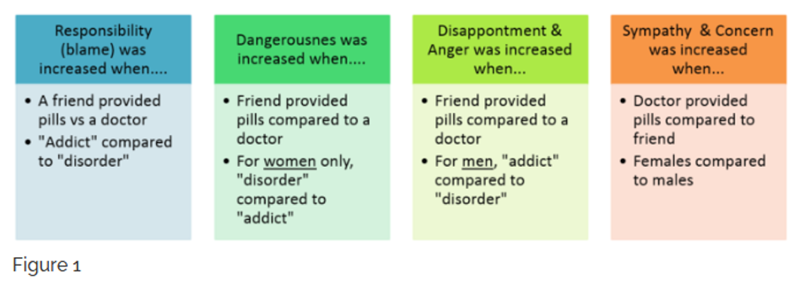
Perceptions of How a Person Starts Using Drugs
When rating hypothetical situations varying in language used and describing where someone received pills:
Bias may be reduced when individuals are depicted as having less
control over drug use
Notes:
In this 2018 randomized between-subjects case vignette study (n=2605) by Goodyear and colleagues, participants rated a hypothetical individual addicted to opioids on different dimensions of stigma after seeing one version of a vignette that varied by three conditions: 1) a male versus a female, 2) an individual labeled as being a "drug addict" versus having an "opioid use disorder" and 3) an individual whose use started by taking prescription opioids from a friend versus receiving a prescription from a doctor. The results indicated that there were higher stigmatizing attitudes overall towards a male, an individual labeled as a "drug addict" and an individual who took prescription opioids from a friend. Interaction effects also showed that a female labeled with an "opioid use disorder" and male labeled as a "drug addict" were rated with higher stigma. The findings from our study are the first to show that information about gender, precipitating events and language matter when assessing stigma and opioid use and may affect the delivery of patient care.
REFERENCE:
Goodyear, K., Haass-Koffler, C. L., & Chavanne, D. (2018). Opioid use and stigma: The role of gender, language, and precipitating events. Drug and Alcohol Dependence, 185, 339–346.

Slide 53
Negative Attitudes Towards People with HIV
Can lead to the concealment of one’s HIV status for fear of being shunned by others
Fear of disclosure can prevent accessing care and treatment for HIV
Patients may be unwilling to take medications where they can be seen by others
Concealment of HIV status leads to social isolation and internalized feelings of self-loathing and cycle of hopelessness
Notes:
Negative attitudes and beliefs about people with HIV can create barriers that impact the timeliness and quality of care. This slide details a few ways that negative attitudes towards people with HIV can lead to adverse health consequences.
REFERENCE:
South Central AETC/UT Health San Antonio. (2026). [Webpage]. HIV Stigma-Free Health Care Series. Accessed March 13, 2026, from: https://aetc.uthscsa.edu/stigma-free-healthcare/.

Slide 54
Implications
Even well-trained clinicians judged same individual differently and more punitively depending on which term exposed to
Use of “abuser” and “addict” may activate implicit cognitive bias perpetuating negative attitudes–could have broad effects (e.g., treatment/funding)
Referring to individuals as having “substance use disorder” may reduce negative attitudes, may enhance treatment and recovery, and still carries some implicit bias
Attitudes are complex and conveyed through language, images, and more
Notes:
This 2010 study by Kelly, Dow, and Westerhoff found that the terminology used to describe individuals with substance-related conditions significantly influences public and clinician perceptions. Using the term “substance abuser” instead of “substance use disorder” evokes more negative attitudes, including higher perceptions of personal culpability, greater social threat, and a stronger preference for punitive measures rather than treatment. This slide lists a few implications of negative provider attitudes and beliefs on the care and treatment of the populations they serve.
REFERENCE:
Kelly, J. F., Dow, S. J., & Westerhoff, C. (2010). Does our choice of substance-related terms influence perceptions of treatment need? An empirical investigation with two commonly used terms. Journal of Drug Issues, 40(4), 805–818. https://doi.org/10.1177/002204261004000403

Slide 55

How Does Bias Harm Patients?
Bias against people in treatment for SUD or HIV is associated with:
  Delays in seeking treatment
  Decreased self-esteem
  Lower quality of life
  Greater likelihood to drop out of treatment early
Notes:
Bias against people in treatment for substance use disorder (SUD) or HIV is strongly associated with negative health outcomes, reduced engagement in care, and higher rates of morbidity.
REFERENCES:
Luoma J et al. (2007). An investigation of stigma in individuals receiving treatment for substance abuse. Addictive Behaviors.
Zwick, J., Appleseth, H. & Arndt, S. (2020). Stigma: How it affects the substance use disorder patient. Subst Abuse Treat Prev Policy 15, 50. https://doi.org/10.1186/s13011-020-00288-0/
Cazalis, A., Lambert, L., & Auriacombe, M. (2023). Stigmatization of people with addiction by health professionals: Current knowledge. A scoping review. Drug Alcohol Depend Rep, 24; 9, 100196. doi: 10.1016/j.dadr.2023.100196. PMID: 38023342; PMCID: PMC10656222.
IMAGE CREDIT:
UCLA ISAP, Purchased Image, Adobe Stock, n.d.

Slide 56
How Do Patients Respond to Bias?
WHO study of 18 most stigmatized social problems in 14 countries:
  Substance addiction ranked 1st
  Alcohol addiction ranked 4th
Bias is associated with poor mental and physical health among people who use drugs
Patients who hold more stigmatizing beliefs about SUDs are less likely to seek treatment; discontinue sooner
Secrecy (concealing the stigmatized condition) is a common coping mechanism to deal with stigma
  Contributes to a cycle of shame and avoidance
Notes:
“We know stigma is a huge issue in addiction because it is the number one reason why people who need treatment don’t access it. We also know from studies across the world that drug addiction is the single most stigmatized condition on earth– more than having HIV or being a criminal.”
In one US study of 13,00 adults looking at weight stigma, people who experienced weight stigma had a 60% increased risk of dying (all causes), independent of BM his was thought to be due to the direct and indirect effects of chronic social stress (Metabolic dysregulation, higher stress hormones, higher inflammation).
Stigma can leads to a vicious cycle:
Get diagnosed with a stigmatizing condition
Feel stigma (it’s not pleasant)
Hide your condition
Have your healthcare provider find out you hid a stigmatized condition
Feel stigma even more since you now both have a stigmatizing condition AND tried to hide it (it’s still not pleasant)
Repeat
REFERENCE:
Isaksson, A., Corker, E., Cotney, J., Hamilton, S., Pinfold, V., Rose, D., Rüsch, N., Henderson, C., Thornicroft, G., & Evans-Lacko, S. (2018). Coping with stigma and discrimination: Evidence from mental health service users in England. Epidemiology and psychiatric sciences, 27(6), 577–588.

Slide 57
Patients Respond to Negative Attitudes by Keeping the Real Issue Secret from You
Secrecy leads to a vicious cycle
Patient gets diagnosed with a stigmatizing condition
They feel stigma (it’s not pleasant)
They therefore hide the condition
Healthcare provider finds out that the patient hid the stigmatized condition
Notes:
Mental health stigma and discrimination are significant problems. Common coping orientations include concealing mental health problems, challenging others and educating others. In their 2018 article, Isaksson and colleagues describe the use of common stigma coping orientations and explain variations within a sample of English mental health service users.
REFERENCE:
Isaksson, A., Corker, E., Cotney, J., Hamilton, S., Pinfold, V., Rose, D., Rüsch, N., Henderson, C., Thornicroft, G., & Evans-Lacko, S. (2018). Coping with stigma and discrimination: evidence from mental health service users in England. Epidemiology and Psychiatric Sciences, 27(6), 577–588.

Slide 58
Patients Respond to Negative Attitudes by Keeping the Real Issue Secret from You, continued
Patient feels stigma even more since they:
  Have a stigmatizing condition
  Tried to hide it
  Stigma magnified by having it AND knowing about it
Repeat from the beginning.
Notes:
Mental health stigma and discrimination are significant problems. Common coping orientations include concealing mental health problems, challenging others and educating others. In their 2018 article, Isaksson and colleagues describe the use of common stigma coping orientations and explain variations within a sample of English mental health service users.
REFERENCE:
Isaksson, A., Corker, E., Cotney, J., Hamilton, S., Pinfold, V., Rose, D., Rüsch, N., Henderson, C., Thornicroft, G., & Evans-Lacko, S. (2018). Coping with stigma and discrimination: evidence from mental health service users in England. Epidemiology and Psychiatric Sciences, 27(6), 577–588.

Slide 59

Negative Attitudes Impact Treatment Seeking
Rates of treatment for chronic diseases in the U.S.:
  Hypertension 77%
  Diabetes 73%
  Major Depression 71%
  Addiction to illicit drugs or alcohol: 18%
SOURCE: Crowley et al., 2017
Notes:
We see the impact on care if we look at rates for treatment for chronic conditions across the U.S. Nearly ¾ of people with hypertension, diabetes and depression get treatment. Less that 1 in 5 people with addiction get care.
IMAGE CREDIT:
Purchased image, UCLA ISAP, (n.d.).
REFERENCE:
Crowley, R. Kirschner, N., Dunn, A. S., & Borenstein, S. S. (2017). Health and public policy to facilitate effective prevention and treatment of substance use disorders involving illicit and prescription drugs: An American College of Physicians Paper. Annals of Internal Medicine, 166(10).

Slide 60
Breakout Activity
How do negative attitudes about people who use drugs impact treatment engagement? What have you noticed?
What successful strategies have you seen that decrease bias in your community?
What is one action you can take to address negative attitudes in your program or community?
Notes:
**ACTIVITY**
Break the audience into 6-8 groups, or fewer, depending on the size of the group, and ask each group to discuss the three questions on the screen. Allow for 7 minutes of discussion, before bringing attendees back for a full-group debrief.

Slide 61
Breakout Activity - Debrief
How do negative attitudes about people who use drugs impact treatment engagement? What have you noticed?
What successful strategies have you seen that decrease bias in your community?
What is one action you can take to address negative attitudes in your program or community?
Notes:
**ACTIVITY**
Ask for one or two spokespeople to share what they discussed, focusing on the 2nd and 3rd bullets. Allow for approximately 3-5 minutes for the debrief.

Slide 62

Stephanie’s Story
SOURCE: Commonwealth of Massachusetts Bureau of Substance Abuse Services, 2015
Notes:
**CAPTIONED VIDEO**
This 1-minute video tells Stephanie’s story of the stigma she encountered due to her opioid addiction and how it discouraged her from seeking health care or treatment. Part of the series of videos from the Commonwealth of Massachusetts “State Without Stigma” public information campaign.
Click the link to play the video.
TRANSCRIPT:
Stephanie describes how even after entering recovery, the stigma of her past addiction continued to haunt her. Transcript: I really felt the stigma of addiction, I mean from everybody. I wouldn’t go to the hospital just because I knew that as soon as I got there, as soon as they looked at my chart and saw that I had a history of heroin addiction, or saw the abscess in my arm, I was instantly labeled a junkie. I was left in the hallway for hours, asking for a glass of water, I’d be ignored for hours. Even when I went there for something that had nothing to do with pain, and I wasn’t requesting pain medication they would automatically think that’s why I was there and tell me that, before I even said anything, “Don’t think you’re getting any narcotics from us.” You know. And it’s, it’s debilitating. It kept me from, for a long time anyway, from getting treatment, you know. I was afraid that everybody would think that I was a junkie and a disgusting, dirty person, you know. That language, clean or dirty or you know, even the word addict has so many connotation to it that it’s just sad and its killing people. It’s literally killing people because it perpetuates the stigma and it prevents people from getting treatment.
REFERENCE:
Commonwealth of Massachusetts Bureau of Substance Abuse Services. (2015). https://www.youtube.com/watch?v=nOeYvlN9g0U.

Slide 63
Facilitating Connection:
Enhancing Patient Engagement in Care
Notes:
One goal of good clinical care is to focus on creating engaging, nonjudgmental, patient-centered treatment settings. Facilitating those connections can increase client success. Let’s look at the importance of engagement.

Slide 64
Why Patient Engagement is So Important
Time in treatment predicts outcome
More is better
How do you engage and retain people in treatment
Notes:
Engaging people in care leads to improved treatment outcomes. Research shows that length of time in treatment predicts outcome and decreases overdose death. In general more is better while considering the clinical needs of each person in care.

Slide 65

Time in Treatment Decreases Overdose
SOURCE: Burns et al., 2022
Notes:
Decades of research affirm the finding that the longer someone stays in treatment, the less likely they are to overdose. The graph shown on this slide features data from Medicaid beneficiaries across the country. The hazard of an overdose event as .90 times lower (95% CI, .88-.92; P < .0001) with each additional 60-days of MOUD continuation from our test for trend regression analysis. This represents a 10% risk reduction with each additional 60-days of MOUD.
REFERENCE:
Burns, M., Tang, L., Chang, C. H., Kim, J. Y., Ahrens, K., Allen, L., Cunningham, P., Gordon, A. J., Jarlenski, M. P., Lanier, P., Mauk, R., McDuffie, M. J., Mohamoud, S., Talbert, J., Zivin, K., & Donohue, J. (2022). Duration of medication treatment for opioid-use disorder and risk of overdose among Medicaid enrollees in 11 states: A retrospective cohort study. Addiction, 117(12), 3079–3088. doi: 10.1111/add.15959. Epub 2022 Jun 13. PMID: 35652681; PMCID: PMC10683938.

Slide 66
Ways to Improve Engagement
Low barrier care
Peer support
Extended hours
Outreach
Nonjudgmental approach
Notes:
There are a number of ways to improve engagement in treatment for OUD:
Low barrier care – includes medication first
Peer support – including peers in the treatment team can help build connection
Extended hours – having availability after hours, including evenings and weekends
Outreach strategies, like street medicine, building relationships with other treatment providers and recovery support services
Nonjudgmental approach – being client centered and meeting someone where they are – so many people experience negative attitudes that keep them from care.
Let’s look at that more closely.

Slide 67
Take a Moment to Reflect
How do negative attitudes toward people who use drugs affect their ability to access and stay engaged in care?
  How might these attitudes impact emotions and behavior?
  What are the ripple effects on individual, staff and the community?
Notes:
**ACTIVITY**
Here are a few questions for reflection. Attendees can reply in the chat or unmute themselves and make comments. Limit the discussion to 5 minutes.

Slide 68
Breaking the Cycle:
Facilitating Connection with Affirming Language
Notes:
The next segment of the presentation focuses on the importance of affirming, person first language to change negative perceptions and attitudes toward drug use and/or people with HIV.

Slide 69
Changing Attitudes Happens on Multiple Levels
Society sees addiction and people who use drugs in negative and stigmatizing ways.
These attitudes are supported by experience and history
These views hold people out of care and reduce life expectancy.
Seeing the whole person is critical. That is why we say, “A person who uses drugs.” It puts the person first and shifts the interaction a positive way.
Notes:
As a society, we are used to thinking about addiction and people who use drugs in negative and often stigmatizing ways. This makes sense give personal and professional experiences with people who are in crisis and/or make not-so-good decisions. The research above shows that these views don’t work as they hold people out of care and reduce life expectancy. Seeing the person and not the disease is critical. That is why we say, “A person who uses drugs.” It puts the person first. If we talk to the that person, we have changed the expected interaction a positive way.

Slide 70
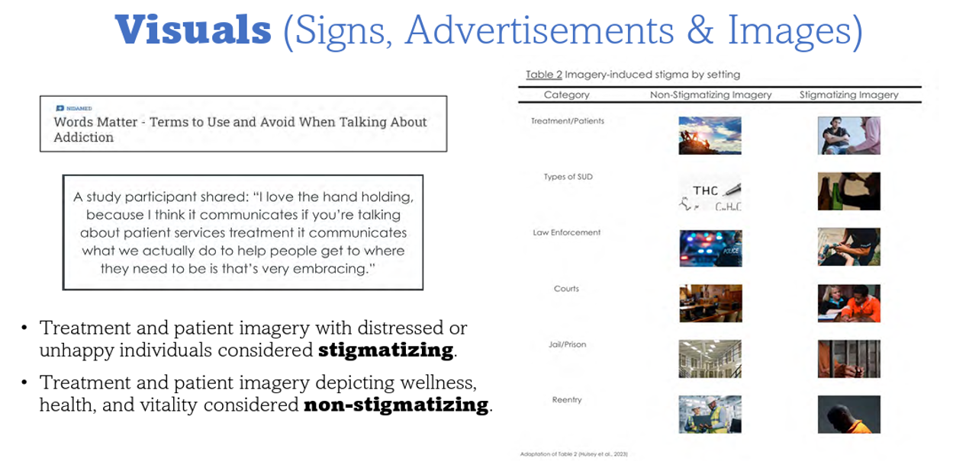
A Picture is Worth 1,000+ Words
Notes:
The images we show depicting people who use drugs can also cause bias. In a study that explored different images, they found differences in attitudes based on the types of images used.
REFERENCES:
National Institute on Drug Abuse. (2021). [Webpage]. NIDAMED: Words Matter – Terms to Use and Avoid When Talking About Addiction. Accessed July 15, 2026, from: https://nida.nih.gov/nidamed-medical-health-professionals/health-professions-education/words-matter-terms-to-use-avoid-when-talking-about-addiction.
Hulsey, J., Zawislak, K., Sawyer-Morris, G., & Earnshaw, V. (2023). Stigmatizing imagery for substance use disorders: A qualitative exploration. Health Justice, 11, 28. https://doi/org/10.1186/s40352-023-00229-6

Slide 71
Changing Our Language
Stigmatizing Language
Abuser, Addict, Alcoholic
You’re Clean
You’re Dirty
Drug Abuse
Relapse
Substance Abuse/Misuse
Drug
Lapse
Medication Assisted Treatment
Affirming, Person-First Language
A person with a substance use disorder
You have a negative/expected result
You have a positive/unexpected result
Substance Use
Recurrence, return to use
Substance Use Disorder
Medication OR psychoactive substances use
Resume OR Experience a recurrence
Medications for Addiction Treatment;
medications for opioid use disorder (MOUD)
Notes:
One of the simplest and most impactful ways we can reduce stigma is by changing the words we use. Language shapes how we think about people, influences how patients feel about themselves, and can affect whether they seek or remain in treatment. The left side of this slide lists terms that have traditionally been used but can be stigmatizing. Words like addict, abuser, or alcoholic define a person by their condition instead of recognizing them as an individual. Similarly, saying someone is clean or dirty suggests a moral judgment rather than describing a clinical test result. Instead, we use person-first language, which acknowledges the person before the diagnosis. Rather than saying an addict, we say a person with a substance use disorder. Instead of drug abuse, we use substance use. Rather than clean or dirty, we refer to negative/expected or positive/unexpected toxicology results. You'll also notice that we recommend using terms like return to use or recurrence instead of relapse or lapse. Substance use disorder is a chronic medical condition, and recurrence of symptoms is common—just as it is with diabetes, hypertension, or asthma. These terms emphasize that recurrence is a clinical event, not a personal failure. Finally, you'll see the shift from Medication-Assisted Treatment (MAT) to Medications for Opioid Use Disorder (MOUD) or Medications for Addiction Treatment. The word assisted can imply that medication is only a secondary component of treatment. In reality, medications such as methadone and buprenorphine are evidence-based treatments that are central to recovery and significantly reduce overdose deaths. Changing our language may seem like a small step, but it has a meaningful impact. Using respectful, person-first language helps build trust, reduces shame, encourages engagement in care, and reinforces that substance use disorder is a treatable medical condition rather than a moral failing."

Slide 72
Frontline Communication Tips
Best practices | Say this!
Encourage dialogue rather than one-word answers | “How may I help you today?” “What’s been going on in your life lately” “How have you been feeling about your fentanyl use?”
Acknowledge and understand that alcohol and drugs often fulfill a need (managing stress, dealing with HIV diagnosis) | “How does methamphetamine help you function and forget about your recent HIV diagnosis?”
Only ask for information that is required. | Ask yourself: What do I need to know? How can I ask in a sensitive way?
Notes:
The way we communicate with patients can build trust, reduce negative attitudes and perceptions, and encourage honest and open dialogue. People are more likely to share important information when they feel respected, heard, and not judged. This slide features a few communication techniques that can make a significant difference in how patients experience clinical services. The goal is to create a safe, welcoming environment where people feel comfortable sharing their needs. Effective frontline communication is not just about asking more questions—it's about asking better questions. Open-ended, empathetic, and purposeful communication helps build trust, reduces stigma, and supports stronger client engagement and better health outcomes.
Best Practice #1: Encourage dialogue rather than one-word answers.
Best Practice #2: Recognize that substance use often serves a purpose.
Best Practice #3: Ask only what you need to know.
REFERENCE:
South Central AETC/UT Health San Antonio. (2026). [Webpage]. HIV Stigma-Free Health Care Series. Accessed March 13, 2026, from: https://aetc.uthscsa.edu/stigma-free-healthcare/.

Slide 73
No. 1 - Perform a Language Audit
Perform a “language audit” of existing materials for language that may promote bias and replace with more inclusive language.
Be aware of subtle message bias that editorializes or adds commentary (“our patients” vs “those patients”).
Notes:
As a society, we are used to thinking about addiction and people who use drugs in negative and often stigmatizing ways. This makes sense given personal and professional experiences with people who are in crisis and/or make not-so-good decisions. The research above shows that these views don’t work as they hold people out of care and reduce life expectancy. Seeing the person and not the disease is critical. That is why we say, “A person who uses drugs.” It puts the person first. If we talk to the that person, we have changed the expected interaction a positive way.
This slide and the following five slides offer tangible things an organization can do to reduce stigma and effectively engage patients in care.
Number 1 – Perform a language audit.

Slide 74
No. 2 - Reflection
Critically reflect on the types of information you choose to disseminate (for example, an email alert) to ensure that you are doing so responsibly.
Notes:
The 2nd thing an organization can do is reflect on the type(s) of information you choose to disseminate. The HIPAA standard is that you share the minimum information the receivers needs to know.

Slide 75
No. 3 – Message Bias
Are you unintentionally editorializing or adding commentary that would bias the message?
Every time you develop a prevention message, consider it as an opportunity to dispel myths and convey respect.
Are you maximizing connection, worth, and community membership related to substance use?
Notes:
The third thing an organization can do is review communication messages for possible bias. For example, consider the differences in the following two statements. (1) “She relapsed” AGAIN versus (2) “She relapsed.” The difference in message may seem subtle, though message #1 carries judgement, where message #2 does not.

Slide 76
No. 4 – Opportunity
Every time you develop a prevention message, consider it as an opportunity to dispel myths and convey respect.
Notes:
The fourth thing an organization can do with regards to developing prevention messages is consider it as an opportunity to dispel myths and convey respect.

Slide 77
No. 5 – Maximize
Am I maximizing connection, worth, and community membership related to substance use?
Notes:
The fifth thing an organization can do is maximize connection, worth, and community. Our patients are more than their disorder(s).

Slide 78
No. 6 – Staff Training
Train staff on issues related to substance use, HIV, and stigma, including the important negative health and community outcomes related to perpetuating stigma.
Give grace – changing language habits is hard.
Share the facts – inform on the negative health and community outcomes related to perpetuating bias.
Notes:
Lastly, the sixth thing an organization can do is train staff on issues related to substance use, HIV, and stigma.

Slide 79
In Summary -- Chose and Use Your Words Carefully
Use person-first language and avoid terms with a judgment
  In front of a client
  In front of providers and other agencies
Ask for permission, and gently educate your colleagues when they use stigmatizing language
Check out the Addictionary, https://www.recoveryanswers.org/addiction-ary/
Notes:
The words we choose matter. Using respectful, person-first, and non-stigmatizing language helps build trust, reduces shame, and supports better engagement in care. Small changes in language can have a big impact. Choosing respectful, person-first words helps create a welcoming, trauma-informed environment where people feel valued, respected, and more willing to engage in care.
The Recovery Research Institute is a leading nonprofit research institute of Massachusetts General Hospital, an affiliate of Harvard Medical School Teaching Hospital, dedicated to the advancement of addiction treatment and recovery.
REFERENCE:
Zwick, J., Appleseth, H. & Arndt, S. (2020). Stigma: How it affects the substance use disorder patient. Subst Abuse Treat Prev Policy 15, 50. https://doi.org/10.1186/s13011-020-00288-0/

Slide 80
In Summary -- Tips for Providers
Remind yourself how much effort it took for your client to show up at all
  Show appreciation for the time, energy, money, etc. it took for them to be present
When clients share experiences of bias, thank them. Acknowledge it takes strength to be vulnerable
Let people choose how they want to be described
If you’re not sure, ask
Avoid using language that defines someone by their condition
Avoid language that makes judgments
Notes:
Pause before engaging with a “challenging” patient. Remind yourself “This patient is suffering. And I am grateful I don’t have to suffer like that.” Share it with those around you. This slide lists a series of tips that providers can reference when engaging in conversations with patients who use substances and/or are in care for HIV.

Slide 81
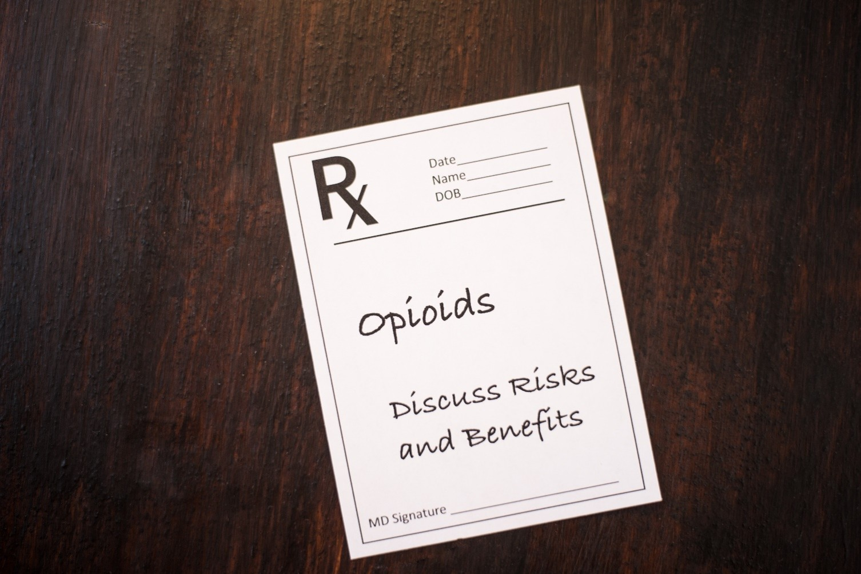
HIV and Opioids
Notes:
This slide serves as a transition into a section on HIV and opioids.
Image Credit:
Purchased image, Adobe Stock, 2022.

Slide 82
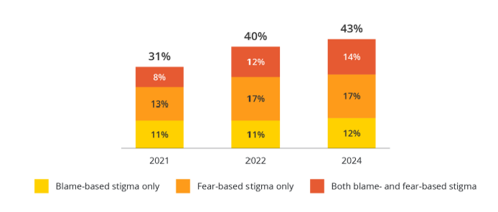
Negative Attitudes and Perceptions of HIV is Widespread and has Increased in Recent Years
Notes:
A 2026 report from the Williams Institute found that in 2024, 43% of adults in the United States held at least one stigmatizing belief about people with HIV, representing an increase from 31% in 2021.
HIV stigma encompasses two primary dimensions. Fear-based stigma refers to discomfort with being around PLWH due to exaggerated or inaccurate beliefs about how HIV is transmitted. Blame-based stigma reflects the belief that PLWH have engaged in immoral or blameworthy behavior and therefore deserve HIV infection.
The proportion of adults endorsing both forms of stigma increased substantially between 2021 and 2024. Heterosexual adults, those with less education, and conservatives were more likely to express stigmatizing views.
REFERENCE:
Grasso, J., Taylor, K. P., & Cisneros, N. (2026). Brief: HIV Stigma is Pervasive and Increasing among US Adults. Los Angeles, CA: UCLA School of Law, Williams Institute.

Slide 83
The Connection between Opioid Use and HIV
Opioid use and HIV are closely linked through behavioral, biological, and clinical factors
  Injection drug use (sharing needles) directly transmits HIV
  Substance use can lead to high-risk sexual behaviors
Opioids can worsen HIV progression by enhancing viral replication
People with HIV have higher rates of opioid use disorder (OUD)
Notes:
Using psychoactive substances can impact your judgment, making you more likely to do things to put you at a higher risk for HIV. Opioid use and HIV are closely linked through behavioral, biological, and clinical factors. People with HIV are more likely to have a co-occurring opioid use disorder and to be prescribed opioids for chronic pain than the general population; however, the effects of opioids on the immune system and HIV disease progression is not fully understood. Opioids may affect HIV reservoirs by enhancing HIV infectivity and replication, and may also modulate immune cell functioning and can reverse viral latency.
REFERENCES:
HIV.gov. (2026). [Webpage]. Substance Use and HIV Risk. Accessed May 14, 2026, from: https://www.hiv.gov/hiv-basics/hiv-prevention/reducing-risk-from-alcohol-and-drug-use/substance-use-and-hiv-risk.
Trunfio, M., Chaillon, A., Beliakova-Bethell, N., Deiss, R., Letendre, S. L., Riggs, P. K., Higgins, N., & Gianella, S. (2023). Beyond the syndemic of opioid use disorders and HIV: The impact of opioids on viral reservoirs. Viruses, 15(8):1712. doi: 10.3390/v15081712. PMID: 37632053; PMCID: PMC10458944.
Azzoni, L., Metzger, D., & Montaner, L. J. (2020). Effect of opioid use on immune activation and HIV persistence on ART. J Neuroimmune Pharmacol, 15(4), 643–657. https://doi.org/10.1007/s11481-020-09959-y

Slide 84
Key Aspects of the Relationship between Opioid Use and HIV
Transmission Risk: Injection of opioids is a major driver of HIV transmission. Sharing injection equipment is highly effective at transmitting HIV.
Behavioral Risk Factors: Opioid use is associated with having sex without condoms, having multiple partners, or exchanging sex for money or drugs.
Increased Risk of Overdose: Individuals with HIV who also have a substance use disorder have a significantly higher risk of experiencing a fatal overdose.
Notes:
Transmission Risk (Injection Drug Use): Injection of opioids, such as heroin or fentanyl, is a major driver of HIV transmission. Sharing contaminated syringes, needles, and other injection equipment is highly effective at transmitting HIV.
Behavioral Risk Factors: Opioid misuse is associated with increased condomless sex, having multiple partners, and exchanging sex for money or drugs, all of which elevate the likelihood of contracting or transmitting HIV.
Increased Risk of Overdose: Individuals with HIV who also have a substance use disorder have a significantly higher risk of experiencing a fatal overdose.
REFERENCE:
HIV.gov. (2026). [Webpage]. Substance Use and HIV Risk. Accessed May 14, 2026, from: https://www.hiv.gov/hiv-basics/hiv-prevention/reducing-risk-from-alcohol-and-drug-use/substance-use-and-hiv-risk.

Slide 85
Opioids, HIV, and Pain
Chronic pain is common among People with HIV (PWH)
Opioids are more commonly prescribed to PWH than those without HIV, ranging from 21%-53% of the PWH population
PWH more likely to receive higher doses of opioid pain medications and are more likely to have SUD and mental illness than the general population
Thus, an elevated risk of OUD in this population
Notes:
People living with HIV are more likely to have chronic pain and, as a result, are prescribed higher doses of opioids more frequently than the general population.
There is an elevated risk of opioid use disorder among people with HIV. Despite viral suppression, chronic pain is common in this population. Opioids are more commonly prescribed to PWH than those without HIV. The rate of opioid prescriptions ranges from 21-53% of the population. PWH are also more likely to receive higher doses of opioid pain medications than the general population and are more likely to have mental health conditions and substance use disorders.
REFERENCE:
Cunningham, C. (2018). Opioids and HIV infection: From pain management to addiction treatment. Topics in Antiviral Medicine, 25(4),143–146.

Slide 86
HIV, Opioids, and Buprenorphine
HRSA-funded project, integrated buprenorphine/naloxone treatment into HIV care settings
386 PWH with opioid dependence
Viral suppression significantly higher for those initiating and maintaining buprenorphine/naloxone treatment
Retention in treatment with bup/naloxone associated with reduced use of opioids and stimulants
Retention in treatment with bup/naloxone also associated with improved physical and mental quality of life
No adverse effects on liver enzymes was observed
Notes:
The BHIVES study was a HRSA-funded project that integrated buprenorphine/naloxone treatment into 10 HIV care settings across the country. Study outcomes were viral suppression and drug use. 303 of the 386 participants received buprenorphine/naloxone treatment; the others received methadone or other treatments. Among the participants receiving buprenorphine, those retained in treatment demonstrated significantly better HIV viral suppression, reduced use of opioids and stimulants, and improved physical and mental quality of life.
REFERENCES:
Weiss, L., Egan J. E., Botsko, M., Netherland, J., Fiellin, D. A., & Finkelstein R. (2011). The BHIVES collaborative: organization and evaluation of a multisite demonstration of integrated buprenorphine/naloxone and HIV treatment. Journal of Acquired Immune Deficiency Syndromes, 56( Suppl 1), S22–S32.
Fiellin, D., Weiss, L., Botsko, M., Egan, J., Altice, F., Bazerman, L. B., … the BHIVES Collaborative. (2011). Drug treatment outcomes among HIV-infected opioid-dependent patients receiving buprenorphine/naloxone. Journal of Acquired Immune Deficiency Syndromes, 56(Suppl 1), S33–38.

Slide 87
SUD/OUD Care Similar to HIV Care
Guiding principles of both conditions:
  Overdose prevention and person-centered care, with a focus on positive changes, patient safety, and well-being
  Treatment and engagement (medications crucial part of treatment, providing “low threshold” care and rapid treatment initiation)
  Linkage to care (early identification of barriers, integrated case management/care navigators)
  Other prevention and screening efforts i.e., screening for SUD in HIV care settings, screening for HIV in SUD treatment settings
Notes:
Healthcare providers are encouraged to screen for both HIV and OUD concurrently. Providing integrated addiction treatment alongside HIV care is considered essential for improving health outcomes.
This information is from a slide set from the AIDS Education and Training Center National Coordinating Resource Center. This technical assistance resource emphasizes that the guiding principles of substance use care — harm reduction, screening and other prevention interventions, treatment initiation, and linkage to ongoing medical care — are like those of viral hepatitis and HIV care. All models focus on patient safety and wellness, with effective medication being critical for the individual’s health and for related public health benefits.
REFERENCE:
Chu, C. (2019). Ending the HIV & HCV Epidemics: A Critical Role for Substance Use Providers. Newark, NJ: AIDS Education and Training Center National Coordinating Resource Center. Retrieved from: https://aidsetc.org/resource/ending-hiv-hcv-epidemics-critical-role-substance-use-providers.

Slide 88
The Gold Standard for Treating Opioid Use Disorder – Medications for OUD
Notes:
The next segment of the training focuses on a review of three FDA-approved medications for treating opioid use disorder – methadone, buprenorphine, and naltrexone.

Slide 89
FDA-Approved Medications for the Treatment of OUD
Methadone:
Methadone hydrochloride tablets for oral suspension
Methadose (methadone hydrochloride) oral concentrate and tablets for oral suspension
Methadone hydrochloride oral concentrate
Naltrexone:
Vivitrol (naltrexone for extended-release injectable suspension) intramuscular
Buprenorphine:
Brixadi (buprenorphine extended‐release) injection for subcutaneous use
Sublocade (buprenorphine extended‐release) injection for subcutaneous use
Suboxone (buprenorphine and naloxone) film for sublingual or buccal use
Zubsolv (buprenorphine and naloxone) tablets for sublingual use
Buprenorphine and naloxone tablets and film for sublingual or buccal use
Buprenorphine tablets for sublingual use
Notes:
Three medications are approved by the U.S. Food and Drug Administration for the treatment of opioid use disorder: methadone, naltrexone, and buprenorphine. All three of these treatments have been demonstrated to be safe and effective.
REFERENCE:
U.S. Food and Drug Administration. (2026). [Webpage]. Information about Medications for Opioid Use Disorder. Accessed March 13, 2026, from: http://fda.gov/drugs/information-drug-class/information-about-medications-opioid-use-disorder-moud.

Slide 90
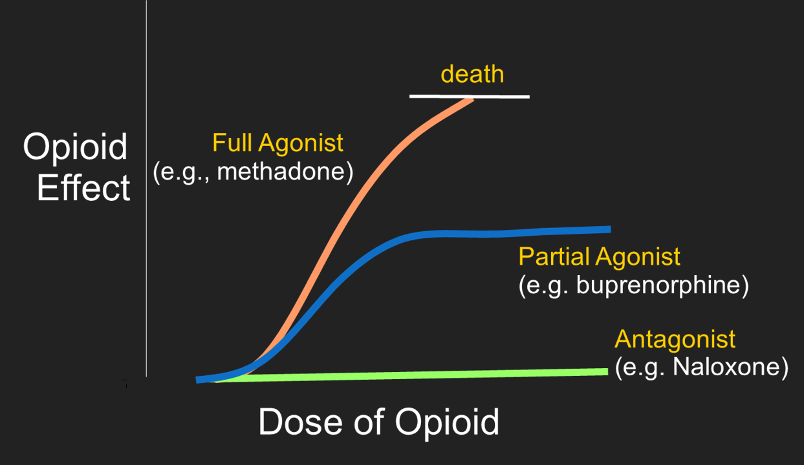
Partial vs. Full Opioid Agonists
Notes:
This slide depicts the differences in opioid effect between full opioid agonists such as methadone, partial agonists such as buprenorphine, and antagonists like naloxone. Taking too much of a full agonist can potentially lead to overdose and death, while partial agonists like buprenorphine have a “ceiling effect”, meaning that the amount of opioid effect levels off at a certain point. Antagonists like naloxone completely block the effects of opioids.
The horizontal axis represents the dose of the opioid. The vertical axis represents the opioid effect, including pain relief, euphoria, sedation, and respiratory depression.
Full Agonists (Orange Line)
Examples include methadone, heroin, fentanyl, morphine, and oxycodone. Full agonists fully activate opioid receptors. As the dose increases, the opioid effect continues to increase. At higher doses, the risk of respiratory depression, overdose, and death also increases. Although methadone is a full agonist, when prescribed and monitored appropriately for opioid use disorder, it is a safe and highly effective treatment.
Antagonists (Green Line)
Naloxone (and naltrexone) are opioid antagonists. Antagonists do not activate opioid receptors. Instead, they block opioid receptors, preventing opioids from producing their effects. Naloxone rapidly reverses opioid overdose by displacing opioids from the receptors. Naloxone has no opioid effect in someone who has not taken opioids and is not addictive.
Partial Agonists (Blue Line)
Buprenorphine is a partial agonist. It activates opioid receptors, though only to a certain extent. As the dose increases, the effects plateau, creating what is known as the ceiling effect. This ceiling effect significantly lowers the risk of respiratory depression and overdose compared with full agonists while still relieving withdrawal symptoms and reducing cravings. More buprenorphine does not continue to produce stronger opioid effects after the ceiling is reached, making it safer than full agonists.
REFERENCE:
Substance Abuse and Mental Health Services Administration. (2021). Medications for Opioid Use Disorder. Treatment Improvement Protocol (TIP). Series 63 Publication No. PEP21-02-01-002. Rockville, MD: Author.

Slide 91
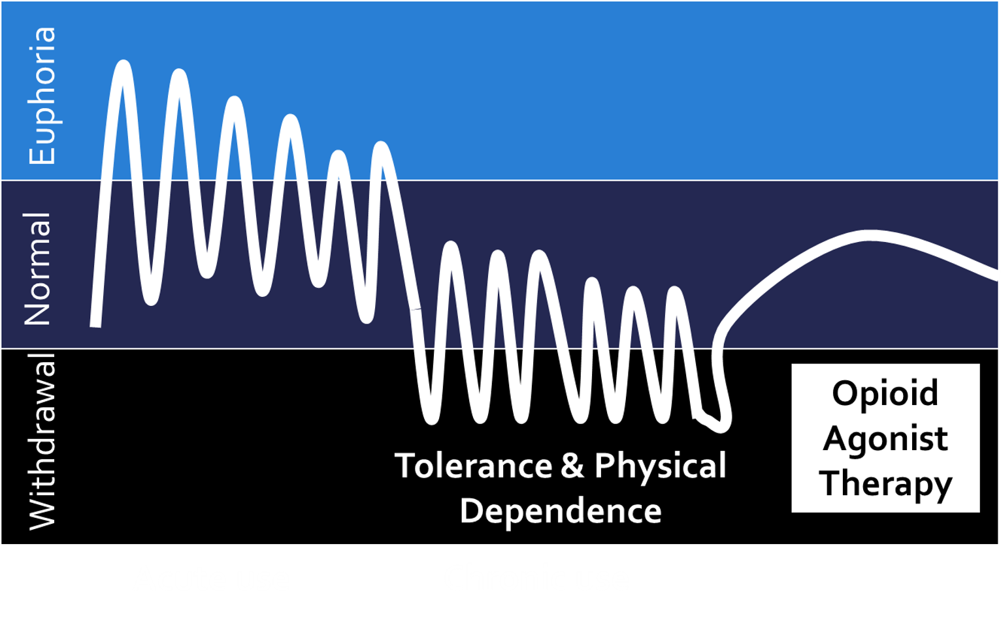
No Longer in the Cycle
Notes:
This graph shows how a person’s experience changes with opioid use over time:
Early (acute use): The person feels strong euphoria (a high), followed by drops back toward normal. The ups and downs are large and noticeable.
With repeated use: The highs become less intense (tolerance develops), and the lows start dipping below normal, leading to discomfort.
Chronic use: The person cycles between small highs and deeper lows, spending more time in withdrawal. At this point, the drug is often taken just to feel “normal,” not to get high.
Dependence: The body becomes physically dependent and stopping causes withdrawal symptoms.
Treatment (opioid agonist therapy): Medication helps stabilize the person, reducing the extreme highs and lows and bringing them closer to a steady, normal state.
In short: initial use creates strong highs, but over time those fade and are replaced by tolerance and physical dependence and withdrawal, unless treated.
REFERENCE:
American Society of Addiction Medicine. (2024). Treatment of Opioid Use Disorder Course. Accessed May 14, 2026, from: https://elearning.asam.org/products/treatment-of-opioid-use-disorder-course.

Slide 92
Methadone Maintenance Therapy
Methadone is a full opioid agonist, meaning if you take too much of it, you can overdose
Used to treat severe pain
Also used to treat opioid use disorder
Suppresses opioid withdrawal symptoms and reduces/prevents cravings
However, typically requires daily dosing at federally-licensed clinic
Historical negative attitudes and perceptions
Notes:
This slide begins to describe methadone maintenance therapy. Methadone is a full opioid agonist, so higher doses can lead to overdose and death. It is prescribed to treat severe pain and opioid use disorder. It suppressed opioid withdrawal symptoms and reduces or completely prevents opioid cravings. One of the features that makes it difficult for people to adhere to treatment is having to go to a methadone clinic every day to get their dose. There has historically been a great deal of stigma attached to methadone clinics.
REFERENCE:
Mattick, R., Breen, C., Kimber, J., & Davoli, M. (2009). Cochrane Database Systematic Reviews, 3, rCD002209.

Slide 93
Methadone Maintenance Therapy (2)
Advantages:
  Suppresses opioid withdrawal and reduces craving
  Reduced participation in crime
  Reduced transmission of blood borne viruses
  Few long-term side-effects
Disadvantages:
  Opioid dependence is maintained
  Withdrawal/tapering can be challenging
  Requires daily time/travel commitment
  Potential for diversion
Notes:
This slide presents advantages and disadvantages of methadone maintenance therapy. Some of the advantages are that it suppresses opioid withdrawal symptoms and reduces cravings, thereby reducing relapses. Studies have shown that individuals on methadone maintenance are less likely to engage in criminal activity and have reduced transmission of blood-borne viruses compared to heroin users. There appear to be few long-term side effects. Some disadvantages of methadone are that dependence on an opioid is being maintained, tapering down and/or discontinuing methadone can be very difficult; it requires a daily time and travel commitment (to the clinic); and that there is the potential for diversion.
REFERENCE:
Salsitz, E., & Wiegand, T. (2016). Pharmacotherapy of opioid addiction: “Putting a real face on a false demon.” Journal of Medical Toxicology, 12, 58–63.

Slide 94
Primary Formulations of Buprenorphine
Sublingual Films and Tablets
Long-Acting Injectables (Subcutaneous)
Buccal Film
Transdermal Patch
Subdermal Implant
Notes:
Buprenorphine is formulated for opioid use disorder (OUD) and pain management, available as sublingual tablets/films, buccal film, subdermal implants, and long-acting injections. Three formulations of buprenorphine were developed for the purpose of analgesia : IV/IM injectable formulation (Buprenex®), transdermal patch formulation (Butrans®), and buccal film formulation (Belbuca®). The formulations developed for the treatment of opioid use disorder are: subcutaneous extended release (Sublocade®), subdermal implant (Probuphine®), and sublingual tablets (Subutex®). Lastly, combination products with naloxone are standard for OUD to discourage misuse, and include: film formulation (Suboxone®) and tablet formulation (Zubsolv®).
REFERENCE:
Poliwoda, S., Noor, N., Jenkins, J. S., Start, C., Steib, M., Hasooon, J., Varrassi, G., Urits, I., Kaye, A. M., and Kaye, A. D. (2022). Buprenorphine and its formulations: A comprehensive review. Health Psychol Res, 10(3), 37517.

Slide 95
Buprenorphine and Buprenorphine/Naloxone
Buprenorphine is a partial opioid agonist
  Provides opioid agonist effects up to a limit
  Has a ceiling effect at higher doses
  Like methadone, it reduces/eliminates withdrawal symptoms and cravings
  When naloxone is added (Suboxone ®), it becomes very difficult to dilute and inject, reducing diversion and allowing for take-home doses
  Usually prescribed at a doctor’s office, unlike methadone
  Less stigma than methadone
Notes:
This slide explains buprenorphine treatment for opioid use disorder. Buprenorphine is a partial opioid agonist, meaning that it provides opioid effects up to a limit. It has a ceiling effect at higher doses, meaning that it is impossible to overdose on it. Similar to methadone, it reduces or eliminates withdrawal symptoms and cravings. When naloxone is added to buprenorphine (i.e., Suboxone), it becomes very difficult to dilute and inject, which reduces diversion and allows for take-home doses. Buprenorphine can be prescribed at any doctor’s office (as long as the physician, NP, or PA has an FDA waiver to prescribe it), which makes it easier in general to access than methadone, and there is less historical stigma around it than there is around methadone.
REFERENCE:
Zoorob, R., Kowalchuk, A., & Mejia de Grubb, M. (2018). Buprenorphine therapy for opioid use disorder. American Family Physician, 97(5), 313–320.

Slide 96
Buprenorphine/Naloxone (Suboxone®)
Naloxone blocks any opioid agonist effect if the Suboxone is illicitly injected, but passes through the GI tract without being absorbed if medication is taken as instructed
Dosage typically starts at 4-8mg/day, going up to 16-24mg for maintenance, although some providers induct on 24 mg, then gradually reduce dose based on response
Notes:
When naloxone is added to buprenorphine, the naloxone blocks the opioid agonist effect if it is illicitly injected, thereby reducing attempts to inject it. If the medication is taken as instructed, in the film or tablet forms, the naloxone passes through the GI tract without being absorbed, thus providing the desired opioid effect. Dosage may start at 4-8mg/day, escalating to 16-24mg/day for maintenance, depending on each patient’s response. However, some providers choose to start patients on a 24mg dose and then gradually reduce the dose depending on the patient’s response.
REFERENCE:
Zoorob, R., Kowalchuk, A., & Mejia de Grubb, M. (2018). Buprenorphine therapy for opioid use disorder. American Family Physician, 97(5), 313–320.

Slide 97
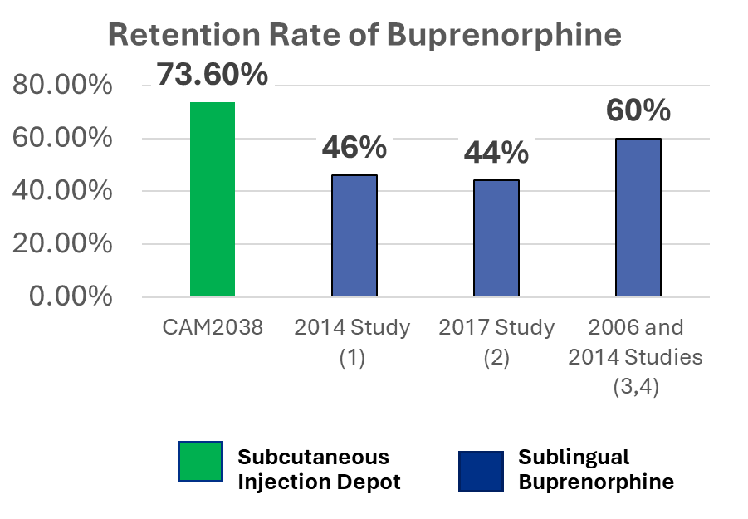
Long-Acting Injectable Buprenorphine (Sublocade®) - Retention
→ High retention rates 2x as high as compared to other large-scale randomized clinical trials (RCTs)
→ Suitable for new patients, as well as for converting for those already prescribed sublingual buprenorphine
Notes:
Long-acting injectable buprenorphine improves retention in treatment by reducing the need for daily dosing, stabilizing medication levels, and lowering barriers such as missed doses, negative attitudes and perceptions, and risk for medication diversion, resulting in more consistent engagement and higher rates of patients staying in care compared to short-acting formulations.
REFERENCES:
Hoffman K., Peyton M. L., Sumner M. Safety of a rapidly dissolving buprenorphine/naloxone sublingual tablet (BNX-RDT) for treatment of opioid dependence: a multicenter, open-label extension study. J Addict Med 2017; 11: 217–23.
Fiellin, D. A., Pantalon, M. V., Chawarski, M. C., Moore, B. A., Sullivan, L. E., O'connor, P. G., & Schottenfeld, R. S. (2006). Counseling plus buprenorphine–naloxone maintenance therapy for opioid dependence. New England Journal of Medicine, 355(4), 365-374.
Gryczynski, J., Mitchell, S. G., Jaffe, J. H., O’Grady, K. E., Olsen, Y. K., & Schwartz, R. P. (2014). Leaving buprenorphine treatment: Patients' reasons for cessation of care. Journal of substance abuse treatment, 46(3), 356-361.

Slide 98
Long-Acting Injectable Buprenorphine (Brixadi®) – Another New Option
Extended-release injection for the treatment of moderate-to-severe opioid use disorder.
Indicated for treatment in patients who have initiated treatment with a single dose of a transmucosal buprenorphine product or who are already being treated with buprenorphine
Exists in two formulations:
  Weekly (8mg, 16mg, 24mg, and 32mg)
  Monthly (64mg, 96mg, and 128mg)
Notes:
BRIXADI®, an extended-release buprenorphine injection, is a prescription medicine for treating people with moderate to severe opioid addiction who have started treatment with a single dose of buprenorphine as a sublingual tablet or buccal film or who are already receiving buprenorphine treatment. It is given once monthly or once weekly to help lower opioid use. The medication delivers a continuous, steady release of buprenorphine without daily ups and downs.
REFERENCE:
Braeburn Pharmaceuticals. (2026). [Webpage]. Brixadi®. Accessed May 1, 2026, from: https://www.brixadi.com/.

Slide 99
Naltrexone
Opioid antagonist, so it blocks opioid effects
Must be inducted after patient has gone through withdrawal, otherwise it will induce withdrawal symptoms
Can be taken orally or as extended-release injection (Vivitrol ®)
Vivitrol® injections only required monthly, so increases medication adherence
Increases opioid abstinence & retention in treatment, and reduces cravings & relapses
Blocks opioid and alcohol effects, so opioid pain meds will not be effective if taken while on naltrexone
Notes:
Naltrexone is a non-addictive FDA-approved medication used to treat alcohol (AUD) and opioid use disorders (OUD) by blocking the euphoric and sedative effects of these substances, thereby reducing cravings. It is available as a daily pill or monthly injection (Vivitrol®).
REFERENCE:
Substance Abuse and Mental Health Services Administration. (2025). [Webpage]. Naltrexone. Accessed March 13, 2026, from: https://www.samhsa.gov/substance-use/treatment/options/naltrexone.

Slide 100
Research on Extended-Release Naltrexone
When compared to placebo, those receiving extended-release naltrexone:
Had fewer opioid positive urines
Stayed in treatment longer
Had fewer cravings
Showed greater improvement in the mental component of quality of life and overall health status
Notes:
In 2010, Krupitsky and colleagues studied whether a monthly injection of extended-release naltrexone could help people with opioid dependence stay off opioids. In this clinical trial, participants were randomly assigned to receive either the medication or a placebo (inactive injection) and were followed over time. The study found that those who received extended-release naltrexone were less likely to use opioids, had fewer cravings, and stayed in treatment longer than those who received placebo. Overall, the medication helped people maintain abstinence and improved aspects of their well-being, suggesting it can be an effective option for supporting recovery after detoxification.
Interpretation: XR-NTX represents a new treatment option that is distinct from opioid agonist maintenance treatment. XR-NTX in conjunction with psychosocial treatment might improve acceptance of opioid dependence pharmacotherapy and provide a useful treatment option for many patients.
REFERENCE:
Krupitsky, E., Nunes, E. V., Ling, W., Illeperuma, A., Gastfriend, D. R., & Silverman, B. L. (2010). Injectable extended-release naltrexone for opioid dependence: A double-blind, placebo-controlled multicentre randomized trial. Lancet, 377(9776), 1506-1513.

Slide 101
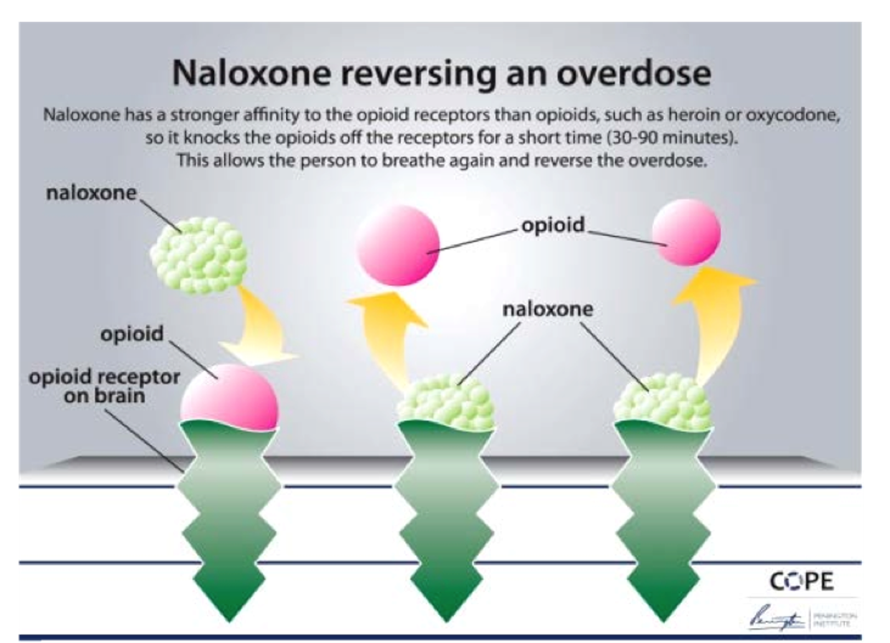
How Naloxone Reverses an Overdose
Notes:
This figure shows how naloxone reverses an opioid overdose by competing for the same receptors in the brain. Opioids like heroin or oxycodone bind to these receptors and can slow or stop breathing. Naloxone has a stronger attraction to the receptors, so it quickly displaces the opioids and takes their place. This blocks the opioid effects and allows breathing to resume, reversing the overdose for a limited period (about 30–90 minutes), after which medical follow-up is still needed.
IMAGE CREDIT:
COPE, Australia. (2017). Accessed from: https://www.northcarolinahealthnews.org/2017/07/12/naloxone-101-works-using/.

Slide 102
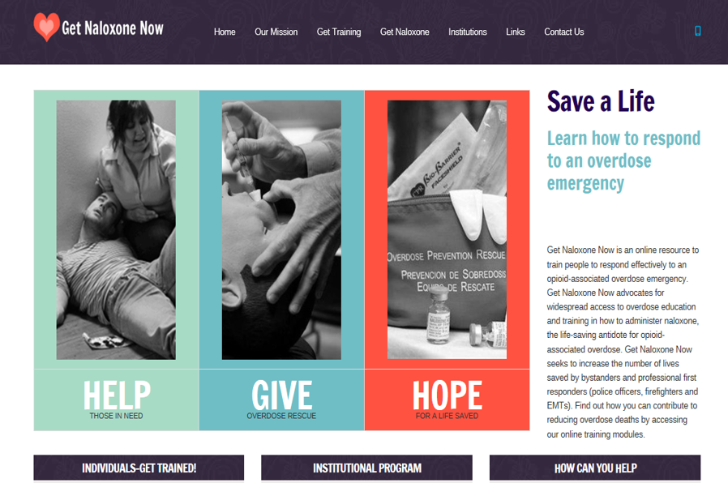
Get Naloxone Now
Notes:
Get Naloxone Now is an online resource to train people to respond effectively to an opioid overdose emergency. The site can be accessed at: https://www.getnaloxonenow.org/#home.

Slide 103
Why are These Medicines
So Important?
Notes:
The next segment of the training focuses on the research evidence regarding the benefits of medications for addiction treatment, more specifically as front-line treatments for opioid use disorder.

Slide 104
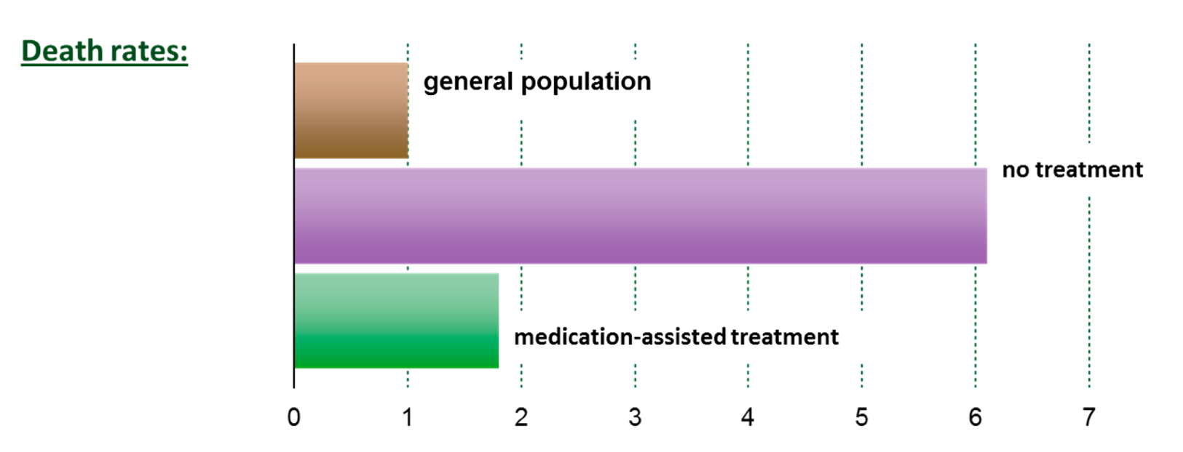
Benefits of MAT: Decreased Mortality
Notes:
Patients out of treatment died at about 6 times the rate of people in the general population, while medications for addiction treatment with methadone brought this to less than 2 times. Retention in methadone and buprenorphine treatment is associated with substantial reductions in the risk for all cause and overdose mortality in people dependent on opioids.
REFERENCES:
Dupouy, J., Palmaro, A., Fatséas, M., Auriacombe, M., Micallef, J., Oustric, S., & Lapeyre-Mestre, M. (2017). Mortality associated with time in and out of buprenorphine treatment in French office-based general practice: A 7-year cohort study. Ann Fam Med, 15(4), 355–358. doi: 10.1370/afm.2098. PMID: 28694272; PMCID: PMC5505455.
Evans, E., Li, L., Min, J., Huang, D., Urada, D., Liu, L., Hser, Y.-I., & Nosyk, B. (2015). Mortality among individuals accessing pharmacological treatment for opioid dependence in California, 2006-10. Addiction, 110(6), 996-1005. doi: 10.1111/add.12863. Epub 2015 Mar 15. PMID: 25644938; PMCID: PMC4452110.
Sordo, L., Barrio, G., Bravo, M. J., Indave, I., Degenhardt, L., Wiessing, L., Ferri, M., & Pastor-Barriuso, R. (2017). Mortality risk during and after opioid substitution treatment: Systematic review and meta-analysis of cohort studies. BMJ, 357, j1550. http://dx.doi.org/10.1136/bmj.j1550

Slide 105
More MOUD Research Evidence: Reduced Mortality
Safety and efficacy profiles differ due to their differing pharmacological, pharmacodynamic, and pharmacokinetic properties (Connery, 2015; Kleber, 2007).
“The evidence for efficacy both in reducing opioid use and retaining patients in care is strongest for agonist treatment” (Connery, 2015, p. 64).
Treatment using agonist medication is estimated to reduce mortality by up to 50 percent among people with OUD (Cicero et al., 2014; Schuckit, 2016).
Methadone and buprenorphine treatment retention have been linked to substantially decreased risks of both all-cause and overdose-related mortality among people with OUD (Schuckit 2016), and both medications reduce the number of opioid overdose deaths in the community (Pierce et al., 2016; Schwartz et al., 2013).
Notes:
The evidence is clear: medications for opioid use disorder (MOUD), particularly methadone and buprenorphine, save lives. They not only reduce opioid use but also improve treatment retention and significantly lower the risk of overdose and death. Although methadone, buprenorphine, and naltrexone work differently, all are evidence-based treatments with distinct safety and effectiveness profiles. Research consistently shows that agonist medications (methadone and buprenorphine) are the most effective at helping people remain in treatment and reduce illicit opioid use. Treatment with methadone or buprenorphine can reduce mortality by up to 50% among people with opioid use disorder. Staying engaged in treatment is critical. The longer individuals remain on effective medication, the lower their risk of overdose and all-cause mortality. Communities with greater access to methadone and buprenorphine also experience fewer opioid overdose deaths, highlighting the public health impact of expanding access to MOUD.
REFERENCES:
National Academies of Sciences, Engineering, and Medicine. (2019). Medications for Opioid Use Disorder Save Lives. Washington, DC: The National Academies Press. https://doi.org/10.17226/25310
Connery, H. S. (2015). Medication-assisted treatment of opioid use disorder: Review of the evidence and future directions. Harv Rev Psychiatry, 23(2), 63–75. https://doi.org/10.1097/HRP0000000000000075
Kleber, H. D. (2007). Pharmacologic treatments for opioid dependence: detoxification and maintenance. Dialogues in Clinical Neuroscience, 9(2), 199–206. https://doi.org/10.31887/DCNS.2007.9.2/hkleber
Cicero, T. J., Ellis, M. S., & Kasper, Z. A. (2017). Increased use of heroin as an initiating opioid of abuse. Addict Behav, 74, 63–66. https://doi.org/10.1016/j.addbeh.2017.030
Schuckit, M. A. (2016). Treatment of opioid use disorders. N Engl J Med, 375(4), 357–368. https://doi.org/10.1056/NEJMra1604339
Pierce, M., Bird, S. M., Hickman, M., Marsden, J., Dunn, G., Jones, A., & Millar, T. (2016). Impact of treatment for opioid dependence on fatal drug-related poisoning: A national cohort study in England. Addiction, 111(2), 298–308. https://doi.org/10.1111/add.13193
Schwartz, R. P., Gryczynski, J., O’Grady, K. E., Sharfstein, J. M., Warren, G., Olsen, Y., Mitchell, S. G., & Jaffe, J. H. (2013). Opioid agonist treatments and heroin overdose deaths in Baltimore, Maryland, 1995-2009. American Journal of Public Health, 103(5), 917–922. https://doi.org/10.2105/AJPH.2012.301049

Slide 106
More on Reduced Mortality and Other Health Benefits of MOUD
Expanding access to these medications reduces the number of deaths due to opioid overdose (Cicero et al., 2014; Larochelle et al., 2017; Sordo et al., 2017).
Studies of extended-release naltrexone have not had sufficient power or duration of follow-up to detect a mortality benefit (Jarvis et al., 2018).
Treatment with methadone or buprenorphine is also associated with lower rates of other opioid use (Kakko et al., 2003; Mattick et al., 2009, 2014)
Improved social functioning (Bart, 2012)
Decreased injection drug use (Woody et al., 2014)
Reduced HIV transmission risk behaviors (Gowing et al., 2011), reduced risk of HIV diagnosis (MacArthur et al., 2012), reduced risk of hepatitis C virus (HCV) infection (Peles et al., 2011)
Notes:
Medications for opioid use disorder (MOUD) do more than reduce overdose deaths—they also improve overall health by reducing injection drug use, lowering HIV and hepatitis C (HCV) transmission risk, and helping people achieve greater stability. Expanding access to methadone and buprenorphine is an evidence-based strategy that reduces opioid overdose deaths and improves long-term outcomes. MOUD helps people reduce or stop illicit opioid use, which often leads to less frequent injection drug use and fewer opportunities for HIV and HCV transmission.
Research shows that people receiving MOUD have:
Lower rates of opioid use
Reduced injection drug use
Improved social functioning, including greater stability in work, housing, and relationships
Lower HIV risk behaviors and reduced rates of HIV and hepatitis C infection
While evidence for extended-release naltrexone is promising, studies have not yet demonstrated the same mortality benefit seen with methadone and buprenorphine due to limited follow-up.
REFERENCES:
National Academies of Sciences, Engineering, and Medicine. (2019). Medications for Opioid Use Disorder Save Lives. Washington, DC: The National Academies Press. https://doi.org/10.17226/25310
Cicero, T. J., Ellis, M. S., & Kasper, Z. A. (2017). Increased use of heroin as an initiating opioid of abuse. Addict Behav, 74, 63–66. https://doi.org/10.1016/j.addbeh.2017.030
Larochelle, M. R., Bernson, D., Land, T., Stopka, T. J., Wang, N., Xuan, Z., Bagley, S. M., Liebschutz, J. M., & Walley, A. Y. (2018). Medication for opioid use disorder after nonfatal opioid overdose and association with mortality: A cohort study. Ann Intern Med, 169(3), 137–145. https://doi.org/10.7326/M17-3107.
Sordo, L., Barrio, G., Bravo, M. J., Iciar Indave, B., Degenhardt, L., Wiessing, L., Ferri, M., & Pastor-Barriuso, R. (2017). Mortality risk during and after opioid substitution treatment: Systematic review and meta-analysis of cohort studies. BMJ, 325, 71550. https://doi.org/10.1136/bmj.j1550
Jarvis, B. P., Holtyn, A. F., Subramaniam, S., Tompkins, D. A., Oga, E. A., Bigelow, G. E., & Silverman, K. (2018). Extended-release injectable naltrexone for opioid use disorder: A systematic review. Addiction, 113(7), 1188–1209. https://doi.org/10.1111/add.14180
Kakko, J., Dybrandt Svanborg, K., Kreek, M. J., & Heilig, M. (2003). 1-year retention and social function after buprenorphine-assisted relapse prevention treatment for heroin dependence in Sweden: A randomized, placebo-controlled trial. Lancet, 361(9358), 662–668. https://doi.org/10.1016/S0140-6736(03)12600
Mattick, R. P., Breen, C., Kimber, J., & Davoli, M. (2009). Methadone maintenance therapy versus no opioid replacement therapy for opioid dependence. Cochrane Database Syst Rev, 2009(3), CD002209. https://doi.org/10.1002/14651858.CD002209.pub2
Mattick, R. P., Breen, C., Kimber, J., & Davoli, M., (2014). Buprenorphine maintenance versus placebo or methadone maintenance for opioid dependence. Cochrane Database Syst Rev, 2014(2), CD002207. https://doi.org/10.1002/14651858.CDC002207.pub4
Bart, G. (2012). Maintenance medication for opiate addiction: The foundation of recovery. Journal of Addictive Diseases, 31(3), 207–225. https://doi.org/10.1080/10550887.2012.694598
Woody, G. E., Bruce, D., Korthuis, P. T., Chhatre, S., Poole, S., Hillhouse, M., Jacobs, P., Sorensen, J., Saxon, A. J., Metzger, D., & Ling, W. (2014). HIV risk reduction with buprenorphine-naloxone or methadone: Findings from a randomized trial. Journal of Acquired Immune Deficiency Syndromes 66(3), 288–293. https://doi.org/10.1097/QAI.0000000000000165
MacArthur, G. J., S. Minozzi, N. Martin, P. Vickerman, S. Deren, J. Bruneau, L. Degenhardt, and M. Hickman. 2012. Opiate substitution treatment and HIV transmission in people who inject drugs: Systematic review and meta-analysis. BMJ 345:e5945. [PMC Free Article]
Peles, E., Schreiber, S. Rados, V., & Adelson, M. (2011). Low risk for hepatitis c seroconversion in methadone maintenance treatment. Journal of Addiction Medicine 5(3), 214–220. https://doi.org/10.1097/ADM.0b013e31820e13dd

Slide 107
MOUD Improves Quality of Life
Improved quality of life compared to individuals with OUD not in treatment (Ponizovsky & Grinshpoon et al., 2007).
Methadone is also associated with reduced levels of criminality for individuals with OUD (Bukten et al., 2012; Gearing & Schweitzer, 1974; Schwartz et al., 2009, 2011; Sun et al., 2015).
Buprenorphine alone and buprenorphine in combination with naloxone administered in office-based treatment settings significantly reduce opioid use and opioid cravings (Fudala et al., 2003).
In women who are pregnant, buprenorphine treatment has been linked to improved maternal and fetal outcomes; infants also tend to have less severe symptoms of neonatal abstinence syndrome when their mothers were treated with buprenorphine during pregnancy (Krishnapura et al., 2025).
Notes:
Medication for Opioid Use Disorder (MOUD) does much more than reduce opioid use—it improves overall health, functioning, and quality of life. The benefits extend to individuals, families, and communities.
REFERENCES:
National Academies of Sciences, Engineering, and Medicine. (2019). Medications for Opioid Use Disorder Save Lives. Washington, DC: The National Academies Press. https://doi.org/10.17226/25310
Ponizovsky, A. M., & Grinshpoon, A. (2007). Quality of life among heroin users on buprenorphine versus methadone maintenance. Am J Drug Alcohol Abuse, 33(5), 31–42. https://doi.org/10.1080/00952990701523698
Bukten, A., Skurtveit, S., Gossop, M., Waal, H., Stangeland, P., Havnes, I., & Clausen, T. (2012). Engagement with opioid maintenance treatment and reductions in crime. A longitudinal national cohort study. Addiction, 107(2), 393–399. https://doi.org/10.1111/j.1360-0443.2011-03637.x
Gearing, F. R., & Schweitzer, M. D. (1974). An epidemiologic evaluation of long-term methadone maintenance treatment for heroin addiction. Am J Epidemiol, 100(2), 101–112. https://doi.org/10.1093/oxfordjournals.aje.a112012
Schwartz, R. P., Jaffe, J. H., O’Grady, K. E., Kinlock, T. W., Gordon, M. S., Kelly, S. M., Wilson, M. E., & Ahmed, A. (2009). Interim methadone treatment: Impact on arrests. Drug Alcohol Depend, 103, 148-154. https://doi.org/10.1016/j.drugalcdep.2009.03.007
Schwartz, R. P., Kelly, S. M., O'Grady, K. E., Gandhi, D., & Jaffe, J. H. (2011). Interim methadone treatment compared to standard methadone treatment: 4-month findings. Journal of Substance Abuse and Treatment, 41(1), 21–29. https://doi.org/10.1016/j.jsat.2011.01.008
Sun, H.-M., Li, X.-Y., Chow, E., P., F., Li, T., Xian, Y., Lu, Y.-H., Tian, T., Zhuang, X., & Zhang, L. (2015). Methadone maintenance treatment programme reduces criminal activity and improves social well-being of drug users in China: A systematic review and meta-analysis. BMJ Open, 5(1), e005997. https://doi.org/10.1136/bmjopen-2014-005997
Fudala, P. J., Bridge, T. P., Herbert, S., Williford, W. O., Chiang, N., Jones, K., Collins, J., Raisch, D., Casadonte, P., Goldsmith, R. J., Ling, W., Malkerneker, U., McNicholas, L., Renner, J., Stine, S., & Tusel, D. (2003). Office-based treatment of opiate addiction with a sublingual-tablet formulation of buprenorphine and naloxone. N Engl J Med, 349(10, 949-958. https://doi.org/10.1056/NEJMoa022164
Krisnapura, S. R., McNeer, E., Loch, S. F., Reese, T., Dudley, J., Phillippi, J. C., Wiese, A. D., Dupont, W. D., Leech, A. A., & Patrick, S. W. (2025). Buprenorphine treatment in pregnancy and maternal-infant outcomes. JAMA Health Forum, 6(4.11), e25184. https://doi.org/10.1001/jamahealthforum.2025.1814

Slide 108
The Role of Psychosocial Interventions in MOUD
Psychosocial interventions play an important adjunctive role in MOUD
CBT, MI, and counseling can help patients develop coping skills, improve medication adherence, address co-occurring mental health conditions, and stabilize social functioning
Adding counseling to MOUD does not consistently improve retention or opioid use outcomes compared to medications alone
Notes:
Psychosocial interventions play an important but adjunctive role in medications for opioid use disorder (MOUD), supporting—but not replacing—pharmacotherapy. Evidence consistently shows that medications such as methadone, buprenorphine, and extended-release naltrexone are the primary drivers of reduced mortality, opioid use, and improved retention, while psychosocial interventions can enhance outcomes by addressing behavioral, psychological, and social factors (National Academies of Sciences, 2019; SAMHSA, 2021).
Psychosocial treatments—such as cognitive behavioral therapy (CBT), contingency management, motivational interviewing, and counseling—can help patients develop coping skills, improve adherence, address co-occurring mental health conditions, and stabilize social functioning. However, research indicates that adding counseling to MOUD does not consistently improve retention or opioid use outcomes compared to medication alone, particularly for buprenorphine, although certain approaches (e.g., contingency management) show benefit in specific contexts (Fiellin et al., 2006; Weiss et al., 2011; Dugosh et al., 2016). As a result, major guidelines emphasize that MOUD should not be withheld if psychosocial services are unavailable or declined, and access to medication should be prioritized (ASAM, 2020; WHO, 2009).
In summary, psychosocial interventions are best viewed as supportive and individualized components of care that can enhance recovery and quality of life, but medication remains the essential, evidence-based foundation of treatment for opioid use disorder.
REFERENCES:
American Society of Addiction Medicine (ASAM). (2020). The ASAM National Practice Guideline for the Treatment of Opioid Use Disorder: 2020 Focused Update. Washington, DC: Author. Accessed July 16, 2026, from: https://www.asam.org/quality-care/clinical-guidelines/national-practice-guideline.
Moran, G., Knudsen, H., & Snyder, C. (2019). Psychosocial supports in medication-assisted treatment: Site visit findings and conclusions, Appendix B. Rockville, MD: U.S. Department of Health & Human Services, Office of the Assistant Secretary for Planning and Evaluation. Accessed July 16, 2026, from: https://aspe.hhs.gov/basic-report/psychosocial-supports-medication-assisted-treatment-recent-evidence-and-current-practice.
National Academies of Sciences, Engineering, and Medicine. (2019). Medications for Opioid Use Disorder Save Lives. Washington, DC: The National Academies Press. https://doi.org/10.17226/25310
Dugosh, K., Abraham, A., Seymour, B., McLoyd, K., Chalk, M., & Festinger, D. (2016). A systematic review on the use of psychosocial interventions in conjunction with medications for opioid addiction. J Addict Med, 10(2), 93–103. https://doi.org/10.1097/ADM.0000000000000193
Fiellin, D. A., Pantalon, M. V., Chawarski, M. C., Moore, B. A., Sullivan, L. E., O’Conner, P. G., & Schottenfeld, R. S. (2006). Counseling plus buprenorphine–naloxone maintenance therapy. N Engl J Med, 355, 365–374. https://doi.org/10.1056/NEJMoa055255

Slide 109
Despite the Evidence, MOUD is Underutilized
Recent evidence indicates that MOUD are vastly underutilized, with only 25% of U.S. adults with OUD receiving medical treatments.
Major barriers to access include:
  Negative attitudes and perceptions from the public and among health care providers
  Provider shortages, especially in rural areas
  Treatment setting gaps
  Low availability in criminal justice settings
  Financial hurdles
Notes:
Recent evidence indicates that medications for opioid use disorder (MOUD)—such as buprenorphine, methadone, and naltrexone—are vastly underutilized, with only 25% of U.S. adults with OUD receiving these treatments. Despite rising overdose deaths, studies show that nearly 90% of individuals with opioid use disorder (OUD) did not receive MOUD, with significant barriers including stigma, lack of trained providers, and low Medicaid reimbursement.
REFERENCES:
Cantor, J., Griffin, B. A., & Levitan, B. (2024). Availability of medications for opioid use disorder in community mental health facilities. JAMA Network Open, 7(6), e2417545. https://doi.org/10.1001/jamanetworkopen.2024.17545
Grassi, G. (2024). The opioid epidemic continues while effective medication is underutilized. Accessed May 14, 2026, from: https://www.ajmc.com/view/the-opioid-epidemic-continues-while-effective-medication-is-underutilized.

Slide 110
Meeting People Where They Are and Motivating Others through Conversation
Notes:
The next segment of the training provides strategies and recommendations for meeting a person who uses drugs where they are to facilitate open and honest conversations about health behavior change.

Slide 111
What if the Person is Ambivalent about Making a Change?
What do they want?
Meet them where they are at
Listen actively to find out what help they want
Be non-judgmental and accepting
Accept small changes; this can start the process
What is the patient experience now?
Show compassion and empathy
Offer them the help that they are willing to accept in the moment
Notes:
The following are a few key points to keep in mind about this process:
Finding out what the person wants (both immediately and in the future) can help us to meet them where they are.
Many people state that they don’t want to change. Listen carefully to what they are saying, and you will likely see areas where you can help.
Even if it’s not what you think is best for them, making a small change can start the process. Be non-judgmental and accepting.
Center the patient and their experience.
Show compassion and empathy for what they are experiencing.
Offer them the help that they are willing to accept in the moment, and then help them prepare for the next decision. “If you decide to do _____ now, you can expect _____, and will have to decide what to do next. Can I help with that?
This is all a bit abstract, so the next section will turn to more concrete recommendation for implementing this “meet them where they’re at” idea.

Slide 112
Patients are the Experts of Themselves
Listen first - let the patient tell their story
Convey respect
Focus on support, not blame
Assess level of health literacy:
  Use language your patient can understand
  Supplement teaching with photos/pictures, videos, etc.
  Use the “teach-back method” to ensure understanding
Notes:
Listen First: If someone discloses their drug use, listen without judgment rather than offering immediate advice or expressing disapproval.
Focus on Support, Not Blame: Shift from blaming individuals to offering support, such as connecting them with harm-reduction services (e.g., syringe service programs) or treatment options.
Respect Autonomy: Understand that abstinence is not the only goal. Some individuals may focus on safer use or managing their health, rather than quitting completely.
REFERENCE:
South Central AETC/UT Health San Antonio. (2026). [Webpage]. HIV Stigma-Free Health Care Series. Accessed March 13, 2026, from: https://aetc.uthscsa.edu/stigma-free-healthcare/.

Slide 113
Avoid Assumptions
Approach each new encounter as a clean slate
Do not assume you know a person’s story
Do not assume that drug use is a choice or sign of weak character
Avoid assumptions about safety/competence
Avoid assumptions about lifestyle
Recognize that recovery is a non-linear journey
Notes:
A key principle of effective communication is to avoid making assumptions.
Avoid the Moral Assumption: Do not assume that drug use is a choice or a sign of weak character. Addiction is a chronic, treatable medical condition involving brain changes.
Understand Genetic/Social Factors: Substance use disorders are influenced by a combination of factors, including genetic predisposition, social environment, and traumatic experiences.
Recognize Recovery is Non-Linear: Understand that recovery is a process, and returning to use (relapse) does not mean a person is failing or unwilling to change.
REFERENCE:
South Central AETC/UT Health San Antonio. (2026). [Webpage]. HIV Stigma-Free Health Care Series. Accessed March 13, 2026, from: https://aetc.uthscsa.edu/stigma-free-healthcare/.

Slide 114
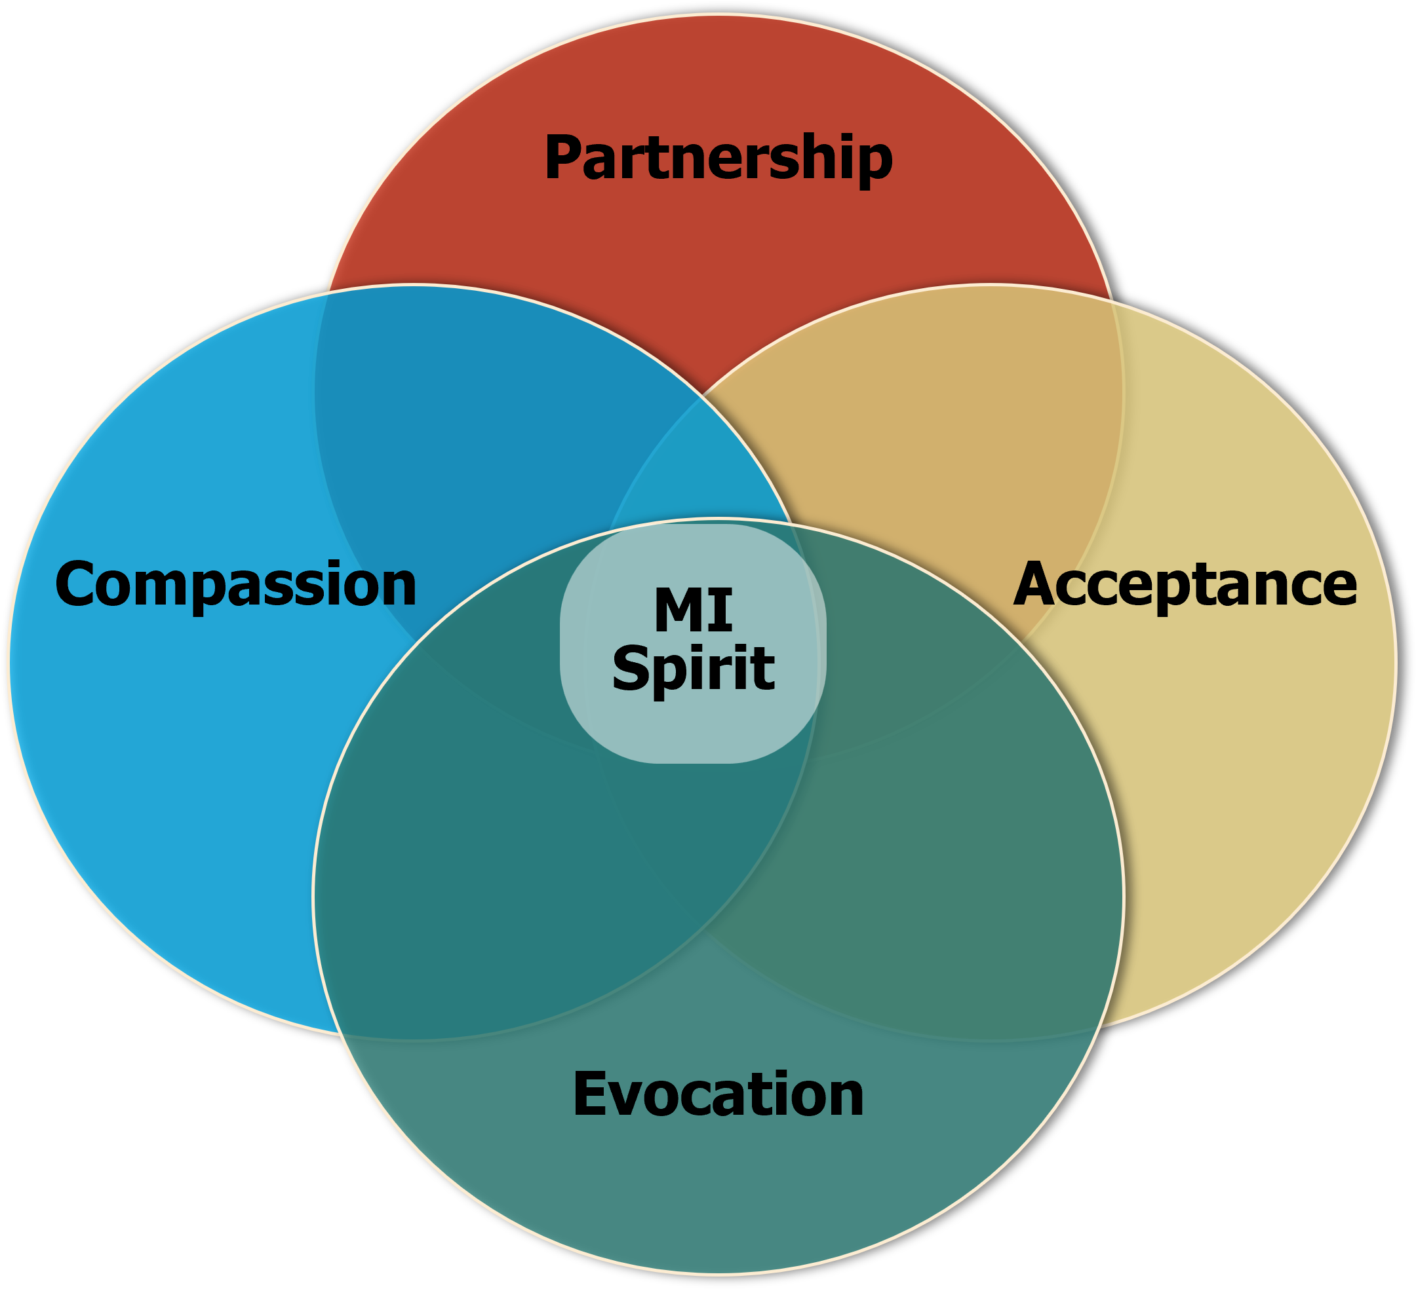
Tap into the Underlying Spirit of Motivational Interviewing
Notes:
To truly tap into someone’s motivation, we must engage with them with a collaborative, interpersonal style. Again, we want to meet them where they are at. To do that, we need to with them with a spirit that has:
Partnership: MI is collaborative, not confrontational. It emphasizes working together with the patient as equals to explore their thoughts and feelings about change.
Acceptance: This involves respecting the patient’s autonomy, and ability to decide what they want to do. Acknowledge their perspective without judgment. Acceptance includes expressing empathy, affirming the patient's strengths and efforts, and supporting their self-efficacy.
Compassion: Demonstrate genuine concern for the patient’s well-being while being supportive and caring. Compassion in MI means working to understand their experiences and feelings.
Evocation: Instead of providing direct solutions or advice, MI aims to evoke the patient’s own motivations and ideas for change. The goal is to draw out their reasons for making a change, rather than imposing external reasons or solutions.

Slide 115

A Helpful Quote
“People are better persuaded
by the reasons they themselves discovered than those that come into the minds of others” ~Blaise Pascal
Notes:
Helping patients state their own reasons for change fosters a sense of empowerment and self-direction, increasing the likelihood that they will follow through.
IMAGE CREDIT:
Adobe Stock, n.d.

Slide 116
Techniques to Enhance Motivation
These skills are very valuable with people experience a crisis from substance use, but can be applied in any situation (even with your spouse or children ☺)
Open-Ended Questions: Not a “yes” or “no”
Reflective Listening: Helps patients feel understood and can clarify their own thoughts.
  It sounds like you're feeling really shaken up by what is happening.
  It seems like you're feeling hopeless and are struggling to see a way forward.
  It sounds like you're concerned about how this treatment might affect you, and that’s making you hesitant to accept it.
  It sounds like you’re worried about what might happen next
Notes:
Review the techniques and examples. Remind learners that these skills are useful with any incident (and often in facilitating discussions with our own friends and families). Encourage discussion and examples of how they have applied this, or where they think that it would be challenging to apply during incidents.
Open-Ended Questions: These questions encourage patients to share what they want. They cannot be answered with a simple "yes" or "no" and help patients articulate their own reasons for change. Examples include:
How are you feeling right now?
What’s been going on for you that has led to this situation?
What specific concerns do you have about your safety right now?
Reflective listening (a.k.a. active listening) helps patients feel understood and can clarify their own thoughts.
It sounds like you're feeling really shaken up by what is happening.
It seems like you're feeling hopeless and are struggling to see a way forward.
It sounds like you're concerned about how this treatment might affect you, and that’s making you hesitant to accept it.
It sounds like you’re worried about what might happen next.

Slide 117
Techniques to Enhance Motivation (2)
Rolling with Resistance: Rolling with Resistance: Acknowledge and explore resistance rather than opposing it. This skill combines use of reflections and open-ended questions
Notes:
Review the techniques and examples. Remind learners that these skills are useful with any incident (and often in facilitating discussions with our own friends and families). Encourage discussion and examples of how they have applied this, or where they think that it would be challenging to apply during incidents.
3. Rolling with Resistance: Instead of confronting resistance directly, MI encourages counselors to roll with it, which means acknowledging and exploring the resistance rather than opposing it. This approach helps to avoid power struggles and fosters a more collaborative atmosphere.
You seem really scared and unsure about talking right now. What would help you feel more comfortable?
It sounds like you have some concerns about buprenorphine and how it might affect you. What specifically worries you about it?
I hear that you’re not ready to go to the hospital right now. Can you tell me more about what concerns you have about going?
It seems like you're unsure about talking to a counselor. What makes you hesitant about that?
If time permits, engage learners in a brief discussion of sympathy vs. empathy and how to avoid burnout from the continual expression of empathy. Sympathy (feeling sorry for someone else’s misfortune) does not convey understanding, whereas empathy (they ability to understand someone’s feelings) does. What must it feel like to be in the patient’s situation? You have to be willing to use feeling words (e.g., scary, sad, concerning, terrifying, etc.) to express empathy to avoid experiencing the emotional impact, which could increase the possibility of burnout. Don’t think about how YOU would be feeling in the patient’s situation, rather, think about what the patient is likely feeling and use that to develop your empathic statement.

Slide 118
What are we focusing on? – An Example
SUD
Pain
MH
Accident
Family
SUD
Medical Issues
Notes:
Note: This slide contains complex animations and it is important to practice with this slide ahead of time to ensure that you understand how the animation works.
Here is a concrete example. Patients often present for treatment with a variety of issues across a number of domains. For example, a patient may be experiencing a variety of family, medical, mental health, and substance use issues.
Click to start animation
…but today when she comes in for service, she says, “I’m really hurting.”
Click to advance animation
You, the clinician, know that she is misusing opioids.
Click to advance animation
You say to your patient, “I want to talk about your use of opioids.”
Click to advance animation
The patient, however, doesn’t want to talk about opioids (unless perhaps to get more). The patient says, “I’m here because of my pain. I’m not a drug addict.”
Click to advance animation
Concerned about opioid hyperalgesia, you state, “Part of the problem with your pain is that you take too many opioids.”
Click to advance animation
You and the patient continue this chase. This does not help you get to the substance use issue, nor does it help the patient deal with her pain.
If, instead of pressing our issue (the opioid use), we listen for what patients see as their issue.
Click to advance animation
We can find ways of connecting our goal with theirs. This allows us to build rapport. If the patient says, “I need help with my pain,” we can work with that by saying, “Ok, let’s find a way to help you deal with your pain.” Eventually, we want to bring the pain and substance use issues together. If we focus on the patient’s pain, we can still ask how her medications are working out, and, once we gain access into her world, we can begin to provide information about the impacts of taking too much medication. We know the two issues are related, so if we focus on the patient’s concern first (the pain), we will undoubtedly be able to introduce our concern (the SUD issue) in a way that is respectful and natural.

Slide 119

Where is Your Focus?
Notes:
**CAPTIONED VIDEO**
Video is an embedded video from YouTube. To play with subtitles, Choose the “Watch on YouTube” button that appears in the lower right when in presentation mode. Once YouTube opens, you can select closed captioning “CC” in the lower right corner.
The purpose of the video is to demonstrate the power of reflections. This activity should take no more than 5-7 minutes, including a quick de-brief to discuss participants’ impressions of the video. Be sure to practice with the video ahead of time, so you can be certain that it will play as intended. When setting up the video, ask participants to write down their general reaction of the conversation that ensues between the man and woman (the good and not so good elements of the conversation), and ask them to think about the question “Why do we want to avoid trying to fix the problem for the client.”
Reflections are a tool to help clients feel heard and understood. It demonstrates that we are listening and curious about their perspectives. Reflections can help us meet the client where he/she is are. They demonstrate the collaborative nature of the conversation.
Length of Video – 1:40.
REFERENCE:
Headley, J. (2013). [Video]. It’s Not About The Nail. Accessed February 19, 2026, from: https://youtu.be/-4EDhdAHrOg?si=2Sp_fnCpqBIe2FCK.

Slide 120
Helping People Make a Change – The Brief Negotiated Interview
Notes:
The final section of this training provides information on using the Brief Negotiated Interview. Gail D'Onofrio, MD, Ed Bernstein, MD, Judith Bernstein, MSN, PhD, and Steven Rollnick, PhD developed the Brief Negotiated Interview (BNI). It is a semi-structured interview process that's based on motivational interviewing principles.
REFERENCE:
D’Onofrio, G., Pantalon, M. V., Degutis, L. C., Fiellin, D. A., & O’Connor, P. G. (2005). Development and implementation of an emergency practitioner-performed brief intervention for hazardous and harmful drinkers in the emergency department. Acad Emerg Med, 12(3), 249–256. https://doi.org/10.1197/j.aem.2004.10.021

Slide 121
Key Features of the Brief Negotiated Interview
Brief and Structured: Often takes between 5 to 15 minutes
Patient-Centered Approach rather than being telling them what to do.
Collaborative Negotiation
Motivational Enhancement: Uses MI techniques
Focus on Behavior Change
Evidence-Based
Notes:
Brief and Structured: Often takes between 5 to 15 minutes to do completely. Despite its brevity, it is structured to be comprehensive and effective.
Patient-Centered Approach: Focuses on the patient's own motivations and goals, so that they state their own reasons for change, rather than being told what to do.
Collaborative Negotiation: The conversation involves discussing the patient’s readiness, identifying barriers, and agreeing on practical steps toward achieving their goals.
Motivational Enhancement: Uses techniques like reflective listening, open-ended questions to enhance the patient’s motivation to focus reasons for change and resolve any ambivalence.
Focus on Behavior Change: The primary goal is to facilitate specific behavior change, such as reducing substance use, adopting healthier behaviors, or mitigating risky behaviors.
Evidence-Based: Research has shown that it is effective in various contexts, particularly in substance use interventions. It is designed to be adaptable to different settings and patient needs.
REFERENCE:
D’Onofrio, G., Pantalon, M. V., Degutis, L. C., Fiellin, D. A., & O’Connor, P. G. (2005). Development and implementation of an emergency practitioner-performed brief intervention for hazardous and harmful drinkers in the emergency department. Acad Emerg Med, 12(3), 249–256. https://doi.org/10.1197/j.aem.2004.10.021

Slide 122
What are the Steps of the BNI?
Engage the patient
Assess Readiness for Change
Explore Motivations and Barriers
Negotiate a Plan
Provide Support and Follow-Up
Notes:
The BNI is useful in many situation for helping to increase motivation for and commitment to accepting medical care.
Engage the patient: Build rapport and establishing a positive, non-judgmental relationship so that person feels comfortable discussing their behavior and goals.
Assess Readiness for Change: Ask open-ended questions and reflect their responses to understand their perspective. What change are they willing to explore?
Explore Motivations and Barriers: Discuss reasons for change and the potential benefits. Also, explore any barriers or challenges they anticipate. This helps to clarify their motivations and identify practical solutions.
Negotiate a Plan: Collaboratively develop a plan for change. This involves setting specific, achievable goals and identifying steps the patient can take to reach these goals. The plan should be realistic and tailored to the patient’s situation.
Provide Support and Follow-Up: Offer support and encouragement and discuss options for follow-up or additional resources if needed. Ensure the patient feels confident in their ability to implement the plan and make changes.
REFERENCE:
D’Onofrio, G., Pantalon, M. V., Degutis, L. C., Fiellin, D. A., & O’Connor, P. G. (2005). Development and implementation of an emergency practitioner-performed brief intervention for hazardous and harmful drinkers in the emergency department. Acad Emerg Med, 12(3), 249–256. https://doi.org/10.1197/j.aem.2004.10.021

Slide 123
Keeping the Positive Perspective, Even When It Looks Like Something Else
Instead, we can see that the person is:
  Doing what they think is necessary to survive.
  Getting their needs met in a way that has worked for them in the past.
  Scared and overwhelmed and having difficulty making decisions
  Mistrustful of others, especially care providers due to their history
  Feeling threatened and/or out of control.
  Feeling disconnected, alone and unheard.
Form a compassionate connection with them can change everything for them
Notes:
Patients sometimes seem manipulative, resistant, unmotivated, and disrespectful. This is especially true when the person is in crisis or under stress. If we as care providers can remember that they are really doing the best they can in the moment.

Slide 124
In Summary
Words matter
The way you engage in a conversation with someone who uses drug can present an opportunity to encourage the person to connect to critically needed medical care
Strategies and tools exist to help lead a person towards positive behavior change, even after just a brief conversation.
Medications are the gold standard for treating opioid use disorder, and several FDA-approved formulations exist today.
Notes:
This summary slide provides closing comments regarding brief positive interactions and conversations with people who use drugs.

Slide 125
What Did You Learn? – Question #1
Approximately _____ people in the U.S. have HIV.
900,000
1.2 million
1.8 million
10 million
Notes:
The post-training What Did You Learn polling questions are for live webcast only. Insert an interactive polling question for participants here. Note in parentheses any instructions to participants (i.e., choose one, choose all that apply, free text). You may insert polling slides throughout your presentation. We suggest no more than 5 polls for an hour-long engagement.
Polling question slides will be converted to interactive live audience response polls during your presentation.
Correct Answer: B – 1.2 million

Slide 126
What Did You Learn? – Question #2
Engagement in care can be improved by all the following except for _____.
High-barrier care
Peer support
Extended clinic hours
Outreach
Notes:
The post-training What Did You Learn polling questions are for live webcast only. Insert an interactive polling question for participants here. Note in parentheses any instructions to participants (i.e., choose one, choose all that apply, free text). You may insert polling slides throughout your presentation. We suggest no more than 5 polls for an hour-long engagement.
Polling question slides will be converted to interactive live audience response polls during your presentation.
Correct Answer: A – High-barrier care

Slide 127
What Did You Learn? – Question #3
Which of the following outcomes is not associated with bias against people in treatment for a substance use disorder (SUD)?
Delays in seeking treatment
Lower quality of life
Increased self-esteem
Greater likelihood to drop out of treatment early
Notes:
The post-training What Did You Learn polling questions are for live webcast only. Insert an interactive polling question for participants here. Note in parentheses any instructions to participants (i.e., choose one, choose all that apply, free text). You may insert polling slides throughout your presentation. We suggest no more than 5 polls for an hour-long engagement.
Polling question slides will be converted to interactive live audience response polls during your presentation.
Correct Answer: C – Increased self-esteem

Slide 128
What Did You Learn? – Question #4
Which of the following is not an FDA-approved medication to treat opioid use disorder?
Naltrexone
Acamprosate
Buprenorphine
Methadone
Notes:
The post-training What Did You Learn polling questions are for live webcast only. Insert an interactive polling question for participants here. Note in parentheses any instructions to participants (i.e., choose one, choose all that apply, free text). You may insert polling slides throughout your presentation. We suggest no more than 5 polls for an hour-long engagement.
Polling question slides will be converted to interactive live audience response polls during your presentation.
Correct Answer: B – Acamprosate

Slide 129
What Did Your Learn? – Question #5
Which of the following is not a step in the Brief Negotiated Interview (BNI)?
Engage the patient
Assess readiness for change
Negotiate a plan
Tell the patient what to do
Notes:
The post-training What Did You Learn polling questions are for live webcast only. Insert an interactive polling question for participants here. Note in parentheses any instructions to participants (i.e., choose one, choose all that apply, free text). You may insert polling slides throughout your presentation. We suggest no more than 5 polls for an hour-long engagement.
Polling question slides will be converted to interactive live audience response polls during your presentation.
Correct Answer: D – Tell the patient what to do

Slide 130
Resources
Shatterproof: https://www.shatterproof.org/
UW ADAI’s Empathy Lens – Humanizing Images & Education: https://empathylens.org/
Recovery Research Institute’s Addictionary®: https://www.recoveryanswers.org/addiction-ary/
Notes:
This slide features resources from Shatterproof, the University of Washington, and the Recovery Research Institute.
Full references for all cited articles and resources are included in the trainer notes for each slide.

Slide 131
Naloxone Resources
SAMHSA:
https://www.samhsa.gov/substance-use/treatment/overdose-prevention/opioid-overdose-reversal
Get Naloxone Now:
https://www.getnaloxonenow.org
Overdose Prevention and Naloxone (HI DOH): https://health.hawaii.gov/harmreduction/for-providers/overdose-prevention-and-naloxone/
Notes:
This slide features naloxone-specific resources.
Full references for all cited articles and resources are included in the trainer notes for each slide.

Slide 132
What Questions Do You Have?
Notes:
INSTRUCTIONS
Ask participants if they have any final questions before wrapping up the training.

Slide 133
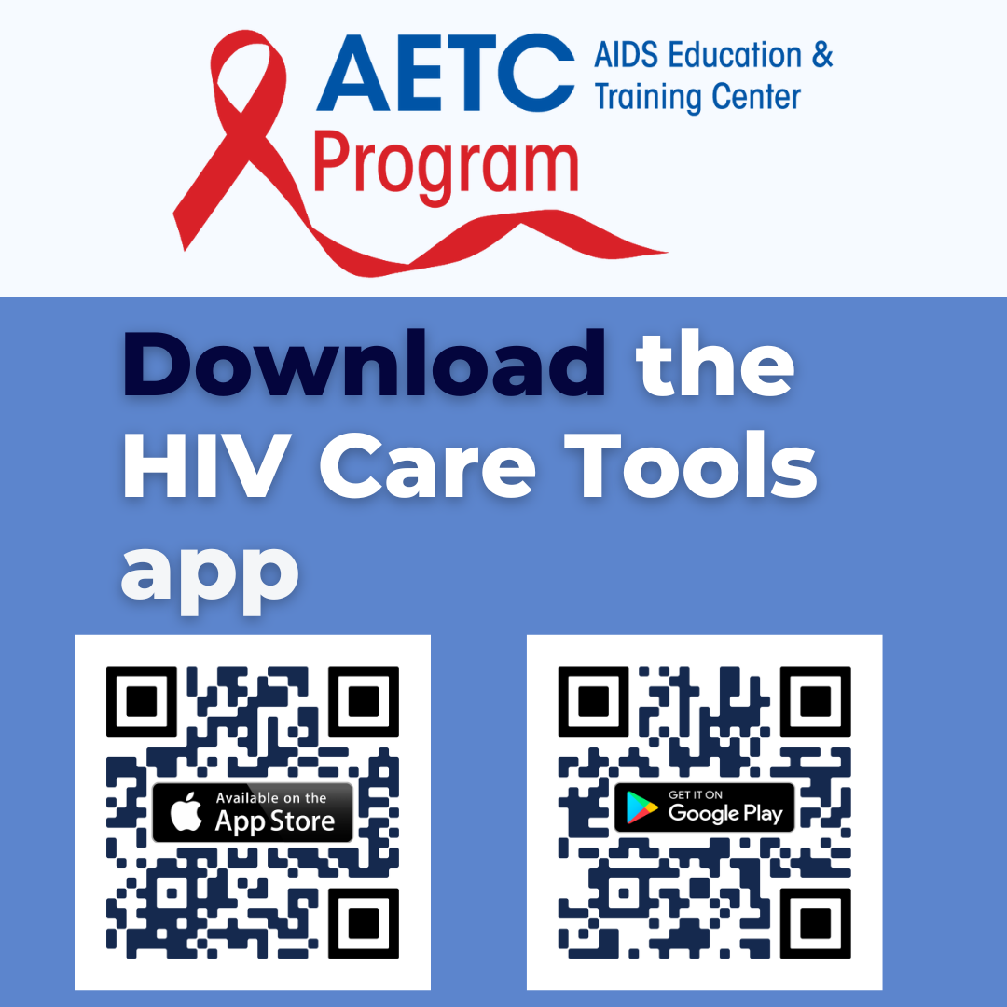

AETC Program Resource Materials
HIV Care Tools App | AETC Program Newsletter
Notes:
This slide provides details on the AETC Program’s Resource Materials.

Slide 134

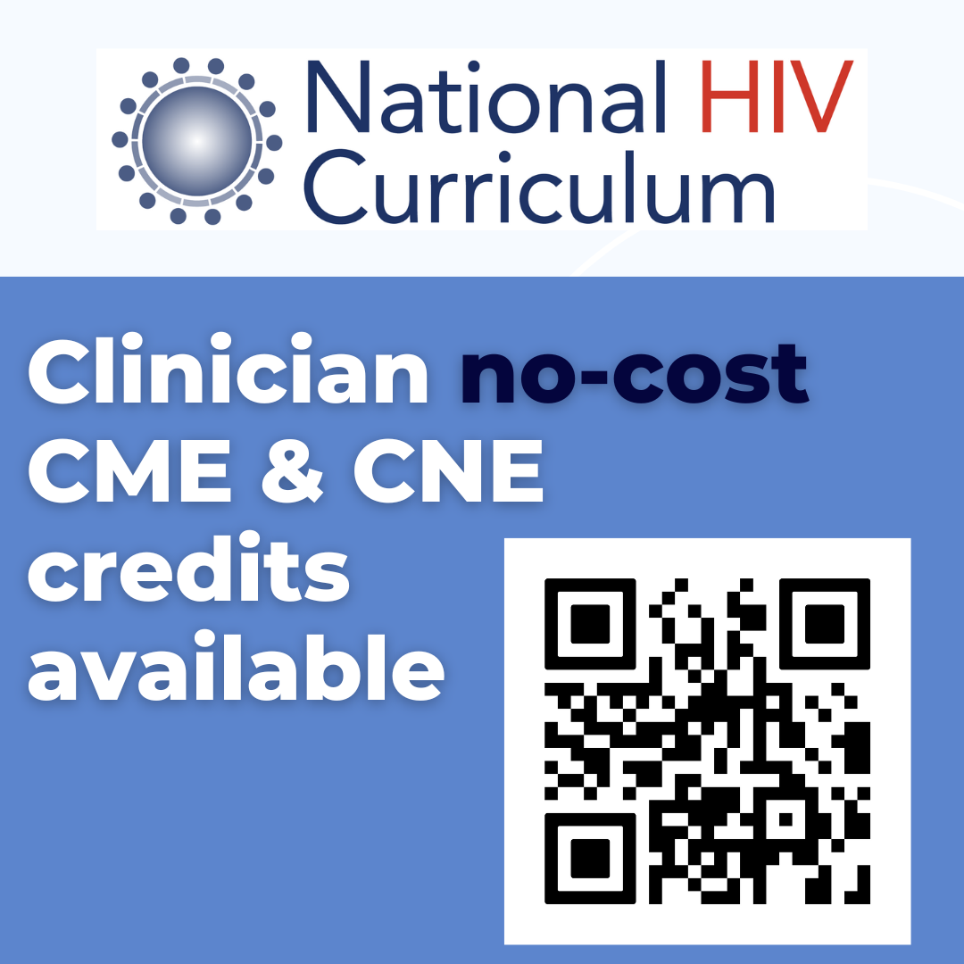
AETC Program Clinician Consultations and National Curriculum
NCCC | NHC
Notes:
This slide provides details on the AETC Program Clinician Consultations and National Curriculum.

Slide 135


THANK YOU
SO MUCH
Contact us:
Phone:
Email:
Website:
Notes:
FINAL SLIDE
This concludes the presentation. Thank the participants for their time and address any last-minute questions about the content. Encourage participants to reach out to the Pacific Southwest ATTC or Pacific AETC – Los Angeles Area, should they have questions or concerns following the training. Personalize the final slide with the trainer’s phone number, email address, and organization’s website.
Prepared in 2026 by: Pacific Southwest Addiction Technology Transfer Center
10911 Weyburn Ave. Ste 200
Los Angeles, CA 90024-2886
T: (310) 388-7647
F: (310) 312-0538
pacificsouthwestca@attcnetwork.org
At the time of this writing, Thomas E. Freese, Ph.D. served as the Principal Investigator and Director of the HHS Region 9, Pacific Southwest Addiction Technology Transfer Center, based at the UCLA Integrated Substance Use and Addiction Programs and Beth A. Rutkowski, MPH served as Co-Director of the HHS Region 9, Pacific Southwest Addiction Technology Transfer Center. Twyla Adams, MHS, served as the ATTC Government Project Officer. Christopher D. Carroll, MSc, served as the Principal Deputy Assistant Secretary for the Substance Abuse and Mental Health Services Administration. The opinions expressed herein are the views of the authors and do not reflect the official position of the Pacific Southwest ATTC/SAMHSA. No official support or endorsement of the Pacific Southwest ATTC/SAMHSA for the opinions described in this document is intended or should be inferred.

