Slide 1

Bridging the Gap: Addressing HIV and SUDs in Rural Communities
Presenter Name(s) & Degrees
Presenter Title, Organization
Date of Presentation
Notes:
TITLE SLIDE
Addressing human immunodeficiency virus (HIV) and substance use disorders (SUDs) in rural communities requires a multifaceted approach that tackles both healthcare access and social labeling. Rural areas often face shortages of medical providers, limited transportation, and heightened social labeling, all of which can delay diagnosis and treatment. Programs like the Ryan White HIV/AIDS Program have made strides by supporting telemedicine, mobile clinics, and community health workers to bridge these gaps. At the same time, integrating HIV care with substance use treatment—especially in areas hit hard by the opioid crisis—can improve outcomes for both conditions. Education campaigns, local leadership engagement, and locally responsive outreach are also key to reducing F and encouraging people to seek care. Bridging the gap in rural communities means expanding access to integrated care and education to effectively confront the intertwined challenges of HIV and SUDs, reducing social labeling and saving lives. The purpose of this introductory training is to provide HIV clinicians (including, but not limited to physicians, dentists, nurses, and other allied medical staff, therapists and social workers, and counselors, specialists, and case managers) with an overview of addressing HIV and SUDs in rural communities.
The duration of the training is approximately 120 minutes (2 hours), depending on whether the trainer chooses to present all the slides, or a selection of slides. A series of Test Your Knowledge/What Did You Learn questions have been inserted at the beginning and end of the presentation to assess a change in the audience’s level of knowledge after the information has been presented. An answer key is provided in the Trainer’s notes on slides 97-101.

Slide 2
Disclaimer
The views and opinions expressed in this presentation are not necessarily those of the Pacific AIDS Education & Training Center (Pacific AETC) or its eight local partner sites in HRSA Region 9, the Regents of the University of California or its San Francisco campus (UCSF or collectively, University) nor of our funder the Health Resources and Services Administration (HRSA). Neither Pacific AETC, University, HRSA nor any of their officers, board members, agents, employees, students, or volunteers make any warranty, express or implied, including the warranties of merchantability and fitness for a particular purpose; nor assume any legal liability or responsibility for the accuracy, completeness or usefulness of information, product or process assessed or described; nor represent that its use would not infringe privately owned rights.
HRSA Acknowledgment Statement
This project is supported by the Health Resources and Services Administration (HRSA) of the U.S. Department of Health and Human Services (HHS) as part of an award (Grant number: 6 TR7HA53196‐01‐01) totaling $4,143,946, with 0% financed with non-governmental sources. The contents are those of the author(s) and do not necessarily represent the official views of, nor an endorsement by, HRSA, HHS, or the U.S. Government.
Trade Name Disclosure Statement
Funding for this presentation was made possible by 6 TR7HA53196‐01‐01 from the Human Resources and Services Administration HIV/AIDS Bureau. The views expressed do not necessarily reflect the official policies of the Department of Health and Human Services nor does mention of trade names, commercial practices, or organizations imply endorsement by the U.S. Government. Any trade/brand names for products mentioned during this presentation are for training and identification purposes only.
Notes:
Trainer Notes
The disclaimer is provided to clarify funding for the project and distinguish the Pacific AIDS Education and Training Center’s role in promoting views and opinions contained in the training.
This PowerPoint presentation and companion 2-page fact sheet was developed by Humberto Carvalho, MPH (Consultant), and Beth A. Rutkowski, MPH (UCLA Integrated Substance Use and Addiction Programs/Pacific Southwest Addiction Technology Transfer Center (ATTC)), through supplemental funding provided by the Pacific AIDS Education and Training Center. We wish to acknowledge Thomas E. Freese, PhD, and Christopher Schamber, LCSW, from the Pacific Southwest ATTC, and Sandra M. Cuevas from the PAETC – Los Angeles Area.

Slide 3
Disclosures
Speakers: please select the appropriate disclosure statement and delete the other statement and this text.
If there are no disclosures, use this statement:
All presenters of this continuing medical education activity have indicated that neither they nor their spouse/legally recognized domestic partner has any financial relationships with commercial interests related to the content of this activity.
If there are relationships to disclose, use this statement (you must include your role in the activity if there is a disclosure), and then erase this line:
The following presenter has disclosed the following relationship with a commercial interest.
Presenter name – Type of relationship: Company Name
Resolution: This presentation has been reviewed by the PAETC Clinical Director, who reports that the above disclosures have had no effect on the content of this presentation.
All other presenters of this continuing medical education activity have indicated that neither they nor their spouse/legally recognized domestic partner has any financial relationships with commercial interests related to the content of this activity.
Notes:
INSTRUCTIONS:
This Disclosures slide should be customized based upon whether the presenter has disclosures.

Slide 4
Learning Objectives
At the completion of this presentation, participants will be able to:
Identify at least three (3) elements of the unique epidemiological landscape of HIV and SUDs in rural settings, including key data trends and risk factors.
Identify at least three (3) locally responsive, person-centered approaches to prevention, diagnosis, and treatment of SUD and HIV in rural communities.
Identify at least three (3) evidence-based preventive strategies, and how to adapt them in resource-limited settings.
Identify at least three (3) strategies to develop community engagement skills to build partnerships with local community experts.
Notes:
The purpose of this training is to discuss the intersection of substance use and HIV in rural settings. Addressing human immunodeficiency virus (HIV) and substance use disorders (SUDs) in rural communities requires a multifaceted approach that tackles both healthcare access and social labeling. Rural areas often face shortages of medical providers, limited transportation, and heightened social labeling, all of which can delay diagnosis and treatment. Programs like the Ryan White HIV/AIDS Program (https://ryanwhite.hrsa.gov/ ) have made strides by supporting telemedicine, mobile clinics, and community health workers to bridge these gaps. At the same time, integrating HIV care with substance use treatment—especially in areas hit hard by the opioid crisis—can improve outcomes for both conditions. Education campaigns, local leadership engagement, and locally responsive outreach are also key to reducing social labeling and encouraging people to seek care. Bridging the gap in rural communities means expanding access to integrated care and education to effectively confront the intertwined challenges of HIV and SUDs, reducing social labeling and saving lives.
Briefly review each of the educational objectives with the audience.

Slide 5
Test Your Knowledge – Question #1
How many rural hospitals closed between 2013 and 2020?
    Less than 25
    53
    77
    More than 100
Notes:
INSTRUCTIONS:
Program the question and responses as a virtual poll. Allow training participants approximately 30 seconds to respond and then close the poll and display the results. Do not provide the correct answer.

Slide 6
Test Your Knowledge – Question #2
Rural Recovery Ecosystems are best described as…
    Complex medical systems, often based in hospitals, that provide a robust array of programs and services for individuals recovering from substance use disorders and/or HIV.
    Coordinated, community-based networks in rural areas that support individuals recovering from substance use disorders and accessing treatment for HIV.
    Partnerships with outpatient and inpatient substance use disorder treatment programs.
    An atmosphere of acceptance and compassion for individuals living with substance use disorders and/or HIV within both medical and non-medical settings.
Notes:
INSTRUCTIONS:
Program the question and responses as a virtual poll. Allow training participants approximately 30 seconds to respond and then close the poll and display the results. Do not provide the correct answer.

Slide 7
Test Your Knowledge – Question #3
Substance use disorders elevate the risk of HIV infection in all of the following ways EXCEPT…
    Direct transmission through shared equipment
    Impaired judgment and risky behavior
    Biological vulnerability
    Social and structural factors
    All of the above are correct
Notes:
INSTRUCTIONS:
Program the question and responses as a virtual poll. Allow training participants approximately 30 seconds to respond and then close the poll and display the results. Do not provide the correct answer.

Slide 8
Test Your Knowledge – Question #4
Peers are best utilized in health integration models by…
    Embedding them in primary care teams
    Utilizing them on a strictly in-person, face-to-face basis
    Placing them in substance use treatment programs
    Encouraging them to focus on increasing billing
Notes:
INSTRUCTIONS:
Program the question and responses as a virtual poll. Allow training participants approximately 30 seconds to respond and then close the poll and display the results. Do not provide the correct answer.

Slide 9
Test Your Knowledge – Question #5
Which is the first step that must be taken to implement a Community Action Plan?
    Implementation of prevention strategies
    Implementation of treatment access
    Monitoring and evaluation
    Community assessment
Notes:
INSTRUCTIONS:
Program the question and responses as a virtual poll. Allow training participants approximately 30 seconds to respond and then close the poll and display the results. Do not provide the correct answer.

Slide 10

Understanding the
Rural Landscape
Notes:
To effectively address HIV and substance use disorders (SUDs) in rural communities, it's crucial to understand the unique challenges and dynamics of the rural landscape.
IMAGE CREDIT:
Adobe Stock, Purchased Image, 2025.

Slide 11
Demographics in Rural America
Population Size: About 81.7 million people—roughly 24.4% of the U.S. population—live in rural areas (U.S. Federal Housing, 2024).
Age Distribution:19.2% of rural residents are aged 65+, compared to 15.7% in urban areas (U.S. Federal Housing, 2024).
Income and Poverty: Rural areas have lower median household incomes and a higher percentage of households earning under $50,000 (Davis J. at al.,2023).
Racial and Ethnic Diversity: Rural America is becoming more diverse: 24% of rural residents are people of color, with Latino populations driving much of the growth (U.S. Census Bureau, 2020).
Notes:
Let us look at the demographics of rural America:
Population Size: About 81.7 million people—roughly 24.4% of the U.S. population—live in rural areas.
Age Distribution: Rural areas have more older residents - 19.2% of rural residents are aged 65+, compared to 15.7% in urban areas. There is also a lower labor force participation, where only 44.6% of rural residents are in the prime working age (18–54), versus 49.7% in urban areas.
Income & Poverty: Rural areas residents have lower median household incomes and a higher percentage of households earning under $50,000. Despite some improvements, housing insecurity and persistent poverty remain widespread.
Racial & Ethnic Diversity: According to the 2020 census, Rural America is becoming more diverse. Contrary to the dominant narratives that use “rural” as a synonym for “white, 24% of rural residents are people of color, with Latino populations driving much of the growth.
REFERENCES:
U.S. Federal Housing. (2024). [Webpage] Who Lives in Rural America. Accessed May 3, 2026, from: https://www.fhfa.gov/blog/insights/who-lives-in-rural-America.
Davis, J. C., Cromartie, J., Farrigan, T., Genetin, B., Sanders, A., & Winikoff, J. B. (2023). Rural America at a Glance 2023 Edition (Report No. EIB-261). U.S. Department of Agriculture, Economic Research Service. Accessed May 3, 2026, from: https://www.ers.usda.gov/publications/pub-details?pubid=107837.
U.S. Census Bureau. (2025). 2020 Census Demographic and Housing Characteristics File (DHC). Accessed May 3, 2026, from: https://www.census.gov/data/tables/2023/dec/2020-census-dhc.html.

Slide 12
Healthcare Access in Rural Communities
Provider Shortages: Over 60% of Primary Care Health Professional Shortage Areas (HPSAs) are in rural regions (RHI Hub, 2026).
Hospital Closures: More than 100 rural hospitals closed between 2013 and 2020, forcing residents to travel 20–40 miles farther for care (GAO, 2023).
Insurance Coverage: Rural residents are more likely to be uninsured or underinsured, especially children and working-age adults (RHI Hub, 2026).
Telehealth and Broadband: 17% of rural residents lack broadband access, limiting its reach (GAO, 2023).
Transportation Barriers: Long distances and lack of public transit make it difficult to access care, especially for elderly or disabled residents (RHI Hub, 2026).
Notes:
Now, let us look at some barriers to healthcare access in rural communities:
Provider Shortages: Over 60% of what is categorized as “Primary Care Health Professional Shortage Areas (HPSAs)” are in rural regions. Many rural counties also lack OB/GYNs, mental health providers, and dental care.
Hospital Closures: More than 100 rural hospitals closed between 2013 and 2020, forcing residents to travel 20–40 miles farther for care.
Insurance Coverage: Rural residents are more likely to be uninsured or underinsured, especially children and working-age adults. Medicaid plays a critical role, covering nearly 1 in 4 non-elderly adults in rural areas.
Telehealth & Broadband: Telemedicine is a promising solution, but 17% of rural residents lack broadband access, limiting its reach.
Transportation Barriers: Long distances and lack of public transit make it difficult to access care, especially for elderly or disabled residents
REFERENCES:
Rural Health Information Hub (RHI Hub). (2026). [Webpage]. Healthcare Access in Rural Communities. Accessed May 3, 2026, from: https://www.ruralhealthinfo.org/topics/healthcare-access.
U.S. Government Accountability Office (GAO). (2023). [Webpage]. Why Health Care Is Harder to Access in Rural America. Accessed May 3, 2026, from: https://www.gao.gov/blog/why-health-care-harder-access-rural-america.

Slide 13
Social Labeling and Local Context Considerations
Social labeling key impacts:
  Social labeling and isolation
  Fear of disclosure
  Internalized shame
Cultural dynamics to consider:
  Privacy and confidentiality
  Mistrust of outsiders
  Moral judgments
  Faith-based Influence
Language Matters !!
Notes:
Social labeling refers to the way individuals are categorized—often negatively—based on behaviors, conditions, or identities. In rural communities, this can deeply affect how people with HIV or SUD are perceived and treated. Social labeling is specially compounded for those who are part of specific segments of the population, making disclosure and care-seeking even more difficult. Addressing HIV SUDs in rural communities requires a nuanced understanding of social labeling and local contextual dynamics that shape social labeling, access to care, and community engagement.
Here are some key considerations:
Key Impacts:
Social labeling and Isolation: Individuals may be labeled as “addicts” or “infected,” leading to social exclusion. In many settings, people with HIV or SUDs are often labeled as immoral or irresponsible, especially in tight-knit rural communities where behaviors are more visible and judged harshly. Once someone is labeled, they may internalize that identity, which can hinder recovery and engagement with services.
Fear of disclosure: People often avoid seeking help due to fear of being judged or ostracized.
Internalized shame: Labels can lead to self-labeling, reducing motivation to pursue treatment or prevention.
Local Contextual Dynamics to Consider:
Privacy and confidentiality: Concerns about being “seen” at a clinic or support group can deter engagement. Individuals may also avoid testing or treatment due to fear of being ostracized by family, church, or neighbors.
Mistrust of outsiders: Programs led by external organizations may be met with skepticism unless local voices are involved.
Moral judgments: Substance use and sexual health may be viewed through a moral lens, increasing social labeling.
Faith-based influence: Religious leaders often play a central role in shaping community attitudes and can be powerful allies—or barriers.
Also, remember that Language Matters. Language matters because the words we choose when discussing substance use and HIV can either reinforce social labeling or promote dignity, understanding, and healing. By using person-first, nonjudgmental language, we create space for compassion, reduce barriers to care, and affirm the humanity of those affected.

Slide 14

Additional Rural Life Local Contextual Considerations
Religious influence
Traditional beliefs
Community norms
Mistrust
Notes:
Several additional local contextual aspects of rural life need to be considered such as:
Religious influence: In many rural areas, especially in the South, churches play a central role. Faith-based messaging can either perpetuate social labeling (e.g., linking HIV to sin) or be a powerful ally in promoting compassion and testing.
Traditional beliefs: Myths about HIV transmission or substance use (e.g., associating HIV only with promiscuity or drug use with moral failure) can block education efforts.
Community norms: Rural communities often value privacy and self-reliance, which can discourage individuals from seeking help or discussing sensitive health issues.
Mistrust: Historical and systemic challenges in accessing person-centered care may lead to mistrust of healthcare systems.
IMAGE CREDIT:
Adobe Stock, Purchased Image, 2025.

Slide 15

Overview of HIV
and SUDs
Notes:
Now we will take a close look at the status of HIV and SUD in the United States.
IMAGE CREDIT:
Adobe Stock, Purchased Image, 2025.

Slide 16
HIV in the United States
Prevalence: Approximately 1.2 million people are living with HIV in the U.S., and about 13% are unaware of their status (CDC, 2024).
New Infections: In 2022, there were an estimated 31,800 new HIV infections, with the South accounting for nearly 49% of these cases.
Disparities:
  Gay and bisexual men accounted for 67% of new infections (HIV.gov, 2026).
  Black/African American individuals made up 38% of new diagnoses, despite being only 12% of the population.
  People who inject drugs (PWID) represented 7% of new infections.
Notes:
According to CDC, this is the current situation of HIV in the U.S.:
Prevalence: Approximately 1.2 million people are living with HIV in the U.S., and about 13% are unaware of their status.
New Infections: In 2022, there were an estimated 31,800 new HIV infections (which represents a 12% decrease compared to 2018, when there were about 36,300 new cases (source HIV.GOV). Nearly 49% of these cases were reported in the South part of the Country.
Disparities: In terms of disparities; gay and bisexual men accounted for 67% of new infections; Black/African American individuals made up 38% of new diagnoses, despite being only 12% of the population.; and people who inject drugs (PWID) represented 7% of new infections.
REFERENCES:
Centers for Disease Control and Prevention. (2024). [Webpage]. Fast Facts: HIV in the United States. Accessed May 4, 2026, from: https://www.cdc.gov/hiv/data-research/facts-stats/index.html.
HIV.Gov. (2026). [Webpage]. U.S Statistics. Accessed May 4, 2026, from: https://www.hiv.gov/hiv-basics/overview/data-and-trends/statistics.

Slide 17
HIV in Rural Communities Across the U.S.
Prevalence: Rural counties have lower overall HIV prevalence than urban ones—about 149 per 100,000 compared to 399 per 100,000 (Schafer et al., 2018)
New Diagnoses: In the South, 23% of new HIV cases occur in rural and suburban areas.
Disproportionate Impact: Individuals from groups that frequently have difficulty accessing services are more affected in rural areas.
Barriers to Care: Limited access to HIV testing and treatment services; geographic isolation and transportation challenges; social labeling around HIV and substance use.
Notes:
If we look at HIV in rural America, here is the current landscape:
Prevalence: Rural counties have lower overall HIV prevalence than urban ones—about 149 per 100,000 compared to 399 per 100,000.
New Diagnoses: The dynamics of new and established infections have shifted from a predominantly urban-centered challenge to become a nonurban-centered problem. Some nonurban counties in the Southeastern United States now have a higher HIV prevalence than most large US cities. In the South, 23% of new HIV cases occur in rural and suburban areas. However, the CDC noted a 12% overall decline in new HIV infections from 2018 to 2022, with the South seeing a 16% drop—a hopeful sign, though rural disparities persist.
Disproportionate Impact: Individuals from groups that frequently have difficulty accessing services are more affected in rural areas.
Barriers to Care: Some of the barriers to care include limited access to HIV testing and treatment services; geographic isolation and transportation challenges; and social labeling around HIV and substance use.
REFERENCE:
Schafer, K. R., Albrecht, H., Dillingham, R., Hogg, R. S., Jaworsky, D., Kasper, K., Loutfy, M., MacKenzie, L. J., McManus, K. A., Oursler, K. A., Rhodes, S. D., Samji, H., Skinner, S., Sun, C. J., Weissman, S., & Ohl, M. E. (2017). The continuum of HIV care in rural communities in the United States and Canada: What is known and future research directions. J Acquir Immune Defic Syndr, 75(1), 35–44. doi: 10.1097/QAI.0000000000001329. PMID: 28225437; PMCID: PMC6169533.

Slide 18
HIV in California
California has one of the largest HIV-positive populations in the U.S.
About 143,254 people were living with diagnosed HIV in 2023.
Earlier estimates:
  137,800 (2019)
  141,000 (2021)
  This shows a gradual increase over time, mainly because:
    People with HIV are living longer due to effective treatment
    New infections still occur each year
Approximately 7,000 to 11,500 people are living with HIV in rural California.
SOURCE: CDPH, 2025
Notes:
This slide includes data related to the prevalence of HIV in California.
REFERENCE:
California Department of Public Health, Center for Infectious Diseases, Office of AIDS. (2025). The California HIV Surveillance Report. Sacramento, California: Author. Accessed May 4, 2026, from: https://www.cdph.ca.gov/Programs/CID/DOA/CDPH%20Document%20Library/California-HIV-Surveillance-Report-2023.pdf.

Slide 19
Substance Use Disorders (SUDs)
Among Americans aged 12 years and older, 47.7 million were current illegal drug users (used within the last 30 days) as of 2023.
70.5 million or 24.9% of people 12 and over have used illegal drugs or misused prescription drugs within the last year.
38.6% of illegal drug users have a drug disorder.
21.6% of those with drug disorders have an opioid disorder; this includes prescription pain relievers or “painkillers” and heroin.
CDC estimates 80,391 drug overdose deaths in the United States during 2024.
SOURCES: SAMHSA, 2024; CDC, 2024
Notes:
Here’s a snapshot of the current state of substance use disorders (SUDs) in the United States as of 2025, based on the latest national data from CDC and the National Survey of Drug Use and Health (NSDUH) from SAMHSA:
Among Americans aged 12 years and older, 47.7 million were current illegal drug users (used within the last 30 days) as of 2023.
70.5 million or 24.9% of people 12 and over have used illegal drugs or misused prescription drugs within the last year.
38.6% of illegal drug users have a drug disorder.
21.6% of those with drug disorders have an opioid disorder; this includes prescription pain relievers or “painkillers” and heroin.
Provisional data from the CDC’s National Center for Health Statistics indicate there were an estimated 80,391 drug overdose deaths in the United States during 2024—a decrease of 26.9% from the 110,037 deaths estimated in 2023.
REFERENCES:
Substance Abuse and Mental Health Services Administration. (2024). Key substance use and mental health indicators in the United States: Results from the 2023 National Survey on Drug Use and Health (HHS Publication No. PEP24-07-021, NSDUH Series H-59). Center for Behavioral Health Statistics and Quality, Substance Abuse and Mental Health Services Administration. https://www.samhsa.gov/data/report/2023-nsduh-annual-national-report.
Centers for Disease Control and Prevention. (2024). [Webpage]. Fast Facts: HIV in the United States. Accessed May 4, 2026, from: https://www.cdc.gov/hiv/data-research/facts-stats/index.html.

Slide 20
Substance Use Disorders (SUDs) in CA
About 5.6 million Californians (age 12+) had a substance use disorder in 2022–2023.
  Substance use disorder (all drugs): 17% (≈ 5.6 million people)
  Alcohol use disorder: 10.4% (≈ 3.4 million people)
  Opioid use disorder: ~1.5–1.9%
SOURCE: CHCF, 2025
Notes:
About 5.6 million Californians (age 12+) had a substance use disorder in 2022–2023. This is slightly higher than the U.S. average (~7.8% adult annual prevalence vs. ~9.4% in California for adults).
Among Californians:
Substance use disorder (all drugs): 17% (≈ 5.6 million people)
Alcohol use disorder: 10.4% (≈ 3.4 million people)
Opioid use disorder: ~1.5–1.9%
Observation: Alcohol remains the most common substance-related disorder.
REFERENCE:
California Health Care Foundation. (2025). California Health Care Almanac: Substance Use in California – 2025 Edition. Accessed May 4, 2026, from https://www.chcf.org/wp-content/uploads/2025/02/SubstanceUseAlmanac2025.pdf.

Slide 21

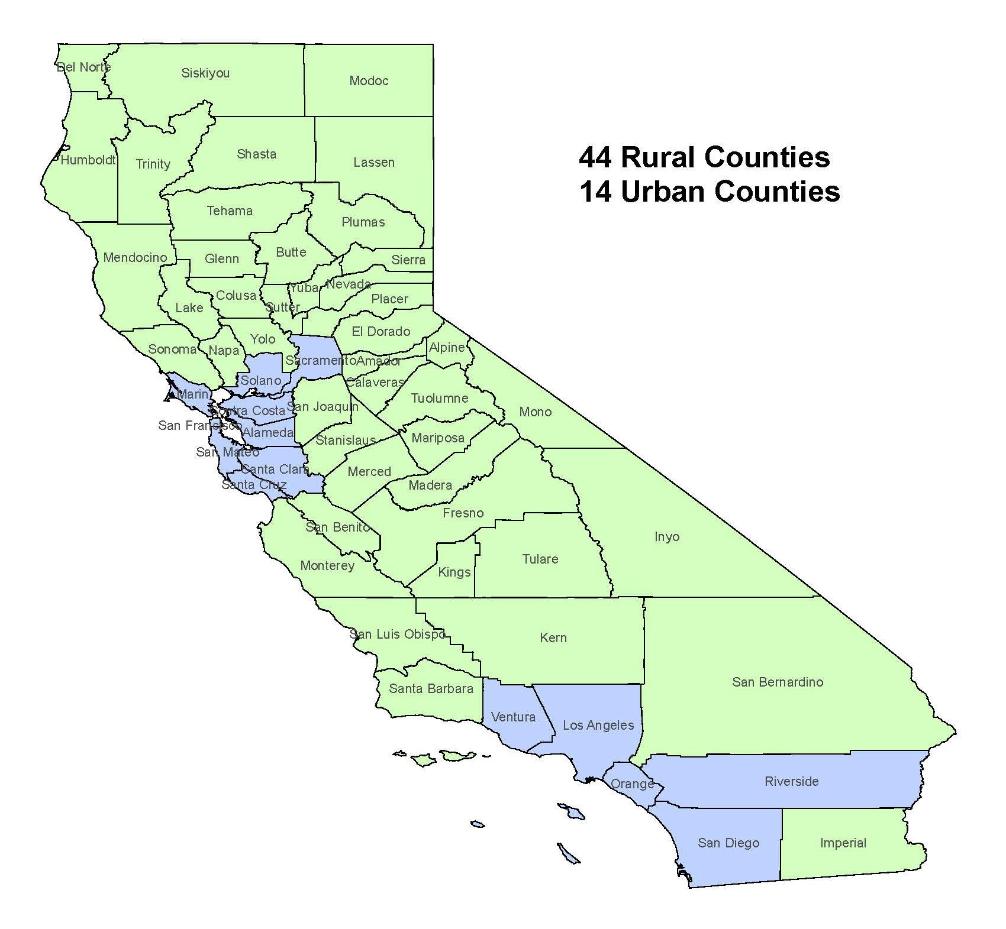
Opioid Overdose Deaths by County in CA
in green
in blue
SOURCE: CDPH, 2026
Notes:
This overdose map shows how rural areas in California have been affected by the opioid crisis.
REFERENCE:
California Department of Public Health. (2026). [Webpage]. California Overdose Surveillance Dashboard. Accessed May 4, 2026, from: https://skylab.cdph.ca.gov/ODdash/?tab=Home.

Slide 22

Substance Use in Rural Communities
Rural Adults - higher rates of use for tobacco and methamphetamines (SAMHSA, 2024)
Rural Adolescents: adults use alcohol at higher rates and are more likely to engage in high-risk behaviors
Notes:
What about Substance Use in Rural areas? Though often perceived to be a problem of the inner city, substance use and misuse have long been prevalent in rural areas.
Rural adults have higher rates of use for tobacco and methamphetamines, while opioid use has grown in towns of every size.
Rural adolescents and young adults use alcohol at higher rates and are more likely to engage in high-risk behaviors, like binge drinking or driving under the influence, than their urban counterparts.
REFERENCE:
Substance Abuse and Mental Health Services Administration. (2024). Key substance use and mental health indicators in the United States: Results from the 2023 National Survey on Drug Use and Health (HHS Publication No. PEP24-07-021, NSDUH Series H-59). Center for Behavioral Health Statistics and Quality, Substance Abuse and Mental Health Services Administration. https://www.samhsa.gov/data/report/2023-nsduh-annual-national-report.
IMAGE CREDIT:
Adobe Stock, Purchased Image, 2025.

Slide 23
HIV and SUDs — A Dual Epidemic
Direct Transmission Through Shared Equipment
Impaired Judgment and Risky Behavior
Biological Vulnerability
Social and Structural Factors
Notes:
Injection drug use is one of the most direct pathways for HIV transmission, and it’s not just about the needle itself. Here's how substance use disorders (SUDs), especially involving injection drugs, elevate the risk:
Direct Transmission Through Shared Equipment: Needles and syringes can carry blood containing HIV. Sharing them allows the virus to pass directly into another person’s bloodstream. Even cookers, cotton filters, and rinse water used in drug preparation can be contaminated with HIV-positive blood.
Impaired Judgment and Risky Behavior: Drugs like opioids, methamphetamine, and cocaine alter decision-making, leading to risky sexual behaviors such as condomless sex or multiple partners. Some individuals may exchange sex for drugs, increasing exposure to HIV.
Biological Vulnerability: Substance use can weaken the immune system, making it easier for HIV to establish infection. It may also interfere with HIV medications, reducing their effectiveness and increasing viral load in those already infected.
Social and Structural Factors: People who inject drugs often face social labeling, unstable housing, and limited access to healthcare, which can delay HIV testing and treatment. Lack of access to overdose prevention programs and pre-exposure prophylaxis (PrEP) further compounds the risk.

Slide 24
Challenges of SUD and HIV Prevention and Treatment in Rural Communities
Lack of awareness and education about HIV and SUDs
Limited access to health care
Financial constraints
Social labeling and social isolation
Substance use trends
Mental health and co-occurring disorders
Notes:
What are the main Challenges of SUD and HIV Prevention and Treatment services in Rural Areas:
1. Lack of awareness and education about HIV and SUDs: misinformation is still a serious issue especially in isolated rural communities.
2. Limited access to health care: Rural areas tend to have fewer clinics and providers trained in HIV care and substance use treatment. Public transportation is usually nonexistent, and patients often must travel long distances, make accessing services difficult.
3. Financial constraints: Rural areas have higher rates of poverty and uninsured individuals. Operating HIV and SUD programs in sparsely populated areas is more expensive, limiting availability.
4. Social Labeling and social isolation: Strong social labeling around HIV and substance use discourages individuals from seeking help. Fear of being recognized in small communities can lead individuals to social isolation and delaying access to services.
5. Substance use trends: As we mentioned before, rural areas have higher rates of tobacco, methamphetamine, and opioid use. Increased injection drug use contributes to rising HIV transmission rates. Also, youth in rural areas tend to engage more in binge drinking and risky behaviors than urban counterparts.
6. Mental health and co-occurring disorders: Rural residents often lack access to mental health services; exacerbating substance use and HIV risk. Depression and trauma are common among individuals with HIV and substance use disorders, yet treatment options are scarce.

Slide 25
Promising Strategies
Telemedicine for HIV care and behavioral health support
Rapid antiretroviral therapy (ART) initiation
Community health workers and peer navigators to build trust
Education campaigns
Mobile clinics and outreach programs
Integration of HIV and substance use services in primary care settings
Notes:
Supporting HIV and substance use disorder (SUD) prevention and treatment in rural areas requires creative and community-driven solutions. Here are some promising strategies that have shown success across the U.S.:
Telemedicine for HIV care and behavioral health support: Virtual appointments help overcome geographic isolation and provider shortages.
Rapid antiretroviral therapy (ART) initiation: Starting ART immediately significantly reduces the time to achieve an undetectable viral load, often by several months compared to delayed treatment
Use of community health workers and peer navigators to build trust: Community Health Workers and Peer Navigators are often the unsung heroes of public health, especially in underserved or rural communities. Their ability to build trust is not just a soft skill; it’s a strategic advantage that transforms health outcomes.
Education Campaigns: Education campaigns play a transformative role in reducing HIV-related social labeling and encouraging testing—especially in communities where misinformation, fear, or negative attitudes persist
Mobile clinics and outreach programs: They bring services directly to people who might otherwise fall through the cracks.
Integration of HIV and substance use services in primary care settings: It creates a one-stop shop for patients, reducing social labeling, improving access, and streamlining care.

Slide 26
Rural Community Engagement Strategies
Local wisdom drives better solutions
Building trust and reducing social labeling
Co-designing sustainable programs
Amplifying underserved voices
Enhancing data and research impact
Empowering local leadership
SOURCE: Wiehe et al., 2024
Notes:
Rural community engagement strategies are essential for effective HIV and substance use disorder (SUD) prevention and treatment, not just as a nice-to-have, but as a cornerstone of sustainable public health. Rural community engagement isn’t just a strategy, it is a moral imperative and a smart investment. Here's why community engagement matters:
Local wisdom drives better solutions: Rural communities have unique social dynamics, norms, and resource limitations. Engaging locals ensures interventions are relevant, respectful, and realistic.
Building trust and reducing social labeling: Engagement fosters relationships and credibility, especially in areas where healthcare systems may be viewed with skepticism. When people see their voices reflected in programs, they're more likely to participate in testing, treatment, and prevention efforts.
Co-designing sustainable programs: Strategies like human-centered design empower residents to co-create solutions, which leads to higher retention and better outcomes. Programs built with the community are more likely to last beyond initial funding cycles.
Amplifying voices: Rural populations often have specific needs that are frequently overlooked. Engagement ensures these voices are heard, respected, and centered in policy and practice.
Enhancing data and research impact: Community-informed research helps fill gaps in data and improves interpretation of findings, making studies more actionable and inclusive. It also boosts participant retention and trust in research teams, which is critical for longitudinal studies.
Empowering local leadership: Engagement builds local capacity. Therefore, training residents to become peer educators, navigators, and advocates will help to create a ripple effect: health literacy rises, social labeling falls, and communities become agents of their own change.
REFERENCE:
Wiehe, S. E., Nelson, T. L., Hawryluk, B., Andres, U.-M., Aalsma, M. C., Rosenman, M. B., Butler, M. S., Harris, M., Moore, K., Scott, C. D., Gharbi, S., Parks, L., Lynch, D., Silverman, R. D., & Fortenberry, J. D. (2024). Unlocking success: Community engagement for enhanced HIV care outcomes. Res Involv Engagem 10, 127. https://doi.org/10.1186/s40900-024-00657-0

Slide 27

Strategies for
Prevention of HIV and SUD in Rural Communities
Notes:
Effective strategies for preventing HIV and substance use disorder (SUD) in rural communities center on expanding access to care, reducing social labeling through education, and leveraging local partnerships to deliver integrated, services responsive to local communities. We will now look at some of these preventive strategies.
IMAGE CREDIT:
Adobe Stock, Purchased Image, 2025.

Slide 28
Screening and Brief Intervention Practice
Implementation of HIV and SUD screening in rural areas:
It normalizes testing and reduces social labeling
It encourages early detection and linkage to care
Strategic Practices:
Integration of HIV and SUD screening in primary care routine check-ups
Integration of SUD screening in school settings
Offer rapid HIV testing, counseling, and basic medical services at community events
Notes:
Screening is the first step in the “Diagnose, Treat, Prevent, Respond” strategy. Early HIV detection saves lives, reduces transmission, and strengthens community health systems. The implementation of screening for HIV and substance use disorders (SUD) in rural areas is critically important due to a unique set of challenges and risk factors that make early detection and intervention both more difficult and more essential. Why screening and brief intervention practice are important?
It normalizes testing and reduces social labeling.
It encourages early detection and linkage to care.
Here are some strategic practices that can be adopted in Rural setting:
Integration of HIV and SUD screening in primary care routine check ups.
Integration of SUD screening in school settings.
Offer rapid HIV testing, counseling, and basic medical services at community events.

Slide 29
Combat Social Labeling and Build Trust
Support Community Health Workers: Train local advocates to provide education and support in ways that are responsive to the needs of local communities.
Provide Peer Educator Programs: Empower individuals with lived experience to guide others through care.
Engage Local Leaders: Involve clergy, educators, and influencers to shift attitudes and reduce negative attitudes and perceptions.
Notes:
Combating social labeling and fostering community trust in rural areas requires education that is responsive to local needs, peer-led support networks, and inclusive outreach to dismantle social labeling and empower individuals to seek HIV and substance use disorder prevention services. Some important strategies include:
Support Community Health Workers: Train local advocates to provide education and support in ways that are responsive to the needs of local communities.
Provide Peer Educator Programs: Empower individuals with lived experience to guide others through care.
Engage Local Leaders: Involve clergy, educators, and influencers to shift attitudes and reduce negative attitudes and perceptions.

Slide 30
Biomedical Prevention for HIV
Pre-Exposure Prophylaxis (PrEP): A daily pill that reduces the risk of HIV by up to 99% when taken consistently.
Post-Exposure Prophylaxis (PEP): Emergency medication taken within 72 hours of potential exposure to prevent infection.
Rapid ART Initiation: Start antiretroviral therapy quickly after diagnosis to improve outcomes.
Antiretroviral Therapy (ART): For people living with HIV, consistent treatment can suppress the virus to undetectable levels — meaning it can’t be transmitted sexually: U=U (Undetectable = Untransmittable).
SOURCE: CDC, 2024
Notes:
Biomedical prevention of HIV in rural areas offers powerful protection against transmission, especially when paired with telemedicine, mobile outreach, and community health workers to overcome barriers. Some important strategies involve the following:
Pre-Exposure Prophylaxis (PrEP): A daily pill that reduces the risk of HIV by up to 99% when taken consistently.
Post-Exposure Prophylaxis (PEP): Emergency medication taken within 72 hours of potential exposure to prevent infection.
Rapid ART Initiation: Start antiretroviral therapy quickly after diagnosis to improve outcomes.
Antiretroviral Therapy (ART): For people living with HIV, consistent treatment can suppress the virus to undetectable levels — meaning it can’t be transmitted sexually. There is a concept called U=U : Undetectable = Untransmittable. This is a groundbreaking public health message backed by decades of scientific research and endorsed by major health organizations like the CDC, UNAIDS, and the National Institute of Allergy and Infectious Diseases (NIAID).
Biomedical HIV prevention in rural areas is critically important because these communities often face higher rates of new infections, limited access to healthcare, and persistent social labeling that discourages people from seeking help.
REFERENCE:
Centers for Disease Control and Prevention. (2024). [Webpage]. Undetectable = Untransmittable. Accessed May 4, 2026, from: https://www.cdc.gov/global-hiv-tb/php/our-approach/undetectable-untransmittable.html.

Slide 31
Behavioral and Sexual Health Strategies
Behavioral Strategies
Risk-reduction counseling
Motivational interviewing
Peer-led interventions
Sexual Health Strategies
Comprehensive sex education
Condom distribution and promotion
Partner services and testing
Notes:
Behavioral and sexual health strategies are essential complements to biomedical HIV prevention, especially in rural areas where social labeling, limited access to care, and misinformation can undermine public health efforts. Here's how they make a difference:
Behavioral Strategies
Risk-reduction counseling: Helps individuals understand and modify behaviors that increase HIV risk, such as unprotected sex or substance use.
Motivational interviewing: Builds trust and encourages people to make healthier choices without judgment.
Peer-led interventions: Empower community members to educate and support each other, which is especially effective in tight-knit rural settings.
Sexual Health Strategies
Comprehensive sex education: Promotes safe practices, consent, and awareness of HIV/STI transmission.
Condom distribution and promotion: Ensures access to protection and normalizes its use.
Partner services and testing: Encourages couples and sexual networks to get tested and treated together, reducing transmission chains.

Slide 32
Preventive Measures for People Who Inject Drugs
Naloxone Distribution: Ensures access to life-saving overdose reversal medication
Medication for Addiction Treatment (MAT): Combines medications like methadone or buprenorphine with counseling to treat opioid use disorder and reduce risky injection behaviors
Notes:
Preventive measures for people who inject drugs are vital for reducing HIV and SUD risks. Here are some strategies:
Naloxone Distribution: Ensures access to life-saving overdose reversal medication.
Medications for Addiction Treatment (MAT): Combines medications like methadone or buprenorphine with counseling to treat opioid use disorder and reduce risky injection behaviors
These interventions are most effective when delivered with compassion, sensitivity, and a commitment to meeting people where they are.

Slide 33
Prevention of Mother-to-Child Transmission
Early HIV Testing: Ensuring pregnant women know their HIV status through routine antenatal screening.
Antiretroviral Therapy (ART): Lifelong treatment for HIV-positive mothers significantly reduces the risk of transmission during pregnancy, childbirth, and breastfeeding.
Safe Delivery Practices: Medical guidance on labor and delivery methods that minimize transmission risk.
Infant Prophylaxis: Providing antiretroviral medication to newborns for a short period after birth.
Safe Infant Feeding: Counseling on breastfeeding vs. formula feeding based on the mother's viral load and access to clean water.
SOURCE: Unicef, 2025
Notes:
Preventing mother-to-child transmission (PMTCT) of HIV is one of the most powerful public health strategies to protect future generations. Some PMTCT strategies include:
Early HIV Testing: Ensuring pregnant women know their HIV status through routine antenatal screening.
Antiretroviral Therapy (ART): Lifelong treatment for HIV-positive mothers significantly reduces the risk of transmission during pregnancy, childbirth, and breastfeeding.
Safe Delivery Practices: Medical guidance on labor and delivery methods that minimize transmission risk.
Infant Prophylaxis: Providing antiretroviral medication to newborns for a short period after birth.
Safe Infant Feeding: Counseling on breastfeeding vs. formula feeding based on the mother's viral load and access to clean water.
REFERENCE:
UNICEF. (2025). [Webpage]. HIV: Elimination of mother-to-child transmission. Accessed May 4, 2026, from: https://data.unicef.org/topic/hivaids/emtct/.

Slide 34
Education and Early Intervention
School & Youth Programs: Integrate prevention education into curricula to reach younger populations. School-based prevention programs like keepin’ it REAL and PROSPER teach youth decision-making, resistance skills, and emotional regulation.
Person-centered care in schools and youth services helps address underlying causes of substance use, especially adverse childhood experiences (ACEs).
Parent engagement initiatives such as Let’s Talk booklets and community forums foster open communication about substance use and HIV.
Tailored Outreach Campaigns: Use radio, social media, and town halls to share accurate HIV/SUD information.
Notes:
Education is the cornerstone of prevention. In rural areas, where misinformation and social labeling often run deep, targeted educational efforts can transform community attitudes and behaviors.
Here are some strategies:
School & Youth Programs: Integrate prevention education into curricula to reach younger populations. School-based prevention programs like keepin’ it REAL and PROSPER teach youth decision-making, resistance skills, and emotional regulation.
Person-centered care in schools and youth services helps address underlying causes of substance use, especially adverse childhood experiences (ACEs).
Parent engagement initiatives such as Let’s Talk booklets and community forums foster open communication about substance use and HIV.
Tailored Outreach Campaigns: Use radio, social media, and town halls to share accurate HIV/SUD information.

Slide 35
Community-Led Prevention Strategies
Peer Education and support networks
Faith-based and Tribal initiatives
Community Health Workers (CHWs)
Local media and storytelling
Youth-led campaigns
Notes:
Community-led prevention strategies are powerful tools for addressing HIV and substance use disorders (SUD) in rural communities, where trust, access, and local relevance are key. Community-led strategies place residents, leaders, and organizations at the center of prevention efforts. These approaches are especially effective in rural areas, where outside interventions often face resistance due to mistrust or disconnect.
1. Peer Education and Support Networks: Trained community members share accurate information about HIV and SUD. Also, peer mentors provide emotional support and model healthy behaviors.
2. Faith-Based and Tribal Initiatives: Churches, mosques, and tribal councils lead prevention efforts grounded in spiritual traditions. These groups often have deep influence and credibility in rural settings.
3. Community Health Workers (CHWs): CHWs conduct outreach, screenings, and referrals. They bridge gaps between healthcare systems and underserved populations.
4. Local Media and Storytelling: Radio programs, local newspapers, and community theater raise awareness and reduce social labeling. Personal stories from community members help humanize HIV and addiction.
5. Youth-Led Campaigns: Young people lead school and social media initiatives to educate peers. These campaigns often focus on prevention, mental health, and resilience.

Slide 36
Workforce Development
Training rural providers in HIV and SUD prevention, including medications for addiction treatment (MAT), person-centered care, and practices responsive to local communities
Expanding roles for community health workers (CHWs), peer navigators, and lay educators who can reach underserved populations
Integrating HIV and SUD services into primary care to maximize limited resources
Using telehealth and mobile units to extend workforce reach across geographic barriers
Implementation of strategies to boost recruitment and retention of healthcare providers in rural areas
Addressing provider burnout and retention, especially in high-stress rural settings
Provide anti-social labeling mandatory training for health care staff
Notes:
Workforce development is a critical and often underappreciated strategy for preventing HIV and substance use disorders (SUD) in rural communities. It’s not just about hiring more people. It’s about building a skilled, sustainable workforce that can meet the unique needs of rural populations. Workforce development refers to efforts that recruit, train, support, and retain professionals and paraprofessionals who deliver effective prevention, care, and support services. In rural areas, where healthcare access is limited and social labeling is high, a strong local workforce can be transformative. Here are some key strategies to support workforce development:
Training rural providers in HIV and SUD prevention, including Medications for Addiction Treatment (MAT), person-centered care, and locally responsive practices
Expanding roles for community health workers (CHWs), peer navigators, and lay educators who can reach underserved populations
Integrating HIV and SUD services into primary care to maximize limited resources
Using telehealth and mobile units to extend workforce reach across geographic barriers
Implementation of strategies to boost recruitment and retention of healthcare providers in rural areas
Addressing provider burnout and retention, especially in high-stress rural settings
Provide anti-social labeling mandatory training for health care staff.

Slide 37
Infrastructure and Access to Care
Expanding rural clinics and health centers to offer HIV testing, SUD screening, and integrated care.
Investing in telehealth platforms to overcome geographic isolation and provider shortages.
Developing mobile health units that bring services directly to remote populations.
Improving transportation networks or offering ride services for patients to access care.
Upgrading data systems for better tracking, referrals, and coordination across providers.
Hub-and-spoke models (like Vermont’s) connect rural clinics with centralized treatment hubs to improve care coordination.
SOURCES: Rawson, 2017; State of Vermont, 2026
Notes:
Infrastructure and access to care are foundational strategies for preventing HIV and substance use disorders (SUD) in rural communities. Without strong systems and reachable services, even the best prevention programs can fall short. In rural communities, prevention isn’t just about education or outreach—it’s about ensuring that people can actually reach and receive the care they need. This means investing in physical, digital, and human infrastructure to close gaps in service delivery. Some key infrastructure strategies include:
Expanding rural clinics and health centers to offer HIV testing, SUD screening, and integrated care
Investing in telehealth platforms to overcome geographic isolation and provider shortages
Developing mobile health units that bring services directly to remote populations
Improving transportation networks or offering ride services for patients to access care
Upgrading data systems for better tracking, referrals, and coordination across providers
Hub-and-spoke models (like Vermont’s) connect rural clinics with centralized treatment hubs to improve care coordination.
REFERENCES:
Rawson, R. (2017). Vermont Hub-and-Spoke Model of Care for Opioid Use Disorders: An Evaluation. Burlington, VT: Vermont Center on Behavior and Health. Accessed May 4, 2026, from: https://www.healthvermont.gov/sites/default/files/documents/pdf/ADAP_Hub_and_Spoke_Evaluation_2017_1.pdf.
State of Vermont Blueprint for Health. (2026). [Webpage]. Hub & Spoke. Accessed May 4, 2026, from: https://blueprintforhealth.vermont.gov/about-blueprint/hub-and-spoke.

Slide 38
Addressing Geographic Barriers
Mobile health units
Telemedicine and digital health
Community-based service hubs
Transportation assistance programs
Notes:
Addressing geographic barriers is a vital strategy for preventing HIV and substance use disorders (SUD) in rural communities, where isolation and limited infrastructure can severely restrict access to care. In rural areas, long distances, poor transportation, and sparse healthcare facilities often mean that individuals can't easily access HIV testing, SUD treatment, or preventive services. Tackling these geographic challenges is essential to ensure equitable care and early intervention. Some strategies to overcome geographic barriers include:
Mobile Health Units: Bring HIV testing, counseling, and SUD services directly to remote communities. It offer regular outreach and follow-up care on-site and it is proven to increase testing rates and reduce social labeling.
Telemedicine and Digital Health: Enable virtual consultations with HIV/SUD specialist, reduce travel burden and improve continuity of care. Supported by programs like the Ryan White HIV/AIDS Program, which funds telehealth expansion in rural areas.
Community-Based Service Hubs: Integrate HIV, SUD, mental health, and primary care in one local facility and use community health workers to extend reach and build trust.
Transportation Assistance Programs: Provide vouchers, ride services, or shuttle systems for medical appointments. It is especially critical for older adults and low-income residents.

Slide 39
Data-Driven Leadership
Collecting localized data on HIV and SUD prevalence, risk factors, and service gaps (Hargreaves et al., 2020).
Analyzing trends to identify high-risk populations and emerging threats.
Using predictive modeling to anticipate outbreaks or spikes in substance use.
Evaluating program effectiveness to refine strategies and scale what works.
Sharing data across sectors—healthcare, criminal justice, education—for a holistic response.
Notes:
Adopting data-driven leadership is a transformative strategy for preventing HIV and substance use disorders (SUD) in rural communities. It empowers decision-makers to move beyond assumptions and act on real-time insights, tailoring interventions to local needs with precision and accountability. In rural settings, where resources are limited and challenges are complex, data-driven leadership helps ensure that every dollar, policy, and program is strategically targeted. It’s about using data not just to track problems, but to solve them. Some important components of a data-driven leadership includes:
Collecting localized data on HIV and SUD prevalence, risk factors, and service gaps.
Analyzing trends to identify high-risk populations and emerging threats.
Using predictive modeling to anticipate outbreaks or spikes in substance use.
Evaluating program effectiveness to refine strategies and scale what works.
Sharing data across sectors—healthcare, criminal justice, education—for a holistic response.
According to the Journal of the International AIDS Society, data-driven HIV prevention strategies like the “HIV prevention cascade” help leaders monitor progress and optimize interventions based on measurable outcomes. Adopting data-driven leadership isn’t just a technical upgrade—it’s a significant shift. It means valuing transparency, accountability, and continuous learning. In rural communities, where every resource counts, it’s one of the most powerful tools we have to prevent HIV and SUD.
REFERENCE:
Hargreaves, J. R., Auerbach, J. D., Hensen, B., & Gregson, S. (2020). Data-driven HIV prevention: The HIV prevention cascade and beyond. Journal of the International AIDS Society, 23(S3), e25538. https://doi.org/10.1002/jia2.25538

Slide 40
Policy & Funding Support
Medicaid expansion to cover HIV/SUD services for low-income rural residents.
Integration mandates that encourage combining HIV, SUD, and mental health services.
Workforce incentives like loan repayment programs for rural providers.
Telehealth reimbursement policies to support remote care delivery.
Anti-social labeling legislation to protect individuals seeking HIV/SUD treatment.
Notes:
Policy and funding support are the engine behind sustainable, scalable strategies to prevent HIV and substance use disorders (SUD) in rural communities. Without strong policies and consistent funding, even the most innovative programs can’t reach the people who need them most. In rural areas, where healthcare systems are often under-resourced and geographically isolated, policy and funding play a critical role in expanding access, reducing disparities, and building long-term capacity. Some key policy strategies include:
Medicaid expansion to cover HIV/SUD services for low-income rural residents
Integration mandates that encourage combining HIV, SUD, and mental health services
Workforce incentives like loan repayment programs for rural providers
Telehealth reimbursement policies to support remote care delivery
Anti—social labeling legislation to protect individuals seeking HIV/SUD treatment
The Ryan White HIV/AIDS Program is a great example of federal policy driving rural HIV care, offering funding for telemedicine, transportation, and rapid antiretroviral therapy.

Slide 41

Strategies for
Treating HIV and SUD
in Rural Communities
Notes:
Treating HIV and substance use disorders (SUD) in rural communities isn’t just a public health priority—it’s a matter of survival and long-term resilience. These strategies are essential because rural populations face unique challenges that make prevention and treatment more complex and urgent.
IMAGE CREDIT:
Adobe Stock, Purchased Image, 2026.

Slide 42
Rapid Antiretroviral Therapy (ART) Initiation
Rapid ART means beginning HIV treatment on the same day or within days of diagnosis. This approach has been shown to:
Improve viral suppression rates
Boost retention in care
Reduce onward transmission
Enhance patient engagement, especially among populations with specific service needs
Notes:
Rapid Antiretroviral Therapy (ART) Initiation is a game-changing strategy for treating HIV in rural communities, especially when paired with efforts to address substance use disorders (SUD). It’s about acting fast—starting HIV treatment immediately after diagnosis—to improve health outcomes and reduce transmission risks. Rapid ART means beginning HIV treatment on the same day or within days of diagnosis. This approach has been shown to:
Improve viral suppression rates
Boost retention in care
Reduce onward transmission
Enhance patient engagement, especially among populations with unique service needs
In rural settings, where access to care is limited and social labeling is high, rapid ART can be a lifeline.

Slide 43
Medication for Addiction Treatment (MAT) for SUD
Combines medications (e.g., buprenorphine, methadone) with counseling
Can be delivered through rural clinics, mobile units, or telehealth
Strategies to expand MAT in rural settings:
  Telemedicine-based MAT
  Training rural providers
  Integrated HIV/SUD care models
  Policy and funding support
SOURCE: SAMHSA, 2025
Notes:
Medication for Addiction Treatment (MAT) is one of the most effective and evidence-based strategies for treating substance use disorders (SUD) in rural communities, and it plays a critical role in improving outcomes for individuals living with or at risk for HIV. MAT combines FDA-approved medications (like buprenorphine, methadone, or naltrexone) with behavioral therapies and counseling to treat opioid and other substance use disorders. It’s not just about managing withdrawal, it’s about restoring health, stability, and dignity.
MAT can be delivered through rural clinics, mobile units, or telehealth. Strategies to expand MAT in rural settings include:
Telemedicine-Based MAT: Enables remote prescribing and counseling and reduces geographic barriers and provider shortages.
Training Rural Providers: Equips primary care clinicians to prescribe buprenorphine and addresses gaps in provider education and social labeling around MAT.
Integrated HIV/SUD Care Models: Combines MAT with HIV testing, treatment, and prevention (e.g., PrEP) and improves coordination and outcomes for patients with co-occurring conditions.
Policy and Funding Support: Medicaid programs and federal grants help expand MAT access. The Medicaid Innovation Accelerator Program offers technical assistance to improve MAT delivery systems.
REFERENCE:
Substance Abuse and Mental Health Services Administration. (2025). [Webpage]. Substance Use Disorder Treatment Options. Accessed May 4, 2026, from: https://www.samhsa.gov/substance-use/treatment/options.

Slide 44
Telemedicine and Virtual Care
Virtual consultations
Telehealth monitoring
Digital health education
Telecounseling and telemental health
Rapid ART & MAT initiation
Proven to improve retention in care and reduce travel burdens
SOURCES: HRSA, 2020; Ezenwajii et al., 2025)
Notes:
Telemedicine and virtual care have emerged as powerful strategies for addressing HIV and substance use disorders (SUD) in rural communities, where access to specialized healthcare is often limited. Telemedicine bridges these gaps by bringing care directly to patients, no matter where they live. Key telemedicine strategies involve:
Virtual Consultations: Remote visits with infectious disease specialists, addiction counselors, and mental health providers. It reduces travel burden and increases confidentiality.
Telehealth Monitoring: Regular follow-ups for HIV viral load and medication adherence and remote monitoring of substance use recovery progress.
Digital Health Education: Online modules and support groups for HIV prevention and PrEP education. It empowers patients with knowledge and reduce social labeling
Telecounseling and Telemental Health: Behavioral therapy and peer support for SUD and HIV-related mental health issues. accessible via phone or video, even in low-bandwidth areas.
Rapid ART & MAT Initiation: Programs like HRSA’s Ryan White HIV/AIDS Program support rapid antiretroviral therapy (ART) and medication-assisted treatment (MAT) for opioid use disorder via telehealth.
Telemedicine isn’t just a workaround, it’s a lifeline. By reimagining how care is delivered, rural communities can overcome systemic barriers and offer compassionate, effective treatment for HIV and SUD.
REFERENCES:
Health Resources and Services Administration, Ryan White HIV/AIDS Program. (2020). HIV Care and Treatment in Rural Communities, HRSA’s Ryan White HIV/AIDS Program. Accessed May 4, 2026, from: https://ryanwhite.hrsa.gov/sites/default/files/ryanwhite/resources/hiv-rural-communities-fact-sheet.pdf.
Ezenwaji, C. O., Alum, E. U. & Ugwu, O. P. C. (2025). Bridging the gap: Telemedicine as a solution for HIV care inequities in rural and vulnerable communities. Int J Equity Health 24, 205. https://doi.org/10.1186/s12939-025-02584-2

Slide 45
Implementation of Integrated Care Models
Co-located services
Mobile health units
Community health centers
Street medicine and differentiated service delivery
Telehealth Integration
SOURCES: Killelea et al., 2023; Hill et al., 2023
Notes:
Integrated care models are very effective for treating HIV and substance use disorders (SUD) in rural communities. These models bring together physical health, behavioral health, and social services under one roof, or through coordinated networks, to provide holistic, patient-centered care. Some implementation strategies include:
Co-located Services: Where clinics offer HIV care, SUD treatment, and mental health services in one location. It helps to reduces travel and increases engagement.
Mobile Health Units: Bring integrated care directly to underserved areas, which is ideal for reaching people who are unhoused or have lack of transportation services.
Community Health Centers: A good example is Federally Qualified Health Centers (FQHCs), which often serve as hubs for integrated care.
Street Medicine & Differentiated Service Delivery: Providers meet patients where they are, literally. This module uses tailored care for those not well-served by traditional clinics.
Telehealth Integration: Combines virtual care with in-person services. Well know for expanding reach and supporting ongoing monitoring.
By weaving together services, these models offer dignity, efficiency, and better health outcomes.
REFERENCES:
Killelea, A., Armstrong, W., Barocas, J., Bergoholz, D., Coribin-Gutierrez, E., Dombrowski, J., Evans, T., Feinberg, F., Gipson, J., Haddad, M., Hanson, H., McManus, K., Oxner, A., Patel, R., Person, A., Tookes, H., & Weddle, A. (2023). A Systems Level Approach to Innovative HIV Care and Treatment Models in the United States: Street Medicine and Differentiated Service Delivery. Arlington, VA: HIV Medicine Association. Accessed May 4, 2026, from: https://www.hivma.org/globalassets/hivma/innovative-service-delivery-whitepaper.pdf.
Hill, K., Kuo, I., Shenoi, S. V., Desruisseaux, M. S., & Springer, S. A. (2023). Integrated care models: HIV and substance use. Curr HIV/AIDS Rep 20, 286–295. https://doi.org/10.1007/s11904-023-00667-9.
https://aidsetc.org/resource/continuum-hiv-care-rural-and-underserved-communities-strategies-addressing-treatment

Slide 46
Use of Community Health Workers and Peer Navigators
Trusted local figures help patients navigate care, adhere to treatment, and overcome social labeling. They play an important role in (Mistry SK at al., 2021):
Linkage to care
Retention and adherence support
Health education and prevention
Social labeling reduction and advocacy
Community outreach and engagement
Notes:
Community Health Workers (CHWs) and Peer Navigators are heroes in the fight against HIV and substance use disorders (SUD), especially in rural communities where healthcare access is fragmented and social labeling runs deep. Their lived experience, community connection, and grassroots approach make them uniquely effective in bridging gaps that traditional healthcare systems often miss. CHWs and Peer Navigators help overcome these challenges by acting as trusted guides, educators, and advocates within their own communities.
They play an important role in:
Linkage to Care: Helping individuals connect with HIV testing, treatment, and SUD services, as well as navigating insurance, transportation, and appointment scheduling.
Retention and Adherence Support: By providing reminders, encouragement, and problem-solving for medication adherence as well as emotional support.
Health Education and prevention: Educate on HIV prevention (e.g., PrEP), overdose prevention (e.g., naloxone), and safer practices.
Social labeling Reduction and Advocacy: Normalizing conversations around HIV and addiction and advocating for patient-centered care and patient rights.
Community Outreach and Engagement: Conducting outreach in homes, shelters, and community centers, as well as building relationships with hard-to-reach populations.
CHW and Peer navigator presence in rural communities transforms care from distant and clinical to personal and empowering. When paired with integrated care models and telehealth, they form a powerful triad for tackling HIV and SUD.
REFERENCE:
Mistry, S. K., Harris, E., & Harris, M. (2021). Community health workers as healthcare navigators in primary care chronic disease management: A systematic review. J Gen Intern Med, 36(9), 2755–2771. doi: 10.1007/s11606-021-06667-y. Epub 2021 Mar 5. PMID: 33674916; PMCID: PMC8390732.

Slide 47
Mobile Clinics and Outreach Programs
Mobile clinics are fully equipped medical units that travel to underserved areas, offering services such as:
  HIV screening and treatment (including ART and PrEP)
  SUD care – MAT and overdose reversal with naloxone
  Overdose prevention services, STI testing, and hepatitis screening
  Primary care and mental health support
Notes:
Mobile clinics are transformative strategies for treating HIV and substance use disorders (SUD) in rural communities. They bring care directly to people who might otherwise be left behind due to geographic isolation, social labeling, or lack of transportation.
Mobile clinics are fully equipped medical units that travel to underserved areas, offering services such as:
HIV testing and treatment (including ART and PrEP)
SUD care, including medication-assisted treatment (MAT) with buprenorphine and overdose reversal with naloxone
Overdose prevention services, STI testing, and hepatitis screening
Primary care and mental health support

Slide 48
Outreach Programs
Outreach programs complement mobile clinics by building trust and engagement:
Engaging hard-to-reach populations through street outreach, home visits, and community events.
Providing education on HIV prevention and recovery.
Distributing supplies like condoms and naloxone.
Connecting individuals to care through referrals and transportation assistance.
Notes:
Outreach Programs, like mobile clinics, is also a transformative strategies for treating HIV and substance use disorders (SUD) in rural communities. Outreach programs complement mobile clinics by building trust and engagement. They are important for:
Engaging hard-to-reach populations through street outreach, home visits, and community events.
Providing education on HIV prevention and recovery.
Distributing supplies like condoms and naloxone.
Connecting individuals to care through referrals and transportation assistance.

Slide 49
Social Labeling Reduction and Education Campaigns
Normalize conversations around HIV and SUD
Promote understanding that both are treatable medical conditions
Encourage individuals to seek care without fear of judgment
What are some core components of Education Campaigns?
SOURCE: UR Medicine, Recovery Center of Excellence, 2026
Notes:
Social labeling surrounding HIV and SUD is a major barrier to treatment, especially in rural communities where anonymity is limited and healthcare resources are scarce. These campaigns aim to promote empathy and understanding around HIV and addiction by:
Normalizing conversations around HIV and SUD.
Promoting understanding that both are treatable medical conditions.
Encouraging individuals to seek care without fear of judgment.
What are some core components of Education Campaigns? (Next Slide)
REFERENCE:
UR Medicine, Recovery Center of Excellence. (2026). Developing a Rural Community Approach to Overcoming social labeling. Accessed May 4, 2026, from: https://recoverycenterofexcellence.org/learn/developing-rural-community-approach-overcoming-.

Slide 50
Core Components of Education Campaigns
Community education
Contact-based interventions
Healthcare provider training
Faith-based and local partnerships
Media and marketing campaigns
Notes:
Here are the core components of education campaigns:
Community education: Public awareness initiatives that explain the science behind HIV and SUD, emphasizing that they are chronic but manageable conditions.
Contact-based interventions: Programs that bring community members into contact with individuals in recovery or living with HIV to humanize their experiences and reduce negative attitudes and perceptions.
Healthcare provider training: Workshops and continuing education for clinicians to reduce bias and improve patient interactions, especially around medications for addiction treatment (MAT) and HIV care.
Faith-based and local partnerships: Churches and community organizations play a key role in supporting affected individuals and reshaping local attitudes.
Media and marketing campaigns: Focused messaging through radio, social media, and local newspapers to challenge stereotypes and promote recovery success stories.

Slide 51

Activity #1: Western New York
Notes:
In just a moment, we’re going to break into groups to plan out how we might address the needs of real-world implementation programs using the strategies we just talked about. Afterwards, we’ll come back together to exchange ideas, and then we’ll see what the program itself actually implemented to build up a recovery ecosystem that fosters support and healing for individuals living with HIV and substance use disorders in rural communities.
IMAGE CREDIT:
Adobe Stock, Purchased Image, 2025.

Slide 52
Case Study 1: Growing Resilience Project – Western New York
Location: Allegany, Cattaraugus, and Steuben counties
Lead Organization: RCORP-Rural Center of Excellence on SUD Prevention, University of Rochester
The project’s goals are to:
  Prevent youth substance use through person-centered approaches
  Strengthen community capacity for early intervention
  Promote child and family well-being to reduce long-term risk of HIV and SUD
SOURCE: UR Medicine, Recovery Center of Excellence, 2025
Notes:
The first case study is the “Growing Resilience Project”, in Western New York State. The communities are in Allegany, Cattaraugus, and Steuben counties and the lead organization implementing the program, is the RCORP-Rural Center of Excellence on SUD Prevention at University of Rochester.
The project Goals are to:
Prevent youth substance use through person-centered approaches
Strengthen community capacity for early intervention
Promote child and family well-being to reduce long-term risk of HIV and SUD
I will leave this slide up now as you break into groups. You will have roughly 7 minutes to discuss with your group what strategies you would implement to meet this project’s goals.
[after breakout groups end, bring attendees back together and facilitate brief exchange of ideas]
Now let’s see what the University of Rochester and RCORP chose to do, and how it worked out.
REFERENCE:
UR Medicine, Recovery Center of Excellence. (2025). [Webpage]. Partnering with Rural Communities on Substance Use Prevention for Youth. Accessed May 4, 2026, from: https://recoverycenterofexcellence.org/articles/partnering-rural-communities-substance-use-prevention-youth.

Slide 53
Key Measures & Outcomes
Key Measures:
Community Engagement
Person-centered Training
Youth-Focused Prevention
Integrated Health Services
Transportation and Telehealth
Outcomes:
Increased awareness of trauma’s role in substance use and HIV risk
Improved access to early intervention services
Strengthened local infrastructure for prevention and recovery
Notes:
Here are the Key Measures implemented:
Community Engagement: Local leaders, schools, and health providers collaborated to identify trauma-related risk factors and tailor interventions.
Person-Centered Training: Educators and service providers were trained to recognize and respond to signs of trauma that may lead to substance use or risky behaviors.
Youth-Focused Prevention: Programs were designed to build resilience in children and teens, including peer support groups and family counseling.
Integrated Health Services: Efforts included screening for HIV and SUD risk, linking youth to care, and promoting rapid antiretroviral therapy (ART) for HIV-positive individuals
Transportation and Telehealth: To overcome rural access barriers, mobile health units and telemedicine were used to deliver care and counseling.
The Outcomes were the following:
Increased awareness of trauma’s role in substance use and HIV risk.
Improved access to early intervention services.
Strengthened local infrastructure for prevention and recovery.

Slide 54

Recovery Support
for Rural
Communities
Notes:
To effectively treat HIV and substance use disorders (SUD) in rural areas, leaders and providers must adopt strategies that address geographic isolation, limited healthcare infrastructure, and social labeling. The next section of the presentation features impactful approaches.
IMAGE CREDIT:
Adobe Stock, Purchased Image, 2025.

Slide 55
Community Health Workers (CHWs)
Why CHWs are essential in Rural recovery (Logan et al., 2020):
Bridge to care
Support
Early intervention and prevention
Social labeling reduction
Continuity and follow-up
Notes:
Community Health Workers (CHWs) are trained, trusted members of the community who serve as liaisons between individuals and healthcare systems. They often share linguistic or lived experiences with the populations they serve, making them uniquely effective in promoting recovery and wellness. Their familiarity, and grassroots approach make them uniquely effective in promoting recovery.
Why CHWs are essential in Rural recovery:
Bridge to care: CHWs help individuals navigate complex healthcare systems, connecting them to HIV treatment, substance use services, mental health support, and social resources like housing and transportation. This can be done in an active (when the CHW brings the patient to care) or passive process (when the CHW refers the patient to care), depending on the resources available.
Support: Because CHWs often come from the same communities they serve, they understand local values, beliefs, and barriers. This allows them to deliver care that feels respectful, relevant, and trustworthy.
Early intervention and prevention: CHWs identify at-risk individuals and intervene before crises escalate. They promote prevention strategies, HIV testing, and education about substance use and recovery options.
Social labeling reduction: By fostering open conversations and modeling compassion, CHWs help reduce social labeling around HIV and addiction—especially critical in small communities where fear and judgment can prevent people from seeking help.
Continuity and follow-up: CHWs maintain regular contact with clients, ensuring they stay engaged in care, adhere to treatment, and feel supported throughout their recovery journey.
Community Health Workers are not just service providers. They are lifelines, advocates, and catalysts for recovery. Their presence transforms rural healthcare from distant and impersonal to local, compassionate, and effective.
REFERENCE:
Logan, R. I., & Castañeda, H. (2020). Addressing health disparities in the rural United States: Advocacy as caregiving among community health workers and promotores de salud. Int J Environ Res Public Health, 10, 17(24), 9223. doi: 10.3390/ijerph17249223. PMID: 33321718; PMCID: PMC7764816.

Slide 56

Peer Support Networks
Builds trust and connection
Fills gaps in professional care
Promotes engagement and retention
Combats isolation
Empowers recovery and resilience
SOURCE: Areán et al., 2025
Notes:
Peer support involves individuals with lived experience of HIV or SUD offering guidance, empathy, and encouragement to others navigating similar challenges. These peer supporters are not just helpers—they are role models, advocates, and trusted companions on the path to recovery. They are crucial in rural settings because:
Builds trust and connection: in small, tight-knit communities, social labeling and fear of judgment can prevent people from seeking help. peer supporters break down these barriers by offering nonjudgmental, relatable support from someone who’s “been there.”
Fills gaps in professional care: rural areas often lack specialized providers. peer support helps bridge the gap by offering emotional and practical assistance between clinical visits, especially for those facing transportation or financial challenges.
Promotes engagement and retention: people are more likely to stay in treatment when they feel understood and supported. peer support increases motivation, reduces dropout rates, and fosters long-term recovery.
Combats isolation: rural life can be isolating, especially for those dealing with HIV or addiction. peer support creates a sense of community, belonging, and hope—essential ingredients for healing.
Empowers recovery and resilience: seeing someone thrive after facing similar struggles inspires confidence and self-efficacy. peer supporters help others set goals, celebrate progress, and navigate setbacks.
REFERENCE:
Areán, P. A., O’Connor, S., & Sherrill, J. (2025). The promise and perils of using peers and other paraprofessionals as mental health service professionals. JAMA Psychiatry, 82(2):107–108. doi:10.1001/jamapsychiatry.2024.4276
IMAGE CREDIT:
Adobe Stock, Purchased Image, 2025.

Slide 57
How Peer Support Works
One-on-One Mentoring: Personalized guidance through treatment, medication adherence, and coping strategies.
Group Facilitation: Safe spaces for sharing experiences, building relationships, and learning together.
Advocacy and Navigation: Help accessing services, understanding rights, and overcoming systemic barriers.
Notes:
How exactly peer support works:
One-on-One Mentoring: Personalized guidance through treatment, medication adherence, and coping strategies.
Group Facilitation: Safe spaces for sharing experiences, building relationships, and learning together.
Advocacy and Navigation: Help accessing services, understanding rights, and overcoming systemic barriers.
When peer support is embedded in rural recovery programs, it transforms communities from the inside out. It fosters compassion, reduces social labeling, and builds a network of care that is sustainable, locally grounded, and deeply personal.

Slide 58
How Peers Are Used in Health Integration Models
Embedded in primary care teams
Recovery coaching and case management
Telehealth and digital platforms
SOURCE: Panaite, et al., 2024
Notes:
How are peers used in health Integration Models?
Embedded in primary care teams: Peers work alongside doctors, nurses, and behavioral health providers to offer support, education, and navigation.
Recovery coaching and case management: Programs like Simply Hope in Idaho use peer-led walking groups, sound therapy, and sober activities to support recovery.
Telehealth and digital platforms: Peers can deliver services remotely, which is vital in areas with limited transportation or broadband.
REFERENCE:
Panaite, A. C., Desroches, O. A., Warren, É., Rouly, G., Castonguay, G., & Boivin, A. (2024). Engaging with peers to integrate community care: Knowledge synthesis and conceptual map. Health Expect, 27(2):e14034. doi: 10.1111/hex.14034. PMID: 38567865; PMCID: PMC10989131. - https://pmc.ncbi.nlm.nih.gov/articles/PMC10989131/pdf/HEX-27-e14034.pdf.

Slide 59
Peer Support Networks - Challenges to Consider
Limited funding and resources
Training and supervision
Burnout and emotional strain
Social labeling and community resistance
Integration with healthcare systems
Recruitment and retention
Policy and reimbursement
Notes:
Peer support networks are powerful tools for recovery, especially in rural communities, but they are not without challenges. Here are key issues to consider when implementing or sustaining peer support programs:
Limited Funding and Resources: Many peer support programs rely on grants or short-term funding. Lack of stable financial support can lead to high turnover, limited training, and inconsistent services.
Training and Supervision: Peer supporters need ongoing training in person-centered care, boundaries, confidentiality, and crisis response. Without proper supervision, peers may feel overwhelmed or unsure how to handle complex situations.
Burnout and Emotional Strain: Supporting others while managing one’s own recovery can be emotionally draining. Rural areas may lack mental health resources to support peer workers themselves.
Social Labeling and Community Resistance: In small towns, social labeling around HIV and SUD can extend to peer supporters. Community members may question the credibility or professionalism of peers, especially if they have criminal or substance use histories.
Integration with Healthcare Systems: Peer support is sometimes undervalued or siloed from clinical care. Lack of coordination with providers can limit effectiveness and create confusion for clients.
Recruitment and Retention: Finding qualified peers who are stable in their recovery and willing to work in rural areas can be challenging. Retaining them long-term requires meaningful compensation, support, and career development.
Policy and Reimbursement: Medicaid and Medicare policies must evolve to support peer services as reimbursable care.

Slide 60
Addressing Peer Support Challenges
Invest in sustainable funding and formalize peer roles within healthcare systems.
Provide robust training, supervision, and mental health support for peer workers.
Educate communities to reduce social labeling and promote the value of lived experience.
Establish clear protocols for confidentiality and professional boundaries.
Notes:
How to address challenges in peer support systems in rural areas?
Invest in sustainable funding and formalize peer roles within healthcare systems.
Provide robust training, supervision, and mental health support for peer workers.
Educate communities to reduce social labeling and promote the value of lived experience.
Establish clear protocols for confidentiality and professional boundaries.

Slide 61
Virtual Care Supporting Recovery
Accessible anytime, anywhere
Reduces isolation
Promotes engagement and retention
Supports mental health
Flexible and scalable
Notes:
Virtual care uses digital technologies like video calls, phone consultations, mobile Apps, and secure messaging to deliver healthcare and recovery services remotely. For rural communities, it’s not just a convenience, it’s a lifeline. Virtual recovery support involves healthcare providers and individuals with lived experience of HIV or SUD offering guidance, empathy, and encouragement through digital platforms. It brings the healing power connection to people who may be isolated by geography, social labeling, or places that lack local resources.
Why virtual care is important:
Accessible Anytime, Anywhere: People in remote areas can connect with peers without needing to travel. This is especially helpful for those with mobility issues, transportation barriers, or limited clinic access.
Reduces Isolation: Virtual platforms create safe spaces for individuals to share their experiences, ask questions, and receive support—helping to combat loneliness and shame.
Promotes Engagement and Retention: Regular check-ins and group sessions via phone or video help individuals stay motivated and committed to their recovery journey.
Supports Mental Health: Peer support often includes emotional validation, coping strategies, and encouragement, which are crucial for managing co-occurring mental health challenges.
Flexible and Scalable: Virtual models can serve more people with fewer resources, making them ideal for underfunded rural programs.

Slide 62
Community-Based Prevention and Education
Reduces social labeling and misinformation
Promotes early intervention
Empowers local leadership
Strengthens social support networks
Tailors messaging to local customs
Notes:
Community-based prevention and education involves engaging residents, organizations, and leaders to raise awareness, reduce risk, and promote healthy behaviors related to HIV and SUD. It’s about meeting people where they are, physically, mentally, and emotionally, to create lasting change. Community-based prevention and education is important because:
Reduces social labeling and misinformation: In small communities, myths and judgment around HIV and addiction can discourage people from seeking help. Education campaigns challenge stereotypes and promote understanding, making recovery more accessible.
Promotes early intervention: By teaching people to recognize signs of substance use and HIV risk, communities can intervene before problems escalate. Prevention is more effective—and less costly—than crisis response.
Empowers local leadership: When education efforts are led by trusted community members—teachers, pastors, youth leaders—they resonate more deeply and foster a sense of shared responsibility.
Strengthens social support networks: Prevention programs often include peer groups, family education, and community events that build connection and reduce isolation—key factors in long-term recovery.
Tailors messaging to local customs: Community-based strategies reflect local values, language, and traditions, making them more relatable and impactful than generic public health campaigns.

Slide 63
Common Approaches for Community-Based Prevention and Education
School-Based Education: Teaching youth about substance use, HIV prevention, and healthy coping skills.
Faith and Civic Engagement: Partnering with churches, tribal councils, and local nonprofits to spread awareness and offer support.
Workshops and Trainings: Equipping community members with tools to recognize risk factors, respond to crises, and support recovery.
Public Awareness Campaigns: Using local media, posters, and events to promote prevention, testing, and treatment options.
Notes:
Here are some common approaches for community-based prevention and education:
School-Based Education: Teaching youth about substance use, HIV prevention, and healthy coping skills.
Faith and Civic Engagement: Partnering with churches, tribal councils, and local nonprofits to spread awareness and offer support.
Workshops and Trainings: Equipping community members with tools to recognize risk factors, respond to crises, and support recovery.
Public Awareness Campaigns: Using local media, posters, and events to promote prevention, testing, and treatment options.
Public health campaigns addressing SUD and HIV play a vital role in raising awareness, reducing social labeling, and disseminating critical information. However, campaigns alone are not sufficient to drive lasting change. Information must be paired with action. To truly fortify the concepts shared, communities must engage in sustained activities such as peer education, prevention programs, counseling services, and accessible testing and treatment initiatives. Without these reinforcing efforts, messages risk fading into the background, leaving individuals informed but unsupported. Real impact comes when education is embedded within a framework of tangible, ongoing support.

Slide 64
Transportation and Housing Support
Transportation’s impact on recovery:
  Reduces missed appointments and improves medication adherence
  Encourages consistent engagement with healthcare providers
  Helps individuals maintain connections with support networks
Housing’s impact on recovery:
  Provides a stable base for attending treatment and rebuilding life
  Supports mental health and reduces exposure to trauma
  Enhances dignity, autonomy, and long-term recovery success
Notes:
Transportation and housing support play a critical role in the recovery journey for individuals living with HIV and substance use disorder (SUD), especially in rural communities where systemic barriers are more pronounced.
In rural areas, clinics and specialists are often far away. Without reliable transportation, individuals may miss appointments for HIV care, medications for addiction treatment (MAT), or counseling. Also, timely access to urgent care or crisis intervention can be life-saving, especially for those experiencing overdose or HIV-related complications. Reliable transportation services is also very important to access social services, peer support groups, prevention programs, and pharmacies.
Housing is one of the most critical foundations for successful recovery from HIV and SUD, especially in rural communities. Without stable housing, individuals face enormous barriers to accessing care, maintaining treatment, and rebuilding their lives. It also supports mental health and reduces exposure to trauma, as well as enhances dignity, autonomy, and long-term recovery success. Housing isn’t just a roof; it is a recovery tool. It transforms survival into stability and opens the door to healing, health, and hope.

Slide 65
Faith-Based Programs
Trusted community anchors
Reducing social labeling through compassion
Providing emotional and spiritual support
Offering practical resources
Creating safe, inclusive spaces
Advocacy and outreach
SOURCE: Great Lakes PTTC, 2019
Notes:
Faith-based programs play a vital and often underutilized role in supporting recovery from HIV and substance use disorder (SUD) in rural communities. Their influence extends beyond spiritual guidance; they offer emotional support, community connection, and practical resources that can significantly enhance recovery outcomes.
Here is how faith-based programs support recovery:
Trusted community anchors: Faith institutions are often deeply embedded in rural communities, making them trusted sources of support and information. Their longstanding presence allows them to reach individuals who may be skeptical of formal healthcare systems or government programs.
Reducing social labeling through compassion: Faith leaders can reshape community attitudes by promoting messages of acceptance, forgiveness, and healing. By openly addressing HIV and addiction as health conditions, not moral failings, faith-based programs help reduce shame and encourage people to seek help.
Providing emotional and spiritual support: Recovery is not just physical, it’s emotional and spiritual. Faith-based programs offer counseling, prayer groups, and mentorship that help individuals find meaning, hope, and resilience. Spiritual practices can foster inner strength and a sense of purpose, which are powerful motivators in recovery.
Offering practical resources: Many faith-based organizations provide food, clothing, transportation, and even housing support, which are critical services for individuals in early recovery. Churches and religious nonprofits may host support groups, recovery meetings, or mobile health clinics.
Creating safe, inclusive spaces: Faith communities can serve as safe havens for people living with HIV or recovering from substance use, especially when other parts of the community are judgmental or isolating. Inclusive congregations foster belonging and reduce the social isolation that often influences relapses.
Advocacy and outreach: Faith leaders can be powerful advocates for policy change, funding, and community education. Their voices can help mobilize support for prevention strategies, HIV testing, and treatment access.
Faith-based programs are more than spiritual institutions; they are recovery allies. When integrated thoughtfully into public health strategies, they can transform rural communities into places of healing, dignity, and hope.
REFERENCE:
Great Lakes Prevention Technology Transfer Center. (2019). Engaging the Faith Community in Substance Use Prevention: The Rationale for Partnering and Resources to Support Your Efforts. Madison, Wisconsin: University of Wisconsin-Madison. Accessed May 4, 2026, from: https://pttcnetwork.org/wp-content/uploads/2019/11/EngagingtheFaithCommunityinSubstanceUsePreventionRationaleandResources_mmf_0.pdf.

Slide 66
Family-Centered Programs
Strengthening support systems
Reducing social labelling and shame
Improving treatment engagement
Providing practical assistance
Addressing co-occurring issues
SOURCE: NCSACW, 2025
Notes:
Family-centered programs are a cornerstone of effective recovery strategies for HIV and SUD, especially in rural areas where social networks are tight-knit and healthcare resources may be limited. These programs recognize that healing doesn’t happen in isolation; it happens within families and communities.
Here is how family-centered programs support recovery:
Strengthening support systems: Families are often the primary source of emotional, financial, and logistical support in rural communities. Family-centered programs help educate and empower loved ones to become active participants in the recovery process.
Reducing social labelling and shame: HIV and addiction carry heavy social labeling, which can fracture family relationships. These programs promote open dialogue, compassion, and understanding, helping families move from judgment to support.
Improving treatment engagement: When families are involved, individuals are more likely to stay in treatment, adhere to medication, and attend appointments. Family support can be a powerful motivator for sustained recovery.
Providing practical assistance: Families often help with transportation, housing, childcare, and daily routines, which are all critical for maintaining stability during recovery. Programs may offer training or resources to help families manage these responsibilities effectively.
Addressing co-occurring issues: Family-centered care can identify and address shared challenges like trauma, poverty, or mental health issues that affect the entire household. This holistic approach improves outcomes for both the individual and their family members.
Family-centered programs don’t just treat individuals; they heal families. In rural communities, where every relationship counts, they are essential for building resilience, restoring trust, and sustaining long-term recovery.
REFERENCE:
National Center on Substance Abuse and Child Welfare. (2025). Fact Sheet 2: Family-Centered Approaches in Early Childhood for Substance Use Disorder (SUD) Treatment Programs. Lake Forest, California: Children and Family Futures. Accessed May 4, 2026, from https://ncsacw.acf.gov/files/early-childhood-factsheet-2.pdf.

Slide 67

Strengthening
Rural Recovery Ecosystems
Notes:
The next section of the presentation focuses on building and strengthening rural recovery ecosystems.
IMAGE CREDIT:
Adobe Stock, Purchased Image, 2026.

Slide 68
Building Rural Recovery Ecosystems
Building rural recovery ecosystems refers to creating coordinated, community-based networks in rural areas that support individuals recovering from substance use disorders (SUD) and accessing preventive and treatment services for HIV.
These ecosystems integrate healthcare, employment, housing, transportation, and peer support services to help people in recovery rebuild their lives sustainably.
Notes:
Building or strengthening rural recovery ecosystems is essential for effectively addressing HIV and substance use disorder (SUD) in underserved communities. These ecosystems are not just about healthcare. They’ are about creating a coordinated, community-driven network of support that fosters healing, resilience, and long-term recovery.
Building rural recovery ecosystems refers to creating coordinated, community-based networks in rural areas that support individuals recovering from substance use disorders (SUD) and accessing preventive and treatment services for HIV. These ecosystems integrate healthcare, employment, housing, transportation, and peer support services to help people in recovery rebuild their lives sustainably.
A rural recovery ecosystem isn’t just a collection of services. It is a community-wide commitment to healing. When built intentionally, it transforms isolated efforts into a unified force for change, giving individuals the tools and support they need to thrive.

Slide 69
The Importance of Strengthening Rural Recovery Ecosystems
Promotes integrated and holistic care
Improvement of access and navigation
Promotes community engagement and ownership
Creates a supportive infrastructure
Promotes education and prevention
Builds sustainability and resilience
Notes:
What is the importance of strengthening rural recovery ecosystems?
Promotes integrated and holistic care: A strong recovery ecosystem connects medical care, behavioral health, housing, transportation, peer support, and social services. This integration ensures that individuals receive comprehensive support—not just treatment for symptoms but help with the underlying social and economic factors that affect recovery.
Improvement of access and navigation: Rural areas often lack centralized services. A well-built ecosystem helps individuals navigate fragmented systems, reducing confusion and dropout rates. It also brings services closer to home through mobile clinics, telemedicine, and community-based outreach.
Promotes community engagement and ownership: Recovery ecosystems thrive when local leaders, faith groups, schools, and families are involved. This grassroots approach builds trust, reduces social labeling, and ensures that solutions reflect the community’s values and needs.
Creates supportive infrastructure: Housing, transportation, and employment services are critical pillars of recovery. Strengthening these supports within the ecosystem helps individuals maintain stability and avoid relapses.
Promotes education and prevention: Ecosystems promote ongoing education about HIV, addiction, prevention, and mental health. They empower communities to prevent new cases and intervene early when risks arise.
Builds sustainability and resilience: A strong ecosystem is built to last. It adapts to changing needs, secures funding, and trains local providers to ensure continuity of care. It also fosters resilience by creating networks of support that extend beyond formal treatment.

Slide 70
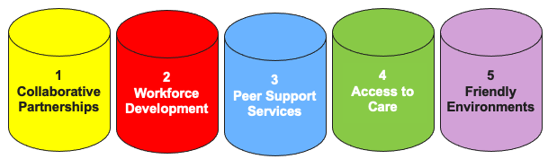
Key Components of Recovery Ecosystems
Notes:
Recovery ecosystems include several components. Let's focus on this model that represents the Recovery Ecosystem supported by five main pillars:
1 – Collaborative Partnerships
2 – Workforce Development
3 – Peer Support Services
4 – Access to Healthcare
5 – Friendly Environments.

Slide 71

1 - Collaborative Partnerships
Bringing together local community experts
Building trust
Promoting open communication and commitment to common objective
Driving innovations and create sustainable solutions
Key partners:
  Local health departments
  Behavioral health providers
  Law enforcement
  Employers
  Faith-based organizations
  Schools and community colleges
Notes:
Collaborative Partnerships bring together individuals, organizations, or communities to achieve shared goals by leveraging collective strengths. These partnerships must be built on trust, mutual respect, and aligned interests, often involving multiple local community experts such as businesses, nonprofits, government agencies, and local communities. Partnerships can drive innovation, amplify resources, and create sustainable solutions, whether in business, social initiatives, disaster, or recovery efforts. Strong partnerships can only thrive on transparency and adaptability, ensuring all members contribute meaningfully while benefiting from the collective efforts.
Who are the key participants in Collaborative Partnerships?
Local health departments
Behavioral health providers
Law enforcement
Employers
Faith-based organizations
Schools and community colleges
Why it is important? Rural communities often have limited resources. Partnerships and collaboration helps to align efforts, reduce duplication, and make better use of funding and services.
A good example is a rural county forms a Recovery Task Force combining local hospital staff, clergy, and local employers to identify community needs and share resources.

Slide 72

2 - Workforce Development
Helping individuals in recovery gain the skills and support they need to find and keep meaningful employment.
Services may include:
  Job readiness training
  Vocational rehabilitation
  Apprenticeship programs
  Soft skills coaching
  Recovery-friendly hiring policies
Notes:
The second component of Recovery Ecosystems is Workforce Development. Workforce development for recovery ecosystems focuses on equipping individuals and communities with the skills and resources needed to support individuals in recover to find and keep meaningful employment. Services may include Job readiness training, vocational rehabilitation, apprenticeship programs, soft skills coaching, and recovery-friendly hiring policies.
Why is it important to find employment for individuals in recovery? Employment promotes self-sufficiency, structure, and purpose, which are key pillars of long-term recovery.
A good example: A local manufacturing plant partners with a recovery center to offer second-chance jobs and onsite job coaching.

Slide 73
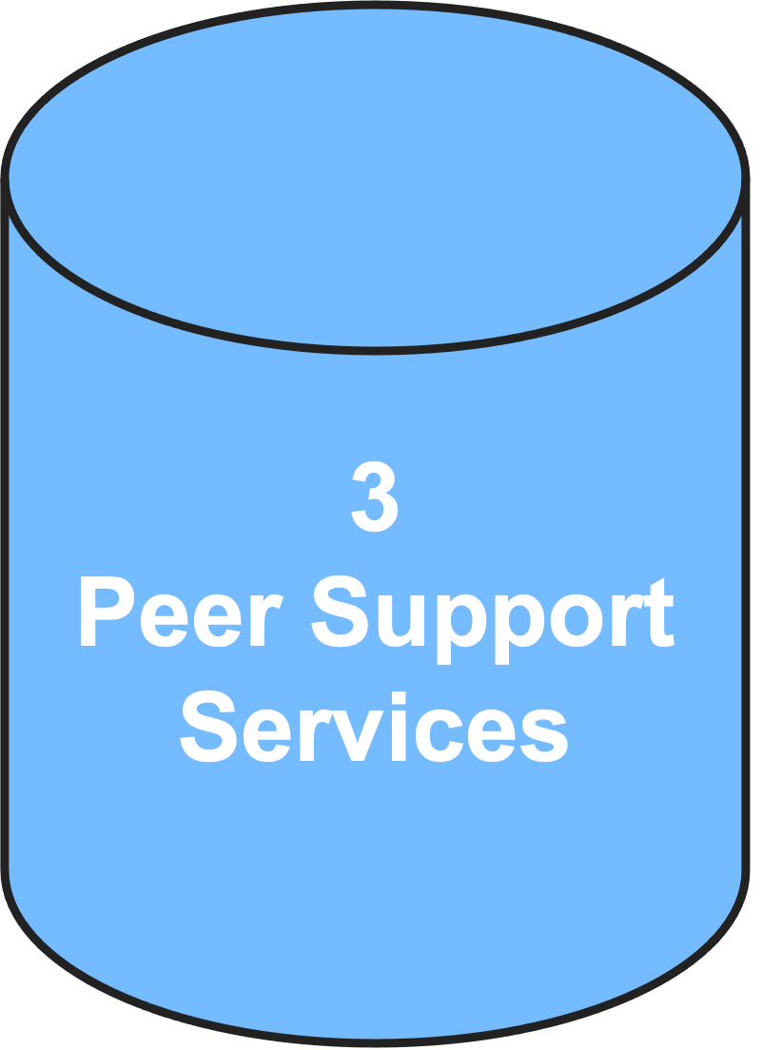
3 - Peer Support Services
Key elements:
Mutual aid and mentorship
Community-based recovery programs
Employment and education assistance
Holistic wellness support
Important Roles
Peer recovery coaches
Navigators
Mentors
Notes:
The third component of Recovery Ecosystems is Peer Support Services. Peer support services play a crucial role in recovery ecosystems by providing individuals with lived experience the opportunity to help others navigate challenges such as substance use recovery, mental health struggles, or economic hardships. These services foster connection, resilience, and empowerment by offering guidance, encouragement, and practical assistance. Peers offer hope, build trust, and serve as relatable role models. Their involvement increases engagement in treatment and recovery services.
Key elements:
Mutual aid and mentorship: where trained peers share their experiences and provide emotional and informational support.
Community-based recovery programs: such as support groups, recovery coaching, and crisis intervention.
Employment and education assistance, helping individuals reintegrate into the workforce or pursue educational opportunities.
Holistic wellness support, including mental health advocacy, housing stability programs, and social services referrals.
Some Important roles in peer support services include:
Peer recovery coaches
Navigators who help connect people to treatment, housing, and jobs
Mentors who offer emotional and motivational support
As we discussed earlier, peer support services enhance traditional recovery frameworks by creating trust-based relationships that encourage sustained healing and personal growth. They are an essential component of resilient communities, strengthening networks that help individuals overcome setbacks and build a foundation for long-term success.
A good example: A rural health clinic embeds a certified peer recovery specialist who meets with patients and follows up regularly by phone or in person.

Slide 74
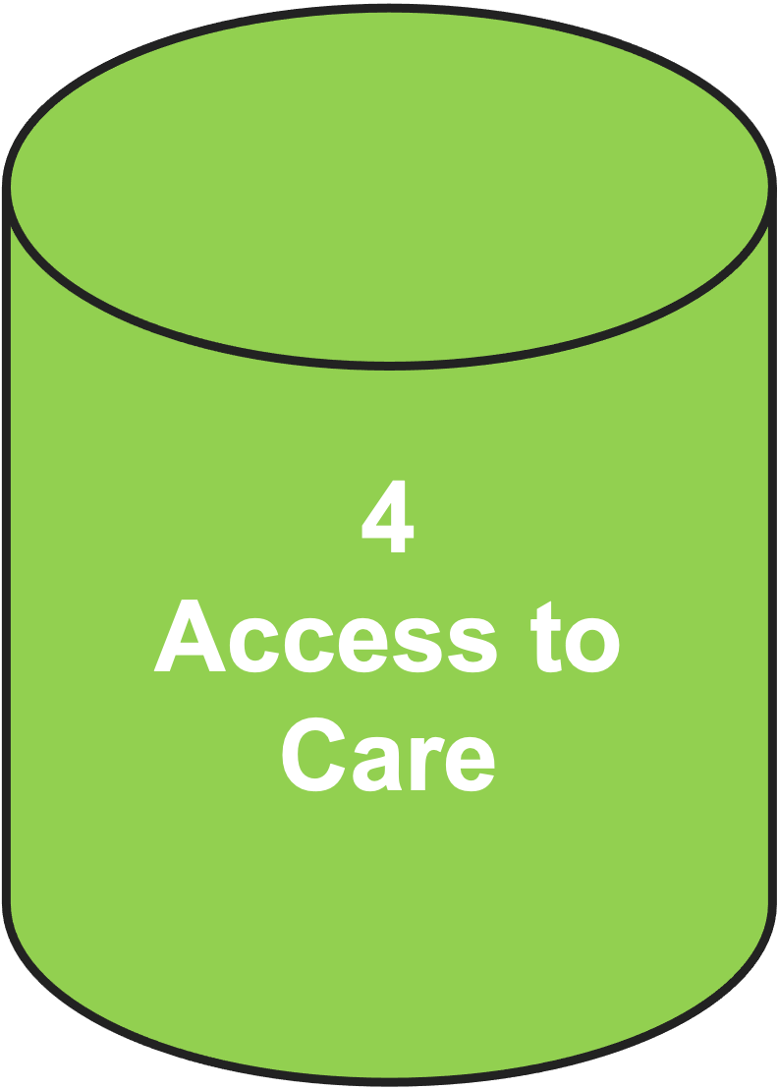
4 - Access to Care
Making sure rural residents can reach high-quality, affordable addiction, mental health, and HIV related services.
Key challenges to access to care include:
  Geographic isolation
  Limited healthcare infrastructure
  Shortages of providers
  Transportation difficulties
Notes:
The fourth component of Recovery Ecosystems is Access to Care. This is essential for ensuring long-term stability and resilience. Rural areas often face unique barriers to healthcare, mental health services, and social support, making recovery efforts more complex. Key challenges include geographic isolation, limited healthcare infrastructure, shortages of providers, and transportation difficulties. Strengthening access to care in rural recovery ecosystems ensures that communities can thrive, with individuals receiving timely and appropriate services.
Some strategies to improve access to care in rural ecosystems include:
Telehealth and mobile clinics, which expand access to medical and behavioral health services for remote communities.
Community-based care models, leveraging local organizations and peer support networks to fill gaps in healthcare.
Investment in rural health workforce development, ensuring training and recruitment of healthcare professionals in underserved areas.
Integration of services, such as housing assistance, employment support, and substance use recovery programs, to create holistic care networks. A special shout out for Integrating SUD and mental health services into primary care is a actually a critical step in improving access, reducing social labeling, and enhancing overall health outcomes for individuals struggling with substance use.
Partnerships with local governments and nonprofit organizations to provide funding and policy support for healthcare accessibility.
Why Access to Care is important? Geographic isolation and lack of providers are major barriers in rural areas. Creative solutions help bridge the gap.
A good example: A mobile clinic travels weekly to remote areas, providing MAT, counseling, and health screenings.

Slide 75
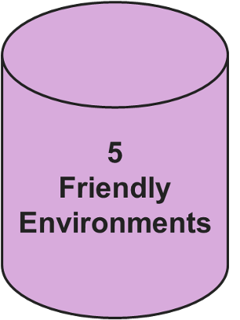
5 - Recovery-Friendly Environments
Initiatives include:
Public education campaigns
Recovery-friendly workplace certification
Sober living housing options
Safe community spaces for support meetings
Key Elements
Community support networks
Accessible healthcare and behavioral health services
Employment and workforce
Housing and stability resources
Education and awareness initiatives
Holistic wellness programs
Collaborative efforts
Notes:
The fifth and last component of Recovery Ecosystems is Recovery-Friendly Environments. Friendly environments in rural community recovery ecosystems are crucial for fostering support, stability, and long-term success for individuals and communities facing challenges such as substance use recovery, economic setbacks, or disaster recovery. These environments must be a safe space for the members , inclusive (which are spaces designed to be welcoming, accessible, and accommodating for all individuals, regardless of their backgrounds, identities, or abilities) , and resource-rich spaces that encourage healing and resilience.
Why it matters: Recovery is easier in a community that accepts and supports people in recovery rather than marginalizing them.
Here are the key elements of Recovery-Friendly Environments:
Community Support Networks – Rural recovery thrives on strong social connections, including peer support groups, mentorship programs, and community-led initiatives that offer encouragement and guidance.
Accessible Healthcare and Behavioral Health Services – Integrated primary care and mental health services, including telehealth, mobile clinics, and local treatment centers, ensure residents receive necessary support without long travel distances.
Employment and Workforce Development – Recovery-friendly communities prioritize job training, fair hiring practices, and workplace wellness programs that accommodate individuals in recovery, helping them achieve economic independence.
Housing and Stability Resources – Safe, affordable housing options, transitional living programs, and supportive housing models create stable foundations for individuals to rebuild their lives.
Education and Awareness Initiatives – Community-wide anti-social labeling campaigns, recovery education, and advocacy efforts help normalize recovery and promote acceptance.
Holistic Wellness Programs – Incorporating mental health, physical wellness, recreational activities, and spiritual support contributes to a more balanced recovery process.
Collaborative Efforts – Local governments, businesses, faith-based organizations, and nonprofits work together to create policy-driven and grassroots solutions that sustain recovery ecosystems.
Initiatives include: (1) public education campaigns; (2) recovery-friendly workplace certification; (3) sober living housing options; and (4) safe community spaces for support meetings.
By building strong recovery-friendly environments, rural communities can empower individuals, reduce social labeling, and create lasting pathways to health, employment, and economic resilience.
A good example includes a rural town hosts a monthly community dinner at a local church, inviting people with HIV and in recovery to speak and share resources.

Slide 76
Additional Elements of a Rural Recovery Ecosystem for HIV and SUD in Rural Areas
Housing and transportation support
Family-centered and faith-based programs
Social labeling reduction and education campaigns
Policy and funding Infrastructure
Data and evaluation systems
SOURCE: Mumba & Mugoya, 2022
Notes:
A strong recovery ecosystem doesn’t just treat illness. It builds a foundation for health, dignity, and resilience.
Some additional elements of a rural recovery ecosystem for HIV and SUD in rural areas involve:
Housing and Transportation Support: Stable housing options (e.g., recovery residences, transitional housing) and transportation assistance ensure access to treatment, support groups, and services.
Family-Centered and Faith-Based Programs: Engage families in recovery through counseling, education, and support. Partner with faith institutions to reduce social labeling and offer spiritual and practical support.
Social labeling reduction and education campaigns: Community-based efforts to normalize HIV and addiction as treatable conditions. Public education to dispel myths and promote compassion and understanding.
Policy and funding Infrastructure: Implementation of local and state policies that support recovery-friendly practices and sustainable funding for community-based organizations and health systems.
Data and evaluation systems: development of tools to track outcomes, identify gaps, and improve service delivery. Use community feedback mechanisms to ensure programs remain responsive and effective.
REFERENCE:
Mumba, M. N., & Mugoya, G. T. (2022). Recovery ecosystems: A whole health approach to substance use prevention and treatment. J Psychosoc Nurs Ment Health Serv, 60(9), 10–14. doi: 10.3928/02793695-20220809-05. PMID: 36044744.

Slide 77
Strategies to Implement Recovery Solutions in Rural Communities
Conduct comprehensive needs assessments
Develop tailored programs
Strengthen public-private partnerships (PPPs)
Expand infrastructure and digital access
Empower local leadership and workforce development
Promote sustainable economic development
Monitor progress and adapt strategies
Notes:
What are some strategies to implement recovery solutions in rural communities?
Conduct comprehensive needs assessments: Begin by evaluating the community’s current landscape—its strengths, resources, and gaps. A thorough assessment helps identify priority areas and ensures that recovery efforts are grounded in real, local needs.
Develop tailored programs: Avoid one-size-fits-all solutions. What works in one community may not work in another. Programs should be customized to reflect the unique social, and economic context of each rural area.
Strengthen public-private partnerships (PPPs): Collaborating with both public agencies and private organizations allows communities to leverage funding, technology, and expertise. PPPs can accelerate innovation and expand access to critical services.
Expand infrastructure and digital access: Invest in broadband and digital tools to support telemedicine, virtual peer support, and remote workforce development. Improved connectivity strengthens both recovery programs and local economies.
Empower local leadership and workforce development: Support the growth of local leaders who understand the community’s challenges and assets. Building a skilled, recovery-informed workforce ensures sustainability and fosters community ownership.
Promote sustainable economic development: Recovery thrives when individuals have access to stable employment and financial independence. Economic development benefits not only those in recovery but the entire community.
Monitor progress and adapt strategies: Regularly evaluate program outcomes and community feedback. Use data to refine approaches, address emerging challenges, and ensure continuous improvement.

Slide 78
Activity #2: Lincoln County Recovery Ecosystem
Notes:
Now we’re going to break into groups one more time to practice implementing strategies using another real-world example.
IMAGE CREDIT:
Adobe Stock, Purchased Image, 2025.

Slide 79
Case Study 2: Lincoln County Recovery Ecosystem – Tennessee
Location: Lincoln County, Tennessee
Lead Organization: Lincoln County Health System in partnership with the Appalachian Regional Commission (ARC)
The project’s goals are to:
  Build a “recovery ecosystem” to support individuals transitioning from treatment to long-term recovery.
  Reduce HIV transmission linked to injection drug use.
  Strengthen workforce reintegration for people in recovery.
SOURCES: East Tennessee State University, 2024; Appalachian Regional Commission, n.d.
Notes:
The second case study is the Lincoln County Recovery Ecosystem – Tennessee. The community is in Lincoln County, Tennessee and the lead organization implementing the program, is the Lincoln County Health System in partnership with the Appalachian Regional Commission (ARC).
The Objectives of the project was to:
Build a “recovery ecosystem” to support individuals transitioning from treatment to long-term recovery.
Reduce HIV transmission linked to injection drug use.
Strengthen workforce reintegration for people in recovery.
We will now break into the same groups as before. Please take about 7 minutes to discuss what strategies you would implement to help meet this project’s goals. I will leave the slide up.
[after breakout groups end, bring attendees back together and facilitate brief exchange of ideas]
Now let’s see what the Lincoln County Health System and ARC decided to do.
REFERENCES:
East Tennessee State University. (2024). [Webpage]. Aligning the Recovery Ecosystem in the Appalachian Highlands. Accessed May 4, 2026, from: https://www.etsu.edu/cph/addiction-science-center/recovery-eco.php.
Appalachian Regional Commission. (n.d.) [Webpage]. Investments Supporting Partnerships in Recovery Ecosystems (INSPIRE). Accessed May 4, 2026, from: https://www.arc.gov/investment/appalachian-tennessee-1-1m-awarded-to-build-recovery-ecosystems/.

Slide 80
Measures Implemented & Outcomes
Key Measures:
Peer Recovery Support
HIV and Hepatitis C Screening
Workforce Development
Transportation and Housing Support
Outcomes:
Increased retention in recovery programs
Improved access to HIV care and reduced social labeling
Enhanced employment rates among individuals in recovery
Strengthened community collaboration across health, education, and business sectors
Notes:
The Measures Implemented were as follows:
Peer Recovery Support: Trained peer recovery specialists provided mentorship, navigation, and emotional support to individuals post-treatment.
HIV and Hepatitis C Screening: Integrated testing into primary care and behavioral health visits, with rapid linkage to care.
Workforce Development: Collaborated with local employers and technical schools to create job training programs tailored for people in recovery.
Community Education: Hosted town halls and school-based programs to reduce social labeling and raise awareness about HIV and SUD.
Transportation and Housing Support: Addressed rural barriers by offering ride-share vouchers and transitional housing for individuals exiting treatment.
The Outcomes were as follows:
Increased retention in recovery programs
Improved access to HIV care and reduced social labeling
Enhanced employment rates among individuals in recovery
Strengthened community collaboration across health, education, and business sectors
This model is especially notable for its holistic approach—linking health, recovery, and economic reintegration.

Slide 81

Developing a
Community Action Plan
for HIV and SUD
Response in
Rural Areas
Notes:
Developing a Community Action Plan for HIV and Substance Use Disorder (SUD) in rural areas is essential to address unique challenges like limited healthcare access, social labeling, and resource gaps, ultimately saving lives and strengthening communities.
IMAGE CREDIT:
Adobe Stock, Purchased Image, 2025.

Slide 82
Impact of a Community Action Plan
Coordinate local resources: It brings together health departments, clinics, schools, faith groups, and law enforcement to create a unified response.
Tailor solutions to local needs: Plans can address specific issues like opioid misuse, methamphetamine use, or rising HIV rates among certain populations.
Improve prevention and education: Community-driven outreach can raise awareness, reduce social labeling, and promote safe practices.
Secure funding and support: A formal plan helps attract state and federal grants, including those from HRSA and SAMHSA
SOURCE: USDA, 2020
Notes:
What is the impact of having a community action guide in place?
Coordinate local resources: It brings together health departments, clinics, schools, faith groups, and law enforcement to create a unified response.
Tailor solutions to local needs: Plans can address specific issues like opioid misuse, methamphetamine use, or rising HIV rates among certain populations.
Improve prevention and education: Community-driven outreach can raise awareness, reduce social labeling, and promote safe practices.
Secure funding and support: A formal plan helps attract state and federal grants, including those from HRSA and SAMHSA
REFERENCE:
U.S. Department of Agriculture. (2020). Rural Community Action Guide: Building Stronger Healthy, Drug-Free Rural Communities. Washington, DC: Author. Accessed May 4, 2026, from: https://www.usda.gov/sites/default/files/documents/rural-community-action-guide.pdf.

Slide 83
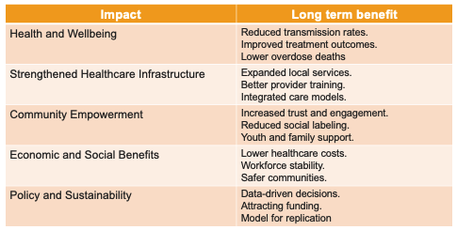
Long-Term Impact
Notes:
Creating and sustaining a Community Action Plan for HIV and SUD response in rural areas can lead to transformative long-term impacts, both for individuals and the broader community.
Health and Wellbeing
Reduced transmission rates: Coordinated prevention strategies (e.g., overdose prevention, PrEP access) lower new HIV infections.
Improved treatment outcomes: Early diagnosis and consistent care lead to better viral suppression and recovery from SUD.
Lower overdose deaths: Community-based prevention and naloxone distribution save lives.
Strengthened Healthcare Infrastructure
Expanded local services: Plans often lead to new clinics, mobile units, or telehealth programs tailored to rural needs.
Better provider training: Ongoing education improves care quality and reduces social labeling among healthcare workers.
Integrated care models: HIV and SUD services become part of a broader, more holistic health system.
Community Empowerment
Increased trust and engagement: Residents feel heard and involved, which boosts participation in prevention and treatment.
Reduced social labeling: Public education and peer support normalize seeking help and reduce shame.
Youth and family support: Programs often include education and outreach that strengthen protective factors for future generations.
Economic and Social Benefits
Lower healthcare costs: Preventing disease and reducing emergency care needs saves public and private dollars.
Workforce stability: Healthier individuals can return to work, reducing unemployment and dependency.
Safer communities: Reduced drug-related crime and improved public safety foster a more stable environment.
Policy and Sustainability
Data-driven decisions: Community plans often include monitoring and evaluation, helping leaders adapt and improve.
Attracting funding: A formal plan makes it easier to secure grants from federal agencies like HRSA, CDC, or SAMHSA.
Model for replication: Successful rural plans can inspire and guide other communities facing similar challenges.

Slide 84
Starting a Community Action Plan:
Key Elements of a Strong Goal:
Specific: Focuses on HIV and SUD together, recognizing their intersection
Measurable: Focuses on reducing incidence and improving outcomes
Community-centered: Emphasizes collaboration and local engagement
Sustainable: Aims for long-term change through education and infrastructure
Example: To reduce the incidence of HIV and substance use disorders (SUD) in the community by improving access to prevention, treatment, and recovery services through locally responsive, community-driven strategies.
Notes:
A meaningful goal for a Community Action Plan addressing HIV and Substance Use Disorder (SUD) in rural areas should be clear, actionable, and deeply rooted in the community’s unique needs and strengths. Here are some key elements of a strong goal:
Specific: Focuses on HIV and SUD together, recognizing their intersection.
Measurable: Focuses on reducing incidence and improving outcomes.
Community-centered: Emphasizes collaboration and local engagement.
Sustainable: Aims for long-term change through education and infrastructure.
Here is an example of a possible goal for a community: “To reduce the incidence of HIV and substance use disorders (SUD) in the community by improving access to prevention, treatment, and recovery services through locally responsive, community-driven strategies.”
Next, we will look at a step-by-step process of creating a community action plan.

Slide 85
Step 1. Community Assessment
Objectives:
Identify local HIV/SUD prevalence, risk factors, and service gaps
Map existing resources (clinics, support groups, outreach programs)
Actions:
Conduct surveys and focus groups with residents
Analyze public health data and collaborate with local health departments
Engage community leaders to understand local community and logistical barriers
Notes:
Step 1 of developing a Community Action Plan for HIV and SUD Response in Rural Areas is community engagement.

Slide 86
Step 2. Local Community Expert Engagement
Objectives:
  Build a coalition of trusted partners to guide and implement the plan
Actions:
  Form a Community Advisory Board (CAB) with representatives from:
    Local clinics and hospitals
    Faith-based organizations
    Schools and youth programs
    Law enforcement and EMS
    People with lived experience
  Host quarterly meetings to review progress and adjust strategies
Notes:
Step 2 of developing a Community Action Plan for HIV and SUD Response in Rural Areas is Local Community Expert engagement.

Slide 87
Step 3. Implementation of Prevention Strategies
Objectives:
  Increase awareness and reduce social labeling around HIV and SUD
  Promote safe practices
Actions:
  Launch locally tailored education campaigns (radio, flyers, social media)
  Distribute free condoms, naloxone, and other overdose prevention resources
  Offer PrEP and HIV testing at community events and mobile clinics
Notes:
Step 3 of developing a Community Action Plan for HIV and SUD Response in Rural Areas is implementation of prevention strategies.

Slide 88
Step 4. Implementation of Treatment Access
Objectives:
  Improve access to HIV care and SUD treatment, including MAT
Actions:
  Expand telehealth services for HIV and SUD care
  Partner with local providers to offer integrated care models
  Provide transportation vouchers or mobile units for remote areas
Notes:
Step 4 of developing a Community Action Plan for HIV and SUD Response in Rural Areas is implementation of treatment access.

Slide 89
Step 5. Implementation of Recovery Support
Objectives:
  Strengthen long-term recovery pathways and reduce return to use
Actions:
  Establish peer support networks and recovery coaches
  Create job training and housing assistance programs
  Support family-based recovery models and person-centered care
Notes:
Step 5 of developing a Community Action Plan for HIV and SUD Response in Rural Areas is implementation of recovery support.

Slide 90
Step 6. Monitoring & Evaluation
Objectives:
  Track progress and ensure accountability
Actions:
  Set measurable goals (e.g., % increase in PrEP uptake, % decrease in overdose rates)
  Collect data quarterly and share results with local community experts
  Adjust strategies based on feedback and outcomes
Notes:
Step 6 of developing a Community Action Plan for HIV and SUD Response in Rural Areas is monitoring and evaluation.

Slide 91
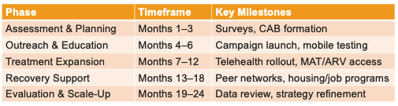
Timeline Overview
Notes:
Here’s a practical timeline overview for implementing a Community Action Plan for HIV and SUD Response in Rural Areas. This phased approach ensures thoughtful planning, community engagement, and sustainable impact. Timeliness can vary. It is important to be committed to the implementation of each step and be open to adaptations and solutions in the case you meet roadblocks along the way.

Slide 92
Conclusion: Turning Awareness into Action
Developing a Community Action Plan for HIV and SUD Response in Rural Areas is not just strategic, it’s essential.
Healthier lives through prevention, treatment, and recovery
Stronger communities built on trust, collaboration, and resilience
Sustainable change driven by local leadership and tailored solutions
Notes:
In conclusion, developing a Community Action Plan for HIV and SUD Response in Rural Areas is not just a strategic necessity, it is essential. These plans empower communities to confront social labeling, close gaps in care, and build resilient systems that save lives. By working together, healthcare providers, local leaders, educators, and residents can create tailored solutions that reflect the unique strengths and needs of rural populations. The long-term impact is profound: healthier individuals, stronger families, and communities that thrive with dignity and hope.

Slide 93
One More Case Study
Notes:
Here is one more case study that demonstrate the strategies discussed, highlighting real-world implementation programs that underscore the critical role each step plays in building a recovery ecosystem that fosters support and healing for individuals living with HIV and substance use disorders in rural communities.
IMAGE CREDIT:
Adobe Stock, Purchased Image, 2025.

Slide 94
Case Study 3: Volunteers of America Southeast Louisiana – Rural HIV and SUD Support
Location: Rural parishes in Southeast Louisiana
Lead Organization: Volunteers of America Southeast Louisiana (VOASELA)
SOURCE: Volunteers of America Southeast Louisiana, n.d.
Notes:
The third case study is the Volunteers of America Southeast Louisiana (VOASELA) – Rural HIV and SUD Support. This case study took place in Rural parishes in Southeast Louisiana. The organization in charge was Volunteers of America Southeast Louisiana (VOASELA).
REFERENCE:
Volunteers of America Southeast Louisiana. (n.d.) [Webpage]. Providing Innovative Behavioral Health Services. Accessed May 4, 2026, from: https://www.voasela.org/services/health-services/.

Slide 95
Measures Implemented and Outcomes
Key Measures:
Virtual Support Groups
Community Outreach and Education
Integrated Services
Peer Navigation
Social Labeling Reduction Campaigns
Outcomes:
Increased engagement in HIV care among rural residents
Improved access to SUD treatment and prevention services
Enhanced community trust and reduced social labeling around HIV and substance use
SOURCE: RHI Hub, 2023
Notes:
These were the Measures Implemented:
Virtual Support Groups: VOASELA transitioned from in-person gatherings to Zoom-based support groups, which increased participation among rural residents who previously avoided public meetings due to social labeling or transportation barriers.
Community Outreach and Education: Staff conducted outreach in rural areas to educate residents about HIV prevention, testing, and treatment options. They also addressed co-occurring substance use issues through prevention messaging.
Integrated Services: HIV care was combined with behavioral health and substance use services, allowing individuals to receive comprehensive support in one setting.
Peer Navigation: Trained peer navigators helped clients access HIV testing, treatment, and recovery resources, while also offering emotional support and guidance.
Social labeling Reduction Campaigns: VOASELA worked to normalize conversations around HIV and SUD through local media, faith-based partnerships, and community events.
And the Outcomes were:
Increased engagement in HIV care among rural residents
Improved access to SUD treatment and prevention services
Enhanced community trust and reduced social labeling around HIV and substance use
This case highlights how small rural communities can leverage virtual tools, peer support, and integrated care models to overcome barriers and improve health outcomes. You can read more about this initiative at the Rural Health Information Hub.
REFERENCE:
Rural Health Information Hub (RHI Hub). (2023). [Webpage]. A Safe Place': Rural HIV Patients and Providers Fight social labeling, Isolation Through Connection. Accessed May 4, 2026, from: https://www.ruralhealthinfo.org/rural-monitor/rural-hiv.

Slide 96
Concluding Thoughts
Rural communities face unique challenges in mitigating the rising incidence of substance use disorders and HIV infections
HIV and SUD prevention requires the implementation of regular screening, biomedical protections, behavioral strategies, and education in tandem with data-driven leadership and policy support
A strong recovery ecosystem requires collaborative partnerships, workforce development, peer support services, access to care, and friendly environments
A Community Action Plan should involve local leaders, healthcare providers, educators, and residents to address the dual HIV and SUD epidemic.

Slide 97
What Did You Learn – Question #1
How many rural hospitals closed between 2013 and 2020?
    Less than 25
    53
    77
    More than 100
Notes:
INSTRUCTIONS:
Program the question and responses as a virtual poll. Allow training participants approximately 30 seconds to respond and then close the poll and display the results. Provide the correct answer.
Answer key: Correct Response is D

Slide 98
What Did You Learn – Question #2
Rural Recovery Ecosystems are best described as…
    Complex medical systems, often based in hospitals, that provide a robust array of programs and services for individuals recovering from substance use disorders and/or HIV.
    Coordinated, community-based networks in rural areas that support individuals recovering from substance use disorders and accessing treatment for HIV.
    Partnerships with outpatient and inpatient substance use disorder treatment programs.
    An atmosphere of acceptance and compassion for individuals living with substance use disorders and/or HIV within both medical and non-medical settings.
Notes:
INSTRUCTIONS:
Program the question and responses as a virtual poll. Allow training participants approximately 30 seconds to respond and then close the poll and display the results. Provide the correct answer.
Answer key: Correct Response is B

Slide 99
What Did You Learn – Question #3
Substance use disorders elevate the risk of HIV infection in all of the following ways EXCEPT…
    Direct transmission through shared equipment
    Impaired judgment and risky behavior
    Biological vulnerability
    Social and structural factors
    All of the above are correct
Notes:
INSTRUCTIONS:
Program the question and responses as a virtual poll. Allow training participants approximately 30 seconds to respond and then close the poll and display the results. Provide the correct answer.
Answer key: Correct Response is E

Slide 100
What Did You Learn – Question #4
Peers are best utilized in health integration models by…
    Embedding them in primary care teams
    Utilizing them on a strictly in-person, face-to-face basis
    Placing them in substance use treatment programs
    Encouraging them to focus on increasing billing
Notes:
INSTRUCTIONS:
Program the question and responses as a virtual poll. Allow training participants approximately 30 seconds to respond and then close the poll and display the results. Provide the correct answer.
Answer key: Correct Response is A

Slide 101
What Did You Learn – Question #5
Which is the first step that must be taken to implement a Community Action Plan?
    Implementation of prevention strategies
    Implementation of treatment access
    Monitoring and evaluation
    Community assessment
Notes:
INSTRUCTIONS:
Program the question and responses as a virtual poll. Allow training participants approximately 30 seconds to respond and then close the poll and display the results. Provide the correct answer.
Answer key: Correct Response is D

Slide 102
References (1)
Appalachian Regional Commission. (n.d.) [Webpage]. Investments Supporting Partnerships in Recovery Ecosystems (INSPIRE). Accessed May 4, 2026, from: https://www.arc.gov/investment/appalachian-tennessee-1-1m-awarded-to-build-recovery-ecosystems/.
California Department of Public Health. (2026). [Webpage]. California Overdose Surveillance Dashboard. Accessed May 4, 2026, from: California Overdose Surveillance Dashboard.
California Department of Public Health, Center for Infectious Diseases, Office of AIDS. (2025). The California HIV Surveillance Report. Sacramento, California: Author. Accessed May 4, 2026, from: The California HIV Surveillanece Report.
California Health Care Foundation. (2025). California Health Care Almanac: Substance Use in California – 2025 Edition. Accessed May 4, 2026, from https://www.chcf.org/wp-content/uploads/2025/02/SubstanceUseAlmanac2025.pdf.
Centers for Disease Control and Prevention. (2024). [Webpage]. Fast Facts: HIV in the United States. Accessed May 4, 2026, from: https://www.cdc.gov/hiv/data-research/facts-stats/index.html.
Centers for Disease Control and Prevention. (2024). [Webpage]. Undetectable = Untransmittable. Accessed May 4, 2026, from: https://www.cdc.gov/global-hiv-tb/php/our-approach/undetectable-untransmittable.html.
Notes:
References – Page 1

Slide 103
References (2)
Davis, J. C., Cromartie, J., Farrigan, T., Genetin, B., Sanders, A., & Winikoff, J. B. (2023). Rural America at a Glance 2023 Edition (Report No. EIB-261). U.S. Department of Agriculture, Economic Research Service. Accessed May 3, 2026, from: Rural America at-a-Glance 2023.
East Tennessee State University. (2024). [Webpage]. Aligning the Recovery Ecosystem in the Appalachian Highlands. Accessed May 4, 2026, from: https://www.etsu.edu/cph/addiction-science-center/recovery-eco.php.
Ezenwaji, C. O., Alum, E. U. & Ugwu, O. P. C. (2025). Bridging the gap: Telemedicine as a solution for HIV care inequities in rural and vulnerable communities. Int J Equity Health 24, 205. https://doi.org/10.1186/s12939-025-02584-2
Great Lakes Prevention Technology Transfer Center. (2019). Engaging the Faith Community in Substance Use Prevention: The Rationale for Partnering and Resources to Support Your Efforts. Madison, Wisconsin: University of Wisconsin-Madison. Accessed May 4, 2026, from: https://pttcnetwork.org/wp-content/uploads/2019/11/EngagingtheFaithCommunityinSubstanceUsePreventionRationaleandResources_mmf_0.pdf.
Hargreaves, J. R., Auerbach, J. D., Hensen, B., & Gregson, S. (2020). Data-driven HIV prevention: The HIV prevention cascade and beyond. Journal of the International AIDS Society, 23(S3), e25538. https://doi.org/10.1002/jia2.25538
Notes:
References – Page 2

Slide 104
References (3)
Health Resources and Services Administration, Ryan White HIV/AIDS Program. (2020). HIV Care and Treatment in Rural Communities, HRSA’s Ryan White HIV/AIDS Program. Accessed May 4, 2026, from: https://ryanwhite.hrsa.gov/sites/default/files/ryanwhite/resources/hiv-rural-communities-fact-sheet.pdf.
Hill, K., Kuo, I., Shenoi, S. V., Desruisseaux, M. S., & Springer, S. A. (2023). Integrated care models: HIV and substance use. Curr HIV/AIDS Rep 20, 286–295. https://doi.org/10.1007/s11904-023-00667-9.
HIV.Gov. (2026). [Webpage]. U.S Statistics. Accessed May 4, 2026, from: https://www.hiv.gov/hiv-basics/overview/data-and-trends/statistics.
Killelea, A., Armstrong, W., Barocas, J., Bergoholz, D., Coribin-Gutierrez, E., Dombrowski, J., Evans, T., Feinberg, F., Gipson, J., Haddad, M., Hanson, H., McManus, K., Oxner, A., Patel, R., Person, A., Tookes, H., & Weddle, A. (2023). A Systems Level Approach to Innovative HIV Care and Treatment Models in the United States: Street Medicine and Differentiated Service Delivery. Arlington, VA: HIV Medicine Association. Accessed May 4, 2026, from: https://www.hivma.org/globalassets/hivma/innovative-service-delivery-whitepaper.pdf.
Logan, R. I., & Castañeda, H. (2020). Addressing health disparities in the rural United States: Advocacy as caregiving among community health workers and promotores de salud. Int J Environ Res Public Health, 10, 17(24), 9223. doi: 10.3390/ijerph17249223. PMID: 33321718; PMCID: PMC7764816.
Notes:
References – Page 3

Slide 105
References (4)
Mistry, S. K., Harris, E., & Harris, M. (2021). Community health workers as healthcare navigators in primary care chronic disease management: A systematic review. J Gen Intern Med, 36(9), 2755–2771. doi: 10.1007/s11606-021-06667-y. Epub 2021 Mar 5. PMID: 33674916; PMCID: PMC8390732.
Mumba, M. N., & Mugoya, G. T. (2022). Recovery ecosystems: A whole health approach to substance use prevention and treatment. J Psychosoc Nurs Ment Health Serv, 60(9), 10–14. doi: 10.3928/02793695-20220809-05. PMID: 36044744.
National Center on Substance Abuse and Child Welfare. (2025). Fact Sheet 2: Family-Centered Approaches in Early Childhood for Substance Use Disorder (SUD) Treatment Programs. Lake Forest, California: Children and Family Futures. Accessed May 4, 2026, from https://ncsacw.acf.gov/files/early-childhood-factsheet-2.pdf.
Panaite, A. C., Desroches, O. A., Warren, É., Rouly, G., Castonguay, G., & Boivin, A. (2024). Engaging with peers to integrate community care: Knowledge synthesis and conceptual map. Health Expect, 27(2):e14034. doi: 10.1111/hex.14034. PMID: 38567865; PMCID: PMC10989131. - https://pmc.ncbi.nlm.nih.gov/articles/PMC10989131/pdf/HEX-27-e14034.pdf.
Rawson, R. (2017). Vermont Hub-and-Spoke Model of Care for Opioid Use Disorders: An Evaluation. Burlington, VT: Vermont Center on Behavior and Health. Accessed May 4, 2026, from: https://www.healthvermont.gov/sites/default/files/documents/pdf/ADAP_Hub_and_Spoke_Evaluation_2017_1.pdf.
Notes:
References – Page 4

Slide 106
References (5)
Rural Health Information Hub (RHI Hub). (2026). [Webpage]. Healthcare Access in Rural Communities. Accessed May 3, 2026, from: https://www.ruralhealthinfo.org/topics/healthcare-access.
Schafer, K. R., Albrecht, H., Dillingham, R., Hogg, R. S., Jaworsky, D., Kasper, K., Loutfy, M., MacKenzie, L. J., McManus, K. A., Oursler, K. A., Rhodes, S. D., Samji, H., Skinner, S., Sun, C. J., Weissman, S., & Ohl, M. E. (2017). The continuum of HIV care in rural communities in the United States and Canada: What is known and future research directions. J Acquir Immune Defic Syndr, 75(1), 35–44. doi: 10.1097/QAI.0000000000001329. PMID: 28225437; PMCID: PMC6169533.
State of Vermont Blueprint for Health. (2026). [Webpage]. Hub & Spoke. Accessed May 4, 2026, from: https://blueprintforhealth.vermont.gov/about-blueprint/hub-and-spoke.
Substance Abuse and Mental Health Services Administration. (2024). Key substance use and mental health indicators in the United States: Results from the 2023 National Survey on Drug Use and Health (HHS Publication No. PEP24-07-021, NSDUH Series H-59). Center for Behavioral Health Statistics and Quality, Substance Abuse and Mental Health Services Administration. https://www.samhsa.gov/data/report/2023-nsduh-annual-national-report.
Substance Abuse and Mental Health Services Administration. (2025). [Webpage]. Substance Use Disorder Treatment Options. Accessed May 4, 2026, from: https://www.samhsa.gov/substance-use/treatment/options.
Notes:
References – Page 5

Slide 107
References (6)
UNICEF. (2025). [Webpage]. HIV: Elimination of mother-to-child transmission. Accessed May 4, 2026, from: https://data.unicef.org/topic/hivaids/emtct/.
UR Medicine, Recovery Center of Excellence. (2026). Developing a Rural Community Approach to Overcoming social labeling. Accessed May 4, 2026, from: https://recoverycenterofexcellence.org/learn/developing-rural-community-approach-overcoming-.
UR Medicine, Recovery Center of Excellence. (2025). [Webpage]. Partnering with Rural Communities on Substance Use Prevention for Youth. Accessed May 4, 2026, from: https://recoverycenterofexcellence.org/articles/partnering-rural-communities-substance-use-prevention-youth.
U.S. Census Bureau. (2025). 2020 Census Demographic and Housing Characteristics File (DHC). Accessed May 3, 2026, from: https://www.census.gov/data/tables/2023/dec/2020-census-dhc.html.
U.S. Department of Agriculture. (2020). Rural Community Action Guide: Building Stronger Healthy, Drug-Free Rural Communities. Washington, DC: Author. Accessed May 4, 2026, from: https://www.usda.gov/sites/default/files/documents/rural-community-action-guide.pdf.
Notes:
References – Page 6

Slide 108
References (7)
U.S. Federal Housing. (2024). [Webpage] Who Lives in Rural America. Accessed May 3, 2026, from: https://www.fhfa.gov/blog/insights/who-lives-in-rural-America.
U.S. Government Accountability Office (GAO). (2023). [Webpage]. Why Health Care Is Harder to Access in Rural America. Accessed May 3, 2026, from: https://www.gao.gov/blog/why-health-care-harder-access-rural-america.
Volunteers of America Southeast Louisiana. (n.d.) [Webpage]. Providing Innovative Behavioral Health Services. Accessed May 4, 2026, from: https://www.voasela.org/services/health-services/.
Wiehe, S. E., Nelson, T. L., Hawryluk, B., Andres, U.-M., Aalsma, M. C., Rosenman, M. B., Butler, M. S., Harris, M., Moore, K., Scott, C. D., Gharbi, S., Parks, L., Lynch, D., Silverman, R. D., & Fortenberry, J. D. (2024). Unlocking success: Community engagement for enhanced HIV care outcomes. Res Involv Engagem 10, 127. https://doi.org/10.1186/s40900-024-00657-0
Notes:
References – Page 7

Slide 109
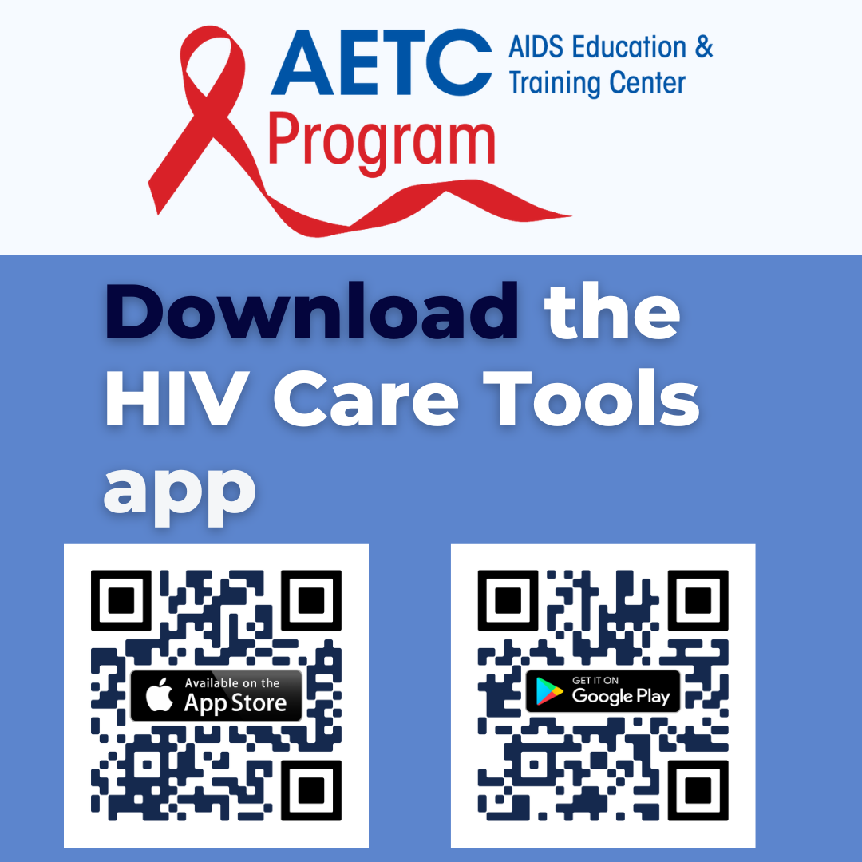
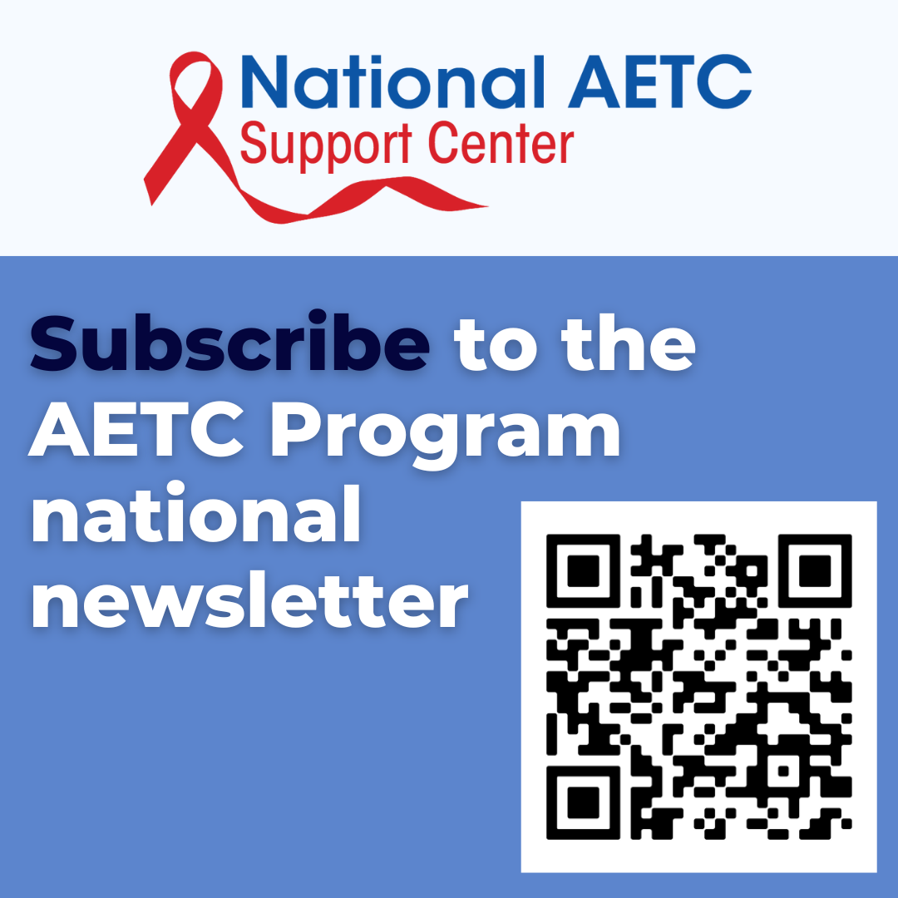
AETC Program Resource Materials
HIV Care Tools App | AETC Program Newsletter
Notes:
This slide provides details on the AETC Program’s Resource Materials.

Slide 110
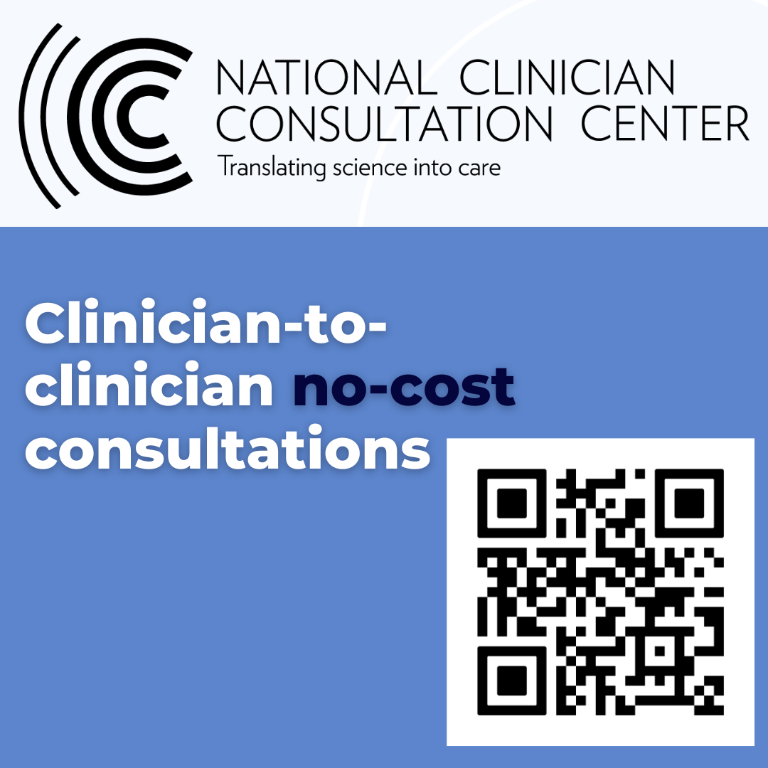
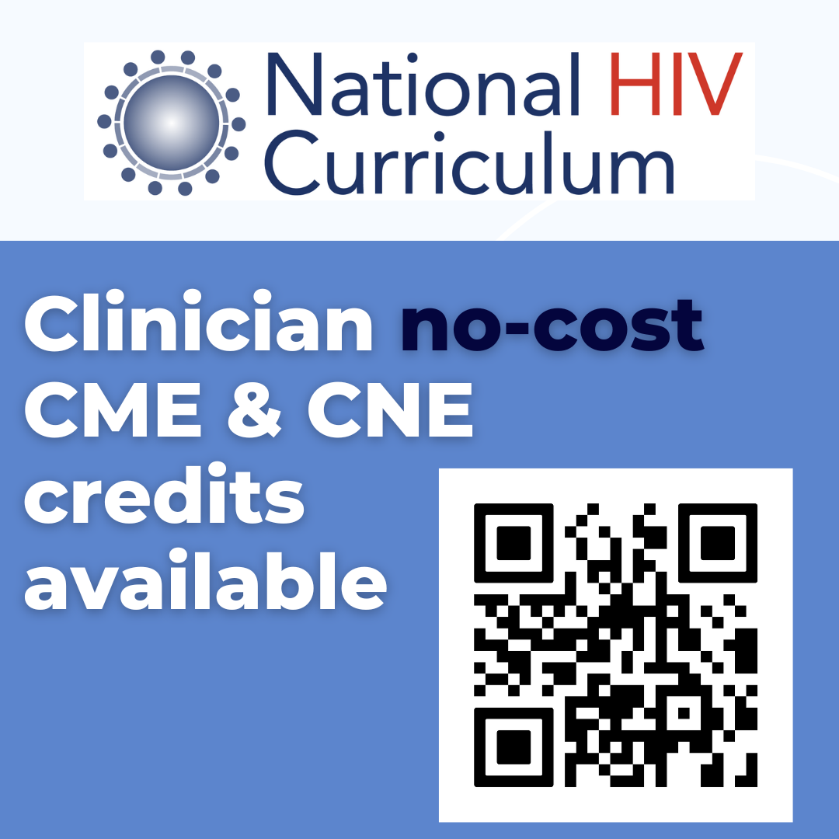
AETC Program Clinician Consultations and National Curriculum
NCCC | NHC
Notes:
This slide provides details on the AETC Program Clinician Consultations and National Curriculum.

Slide 111


THANK YOU
SO MUCH
Contact us:
Phone:
Email:
Website:
Notes:
FINAL SLIDE
This concludes the presentation. Thank the participants for their time and address any last-minute questions about the content. Encourage participants to reach out to the Pacific Southwest ATTC or Pacific AETC – Los Angeles Area, should they have questions or concerns following the training. Personalize the final slide with the trainer’s phone number, email address, and organization’s website.
Prepared in 2026 by: Pacific Southwest Addiction Technology Transfer Center
10911 Weyburn Ave. Ste 200
Los Angeles, CA 90024-2886
T: (310) 388-7647
F: (310) 312-0538
pacificsouthwestca@attcnetwork.org
At the time of this writing, Thomas E. Freese, Ph.D. served as the Principal Investigator and Director of the HHS Region 9, Pacific Southwest Addiction Technology Transfer Center, based at the UCLA Integrated Substance Use and Addiction Programs and Beth A. Rutkowski, MPH served as Co-Director of the HHS Region 9, Pacific Southwest Addiction Technology Transfer Center. Twyla Adams, MHS, served as the ATTC Government Project Officer. Christopher D. Carroll, MSc, served as the Principal Deputy Assistant Secretary for the Substance Abuse and Mental Health Services Administration. The opinions expressed herein are the views of the authors and do not reflect the official position of the Pacific Southwest ATTC/SAMHSA. No official support or endorsement of the Pacific Southwest ATTC/SAMHSA for the opinions described in this document is intended or should be inferred.

